Slide 1

Artificial Intelligence for Robotics II
Università di Genova
Robotics Engineering MSc
Planetary Rover
Memory Constraints and Data Management
Classical PDDL and PDDL+ Planning
Student: Endri Gjinaj · 5418701
D1-V8 · Planetary Rover · Memory Constraints and Data Management
1

Slide 2
1. Problem & Domain Overview
Main constrained classical instance used in the presentation
Scenario
Single rover mission on a known map.
The rover visits scientific sites and returns to a base station.
Base
Site 1
Site 2
Site 3
Site 4
offload
data1 = 4
data2 = 4
data3 = 10
data4 = 6
Objects
rover · locations · base · datasets
Each dataset has a fixed memory size.
Key constraint
Why this domain matters
The rover has capacity 10.
If used-memory + data-size exceeds 10, collection is impossible.
It isolates resource management.
Navigation is simple; memory capacity creates the interesting decisions.
Planning problem
Collect required data and ensure that every required dataset is eventually offloaded at the base.
Goal intuition
The rover cannot simply collect everything. It must choose when to return, what to carry together, and when to free memory.
D1-V8 · Planetary Rover · Memory Constraints and Data Management
2

Slide 3
2. Classical PDDL Design
move
collect-data
store onboard
offload-data
Core idea
Memory is a numeric resource, not a Boolean flag.
Numeric fluents
Key precondition in collect-data
(used-memory ?r) (memory-capacity ?r) (data-size ?d)
(>= (memory-capacity ?r) (+ (used-memory ?r) (data-size ?d)))
Meaning
Why numeric fluents?
Expected classical behaviour
Collection increases used-memory.
Offloading decreases used-memory.
The planner distinguishes 0, 4, 6 and 10 units.
This enables exact capacity reasoning.
Problem 1 validates the action chain.
Problem 2 forces offloading choices and memory reuse.
Takeaway
The classical model already captures the main planning trade-off: collection order depends on available memory.
D1-V8 · Planetary Rover · Memory Constraints and Data Management
3

Slide 4
3. PDDL+ Design Choices
Available at site
Stored
Encoded
Offloaded
Why PDDL+?
encoding-complete
Corruption and encoding are not chosen actions.
They evolve automatically while the data remains stored.
data-loss
Lost
Processes
Events
Numeric fluents
memory-corruption
data-encoding
encoding-complete
data-loss
corruption, corruption-limit, corruption-rate
encoding-progress, encoding-required, encoding-rate
memory-corruption process
data-encoding process
(increase (corruption ?d) (* #t (corruption-rate ?d)))
(increase (encoding-progress ?d) (* #t (encoding-rate ?d)))
A mission can be memory-feasible but still fail if data is lost before encoding completes.
D1-V8 · Planetary Rover · Memory Constraints and Data Management
4

Slide 5
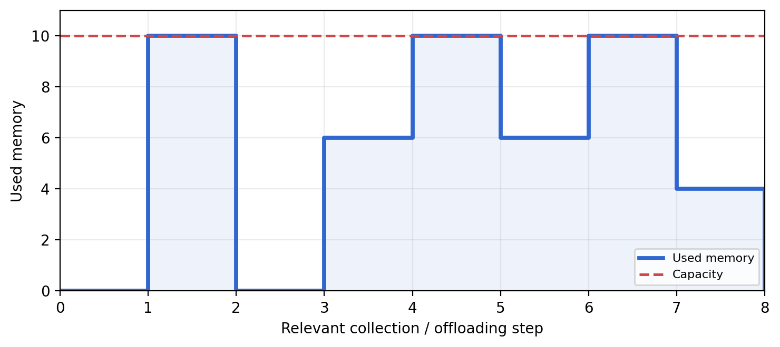
4. Live Demo / Output — Classical PDDL
Run command
Key output lines to show live
java -jar ~/enhsp/.../enhsp.jar \ -o .../pddl/domain-memory-rover.pddl \ -f .../pddl/problem-2-memory-constrained.pddl \ -planner opt-hrmax
Problem Solved Found Plan ... (collect-data rover1 data3 site3) ... (offload-data rover1 data3 base) ... (collect-data rover1 data4 site4) ... (collect-data rover1 data2 site2)
Step 1
Step 2
Step 3
data3 = 10
travels alone
data4 + data2
exactly fill 10
offload data2
collect data1
Why the output is correct
The planner exploits numeric memory capacity: solo transport for data3, exact filling with data4+data2, partial offloading, then memory reuse for data1.
D1-V8 · Planetary Rover · Memory Constraints and Data Management
5

Slide 6
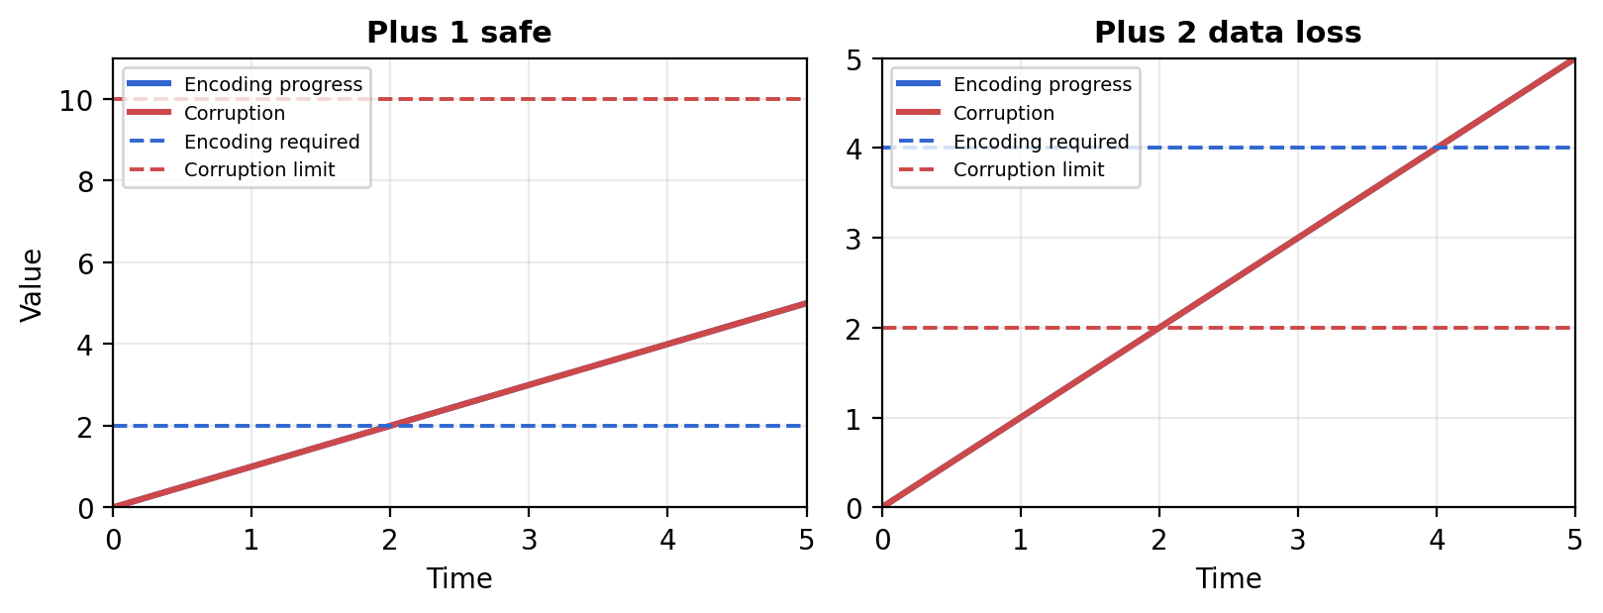
5. Live Demo / Output — PDDL+
Plus 1 safe
Plus 2 unsolvable
Encoding finishes at t = 2.
Data loss would happen at t = 10.
Data loss occurs at t = 2.
Encoding would finish only at t = 4.
Safe output to show live
Failure output to show live
Problem Solved ... (collect-data rover1 data1 site1) -----waiting---- [2.0] ... (offload-data rover1 data1 base)
Problem unsolvable T_loss = 2, T_enc = 4 → the data-loss event fires before encoding-complete
D1-V8 · Planetary Rover · Memory Constraints and Data Management
6

Slide 7
6. Reflection & Limitations
Main challenges
Known limitations
Future work
• modelling memory as a numeric quantity
• understanding PDDL+ processes and events
• separating real model failures from syntax/tool issues
• instantaneous movement
• offloading has no bandwidth or duration
• deterministic linear corruption
• perfect knowledge and one rover only
• durative movement
• communication windows
• offloading duration
• compression, deletion, or probabilistic corruption
Final takeaway
Classical PDDL captures memory-capacity trade-offs. PDDL+ adds timing, so a mission may be memory-feasible but temporally infeasible because data can be lost before it is encoded and offloaded.
Thank you.
D1-V8 · Planetary Rover · Memory Constraints and Data Management
7

