Slide 1
From actors to gates
Notes on implementing dataflow programs in programmable hardware
Jörn W. Janneck
Xilinx

Slide 2
Credits
Ian D. Miller
Dave B. Parlour

Slide 3
Overview
dataflow programming
  dataflow, actors, actions
tool overview
actors to gates
  precompilation, hardware generation
some results

Slide 4
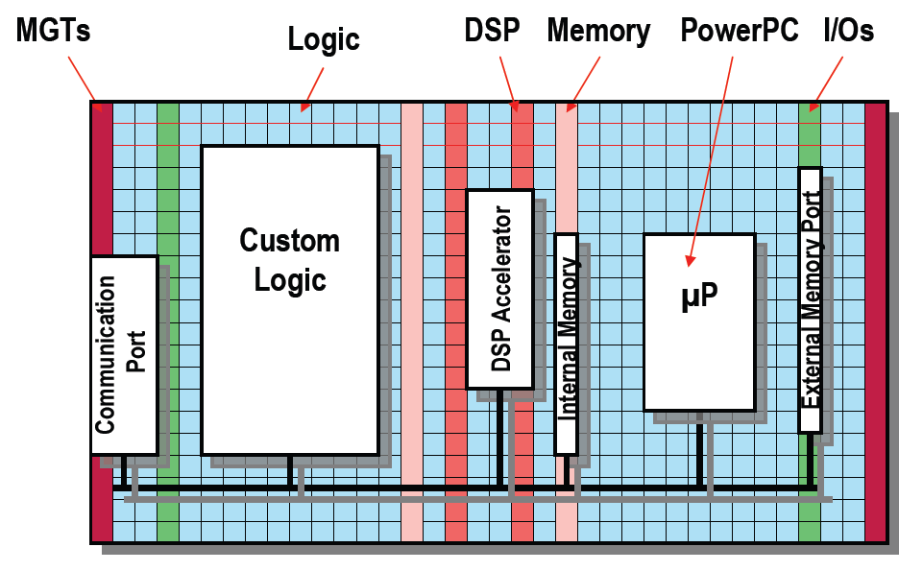
FPGA programming problem
What problem?
  Modern FPGAs are huge.
  They have a zoo of different blocks.
  RTL (VHDL, Verilog) not very good at expressing algorithms.
1985:
  128 4-LUTs
2006: [V5-LX]
  207360 6-LUTs
  10Mbit BRAM
  192 ALUs
Notes:
The size of a Platform FPGA is arguably the biggest challenge for a programming methodology targeting it. Because of their size, these chips will be used for large and complex designs. For this reason, the productivity of the design methodology shifts into focus. HDLs are fine for small or regular designs. For large, algorithmically complex designs, the productivity of HDLs conflicts with the fundamental value proposition of FPGAs, viz. that of reducing the NRE and TTM of hardware designs compared with ASICs.

Slide 5
dataflow

Slide 6
actors & actions
Actions
State

Slide 7
actors & actions
actor SendDC (int T_INTER) int TYPE, int IN ==> int DC :
int count := 0;
action TYPE: [t], IN: [v] ==> DC: [v]
guard count = 0, t = T_INTER
do
count := count + 1;
end
action TYPE: [t], IN: [v] ==>
guard count = 0, t != T_INTER
do
count := count + 1;
end
action IN: [v] ==>
guard count > 0
do
if count < 63 then
count := count + 1;
else
count := 0;
end
end
end
actor SendDC (int T_INTER) int TYPE, int IN ==> int DC :
int count := 0;
action TYPE: [t], IN: [v] ==> DC: [v]
guard count = 0, t = T_INTER
do
count := count + 1;
end
action TYPE: [t], IN: [v] ==>
guard count = 0, t != T_INTER
do
count := count + 1;
end
action IN: [v] ==>
guard count > 0
do
if count < 63 then
count := count + 1;
else
count := 0;
end
end
end
actor SendDC (int T_INTER) int TYPE, int IN ==> int DC :
int count := 0;
action TYPE: [t], IN: [v] ==> DC: [v]
guard count = 0, t = T_INTER
do
count := count + 1;
end
action TYPE: [t], IN: [v] ==>
guard count = 0, t != T_INTER
do
count := count + 1;
end
action IN: [v] ==>
guard count > 0
do
if count < 63 then
count := count + 1;
else
count := 0;
end
end
end
actor SendDC (int T_INTER) int TYPE, int IN ==> int DC :
int count := 0;
action TYPE: [t], IN: [v] ==> DC: [v]
guard count = 0, t = T_INTER
do
count := count + 1;
end
action TYPE: [t], IN: [v] ==>
guard count = 0, t != T_INTER
do
count := count + 1;
end
action IN: [v] ==>
guard count > 0
do
if count < 63 then
count := count + 1;
else
count := 0;
end
end
end
actor SendDC (int T_INTER) int TYPE, int IN ==> int DC :
int count := 0;
action TYPE: [t], IN: [v] ==> DC: [v]
guard count = 0, t = T_INTER
do
count := count + 1;
end
action TYPE: [t], IN: [v] ==>
guard count = 0, t != T_INTER
do
count := count + 1;
end
action IN: [v] ==>
guard count > 0
do
if count < 63 then
count := count + 1;
else
count := 0;
end
end
end
Actions
Actions
Actions
Actions
Actions
State
State
State
State
State

Slide 8
actions
actor SendDC (int T_INTER) int TYPE, int IN ==> int DC :
int count := 0;
action TYPE: [t], IN: [v] ==> DC: [v]
guard count = 0, t = T_INTER
do
count := count + 1;
end
action TYPE: [t], IN: [v] ==>
guard count = 0, t != T_INTER
do
count := count + 1;
end
action IN: [v] ==>
guard count > 0
do
if count < 63 then
count := count + 1;
else
count := 0;
end
end
end
actor SendDC (int T_INTER) int TYPE, int IN ==> int DC :
int count := 0;
action TYPE: [t], IN: [v] ==> DC: [v]
guard count = 0, t = T_INTER
do
count := count + 1;
end
action TYPE: [t], IN: [v] ==>
guard count = 0, t != T_INTER
do
count := count + 1;
end
action IN: [v] ==>
guard count > 0
do
if count < 63 then
count := count + 1;
else
count := 0;
end
end
end
actor SendDC (int T_INTER) int TYPE, int IN ==> int DC :
int count := 0;
action TYPE: [t], IN: [v] ==> DC: [v]
guard count = 0, t = T_INTER
do
count := count + 1;
end
action TYPE: [t], IN: [v] ==>
guard count = 0, t != T_INTER
do
count := count + 1;
end
action IN: [v] ==>
guard count > 0
do
if count < 63 then
count := count + 1;
else
count := 0;
end
end
end
input, guards:
when can this
action execute
actor SendDC (int T_INTER) int TYPE, int IN ==> int DC :
int count := 0;
action TYPE: [t], IN: [v] ==> DC: [v]
guard count = 0, t = T_INTER
do
count := count + 1;
end
action TYPE: [t], IN: [v] ==>
guard count = 0, t != T_INTER
do
count := count + 1;
end
action IN: [v] ==>
guard count > 0
do
if count < 63 then
count := count + 1;
else
count := 0;
end
end
end
body, output:
what does it do
during execution

Slide 9
tool structure
V
precompile
ThreadSSA
XLIM
synthesize
CAL
CAL
CALML
CAL
CALML
parse
instantiate
ActorC
parse
simulate
actor
network
NL
NL
XNL
elaborate
Network
XDF
codegen
VHDL
parse
XDF
class
instance

Slide 10
translating actors to gates
CAL
CALML
instantiate
CAL
CALML
precompile
ThreadSSA
XLIM
synthesize
V
parameters

Slide 11
instantiate
actor SendDC (int T_INTER) int TYPE, int IN ==> int DC :
int count := 0;
...
end
SendDC(T_INTER = 1)
actor SendDC () int TYPE, int IN ==> int DC :
int T_INTER = 1;
int count := 0;
...
end

Slide 12
precompile
operators (binding and substitution)
a + b * c
a + (b * c)
$add(a, $mul(b, c))
constant propagation
int T_INTER = 1;
...
guard t = T_INTER
guard t = 1
dead code elimination
if true then
Stmts1;
else
Stmts2;
end
Stmts1;
function/procedure inlining
function f (x) : g(x, h(x)) end
...
y := f(E);
y := let x’ = E : g(x’, h(x’)) end;

Slide 13
actions (recap)
input, guards:
when can this
action execute
actor SendDC () int TYPE, int IN ==> int DC :
int count := 0;
action TYPE: [t], IN: [v] ==> DC: [v]
guard count = 0, t = 1
do
count := count + 1;
end
action TYPE: [t], IN: [v] ==>
guard count = 0, t != T_INTER
do
count := count + 1;
end
action IN: [v] ==>
guard count > 0
do
if count < 63 then
count := count + 1;
else
count := 0;
end
end
end
body, output:
what does it do
during execution

Slide 14
generating threads
actor SendDC (int T_INTER) int TYPE, int IN ==> int DC :
int count := 0;
action TYPE: [t], IN: [v] ==> DC: [v]
guard count = 0, t = 1
do
count := count + 1;
end
action TYPE: [t], IN: [v] ==>
guard count = 0, t != 1
do
count := count + 1;
end
action IN: [v] ==>
guard count > 0
do
if count < 63 then
count := count + 1;
else
count := 0;
end
end
end
action
thread 1
action
thread 2
action
scheduler
action
thread 3

Slide 15
generating threads
actor SendDC (int T_INTER) int TYPE, int IN ==> int DC :
int count := 0;
action TYPE: [t], IN: [v] ==> DC: [v]
guard count = 0, t = 1
do
count := count + 1;
end
action TYPE: [t], IN: [v] ==>
guard count = 0, t != 1
do
count := count + 1;
end
action IN: [v] ==>
guard count > 0
do
if count < 63 then
count := count + 1;
else
count := 0;
end
end
end
action
thread 1
TYPE
count
DC
action
thread 2
action
scheduler
IN
action
thread 3

Slide 16
generating threads
wait A1_{GO} do
v <- IN;
t <- TYPE;
count_{OUT} := count_{IN} + 1;
v -> DC;
end A1_{DONE};
actor SendDC (int T_INTER) int TYPE, int IN ==> int DC :
int count := 0;
action TYPE: [t], IN: [v] ==> DC: [v]
guard count = 0, t = T_INTER
do
count := count + 1;
end
action TYPE: [t], IN: [v] ==>
guard count = 0, t != T_INTER
do
count := count + 1;
end
action IN: [v] ==>
guard count > 0
do
if count < 63 then
count := count + 1;
else
count := 0;
end
end
end
v <- IN;
t <- TYPE;
count_{OUT} := count_{IN} + 1;
v -> DC;
wait A2_{GO} do
v <- IN;
t <- TYPE;
count_{IN} + 1 -> count_{OUT};
end A2_{DONE};
wait A3_{GO} do
v <- IN;
if count_{IN} < 63 then
count_{OUT} := count_{IN} + 1;
else
count_{OUT} := 0;
end
end A3_{DONE};

Slide 17
generating threads
actor SendDC (int T_INTER) int TYPE, int IN ==> int DC :
int count := 0;
action TYPE: [t], IN: [v] ==> DC: [v]
guard count = 0, t = T_INTER
do
count := count + 1;
end
action TYPE: [t], IN: [v] ==>
guard count = 0, t != T_INTER
do
count := count + 1;
end
action IN: [v] ==>
guard count > 0
do
if count < 63 then
count := count + 1;
else
count := 0;
end
end
end
forever
var
t = peek(TYPE, 0);
c1 = TYPE_{#1} && IN_{#1} && count_{IN} = 0 && t = 1;
c2 = TYPE_{#1} && IN_{#1} && count_{IN} = 0 && t != 1;
c3 = IN_{#1} && count_{IN} > 0 && count_{IN} > 0;
do
parcase
c1: set A1_{GO}; wait A1_{DONE}; unset A1_{GO};
c2: set A2_{GO}; wait A2_{DONE}; unset A2_{GO};
c3: set A3_{GO}; wait A3_{DONE}; unset A3_{GO};
end
end

Slide 18
SSA form
(static single assignment)
wait A3_{GO} do
v <- IN;
if count_{IN} < 63 then
count_{OUT} := count_{IN} + 1;
else
count_{OUT} := 0;
end
end A3_{DONE};
wait A3_{GO} do
v <- IN;
if count_{IN} < 63 then
$1 := count_{IN} + 1;
else
$2 := 0;
end
count_{OUT} := PHI($1, $2);
end A3_{DONE};
n := 0;
while P(n) do
n := n + 1;
S1(n);
end
S2(n);
$1 := 0;
L1: $2 := PHI($1, $3);
if not P($2) then goto L2;
$3 := $2 + 1;
goto L1;
L2: S2($2);
n := $2;

Slide 19
SSA form
(static single assignment)
a
63
if a < 63 then
$1 := a + 1;
else
$2 := 0;
end
b := PHI($1, $2);
1
<
0
+
$2
Φ
$1
b
SSA representation
  straightforward extraction of parallelism
  local scalar variables become arcs
    = wires in hardware implementation
  good starting point for hardware and software backends

Slide 20
synthesize
macro-scale synthesis
  action segmentation and pipelining
micro-scale synthesis
  operator-level control and scheduling
  optimizations

Slide 21
macro-scale synthesis
actor A () int X ==> int Y :
int s := 0;
action X: [x] ==> Y: [g(s)]
do
s := f(x, s);
end
end
forever
var
c1 = X_{#1};
do
parcase
c1: set A1_{GO};
wait A1_{DONE};
unset A1_{GO};
end
break;
end
wait A1_{GO} do
x <- X;
tmp := f(x, s_{IN});
s_{OUT} := tmp;
g(tmp) -> Y;
end A1_{DONE};
X
Y
s

Slide 22
macro-scale synthesis
actor A () int X ==> int Y :
int s := 0;
action X: [x] ==> Y: [g(s)]
do
s := f(x, s);
end
end
forever
var
c1 = X_{#1};
do
parcase
c1: set A1_{GO};
wait A1_{DONE};
unset A1_{GO};
end
break;
end
...
x <- X;
tmp := f(x, s_{IN});
s_{OUT} := tmp;
...
...
g(tmp) -> Y;
...
Y
X
tmp
s
Degrees of freedom
  segment granularity, segmentation boundaries
  locking mechanism of common resources (variables, ports)

Slide 23
micro-scale synthesis
input: communicating threads in SSA form
output: Verilog
scheduling
  control inference
  register insertion: balancing and pipelining
logic reduction optimizations
  data path sizing / bit-accurate constant propagation
  dead code elimination
  operator simplification
  memory reduction
throughput optimizations
  loop unrolling
  memory splitting
  memory optimization

Slide 24
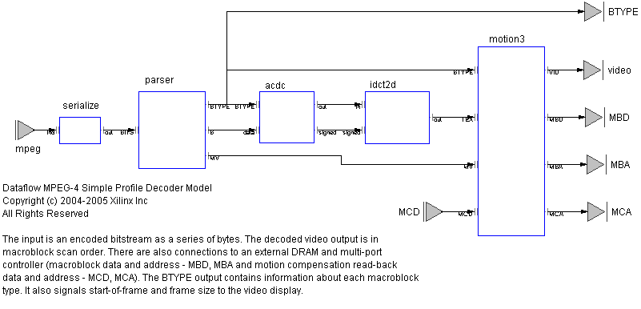
Application
MPEG-4 SP Decoder

Slide 25
MPEG-4 SP Decoder QoR
Version | Area |  |  |  |  | Performance
 | Slice | LUT | FF | BRAM | MULT
VHDL ¹ (15000 lines) | 4637 | 7923 | 2637 | 26 ² | 34 | 4-CIF image size 180K macroblock/s @ 100MHz Requires ZBT SRAM framebuf
dataflow (4000 lines) | 3872 | 7720 | 3576 | 22 ³ | 7 | HD image size 243K macroblock/s @ 120MHz Interfaces to DRAM framebuf I-frame parsing: 50 Mbit/s
¹ http://www.xilinx.com/bvdocs/ipcenter/data_sheet/ds520_prod_brf.pdf
² BRAM-limited to 4-CIF image size.
³ Supports HD image size. Reduces to 16 BRAMs for 4-CIF image size.

Slide 26
Concluding remarks
much of this work is open-sourced
  ... and we are trying to work on the rest
  sf.net/projects/caltrop
lots of stuff to do
  software code generation
  hardware code generation improvements
    operator folding
    cross-actor optimizations
    better pipelining
    ...
  mixed hardware/software systems
  contributions & extensions welcome

Slide 27
Thank you.
Questions?

Slide 28
Backup

Slide 29
Comparing Decoder Solutions
relative area efficiency
  10
  5
d
  2
c
  1
a
b
CIF
SD
HD
10
100
1000
Legend
throughput
macroblocks/sec
x1000
a TI64xx MPEG-4 (CPU + L1 cache only)
b FPGA MPEG-4 using traditional HDL flow (12 MM effort)
c FPGA MPEG-4 using actor/dataflow synthesis (3 MM effort)
d ISSCC’06 H.264 capable (includes periphery)

Slide 30
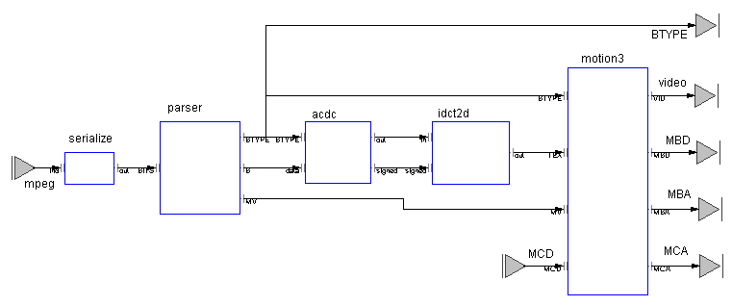
FPGA Programming In Practice
Networked MPEG-4 Viewer
Microblaze running LWIP protocol stack
XUP Board
(2VP30)
Ethernet
UDP
Raster Scan Actor
Decoder Actor Network
VGA Display IP
VGA
Display IP
Memory Controller
UDP over Ethernet
Remote Video Stream Server
Local
VGA Monitor
Notes:
Here is a block diagram of a working system of significant complexity that we will demo at the Labs Day exhibition on November 9th.
The diagram uses the same color scheme as the previous slides, with the gray boxes representing library IP and the red boxes representing unique programming in support of the application. This shows “Platform FPGA Programming” at work today. The algorithmic core of the system, an MPEG-4 decoder, is implemented as a dataflow network. Several support functions (“hardware drivers”) were also created to make this application work on a specific platform, and the rest of the IP is off-the-shelf Xilinx IP provided through Platform Studio, or as part of the board support package for the XUP board.
The decoder has the same configuration, and was verified using the same test vectors, as a VHDL implementation created in the Labs, to permit direct comparison on quality-of-result. A separate rasterizing actor converts the YUV4:2:0 macroblock output of the decoder into RGB4:4:4 raster-scan for display on a local VGA controller. A small “shim”, written in HDL, converts the control signals for a stock multi-port memory controller into the token-passing protocol employed in the actor/dataflow component model.
Connectivity is provided by a Microblaze running LWIP (the open-source Light Weight Internet Protocol stack), which is supplied with Platform Studio. The dataflow protocol is pin-compatible with FSL links, making it simple to mix hardware and software Actors. Platform Studio is used to assemble the Microblaze and all the other HDL IP blocks into a single component with dataflow ports. This is then linked to the Actor network produced by SystemBuilder in a scripted ISE flow to produce the final bit stream.
During the final debug of the system, the Microblaze provided network connectivity in both directions so that the hardware on the board could communicate with a dataflow simulation on the host computer. Sub-networks of the decoder were moved onto the board one at a time so that correctness of the physical implementation could be verified piecemeal in cosimulation with the dataflow testbench and test vectors on the host.

Slide 31
Scheduling:
Control Inference
Inserts minimum logic necessary to preserve functionality
  Completely automatic!
  Guarantees equivalent functionality with software source
  Utilizes data/control dependencies derived from source code analysis
    Multiple operations may execute simultaneously during same clock cycle
  Assumes all operations are combinational
    Allows deep sequences of combinational logic
    Allows many designs to achieve a fully combinational implementation
Controls accesses to memory and other ‘shared’ resources
Controls iteration of loop structures
Preserves validity of data at all points in design
Notes:
Minimum logic inserted to preserve functionality.
All operations considered combinational unless register necessary to preserve functionality
Memory accesses
loops infer registers to control iteration (1 cycle min)
Implementations will range from combinational to sequential depending on what software constructs are used.
Forge automatically infers CLK as needed.

Slide 32
Scheduling:
Register Insertion
?
Balancing
  Additional registers inserted to balance data flow
  All data paths to any given point in design arrive at same time (equal latency from inputs)
  New input data may be asserted before first output is calculated (Parallelism through Time)
Pipelining
  Inserts registers to break long combinational paths
  Increased clock rate and throughput
  Does not insert registers within operations
  Increased area and latency
1 Cycle
Op
1 Cycle
Op
1 Cycle
Op
Not balanced
?
1 Cycle
Op
1 Cycle
Op
Register
1 Cycle
1 Cycle
Op
Balanced
Notes:
Detail the ‘ideal’ case here. Talk to again during opts.
Ideal case is a design in which new data may be asserted to the design every clock cycle achieving maximum data throughput. Achieved through fully balancing then adding pipeline registers to achieve desired throughput via clock frequency.

Slide 33
Logic Reduction -
Data Path Sizing
Default size of operations is based on data type size
Many algorithms don’t require full range of data type
Optimal sizing of operators eliminates wasted logic
Automatic propagation of optimal sizing based on information obtained from:
  interface sizes
  logical masking
  shifting operations
:
A = (A >>> 20);
B &= 0xFFF;
C = (A + B);
return C & 0xFF;
A and B are both sized to 12 bits
C is sized to 13 bits,
the return value is 8 bits
A, B, & C are re-sized to 8 bits
Notes:
Key points:
Sizing data comes from I/F masks and shifts.
Iterative process. Runs until optimal solution found.
In microprocessor the overhead of extra bits doesn’t matter. Resources are fixed either way. In H/W we want minimal functional solution.
Example assumes initial size is 32 bits.

Slide 34
Logic Reduction -
Operator Simplification
Reduces the instantiated logic for operations with one or more constant valued input
  Fully constant operations are evaluated and replaced with resulting constant.
  Operations with one constant input may be replaced with a simpler implementation
Examples
  a * 8 = a << 3; Reduces to wires in HDL implementation!
  a * 3 = ((a << 1) + a); Reduces to a single add
  a + 0 = a; Often a result of constant propagation
Notes:
Found in conjunction with propagation of constants through the design.

Slide 35
Logic Reduction -
Dead Code Elimination
Removes logic which is not used
  Blocks of code that are not reachable
  Operations with results that are not consumed
  These blocks can be created as a result of other optimizations (loop unrolling, constant propagation, etc.)
Reduces the effective area of the implementation without compromising functionality.
:
a &= 0xFF;
if (a < 0)
a += 5;
return a;
:
c = a + b;
d = a - b;
return c;
Notes:
Italicized code will be removed by Forge
Removed code may be unused expressions or unreachable code.
Often found after other optimizations and propagation of constants

Slide 36
Logic Reduction -
Memory Reduction
Elimination of memory locations by access characteristics
  Access to read only location replaced with constant value
  Write-only locations eliminated
  Non-accessed locations eliminated
Detailed analysis of code identifies all possible accessors for every memory location
Reductions of memory size frees up critical memory resources on target FPGA
Elimination of memory accesses may also improve throughput
Notes:
First mention of contention (since scheduling), refer back to ‘ideal’ case. Why memories reduce throughput:
Ports are shared resource.
Space between new data assertion is space between first and last access to memory.
Last bullet leads in to next section which is throughput optimizations.

Slide 37
Throughput Optimization:
Loop Unrolling
Loop ‘body’ is a shared resource
  Body is shared across all iterations of the loop (minimum of 1 cycle per iteration)
Once initiated, the loop must run to completion before new data may be processed
Loop imposes limitation on final throughput of design
Unrolling replicates hardware and makes it a pipeline
Notes:
Like memories, loop bodies are a shared resource that must run to completion before new data can be processed.
Unrolling replicates body so that it is not shared

Slide 38
Throughput Optimization:
Loop Unrolling
Automatic compile-time unrolling transforms loop to sequence of logic performing the same function
  Must be bounded, meaning the loop must iterate a finite number of times as determined at compile time
  Preference controlled. Unrolling can be applied to some, all, or none of the loops in a design!
Unrolling improves performance at expense of area
  One instantiation of the loop body logic per iteration
  Control logic is eliminated or reduced
  May generate constants that allow removal of hardware = increased performance, lower area!
Notes:
Key points:
must be bounded loop
preference controlled at per loop level!
Constants generated for loop variable
propagate through design
enables other optimizations

Slide 39
Throughput Optimization: Memory Splitting
Memories are a shared resource
  Accesses must be scheduled sequentially
  Repeated accesses to memory limits design throughput
Groups memory locations by common accessors
  These groupings are split into independent memories
  Allows sequenced accesses to occur concurrently (eliminates contention for access port of the memory)
:
A = Location_0;
B = Array[i];
return A + B;
Location_0
Location_1
Location_0
Array[0]
Array[0]
Location_1
Array[1]
Array[1]
Location_5
Array[2]
Array[2]
Location_6
Memory 2
A accesses Memory 1
B accesses Memory 2
Location_5
Memory 1
Location_6
Memory
Notes:
Eg, an array is an association of many locations. An access to that array will always go to one of those locations.
Array memory can be separated from the other memory, thus reducing memory contention.

Slide 40
Throughput Optimization: Memory Optimization
Read-only memories are replicated
  As available in target technology, dual ports are allocated on ROM
  ROM is duplicated, allowing multiple, simultaneous accesses
  Effectively increases memory ports to reduce contention
Memories with fully determinate accesses are decomposed
  Memory is converted to a series of independent parallel registers
  Each register maintains storage for one location of the memory
  All locations of the decomposed memory may be accessed simultaneously
  Effectively ‘in-lines’ the memory for maximal throughput
Notes:
Sequenced accesses reduce throughput because the design is not pipelined. Cannot assert new data until the last memory access has completed.

Slide 41
Backend Compilation Flow
LIM Processing
Scheduling
-parallelism extraction
-control inference
-register insertion
Source
Code
Parse
and
Link
Source
Code
Files
HDL
Files
Logic Reduction Opts
-data path sizing
-operator simplification
-dead code elimination
-memory reduction
Translation
Forge
Compiler
Preferences
Throughput Optimizations
-loop unrolling
-memory splitting
-memory optimization

Slide 42
programming language adoption
Name TPCI TPCI cum. Year
C 17.66% 17.66% 1973
C++ 11.06% 28.73% 1985
Perl 5.48% 34.20% 1987
Python 3.47% 37.67% 1990
VB 9.73% 47.40% 1991
Delphi 2.15% 49.54% 1994
Java 21.17% 70.72% 1995
PHP 9.86% 80.58% 1995
JavaScript 2.20% 82.78% 1995
C# 3.07% 85.85% 2002
100
cumulative TCPI by
language creation date
(for top 10 languages)
Java
PHP
JavaScript
C#
50
Delphi
VB
Perl
Python
C++
C
1970
1975
1980
1985
1990
1995
2000
2005
source: TIOBE Programming Community Index, TPCI, October 2006, http://www.tiobe.com/tpci.htm

