Slide 1
A Language for Dataflow Actors
Jörn W. Janneck
Xilinx

Slide 2
overview
Xilinx & parallel programming, dataflow, actors
CAL
status of the project
ongoing and future work
  analysis, software synthesis, profiling
Q & A

Slide 3
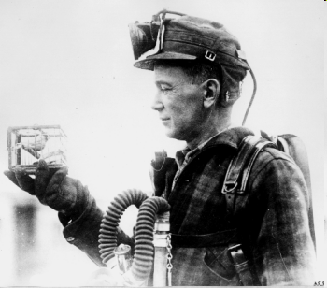
Xilinx & parallel programming

Slide 4
dataflow
F

Slide 5
dataflow with firing
F
f



Slide 6
example: adder
+
... 12 -3 17 2 -11

... 17 -10 18 3 8
... 5 -7 1 1 19
a
b
a + b
actor Add () A, B ==> X:
action A: [a], B: [b] ==> X: [a + b] end
end
actor Add () A, B ==> X:
action A: [a], B: [b] ==> X: [a + b] end
end
port declarations
actor Add () A, B ==> X:
action A: [a], B: [b] ==> X: [a + b] end
end
transition function
(“action”)

Slide 7
actions can be picky: guards
actor Add () A, B ==> X:
action A: [a], B: [b] ==> X: [a + b] end
end
actor AddConditionally () A, B ==> X:
action A: [a], B: [b] ==> X: [a + b]
guard a < b end
end
guards can peek
+cond
... 12 -3 17 2 -11

8
... 5 -7 1 1 19
a
b
a + b
a < b

Note: So far, we cannot express

. We’ll get there.

Slide 8
CAL – three basic extensions
actor Add () A, B ==> X:
action A: [a], B: [b] ==> X: [a + b] end
end
1. state
actor Sum () A ==> X:
s := 0;
action A: [a] ==> X: [s]
do
s := s + a;
end
end
2. multiple actions
actor Merge () A, B ==> X:
action A: [v] ==> X: [v] end
action B: [v] ==> X: [v] end
end
3. priorities
actor BiasedMerge () A, B ==> X:
CopyA: action A: [v] ==> X: [v] end
CopyB: action B: [v] ==> X: [v] end
priority CopyA > CopyB; end
end

Slide 9
1. state
actor Sum () A ==> X:
s := 0;
action A: [a] ==> X: [s]
do
s := s + a;
end
end
strong encapsulation
  no two actors share state
actions modify state atomically
actions may use state in guards

Slide 10
2. multiple actions
extends expressiveness to functions acting on prefixes of different lengths:
actor F () A, B ==> X:
action A: [a1, a2], B: [b] ==> X: [blue]
guard a1 = black, a2 = black, b = red
end
action A: [a], B: [b] ==> X: [black]
guard a = black, b = black
end
end


introduces potential for nondeterminism:
v
-

actor Merge () A, B ==> X:
action A: [v] ==> X: [v] end
action B: [v] ==> X: [v] end
end
... 1
v
... 1
or
... 2
-
v

... 2
v
not actually a stream function anymore!

Slide 11
2. multiple actions, cont’d
actor PingPongMerge () A, B ==> X:
s := 0;
action A: [v] ==> X: [v]
guard s = 0
do
s := 1;
end
action B: [v] ==> X: [v]
guard s = 1
do
s := 0;
end
end
“FSM” pattern of state use,
for selecting actions
actor PingPongMerge () A, B ==> X:
CopyA: action A: [v] ==> X: [v] end
CopyB: action B: [v] ==> X: [v] end
schedule fsm s0:
s0 (CopyA) --> s1;
s1 (CopyB) --> s0;
end
end
so pervasive, it merits syntactical sugar
(also helps analysis)

Slide 12
3. priorities
v
-

actor Merge () A, B ==> X:
action A: [v] ==> X: [v] end
action B: [v] ==> X: [v] end
end
... 1
v
... 1
or
... 2
-
v

... 2
v

actor BiasedMerge () A, B ==> X:
CopyA: action A: [v] ==> X: [v] end
CopyB: action B: [v] ==> X: [v] end
priority CopyA > CopyB; end
end
v
-
v
... 1
... 1
... 2
-
v

v
A stream function once again!
Alas, a timing-dependent one.
(It’s not prefix-monotonic.)
Notes:
Priorities can be used to test for the absence of tokens.

Slide 13
a note on nondeterminism
actor PingPongMerge () A, B ==> X:
CopyA: action A: [v] ==> X: [v] end
CopyB: action B: [v] ==> X: [v] end
schedule fsm s0:
s0 (CopyA) --> s1;
s1 (CopyB) --> s0;
end
end
actor Add () A, B ==> X:
action A: [a], B: [b] ==> X: [a + b] end
end
deterministic
e.g. signal processing,
video
prefix-monotonic
nondeterministic/
timing-dependent
e.g. reactive systems,
GUIs
actor BiasedMerge () A, B ==> X:
CopyA: action A: [v] ==> X: [v] end
CopyB: action B: [v] ==> X: [v] end
priority CopyA > CopyB; end
end
functional
actor Merge () A, B ==> X:
action A: [v] ==> X: [v] end
action B: [v] ==> X: [v] end
end
nondeterministic
e.g. networking,
resource management

Slide 14
example priorities, timing-dependence, covariant patterns
actor PM () A ==> X:
A1: action A: [v] ==> X: [v]
guard P(v) end
A2: action A: [v, w] ==> X: [v + w] end
priority A1 > A2; end
end
higher-priority action
requires fewer tokens
(i.e. has smaller input patterns)
actor NPM () A ==> X:
A1: action A: [v, w] ==> X: [v + w] end
A2: action A: [v] ==> X: [v] end
priority A1 > A2; end
end
higher-priority action
requires more tokens
(i.e. has larger input patterns)
could be on different ports
Covariant input patterns (can) cause timing-dependence.
behavior dependent on absence of tokens
resulting stream function not prefix-monotonic

Slide 15
expressions and statements
expressions
statements
computes value
no side-effects
initial values, guards, output tokens, statements
abstraction: function
lambda (f, x) : f(f(x)) end
comprehensions
computes no value
has side-effects
action bodies
abstraction: procedure
proc (p, x) begin p(x); p(x); end
loops
actor TestSource () int(size=8) MPEG, int(size=8) COMPARE
==> int(size=8) dataout, int(size=32) errors :
int mismatch := 0;
int(size=24) count := 0;
action MPEG:[mpeg], COMPARE:[comp] ==> dataout:[ mpeg ]
guard
mismatch = 0
do
mismatch := bitxor(mpeg, comp);
count := count + 1;
end
action ==> errors:[ bitor(lshift(count, 8), bitand(old mismatch, 0xFF)) ]
guard
mismatch != 0
do
mismatch := 0;
end
end

Slide 16
“parallelism in the small”
no aliasing
for i in 1 .. n do
a[i] := F(a[i - 1]);
end
for i in n .. 1 do
b[i - i] := F(b[i]);
end
no side-effects in expressions
action ...
guard E1
...
action ...
guard E2
...
encourage users to write code that is easy to parallelize
for i in 1 .. #a – 1 do
a[i-1] := F(a[i]);
end
a[#a – 1] := v;
a := [F(a[i]) : for i in 1 .. #a – 1] + [v];

Slide 17
actors, big and small
/*
BEGINCOPYRIGHT X
Copyright (c) 2004-2006, Xilinx Inc.
All rights reserved.
Redistribution and use in source and binary forms,
with or without modification, are permitted provided
that the following conditions are met:
- Redistributions of source code must retain the above
copyright notice, this list of conditions and the
following disclaimer.
- Redistributions in binary form must reproduce the
above copyright notice, this list of conditions and
the following disclaimer in the documentation and/or
other materials provided with the distribution.
- Neither the name of the copyright holder nor the names
of its contributors may be used to endorse or promote
products derived from this software without specific
prior written permission.
THIS SOFTWARE IS PROVIDED BY THE COPYRIGHT HOLDERS AND
CONTRIBUTORS "AS IS" AND ANY EXPRESS OR IMPLIED WARRANTIES,
INCLUDING, BUT NOT LIMITED TO, THE IMPLIED WARRANTIES OF
MERCHANTABILITY AND FITNESS FOR A PARTICULAR PURPOSE ARE
DISCLAIMED. IN NO EVENT SHALL THE COPYRIGHT OWNER OR
CONTRIBUTORS BE LIABLE FOR ANY DIRECT, INDIRECT, INCIDENTAL,
SPECIAL, EXEMPLARY, OR CONSEQUENTIAL DAMAGES (INCLUDING, BUT
NOT LIMITED TO, PROCUREMENT OF SUBSTITUTE GOODS OR SERVICES;
LOSS OF USE, DATA, OR PROFITS; OR BUSINESS INTERRUPTION)
HOWEVER CAUSED AND ON ANY THEORY OF LIABILITY, WHETHER IN
CONTRACT, STRICT LIABILITY, OR TORT (INCLUDING NEGLIGENCE OR
OTHERWISE) ARISING IN ANY WAY OUT OF THE USE OF THIS
SOFTWARE, EVEN IF ADVISED OF THE POSSIBILITY OF SUCH DAMAGE.
ENDCOPYRIGHT
*/
// ParseHeaders.cal
//
// Author: David B. Parlour (dave.parlour@xilinx.com)
//
import all caltrop.lib.BitOps;
// BTYPE Output
// A single stream of control tokens is sent on the BTYPE output to distribute
// VOP and block type information. A minimum of 12 bits is required for this token,
// which also sends the VOP width and height parameters. The relevant parameters are:
// MB_COORD_SZ - size of any variable that contains a macroblock coordinate
// BTYPE_SZ - size of the BTYPE output (min. 12)
// Bits to signal token type
// NEWVOP 2048
// INTRA 1024
// INTER 512
// If the NEWVOP bits is set, the following field can be masked off:
// QUANT_MASK 31
// ROUND_TYPE 32
// FCODE_MASK 448
// FCODE_SHIFT 6
// The next two tokens after NEWVOP are the width and height in macroblocks
// The INTER type also has
// ACPRED 1
// ACCODED 2
// FOURMV 4
// MOTION 8
// The INTRA type also has ACPRED
actor ParseHeaders (
// Maximum image width (in units of macroblocks) that the decoder can handle.
// It is used to allocate line buffer space at compile time.
int MAXW_IN_MB,
int MB_COORD_SZ,
int BTYPE_SZ,
int MV_SZ,
int NEWVOP,
int INTRA,
int INTER,
int QUANT_MASK,
int ROUND_TYPE,
int FCODE_MASK,
int FCODE_SHIFT,
int ACPRED,
int ACCODED,
int FOURMV,
int MOTION,
int SAMPLE_COUNT_SZ,
int SAMPLE_SZ
) bool bits ==> int(size=BTYPE_SZ) BTYPE, int(size=MV_SZ) MV, int(size=SAMPLE_COUNT_SZ) RUN, int(size=SAMPLE_SZ) VALUE, bool LAST :
// Constants for various field lengths (bits) and special values.
int VO_HEADER_LENGTH = 27;
int VO_NO_SHORT_HEADER = 8;
int VO_ID_LENGTH = 5;
int VOL_START_CODE_LENGTH = 28;
int VOL_START_CODE = 18;
int VOL_ID_LENGTH = 5;
int VIDEO_OBJECT_TYPE_INDICATION_LENGTH = 8;
int VISUAL_OBJECT_LAYER_VERID_LENGTH = 4;
int VISUAL_OBJECT_LAYER_PRIORITY_LENGTH = 3;
int ASPECT_RATIO_INFO_LENGTH = 4;
int ASPECT_RATIO_INFO_IS_DETAILED = 15;
int PAR_WIDTH_LENGTH = 8;
int PAR_HEIGHT_LENGTH = 8;
int CHROMA_FORMAT_LENGTH = 2;
int LOW_DELAY_LENGTH = 1;
int FIRST_HALF_BIT_RATE_LENGTH = 15;
int LAST_HALF_BIT_RATE_LENGTH = 15;
int FIRST_HALF_VBV_BUF_SZ_LENGTH = 15;
int LAST_HALF_VBV_BUF_SZ_LENGTH = 3;
int FIRST_HALF_VBV_OCC_LENGTH = 11;
int LAST_HALF_VBV_OCC_LENGTH = 15;
int VOL_SHAPE_LENGTH = 2;
int MARKER_LENGTH = 1;
int TIME_INC_RES_LENGTH = 16;
int VOL_WIDTH_LENGTH = 13;
int VOL_HEIGHT_LENGTH = 13;
//int TIME_INC_RES_MASK = lshift( 1, TIME_INC_RES_LENGTH ) - 1;
// Note: mask off width, height in units of MBs, not pixels
//int VOL_WIDTH_MASK = lshift( 1, VOL_WIDTH_LENGTH - 4 ) - 1;
//int VOL_HEIGHT_MASK = lshift( 1, VOL_HEIGHT_LENGTH - 4 ) - 1;
//int ASPECT_RATIO_INFO_MASK = lshift( 1, ASPECT_RATIO_INFO_LENGTH ) - 1;
int RUN_LENGTH = 6;
int RUN_MASK = lshift( 1, RUN_LENGTH ) - 1;
int LEVEL_LENGTH = 12;
int LEVEL_MASK = lshift( 1, LEVEL_LENGTH ) - 1;
// count of misc VOL bits:
// interlaced OBMC_disabled vol_sprite_usage not_8_bit
// vol_quant_type complexity_est_disable resync_marker_disable data_partitioning_enable
// scalability
// Note: We assume data_partitioning_enable is always false, so the model
// does not do a conditional read of reversible_vlc_enable
int MISC_BIT_LENGTH = 9;
int VOP_START_CODE_LENGTH = 32;
int VOP_START_CODE = 438;
int VOP_PREDICTION_LENGTH = 2;
int B_VOP = 2;
int P_VOP = 1;
int I_VOP = 0;
int INTRA_DC_VLC_THR_LENGTH = 3;
int VOP_FCODE_FOR_LENGTH = 3;
int VOP_FCODE_FOR_MASK = lshift( 1, VOP_FCODE_FOR_LENGTH ) - 1;
int BITS_QUANT = 5;
int BITS_QUANT_MASK = lshift( 1, BITS_QUANT ) - 1;
int MCBPC_LENGTH = 9;
int ESCAPE_CODE = 7167;
function mask_bits( v, n ) --> int :
bitand( v, lshift(1,n)-1 )
end
// Utility action to read a specified number of bits.
// This is an unnamed action, ie it is always enabled and has highest priority.
// Use the procedures set_bits_to_read() to start reading, test for
// completion with the boolean done_reading_bits() and get the value
// with read_result(). Use the done function in a guard to wait for the
// reading to be complete.
int(size=7) bits_to_read_count := -1;
int(size=33) read_result_in_progress;
procedure set_bits_to_read( int count )
begin
bits_to_read_count := count - 1;
read_result_in_progress := 0;
end
function done_reading_bits() --> bool : bits_to_read_count < 0 end
function read_result() --> int : read_result_in_progress end
action bits:[ b ] ==>
guard
not done_reading_bits()
do
read_result_in_progress := bitor( lshift( read_result_in_progress, 1), if b then 1 else 0 end );
bits_to_read_count := bits_to_read_count - 1;
bit_count := bit_count + 1;
end
int(size=4) bit_count := 0;
/*************************************************************
*************************************************************
******** start VOL ********
*************************************************************
*************************************************************/
// DBP: modified to support only VO_NO_SHORT_HEADER
look_for_vo: action ==>
do
set_bits_to_read( VO_HEADER_LENGTH + VO_ID_LENGTH );
end
// We can only handle VOL without short header
vo_header.good: action ==>
guard
done_reading_bits(),
mask_bits( rshift( read_result(), VO_ID_LENGTH ), VO_HEADER_LENGTH ) = VO_NO_SHORT_HEADER
do
set_bits_to_read( VOL_START_CODE_LENGTH );
end
vol_startcode.good: action ==>
guard
done_reading_bits(),
mask_bits( read_result(), VOL_START_CODE_LENGTH ) = VOL_START_CODE
do
// Ignore the next two fields
set_bits_to_read( VOL_ID_LENGTH + VIDEO_OBJECT_TYPE_INDICATION_LENGTH );
end
vol_object_layer_identification: action bits:[b] ==>
guard
done_reading_bits()
do
set_bits_to_read(
if b then
// is_object_layer_identifier asserted
VISUAL_OBJECT_LAYER_VERID_LENGTH + VISUAL_OBJECT_LAYER_PRIORITY_LENGTH + ASPECT_RATIO_INFO_LENGTH
else
ASPECT_RATIO_INFO_LENGTH
end );
bit_count := bit_count + 1;
end
vol_aspect.detailed: action ==>
guard
done_reading_bits(),
mask_bits( read_result(), ASPECT_RATIO_INFO_LENGTH ) = ASPECT_RATIO_INFO_IS_DETAILED
do
// Skip over aspect ratio details
set_bits_to_read( PAR_WIDTH_LENGTH + PAR_HEIGHT_LENGTH );
end
vol_control.detailed: action bits:[b] ==>
guard
done_reading_bits(),
b
do
set_bits_to_read( CHROMA_FORMAT_LENGTH + LOW_DELAY_LENGTH );
bit_count := bit_count + 1;
end
vol_vbv.detailed: action bits:[b] ==>
guard
done_reading_bits(),
b
do
set_bits_to_read( FIRST_HALF_BIT_RATE_LENGTH + MARKER_LENGTH +
LAST_HALF_BIT_RATE_LENGTH + MARKER_LENGTH +
FIRST_HALF_VBV_BUF_SZ_LENGTH + MARKER_LENGTH +
LAST_HALF_VBV_BUF_SZ_LENGTH +
FIRST_HALF_VBV_OCC_LENGTH + MARKER_LENGTH +
LAST_HALF_VBV_OCC_LENGTH + MARKER_LENGTH );
bit_count := bit_count + 1;
end
vol_shape: action ==>
guard
done_reading_bits()
do
set_bits_to_read( VOL_SHAPE_LENGTH + MARKER_LENGTH + TIME_INC_RES_LENGTH + MARKER_LENGTH + 1 );
end
int(size=7) mylog;
vol_time_inc_res: action ==>
guard
done_reading_bits()
var
int(size=TIME_INC_RES_LENGTH+1) time_inc_res := mask_bits( rshift( read_result(), 2 ), TIME_INC_RES_LENGTH ), // pick out the time_inc_res field
int(size=7) count := 0,
int(size=7) ones := 0
do
while ( count = 0 or time_inc_res != 0 ) do
if bitand( time_inc_res, 1 ) = 1 then
ones := ones + 1;
end
count := count + 1;
time_inc_res := rshift( time_inc_res, 1 );
end
mylog := if ones > 1 then count else count - 1 end;
mylog := if mylog < 1 then 1 else mylog end;
set_bits_to_read(if bitand( read_result(), 1 ) = 1 then
// fixed vop rate
//mylog + MARKER_LENGTH
mylog
else
// variable vop rate
//MARKER_LENGTH
0
end + MARKER_LENGTH + VOL_WIDTH_LENGTH + MARKER_LENGTH );
end
// The vol width and height in units of macroblocks, ie. the pixel w/h divided by 16.
// Note: there is no provision in the model for pixel sizes that are no multiples of 16.
int(size=MB_COORD_SZ) vol_width;
int(size=MB_COORD_SZ) vol_height;
vol_width: action ==>
guard
done_reading_bits()
do
vol_width := mask_bits( rshift( read_result(), MARKER_LENGTH + 4 ), VOL_WIDTH_LENGTH-4 ); // strip marker and divide by 16
set_bits_to_read( VOL_HEIGHT_LENGTH + MARKER_LENGTH );
end
vol_height: action ==>
guard
done_reading_bits()
do
vol_height := mask_bits( rshift( read_result(), MARKER_LENGTH + 4 ), VOL_HEIGHT_LENGTH ); // strip marker and divide by 16
set_bits_to_read( MISC_BIT_LENGTH );
end
// Detect unsupported features:
// interlaced, sprites, not 8-bit pixels, not using method 2 quantization, data partitioning, scalability
// vol_misc.unsupported: action ==>
// guard
// done_reading_bits(),
// test mask is 9-bit binary 101110011
// bitand( read_result(), 371 ) != 0
// end
/*************************************************************
*************************************************************
******** start VOP ********
*************************************************************
*************************************************************/
byte_align: action ==>
do
set_bits_to_read( 8 - bitand( bit_count, 7 ) );
end
// Note: no check for correct bit stuffing
get_vop_code: action ==>
guard
done_reading_bits()
do
set_bits_to_read( VOP_START_CODE_LENGTH );
end
// Note: the model does not support user data here
vop_code.done: action ==>
guard
done_reading_bits(),
read_result() = 1
do
bit_count := 0;
end
int(size=MB_COORD_SZ) mbx;
int(size=MB_COORD_SZ) mby;
vop_code.start: action ==>
guard
done_reading_bits(),
read_result() = VOP_START_CODE
do
mbx := 0;
mby := 0;
set_bits_to_read( VOP_PREDICTION_LENGTH );
end
// int(size=2) prediction_type;
// vop_predict.supported: action ==>
// guard
// done_reading_bits(),
// mask_bits( read_result(), VOP_PREDICTION_LENGTH ) = I_VOP or
// mask_bits( read_result(), VOP_PREDICTION_LENGTH ) = P_VOP
// do
// prediction_type := read_result();
// end
bool prediction_is_IVOP;
vop_predict: action ==>
guard
done_reading_bits()
do
prediction_is_IVOP := mask_bits( read_result(), VOP_PREDICTION_LENGTH ) = I_VOP;
end
// Note: the model does not support time_base. It just skips over the right number of bits.
vop_timebase.one: action bits:[b] ==>
guard
b
do
// Skip over module-time_base
bit_count := bit_count + 1;
end
vop_timebase.zero:action bits:[b] ==>
do
bit_count := bit_count + 1;
set_bits_to_read( MARKER_LENGTH + mylog + MARKER_LENGTH );
end
int(size=4) comp;
// TODO: the model does not communicate to the display driver
// to re-use the current VOP in place of the uncoded one.
vop_coding.uncoded: action bits:[b] ==>
guard
done_reading_bits(),
not b
do
comp := 0;
bit_count := bit_count + 1;
end
vop_coding.coded: action bits:[b] ==>
guard
done_reading_bits()
do
set_bits_to_read(
if not prediction_is_IVOP then
// round_type, intra_dc_vlc_thr[3], vop_quant[5], vop_fcode_for[3]
1 + INTRA_DC_VLC_THR_LENGTH + BITS_QUANT + VOP_FCODE_FOR_LENGTH
else
// intra_dc_vlc_thr[3], vop_quant[5]
INTRA_DC_VLC_THR_LENGTH + BITS_QUANT
end );
bit_count := bit_count + 1;
end
// int(size=10) resync_marker_length;
int(size=VOP_FCODE_FOR_LENGTH+1) fcode;
send_new_vop_cmd: action ==> BTYPE:[ cmd ]
guard
done_reading_bits()
var
bool round := false,
int(size=BTYPE_SZ) cmd := bitor( NEWVOP, if prediction_is_IVOP then INTRA else INTER end ),
int(size=BITS_QUANT+1) vop_quant
do
if not prediction_is_IVOP then
round := bitand( rshift( read_result(), INTRA_DC_VLC_THR_LENGTH + BITS_QUANT + VOP_FCODE_FOR_LENGTH ), 1 ) = 1;
vop_quant := bitand( rshift( read_result(), VOP_FCODE_FOR_LENGTH ), BITS_QUANT_MASK );
fcode := bitand( read_result(), VOP_FCODE_FOR_MASK );
// resync_marker_length := 16 + fcode;
else
vop_quant := bitand( read_result(), BITS_QUANT_MASK );
fcode := 0;
// resync_marker_length := 17;
end
cmd := bitor( cmd, bitand(vop_quant,QUANT_MASK) );
cmd := bitor( cmd, if round then ROUND_TYPE else 0 end );
cmd := bitor( cmd, bitand( lshift( fcode, FCODE_SHIFT), FCODE_MASK) );
end
send_new_vop_width: action ==> BTYPE: [ vol_width ] end
send_new_vop_height: action ==> BTYPE: [ vol_height ] end
/*************************************************************
*************************************************************
******** start MB ********
*************************************************************
*************************************************************/
int CBP_SZ = 7;
int(size=CBP_SZ) cbp;
// Advance the mb coordinates with wrap
procedure next_mbxy()
begin
mbx := mbx + 1;
if mbx = vol_width then
mbx := 0;
mby := mby + 1;
end
end
// Go look for next VOP
mb_done: action ==>
guard
mby = vol_height
end;
get_mcbpc.ivop: action ==>
guard
prediction_is_IVOP
do
start_vld_engine( MCBPC_IVOP_START_INDEX );
end
get_mcbpc.pvop: action bits:[b] ==>
guard
not prediction_is_IVOP,
not b
do
start_vld_engine( MCBPC_PVOP_START_INDEX );
bit_count := bit_count + 1;
end
// Nothing to do - uncoded
mcbpc_pvop_uncoded: action bits:[b] ==>
BTYPE:[ INTER ]
guard
not prediction_is_IVOP
do
next_mbxy();
bit_count := bit_count + 1;
end
mcbpc_pvop_uncoded1: action ==>
BTYPE:[ INTER ]
end
bool acpredflag;
bool btype_is_INTRA;
int(size=CBP_SZ) cbpc;
bool fourmvflag;
get_mbtype.noac: action ==>
guard
vld_success(),
type != 3,
type != 4
var
int mcbpc = vld_result(),
int type = bitand( mcbpc, 7 )
do
btype_is_INTRA := type >= 3;
fourmvflag := (type = 2);
cbpc := bitand( rshift( mcbpc, 4 ), 3 );
acpredflag := false;
start_vld_engine( CBPY_START_INDEX );
end
get_mbtype.ac: action bits:[b] ==>
guard
vld_success()
var
int mcbpc = vld_result(),
int type = bitand( mcbpc, 7 )
do
btype_is_INTRA := true;
cbpc := bitand( rshift( mcbpc, 4 ), 3 );
acpredflag := b;
bit_count := bit_count + 1;
start_vld_engine( CBPY_START_INDEX );
end
bool ac_coded;
int(size=4) mvcomp;
final_cbpy_inter: action ==>
guard
vld_success(),
not btype_is_INTRA
var
int cbpy = 15 - vld_result()
do
comp := 0;
mvcomp := 0;
cbp := bitor( lshift( cbpy, 2), cbpc );
end
final_cbpy_intra: action ==>
guard
vld_success()
var
int cbpy = vld_result()
do
comp := 0;
cbp := bitor( lshift(cbpy, 2), cbpc );
end
mb_dispatch_done: action ==>
guard
comp = 6
do
next_mbxy();
end
mb_dispatch_intra: action ==> BTYPE:[ cmd ]
guard
btype_is_INTRA
var
int(size=BTYPE_SZ) cmd := INTRA
do
ac_coded := bitand( cbp, lshift( 1, 5 - comp)) != 0;
cmd := bitor( cmd, if ac_coded then ACCODED else 0 end );
cmd := bitor( cmd, if acpredflag then ACPRED else 0 end );
end
mb_dispatch_inter_no_ac: action ==> BTYPE:[ bitor( INTER, bitor( MOTION, if fourmvflag then FOURMV else 0 end ) ) ]
guard
bitand( cbp, lshift( 1, 5 - comp)) = 0
do
ac_coded := false;
comp := comp + 1;
end
mb_dispatch_inter_ac_coded: action ==> BTYPE:[ bitor(bitor( INTER, ACCODED ), bitor( MOTION, if fourmvflag then FOURMV else 0 end ) ) ]
do
ac_coded := true;
end
vld_start_intra: action ==>
guard
btype_is_INTRA
do
start_vld_engine( if comp < 4 then DCBITS_Y_START_INDEX else DCBITS_UV_START_INDEX end );
b_last := false;
end
// There are AC coefficients
vld_start_inter.ac_coded: action ==>
guard
ac_coded
do
b_last := false;
end
// No AC coefficients
vld_start_inter.not_ac_coded: action ==> RUN:[0], VALUE:[0], LAST:[true]
do
b_last := true;
end
// The Y DC value is at most 12 bits, UV at most 13 bits
int(size=5) dc_bits;
get_dc_bits.none: action ==> RUN:[0], VALUE:[0], LAST:[ not ac_coded ]
guard
vld_success(),
vld_result() = 0
do
b_last := not ac_coded;
end
get_dc_bits.some: action ==>
guard
vld_success()
do
dc_bits := vld_result();
set_bits_to_read( dc_bits );
end
int(size=14) msb_result;
dc_bits_shift: action ==>
var
int(size=5) count = dc_bits,
int(size=14) shift = 1
do
while count > 1 do
shift := lshift( shift, 1 );
count := count - 1;
end
msb_result := shift;
end
get_dc: action ==> RUN:[0], VALUE:[v], LAST:[ not ac_coded ]
guard
done_reading_bits()
var
int(size=14) v = read_result()
do
if bitand( v, msb_result ) = 0 then
v := v + 1 - lshift( msb_result, 1 );
end
set_bits_to_read( if dc_bits > 8 then MARKER_LENGTH else 0 end );
b_last := not ac_coded;
end
bool b_last;
block_done: action ==>
guard
done_reading_bits(),
b_last
do
comp := comp + 1;
end
dct_coeff: action ==>
guard
done_reading_bits()
do
start_vld_engine( if btype_is_INTRA then COEFF_INTRA_START_INDEX else COEFF_INTER_START_INDEX end );
end
vld_code: action bits:[sign] ==> VALUE:[if sign then -level else level end], RUN:[run], LAST:[ last ]
guard
vld_success(),
val != ESCAPE_CODE
var
int(size=VLD_TABLE_DATA_BITS) val = vld_result(),
int(size=SAMPLE_COUNT_SZ) run,
int(size=SAMPLE_SZ) level,
bool last
do
run := if btype_is_INTRA then bitand( rshift( val, 8), 255)
else bitand( rshift( val, 4), 255) end;
last := if btype_is_INTRA then bitand( rshift( val, 16), 1) != 0
else bitand( rshift( val, 12), 1) != 0 end;
level := if btype_is_INTRA then bitand( val, 255)
else bitand( val, 15) end;
b_last := last;
bit_count := bit_count + 1;
end
vld_level: action bits:[level_offset] ==>
guard
vld_success(),
not level_offset
do
bit_count := bit_count + 1;
start_vld_engine( if btype_is_INTRA then COEFF_INTRA_START_INDEX else COEFF_INTER_START_INDEX end );
end
vld_run_or_direct: action bits:[level_offset] ==>
guard
vld_success()
do
bit_count := bit_count + 1;
end
vld_run: action bits:[run_offset] ==>
guard
not run_offset
do
bit_count := bit_count + 1;
start_vld_engine( if btype_is_INTRA then COEFF_INTRA_START_INDEX else COEFF_INTER_START_INDEX end );
end
vld_direct_read: action bits:[run_offset] ==>
do
bit_count := bit_count + 1;
set_bits_to_read( 1 + RUN_LENGTH + MARKER_LENGTH + LEVEL_LENGTH + MARKER_LENGTH );
end
vld_direct: action ==> VALUE:[if sign then -level else level end], RUN:[run], LAST:[ last ]
guard
done_reading_bits()
var
int(size=SAMPLE_COUNT_SZ) run,
int(size=SAMPLE_SZ) level,
bool sign,
bool last
do
last := bitand( rshift( read_result(), RUN_LENGTH + MARKER_LENGTH + LEVEL_LENGTH + MARKER_LENGTH ), 1 ) != 0;
run := bitand( rshift( read_result(), MARKER_LENGTH + LEVEL_LENGTH + MARKER_LENGTH ), RUN_MASK );
level := bitand( rshift( read_result(), MARKER_LENGTH ), LEVEL_MASK );
if level >= 2048 then
sign := true;
level := 4096 - level;
else
sign := false;
end
b_last := last;
end
function intra_max_level( bool last, int run) :
if not last then
if run = 0 then 27 else
if run = 1 then 10 else
if run = 2 then 5 else
if run = 3 then 4 else
if run < 8 then 3 else
if run < 10 then 2 else
if run < 15 then 1 else 0 end
end
end
end
end
end
end
else
if run = 0 then 8 else
if run = 1 then 3 else
if run < 7 then 2 else
if run < 21 then 1 else 0 end
end
end
end
end
end
function inter_max_level( bool last, int run) :
if not last then
if run = 0 then 12 else
if run = 1 then 6 else
if run = 2 then 4 else
if run < 7 then 3 else
if run < 11 then 2 else
if run < 27 then 1 else 0 end
end
end
end
end
end
else
if run = 0 then 3 else
if run = 1 then 2 else
if run < 41 then 1 else 0 end
end
end
end
end
int(size=SAMPLE_SZ) level_lookup_inter;
int(size=SAMPLE_SZ) level_lookup_intra;
do_level_lookup: action ==>
guard
vld_success()
var
int(size=VLD_TABLE_DATA_BITS-2) val = vld_result()
do
level_lookup_inter := inter_max_level( bitand( rshift( val, 12), 1) != 0, bitand( rshift( val, 4), 255));
level_lookup_intra := intra_max_level( bitand( rshift( val, 16), 1) != 0, bitand( rshift( val, 8), 255));
end
vld_level_lookup: action bits:[sign] ==> VALUE:[if sign then -level else level end], RUN:[run], LAST:[ last ]
var
int(size=VLD_TABLE_DATA_BITS-2) val = vld_result(),
int(size=SAMPLE_COUNT_SZ) run,
int(size=SAMPLE_SZ) level,
bool last
do
run := if btype_is_INTRA then bitand( rshift( val, 8), 255)
else bitand( rshift( val, 4), 255) end;
last := if btype_is_INTRA then bitand( rshift( val, 16), 1) != 0
else bitand( rshift( val, 12), 1) != 0 end;
level := if btype_is_INTRA then bitand( val, 255) + level_lookup_intra
else bitand( val, 15) + level_lookup_inter end;
b_last := last;
bit_count := bit_count + 1;
end
function intra_max_run( bool last, int level) :
if not last then
if level = 1 then 14 else
if level = 2 then 9 else
if level = 3 then 7 else
if level = 4 then 3 else
if level = 5 then 2 else
if level < 11 then 1 else 0 end
end
end
end
end
end
else
if level = 1 then 20 else
if level = 2 then 6 else
if level = 3 then 1 else 0 end
end
end
end
end
function inter_max_run( bool last, int level) :
if not last then
if level = 1 then 26 else
if level = 2 then 10 else
if level = 3 then 6 else
if level = 4 then 2 else
if level = 5 or level = 6 then 1 else 0 end
end
end
end
end
else
if level = 1 then 40 else
if level = 2 then 1 else 0 end
end
end
end
int(size=SAMPLE_SZ) run_lookup_inter;
int(size=SAMPLE_SZ) run_lookup_intra;
// Do lookup both ways
do_run_lookup: action ==>
guard
vld_success()
var
int(size=VLD_TABLE_DATA_BITS-2) val = vld_result()
do
run_lookup_inter := inter_max_run( bitand( rshift( val, 12), 1) != 0,
bitand( val, 15) );
run_lookup_intra := intra_max_run( bitand( rshift( val, 16), 1) != 0,
bitand( val, 255) );
end
vld_run_lookup: action bits:[sign] ==> VALUE:[if sign then -level else level end], RUN:[run], LAST:[ last ]
var
int(size=VLD_TABLE_DATA_BITS-2) val = vld_result(),
int(size=SAMPLE_COUNT_SZ) run,
int(size=SAMPLE_SZ) level,
bool last
do
last := if btype_is_INTRA then bitand( rshift( val, 16), 1) != 0
else bitand( rshift( val, 12), 1) != 0 end;
level := if btype_is_INTRA then bitand( val, 255)
else bitand( val, 15) end;
run := if btype_is_INTRA then bitand( rshift( val, 8), 255) + run_lookup_intra
else bitand( rshift( val, 4), 255) + run_lookup_inter end + 1;
b_last := last;
bit_count := bit_count + 1;
end
/*************************************************************
*************************************************************
******** Motion Decode ********
*************************************************************
*************************************************************/
mvcode_done: action ==>
guard
mvcomp = 4 or (mvcomp = 1 and not fourmvflag )
end
mvcode: action ==>
do
start_vld_engine( MV_START_INDEX );
end
mag_x: action ==> MV:[ mvval ]
guard
vld_success()
var
int (size=VLD_TABLE_DATA_BITS) mvval = vld_result()
do
set_bits_to_read( if fcode <= 1 or mvval = 0 then 0 else fcode end );
end
get_residual_x: action ==> MV:[ read_result() ]
guard
done_reading_bits()
end
mag_y: action ==> MV:[ mvval ]
guard
vld_success()
var
int (size=VLD_TABLE_DATA_BITS) mvval = vld_result()
do
set_bits_to_read( if fcode <= 1 or mvval = 0 then 0 else fcode-1 end );
end
get_residual_y: action ==> MV:[ read_result() ]
guard
done_reading_bits()
do
mvcomp := mvcomp + 1;
end
int VLD_TABLE_ADDR_BITS = 12;
int VLD_TABLE_DATA_BITS = 20;
list( type:int( size=VLD_TABLE_DATA_BITS ), size=760 ) vld_table = [
// Automatically-generated tables for bitwise MPEG-4 VLD
//
// Decoding proceeds as follows:
// 1. Set index to a starting value for the desired code (see embedded comments).
// 2. Read the next bit in the incoming stream.
// 3. Fetch the value at table[ index + bit ]
// 4. Take the following action based on table value:
// 4.1. If lsb = 1, terminate decoding with illegal codeword error.
// 4.2. If 2nd lsb = 1, the codeword is not complete,
// so set index to value >> 2, go to step 2.
// 4.3. For all other values stop decoding and return value >> 2
// start index for MCBPC_IVOP is 0
// (cumulative table size is 16 words x 20 bits)
10, 12, 18, 58, 26, 76, 34, 16,
42, 50, 1, 80, 144, 208, 140, 204,
// start index for MCBPC_PVOP is 16
// (cumulative table size is 58 words x 20 bits)
74, 0, 82, 226, 90, 218, 98, 202,
106, 178, 114, 162, 122, 146, 130, 138,
1, 1, 208, 144, 154, 140, 80, 196,
170, 204, 76, 200, 186, 194, 136, 72,
132, 68, 210, 12, 16, 192, 128, 64,
8, 4,
// start index for CBPY is 58
// (cumulative table size is 92 words x 20 bits)
242, 338, 250, 314, 258, 298, 266, 290,
274, 282, 1, 1, 24, 36, 32, 16,
306, 0, 8, 4, 322, 330, 48, 40,
56, 20, 346, 60, 354, 362, 52, 12,
44, 28,
// start index for DCBITS_Y is 92
// (cumulative table size is 118 words x 20 bits)
378, 466, 386, 458, 394, 16, 402, 20,
410, 24, 418, 28, 426, 32, 434, 36,
442, 40, 450, 44, 1, 48, 12, 0,
8, 4,
// start index for DCBITS_UV is 118
// (cumulative table size is 144 words x 20 bits)
482, 570, 490, 8, 498, 12, 506, 16,
514, 20, 522, 24, 530, 28, 538, 32,
546, 36, 554, 40, 562, 44, 1, 48,
4, 0,
// start index for COEFF_INTER is 144
// (cumulative table size is 380 words x 20 bits)
586, 1498, 594, 1426, 602, 1338, 610, 1194,
618, 1066, 626, 874, 634, 818, 642, 794,
650, 770, 658, 714, 666, 690, 674, 682,
1, 1, 1, 1, 698, 706, 1, 1,
1, 1, 722, 746, 730, 738, 1, 1,
1, 1, 754, 762, 1, 1, 1, 1,
778, 786, 16456, 16396, 44, 40, 802, 810,
18180, 18116, 18052, 17988, 826, 850, 834, 842,
584, 520, 456, 392, 858, 866, 328, 204,
140, 80, 882, 28668, 890, 946, 898, 922,
906, 914, 48, 84, 1476, 1540, 930, 938,
18244, 18308, 18372, 18436, 954, 1010, 962, 986,
970, 978, 88, 144, 268, 332, 994, 1002,
396, 648, 1604, 1668, 1018, 1042, 1026, 1034,
18500, 18564, 18628, 18692, 1050, 1058, 18756, 18820,
18884, 18948, 1074, 1138, 1082, 1114, 1090, 1106,
1098, 17924, 36, 32, 17860, 17796, 1122, 1130,
17732, 17668, 17604, 17540, 1146, 1170, 1154, 1162,
17476, 16392, 1412, 1348, 1178, 1186, 1284, 1220,
1156, 1092, 1202, 1282, 1210, 1258, 1218, 1242,
1226, 1234, 1028, 964, 264, 200, 1250, 17412,
28, 24, 1266, 1274, 17348, 17284, 17220, 17156,
1290, 1314, 1298, 1306, 17092, 17028, 16964, 900,
1322, 1330, 836, 136, 76, 20, 1346, 1402,
1354, 1378, 1362, 1370, 16900, 16836, 16772, 16708,
1386, 1394, 772, 708, 644, 16, 1410, 1418,
16644, 16580, 16516, 16452, 1434, 1482, 1442, 1466,
1450, 1458, 580, 516, 452, 388, 1474, 324,
72, 12, 1490, 16388, 260, 196, 4, 1506,
68, 1514, 132, 8,
// start index for COEFF_INTRA is 380
// (cumulative table size is 616 words x 20 bits)
1530, 2442, 1538, 2370, 1546, 2282, 1554, 2138,
1562, 2010, 1570, 1818, 1578, 1762, 1586, 1738,
1594, 1714, 1602, 1658, 1610, 1634, 1618, 1626,
1, 1, 1, 1, 1642, 1650, 1, 1,
1, 1, 1666, 1690, 1674, 1682, 1, 1,
1, 1, 1698, 1706, 1, 1, 1, 1,
1722, 1730, 262172, 262168, 88, 84, 1746, 1754,
264200, 263180, 262164, 13316, 1770, 1794, 1778, 1786,
5132, 8200, 4108, 3088, 1802, 1810, 2064, 1052,
80, 76, 1826, 28668, 1834, 1890, 1842, 1866,
1850, 1858, 92, 96, 1056, 9224, 1874, 1882,
265224, 266248, 277508, 278532, 1898, 1954, 1906, 1930,
1914, 1922, 100, 104, 108, 1060, 1938, 1946,
6156, 1064, 2068, 7180, 1962, 1986, 1970, 1978,
14340, 262176, 267272, 268296, 1994, 2002, 279556, 280580,
281604, 282628, 2018, 2082, 2026, 2058, 2034, 2050,
2042, 276484, 72, 68, 275460, 274436, 2066, 2074,
273412, 272388, 263176, 262160, 2090, 2114, 2098, 2106,
12292, 11268, 7176, 6152, 2122, 2130, 5128, 3084,
2060, 1048, 2146, 2226, 2154, 2202, 2162, 2186,
2170, 2178, 1044, 64, 4104, 60, 2194, 270340,
56, 52, 2210, 2218, 269316, 268292, 262156, 10244,
2234, 2258, 2242, 2250, 9220, 8196, 271364, 3080,
2266, 2274, 1040, 48, 44, 40, 2290, 2346,
2298, 2322, 2306, 2314, 266244, 265220, 6148, 267268,
2330, 2338, 7172, 2056, 1036, 36, 2354, 2362,
262152, 5124, 264196, 263172, 2378, 2426, 2386, 2410,
2394, 2402, 4100, 3076, 32, 28, 2418, 2052,
1032, 24, 2434, 262148, 20, 16, 4, 2450,
8, 2458, 1028, 12,
// start index for MV is 616
// (cumulative table size is 760 words x 20 bits)
2474, 0, 2482, 3034, 2490, 3026, 2498, 3018,
2506, 2978, 2514, 2890, 2522, 2770, 2530, 2714,
2538, 2658, 2546, 2634, 2554, 2610, 2562, 2586,
2570, 2578, 1, 1, 1, 1, 2594, 2602,
1, 1, 1, 1, 2618, 2626, 128, -128,
124, -124, 2642, 2650, 120, -120, 116, -116,
2666, 2690, 2674, 2682, 112, -112, 108, -108,
2698, 2706, 104, -104, 100, -100, 2722, 2746,
2730, 2738, 96, -96, 92, -92, 2754, 2762,
88, -88, 84, -84, 2778, 2834, 2786, 2810,
2794, 2802, 80, -80, 76, -76, 2818, 2826,
72, -72, 68, -68, 2842, 2866, 2850, 2858,
64, -64, 60, -60, 2874, 2882, 56, -56,
52, -52, 2898, 2970, 2906, 2946, 2914, 2938,
2922, 2930, 48, -48, 44, -44, 40, -40,
2954, 2962, 36, -36, 32, -32, 28, -28,
2986, 3010, 2994, 3002, 24, -24, 20, -20,
16, -16, 12, -12, 8, -8, 4, -4
];
// Starting indices into VLD table above
int MCBPC_IVOP_START_INDEX = 0;
int MCBPC_PVOP_START_INDEX = 16;
int CBPY_START_INDEX = 58;
int DCBITS_Y_START_INDEX = 92;
int DCBITS_UV_START_INDEX = 118;
int COEFF_INTER_START_INDEX = 144;
int COEFF_INTRA_START_INDEX = 380;
int MV_START_INDEX = 616;
// VLD decode engine.
int( size=VLD_TABLE_ADDR_BITS ) vld_index;
int( size=VLD_TABLE_DATA_BITS ) vld_codeword := 1;
procedure start_vld_engine( int index )
begin
vld_index := index;
vld_codeword := 2;
end
function vld_success() --> bool : bitand(vld_codeword,3) = 0 end
function vld_failure() --> bool : bitand(vld_codeword,1) = 1 end
function vld_result() --> int( size=VLD_TABLE_DATA_BITS ) : rshift(vld_codeword,2) end
action bits:[ b ] ==>
guard
bitand(vld_codeword,3) = 2
do
vld_codeword := vld_table[ vld_index + if b then 1 else 0 end ];
vld_index := rshift(vld_codeword,2);
bit_count := bit_count + 1;
end
vld_failure: action ==>
guard
vld_failure()
// do
// println("Bad VLD codeword");
end
generic_done: action ==>
guard
done_reading_bits()
end
generic_done_with_bitread: action bits:[b] ==>
guard
done_reading_bits()
do
bit_count := bit_count + 1;
end
// stuck: action ==>
// do
// set_bits_to_read(0);
// reset_texture();
// println("Stuck at bit_count " + bit_count);
// end
test_zero_byte: action ==>
guard
done_reading_bits(),
bitand( read_result(), 255 ) = 0
end
test_one_byte: action ==>
guard
done_reading_bits(),
bitand( read_result(), 255 ) = 1
end
request_byte: action ==>
guard
done_reading_bits()
do
set_bits_to_read( 8 );
end
request_vol: action ==>
do
set_bits_to_read( VOL_START_CODE_LENGTH );
end
schedule fsm stuck_1a /* look_for_vo */ :
// Process a new VOL
look_for_vo ( look_for_vo ) --> vo_header;
vo_header ( generic_done ) --> stuck;
vo_header ( vo_header.good ) --> look_for_vol;
// Process a new VOL
look_for_vol ( generic_done ) --> stuck;
look_for_vol ( vol_startcode.good ) --> vol_object;
vol_object ( vol_object_layer_identification ) --> vol_aspect;
vol_aspect ( vol_aspect.detailed ) --> vol_control;
vol_aspect ( generic_done ) --> vol_control;
vol_control ( vol_control.detailed ) --> vol_vbv;
vol_control ( generic_done_with_bitread ) --> vol_shape;
vol_vbv ( vol_vbv.detailed ) --> vol_shape;
vol_vbv ( generic_done_with_bitread ) --> vol_shape;
vol_shape ( vol_shape ) --> vol_time_inc_res;
vol_time_inc_res ( vol_time_inc_res ) --> vol_width;
vol_width ( vol_width ) --> vol_height;
vol_height ( vol_height ) --> vol_misc;
// vol_misc ( vol_misc.unsupported ) --> stuck;
vol_misc ( generic_done ) --> look_for_vop;
// Process a new VOP
look_for_vop ( byte_align ) --> get_vop_code;
get_vop_code ( get_vop_code ) --> vop_code;
vop_code ( vo_header.good ) --> look_for_vol; // DBP: permit concatenation of sequences without proper end code
vop_code ( vop_code.done ) --> look_for_vo; // DBP: start from the beginning
vop_code ( vop_code.start ) --> vop_predict;
vop_code ( generic_done ) --> stuck;
vop_predict ( vop_predict /* .supported */ ) --> vop_timebase;
// vop_predict ( generic_done ) --> stuck;
vop_timebase ( vop_timebase.one ) --> vop_timebase;
vop_timebase ( vop_timebase.zero ) --> vop_coding;
vop_coding ( vop_coding.uncoded ) --> look_for_vop;
vop_coding ( vop_coding.coded ) --> send_new_vop_info;
send_new_vop_info ( send_new_vop_cmd ) --> send_new_vop_width;
send_new_vop_width ( send_new_vop_width ) --> send_new_vop_height;
send_new_vop_height( send_new_vop_height ) --> mb;
// Start MB
mb ( mb_done ) --> look_for_vop;
mb ( mcbpc_pvop_uncoded ) --> pvop_uncoded1;
pvop_uncoded1 ( mcbpc_pvop_uncoded1 ) --> pvop_uncoded2;
pvop_uncoded2 ( mcbpc_pvop_uncoded1 ) --> pvop_uncoded3;
pvop_uncoded3 ( mcbpc_pvop_uncoded1 ) --> pvop_uncoded4;
pvop_uncoded4 ( mcbpc_pvop_uncoded1 ) --> pvop_uncoded5;
pvop_uncoded5 ( mcbpc_pvop_uncoded1 ) --> mb;
mb ( get_mcbpc ) --> get_mbtype;
get_mbtype ( vld_failure ) --> stuck;
get_mbtype ( get_mbtype ) --> final_cbpy;
final_cbpy ( vld_failure ) --> stuck;
final_cbpy ( final_cbpy_intra ) --> block;
final_cbpy ( final_cbpy_inter ) --> mv;
// process all blocks in an MB
block ( mb_dispatch_done ) --> mb;
block ( mb_dispatch_intra ) --> texture;
block ( mb_dispatch_inter_ac_coded ) --> texture;
block ( mb_dispatch_inter_no_ac ) --> block;
// Start texture
texture ( vld_start_intra ) --> get_dc_bits;
texture ( vld_start_inter ) --> texac;
get_dc_bits ( get_dc_bits.none ) --> texac;
get_dc_bits ( get_dc_bits.some ) --> get_dc;
get_dc_bits ( vld_failure ) --> stuck;
get_dc ( dc_bits_shift ) --> get_dc_a;
get_dc_a ( get_dc ) --> texac;
texac ( block_done ) --> block;
texac ( dct_coeff ) --> vld1;
vld1 ( vld_code ) --> texac;
vld1 ( vld_level ) --> vld4;
vld1 ( vld_run_or_direct ) --> vld7;
vld7 ( vld_run ) --> vld6;
vld7 ( vld_direct_read ) --> vld_direct;
vld1 ( vld_failure ) --> stuck;
vld_direct ( vld_direct ) --> texac;
vld4 ( do_level_lookup ) --> vld4a;
vld4 ( vld_failure ) --> stuck;
vld4a ( vld_level_lookup ) --> texac;
vld6 ( do_run_lookup ) --> vld6a;
vld6 ( vld_failure ) --> stuck;
vld6a ( vld_run_lookup ) --> texac;
// mv()
mv ( mvcode_done ) --> block;
mv ( mvcode ) --> mag_x;
mag_x ( vld_failure ) --> stuck;
mag_x ( mag_x ) --> get_residual_x;
get_residual_x ( get_residual_x ) --> mv_y;
mv_y ( mvcode ) --> mag_y;
mag_y ( vld_failure ) --> stuck;
mag_y ( mag_y ) --> get_residual_y;
get_residual_y ( get_residual_y ) --> mv;
// stuck( stuck ) --> stuck_for_good;
// DBP: add minimal error resilience.
// byte align, then look for a VO header starting on any byte boundary.
// Can't handle bit insertion or deletion, obviously. The VO header
// is hex 00000100.
stuck ( byte_align ) --> stuck_1a;
stuck_1a ( request_byte ) --> stuck_1b;
stuck_1b ( test_zero_byte ) --> stuck_2a;
stuck_1b ( generic_done ) --> stuck_1a;
stuck_2a ( request_byte ) --> stuck_2b;
stuck_2b ( test_zero_byte ) --> stuck_3a;
stuck_2b ( generic_done ) --> stuck_1a;
stuck_3a ( request_byte ) --> stuck_3b;
stuck_3b ( test_zero_byte ) --> stuck_3a;
stuck_3b ( test_one_byte ) --> stuck_4a;
stuck_3b ( generic_done ) --> stuck_1a;
stuck_4a ( request_byte ) --> stuck_4b;
stuck_4b ( test_zero_byte ) --> request_vol; // Found a good VO header (Assumes VO ID field=0)
stuck_4b ( generic_done ) --> stuck_1a;
request_vol ( request_vol ) --> look_for_vol;
end
priority
vo_header.good > generic_done;
vol_aspect.detailed > generic_done;
vol_control.detailed > generic_done_with_bitread;
vol_vbv.detailed > generic_done_with_bitread;
// vol_misc.unsupported > generic_done;
vop_code.done > generic_done;
vop_code.start > generic_done;
// vop_predict.supported > generic_done;
vop_timebase.one > vop_timebase.zero;
vop_coding.uncoded > vop_coding.coded;
mb_done > get_mcbpc;
mb_done > mcbpc_pvop_uncoded;
get_mcbpc.pvop > mcbpc_pvop_uncoded;
get_mbtype.noac > get_mbtype.ac;
final_cbpy_inter > final_cbpy_intra;
mb_dispatch_done > mb_dispatch_intra >
mb_dispatch_inter_no_ac > mb_dispatch_inter_ac_coded;
vld_start_intra > vld_start_inter;
get_dc_bits.none > get_dc_bits.some;
block_done > dct_coeff;
vld_code > vld_level > vld_run_or_direct;
vld_run > vld_direct_read;
vld_start_inter.ac_coded > vld_start_inter.not_ac_coded;
mvcode_done > mvcode;
test_zero_byte > generic_done;
test_one_byte > generic_done;
end
end
/*
BEGINCOPYRIGHT X
Copyright (c) 2007, Xilinx Inc.
All rights reserved.
Redistribution and use in source and binary forms,
with or without modification, are permitted provided
that the following conditions are met:
- Redistributions of source code must retain the above
copyright notice, this list of conditions and the
following disclaimer.
- Redistributions in binary form must reproduce the
above copyright notice, this list of conditions and
the following disclaimer in the documentation and/or
other materials provided with the distribution.
- Neither the name of the copyright holder nor the names
of its contributors may be used to endorse or promote
products derived from this software without specific
prior written permission.
THIS SOFTWARE IS PROVIDED BY THE COPYRIGHT HOLDERS AND
CONTRIBUTORS "AS IS" AND ANY EXPRESS OR IMPLIED WARRANTIES,
INCLUDING, BUT NOT LIMITED TO, THE IMPLIED WARRANTIES OF
MERCHANTABILITY AND FITNESS FOR A PARTICULAR PURPOSE ARE
DISCLAIMED. IN NO EVENT SHALL THE COPYRIGHT OWNER OR
CONTRIBUTORS BE LIABLE FOR ANY DIRECT, INDIRECT, INCIDENTAL,
SPECIAL, EXEMPLARY, OR CONSEQUENTIAL DAMAGES (INCLUDING, BUT
NOT LIMITED TO, PROCUREMENT OF SUBSTITUTE GOODS OR SERVICES;
LOSS OF USE, DATA, OR PROFITS; OR BUSINESS INTERRUPTION)
HOWEVER CAUSED AND ON ANY THEORY OF LIABILITY, WHETHER IN
CONTRACT, STRICT LIABILITY, OR TORT (INCLUDING NEGLIGENCE OR
OTHERWISE) ARISING IN ANY WAY OUT OF THE USE OF THIS
SOFTWARE, EVEN IF ADVISED OF THE POSSIBILITY OF SUCH DAMAGE.
ENDCOPYRIGHT
*/
import all caltrop.lib.BitOps;
actor ForemanSource () int(size=8) MPEG, int(size=8) COMPARE ==> int(size=8) dataout, int(size=32) errors :
int mismatch := 0;
int(size=24) count := 0;
action MPEG:[mpeg], COMPARE:[comp] ==> dataout:[ mpeg ]
guard
mismatch = 0
do
mismatch := bitxor(mpeg, comp);
count := count + 1;
end
action ==> errors:[ bitor(lshift(count, 8), bitand(old mismatch, 0xFF)) ]
guard
mismatch != 0
do
mismatch := 0;
end
end
Compare
23 lines
(without header comments)
ParseHeaders
1320 lines
(without header comments)
http://opendf.svn.sourceforge.net/viewvc/opendf/models/MPEG4_SP_Decoder/

Slide 18
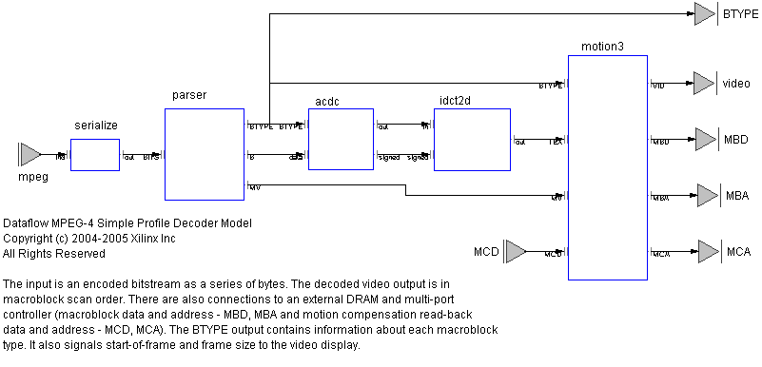
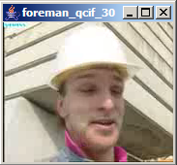
status generating soft circuits
MPEG4 SP Decoder
...0101001111010010010
4
3
relative improvement over
VHDL reference design
2
1
1.2
1.6
3.75
Size
CAL: 3872, 22
VHDL: 4637, 26
(Slices, BRAM)
Speed
CAL: 290K
VHDL: 180k
(MacroBlocks/s)
[1080p30: 245k]
Productivity
CAL: 4k
VHDL: 15k
(LOC)

Slide 19
status comparing decoders
density
throughput/area
(relative)
CIF
SD
1080p30
  5
ASIC²
  2
FPGA – CAL
  1
TI64xx¹
FPGA – VHDL
throughput
macroblocks/sec
x1000
10
100
1000
¹ CPU + L1 cache only
² ISSCC’06, H.264 capable

Slide 20



status adoption, impact
MPEG moving toward a library-based standards process
... and also toward self-describing bitstreams:
“Reconfigurable Video Coding”
reference code for standard library to be written in CAL
  MPEG-B (Decoder Description Language), ISO 23001-4
  MPEG-C (MPEG Toolbox), ISO 23002-4
  scheduled for late 2008/early 2009
industrial and academic community
  building MPEG toolbox in CAL
  tools, e.g. CAL2C compiler project (INSA, Rennes)
“Adaptivity and ConTrol Of Resources in embedded Systems”
  EU-supported, 3 years, total EUR 3.5M
dataflow programming for embedded mobile systems
  CAL-to-ARM11 translator (Ericsson)
open-source infrastructure
  simulator, compiler front-end, Eclipse plugin, etc.
  sf.net/projects/opendf

Slide 21
ongoing & future work
profiling
analysis
actor Z () A, B ==> X, Y:
s := 0;
action A: [a] ==> X: [f(a)]
do
s := g(a, s);
end
action B: [b] ==> Y: [s]
do
s := h(a, s);
end
end

Slide 22
profiling the structure of a computation
actor Src () ==> X:
s := 0;
action ==> X: [s]
do
s := h(s);
end
end
actor F () A ==> X:
x := 0;
action A: [a] ==> X: [f(x)]
do
x := g(a, x);
end
end
actor F () A ==> X:
action A: [a] ==> X: [f(a)] end
end
actor Snk () A ==> X:
action A: [a] ==> end
end
≡
actor Src () S ==> X, Y:
action S: [s] ==> X: [h(s)] end
end
Src
Src
F
Src
F
Snk
F
Snk
Snk

Slide 23
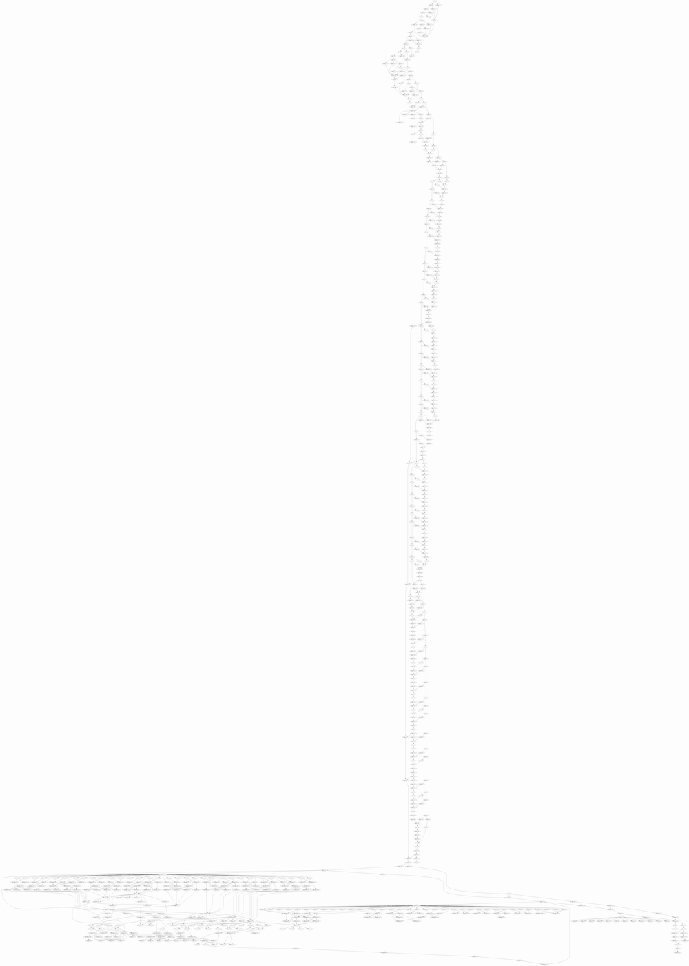
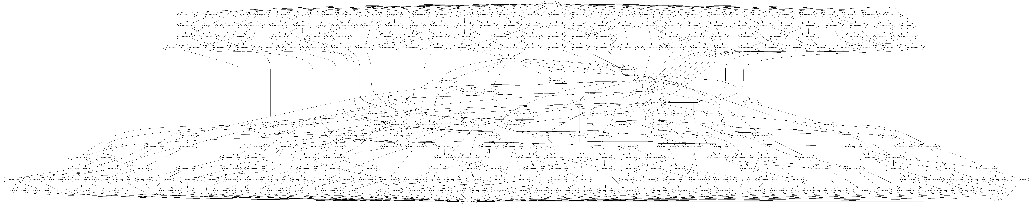
profiling traces of a decoder
8x8 2D IDCT
parsing, then IDCT
tail end of reconstruction,
followed by IDCT

Slide 24
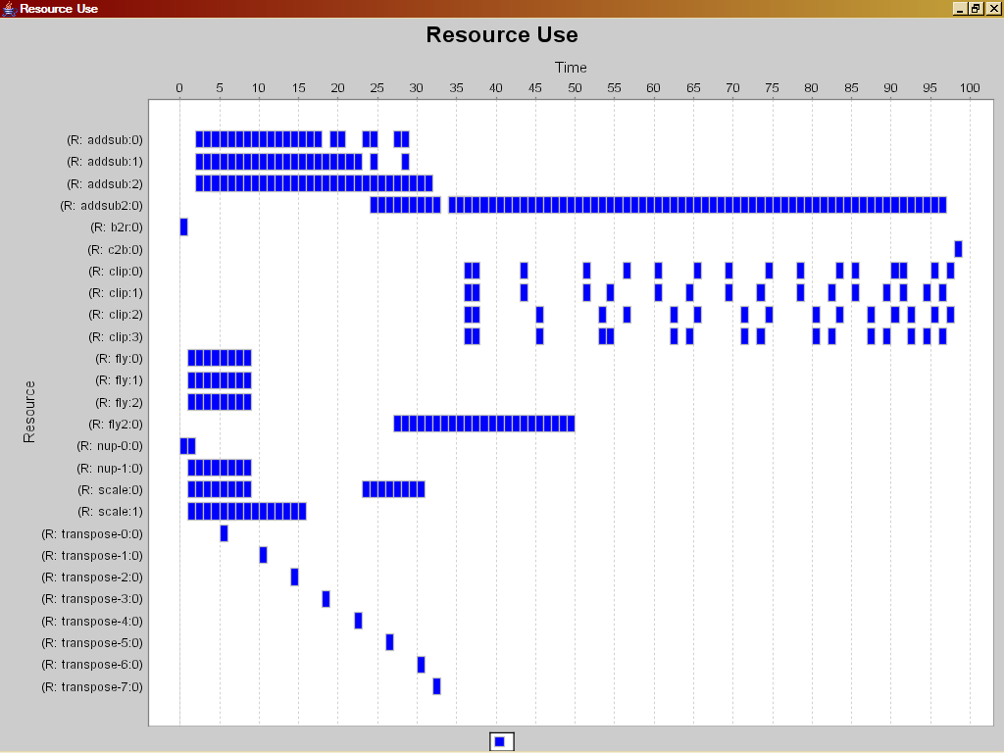
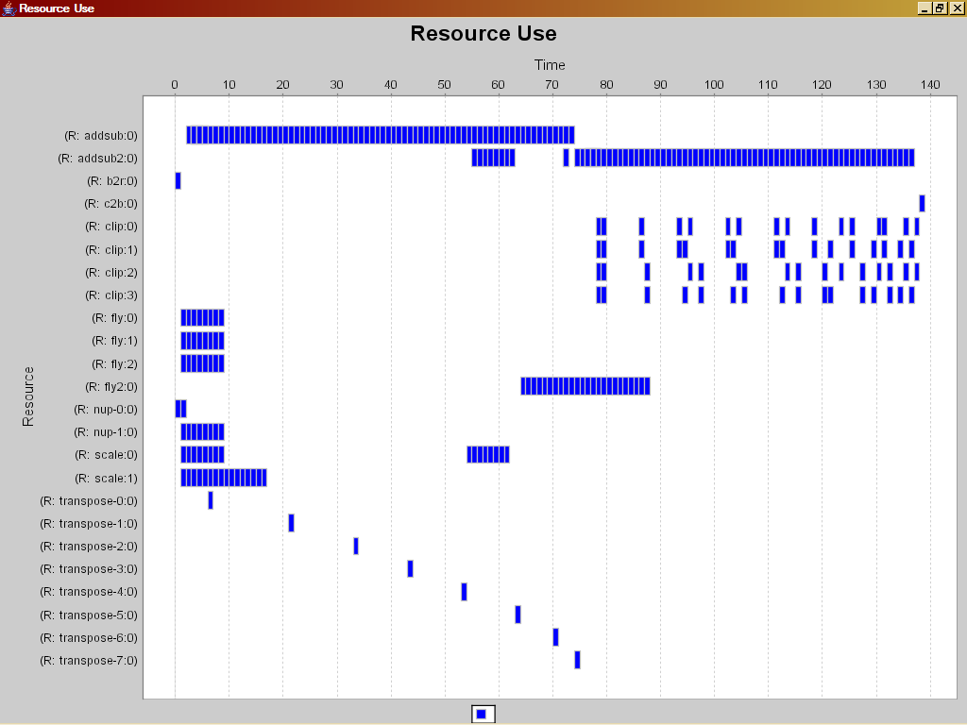
profiling post-mortem scheduling
basic schedule of trace
  latency
  density
laboratory for
hypothetical designs/architectures
What if we...
  ... changed latency somewhere?
  ... multiplexed resources?
  ... did so dynamically?
  ... used different
  communication fabric?
  ...

Slide 25
profiling trace analysis
...0111010010010
Src^{N1}
Src^{N2}
F1
Src^{N3}
longest path (min latency)
area * time (effort)
energy
... ?
F2
Snk
F3
Snk
Snk
output

Slide 26
analysis discovering statically schedulable regions
statically schedulable networks desirable
  efficient software implementations
  no deadlocks, yet small buffers
  reduced synchronization overhead (in hardware)
traditionally classify networks and actors as SDF/CSDF etc.
2
1
2
B
C
2
1
1
1
1
ACABC
A
instead: use internal actor structure to identify
analyzable regions defined by sets of ports
?
F

1
2
2
B

2
1
FBF
[Joint work with Shuvra Bhattacharyya, Jerry Hsu, et al., UMD.]

Slide 27
analysis example: variable polyphase video scaler
DVIin
RGB to
YUV422
PiP
YUV422 to RGB
DVIout
IN
OUT
CMD
crop /
pan
Resizer
Frame
Buf
{x₀,y₀,w,h}
HPARAM
VPARAM
WA
WD

Slide 28
analysis threaded implementations
Thread 1
actor Z () A, B ==> X, Y:
s := 0;
action A: [a] ==> X: [f(a)]
do
s := g(a, s);
end
action B: [b] ==> Y: [s]
do
s := h(a, s);
end
end
Thread 2
Thread 1:
forever {
...
P(lockZ);
a := ...;
s := g(a, s);
... := f(a);
V(lockZ);
...
}
Thread 2:
forever {
...
P(lockZ);
b := ...;
s := h(a, s);
... := s;
V(lockZ);
...
}
Thread 1:
forever {
...
a : ..;
s := g(a, s);
... := f(a);
...
}
Thread 2:
forever {
...
b := ...;
s := h(a, s);
... := s;
...
}

Slide 29
the bottom line
F

actor F () A, B ==> X:
action A: [a1, a2], B: [b] ==> X: [blue]
guard a1 = black, a2 = black, b = red
end
action A: [a], B: [b] ==> X: [black]
guard a = black, b = black
end
end
dataflow with firing
+ a few extensions
CAL :

can be compiled to efficient FPGA implementations
1.2
1.6
3.75
some adoption, notably by MPEG
more work to be done!

Slide 30
Q & A
credits:
  Dave Parlour (Xilinx) – dataflow wizard and visionary, applications
  Ian Miller (Xilinx) – behavioral compilation, anything to do with FPGA hardware
  Johan Eker (Ericsson) – CAL brother in arms, mobile applications
  Marco Mattavelli (EPFL) – Dr. MPEG, profiling (the SIT tool)
  Shuvra Bhattacharyya (UMD) – dataflow analysis and scheduling, DIF
opendf.sf.net
jorn.janneck@xilinx.com

Slide 31
Backup

Slide 32
programming language adoption
Name TPCI TPCI cum. Year
C 17.66% 17.66% 1973
C++ 11.06% 28.73% 1985
Perl 5.48% 34.20% 1987
Python 3.47% 37.67% 1990
VB 9.73% 47.40% 1991
Delphi 2.15% 49.54% 1994
Java 21.17% 70.72% 1995
PHP 9.86% 80.58% 1995
JavaScript 2.20% 82.78% 1995
C# 3.07% 85.85% 2002
100
cumulative TCPI by
language creation date
(for top 10 languages)
Java
PHP
JavaScript
C#
50
Delphi
VB
Perl
Python
C++
C
1970
1975
1980
1985
1990
1995
2000
2005
source: TIOBE Programming Community Index, TPCI, October 2006, http://www.tiobe.com/tpci.htm

Slide 33
MPEG-4 SP Decoder QoR
Version | Area |  |  |  |  | Performance
 | Slice | LUT | FF | BRAM | MULT
VHDL IP ¹ (15000 lines) | 4637 | 7923 | 2637 | 26 ² | 34 | 4-CIF image size 180K macroblock/s @ 100MHz Requires ZBT SRAM framebuf
CAL decoder (4000 lines) | 3872 | 7720 | 3576 | 22 ³ | 7 | HD image size 243K macroblock/s @ 120MHz Interfaces to DRAM framebuf I-frame parsing: 50 Mbit/s
¹ http://www.xilinx.com/bvdocs/ipcenter/data_sheet/ds520_prod_brf.pdf
² BRAM-limited to 4-CIF image size.
³ Supports HD image size. Reduces to 16 BRAMs for 4-CIF image size.

Slide 34
Design Space Exploration
Polyphase Video Scaler Example
relative area efficiency
VHDL – est. 35 weeks
  10
+ 5 weeks
  1
+ 1 week
CAL – 5 weeks
  0.1
1
2
5
10
throughput
taps/sec
x10⁹
1920x1080 @ 30Hz
YUV 7-tap

Slide 35
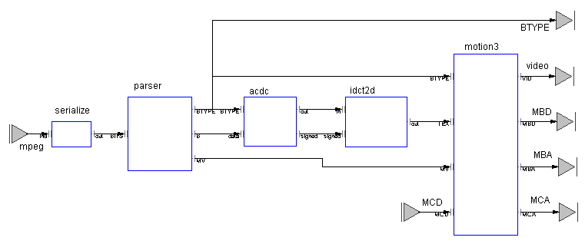
FPGA Programming In Practice
Networked MPEG-4 Viewer
Microblaze running LWIP protocol stack
XUP Board
(2VP30)
Ethernet
UDP
Raster Scan Actor
Decoder Actor Network
VGA Display IP
VGA
Display IP
Memory Controller
UDP over Ethernet
Remote Video Stream Server
Local
VGA Monitor

Slide 36
comprehensions, closures
actor FIR (taps) In ==> Out :
n = #taps;
data := [0 : for i in 1..n];
action [a] ==> [b]
var
newData = [data[i] : for i in 1..n-1] + [a],
b = sum([taps[i] * newData[i] : for i in 0..n-1])
do
data := newData;
end
function sum (L) :
accumulate(lambda (x, y) : x + y end, 0, L)
end
end
http://opendf.svn.sourceforge.net/viewvc/opendf/models/FIR/v1/FIR.cal?view=markup

Slide 37
NL – simple network
network Top () ==> :
import entity net.sf.caltrop.actors.Plotter;
var
noise = .1;
taps = [-.040609, -.001628, .17853, .37665, .37665, .17853, -.001628, -.040609];
entities
r = Random();
mul = ConstantMultiply(c = noise);
add = Add();
s = Sine(d = .01);
p = Plotter(autoredraw = 50);
clk = Clock(dt = 1);
tagOrig = Tag(tag = "Original");
tagFIR = Tag(tag = "FIR");
fir = FIR(taps = taps);
structure
clk.Out --> r.Trigger;
clk.Out --> s.Trigger;
r.Out --> mul.In;
mul.Out --> add.A;
s.Out --> add.B;
add.Out --> tagOrig.In;
add.Out --> fir.In;
fir.Out --> tagFIR.In;
tagOrig.Out --> p.Data;
tagFIR.Out --> p.Data;
end
http://opendf.svn.sourceforge.net/viewvc/opendf/models/FIR/v1/Top.nl?view=markup

Slide 38
NL – parametric structures
network FIR (taps) In ==> Out :
var
n = #taps;
entities
m = [ConstantMultiply(c = t) : for t in taps];
a = [Add() : for i in 0 .. n - 2];
z = [Z(tokens = [0]) : for _1 in taps];
structure
foreach i in 0 .. n - 1 do
In --> m[i].In;
if i > 0 then
m[i].Out --> a[i - 1].A;
z[i - 1].Out --> a[i - 1].B;
if i < (n - 1) then
a[i - 1].Out --> z[i].In;
else
a[i - 1].Out --> Out;
end
else
m[i].Out --> z[0].In;
end
end
end
http://opendf.svn.sourceforge.net/viewvc/opendf/models/FIR/v2/FIR.nl?view=markup

Slide 39
priorities (when order matters)
actor ProcessStream () In, Config ==> Out:
c := initialConfig();
action Config: [newC] ==>
do
c := newC;
end
action In: [data]
==> [compute(data, c)] end
end
how to enforce firing of one action
over another?
actor ProcessStream () In, Config ==> Out:
c := initialConfig();
config: action Config: [newC] ==>
do
c := newC;
end
process: action In: [data]
==> [compute(data, c)] end
priority
config > process;
end
end
intuition:
among the enabled actions,
one with highest priority is
fired

Slide 40
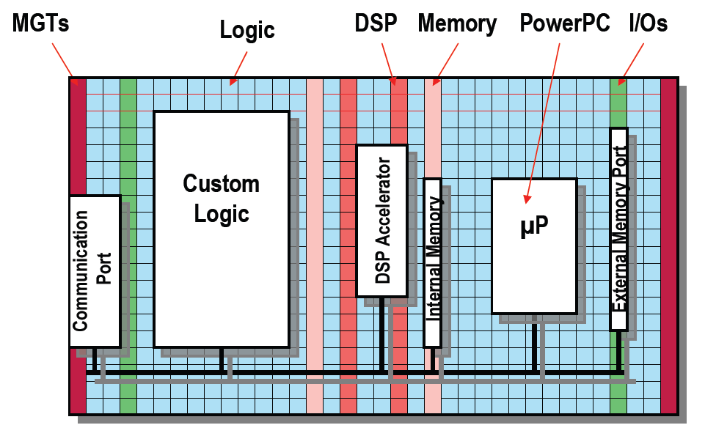
FPGA programming problem
What problem?
  Modern FPGAs are huge.
  They have a zoo of different blocks.
  RTL (VHDL, Verilog) not very good at expressing algorithms.
1985:
  128 4-LUTs
2006: [V5-LX]
  207360 6-LUTs
  10Mbit BRAM
  192 ALUs
Notes:
The size of a Platform FPGA is arguably the biggest challenge for a programming methodology targeting it. Because of their size, these chips will be used for large and complex designs. For this reason, the productivity of the design methodology shifts into focus. HDLs are fine for small or regular designs. For large, algorithmically complex designs, the productivity of HDLs conflicts with the fundamental value proposition of FPGAs, viz. that of reducing the NRE and TTM of hardware designs compared with ASICs.

Slide 41
tool structure
V
precompile
ThreadSSA
XLIM
synthesize
CAL
CAL
CALML
CAL
CALML
parse
instantiate
ActorC
parse
simulate
actor
network
NL
NL
XNL
elaborate
Network
XDF
codegen
VHDL
parse
XDF
class
instance

