Slide 1
Some research directions in dataflow programming
Jörn W. Janneck
Xilinx

Slide 2
overview
implementing actor networks (model compilation)
  actors and threads
profiling
implementation tools
  e.g. Cal2HDL
others

Slide 3
overview
implementing actor networks (model compilation)
  actors and threads
profiling
implementation tools
  e.g. Cal2HDL
others

Slide 4
implementing actor networks
One thread per application.
simulation
unicore software
(usually with static/almost-static schedule)
DVIin
RGB to
YUV422
PiP
YUV422 to RGB
DVIout
IN
OUT
CMD
crop /
pan
Resizer
Frame
Buf
{x₀,y₀,w,h}
HPARAM
VPARAM
WA
WD

Slide 5
implementing actor networks
One thread per actor.
simple hardware
multicore software
DVIin
RGB to
YUV422
PiP
YUV422 to RGB
DVIout
IN
OUT
CMD
crop /
pan
Resizer
Frame
Buf
{x₀,y₀,w,h}
HPARAM
VPARAM
WA
WD

Slide 6
implementing actor networks
Many threads per actor.
pipelined hardware
DVIin
RGB to
YUV422
PiP
YUV422 to RGB
DVIout
IN
OUT
CMD
crop /
pan
Resizer
Frame
Buf
{x₀,y₀,w,h}
HPARAM
VPARAM
WA
WD

Slide 7
implementing actor networks
One thread per statically schedulable region.
multicore software
starting point for mixed hardware/software implementations
DVIin
RGB to
YUV422
PiP
YUV422 to RGB
DVIout
IN
OUT
CMD
crop /
pan
Resizer
Frame
Buf
{x₀,y₀,w,h}
HPARAM
VPARAM
WA
WD

Slide 8
analysis discovering statically schedulable regions
statically schedulable networks desirable
  efficient software implementations
  no deadlocks, yet small buffers
  reduced synchronization overhead (in hardware)
traditionally classify networks and actors as SDF/CSDF etc.
2
1
2
B
C
2
1
1
1
1
ACABC
A
instead: use internal actor structure to identify
analyzable regions defined by sets of ports
?
F

1
2
2
B

2
1
FBF
[Joint work with Shuvra Bhattacharyya, Jerry Hsu, Ruirui Gu, UMD.]

Slide 9
analysis threaded implementations
Thread 1
actor Z () A, B ==> X, Y:
s := 0;
action A: [a] ==> X: [f(a)]
do
s := g(a, s);
end
action B: [b] ==> Y: [s]
do
s := h(a, s);
end
end
Thread 2
Thread 1:
forever {
...
P(lockS);
a := ...;
s := g(a, s);
... := f(a);
V(lockS);
...
}
Thread 2:
forever {
...
P(lockS);
b := ...;
s := h(a, s);
... := s;
V(lockS);
...
}
Thread 1:
forever {
...
a : ..;
s := g(a, s);
... := f(a);
...
}
Thread 2:
forever {
...
b := ...;
s := h(a, s);
... := s;
...
}

Slide 10
overview
implementing actor networks (model compilation)
  actors and threads
profiling
implementation tools
  e.g. Cal2HDL
others

Slide 11
profiling the structure of a computation
actor Src () ==> X:
s := 0;
action ==> X: [s]
do
s := h(s);
end
end
actor F () A ==> X:
x := 0;
action A: [a] ==> X: [f(x)]
do
x := g(a, x);
end
end
actor F () A ==> X:
action A: [a] ==> X: [f(a)] end
end
actor Snk () A ==> X:
action A: [a] ==> end
end
≡
actor Src () S ==> X, Y:
action S: [s] ==> X: [h(s)] end
end
Src
Src
F
Src
F
Snk
F
Snk
Snk

Slide 12
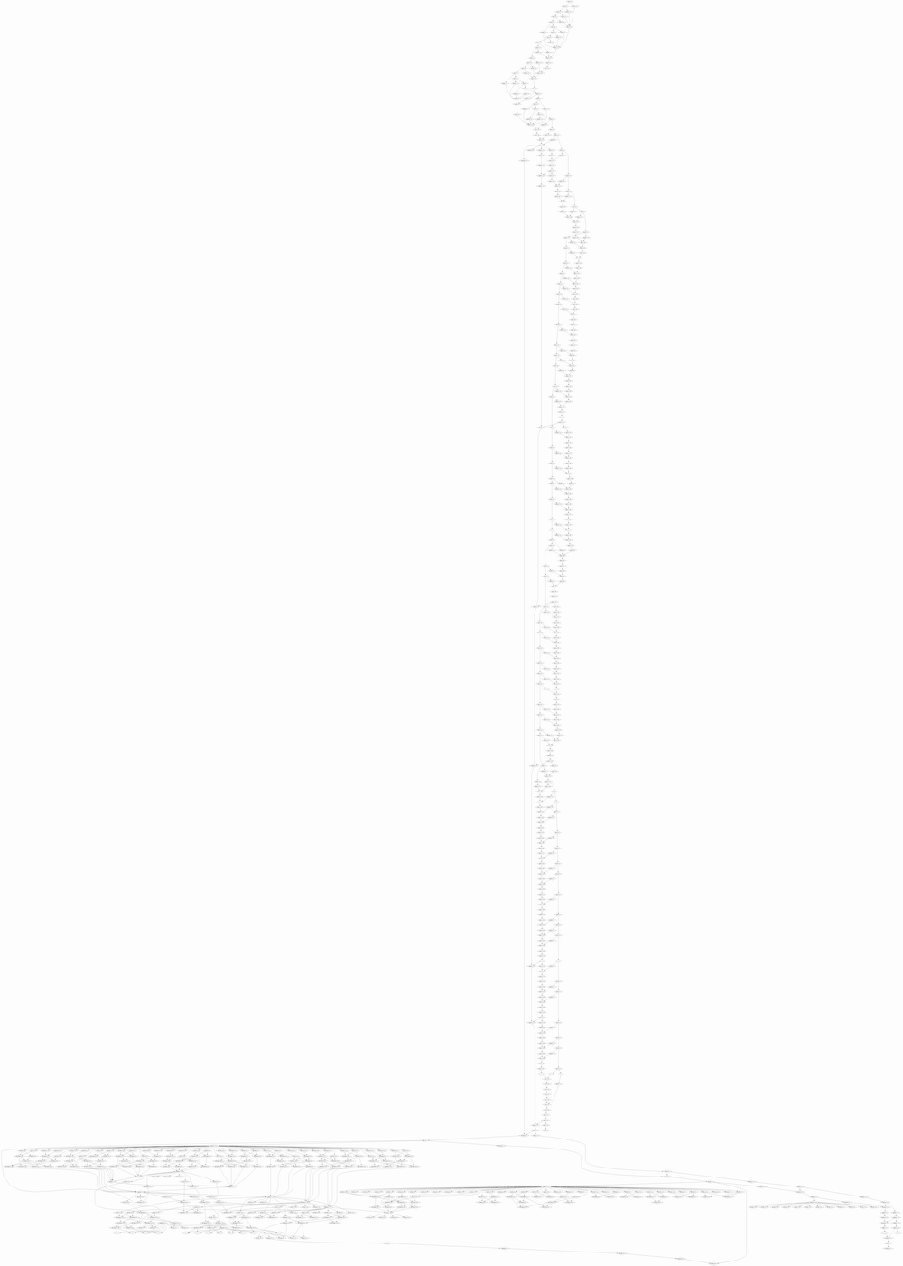
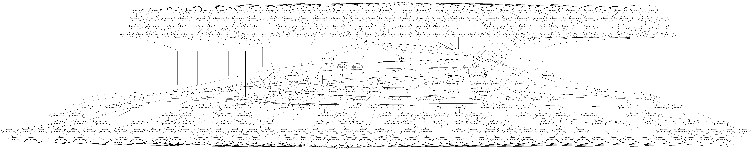
profiling traces of a decoder
8x8 2D IDCT
parsing, then IDCT
tail end of reconstruction,
followed by IDCT

Slide 13
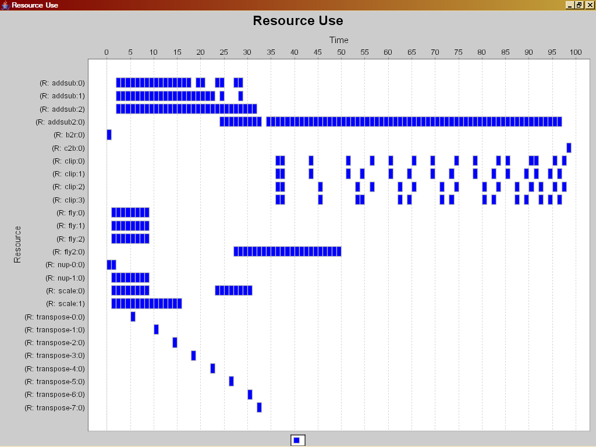
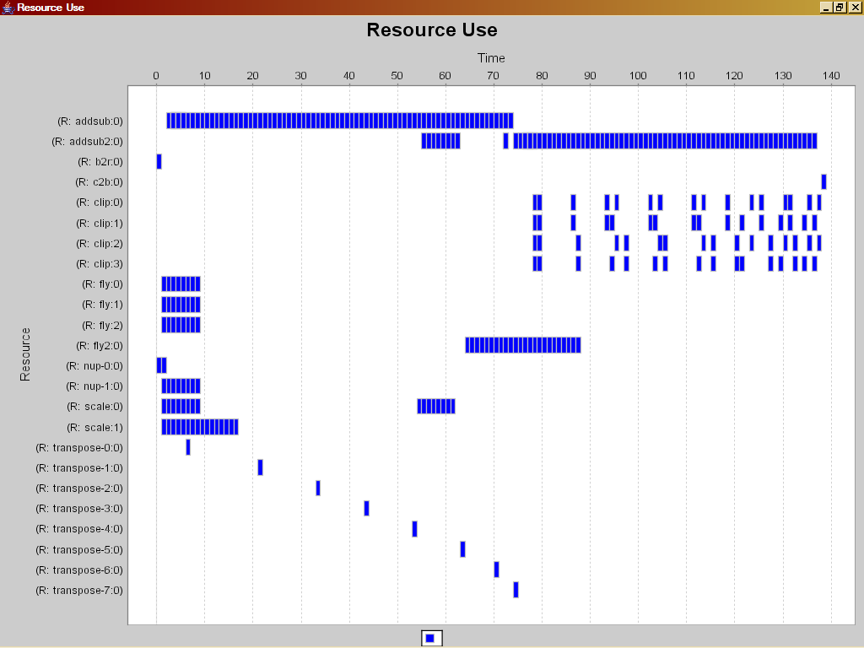
profiling post-mortem scheduling
basic schedule of trace
  latency
  density
laboratory for
hypothetical designs/architectures
What if we...
  ... changed latency somewhere?
  ... multiplexed resources?
  ... did so dynamically?
  ... used different
  communication fabric?
  ...

Slide 14
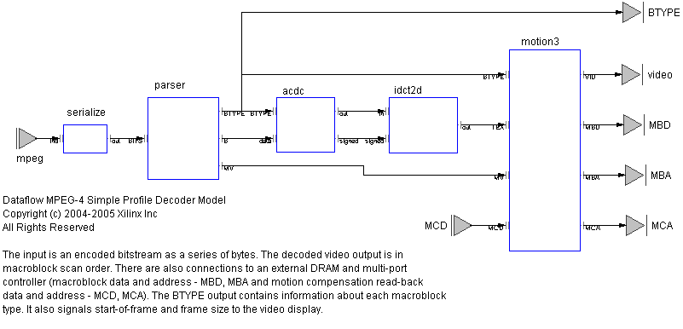
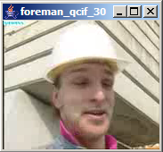
profiling trace analysis
input/output tagging
...0111010010010
Src^{N1}
Src^{N2}
F1
Src^{N3}
longest path (min latency)
area * time (effort)
energy
... ?
F2
Snk
F3
Snk
Snk
output

Slide 15
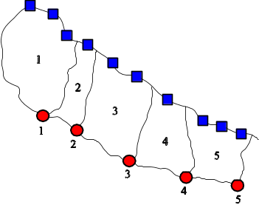
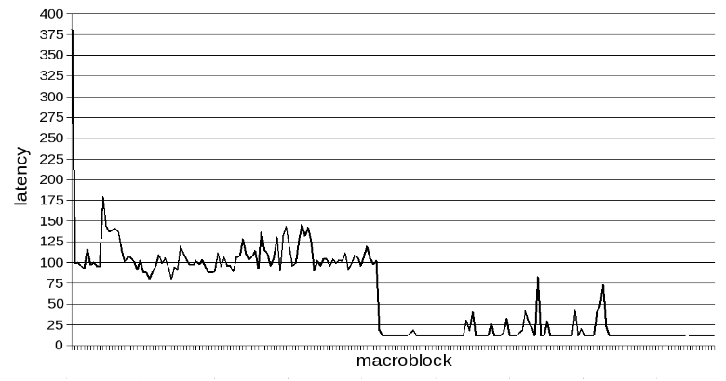
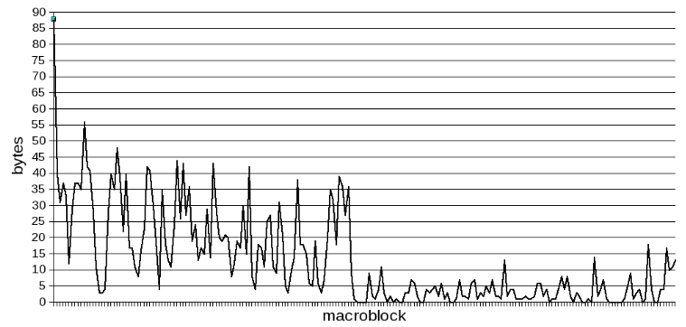
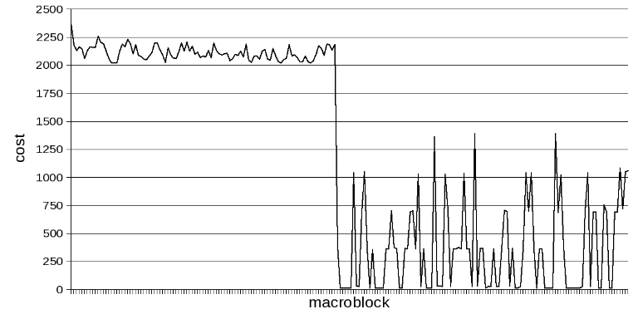
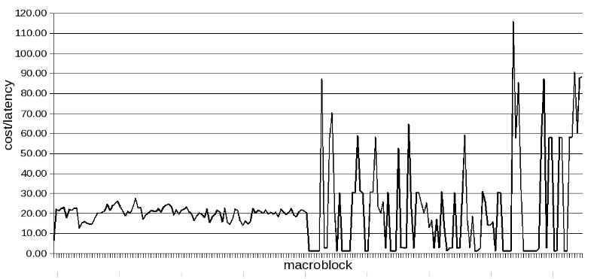
profile metrics
latency (incr.)
input
(bytes)
cost
(Σ area * time)
parallelizability
(cost/latency)

Slide 16
overview
implementing actor networks (model compilation)
  actors and threads
profiling
implementation tools
  e.g. Cal2HDL
others

Slide 17



dataflow tools
Structure
Behavior
NL
CAL
XDF
ActorC
Open Dataflow Infrastructure
opendf.sf.net
Translator
Simulator
Analysis
XLIM
CodeGen
CodeGen
CodeGen
Partitioning
HDL
ARM11
C
HDL
C
HDL
C
HDL
C
Notes:
Our tool work is currently labeled “SystemBuilder”. We adopted some infrastructure from UC Berkeley for CAL simulation, and added:
- Textual description of structure, so that we can describe and simulate networks of actors.
Hardware code generation. This was the big unknown since actors had not been mapped to hardware before. The compilation process is split into stages. XLIM is an intermediate program representation that is a useful starting point for a variety of code generators.
We can access these tools through a command-line interface or an Eclipse-based IDE which also gives on-the-fly checking.

Slide 18
tool structure
V
precompile
ThreadSSA
XLIM
synthesize
CAL
CAL
CALML
CAL
CALML
parse
instantiate
ActorC
parse
simulate
actor
network
NL
NL
XNL
elaborate
Network
XDF
codegen
VHDL
parse
XDF
class
instance

Slide 19
translating actors to gates
CAL
CALML
instantiate
CAL
CALML
precompile
ThreadSSA
XLIM
synthesize
V
parameters

Slide 20
instantiate
actor SendDC (int T_INTER) int TYPE, int IN ==> int DC :
int count := 0;
...
end
SendDC(T_INTER = 1)
actor SendDC () int TYPE, int IN ==> int DC :
int T_INTER = 1;
int count := 0;
...
end

Slide 21
precompile
operators (binding and substitution)
a + b * c
a + (b * c)
$add(a, $mul(b, c))
constant propagation
int T_INTER = 1;
...
guard t = T_INTER
guard t = 1
dead code elimination
if true then
Stmts1;
else
Stmts2;
end
Stmts1;
function/procedure inlining
function f (x) : g(x, h(x)) end
...
y := f(E);
y := let x’ = E : g(x’, h(x’)) end;

Slide 22
actions (recap)
input, guards:
when can this
action execute
actor SendDC () int TYPE, int IN ==> int DC :
int count := 0;
action TYPE: [t], IN: [v] ==> DC: [v]
guard count = 0, t = 1
do
count := count + 1;
end
action TYPE: [t], IN: [v] ==>
guard count = 0, t != T_INTER
do
count := count + 1;
end
action IN: [v] ==>
guard count > 0
do
if count < 63 then
count := count + 1;
else
count := 0;
end
end
end
body, output:
what does it do
during execution

Slide 23
generating threads
actor SendDC (int T_INTER) int TYPE, int IN ==> int DC :
int count := 0;
action TYPE: [t], IN: [v] ==> DC: [v]
guard count = 0, t = 1
do
count := count + 1;
end
action TYPE: [t], IN: [v] ==>
guard count = 0, t != 1
do
count := count + 1;
end
action IN: [v] ==>
guard count > 0
do
if count < 63 then
count := count + 1;
else
count := 0;
end
end
end
action
thread 1
action
thread 2
action
scheduler
action
thread 3

Slide 24
generating threads
actor SendDC (int T_INTER) int TYPE, int IN ==> int DC :
int count := 0;
action TYPE: [t], IN: [v] ==> DC: [v]
guard count = 0, t = 1
do
count := count + 1;
end
action TYPE: [t], IN: [v] ==>
guard count = 0, t != 1
do
count := count + 1;
end
action IN: [v] ==>
guard count > 0
do
if count < 63 then
count := count + 1;
else
count := 0;
end
end
end
action
thread 1
TYPE
count
DC
action
thread 2
action
scheduler
IN
action
thread 3

Slide 25
generating threads
wait A1_{GO} do
v <- IN;
t <- TYPE;
count_{OUT} := count_{IN} + 1;
v -> DC;
end A1_{DONE};
actor SendDC (int T_INTER) int TYPE, int IN ==> int DC :
int count := 0;
action TYPE: [t], IN: [v] ==> DC: [v]
guard count = 0, t = T_INTER
do
count := count + 1;
end
action TYPE: [t], IN: [v] ==>
guard count = 0, t != T_INTER
do
count := count + 1;
end
action IN: [v] ==>
guard count > 0
do
if count < 63 then
count := count + 1;
else
count := 0;
end
end
end
v <- IN;
t <- TYPE;
count_{OUT} := count_{IN} + 1;
v -> DC;
wait A2_{GO} do
v <- IN;
t <- TYPE;
count_{IN} + 1 -> count_{OUT};
end A2_{DONE};
wait A3_{GO} do
v <- IN;
if count_{IN} < 63 then
count_{OUT} := count_{IN} + 1;
else
count_{OUT} := 0;
end
end A3_{DONE};

Slide 26
generating threads
actor SendDC (int T_INTER) int TYPE, int IN ==> int DC :
int count := 0;
action TYPE: [t], IN: [v] ==> DC: [v]
guard count = 0, t = T_INTER
do
count := count + 1;
end
action TYPE: [t], IN: [v] ==>
guard count = 0, t != T_INTER
do
count := count + 1;
end
action IN: [v] ==>
guard count > 0
do
if count < 63 then
count := count + 1;
else
count := 0;
end
end
end
forever
var
t = peek(TYPE, 0);
c1 = TYPE_{#1} && IN_{#1} && count_{IN} = 0 && t = 1;
c2 = TYPE_{#1} && IN_{#1} && count_{IN} = 0 && t != 1;
c3 = IN_{#1} && count_{IN} > 0 && count_{IN} > 0;
do
parcase
c1: set A1_{GO}; wait A1_{DONE}; unset A1_{GO};
c2: set A2_{GO}; wait A2_{DONE}; unset A2_{GO};
c3: set A3_{GO}; wait A3_{DONE}; unset A3_{GO};
end
end

Slide 27
SSA form
(static single assignment)
wait A3_{GO} do
v <- IN;
if count_{IN} < 63 then
count_{OUT} := count_{IN} + 1;
else
count_{OUT} := 0;
end
end A3_{DONE};
wait A3_{GO} do
v <- IN;
if count_{IN} < 63 then
$1 := count_{IN} + 1;
else
$2 := 0;
end
count_{OUT} := PHI($1, $2);
end A3_{DONE};
n := 0;
while P(n) do
n := n + 1;
S1(n);
end
S2(n);
$1 := 0;
L1: $2 := PHI($1, $3);
if not P($2) then goto L2;
$3 := $2 + 1;
goto L1;
L2: S2($2);
n := $2;

Slide 28
SSA form
(static single assignment)
a
63
if a < 63 then
$1 := a + 1;
else
$2 := 0;
end
b := PHI($1, $2);
1
<
0
+
$2
Φ
$1
b
SSA representation
  straightforward extraction of parallelism
  local scalar variables become arcs
    = wires in hardware implementation
  good starting point for hardware and software backends

Slide 29
synthesize
macro-scale synthesis
  action segmentation and pipelining
micro-scale synthesis
  operator-level control and scheduling
  optimizations

Slide 30
macro-scale synthesis
actor A () int X ==> int Y :
int s := 0;
action X: [x] ==> Y: [g(s)]
do
s := f(x, s);
end
end
forever
var
c1 = X_{#1};
do
parcase
c1: set A1_{GO};
wait A1_{DONE};
unset A1_{GO};
end
break;
end
wait A1_{GO} do
x <- X;
tmp := f(x, s_{IN});
s_{OUT} := tmp;
g(tmp) -> Y;
end A1_{DONE};
X
Y
s

Slide 31
macro-scale synthesis
actor A () int X ==> int Y :
int s := 0;
action X: [x] ==> Y: [g(s)]
do
s := f(x, s);
end
end
forever
var
c1 = X_{#1};
do
parcase
c1: set A1_{GO};
wait A1_{DONE};
unset A1_{GO};
end
break;
end
...
x <- X;
tmp := f(x, s_{IN});
s_{OUT} := tmp;
...
...
g(tmp) -> Y;
...
Y
X
tmp
s
Degrees of freedom
  segment granularity, segmentation boundaries
  locking mechanism of common resources (variables, ports)

Slide 32
micro-scale synthesis
input: communicating threads in SSA form
output: Verilog
scheduling
  control inference
  register insertion: balancing and pipelining
logic reduction optimizations
  data path sizing / bit-accurate constant propagation
  dead code elimination
  operator simplification
  memory reduction
throughput optimizations
  loop unrolling
  memory splitting
  memory optimization

Slide 33
Example: MPEG-4 SP decoder
...0101001111010010010
4
3
comparison to
VHDL reference design
2
1
0.8
1.6
3.75
Size
CAL: 3872, 22
VHDL: 4637, 26
(Slices, BRAM)
Speed
CAL: 290K
VHDL: 180k
(MacroBlocks/s)
[1080p30: 245k]
Productivity
CAL: 4k
VHDL: 15k
(LOC)
Notes:
Here is our first example of the power of design space exploration. In about 3MM vs 1 MY we can achieve higher throughput with reduce area, system resource utilization.
This decoder was demonstrated on a networked V2Pro FPGA board with VGA display.

Slide 34
status comparing decoders
density
throughput/area
(relative)
CIF
SD
1080p30
  5
ASIC²
  2
FPGA – CAL
  1
TI64xx¹
FPGA – VHDL
throughput
macroblocks/sec
x1000
10
100
1000
¹ CPU + L1 cache only
² ISSCC’06, H.264 capable

Slide 35
MPEG-4 SP Decoder QoR
Version | Area |  |  |  |  | Performance
 | Slice | LUT | FF | BRAM | MULT
VHDL IP ¹ (15000 lines) | 4637 | 7923 | 2637 | 26 ² | 34 | 4-CIF image size 180K macroblock/s @ 100MHz Requires ZBT SRAM framebuf
CAL decoder (4000 lines) | 3872 | 7720 | 3576 | 22 ³ | 7 | HD image size 243K macroblock/s @ 120MHz Interfaces to DRAM framebuf I-frame parsing: 50 Mbit/s
¹ http://www.xilinx.com/bvdocs/ipcenter/data_sheet/ds520_prod_brf.pdf
² BRAM-limited to 4-CIF image size.
³ Supports HD image size. Reduces to 16 BRAMs for 4-CIF image size.

Slide 36
overview
implementing actor networks (model compilation)
  actors and threads
profiling
implementation tools
  e.g. Cal2HDL
others

Slide 37
other work to be done...
advanced compilers
  HW, SW, HW/SW co-synthesis
  asynchronous implementations
  model compilation, scheduling
advanced implementation techniques / transformations
  automatic “multi-channelization”
  folding/unfolding of actor networks
  “actor machine”
development tools
  refactoring engines, IDEs, debuggers
programming techniques, patterns, libraries
  such as RVC for video

Slide 38
Q & A
credits:
  Shuvra Bhattacharyya (UMD) – dataflow analysis and scheduling, DIF
  Johan Eker (Ericsson) – CAL brother in arms, mobile applications
  Christophe Lucarz (EPFL) – MPEG - RVC
  Marco Mattavelli (EPFL) – Dr. MPEG, profiling (the SIT tool)
  Ian Miller (Xilinx) – behavioral compilation, anything to do with FPGA hardware
  Dave Parlour (Xilinx) – dataflow wizard and visionary, applications
  Carl v Platen (Ericsson) – code generation, ARM
  Mickaël Raulet, J-F Nezan, Matthieu Wipliez (INSA) – Cal2C and beyond
  ...
opendf.sf.net
jorn.janneck@xilinx.com

