Slide 1
Memory
“It’s just like an array… but bigger.”
………………….
Byte 0
Size = max
The memory needs of most programs change whilst they are running.
How is the memory managed?

Slide 2
Simple case
Anything a program needs exactly one copy of can go in memory at a fixed address.
Global and static variables
Can optionally be ‘read only’ (final) – the actual program code, fixed strings, …
Known as text
Anything static but not read-only: data

Slide 3
Global variables
int a, b, c;
int main() {
a = 3;
b = 7;
c = a + b;
cout << c << endl;
}

Slide 4
text
data
………………….

Slide 5
Variables within functions
void someFunction() {
int a = 3;
int b = 7;
int c = a + b;
cout << c << endl;
}

Slide 6
More braces (a)
{
int a = 3; int b = 7; int c = a+b;
for (int j = 0; j < 10; ++j) {
c += j;
}
for (int k = 0; k < 10; ++k) {
c += j;
}
cout << c << endl;
}

Slide 7
More braces (b)
{
int a = 3; int b = 7; int c = a+b;
for (int j = 0; j < 10; ++j) {
c += j;
}
for (int k = 0; k < 10; ++k) {
c += k;
}
cout << c << endl;
}

Slide 8
A stack
J
A
B
C
K
A
B
C
A
B
C

Slide 9
Function calls
void steve() {
int a = 3; int b = 7;
cout << (a + b) << endl;
}
int main() {
int v = 100;
steve();
}

Slide 10
Function calls
void steve() {
1: int a = 3; int b = 7;
2: cout << (a + b) << endl;
}
int main() {
3: int v = 100;
4: steve();
5: cout << 9001 << endl;
6: steve();
7: cout << “Done” << endl;
}

Slide 11
‘call’ in x86 assembler
Push the address of the next line of code to the front of the stack
Jump to the code for the named function
‘ret’ in x86 assembler
Pop a memory address off the front of the stack
Jump to the code at that address

Slide 12
4e <main>:
...
5c: sub $0x4,%esp
5f: movl $0x64,0x0(%esp)
66: call 1b <steve>
6b: ...
78: call f0 <operator<<…>
7d: ...
80: call 1b <steve>
85: ...
92: call f0 <operator<<…>
97: add $0x4,%esp

Slide 13
1b <steve>:
1b: sub $0x8,%esp
1e: movl $0x3,0x4(%esp)
26: movl $0x7,0x0(%esp)
...
4a: add $0x8,%esp
4d: ret

Slide 14
Method parameters
void printNumbers(int a) {
cout << a << endl;
if (a > 0) {
printNumbers(a – 1);
}
cout << a << endl;
}
...
printNumbers(100);

Slide 15
Push parameters onto stack (here, the hex value 0x64 = decimal 100)
push $0x64
call 1b <printNumbers>
add $0x4,%esp
Increment the stack pointer by the size of what was pushed onto it

Slide 16
Stack frames
Local Variables
One stack frame
Everything a method needs to run.
Exact details are a calling convention)
Return Address
Parameters
Local Variables
Return Address
Parameters
…

Slide 17
What kind of sorcery is this?
vector<int> * li;
void makeVector() {
vector<int> * here
= new vector<int>(10);
li = here;
}
int main() {
makeVector();
cout << li->size() << endl;
}

Slide 18
new vector<int>(10);
Make an vector<int> object somewhere in memory; return the memory address of where it is
vector<int> * here =
here goes on the stack as it is a local variable, but here is not the object itself – it is only a pointer to it

Slide 19

Local variables, return addresses, etc.
Anything made with new
Static and global variables

Slide 20
The heap
Reasonable assumption: it's a block of memory, starting at address x, finishing at address y.
Some parts are free; other parts are in use
new: take some of the free memory, mark it as in use
Memory marked as free again, when no longer needed
  Garbage collection in Java
  delete in C++
  ...

Slide 21
Choosing which hole to use
n bytes of memory requested – choose a hole of size m (m ≥ n). Any leftover space becomes a new hole, in theory, of size (m - n).
First-fit: from the list of holes, choose the first of size m ≥ n
Best-fit: from the list of holes, choose the smallest hole of size m ≥ n
Worst-fit: choose the largest hole, hence leaving the biggest possible new (m - n).

Slide 22
Storing the list of holes and in-use memory
class MemControlBlock {
public:
bool available;
int size;
MemControlBlock* previous;
MemControlBlock* next;
};

Slide 23
First fit
MemoryAddress getMemory(int size) {
MemControlBlock* curr = startOfHeap;
while (curr != nullptr &&
(!curr->available || curr->size < size)){
curr = curr->next;
}
// now what?
}

Slide 24
sizeof() in C++
class MemControlBlock {
public:
bool available;
int size;
MemControlBlock* previous;
MemControlBlock* next;
};

Slide 25
sizeof() in C++ (32 bits)
class MemControlBlock {
public:
bool available; // 1 byte
int size; // 4 bytes
MemControlBlock* previous; // 4
MemControlBlock* next; // 4
};

Slide 26
Alignment
‘size’, ‘previous’ and ‘next’ are 4 bytes each
Must be aligned to a memory address that is a multiple of 4
Suppose we had a MemControlBlock at memory address 1024:
  ‘available’ is at 1024
  ‘size’ is at…?
sizeof(MemControlBlock) is then…?

Slide 27
Leftover space
int spare = curr->size - size
- sizeof(MemControlBlock);
if (spare > 0) {
...make a new MemControlBlock...
}

Slide 28
Internal fragmentation

Slide 29
Addressing memory
A MemControlBlock is at address x
The block of memory it is controlling is 16 bytes later (immediately after it)
How do we get to it? Add 16 bytes to x
In C++ bytes are chars
char * y = reinterpret_cast<char*>(x);
y += 16; // is now 16 bytes after x
x
y
z

Slide 30
Placement new
Normal ‘new’ lets the system decide the memory address for the object to make
We want to make a new MemControlBlock at address z
Use placement new:
MemControlBlock* newMCB
= new(z) MemControlBlock(…);
Takes a memory address, e.g. a char*

Slide 31
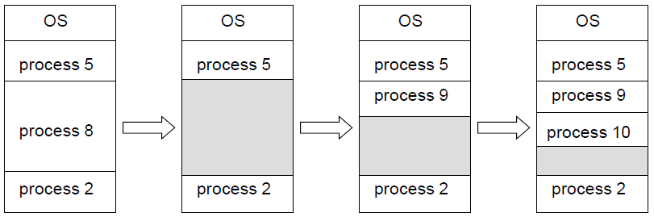
Back to Operating Systems
NB It’s 2017 – don’t actually do this

Slide 32
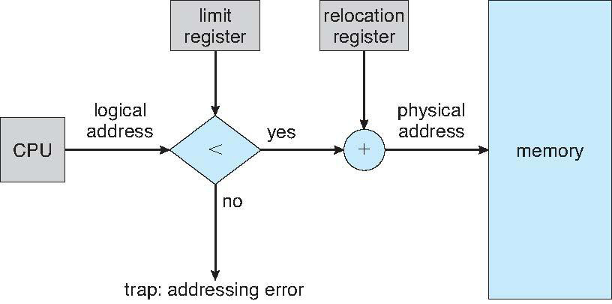
For a process
The base register records where its memory starts (base)
The limit register records how much memory is available (limit)
base
register
uh-oh

Slide 34
Why doubly linked?
b
c
…
512
T
a
c
1024
F
b
d

Slide 35
Why doubly linked?
b
c
…
512
T
a
c
1024
T
b
d
…
?
T
a
d

Slide 36
External fragmentation

Slide 37
Placement new meets delete
When using normal ‘new’, ‘delete’ does two things:
  Calls the destructor
  Marks the memory as being free
If we are used placement new, we are doing our own memory management, so delete an object of type Foo at address y we:
  Call its destructor: y->~Foo();
  Take 16 bytes off y to get the MemControlBlock address, and reinterpret_cast<MemControlBlock*>(..)
  Mark it as available; and merge with adjacent free blocks (if there are any)

Slide 38
Avoiding fragmentation when using a base/limit model
Q: We have external fragmentation, between processes.
How can we fix this?

Slide 39
Avoiding fragmentation in a process itself
Memory pools: keep small objects together

Slide 40
Memory pools are awesome (pt. 1)
Allocate space for several small objects in one go, in one contiguous block
Keep a (singly linked) list of which are free (initially, every object in the block)
Allocation request: pop item off the list
  If none left, make another block’s worth
Deallocation request: push item onto the list
The block itself is only deallocated when every object inside it is free

Slide 41
Dave
class Dave {
public:
int a;
int b;
};
int main() {
for (int i = 0; i < 1024; ++i) {
new Dave();
}
}

Slide 42
Allocation overheads
(or: Memory pools are awesome pt. 2)
Assume 1024 Daves, pool size of 60 Daves,
sizeof(MemControlBlock) = 16,
sizeof(SinglyLinkedListNode) = 8
Without a memory pool:
Each call to new creates a MemControlBlock.
1024 calls @ 16 bytes each = 16 bytes per Dave
With a memory pool?

Slide 43
Fixed size? (ulimit –v)
If data and text are fixed…
…and we can determine the max size of stack and heap…
…we can fix ‘max’.

Slide 44
base
register
uh-oh

Slide 45
Paged memory
Split physical memory into frames of some (power-of-two) size, e.g. 4Kb
Split logical memory into pages of the same size
A process has 1 or more pages of memory
Each page is stored in a frame
Pages 0,1,2,3 could be stored in frames 97,1,14,7

Slide 46
Paged address binding
A page table (an array) gives the memory address (frame) of each page of memory
Logical memory addresses split into two parts:
  The page number (p)
  The page offset (d)
Physical address = page_table[p] + d
Logical
p (m - n bits)
d (n bits, i.e. page size 2^{n})
Physical
page-table[p]
d

Slide 47
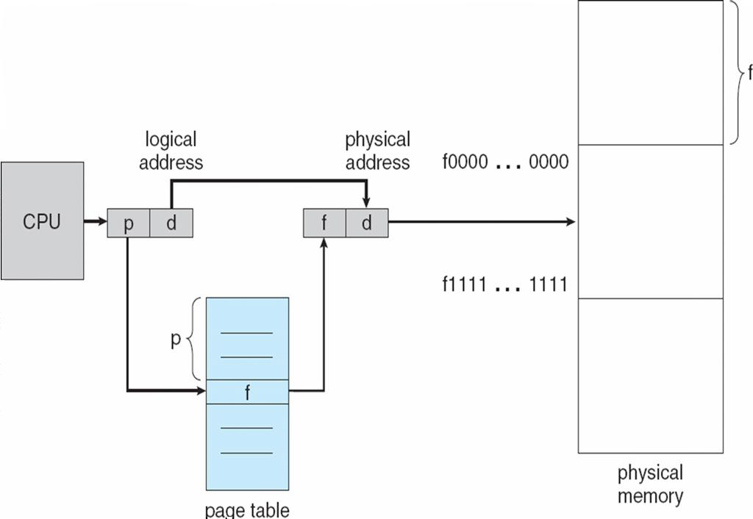

Slide 48
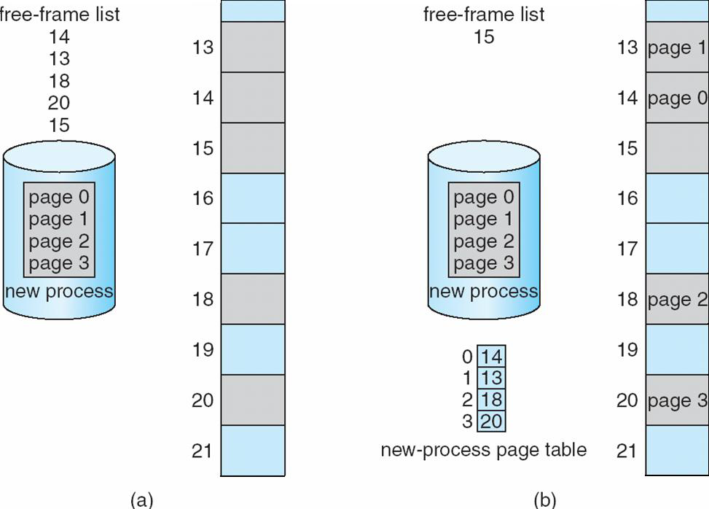
Allocating memory

Slide 49
Should we do this?
Dave * d = new Dave();
If we are using pages 0 to 3 (inclusive) of memory, we could:
Get another frame of memory;
Put its address into page table entry 4
Store Dave at the logical memory address (4,0)

Slide 50
Not always:
For small objects – use the ‘hole’ model, within pages of memory:
Get a frame of memory, put it in the page table
Put a MemControlBlock at the start
Store Dave in that page, making a new hole
For the next Dave, it can go in that page too
Only start filling new pages of memory, when the current pages of small objects are full

Slide 51
Performance?

Slide 52
Translation Lookaside Buffer
Effectively, a cache of the page table: each entry is a (page,frame) pair
Uses fast associative memory – implemented in hardware, not software: if page p is requested, compare p to the page of each pair
  TLB hit: an appropriate TLB entry was found (with page = p), the associated frame is returned
  TLB miss: no TLB entry is found, the frame number is returned from the page table in memory (as before)

Slide 53


Slide 54
Much fast, many performance, wow
Assume:
  TLB lookup takes time ε (a small amount)
  Memory access cycle takes 50μs
  Probability of a TLB hit: α
Effective access time is ε + a weighted mean of one access (probability α) and two accesses (probability 1 - α):
= ε + α.50 + (1 – α).100
= ε + α.50 + 100 – α.100
= ε + 100 – α.50

Slide 55
But why Phantom Memory?
We have several processes running
Each has a page table, and gradually uses more memory (is allocated more frames)
Eventually, we run out of free frames
Uh-oh

Slide 56
Memory
Management
Unit
Process
(p,d)
RAM
(f,d)
1 word of data from address (f,d)

Slide 57
???
Process
(p,d)
1 word of data from address (f,d)

Slide 58
Use page table to
find frame containing
page p
ii) Fetch data
from (f,d)
pt[p]
Process
(p,d)
f
RAM
(f,d)
1 word of data from address (f,d)

Slide 59
Use page table to
find frame f and
valid bit v for page p
ii) ???
iii) Fetch data
from (f,d)
pt[p]
Process
(p,d)
f | v
RAM
(f,d)
1 word of data from address (f,d)

Slide 60
Virtual memory
Accessing some page ‘p’, with valid bit set to false: triggers a page fault
The page fault handler in the operating system kernel kicks in:
  Choose a victim frame ‘f’: swap out (copy to disk) its contents; set the valid bit to false in the page table entry containing that frame.
  Swap in ‘p’ (copy from disk), into ‘f’
  page_table[p] = f, and mark as valid
Get the data from (f,d) as before.
Our process doesn’t know this has happened.

Slide 61
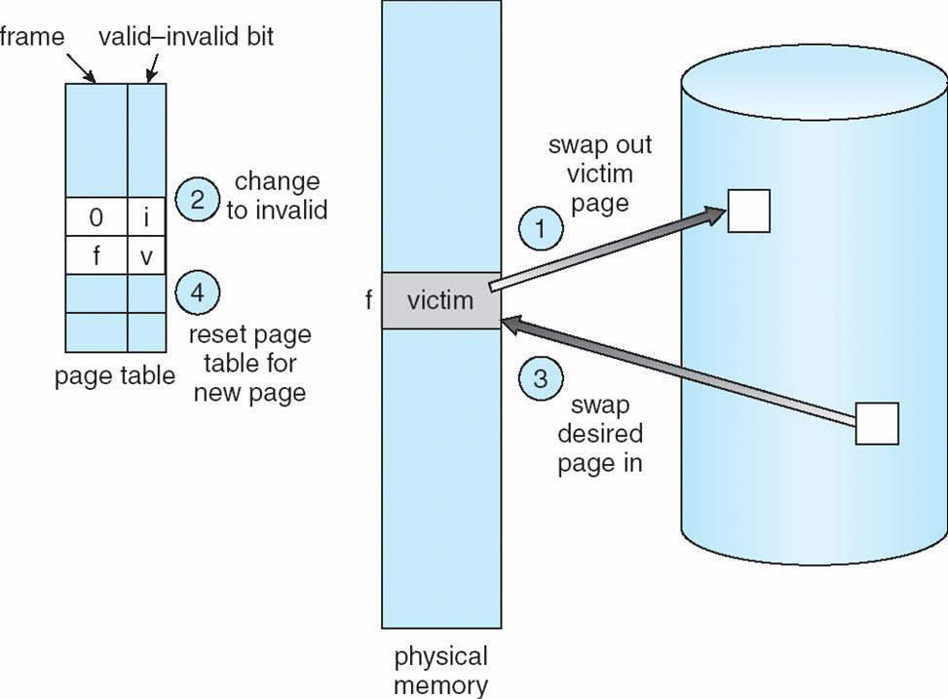

Slide 62
Does the valid bit take space?
class PageTableEntry {
public:
Frame* frameAddress;
bool valid;
};

Slide 63
The valid-bit hack
Page number | Frame address (in decimal) | Frame address (in binary)
0 | 4096 | 0001000000000000
1 | 16384 | 0100000000000000
2 | 8192 | 0010000000000000
3 | 12288 | 0011000000000000

Slide 64
Moar bits
Swapping takes time: uses hard disk
What if
  A page was swapped out to disk
  It was swapped back in
  It was swapped back out again
If between (a) and (c) it hasn’t changed, we already have a copy of it on disk
Each page has a dirty bit set to 0 when swapped in; set to 1 when the page is written to.
Don’t swap out pages whose dirty bit is 0.

Slide 65
Dirty bits
Page number | Frame address (in decimal) | Frame address (in binary)
0 | 4096 | 0001000000000000
1 | 16384 | 0100000000000000
2 | 8192 | 0010000000000000
3 | 12288 | 0011000000000000
Dirty bit Valid bit

Slide 66
Even moar bits
Our program code is stored in memory
It normally shouldn’t change whilst the program is running
Further, we should only be able to execute code
  Does it make sense to write a for loop over a block of memory that contains compiled code?
Extra bits on pages: read-only and execute-only
(More on these in the security lecture)

Slide 67
Choose a victim frame…
We need to somehow pick a page to swap out
  Its frame is then replaced by the page requested
The page fault handler deals with this.
Aim: swap out the frame that minimises the number of page faults
  (or at least, that we hope will do this)

Slide 68
Algorithm Sketch
A page fault occurs accessing page p
Find p on disk
If there is a free frame, f is some free frame
Otherwise, choose a victim frame f, swap out its contents
Copy p from disk to f ; update tables, valid bits
Resume execution

Slide 69
Page Replacement Algorithms
Important detail: choosing a victim frame
Whatever we do, minimise page-fault rate
To compare page replacement algorithms:
  Fix the number of free frames
  Take some sequence of page accesses
  Count the number of page faults
Running example: 1, 2, 3, 4, 1, 2, 5, 1, 2, 3, 4, 5

Slide 70
First-In First-Out
Replace frames in round-robin order
1,2,3,4,1,2,5,1,2,3,4,5
1
1
1
1
4
4
4
5
5
5
5
5
5
9 page faults
2
2
2
2
1
1
1
1
1
3
3
3
3
3
3
2
2
2
2
2
4
4
1
1
1
1
1
1
5
5
5
5
4
4
2
2
2
2
2
2
1
1
1
1
5
10 page faults
3
3
3
3
3
3
2
2
2
2
4
4
4
4
4
4
3
3
3

Slide 71
Belady’s anomaly

Slide 72
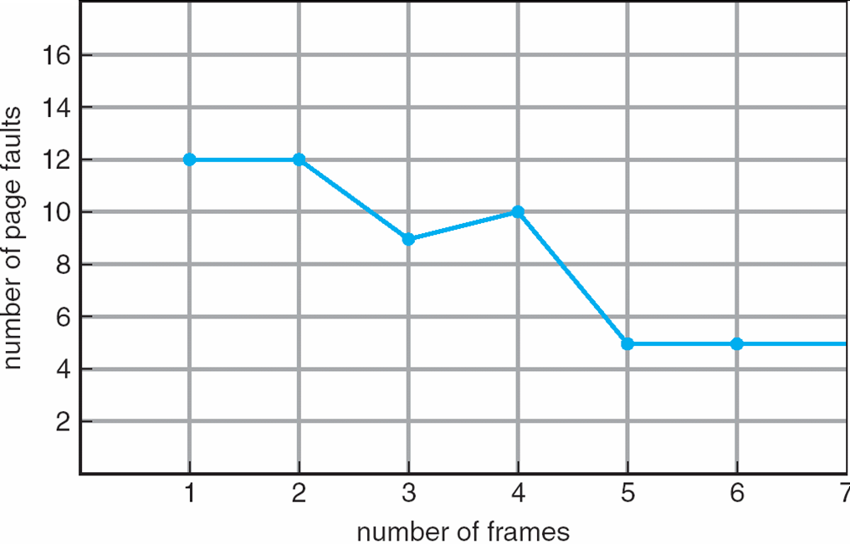
With our example page sequence

Slide 73

In the general case

Slide 74
Beating Belady: Optimal Replacement
Replace the page that will not be used for the longest amount of time from now
1,2,3,4,1,2,5,1,2,3,4,5
Caveat: we do not normally know the page sequence
  But, it gives us a theoretical lower bound against which we can compare page replacement algorithms
1
1
1
1
1
1
1
1
1
1
1
4
4
Needed 1 ahead
Needed 2 ahead
Needed 3 ahead
Needed 4 ahead
2
2
2
2
2
2
2
2
2
2
2
pick one
6 page faults
3
3
3
3
3
3
3
3
3
3
4
4
4
4
5
5
5
5
5
5

Slide 75
Least Recently Used
Try to estimate the working set by using the least recently used frames as victims
Use a counter for each page table entry:
  When a page is accessed copy the clock to its counter
  The LRU page has the oldest (smallest) clock
1,2,3,4,1,2,5, 1,2,3, 4, 5
1
1
1
1
1
1
1
4
1
1
1
7
1
7
1
5
7
11
2
2
2
2
2
2
5
2
2
2
8
2
8
2
8
8 page faults
3
3
3
3
3
5
2
6
5
5
5
6
5
4
6
10
4
10
4
4
4
4
3
4
4
4
3
3
9
3
9
3
9
Clock: 0 1 2 3 4 5 6 7 8 9 10 11

Slide 76
Implementing LRU
As presented: need to loop over n frames of memory to find the least recently used
Instead, have a priority queue of page numbers:
  Use a doubly linked list
  Each valid page table entry points to its list entry
  When a page is accessed, move it to the head of the list (6 pointer changes in total)
At the point of choosing a victim: use the page at the tail of the list – no search.
head
3
2
1
5
tail

Slide 77
head
1
2
5
4
tail
head
2
1
5
4
tail
Page fault, as page 3 requested:
head
3
2
1
5
tail

Slide 78
Approximating LRU
Instead of a clock per page, have a single bit – a reference bit (rb(i) for page i)
  Whenever the page is accessed, set it to 1
Use a 'second chance' algorithm:
  i = some page table entry, n = size of page table
  while (rb(i) == 1) { rb(i) = 0; ++i; if (i >=n) i = 0; };
  Victim is then page rb(i)
Avoids victimising pages that were used between page faults

Slide 79
Swapping and performance suck (i)
RAM: data access time ~ 50ns
Hard disk: data access time ~ 5ms = 50,000,000ns
Probability of page fault p
Effective access time?

Slide 80
Swapping and performance suck (ii)
Why does it even work if disks are so slow?

Slide 81
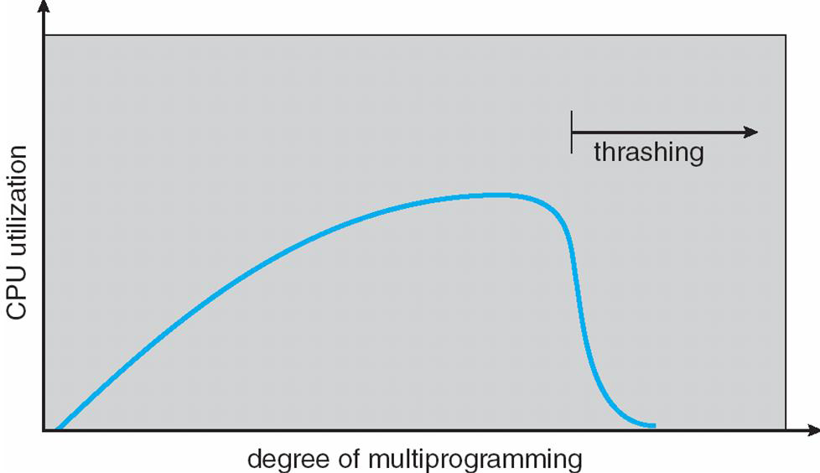
If sum of processes’ working sets (localities) exceeds available memory, page faults are frequent
  Low CPU usage as time is spent swapping
  As processes are waiting, the OS switches between them, triggering even more page faults
Thrashing = almost no useful work is getting done, as all the time is spent swapping

Slide 82
Localities matter
Say we had an image, stored as a square array:
  int** data = new int[128][128];
  Each row stored on one page, and we have one free frame
We could fill with zeroes using:
for (col = 0; col <128; ++col) {
for (row = 0; row < 128; ++row) {
data[row][col] = 0;
}
}
One page fault each time the row changes: page faults = ?

Slide 83
Pre-fetching
Hint what data might be accessed next
(Think back to ‘optimal page replacement’)
__builtin_prefetch(data[0]);
for (row = 0; row <128; ++row) {
if (row < 127) __builtin_prefetch(data[row+1]);
for (col = 0; col < 128; ++col) {
do something with data[row][col];
}
}

Slide 84
The Free Frames List is (almost) a Lie
We want a compact representation of where the free memory is, and to try to preserve contiguous blocks of free space: it uses the buddy system
Free space list split into blocks covering a power of 2 amount of memory
  Each has a start frame and frame count
When a 2^{n} amount of memory requested:
  While the best-fit block is too big, split it in two buddies, put the two buddies back on the list
  This will leave a block of just the right size

Slide 85
Buddy example
One free space entry: start 512, limit 512
64 contiguous free frames requested:
  Split [512,512] into [512,256], [768,256]
  Split [768,256] into [768,128], [896,128]
  Split [896,128] into [896,64], [960,64]
  Mark [960,64] as used, return frame 960 as the start of the block of memory.
Left with 4 free-space entries, for 448 frames

Slide 86
How do we choose page size?
Criterion | Small Pages | Large Pages
Page table size | Large | Small
Internal Fragmentation | Not very much | Crazy amounts
I/O implications | Small pages quicker to swap out individually | Swapping one large page quicker than swapping several smaller pages
Locality | Fine-grained locality: several small pages, just the ones needed | Larger locality: a code or data page must be kept in memory even if partially used
TLB | Locality requires several TLB entries | Locality requires few TLB entries: reduced TLB miss rate

Slide 87
TLBs and Page Size
Small page size → higher TLB miss rate
Key term: TLB reach
  The amount of memory accessible via the TLB
  No. of TLB entries x Size of a page
Target: TLB reach ≥ sum of process localities
  Could make pages larger (but see previous slide)
  Could use multiple page sizes: larger pages for processes needing lots of memory.
    'Huge pages' on Linux, 'Large pages' on Windows.
    Intel x86: 4KB page size; 4Mb huge page size.

Slide 88
Summary
Use the stack for local variables, return addresses, etc.
Use the heap for ‘new’
Memory paging = non-contiguous process memory
Virtual memory = swap out inactive pages to disk
Guessing which page to swap to disk is hard

