Slide 1
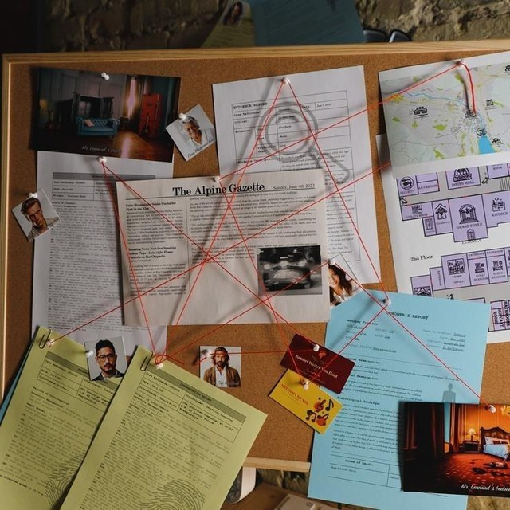
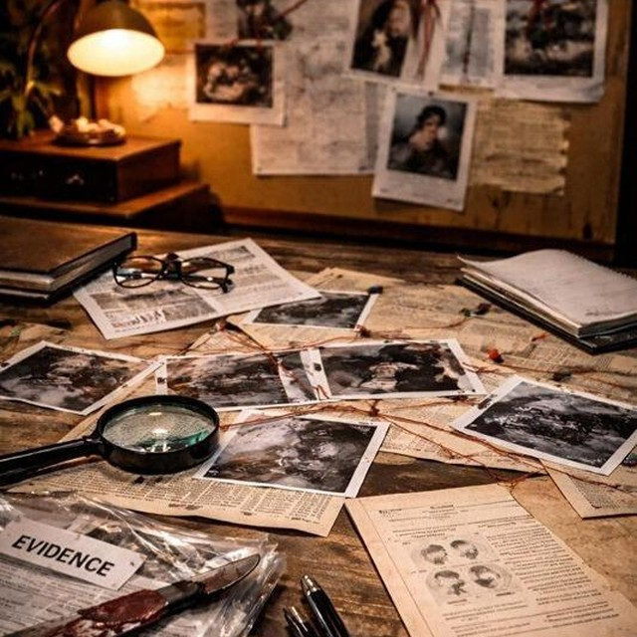
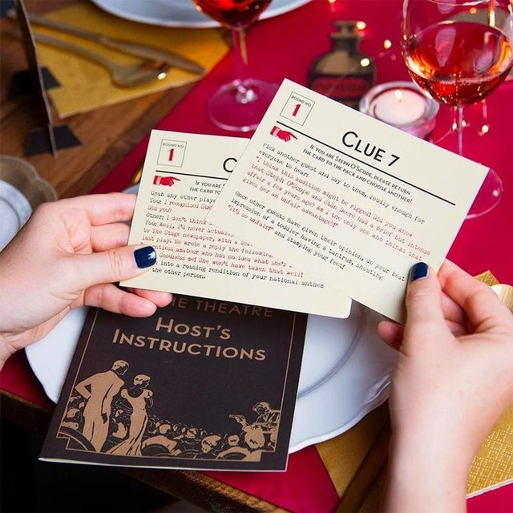
ESCAPE ROOM
THE LAST GUEST
20 minutes · one live actor · two zones running at once · one phone
Notes:
Killer: Chloe. Trap: Ziv. Spine: the camera clock is 15 minutes fast, proved by a wall clock visible inside one of the stills.

Slide 2

Concept — The Last Guest
Who died? → When did it really happen? → Who was there at that minute? → Why? → How do we get out?
PREMISE
Tonight, Si Hong hosted four people at his flat. At 10:30 PM he collapsed. Whoever found him called for help at 10:33. The police are twenty minutes out — and all four guests say they had already left.
1
WHEN did it actually happen?
2
WHO was in the room at that minute?
3
WHY did they want him dead?
4
HOW did they do it?
SI HONG
The victim · the host
Living sacrifice: Sihong
They write all four onto an arrest warrant. That is the win condition — not the padlock.

Slide 3
The spine — the camera clock is wrong
The one fact that links every puzzle. Organisers only.
The camera's clock was never set. It runs 15 minutes fast.
Nobody sets them. It's the same reason half the microwaves and car dashboards in the world show the wrong time. Players don't have to guess this — a wall clock is visible inside one of the pictures, and it disagrees with the stamp.
IF THEY TRUST THE STAMPS
IF THEY FIX THE CLOCK FIRST
ZIV
CHLOE
Ziv told everyone she left at 9:45. The stamps put her in the kitchen at 10:15 — a twenty-minute lie, right inside the window. Every team accuses her.
Subtract 15 and the night slides. Ziv was really there 10:00–10:08 — still a liar, but clear of the window. Chloe lands dead centre in it.
WRONG
CORRECT
In 20 minutes teams won't find the Ziv dead end on their own — so the dispatcher plants it for them at minute 6.

Slide 4
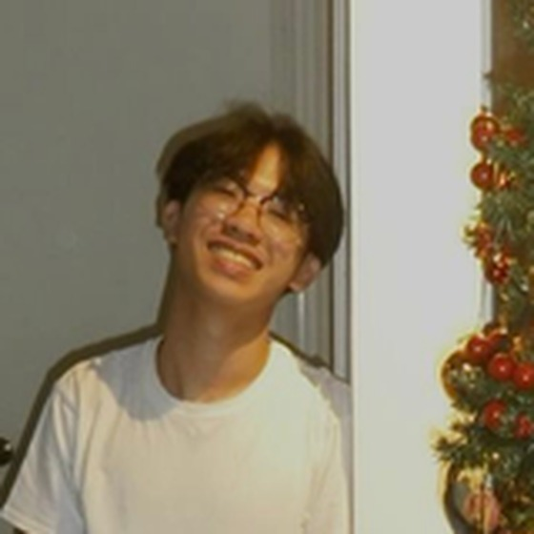

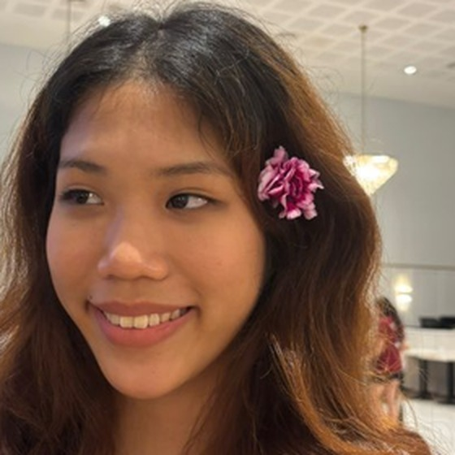
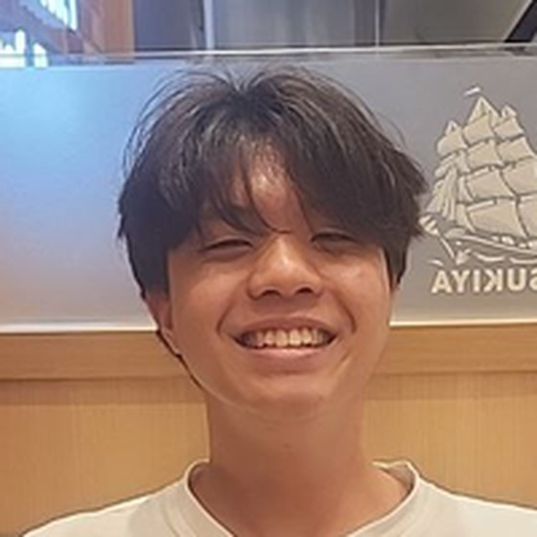
Suspects
All four gave a statement. All four went home. None of them are in the room.
Ryan Tan
Abel
Chloe
Ziv
Best Friend
Business Partner
Sister
Ex-Girlfriend
Argued with Si Hong that night — because Ryan is the one who told him about the money
Si Hong wanted him out of the company. He also brought the dessert
Being written out of Si Hong's will, signed 9 AM tomorrow
Says she left at 9:45. The camera says otherwise
One of them is lying. One of them is guilty. They are not the same person.

Slide 5
What each suspect is for
Nobody is filler. Each one hands the players something they cannot finish without.
SUSPECT
WHAT THEY GIVE THE PLAYERS
HOW THEY'RE CLEARED
Ryan
The reason Si Hong knew about the money. He found out and told him — which is why the new will exists at all.
Call log: one outgoing call, 10:06 to 10:24. Eighteen minutes, taken outside. Covers the whole window.
Abel
The dessert receipt. Two ordered, one marked NUT FREE. Without it, nobody knows a safe plate ever existed.
Camera stamp 10:20, so really 10:05 — walks out to take a call before the window opens.
Ziv
The lie. She says 9:45; the camera says 10:15. She is what a guilty person looks like.
Only by fixing the clock. Corrected, she was there 10:00–10:08 — before the window.
Chloe
Motive and opportunity. The will, the missing money, and the kitchen.
She isn't. Corrected stamp 10:12, alone with both plates, inside the window.
All four knew about the allergy, so knowing it clears nobody. Only the clock does.

Slide 6
The room — two zones, two media
Anything with a signature is paper. Anything with a timestamp is on the phone.
A
Zone A — the flat
B
Zone B — the desk
PHYSICAL
DIGITAL
Two dessert plates, one half-eaten
Abel's dessert receipt (two items)
The unsigned will + solicitor's letter
Si Hong's notebook of missing money
Paramedic's preliminary note
EpiPen case on the shelf — empty
The kitchen wall clock (correct)
The phone, unlocked, in a stand
Group chat from that night
Call log
Four camera stills in Photos
Part-filled timeline board + markers
Four printed suspect statements
Why the split matters
Team A has the how and the why but no times. Team B has every time but no idea which minute matters. Neither can name a killer alone — so the merge isn't a rule you impose, it's forced by the evidence.

Slide 7
The phone
It belongs to the man who found him. He hands it over, already unlocked — no lock-screen puzzle, no wasted minute.
MESSAGES
PHONE
PHOTOS
The group chat
The call log
Four camera stills
Everyday chatter from that night, timestamped. Buried in it: Ziv's "heading off now, night!" at 9:45 — her lie in her own words. Write 80% filler so it doesn't read as a puzzle sheet.
Ryan's outgoing call, 10:06 PM, duration 18:14. The emergency call at 10:33 PM. Both network-timestamped, so both are correct.
Saved off the camera. Each has a stamp burnt into the corner. Still #2 is the one with the wall clock in shot — players must be able to pinch-zoom into it.
BUILD IT SO IT CANNOT FAIL
USE TWO DEVICES, NOT ONE
Run it as a local file. No wifi, no server, no loading spinner.
Guided Access (iOS) or screen pinning (Android) so nobody can navigate out.
Full charge, charger attached, screen timeout off.
Sealed envelope of printed screenshots: IF THE PHONE DIES.
One phone and ten players means nine people watching one person scroll. Put the same site on a second phone or a tablet at the desk. If you only have one screen, print the four camera stills and keep only the chat and call log digital.

Slide 8
Game begins
Lights low. BGM under. One live actor — and he never has to improvise.
THE DOOR SLAMS OPEN
THE TIMER IS REAL
"I found him. I already called — they're coming, but they said twenty minutes."
"He was fine. He was fine an hour ago."
"Everyone who was here tonight says they'd already gone home. All four of them. That can't be right."
"Here — take my phone. Our group chat's on it, and I pulled the camera pictures onto it. I can't touch anything once they get here."
"Just tell me when it happened. If we know when, we know who."
20:00
It isn't a voice announcing a rule. It's how long until the police arrive and seal the flat.
Twenty minutes only works because both zones run at once. Split the group at the door, before anyone starts talking.
He stays in the room for the whole game, on the phone with the dispatcher.

Slide 9
Puzzle 1 — Two clocks, one picture
Difficulty ★★☆☆☆
Every camera still has a timestamp burnt into the corner. One of those stills was taken in the kitchen — and the wall clock is in the shot.
CAMERA STILL #2 — THE KITCHEN
Stamped in the corner
On the wall, in the photo
What the camera thinks
−
What the clock in the room says
10:27 PM
10:12 PM
Its internal clock. Never set.
Right — check it against your own watch.
The camera runs 15 minutes fast. Subtract 15 from every stamp on every still.
This needs no technical knowledge at all. It is two clocks in one photograph disagreeing, and a real clock on a real wall the players can walk over and check. Nobody has to be told cameras can be wrong — they can see that this one is.

Slide 10
Puzzle 2 — Rebuild the timeline
Difficulty ★★★★☆
1
2
3
4
Pin the collapse
Open the window
Read the stamps as printed
Now subtract 15
The emergency call in the log went out at 10:33. He went down at roughly 10:30. Network time — nobody can argue with it.
Paramedic's note: a severe nut reaction starts 10–20 minutes after eating. So he ate it between 10:10 and 10:20.
Only one person sits inside that window — Ziv, stamped 10:15, who swore she left at 9:45. Every team stops here.
The whole night slides. Ziv's 10:15 was really 10:00. Chloe's 10:27 was really 10:12 — alone with both plates.
Chloe was alone with the dessert at 10:12 — inside the window. Every step needs the one before it.

Slide 11
The same night, two readings
Print the board with the left column already filled. They only write the right one.
EVENT
WHAT THE CAMERA SAYS
WHAT ACTUALLY HAPPENED
Ziv in the kitchen with Si Hong
10:15 PM
10:00 PM
Abel steps out to take a call
10:20 PM
10:05 PM
Ziv leaves the flat
10:23 PM
10:08 PM
Chloe alone with the dessert plates
10:27 PM
10:12 PM
Si Hong collapses
10:45 PM
10:30 PM
THE WINDOW
A FREE CHECK
10:10 – 10:20 PM he ate it in here
The last row proves the subtraction. 10:45 minus 15 is 10:30 — three minutes before the emergency call in the log. If that lines up, they know the 15 is right.
Fixed by the collapse time and the reaction onset — not by the camera.

Slide 12
Puzzle 3 — Motive and method
Difficulty ★★★☆☆
H
HOW
W
WHY
Si Hong had a severe nut allergy. Every person at that table knew it.
Abel's receipt: two desserts ordered at 8:40, one written up as NUT FREE — SH.
Two plates on the table. The safe one is sitting at the wrong seat.
The EpiPen case is on the shelf. Empty, and the pen is nowhere in the flat.
Because everyone knew about the allergy, knowing it clears nobody. Only the timeline does.
Ryan found out money was leaving Si Hong's account and told him. That's what the argument was about.
Si Hong's notebook tracks four months of it, matched to Chloe.
An unsigned will on the desk removes her. The solicitor's letter sets the signing for 9:00 AM tomorrow.
If he dies tonight, the old will stands. That is why it could not wait until tomorrow.
The motive is a deadline. Time isn't just the mechanic here — it's the reason there's a body.

Slide 13
Final answer — the warrant
The code proves they know WHEN. It does not prove they know who. So the box isn't the exit — it's the paperwork.
1
0
1
2
The minute it actually happened · CLICK · inside the box: a blank arrest warrant and a pen
NAME
TIME
MOTIVE
METHOD
Chloe
10:12 PM
The will was being signed at 9 AM tomorrow
Swapped dessert, nut allergy, EpiPen taken
They fill it in and hand it to him. He reads it down the phone to the dispatcher. If it's right, he opens the door — sixty seconds, still inside the fiction, and no Game Master quiz.

Slide 14
Running the room
Twenty minutes, ten players, groups back to back. Everything here exists to protect the clock.
ONE ACTOR, ZERO IMPROV
TWO ZONES, RUN AT ONCE
HINTS = DISPATCHER
He stays for the whole game, on the phone with the dispatcher. He never answers a question — he relays one. The GM texts him the line; he reads it off the screen.
Five in the flat, five at the desk. At minute 10 the actor forces the merge: the dispatcher wants one story, not two. Without that line, teams run out of clock.
Min 6 — "They're saying the ex lied about her timings." (the plant)
Min 9 — "They're asking whether that clock on the wall matches the pictures."
Min 14 — "They want a name and a reason, not just a time."
TIMING
0–2
2–10
10–13
13–17
17–20
Door opens, split at the door
Both zones in parallel
Merge, forced by the actor
Name Chloe, prove the minute
1012, fill the warrant, out
Reset target: 4 minutes. Swap the plates back · wipe the right column of the board · empty the EpiPen case · reset the lock to 1012 · fresh blank warrant · phone back to the home screen.

