Slide 1

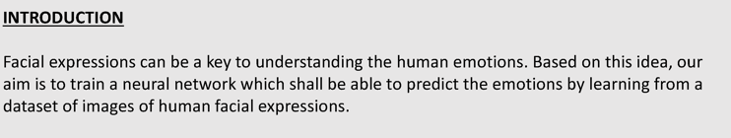
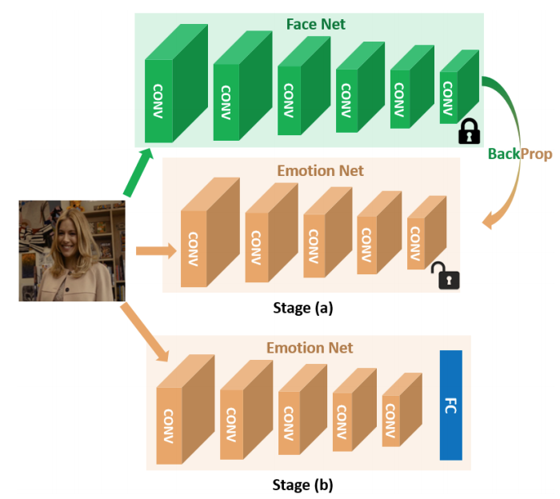
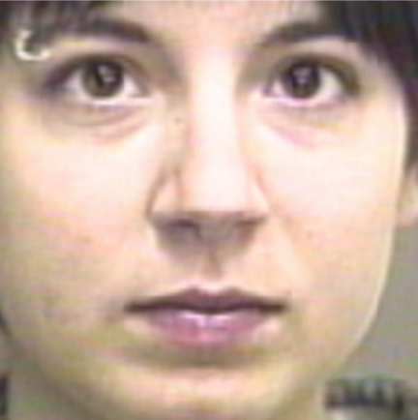
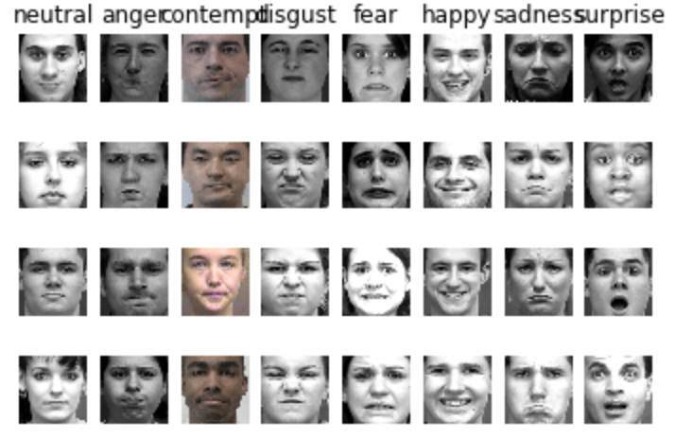
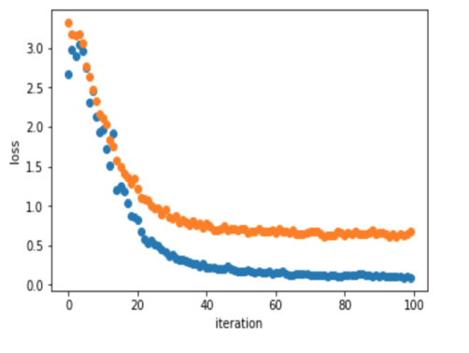

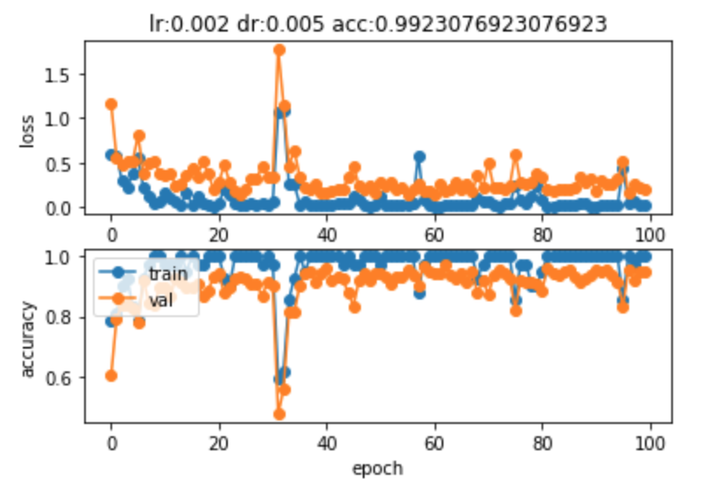
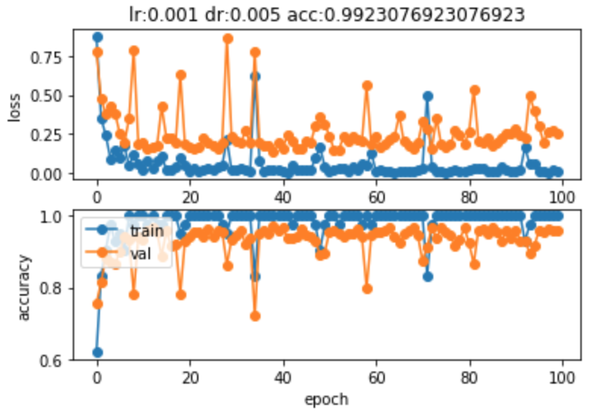
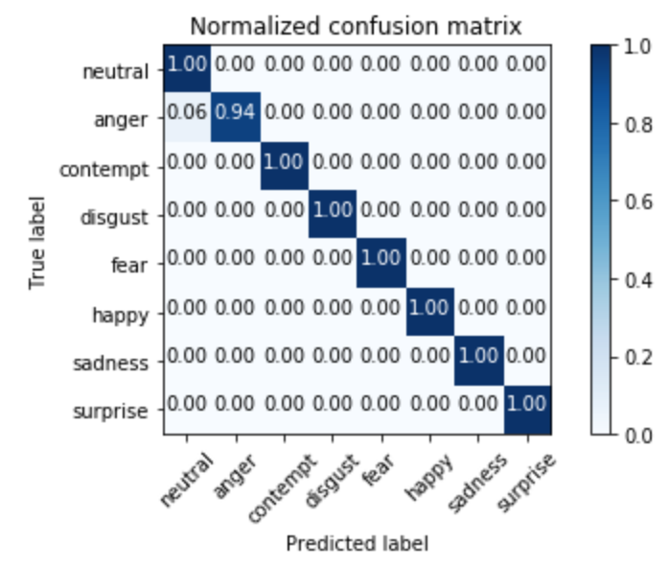
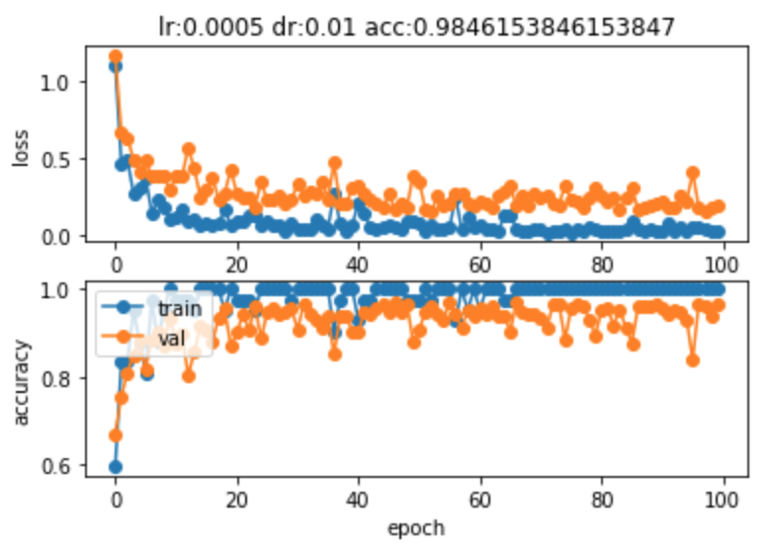
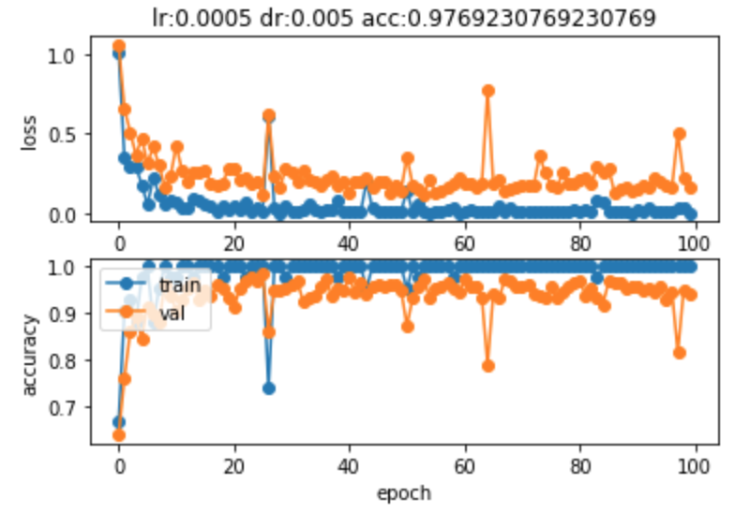
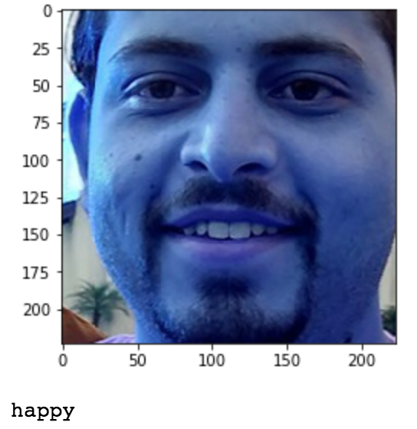
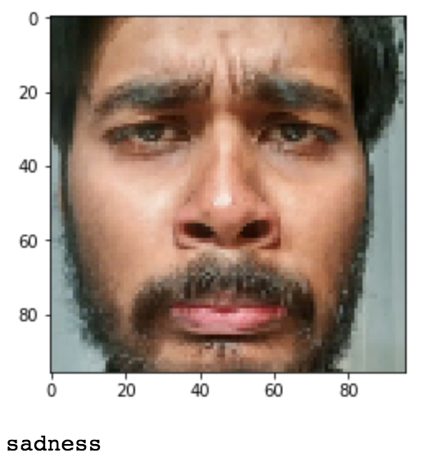
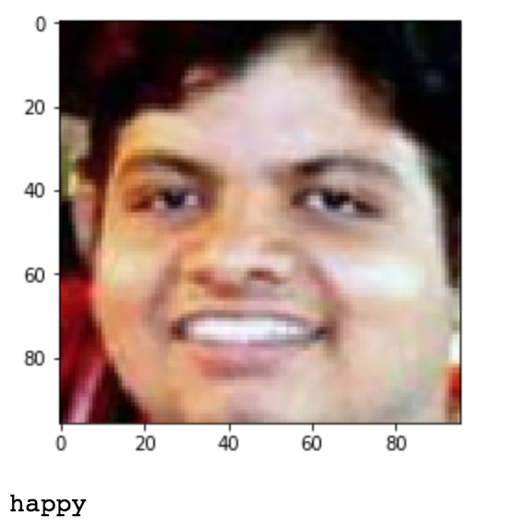
Facial Expression Prediction
DATASET
The Extended Cohn-Kanade Dataset (CK+)
PROCESS
DATA PRE_PROCESSING
Filter labelled images from CK+ dataset
Picked last 3 pick expression frames and one neutral frame.
Aligned selected images using dlib framework.
Split aligned dataset into training, testing and validation set with the ratio of 8:1:1.
Augmented training dataset by flipping images horizontally.
Testing and validation dataset left untouched as aligned original dataset.
TRAINING
PHASE 1
Used pytorch implemented openface/facenet pre-trained network to start with the first phase.
Used L2 loss to train Convolutional Neural Network to imitate facenet.
2092 training samples with 131 validation samples has been used.
Adam with learning rate 0.001 and batch size of 50 has been used with 100 epochs.
PHASE 2
Added two Fully Connected Network after the network learned in phase 1.
Loaded pre trained model from phase1.
Tuned hyper-parameters like learning rate and weight decay for phase2.
Adam with learning rate 0.002, batch size of 50 and weight decay 0.005 has been used.
Stopped at validation accuracy of 96.95%.
Tested the model on untouched training set, and the result was 99.23%.
Saved the model.
PREDICTION
Prediction on Test set gives a whooping 99.23% accuracy.
We also tested on real time images and with some old images and it predicts correct most of the time.
Achieved 99.55% of multiclass roc score.
SHAYAN ABHIJEET JYOTIRMAY
CITATION
FaceNet2ExpNet: Regularizing a Deep Face Recognition Net for Expression Recognition Hui Ding1 , Shaohua Kevin Zhou2 and Rama Chellappa1 1 University of Maryland, College Park 2 Siemens Healthcare Technology Center, Princeton, New Jersey
http://dlib.net/
https://github.com/thnkim/OpenFacePytorch
P. Lucey, J. F. Cohn, T. Kanade, J. Saragih, Z. Ambadar and I. Matthews, "The Extended Cohn-Kanade Dataset (CK+): A complete dataset for action unit and emotion-specified expression," 2010 IEEE Computer Society Conference on Computer Vision and Pattern Recognition - Workshops, San Francisco, CA, 2010, pp. 94-101. doi: 10.1109/CVPRW.2010.5543262. URL: http://ieeexplore.ieee.org/stamp/stamp.jsp?tp=&arnumber=5543262&isnumber=5543135

