Slide 1
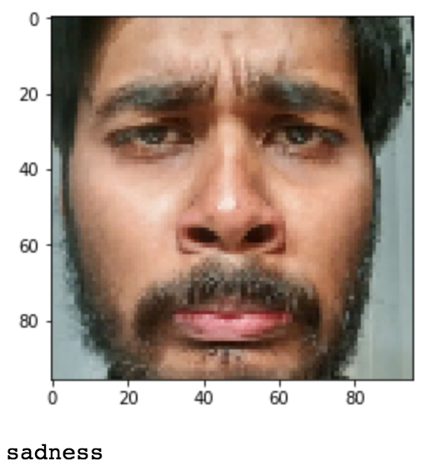
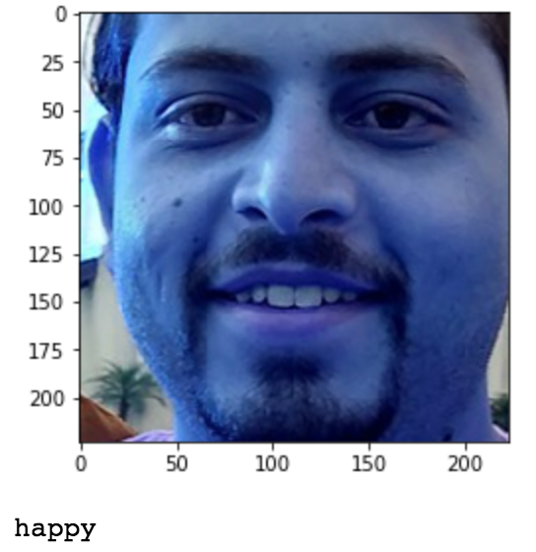
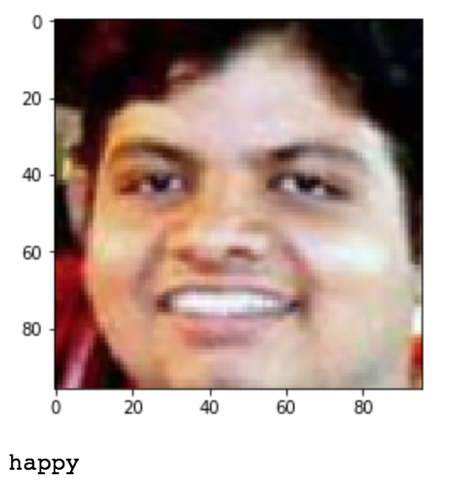
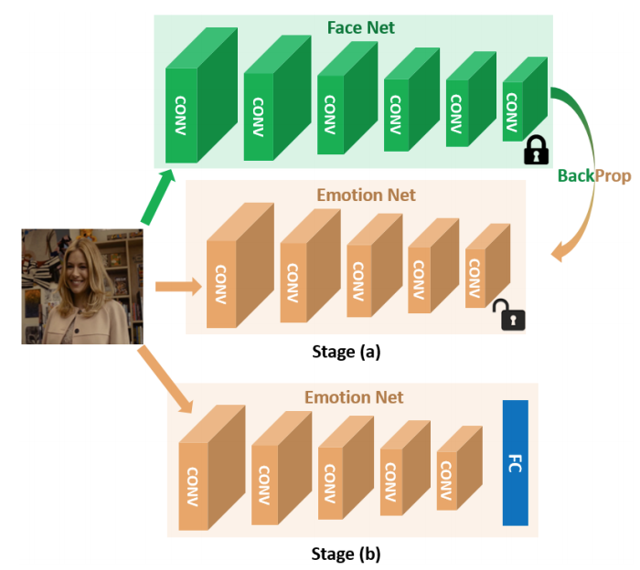
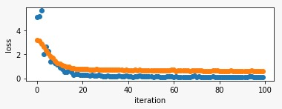
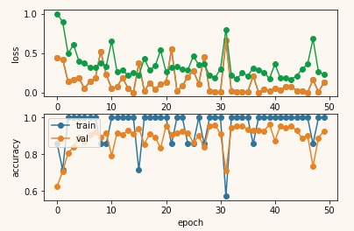
Facial Expression Prediction
CONTRIBUTORS
Abhijeet Parida
Shayan Ahmed Siddiqui
Jyotirmay Senapati
DATASET
The Extended Cohn-Kanade Dataset (CK+)
PROCESS
DATA PRE_PROCESSING
Filter labelled images from CK+ dataset
Picked last 3 pick expression frames and one neutral frame.
Aligned selected images using dlib framework.
Split aligned dataset into training, testing and validation set with the ratio of 8:1:1.
Augmented training dataset by flipping images horizontally.
Testing and validation dataset left untouched as aligned original dataset.
TRAINING
PHASE 1
Used pytorch implemented openface pre-trained network to start with the first phase.
Used L2 loss to train Convolutional Neural Network to immitate openface.
2092 training samples with 136 validation samples has been used.
Adam with learning rate 0.001 and batch size of 50 has been used with 100 epochs.
Reached a training loss of 0.093 and validation loss till 0.518
Saved the trained model at last.
PHASE 2
Added two Fully Connected Network after the network learned in phase 1.
Loaded pre trained model from phase1.
Same configuration has been used with additional parameter; decaying_weights = 0.01.
Reached a training loss of 0.052 and validation loss of 0.246 with training accuracy 100% and validation accuracy 94.5%.
Tested the model on untouched training set, and the result was 98.5%.
Saved the model.
PREDICTION
Prediction on Test set gives a whooping 98.5% accuracy.
We also tested on real time images and with some old images and it predicts correct most of the time.
CITATION
FaceNet2ExpNet: Regularizing a Deep Face Recognition Net for Expression Recognition Hui Ding1 , Shaohua Kevin Zhou2 and Rama Chellappa1 1 University of Maryland, College Park 2 Siemens Healthcare Technology Center, Princeton, New Jersey
http://dlib.net/
https://github.com/thnkim/OpenFacePytorch
P. Lucey, J. F. Cohn, T. Kanade, J. Saragih, Z. Ambadar and I. Matthews, "The Extended Cohn-Kanade Dataset (CK+): A complete dataset for action unit and emotion-specified expression," 2010 IEEE Computer Society Conference on Computer Vision and Pattern Recognition - Workshops, San Francisco, CA, 2010, pp. 94-101. doi: 10.1109/CVPRW.2010.5543262. URL: http://ieeexplore.ieee.org/stamp/stamp.jsp?tp=&arnumber=5543262&isnumber=5543135

