Slide 1
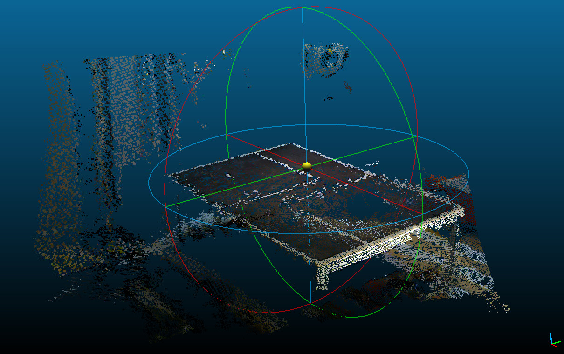
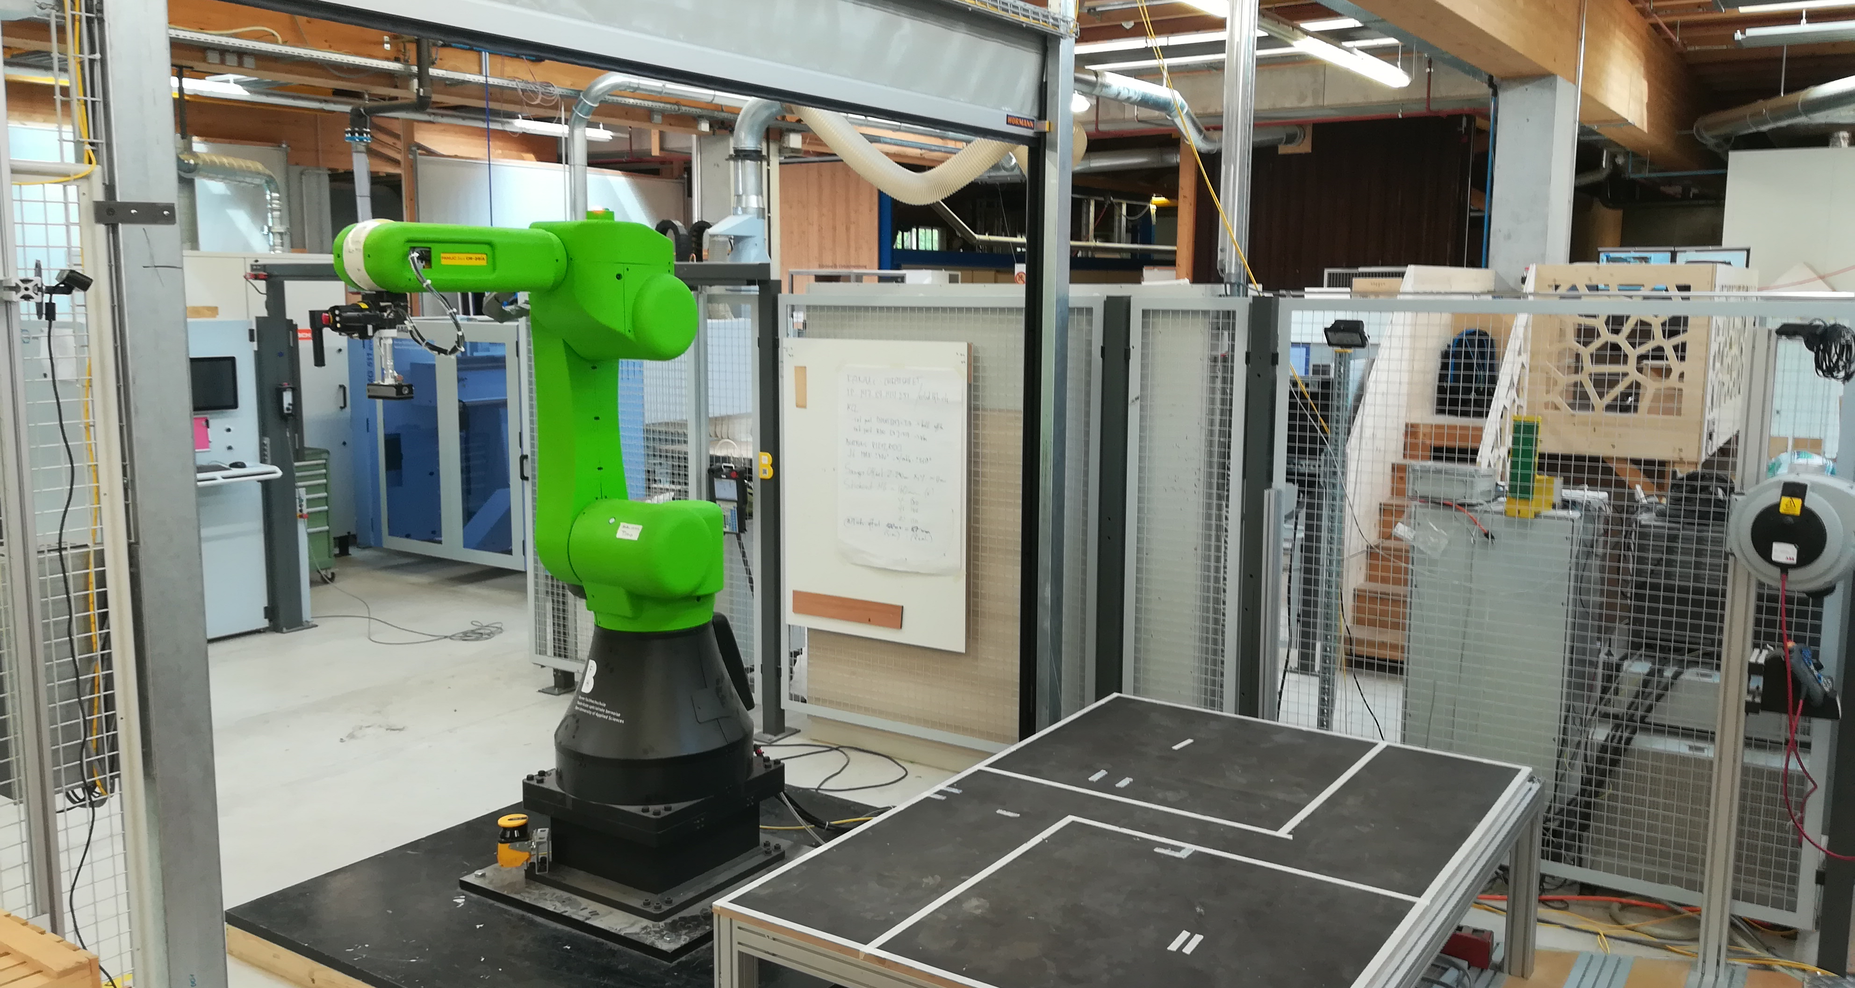
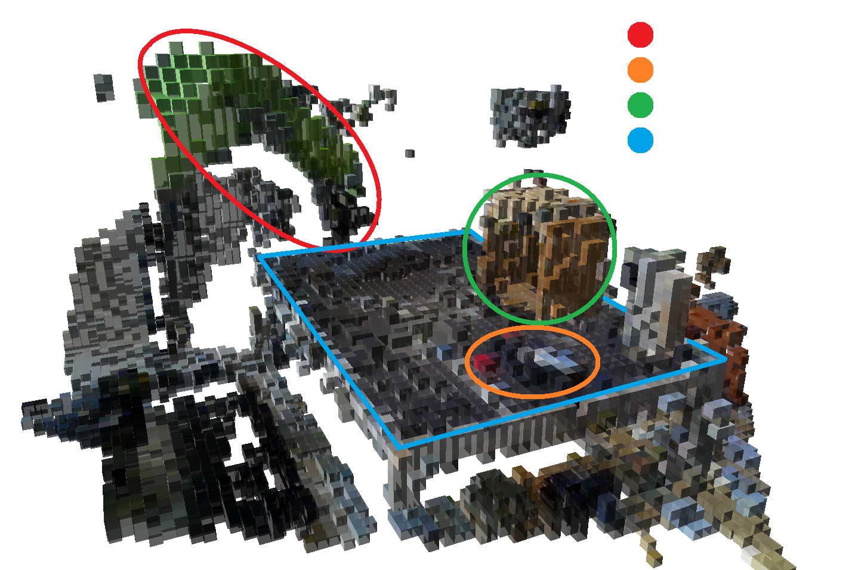
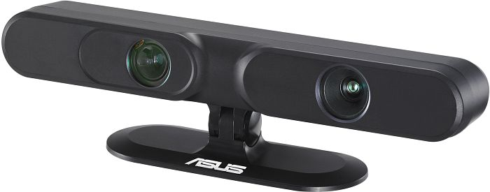
Automated Object Detection in a Collaborative Robot Workspace
Dario Aeschlimann
BSc in Micro- and Medical Technology | Specialisation: Robotics | Industrial Partner: BFH AHB
Introduction
Software
Collaborative Robots need to be flexible, easy to be reprogrammed and safe. In this work a collision avoidance system is integrated based on 3D images, in which foreign objects are detected to allow modifications of the robot’s movements.
The RGB-D Cameras provide the gathered data as a collection of points with XYZ coordinates and color information. In order to process the so called point clouds, the point cloud library (PCL) is used. The PCL provides methods to transform and merge the point clouds into a single entity and filtering unnecessary or noisy data (Fig.3).
Motivation
The workspace of a collaborative robot is also a human’s workspace and therefore dynamic. Objects can be added, removed or replaced. Most cobots stop when a force sensor is activated. This happens after a collision. The contact forces are dimensioned such that a collision will not harm a human. However, being as high as 150 N, collisions can still cause light or instable objects to be tipped over by the robot. Such an object could be a vessel containing toxic or otherwise dangerous fluids, thus posing a danger to the operator and the environment. This can be avoided by stopping or re-planning the robot’s motion before the collision takes place, thereby improving the safety and efficiency of the robot.
Goal
The goal of this thesis is to implement a system, that detects objects inside the robot’s workspace in real time. This information will then be used to adapt the robot’s path to avoid a collision. If an alternative path is not found, the system shall stop the robot before a collision occurs
Fig 3: Data from both cameras transformed and merged into a single point cloud. Points too far away from the robot workspace are filtered.
The point cloud data is then voxelized and processed into an occupancy grid using the octomap library. Inside the occupancy grid (Fig.4), robot trajectories can be simulated and collisions with any occupied cell can be detected and thus providing the necessary data to re-plan the robot movements.
Robot arm
Teach pendant
Wooden box
Table/Workspace
Fig 1: Fanuc CR35-iA Cobot with its workspace at the premises of the BFH AHB
Method
Hardware
The project is executed on a Fanuc CR35-iA cobot (Fig 1) with a R-30iB controller, which is currently one of the strongest collaborative robots on the market. The CR35-iA can lift up to 35kg, has a working range up to 1.8m and a maximum speed of 250 mm/s.
The live data of the robot workspace is captured by two Asus Xtion Pro Live RGB-D cameras (Fig.2). The cameras use the structured light technology to gather depth data. This means a pattern of Light is projected and recorded with a CMOS sensor. Through the distortion of the pattern the depth can be calculated.
Fig 4: Occupancy grid of the robot workspace. The robot arm and different objects on the table are illustrated. The voxel size is 5cm³.
Outlook
The current collision detection only accounts for the tool center point, which means that collisions with the robot arm are not recognised by the system and therefore not avoided. To improve the system a collision detection for the whole robot model can be implemented. The communication with the robot is currently also limited to trajectory planning. This work serves as a proof of concept and outlines the requirements and limits of robot controllers and vision systems in order to implement a safe and robust version of this type of workspace monitoring.
Fig 2: Asus Xtion Pro Live Camera
Micro- and Medicaltechnology

