Slide 1


Customer Behavior
&
Revenue Drivers Analysis
Turning purchase data into actionable business insights
by Apoorv Sharma

Slide 2


Why this analysis was done
The business wanted to understand what drives revenue, who its most valuable customers are, and how discounts and subscriptions influence purchasing behavior.
Business Context & Objective
Core Questions Answered
  Are we dependent on repeat customers?
  Which customer segments drive high-value purchases?
  Do discounts grow revenue or dilute value?
  Which products and experiences create loyalty?

Slide 3
Data Scope & Analytical Lens
Dataset Snapshot
3,900 purchases | ~233K total revenue
Customer demographics, product attributes, discounts, ratings
Analytical Lens
  Focused on revenue contribution (%), not just totals
  Compared behavioral segments, not isolated metrics
  Prioritized decision-making insights over descriptive charts

Slide 4
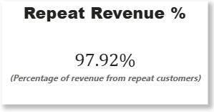
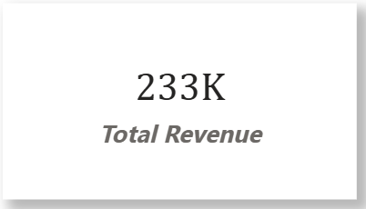
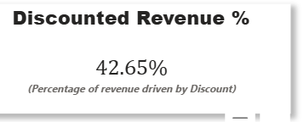
Revenue Is Extremely Repeat-Driven
What the data shows
~98% of revenue comes from repeat customers
Average order value is stable (~$60)
Why this matters ?
The business has strong retention, but is also highly exposed if repeat behavior drops.
Strategic Signal
Retention is a strength — but need to work on acquisition diversification.

Slide 5
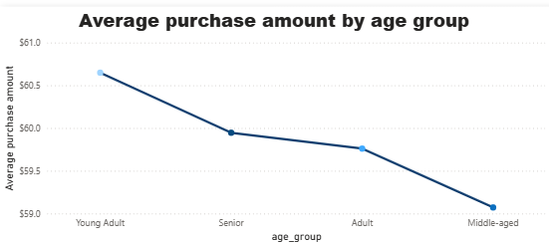
High-Value Customers Are Not the Most Frequent Buyers
Key Observation
  ~Young Adults & Adults spend more per transaction
  High-frequency buyers tend to spend less per order
What this means
There are two different customer types:
  Value-driven frequent shoppers
  Premium, low-frequency high spenders
Business Implication
Pricing, discounts, and communication should not be one-size-fits-all.

Slide 6
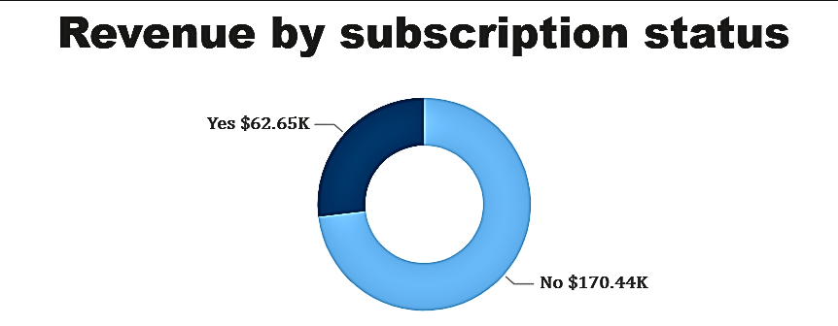
Subscriptions Stabilize Revenue but Are Underleveraged
What data shows
  Subscribers contribute a disproportionate share of revenue
  Non-subscribers still form a large, untapped base
Opportunity
Converting high-spending non-subscribers could significantly improve revenue predictability.

Slide 7
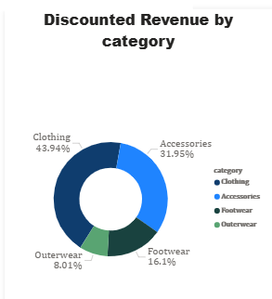
Discounts Drive Volume — Especially in Clothing
Key Insight
  ~43% of revenue is influenced by discounts
  Clothing alone drives ~44% of discounted revenue
Risk
Discounts work — but overuse may compress margins in top categories.
Smart Move
Use discounts selectively on high-margin or inventory-heavy categories, not blindly.

Slide 8
Quality Signals & Actionable Recommendations
Quality Insight
Some high-revenue products show weaker ratings, indicating potential long-term retention risk.
Business Recommendations
  Strengthen quality control for high-volume products
  Personalize offers by customer value segment
  Push subscriptions for premium non-members
  Balance discounts with margin awareness
Final Takeaway
Revenue growth, loyalty, and product quality must move together — not independently.

Slide 9


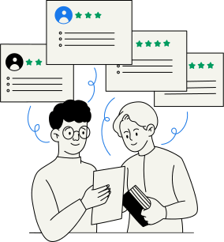

Thank
You
A clear brand strategy fuels recognition, loyalty, and business success.

