Slide 1
{1, 2, 3, 4, 5, 6, 7, 8, 9, 10, 11, 12, 13, 14, 15}
P1
1
0
{3, 5, 6, 9, 13, 14, 15}
{1, 2, 4, 7, 8, 10, 11, 12}
P8
1
0
1
0
{3, 6, 13, 15}
{5, 9, 14}
{2, 7, 10, 12}
{1, 4, 8, 11}
P5
1
0
1
0
0
1
0
1
{3, 15}
{6, 13}
{9, 14}
{5}
{7, 12}
1
{2, 10}
{4}
1
{1, 8, 11}
P10
1
1
0
1
0
1
0
0
{3}
{15}
{13}
{6}
{9, 14}
{}
{7, 12}
{}
{2, 10}
{}
{1}
1
{8, 11}
P4
1
0
1
0
1
0
{9}
{14}
{}
{7, 12}
{2}
{10}
{11}
{8}
P3
1
0
{7}
{12}

Slide 2
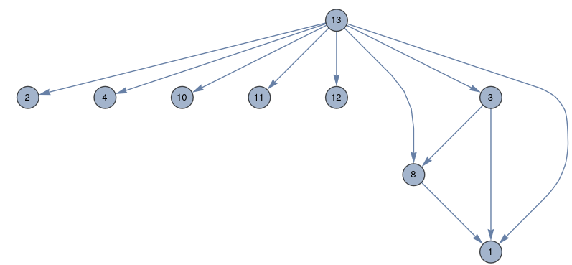
1
2
3
4
5

