Slide 1
ENEE351 Mathematical Induction
By Rajdeep Talapatra

Slide 2

An Example
You may have seen the formula $\frac{1}{6}n(n+1$)(2n+1) for the sum
$$\sum_{i=1}^{n}{i^{2}}=1^{2}+ 2^{2}+…+n^{2}$$

Slide 3
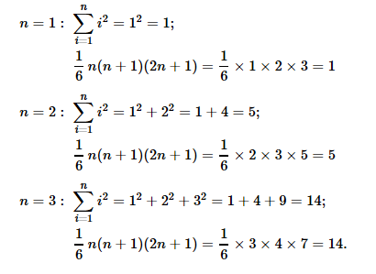
Enumeration

Slide 4
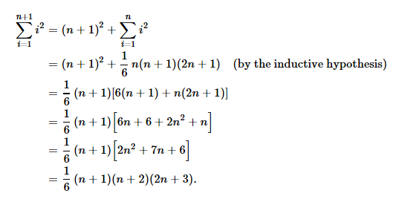
Induction Step

Slide 5
Mathematical Induction
Basis step
Induction Hypothesis
Inductive Step

Slide 6


Problems
Prove by induction
1.
2.
Use induction to show that 4^{n}+6n is divisible by 6 for n≥1. [ What part of the argument works? What part fails?]
Use induction to show that 4^{n}+6n−1 is divisible by 9 for n≥1.

