Slide 1
Introduction to Probability Distributions

Slide 2
Random Variable
A random variable x takes on a defined set of values with different probabilities.
    For example, if you roll a die, the outcome is random (not fixed) and there are 6 possible outcomes, each of which occur with probability one-sixth.
    For example, if you poll people about their voting preferences, the percentage of the sample that responds “Yes on Proposition 100” is a also a random variable (the percentage will be slightly differently every time you poll).
Roughly, probability is how frequently we expect different outcomes to occur if we repeat the experiment over and over (“frequentist” view)

Slide 3
Random variables can be discrete or continuous
Discrete random variables have a countable number of outcomes
  Examples: Dead/alive, treatment/placebo, dice, counts, etc.
Continuous random variables have an infinite continuum of possible values.
  Examples: blood pressure, weight, the speed of a car, the real numbers from 1 to 6.

Slide 4
Probability functions
A probability function maps the possible values of x against their respective probabilities of occurrence, p(x)
p(x) is a number from 0 to 1.0.
The area under a probability function is always 1.
Notes:
It turns out that if you were to go out and sample many, many times, most sample statistics that you could calculate would follow a normal distribution.
What are the 2 parameters (from last time) that define any normal distribution?
Remember that a normal curve is characterized by two parameters, a mean and a variability (SD)
What do you think the mean value of a sample statistic would be? The standard deviation?
Remember standard deviation is natural variability of the population
Standard error can be standard error of the mean or standard error of the odds ratio or standard error of the difference of 2 means, etc. The standard error of any sample statistic.

Slide 5
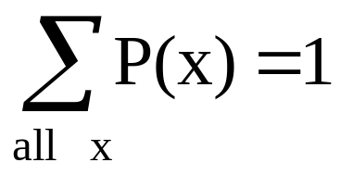
Discrete example: roll of a die
p(x)
1/6
x
1
2
3
4
5
6

Slide 6
Probability mass function (pmf)
x
p(x)
1
p(x=1)=1/6
2
p(x=2)=1/6
3
p(x=3)=1/6
4
p(x=4)=1/6
5
p(x=5)=1/6
6
p(x=6)=1/6
1.0

Slide 7
Cumulative distribution function (CDF)
1.0
P(x)
5/6
2/3
1/2
1/3
1/6
1
2
3
4
5
6
x

Slide 8
Cumulative distribution function
x
P(x≤A)
1
P(x≤1)=1/6
2
P(x≤2)=2/6
3
P(x≤3)=3/6
4
P(x≤4)=4/6
5
P(x≤5)=5/6
6
P(x≤6)=6/6

Slide 9
Practice Problem:
The number of patients seen in the ER in any given hour is a random variable represented by x. The probability distribution for x is:
x
10
11
12
13
14
P(x)
.4
.2
.2
.1
.1
Find the probability that in a given hour:
a. exactly 14 patients arrive
b. At least 12 patients arrive
c. At most 11 patients arrive
p(x=14)= .1
p(x≥12)= (.2 + .1 +.1) = .4
p(x≤11)= (.4 +.2) = .6

Slide 10
Review Question 1
If you toss a die, what’s the probability that you roll a 3 or less?
1/6
1/3
1/2
5/6
1.0

Slide 11
Review Question 1
If you toss a die, what’s the probability that you roll a 3 or less?
1/6
1/3
1/2
5/6
1.0

Slide 12
Review Question 2
Two dice are rolled and the sum of the face values is six? What is the probability that at least one of the dice came up a 3?
1/5
2/3
1/2
5/6
1.0

Slide 13
Review Question 2
Two dice are rolled and the sum of the face values is six. What is the probability that at least one of the dice came up a 3?
1/5
2/3
1/2
5/6
1.0
How can you get a 6 on two dice? 1-5, 5-1, 2-4, 4-2, 3-3
One of these five has a 3.
∴1/5

Slide 14
Expected Value and Variance
All probability distributions are characterized by an expected value (mean) and a variance (standard deviation squared).

Slide 15
Expected value of a random variable
Expected value is just the average or mean (µ) of random variable x.
It’s sometimes called a “weighted average” because more frequent values of X are weighted more highly in the average.
It’s also how we expect X to behave on-average over the long run.

Slide 16
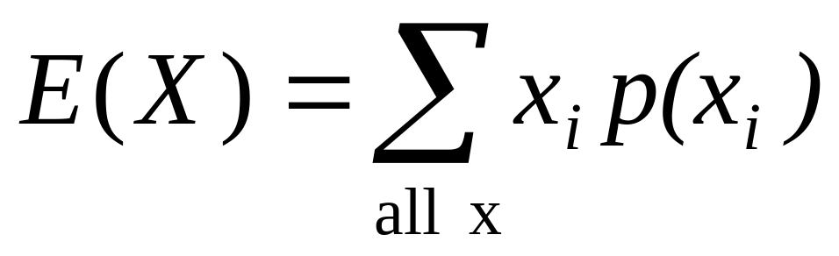
Expected value, formally
Discrete case:

Slide 17
Symbol Interlude
E(X) = µ
  these symbols are used interchangeably

Slide 18
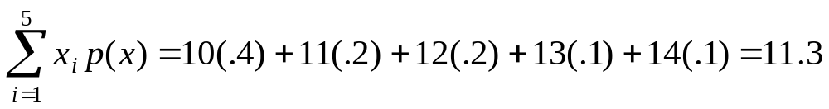
Example: expected value
Recall the following probability distribution of ER arrivals:
x
10
11
12
13
14
P(x)
.4
.2
.2
.1
.1

Slide 19
Expected Value
Expected value is an extremely useful concept for good decision-making!

Slide 20
Example: the lottery
The Lottery
A certain lottery works by picking 6 numbers from 1 to 49. It costs $1.00 to play the lottery, and if you win, you win $2 million after taxes.
If you play the lottery once, what are your expected winnings or losses?

Slide 21
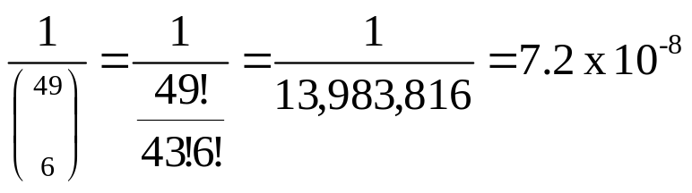
Lottery
Calculate the probability of winning in 1 try:
“49 choose 6”
Out of 49 numbers, this is the number of distinct combinations of 6.
The probability function (note, sums to 1.0):
x$
p(x)
-1
.999999928
+ 2 million
7.2 x 10⁻⁻⁸

Slide 22
Expected Value
The probability function
x$
p(x)
-1
.999999928
+ 2 million
7.2 x 10⁻⁻⁸
Expected Value
E(X) = P(win)*$2,000,000 + P(lose)*-$1.00
= 2.0 x 10⁶ * 7.2 x 10⁻⁸+ .999999928 (-1) = .144 - .999999928 = -$.86
Negative expected value is never good!
You shouldn’t play if you expect to lose money!

Slide 23
Expected Value
If you play the lottery every week for 10 years, what are your expected winnings or losses?
520 x (-.86) = -$447.20

Slide 24
Expected value isn’t everything though…
Suppose you are playing “Deal or No Deal”
Let’s say you are down to two cases left. $1 and $400,000. The banker offers you $200,000.
So, Deal or No Deal?

Slide 25
Deal or No Deal…
This could really be represented as a probability distribution and a non-random variable:
x$
p(x)
+1
.50
+$400,000
.50
x$
p(x)
+$200,000
1.0

Slide 26

Expected value doesn’t help…
x$
p(x)
+1
.50
+$400,000
.50
x$
p(x)
+$200,000
1.0

Slide 27
How to decide?
Variance!
If you take the deal, the variance/standard deviation is 0.
If you don’t take the deal, what is average deviation from the mean?
What’s your gut guess?

Slide 28
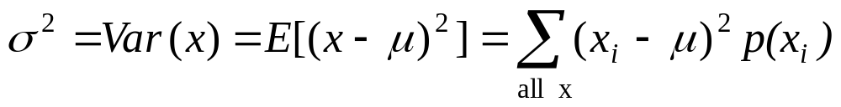
Variance/standard deviation
σ²=Var(x) =E(x-μ)²
“The expected (or average) squared distance (or deviation) from the mean”

Slide 29
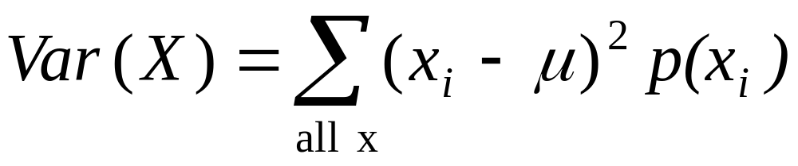
Variance
Discrete case:

Slide 30
Symbol Interlude
Var(X)= σ²
SD(X) = σ
  these symbols are used interchangeably

Slide 31
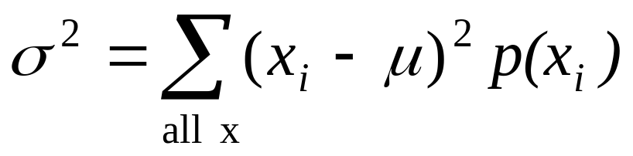
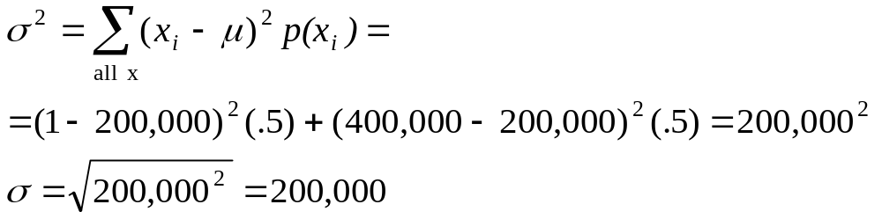
Variance
Now you examine your personal risk tolerance…

Slide 32
Practice Problem
On the roulette wheel, X=1 with probability 18/38 and X= -1 with probability 20/38.
  The mean would be = -$.053. What’s the variance of X?

Slide 33
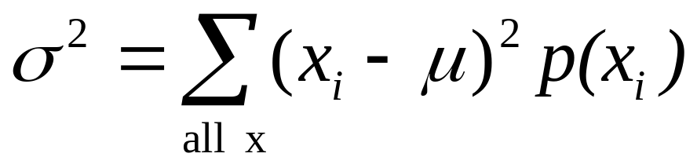
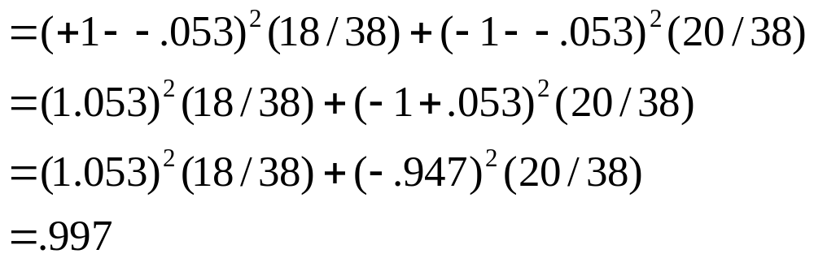
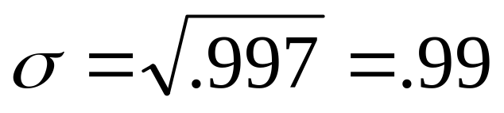
Answer
Standard deviation is $.99. Interpretation: On average, you’re either 1 dollar above or 1 dollar below the mean, which is just under zero. Makes sense!

Slide 34
Review Question 3
The expected value and variance of a coin toss (H=1, T=0) are?
.50, .50
.50, .25
.25, .50
.25, .25

Slide 35
Review Question 3
The expected value and variance of a coin toss are?
.50, .50
.50, .25
.25, .50
.25, .25

Slide 36
Review Question 4
C.2-3 Suppose we shuffle a deck of 10 cards, each bearing a distinct number from 1 to 10, to mix the cards thoroughly. We then remove three cards, one at a time, from the deck. What is the probability that we select the three cards in sorted (increasing) order?

Slide 37
Review Question 4
C.2-3 Suppose we shuffle a deck of 10 cards, each bearing a distinct number from 1 to 10, to mix the cards thoroughly. We then remove three cards, one at a time, from the deck. What is the probability that we select the three cards in sorted (increasing) order?
Ans:
Select 3 ordered numbers out of 10 = 1P(10,3) = 720
Select 3 unordered numbers out of 10 = C(10,3) = 120
Thus, probability = 120/720 = 1/6

Slide 38
Review Question 5
C.2-9 You are a contestant in a game show in which a prize is hidden behind one of three curtains. You will win the prize if you select the correct curtain. After you have picked one curtain but before the curtain is lifted, the emcee lifts one of the other curtains, knowing that it will reveal an empty stage, and asks if you would like to switch from your current selection to the remaining curtain. How would your chances change if you switch? (This question is the celebrated Monty Hall problem, named after a game-show host who often presented contestants with just this dilemma.)

