Slide 1
Discussion 1
By Rajdeep Talapatra

Slide 2
Some Problems

Slide 3
Question 1
3.1-1 Let f(n) and g(n) be asymptotically nonnegative functions. Using the basic definition of Θ notation, prove that max (f(n),g(n)) = Θ(f(n) + g(n))

Slide 4
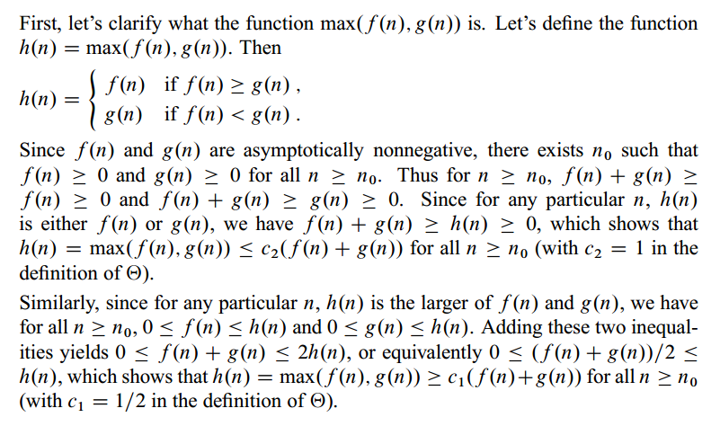
Solution

Slide 5

Question 2

Slide 6
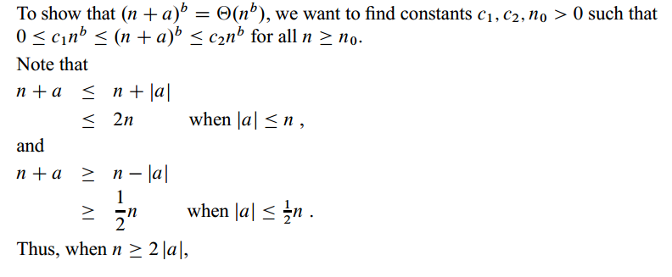
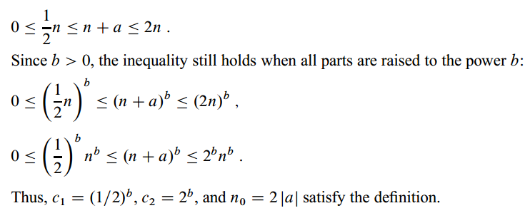
Solution

Slide 7

Question 3

Slide 8
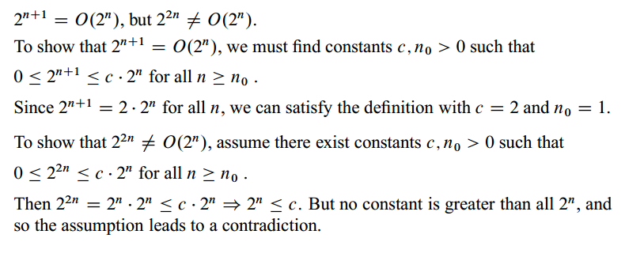
Solution

Slide 9

Question 4

Slide 10
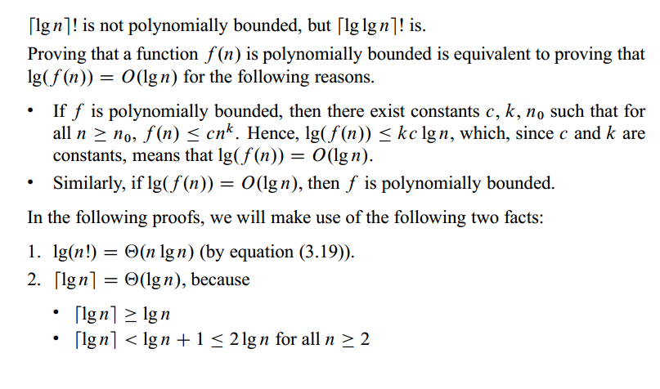
Solution

Slide 11
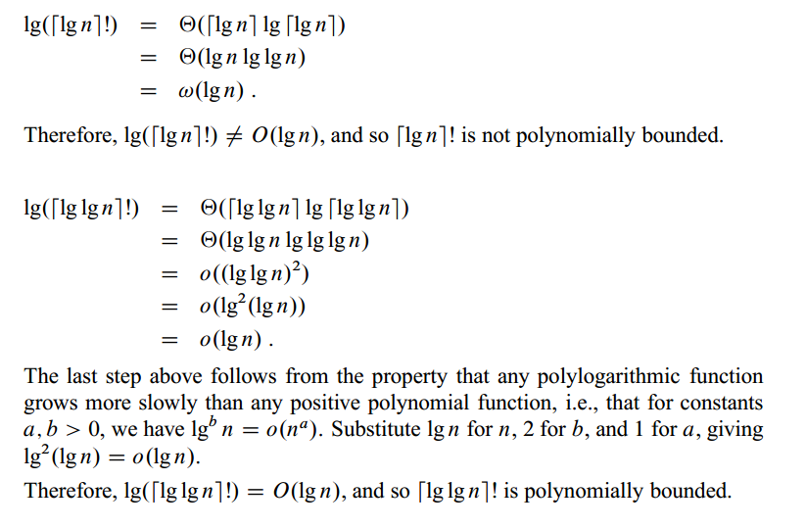
Solution Contd

