Slide 1
ENEE351 GCD Algorithm
By Rajdeep Talapatra

Slide 2
Euclid Algorithm

Slide 3
Euclid Algorithm
EUCLID(a, b) 1 if b == 0 2 return a 3 else return EUCLID(b, a mod b)
As an example of the running of EUCLID, consider the computation of gcd(30, 21):
EUCLID(30, 21) = EUCLID(21, 9) = EUCLID(9, 3) = EUCLID(3, 0) = 3
This computation calls EUCLID recursively three times.

Slide 4
C Code - Recursive
#include <stdio.h>
int gcd_algorithm(int x, int y)
{
if (y == 0)
return x;
return gcd_algorithm(y, (x % y));
}
int main(void)
{
int num1, num2, gcd;
printf("\nEnter two numbers: ");
scanf("%d%d", &num1, &num2);
if (num1<0) num1 = -num1;
if (num2<0) num2 = -num2;
gcd = gcd_algorithm(num1, num2);
if (gcd)
printf("\nThe GCD of %d and %d is %d\n", num1, num2, gcd);
else
printf("\nInvalid input!!!\n");
return 0;
}

Slide 5
Extended Euclidean Algorithm

Slide 6
The extended form of Euclid Algorithm
It also returns the integer coefficients x and y such that d = gcd(a, b) = ax + by
EXTENDED-EUCLID(a, b) 1 if b == 0 2 return (a, 1, 0) 3 else (d’, x’, y’) = EXTENDED-EUCLID(b, a mod b) 4 (d, x, y) = (d’,y’,x’ - └ a/b ┘y’) 5 return (d, x, y)

Slide 7
The extended form of Euclid Algorithm Contd.
EXTENDED-EUCLID returns not only d = a in line 2, but also the coefficients x = 1 and y = 0, so that a = ax + by. If b ≠ 0, EXTENDED-EUCLID first computes d’, x’, y’ such that d = gcd(b, a mod b) and d’ = bx’ + (a mod b)y’
As for EUCLID, we have in this case d = gcd(a, b) = d’ = gcd(b, a mod b) To obtain x and y such that d = ax + by, we start by rewriting the above equation and using d = d’ d = bx’ + (a - b └ a/b ┘)y’ = ay’ + b(x’ - └ a/b ┘ y’) Thus, choosing x = y’ and y = (x’ - └ a/b ┘ y’) satisfies the equation d = ax + by, proving the correctness of EXTENDED-EUCLID
Since the number of recursive calls made in EUCLID is equal to the number of recursive calls made in EXTENDED-EUCLID, the running times of EUCLID and EXTENDED-EUCLID are the same, to within a constant factor.

Slide 8
The extended form of Euclid Algorithm Contd.
int gcdExtended(int a, int b, int *x, int *y)
{
// Base Case
if (a == 0)
{ *x = 0;
*y = 1;
return b;
}
int x1, y1; // To store results of recursive call
int gcd = gcdExtended(b%a, a, &x1, &y1);
// Update x and y using results of recursive
// call
*x = y1 - (b/a) * x1;
*y = x1;
return gcd;
}
int main()
{
int x, y;
int a = 35, b = 15;
int g = gcdExtended(a, b, &x, &y);
printf("gcd(%d, %d) = %d, x = %d, y = %d",
a, b, g, x, y);
return 0;
}

Slide 9
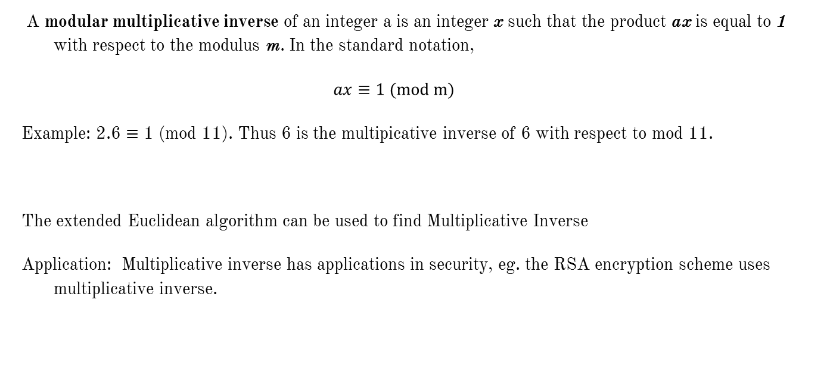
Multiplicative Inverse
A modular multiplicative inverse of an integer a is an integer x such that the product ax is equal to 1 with respect to the modulus m. In the standard notation,
$$ax≡1 (mod m)$$
Example: 2.6 $≡$ 1 (mod 11). Thus 6 is the multipicative inverse of 6 with respect to mod 11.
The extended Euclidean algorithm can be used to find Multiplicative Inverse
Application: Multiplicative inverse has applications in security, eg. the RSA encryption scheme uses multiplicative inverse.

Slide 10
Example
Use Euclid's Algorithm to find the multiplicative inverse of 13 with respect to 35:
Answer: 13 and 35 are relatively prime. Extended Euclidean algorithm gives x and y such that:
13x+35y = gcd(13,35) = 1
Now taking mod of both sides by 35:
13x ≡ 1(mod35)

Slide 11
Backup

Slide 12
C Code - Iterative
#include <stdio.h>
int gcd(int m, int n) {
if(m == 0 && n == 0)
return -1;
if(m < 0) m = -m;
if(n < 0) n = -n;
int r;
while(n) {
r = m % n;
m = n;
n = r;
}
return m;
}
int main(void)
{
int num1 = 600, num2 = 120;
int result = gcd(num1, num2);
printf("The GCD of %d and %d is %d\n", num1, num2, result);
getchar();
return 0;
}

