Slide 1
The 24M Data & Controls Experience
Ethan Neidhart
07/01/2015

Slide 2
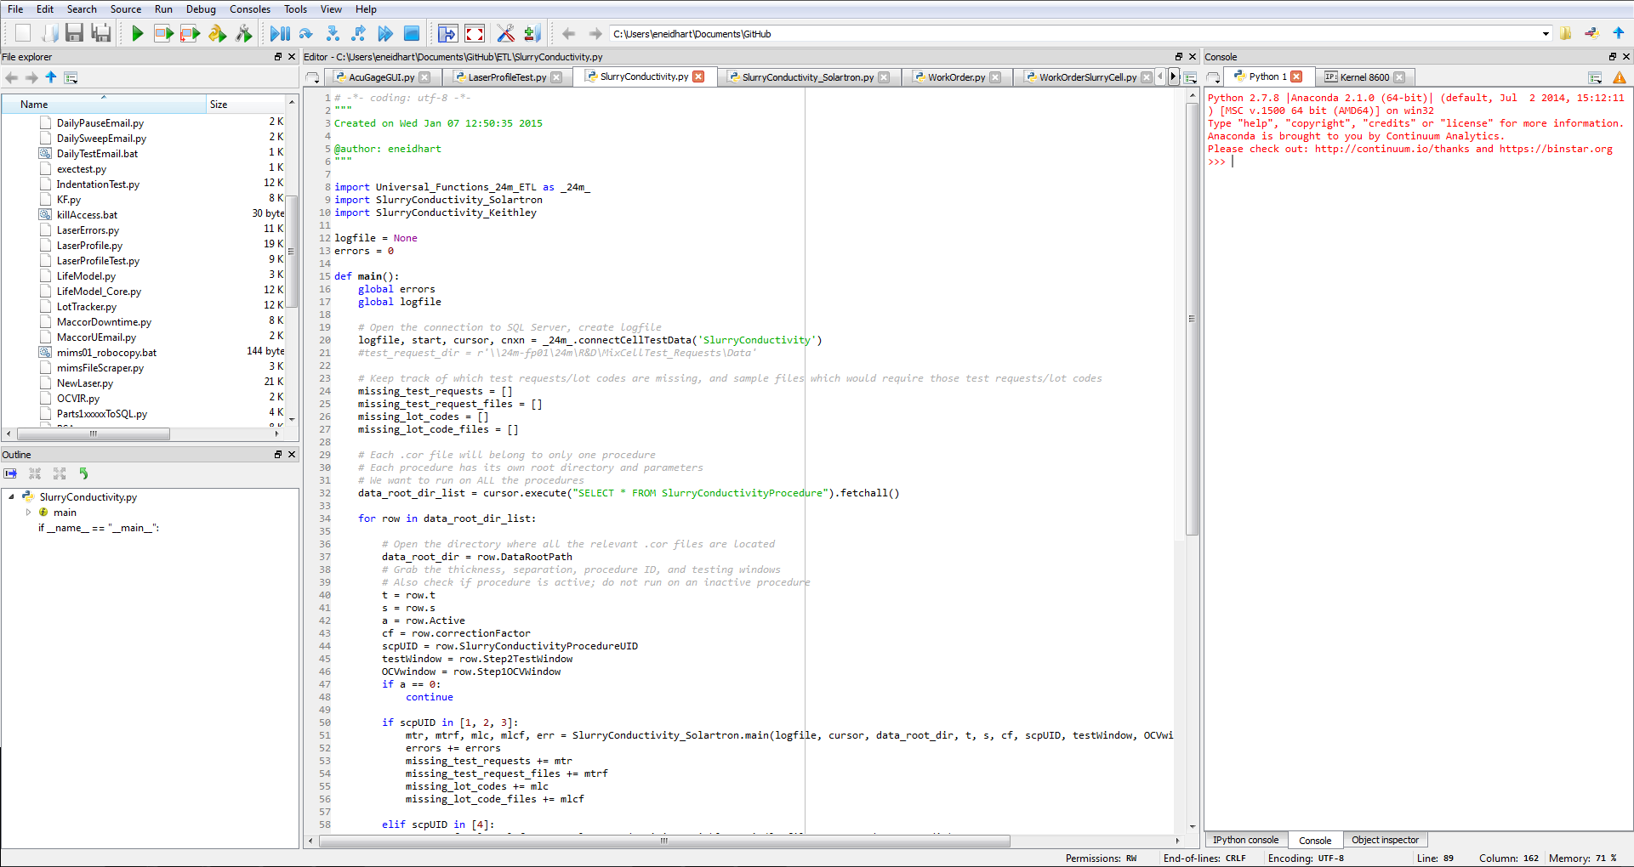

Slide 3
What do I do here?
Database
All data is uploaded to database tables via SSMS/SQL
Columns track measurements/IDs (conductivity, SlurryLotUID, etc.)
Rows track separate entries
Issues
Script is causing errors
Script needs some modification/improvement
Projects
New script/program needed
Old script/program needs major update
Python and SQL for almost all of this!

Slide 4
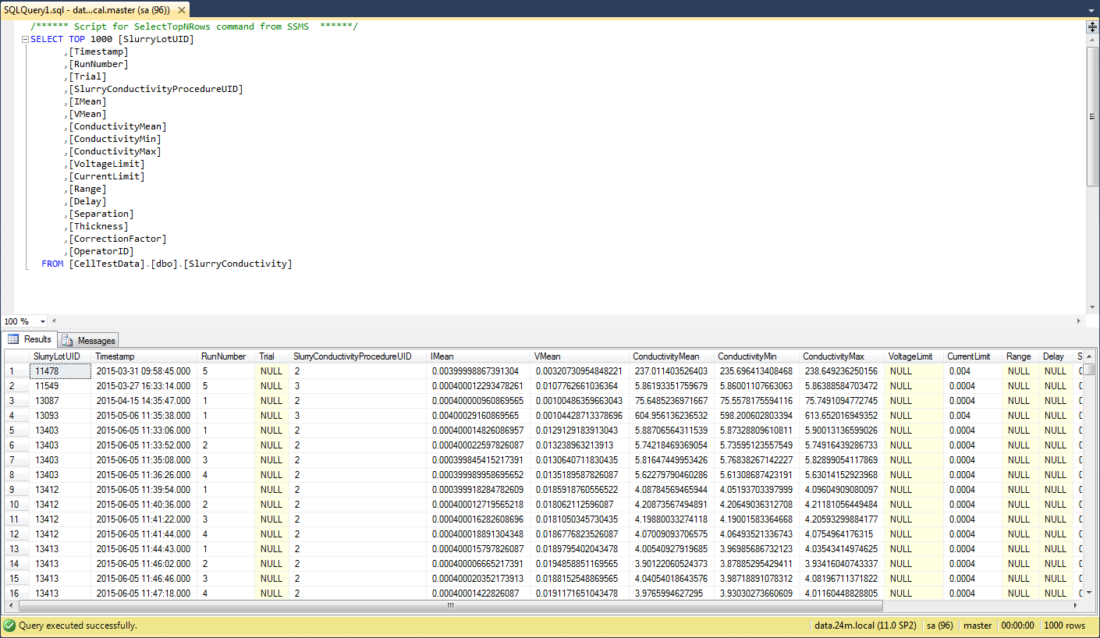

Slide 5

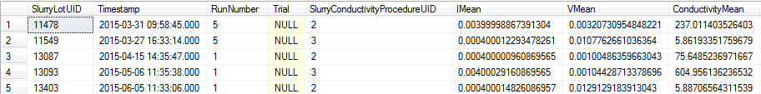
Database
SQL Queries:
Pull information from data tables
Push information to data tables
MERGE into SlurryConductivity AS T
USING (SELECT ?, ?, ?, ?, ?, ?, ?, ?, ?, ?, ?, ?, ?, ?, ?, ?, ?, ?) AS S (SlurryLotUID, Timestamp, Run, Trial, SlurryConductivityProcedureUID, IMean, VMean, ConductivityMean, cmin, cmax, v, c, r, d, s, t, cf, op)
ON S.SlurryLotUID = T.SlurryLotUID AND S.SlurryConductivityProcedureUID = T.SlurryConductivityProcedureUID AND S.Run = T.RunNumber AND (S.Trial = T.Trial OR (ISNULL(S.Trial, 'A') = 'A' AND ISNULL(T.Trial, 'A') = 'A'))
WHEN MATCHED THEN UPDATE SET T.IMean = S.IMean, T.VMean = S.VMean, T.ConductivityMean = S.ConductivityMean, T.Timestamp = S.Timestamp, T.ConductivityMin = S.cmin, T.ConductivityMax = S.cmax, T.VoltageLimit = S.v, T.CurrentLimit = S.c, T.Range = S.r, T.Delay = S.d, T.Separation = S.s, T.Thickness = S.t, T.CorrectionFactor = S.c, T.OperatorID = S.op
WHEN NOT MATCHED BY TARGET THEN INSERT (SlurryLotUID, Timestamp, RunNumber, Trial, SlurryConductivityProcedureUID, IMean, VMean, ConductivityMean, ConductivityMin, ConductivityMax, VoltageLimit, CurrentLimit, Range, Delay, Separation, Thickness, CorrectionFactor, OperatorID)
VALUES (S.SlurryLotUID, S.Timestamp, S.Run, S.Trial, S.SlurryConductivityProcedureUID, S.IMean, S.VMean, S.ConductivityMean, S.cmin, S.cmax, S.v, S.c, S.r, S.d, S.s, S.t, S.cf, S.op);
Table Structure

Slide 6
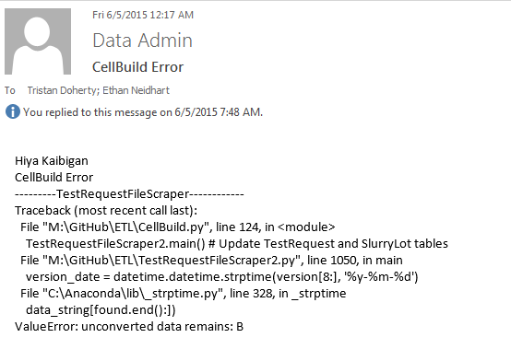

Slide 7
Issues
CellBuild script runs nightly
CellBuild runs almost all of our Python scripts
Sends out emails when something goes wrong
Begin testing/error tracking cycle
Include more detailed logging around “afflicted” area
Run script; view output/log
Analyze error source
Apply changes and run again
Repeat if necessary
Often resolved very quickly

Slide 9
Projects
Someone (Tristan) comes to me with an idea for a data project
New test, equipment, or procedure
May take less than a day, or many weeks
Major Projects List:
Slurry Conductivity Script
Incubator Control GUI
Ulysses Laser Profiles Script
Remote Script Executor (beta)
Acu-Gage Laser GUI

Slide 10
Slurry Conductivity
Goals
Extract time, voltage, and current data from each output file
Calculate mean voltage, current, conductivity in test window
Store data in database with proper identification
Results
Grabs parameters from database
Loops through all folders in root directory
Loops through all files in folder
Process & upload data
Success!

Slide 11
Incubator Control
Goals
Connect to incubator
Read incubator data
Temperature set point
Thermometer reading
Error status
Heating status
Set incubator temperature
Display in clear, organized manner
Results
Take a look!

Slide 12
Ulysses Laser Profiles
Goals
From laser data, generate “side profile” data
Filter and decimate data to reduce “noise”
Run script quickly
Results
Only processes files not in the database (very low run time)
Averages along x axis, and along y axis for side profile plots
Also takes average height, standard deviation, at “squares”
Data filtered and decimated, but still “noisy”

Slide 13
Remote Script Executor (Beta)
Goals
Run any ETL Python script from any network computer at any time
Results
Simple interface for selecting and running a script
Website calls PHP script on data01, which runs the selected Python script
User must wait until script finishes running for any real feedback
Due to PHP running Python, some scripts have issues they don’t normally have

Slide 14
Acu-Gage GUI
Much more accurate than Ulysses Laser
Does not run automatically
Does not run quickly
Takes data in a snake-like pattern
Demo!

Slide 15


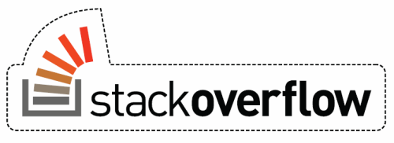
My Best Friends

Slide 16
What I’ve learned
Resourcefulness
Google-fu
Self-taught Python
Plenty of trial and error
Programming
Self-taught GUIs
File I/O
SQL
A different side of problem solving
No more “Here you go, Professor”
Applications lead to a better understanding

Slide 17
Questions?

