Slide 1
BDA Project
2023-2024

Slide 2
L4
Organization of individuals for Business Process Modeling and Management Project
L3
PM
PA
PA
PO
PI
PI
L2 and L2-bis
PM
PO
L1
L0
4

Slide 3
L4
Organization of individuals for Data Modeling and Management Project
L3
L2 and L2-bis
L1
L0
4

Slide 4
Collaborative work: principles
Everyone is involved during the whole period
Our working protocol will let us know those who are participating actively. Thus, this will impact their score positively
Our working protocol will let us know those who are not participating actively and thus this will impact their score negatively
Every synthesis shall reference all the works it summarizes

Slide 5
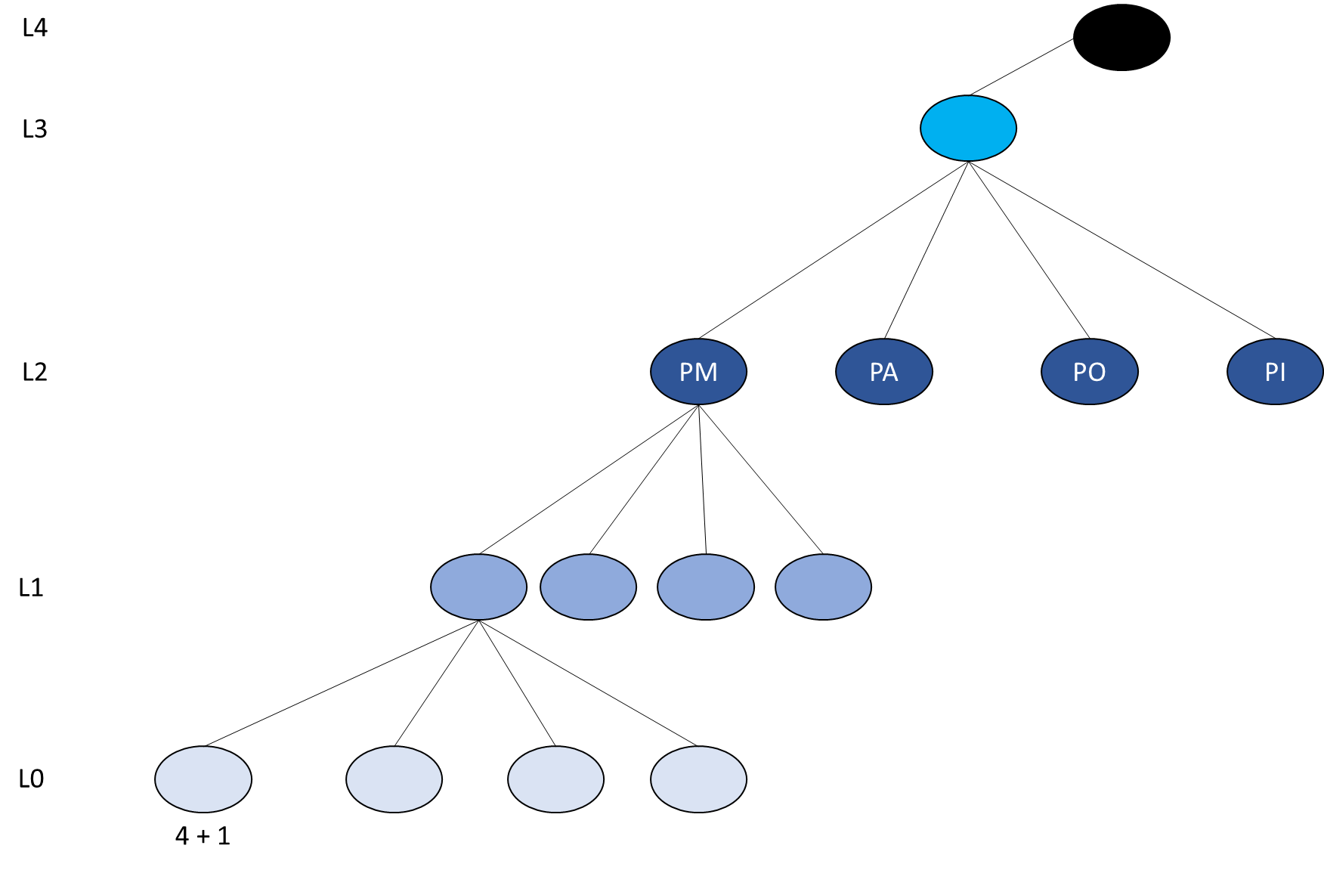
The collaboration approach
L0 individual shall identify 4 high-quality papers about the subject they have chosen or that was assigned to them.
L0 individual shall validate as soon as possible the papers they have identified by contacting L4 individuals.
L0 individual shall read the 4 papers carefully and shall understand all the details. It is very important that the synthesis of the paper is not a copy/past of its content.
L0 shall create 4 synthetizes about the 4 papers identified following the given template
L0 individual work stops here

Slide 6
The collaboration approach
L1 in collaboration with 4*L0 shall read carefully the created synthetizes
L1 shall be able to ask L0 individuals to improve their work if it is not clear enough
L1, in collaboration with each 4*L0, shall produce 4 synthetizes and signs them to validate their relevance and their quality
L1 shall ensure that are read papers are referenced in the 4 synthetizes they made
L1, with the help of 4*L0, shall identify a topic summarizing the 4 synthetizes they have identified
L1 alone shall create one single synthesis summarizing all the works explored
L1 individual generates 4 synthetizes that they sign

Slide 7
The collaboration approach
L2 shall start by identifying and synthetizing the related works associated with their topic
L2 shall meet with 4*L1 to create one single synthesis summarizing and adapting the 4 topics identified. At this stage, the 4 topics can still be adapted
L2 shall write a synthesis that is accurate, clear, with high-quality English and that references all the works summarized before
L2 is encouraged to use tables, to compare works
L2 has the capability to assign additional work to L1 and L0 in order to improve their summary
L2 shall report to L3 two synthetizes documents:
The report of the related work about their main topic
The synthesis obtained from L1,L0 works
L2 individual generates 2 synthetizes that they sign

Slide 8
The collaboration approach
L2-bis*4 are groups of at most 4 members whose mission is:
Survey the software tools and the libraries related to their topic
Develop some scenarios to show how these tools work
It is strongly advised to record their showcases on YouTube and report the videos
L2-bis individual work generates 1 synthesis that they sign

Slide 9
The collaboration approach
L3 is a group of at most 4 students whose mission is:
Synthesize the related works about AI, MBSE, BPM and the importance of these reviews. They could rely on the related works report provided by 4*L2
Describe the adopted protocol carefully with the help of L4
Meet with 4*L2 to create one global synthesis that must reference all the works summarized
Meet with 4*L2-bis to add the implementation summary to their global synthesis
L3 has the capability to assign works to L0, L1, L2, L2-bis to improve their synthesizes
L3 individual generates 1 synthetic document upholding latex format (overleaf.com) that summarizes the works on the 4 subjects

Slide 10
The collaboration approach
L4 is a group of 4 members whose mission is:
Create a well organized data store repository on GitHub to manage the documents of this project
Be the contact point for all individuals (L0,L1,L2,L2-bis,L3) to find the right document very quickly on GitHub or to upload their document (scihb)
Ensure that every document, file, video, is uploaded into GitHub in the appropriate location
Report every evening the added papers so that I can validate them to allow L0 to start their work. To achieve this, L4 has to identify and propose an appropriate validation tool
Monitor the work progress and report to the individuals any delay
Organize regular meetings with myself to check the progress
Organize the global workshop that will take place on March 30th and play the role of the chairman to give the opportunity to everybody to present their achivements

Slide 11
Schedule
Week | Deadline | To do | To do in parallel
 | January 27th | L0 starts identifying and reading their papers L0 can request some help from L2 and from L3 to test, to summarize and to better understand what they are reading L4 defines the organization of the data store on GitHub and provide the other individuals the required support to access the documents L4 creates a file with the right structure to capture the assignment to groups of the different individuals L2-Bis starts searching and testing software tools related to their subject | L1,L2,L3 can, in parallel, read the papers identified by L0 to be well-prepared L1,L2,L3 have the possibility to propose their help to L0
1 | February 3rd | GitHub should be up and running Every individual should know to which level and to which subject they have been assigned At this date, delays will start impacting the scores negatively
2 | February 10th | Informal meetings are encouraged at this stage Always keep L4 in the loop
3 | February 16th at 23:59 | (L0, L1) 1st formal meeting should have been done | L2 and L3 can participate passively L2 are also searching for the related works L3 are developing the protocol tool
4 | February 23rd at 23:59 | (L0, L1) final meeting should have been done → Topics are determined here
5 | Mars 1st at 23:59 | (L2, L1*4) meeting to synthetize the 4 topics identified should have been done | L0 can participate and help improve the summary made L2 has the responsibility to report the L0 participants who helped
6 | Mars 9th | L3 are doing their work with the help of L0, L1 and L2
7 | Mars 15th at 23:59 | (L3, L2*4) 1st formal meeting to synthetize the 4 subjects should have been done | L0, L1, L2 are encouraged to participate actively L4 captures the names of the participants who have had an added value
8 | Mars 22nd at 23:59 | (L3, L2*4) last formal meeting to synthetize the 4 subjects should have been done
9 | Mars 28th at 23:59 | L4 should have be prepared the Global workshop | During the workshop: L3 shall prepare a presentation of their synthesis
10 | April 6th | Final scores assigned

