Slide 1
Complex event processing with Esper: theoretical background and applications
Malik Khalfallah

Slide 2
Brief bio of the presenter
CS engineer diploma from the university of Constantine
PhD from the university of Lyon & Airbus Group research center
Maitre de Conférences associé at the university of Créteil in Paris
Industry and research interests: data management, avionics systems

Slide 3
Presentation outline
Complex event processing: conceptual presentation
Processing stream of events
Aggregating data to process them windows mechanism
Queries to detect patterns of events
Application of complex event processing with Esper
Use case: Trivia example
Limitations of Esper and workarounds from the industry

Slide 4
Complex Event Processing: Definition of terms
In organizations, events are generated and handled by business processes

Slide 5
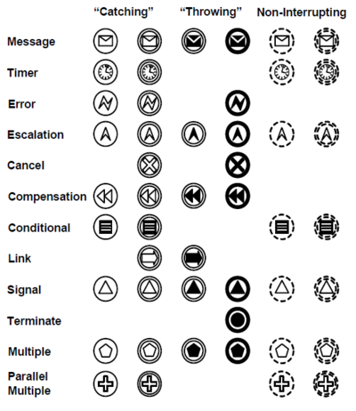
Complex Event Processing: Definition of terms
In organizations, events are generated and handled by business processes
Languages to model business processes, such as BPMN, capture different types of events that could be of interest in business processes

Slide 6



Complex Event Processing: Definition of terms
Event 1: professors appear in suit
Event 2: A student appears in suit
Event 3: laughs
Successful thesis defense

Slide 7
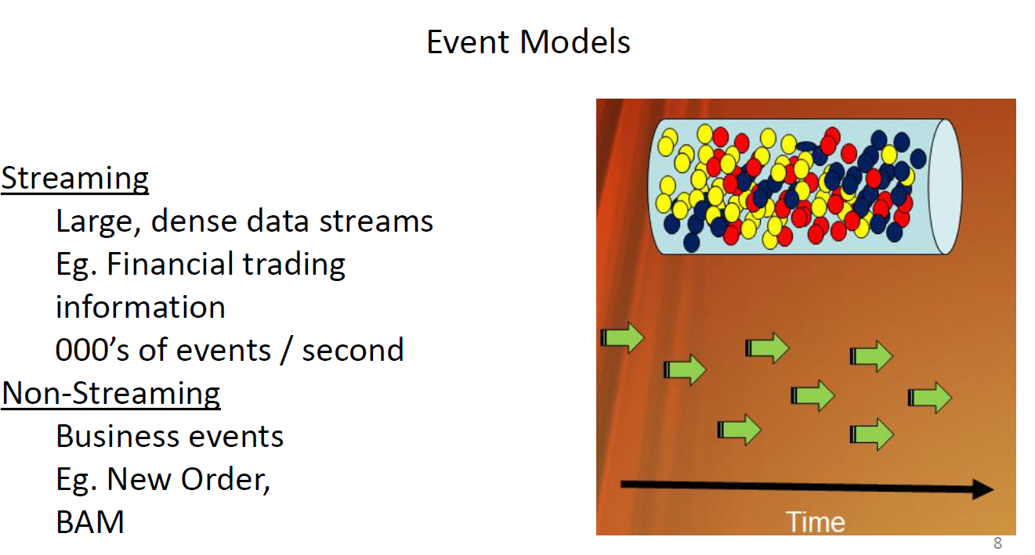
Complex Event Processing: Definition of terms

Slide 8
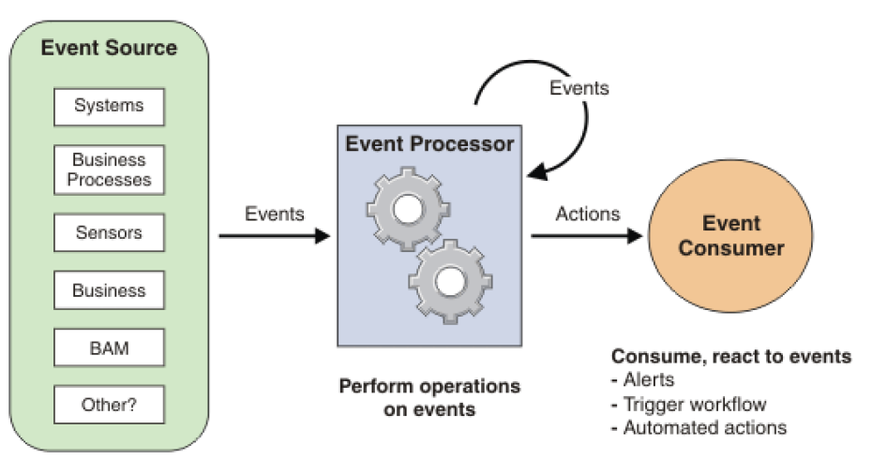
Complex Event Processing: Global Architecture

Slide 9
Complex event processing vs Stream processing
 | Complex event processing | Stream processing
Also known as | CEP, event stream analysis and event series analysis | Real-time computation, stream computing
Example providers | Esper | Spark, Flink, drooles
Type | Business Intelligence and decision making | Container technologies e.g. J2EE
Pattern matching and detection, filtering, transformation, aggregation, event hierarchies, detecting | Central to CEP | Not central to stream processing
Transporting events between processes and hosts | Bot central to CEP in general | Central to stream processing
Continuous Queries (Statements) | Express stream analysis in event processing language (EPL)no need to restart the server or container | Code your own operators
Target | Analysis | Extract-Transform-Load (ETL)
Notes:
https://www.espertech.com/esper/esper-faq/

Slide 10
Event processing language (EPL)
The Esper event processing language (EPL) converges event stream processing (filtering, joins, aggregation) and complex event processing (causality) into one single language
The core language is SQL conforming ensuring rapid learning
The language, of course, includes event windows and causality patterns as first citizens
Notes:
https://www.espertech.com/esper/esper-faq/

Slide 11
EPL: Operators
Operators on events let a business situation be inferred or identified
This might involve combining multiple methods to identify a specific pattern:
Correlation
Filtering
Causality
Event operators can function on a single stream as well as across streams
Notes:
http://esper.espertech.com/release-8.8.0/reference-esper/html/processingmodel.html

Slide 12
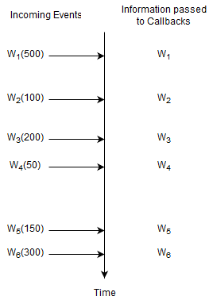
EPL: simple Select statements
Notes:
http://esper.espertech.com/release-8.8.0/reference-esper/html/processingmodel.html

Slide 13
EPL: simple Select statements
select * from Withdrawal
For this statement, the runtime remembers no information and does not remember any events. A statement where the runtime does not need to remember any information at all is a statement without state (a stateless statement).
Notes:
http://esper.espertech.com/release-8.8.0/reference-esper/html/processingmodel.html

Slide 14
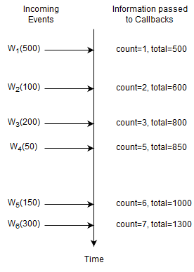
EPL: Aggregation

Slide 15
EPL: Aggregation
select count(*), sum(amount) from Withdrawal
Here, the runtime only remembers the current number of events and the total amount. The count is a single long-type value and the total is a single double-type value (assuming amount is a double-value, the total can be BigDecimal as applicable). This statement is not stateless and the state consists of a long-typed value and a double-typed value.

Slide 16
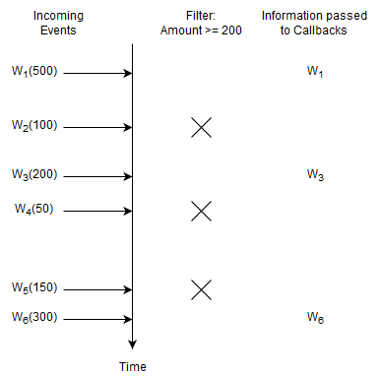
EPL: Basic Filter
select * from Withdrawal(amount >= 200)

Slide 17
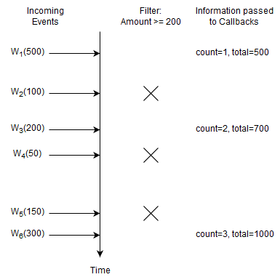
EPL: Basic Filter and Aggregation
select count(*), sum(amount) from Withdrawal(amount >= 200)

Slide 18
Hands-On
Tool to test EPL queries
Example of a simple EPL query

Slide 19
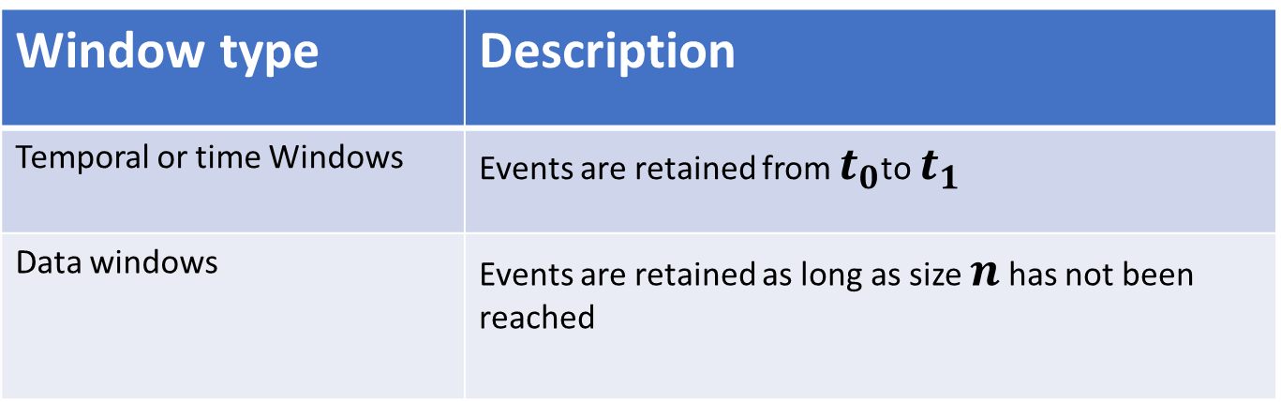
EPL: Windows
Certain operators need that events be grouped before being applied
Grouping relevant events is done via “Windows”
Windows could have different policies:
Window type | Description
Temporal or time Windows | Events are retained from $t_{0}$to $t_{1}$
Data windows | Events are retained as long as size $n$ has not been reached

Slide 20
EPL: Windows
Following the mechanism of evicting events from windows, we can identify two types of windows
Window type | Description
Tumbling windows | Events in the window are evicted
Sliding windows | Only the oldest event or events are evicted

Slide 21
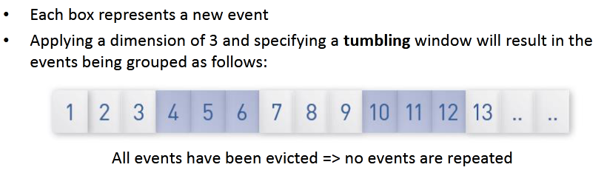
EPL: Windows Illustration

Slide 22
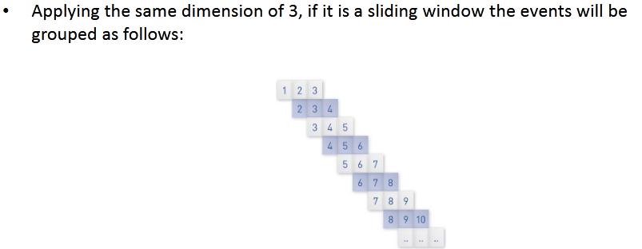
EPL: Windows Illustration

Slide 23
Hands-On
Time Window Example
Data Window Example

Slide 24
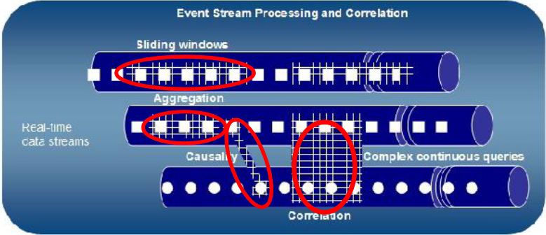
EPL: detecting patterns

Slide 25
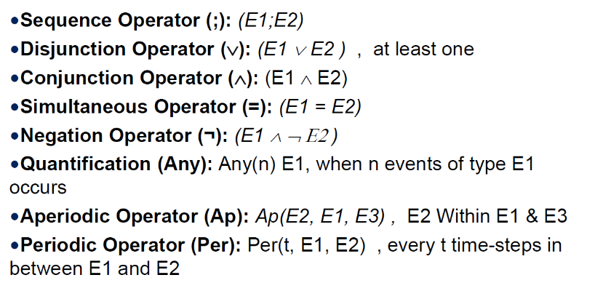
EPL: Event Patterns
Notes:
file:///E:/old20202021DTransform/session7-8-CEP/CEP.pdf

Slide 26
EPL: Event Patterns
Notes:
file:///E:/old20202021DTransform/session7-8-CEP/CEP.pdf

Slide 27
EPL: Event Patterns
Notes:
file:///E:/old20202021DTransform/session7-8-CEP/CEP.pdf

Slide 28

EPL: Event patterns with ‘Every’ operator
Example of event stream:
$A_{1}, B_{1},C_{1}, B_{2}, A_{2},D_{1},A_{3}, B_{3}, E_{1}, A_{4},F_{1}, B_{4}$
The result of $every(A−>B)$
Notes:
file:///E:/old20202021DTransform/session7-8-CEP/CEP.pdf

Slide 29

EPL: Event patterns with ‘Every’ operator
Example of event stream:
$A_{1}, B_{1},C_{1}, B_{2}, A_{2},D_{1},A_{3}, B_{3}, E_{1}, A_{4},F_{1}, B_{4}$
The result of $every(A−>B)$
Matches on $B_{1}$
Notes:
file:///E:/old20202021DTransform/session7-8-CEP/CEP.pdf

Slide 30

EPL: Event patterns with ‘Every’ operator
Example of event stream:
$A_{1}, B_{1},C_{1}, B_{2}, A_{2},D_{1},A_{3}, B_{3}, E_{1}, A_{4},F_{1}, B_{4}$
The result of $every(A−>B)$
Matches on $B_{1}$
Matches on $B_{3}$
Notes:
file:///E:/old20202021DTransform/session7-8-CEP/CEP.pdf

Slide 31

EPL: Event patterns with ‘Every’ operator
Example of event stream:
$A_{1}, B_{1},C_{1}, B_{2}, A_{2},D_{1},A_{3}, B_{3}, E_{1}, A_{4},F_{1}, B_{4}$
The result of $every(A−>B)$
Matches on $B_{1}$
Matches on $B_{3}$
Matches on $B_{4}$
Notes:
file:///E:/old20202021DTransform/session7-8-CEP/CEP.pdf

Slide 32
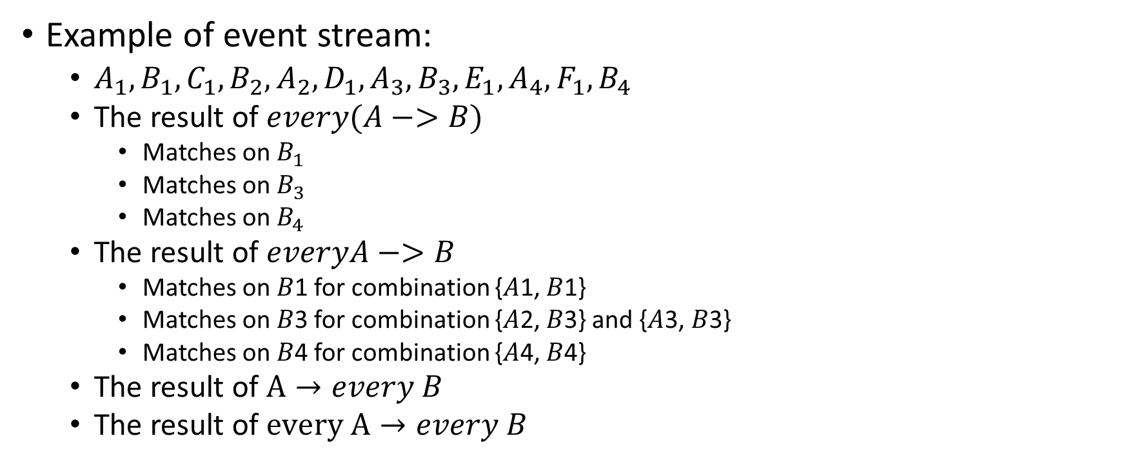
EPL: Event patterns with ‘Every’ operator
Example of event stream:
$A_{1}, B_{1},C_{1}, B_{2}, A_{2},D_{1},A_{3}, B_{3}, E_{1}, A_{4},F_{1}, B_{4}$
The result of $every(A−>B)$
Matches on $B_{1}$
Matches on $B_{3}$
Matches on $B_{4}$
The result of $everyA−>B$
Matches on 𝐵1 for combination {𝐴1, 𝐵1}
Matches on 𝐵3 for combination {𝐴2, 𝐵3} and {𝐴3, 𝐵3}
Matches on 𝐵4 for combination {𝐴4, 𝐵4}
The result of $A→every B$
The result of $every A→every B$
Notes:
file:///E:/old20202021DTransform/session7-8-CEP/CEP.pdf

Slide 33
Hands-On
Example of a simple pattern of events
Example of a complex pattern of events

Slide 34
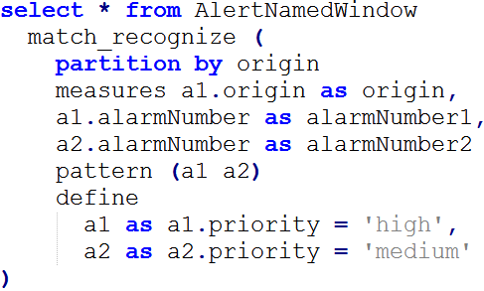
EPL: Match-Recognize Patterns
Match-Recognize allows us to find patterns among events. Let’s consider the following match-recognize expression
e1
e2
e3
e4
Notes:
http://esper.espertech.com/release-8.8.0/reference-esper/html/processingmodel.html#processingmodel_matchrecognizepattern

Slide 35
EPL: Match-Recognize Patterns
Match-Recognize allows us to find patterns among events. Let’s consider the following match-recognize expression
e1
e2
e3
e4
Notes:
http://esper.espertech.com/release-8.8.0/reference-esper/html/processingmodel.html#processingmodel_matchrecognizepattern

Slide 36
EPL: Match-Recognize Patterns
Match-Recognize allows us to find patterns among events. Let’s consider the following match-recognize expression
e1
e2
e3
e4
Notes:
http://esper.espertech.com/release-8.8.0/reference-esper/html/processingmodel.html#processingmodel_matchrecognizepattern

Slide 37
EPL: Match-Recognize Patterns
Match-Recognize allows us to find patterns among events. Let’s consider the following match-recognize expression
e1
e2
e3
e4
Notes:
http://esper.espertech.com/release-8.8.0/reference-esper/html/processingmodel.html#processingmodel_matchrecognizepattern

Slide 38
EPL: Match-Recognize Patterns
Match-Recognize allows us to find patterns among events. Let’s consider the following match-recognize expression
e1
e2
e3
e4
Example: here
Notes:
http://esper.espertech.com/release-8.8.0/reference-esper/html/processingmodel.html#processingmodel_matchrecognizepattern

Slide 39
EPL: Match-Recognize Patterns
Match-Recognize allows us to find patterns among events. Let’s consider the following match-recognize expression
e1
e2
e3
e4
Example: here
Notes:
http://esper.espertech.com/release-8.8.0/reference-esper/html/processingmodel.html#processingmodel_matchrecognizepattern

Slide 40
Hands-On
Example 1 of match-recognize
Example 2 of match-recognize

Slide 41
Solution Patterns
https://www.espertech.com/esper/solution-patterns/

Slide 42
Use case: implementing Trivia game using CEP
For this use case, we will use EPL notebook
It is a Jupyter-like notebook
Two main clauses are used:
%esperepl
%esperscenario
We re-run our simple EPL example here

Slide 43
Trivia Game
Trivia
Qn
Q2

Slide 44
Trivia Game
Trivia
Answer
Qn
Player
Answer Annulment
Q2
Request for most frequent answer

Slide 45
Trivia Game
Trivia
Answer
Qn
Player
Answer Annulment
Q2
Request for most frequent answer
Q1
A1
A2
A3
A4
Scoreboard manager

Slide 46
Trivia Game
Trivia
Answer
Qn
Player
Answer Annulment
Q2
Control
Trivia
Request for most frequent answer
Q1
A1
A2
A3
A4
Scoreboard manager

Slide 47
Trivia Game: Illustration
Q1
Wed Mar 06 2024 09:00:00
Answer = 2

Slide 48
Trivia Game: Illustration
Q1
Wed Mar 06 2024 09:00:00
Answer = 2
Player 1
Player 2
Player 3
Wed Mar 06 2024 09:00:01
Wed Mar 06 2024 09:00:01
Wed Mar 06 2024 09:00:02

Slide 49
Trivia Game: Illustration
Q1
Wed Mar 06 2024 09:00:00
Answer = 2
A1
A2
A2
Player 1
Player 2
Player 3
Wed Mar 06 2024 09:00:01
Wed Mar 06 2024 09:00:01
Wed Mar 06 2024 09:00:02

Slide 50
Trivia Game: Illustration
Q1
Wed Mar 06 2024 09:00:00
Answer = 2
Update Score
A1
A2
A2
Player 1
Player 2
Player 3
Wed Mar 06 2024 09:00:01
Wed Mar 06 2024 09:00:01
Wed Mar 06 2024 09:00:02

Slide 51
Trivia Game: Illustration
Q1
Wed Mar 06 2024 09:00:00
Answer = 2
Update Score
A1
A2
A2
-1
105
5
Player 1
Player 2
Player 3
Wed Mar 06 2024 09:00:01
Wed Mar 06 2024 09:00:01
Wed Mar 06 2024 09:00:02

Slide 52
Trivia rules
The scoring system creates score event with points for player according to the following scoring table:
Correct answer 5
Correct answer after asking for the most frequent answer 1
First who answered 100
Incorrect answer -1
Three answers incorrect without a correct answer in the middle -50
Correct answers to 10 consecutive questions* 500
Correct answers to 10 questions within 30 minutes* during late night hours (1:00 – 5:00) 500
each correct answer is counted towards a single bonus of the same type and cannot be counted twice.
If there are several players that are tied in one of the "best" categories, each of them receives the bonus of 1000 points.

Slide 53

Trivia
Question
Player
Answer
PlayerFA
Request
Player
Annulment
Update
Score
Change
Rule
PlayerFAResponse
Frequent Answered Responses

Slide 54
Trivia
Question
Player
Answer
PlayerFA
Request
Player
Annulment
Update
Score
Change
Rule
PlayerFAResponse
Windows to retain information on questions, players and answers
Frequent Answered Responses
Player
Fastest
Answer
Window
Player
Answer
History
Window
Player
Score
Window
Player
Answer
Window
Question
Window
Players with their scores
Players with their scores for 5 minutes
Question with player who was fastest
All the questions asked during 1 hour
History of all players regarding all questions

Slide 55

Trivia
Question
Player
Answer
PlayerFA
Request
Player
Annulment
Update
Score
Change
Rule
Q
Q
PlayerFAResponse
When a question arrives, we push it into the questions window
Player
Fastest
Answer
Window
Player
Answer
History
Window
Player
Score
Window
Player
Answer
Window
Question
Window

Slide 56
Trivia
Question
Player
Answer
PlayerFA
Request
Player
Annulment
Update
Score
Change
Rule
A
PlayerFAResponse
When an answer arrives:
We insert it into the appropriate window. However, the player could change their mind and accordingly, it is necessary to update the answer in the window
We identify the questionID
We bring the questionTime
We identify the playerId,
We identify the answer
We identify the clientAnswerTime
Player
Fastest
Answer
Window
Player
Answer
History
Window
Player
Score
Window
Player
Answer
Window
Question
Window

Slide 57
Trivia
Question
Player
Answer
PlayerFA
Request
Player
Annulment
Update
Score
Change
Rule
FA
FA
PlayerFAResponse
When a request for frequent answer arrives:
When the question was already answered, then we set the status of hasReceivedFA to true
When the question is not answered, then we insert the event capturing the question details and the null answer
When a request for frequent answer arrives, we insert the most frequent answer.
Player
Fastest
Answer
Window
Player
Answer
History
Window
Player
Score
Window
Player
Answer
Window
Question
Window
A
Q

Slide 58
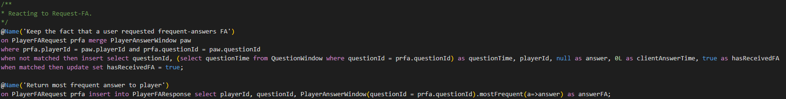
Trivia
Question
Player
Answer
PlayerFA
Request
Player
Annulment
Update
Score
Change
Rule
FA
FA
PlayerFAResponse
When a request for frequent answer arrives:
When the question was already answered, then we set the status of hasReceivedFA to true
When the question is not answered, then we insert the event capturing the question details and the null answer
When a request for frequent answer arrives, we insert the most frequent answer.
Player
Fastest
Answer
Window
Player
Answer
History
Window
Player
Score
Window
Player
Answer
Window
Question
Window
A
Q

Slide 59
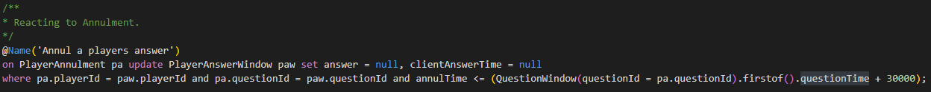
TriviaQuestion
PlayerAnswer
PlayerFARequest
PlayerAnnulment
UpdateScore
ChangeRule
N
FA
PlayerFAResponse
When a request for annulment arrives, we update the appropriate answer in the window
PlayerScoreWindow
PlayerAnswerWindow
PlayerFastestAnswerWindow
QuestionWindow
PlayerAnswerHistoryWindow
A
Q

Slide 60
Hands-On
Trivia Example in EPL notebook

Slide 61
Limitations of Esper
In certain circumstances Esper’s implementation is not efficient and thus was not adequate for industrial deployment
This occurred with Esper’s feature of User Defined Functions (UDF)
UDFs are services that can be called when running EPL queries to further process incoming events

Slide 62


Limitation of Esper: Industrial Use Case
S3
Post-order tree
traversal
S1
S2
X1
X2
X3
X4
X2
X5
Need for a more dynamic structure

Slide 63

Algorithm: Optimization of parallelism of services
X1
X3
X2
X4
X5
duplicate
X2’
X2’’
S1
S2
Y1
Y2
S3
S3
Parallelism of services
No recall to a service for the
same inputs
Coherence of data
S1
S2
X1
X2
X3
X4
X2
X5
Result

Slide 64
Feedback
Ensuring parallel execution of independent services
Preventing the execution of the same service two times for the same inputs
Upholding the preconditions of the services prior to their invocation
Maintaining the history of all inputs and intermediate results
Published paper [IEEE SCC conferences]

Slide 65
Conclusion
CEP constitutes an important asset in data analytics
It is widely used in the industry and simplifies the implementation of numerous use cases
Multiple contributions are being made in this area
Multiple challenges still exist and more particularly the added value of AI in this field
Esper constitutes one of the well documented open source frameworks that could be used as a benchmark for future improvements

