Slide 1
Complex event processing with Esper: theoretical background and applications
Malik Khalfallah

Slide 2
Brief bio of the presenter
CS engineer diploma from the university of Constantine
PhD from the university of Lyon & Airbus Group research center
Maitre de Conférences associé at the university of Creteil in Paris
Interests: data management, avionics

Slide 3
Presentation outline
Complex event processing: conceptual presentation
Processing stream of events
Aggregating data to process them windows mechanism
Queries to detect patterns of events
Application of complex event processing with Esper
Use case: Trivia example
Limitations of Esper and workarounds from the industry

Slide 4
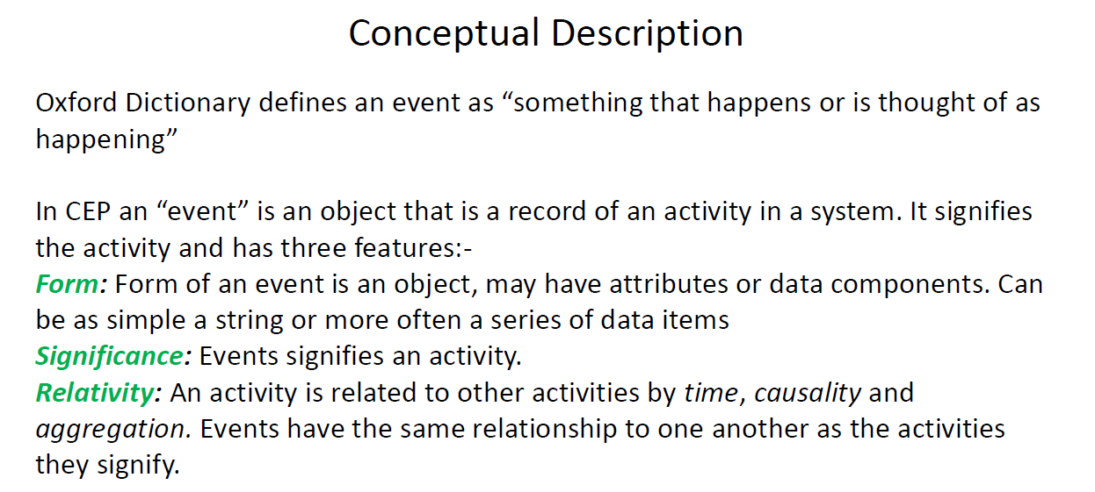
Complex Event Processing

Slide 5
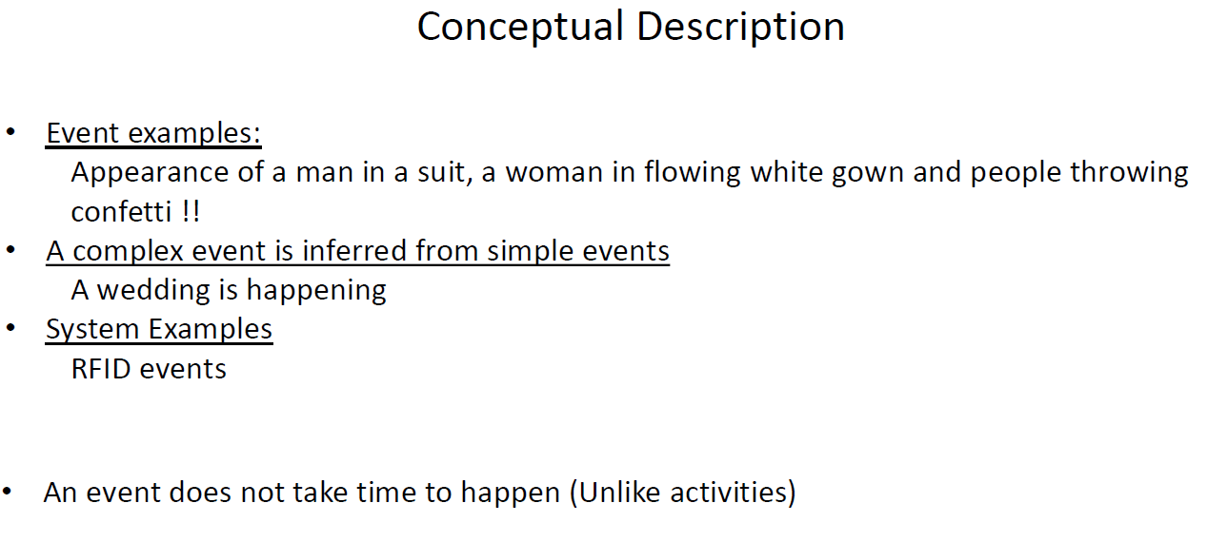
Conceptual Description

Slide 6
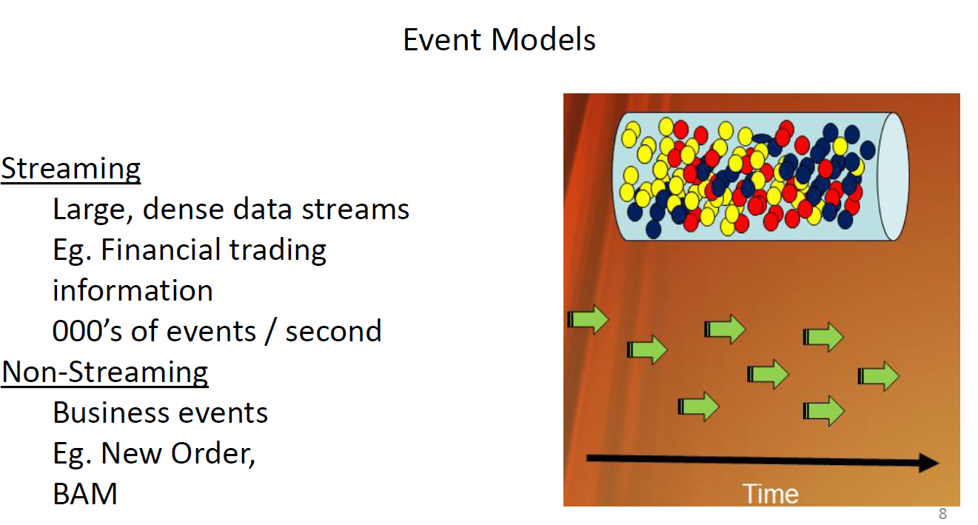
Event Models

Slide 7
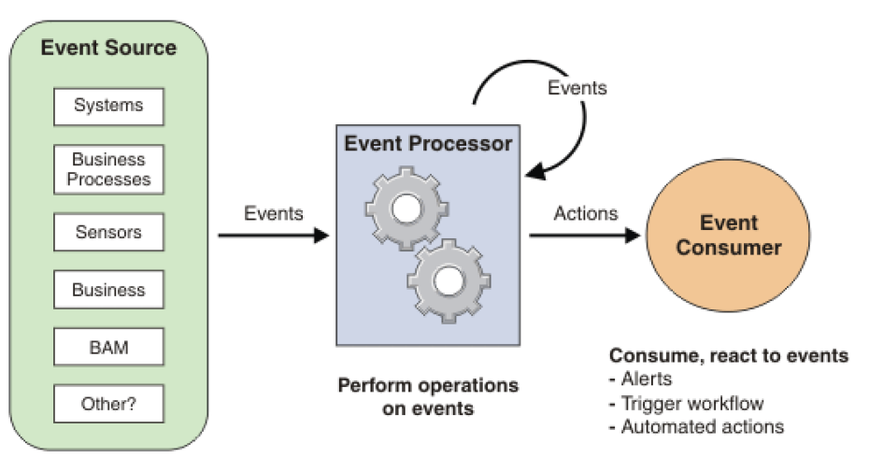
Complex Event Processing Architecture

Slide 8
Complex event processing vs stream processing
 | Complex event processing | Stream processing
Also known as | CEP, event stream analysis and event series analysis | Real-time computation, stream computing
Example providers | Esper | Spark, Flink
Type | Business Intelligence and decision making | Container technologies e.g. J2EE
Pattern matching and detection, filtering, transformation, aggregation, event hierarchies, detecting relationships (such as causality, membership or timing) between events, managing event lifecycle | Central to CEP | Not central to stream processing
Transporting events between processes and hosts | Bot central to CEP in general | Central to stream processing
Continuous Queries (Statements) | Express stream analysis in event processing language (EPL); Compile using the compiler; Deploy into a runtime; (all at runtime); no need to restart the server or container | Code your own operators
Target | Analysis | Extract-Transform-Load (ETL)
Notes:
https://www.espertech.com/esper/esper-faq/

Slide 9
Event processing language (EPL)
The Esper event processing language (EPL) converges event stream processing (filtering, joins, aggregation) and complex event processing (causality) into one single language
The core language is SQL conforming ensuring rapid learning
The language, of course, includes event windows and causality patterns as first citizens
Notes:
https://www.espertech.com/esper/esper-faq/

Slide 10
EPL: Operators
Operators on events let a business situation be inferred or identified
This might involve combining multiple methods to identify a specific pattern:
Correlation
Filtering
Causality
Event operators can function on a single stream as well as across streams
Notes:
http://esper.espertech.com/release-8.8.0/reference-esper/html/processingmodel.html

Slide 11
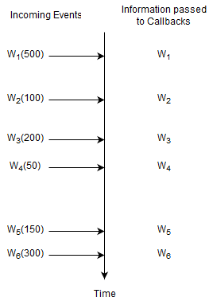
EPL: simple Select statements
Notes:
http://esper.espertech.com/release-8.8.0/reference-esper/html/processingmodel.html

Slide 12
EPL: simple Select statements
select * from Withdrawal
For this statement, the runtime remembers no information and does not remember any events. A statement where the runtime does not need to remember any information at all is a statement without state (a stateless statement).
Notes:
http://esper.espertech.com/release-8.8.0/reference-esper/html/processingmodel.html

Slide 13
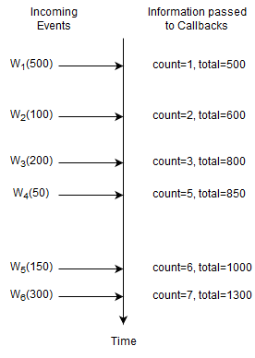
EPL: Aggregation

Slide 14
EPL: Aggregation
select count(*), sum(amount) from Withdrawal
Here, the runtime only remembers the current number of events and the total amount. The count is a single long-type value and the total is a single double-type value (assuming amount is a double-value, the total can be BigDecimal as applicable). This statement is not stateless and the state consists of a long-typed value and a double-typed value.

Slide 15
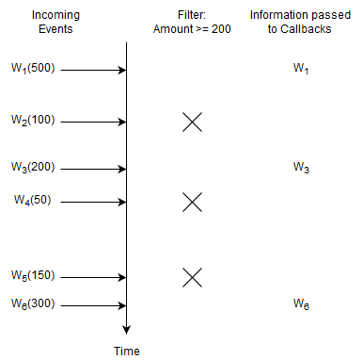
EPL: Basic Filter
select * from Withdrawal(amount >= 200)

Slide 16
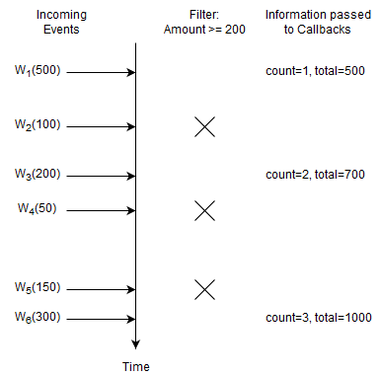
EPL: Basic Filter and Aggregation
select count(*), sum(amount) from Withdrawal(amount >= 200)

Slide 17
Hands-On
https://esper-epl-tryout.appspot.com/epltryout/mainform.html
https://github.com/enercom25/sem3_24/blob/main/agg_and_filt_examples/PriceAbove40.txt

Slide 18
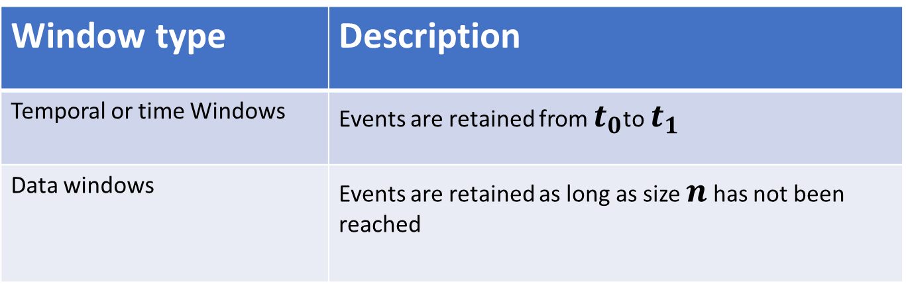
EPL: Windows
Certain operators need that events be grouped before being applied
Grouping relevant events is done via “Windows”
Windows could have different policies:
Window type | Description
Temporal or time Windows | Events are retained from $t_{0}$to $t_{1}$
Data windows | Events are retained as long as size $n$ has not been reached

Slide 19
EPL: Windows
Following the mechanism of evicting events from windows, we can identify two types of windows
Window type | Description
Tumbling windows | Events in the window are evicted
Sliding windows | Only the oldest event or events are evicted

Slide 20
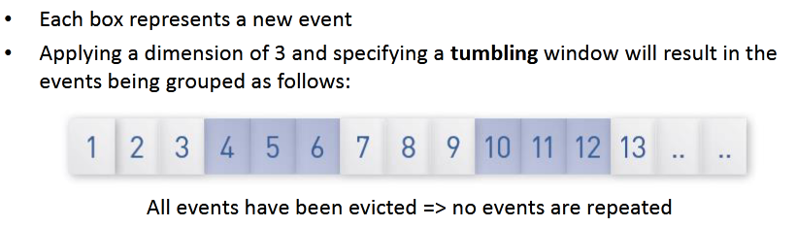
EPL: Windows Illustration

Slide 21
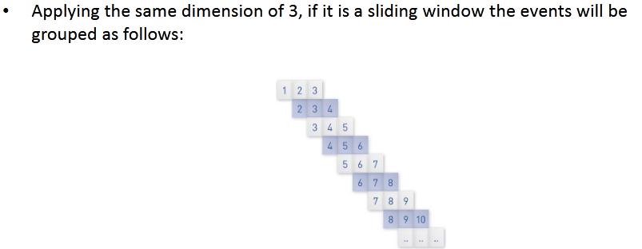
EPL: Windows Illustration

Slide 22
Hands-On
Time Window Example
Data Window Example

Slide 23
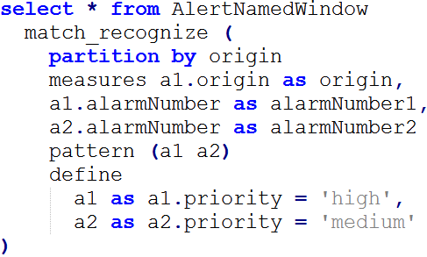
EPL: Match-Recognize Patterns
Match-Recognize allows us to find patterns among events. Let’s consider the following match-recognize expression
e1
e2
e3
e4
Notes:
http://esper.espertech.com/release-8.8.0/reference-esper/html/processingmodel.html#processingmodel_matchrecognizepattern

Slide 24
EPL: Match-Recognize Patterns
Match-Recognize allows us to find patterns among events. Let’s consider the following match-recognize expression
e1
e2
e3
e4
Notes:
http://esper.espertech.com/release-8.8.0/reference-esper/html/processingmodel.html#processingmodel_matchrecognizepattern

Slide 25
EPL: Match-Recognize Patterns
Match-Recognize allows us to find patterns among events. Let’s consider the following match-recognize expression
e1
e2
e3
e4
Notes:
http://esper.espertech.com/release-8.8.0/reference-esper/html/processingmodel.html#processingmodel_matchrecognizepattern

Slide 26
EPL: Match-Recognize Patterns
Match-Recognize allows us to find patterns among events. Let’s consider the following match-recognize expression
e1
e2
e3
e4
Notes:
http://esper.espertech.com/release-8.8.0/reference-esper/html/processingmodel.html#processingmodel_matchrecognizepattern

Slide 27
EPL: Match-Recognize Patterns
Match-Recognize allows us to find patterns among events. Let’s consider the following match-recognize expression
e1
e2
e3
e4
Example: here
Notes:
http://esper.espertech.com/release-8.8.0/reference-esper/html/processingmodel.html#processingmodel_matchrecognizepattern

Slide 28
EPL: Match-Recognize Patterns
Match-Recognize allows us to find patterns among events. Let’s consider the following match-recognize expression
e1
e2
e3
e4
Example: here
Notes:
http://esper.espertech.com/release-8.8.0/reference-esper/html/processingmodel.html#processingmodel_matchrecognizepattern

Slide 29
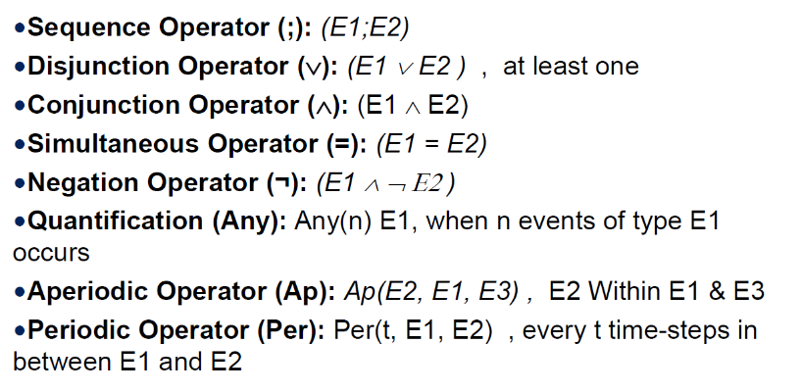
EPL: Event Patterns
Notes:
file:///E:/old20202021DTransform/session7-8-CEP/CEP.pdf

Slide 30

EPL: Event patterns with ‘Every’ operator
Example of event stream:
$A_{1}, B_{1},C_{1}, B_{2}, A_{2},D_{1},A_{3}, B_{3}, E_{1}, A_{4},F_{1}, B_{4}$
The result of $every(A−>B)$
Notes:
file:///E:/old20202021DTransform/session7-8-CEP/CEP.pdf

Slide 31

EPL: Event patterns with ‘Every’ operator
Example of event stream:
$A_{1}, B_{1},C_{1}, B_{2}, A_{2},D_{1},A_{3}, B_{3}, E_{1}, A_{4},F_{1}, B_{4}$
The result of $every(A−>B)$
Matches on $B_{1}$
Notes:
file:///E:/old20202021DTransform/session7-8-CEP/CEP.pdf

Slide 32

EPL: Event patterns with ‘Every’ operator
Example of event stream:
$A_{1}, B_{1},C_{1}, B_{2}, A_{2},D_{1},A_{3}, B_{3}, E_{1}, A_{4},F_{1}, B_{4}$
The result of $every(A−>B)$
Matches on $B_{1}$
Matches on $B_{3}$
Notes:
file:///E:/old20202021DTransform/session7-8-CEP/CEP.pdf

Slide 33

EPL: Event patterns with ‘Every’ operator
Example of event stream:
$A_{1}, B_{1},C_{1}, B_{2}, A_{2},D_{1},A_{3}, B_{3}, E_{1}, A_{4},F_{1}, B_{4}$
The result of $every(A−>B)$
Matches on $B_{1}$
Matches on $B_{3}$
Matches on $B_{4}$
Notes:
file:///E:/old20202021DTransform/session7-8-CEP/CEP.pdf

Slide 34
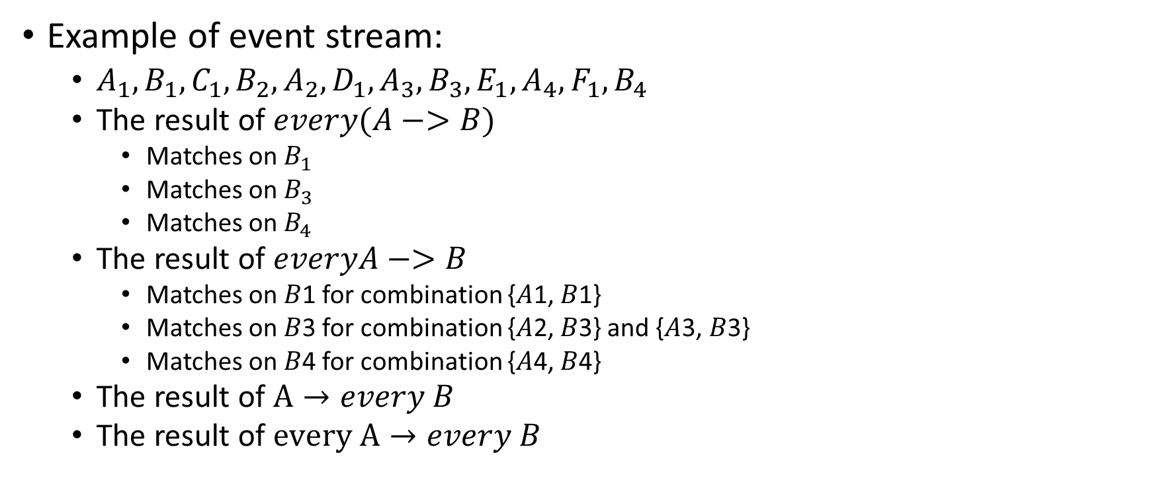
EPL: Event patterns with ‘Every’ operator
Example of event stream:
$A_{1}, B_{1},C_{1}, B_{2}, A_{2},D_{1},A_{3}, B_{3}, E_{1}, A_{4},F_{1}, B_{4}$
The result of $every(A−>B)$
Matches on $B_{1}$
Matches on $B_{3}$
Matches on $B_{4}$
The result of $everyA−>B$
Matches on 𝐵1 for combination {𝐴1, 𝐵1}
Matches on 𝐵3 for combination {𝐴2, 𝐵3} and {𝐴3, 𝐵3}
Matches on 𝐵4 for combination {𝐴4, 𝐵4}
The result of $A→every B$
The result of $every A→every B$
Notes:
file:///E:/old20202021DTransform/session7-8-CEP/CEP.pdf

Slide 35
Use case: implementing Trivia game using CEP

Slide 36
Trivia
Trivia
Answer
Qn
Player
Answer Annulment
Q2
Control
Trivia
Request for most frequent answer
Q1
A1
A2
A3
A4
Scoreboard manager

Slide 37
Trivia data
QuestionEvent(Q1, 2, a, b, c, d) at 09:00:00
AnswerEvent(User1, Q1, 1) at 09:00:01.32
AnswerEvent(User2, Q1, 2) at 09:00:01.18
AnswerEvent(User3, Q1, 3) at 09:00:02.10
AnswerEvent(User4, Q1, 1) at 09:00:03.34
AnswerEvent(User5, Q1, 2) at 09:00:04.21
AnswerEvent(User6, Q1, 4) at 09:00:04.44
AnswerEvent(User7, Q1, 1) at 09:00:05.32
AnswerEvent(User8, Q1, 2) at 09:00:06.55
AnswerEvent(User9, Q1, 2) at 09:00:12.10
AnswerEvent(User10, Q1, 1) at 09:00:15.34
AnswerEvent(User11, Q1, 3) at 09:00:24.21
AnswerEvent(User12, Q1, 2) at 09:00:28.44
QuestionEvent(Q2, 1, a, b, c, d) at 09:00:30
AnswerEvent(User1, Q2, 1) at 09:00:31.32
AnswerEvent(User8, Q2, 2) at 09:00:42.18
AnswerEvent(User11, Q2, 3) at 09:00:44.10
AnswerEvent(User7, Q2, 1) at 09:00:45.34
RequestAnswerEvent(User6, Q2) at 09:00:45.37
AnswerEvent(User12, Q2, 3) at 09:00:46.21
AnswerEvent(User6, Q2, 3) at 09:00:54.44
AnswerEvent(User4, Q2, 1) at 09:00:55.32
AnswerEvent(User2, Q2, 1) at 09:00:56.55
AnswerEvent(User9, Q2, 2) at 09:00:57.10
AnswerEvent(User10, Q2, 2) at 09:00:58.34
AnswerEvent(User3, Q2, 1) at 09:00:58.41
AnswerEvent(User5, Q2, 1) at 09:00:59.44
QuestionEvent(Q3, 4, a, b, c, d) at 09:01:00
AnswerEvent(User11, Q3, 4) at 09:01:01.33
AnswerEvent(User12, Q3, 4) at 09:01:02.18
RequestAnswerEvent(User7, Q3) at 09:01:02.37
AnswerEvent(User4, Q3, 3) at 09:01:02.44
AnswerAnnulmentEvent(User11, Q3) at 09:01:02.51
AnswerEvent(User3, Q3, 4) at 09:01:03.54
AnswerEvent(User5, Q3, 2) at 09:01:07.21
AnswerEvent(User7, Q3, 4) at 09:01:11.44
AnswerEvent(User6, Q3, 4) at 09:01:15.32
AnswerEvent(User8, Q3, 2) at 09:01:19.56
AnswerEvent(User9, Q3, 3) at 09:01:21.10
AnswerEvent(User10, Q3, 4) at 09:01:23.34
AnswerEvent(User1, Q3, 3) at 09:01:24.24
AnswerEvent(User2, Q3, 4) at 09:01:29.55
QuestionEvent(Q4, 2, a, b, c, d) at 09:01:30
AnswerEvent(User5, Q4, 2) at 09:01:32.32
AnswerEvent(User9, Q4, 2) at 09:01:33.18
AnswerEvent(User3, Q4, 2) at 09:01:34.10
AnswerEvent(User4, Q4, 2) at 09:01:35.34
AnswerEvent(User1, Q4, 3) at 09:01:41.21
AnswerEvent(User7, Q4, 2) at 09:01:44.44
AnswerEvent(User6, Q4, 1) at 09:01:45.32
AnswerAnnulmentEvent(User1, Q4) at 09:01:45.51
AnswerEvent(User12, Q4, 2) at 09:01:46.55
AnswerEvent(User2, Q4, 2) at 09:01:57.10
AnswerEvent(User1, Q4, 2) at 09:01:41.21
AnswerEvent(User10, Q4, 2) at 09:01:59.34
AnswerEvent(User11, Q4, 1) at 09:01:59.42
AnswerEvent(User8, Q4, 1) at 09:01:59.44
QuestionEvent(Q5, 3, a, b, c, d) at 09:02:00
AnswerEvent(User7, Q5, 3) at 09:02:01.33
AnswerEvent(User6, Q5, 1) at 09:02:02.18
AnswerEvent(User4, Q5, 3) at 09:02:02.15
RequestAnswerEvent(User8, Q5) at 09:02:02.37
AnswerEvent(User3, Q5, 3) at 09:02:03.54
AnswerEvent(User5, Q5, 3) at 09:02:07.21
AnswerEvent(User2, Q5, 2) at 09:02:11.44
AnswerEvent(User1, Q5, 4) at 09:02:15.32
AnswerEvent(User11, Q5, 1) at 09:02:19.56
AnswerEvent(User9, Q5, 3) at 09:02:21.10
RequestAnswerEvent(User11, Q5) at 09:02:22.37
AnswerEvent(User11, Q5, 4) at 09:02:23.34
AnswerEvent(User8, Q5, 3) at 09:02:24.24
AnswerEvent(User12, Q5, 3) at 09:02:29.55
QuestionEvent(Q6, 4, a, b, c, d) at 09:02:30
AnswerEvent(User4, Q6, 2) at 09:02:34.32
AnswerEvent(User8, Q6, 4) at 09:02:35.18
AnswerEvent(User6, Q6, 1) at 09:02:36.10
AnswerEvent(User1, Q6, 4) at 09:02:36.34
AnswerEvent(User5, Q6, 3) at 09:02:38.21
RequestAnswerEvent(User2, Q6) at 09:02:39.37
AnswerEvent(User6, Q6, 2) at 09:02:41.44
AnswerEvent(User3, Q6, 4) at 09:02:41.33
AnswerEvent(User2, Q6, 2) at 09:02:43.55
AnswerEvent(User9, Q6, 4) at 09:02:46.10
AnswerEvent(User10, Q6, 4) at 09:02:48.34
AnswerEvent(User11, Q6, 4) at 09:02:52.23
AnswerEvent(User12, Q6, 1) at 09:02:54.46
QuestionEvent(Q7, 3, a, b, c, d) at 09:03:00
AnswerEvent(User1, Q7, 3) at 09:00:03.32
AnswerEvent(User2, Q7, 3) at 09:00:03.17
AnswerEvent(User3, Q7, 3) at 09:00:03.05
AnswerEvent(User4, Q7, 1) at 09:00:03.34
AnswerEvent(User5, Q7, 2) at 09:03:04.21
AnswerEvent(User6, Q7, 1) at 09:03:05.12
AnswerEvent(User7, Q7, 3) at 09:03:05.32
RequestAnswerEvent(User10, Q7) at 09:03:06.37
AnswerEvent(User8, Q7, 2) at 09:03:07.52
AnswerEvent(User9, Q7, 3) at 09:03:08.10
AnswerEvent(User10, Q7, 1) at 09:03:11.33
AnswerEvent(User11, Q7, 3) at 09:03:12.57
AnswerEvent(User12, Q7, 3) at 09:03:15.42
QuestionEvent(Q8, 1, a, b, c, d) at 09:03:30
AnswerEvent(User1, Q8, 1) at 09:03:31.32
AnswerEvent(User8, Q8, 1) at 09:03:42.18
AnswerEvent(User7, Q8, 3) at 09:03:44.10
AnswerEvent(User11, Q8, 1) at 09:03:45.34
AnswerEvent(User12, Q8, 3) at 09:03:46.21
AnswerEvent(User4, Q8, 3) at 09:03:54.44
AnswerEvent(User6, Q8, 2) at 09:03:55.32
AnswerEvent(User9, Q8, 1) at 09:03:56.55
AnswerEvent(User2, Q8, 2) at 09:03:57.10
AnswerEvent(User10, Q8, 1) at 09:03:58.34
AnswerEvent(User3, Q8, 1) at 09:03:58.41
AnswerEvent(User5, Q8, 1) at 09:03:59.44
QuestionEvent(Q9, 4, a, b, c, d) at 09:04:00
AnswerEvent(User11, Q9, 4) at 09:04:01.33
AnswerEvent(User12, Q9, 4) at 09:04:02.18
AnswerEvent(User5, Q9, 3) at 09:04:02.15
AnswerEvent(User3, Q9, 4) at 09:04:03.54
AnswerEvent(User4, Q9, 2) at 09:04:07.21
RequestAnswerEvent(User1, Q9) at 09:04:10.37
AnswerEvent(User7, Q9, 4) at 09:04:11.44
AnswerEvent(User6, Q9, 4) at 09:04:15.32
AnswerEvent(User8, Q9, 2) at 09:04:19.56
AnswerEvent(User1, Q9, 3) at 09:04:21.10
AnswerEvent(User10, Q9, 4) at 09:04:23.34
AnswerEvent(User1, Q9, 3) at 09:04:24.24
AnswerEvent(User2, Q9, 4) at 09:04:29.55
QuestionEvent(Q10, 2, a, b, c, d) at 09:04:30
AnswerEvent(User5, Q10, 2) at 09:04:32.32
AnswerEvent(User9, Q10, 2) at 09:04:33.18
AnswerEvent(User3, Q10, 2) at 09:04:34.10
AnswerEvent(User4, Q10, 2) at 09:04:35.34
AnswerEvent(User1, Q10, 3) at 09:04:41.21
AnswerEvent(User7, Q10, 2) at 09:04:44.44
AnswerEvent(User6, Q10, 1) at 09:04:45.32
AnswerEvent(User12, Q10, 2) at 09:04:46.55
AnswerAnnulmentEvent(User1, Q10) at 09:04:48.51
AnswerEvent(User2, Q10, 2) at 09:04:57.10
AnswerEvent(User10, Q10, 2) at 09:04:59.34
AnswerEvent(User11, Q10, 1) at 09:04:59.42
AnswerEvent(User8, Q10, 1) at 09:01:59.44
QuestionEvent(Q11, 2, a, b, c, d) at 09:05:00
AnswerEvent(User7, Q11, 2) at 09:05:01.33
AnswerEvent(User6, Q11, 2) at 09:05:02.18
AnswerEvent(User2, Q11, 2) at 09:05:02.15
AnswerEvent(User9, Q11, 2) at 09:05:03.54
AnswerEvent(User5, Q11, 3) at 09:05:07.21
AnswerEvent(User4, Q11, 2) at 09:05:11.44
AnswerEvent(User1, Q11, 2) at 09:05:15.32
AnswerEvent(User11, Q11, 1) at 09:05:19.56
AnswerEvent(User3, Q11, 2) at 09:05:21.10
AnswerEvent(User11, Q11, 2) at 09:05:23.34
AnswerEvent(User8, Q11, 3) at 09:05:24.24
AnswerEvent(User12, Q11, 3) at 09:05:29.55
QuestionEvent(Q12, 2, a, b, c, d) at 09:05:30
AnswerEvent(User4, Q12, 2) at 09:05:33.32
AnswerEvent(User8, Q12, 4) at 09:05:35.18
AnswerEvent(User6, Q12, 2) at 09:05:36.10
AnswerEvent(User1, Q12, 2) at 09:05:36.34
AnswerEvent(User5, Q12, 3) at 09:05:39.23
AnswerEvent(User6, Q12, 2) at 09:05:41.44
AnswerEvent(User3, Q12, 2) at 09:05:42.34
AnswerEvent(User2, Q12, 2) at 09:05:43.55
AnswerEvent(User9, Q12, 4) at 09:05:47.10
AnswerEvent(User10, Q12, 4) at 09:05:49.33
AnswerEvent(User11, Q12, 3) at 09:05:53.23
AnswerEvent(User12, Q12, 1) at 09:05:53.46
QuestionEvent(Q13, 4, a, b, c, d) at 09:06:00
AnswerEvent(User1, Q13, 1) at 09:06:01.32
AnswerEvent(User2, Q13, 2) at 09:06:02.18
AnswerEvent(User3, Q13, 4) at 09:06:03.10
AnswerEvent(User4, Q13, 1) at 09:06:05.34
AnswerEvent(User5, Q13, 2) at 09:06:08.21
AnswerEvent(User6, Q13, 4) at 09:06:08.44
AnswerEvent(User7, Q13, 1) at 09:06:09.32
AnswerEvent(User8, Q13, 2) at 09:06:10.55
AnswerEvent(User9, Q13, 2) at 09:06:12.10
AnswerEvent(User10, Q13, 1) at 09:06:15.34
AnswerEvent(User11, Q13, 3) at 09:06:24.21
AnswerEvent(User12, Q13, 2) at 09:06:28.44
QuestionEvent(Q14, 4, a, b, c, d) at 09:06:30
AnswerEvent(User1, Q14, 2) at 09:06:32.32
AnswerEvent(User3, Q14, 4) at 09:06:33.18
AnswerEvent(User9, Q14, 4) at 09:06:34.10
AnswerEvent(User4, Q14, 2) at 09:06:37.34
AnswerEvent(User5, Q14, 3) at 09:06:39.21
AnswerEvent(User7, Q14, 2) at 09:06:41.42
AnswerEvent(User6, Q14, 1) at 09:06:43.32
AnswerEvent(User2, Q14, 2) at 09:06:46.55
AnswerEvent(User12, Q14, 2) at 09:06:57.10
AnswerEvent(User11, Q14, 2) at 09:06:59.34
AnswerEvent(User10, Q14, 1) at 09:06:59.42
AnswerEvent(User7, Q14, 1) at 09:06:59.44
QuestionEvent(Q15, 2, a, b, c, d) at 09:07:00
AnswerEvent(User7, Q15, 3) at 09:07:01.33
AnswerEvent(User6, Q15, 4) at 09:07:02.18
AnswerEvent(User4, Q15, 3) at 09:07:02.15
AnswerEvent(User3, Q15, 3) at 09:07:03.54
AnswerEvent(User5, Q15, 3) at 09:07:07.21
AnswerEvent(User2, Q15, 2) at 09:07:11.44
AnswerEvent(User1, Q15, 2) at 09:07:15.32
AnswerEvent(User11, Q15, 1) at 09:07:19.56
AnswerEvent(User9, Q15, 2) at 09:07:21.10
AnswerEvent(User11, Q15, 2) at 09:02:23.34
AnswerEvent(User8, Q15, 3) at 09:02:24.24
AnswerEvent(User12, Q15, 2) at 09:02:29.55
QuestionEvent(Q16, 1, a, b, c, d) at 09:07:30
AnswerEvent(User4, Q16, 1) at 09:07:34.32
AnswerEvent(User8, Q16, 1) at 09:07:35.18
AnswerEvent(User6, Q16, 1) at 09:07:36.10
AnswerEvent(User1, Q16, 4) at 09:07:36.34
AnswerEvent(User5, Q16, 3) at 09:07:38.21
AnswerEvent(User6, Q16, 2) at 09:07:41.22
AnswerEvent(User3, Q16, 4) at 09:07:41.33
AnswerEvent(User2, Q16, 2) at 09:07:44.55
AnswerEvent(User9, Q16, 1) at 09:07:46.10
AnswerEvent(User10, Q16, 4) at 09:07:48.34
AnswerEvent(User11, Q16, 4) at 09:07:52.23
AnswerEvent(User12, Q16, 1) at 09:07:54.46;

Slide 38
Trivia rules
The scoring system creates score event with points for player according to the following scoring table:
Correct answer 5
Correct answer after asking for the most frequent answer 1
First who answered 100
Incorrect answer -1
Three answers incorrect without a correct answer in the middle -50
Correct answers to 10 consecutive questions* 500
Correct answers to 10 questions within 30 minutes* during late night hours (1:00 – 5:00) 500
each correct answer is counted towards a single bonus of the same type and cannot be counted twice.
If there are several players that are tied in one of the "best" categories, each of them receives the bonus of 1000 points.

Slide 39

TriviaQuestion
PlayerAnswer
PlayerFARequest
PlayerAnnulment
UpdateScore
ChangeRule
PlayerFAResponse
Frequent Answered Responses
PlayerScoreWindow
PlayerAnswerWindow
PlayerFastestAnswerWindow
QuestionWindow
PlayerAnswerHistoryWindow
Windows to retain information on questions, players and answers
Players with their scores
Players with their scores during 5 minutes
Question with player who was fastest
All the questions asked during 1 hour
History of all players regarding all questions

Slide 40

TriviaQuestion
PlayerAnswer
PlayerFARequest
PlayerAnnulment
UpdateScore
ChangeRule
Q
PlayerFAResponse
When a question arrives, we push it to the questions window
PlayerScoreWindow
PlayerAnswerWindow
PlayerFastestAnswerWindow
QuestionWindow
PlayerAnswerHistoryWindow

Slide 41
TriviaQuestion
PlayerAnswer
PlayerFARequest
PlayerAnnulment
UpdateScore
ChangeRule
A
PlayerFAResponse
When an answer arrives:
We insert it into the appropriate window. However, the player could change their mind and accordingly, it is necessary to update the answer in the window
We identify the questionID
We bring the questionTime
We identify the playerId,
We identify the answer
We identify the clientAnswerTime
PlayerScoreWindow
PlayerAnswerWindow
PlayerFastestAnswerWindow
QuestionWindow
PlayerAnswerHistoryWindow
Q

Slide 42
TriviaQuestion
PlayerAnswer
PlayerFARequest
PlayerAnnulment
UpdateScore
ChangeRule
FA
FA
PlayerFAResponse
When a request for frequent answer arrives:
When the question was already answered, then we set the status of hasReceivedFA to true
When the question is not answered, then we insert the event capturing the question details and the null answer
When a request for frequent answer arrives, we insert the most frequent answer.
PlayerScoreWindow
PlayerAnswerWindow
PlayerFastestAnswerWindow
QuestionWindow
PlayerAnswerHistoryWindow
A
Q

Slide 43
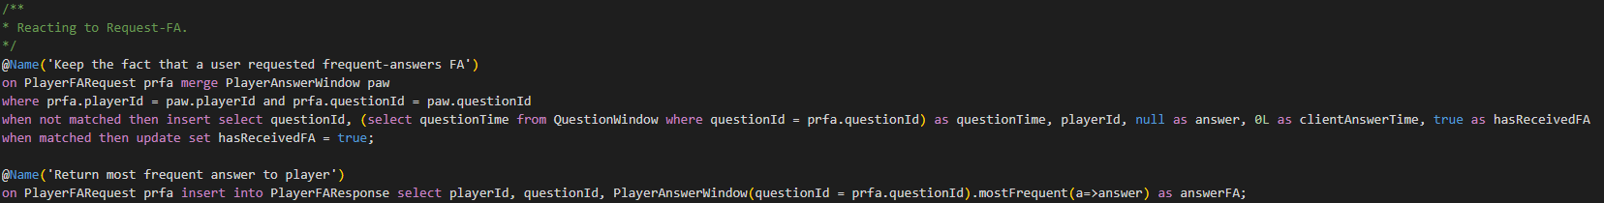
TriviaQuestion
PlayerAnswer
PlayerFARequest
PlayerAnnulment
UpdateScore
ChangeRule
FA
FA
PlayerFAResponse
When a request for frequent answer arrives:
When the question was already answered, then we set the status of hasReceivedFA to true
When the question is not answered, then we insert the event capturing the question details and the null answer
When a request for frequent answer arrives, we insert the most frequent answer. This answer can be shown to the user but we no longer process this event
PlayerScoreWindow
PlayerAnswerWindow
PlayerFastestAnswerWindow
QuestionWindow
PlayerAnswerHistoryWindow
A
Q

Slide 44
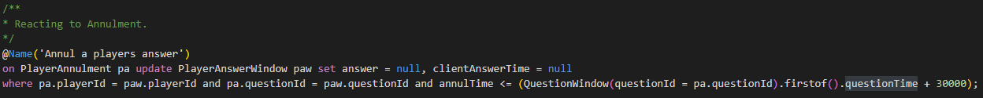
TriviaQuestion
PlayerAnswer
PlayerFARequest
PlayerAnnulment
UpdateScore
ChangeRule
N
FA
PlayerFAResponse
When a request for annulment arrives, we update the appropriate answer in the window
PlayerScoreWindow
PlayerAnswerWindow
PlayerFastestAnswerWindow
QuestionWindow
PlayerAnswerHistoryWindow
A
Q

Slide 45
TriviaQuestion
PlayerAnswer
PlayerFARequest
PlayerAnnulment
UpdateScore
ChangeRule
FA
PlayerFAResponse
PlayerScoreWindow
PlayerAnswerWindow
PlayerFastestAnswerWindow
QuestionWindow
PlayerAnswerHistoryWindow
A
Q

