Slide 1
Environmental impact assessment of the « Crédit d'Impôt pour la Transition Énergétique (CITE) »
CGDD/SEEIDD/MA
12/07/2018

Slide 2
Outline
Description and relevance of the CITE
Description of the model Res-IRF and evaluation method
Detailed results :
  Relevance and effectiveness of the CITE
  Cost distribution analysis
  Additional effect of the CITE
  Economic efficiency of the CITE
  Sensitivity analysis

Slide 3
Evaluation team and work process
Evaluation was carried out by the CGDD, in the Sustainable Development Management, Assessment and integration Department (SEEIDD), sub-directorate “Mobility and Planning” (MA)
Role of CGDD/MA within the French Administration :
  Carry out socio economic analysis of policy measures and provide insights on long term impacts of these policies
  CGDD is not in charge of implementing the CITE
Model used : The Res-IRF model co-developed with the CIRED (International Research Centre on Environment and Development)
  Contract between CDGG/MA and the CIRED to organize the work and upgrade the model
  Part of the contract : CGDD can use the model to carry out public policies analysis

Slide 4
Description and relevance of the CITE

Slide 5
Description of the CITE
An income tax credit (or direct funding if no income tax paid) for building energy retrofit expenditures → households receive the tax credit the year after completion of the dwelling’s renovation.
No income requirement but only for main home (construction > 2 years)
30 % of the amount of material expenditure (labor excluded) since September 2014.
  Capped at 16,000 euros for a couple, 8,000 euros for a single person plus 400 euros per dependent
Eligible equipments : Replacement of heating systems, insulation (walls, floor, ceiling, roof, windows, doors), renewable energy, etc.
Technical requirements :
  Eligible equipment and materials must meet minimum technical criteria regarding energy efficiency (in absolute level and more ambitious than the average efficiency of materials sold on the market)
  The companies carrying out the renovation work must comply with a label (« RGE label »)

Slide 6
Description of the CITE
2016 expenditure breakdown
Eligible investments and equipments :
  Replacement of heating systems and heating control systems → 11 %
  Insulation (walls, floor, ceiling, roof, windows, doors) → 73 %
  Renewable energy production equipment (hot water production, heat pump, eletricity supply) → 16 %
Budgetary cost :
Renovation year (model year) | 2015 | 2016
Observed public budgetary cost year | 2016 | 2017
Observed public budgetary cost (billion euros) | 1.67 | 1.68

Slide 7
The CITE is relevant with respect to the French government’s objectives regarding energy efficiency and greenhouse gas emissions
Housing sector in France : 30 % (485 TWh of which 2/3 for heating) of total energy consumption and 15% of GHG emissions (49 MtCO₂)
Very ambitious general objectives:
  GHG : in july 2017, the “Plan Climat” targets carbon neutrality for the whole economy in 2050
  Energy consumption: the LTECV (Energy transition and green growth act) sets final energy consumption targets: - 20% by 2030 and - 50% by 2050 (all sectors)
The building sector is expected to be one of the main contributors:
  Renovation of 500 000 homes per year (LTECV)
  Fade out of the most energy-intensive housing by 2025 (>330 kWh/m²) (LTECV)
  Entire housing stock with a consumption of less than 80 kWh/m² in 2050 ("low energy consumption building" ) (LTECV)

Slide 8
Description of the Res-IRF model and evaluation method

Slide 9
Why do we use a simulation model?
A direct approach would consist in assessing energy saving (and CO2) for each eligible equipment installed in 2015 and 2016 (bottom-up approach)
To measure energy savings, information on consumption before and after renovation is required.
No database currently gathers all the information :
  Treasury data on household expenditures : no information about energy consumption before and after the completion of the work
  Phebus survey on housing performance: no information on energy consumption before the renovation
We therefore adopted a modeling approach, allowing us to convert renovation expenditures in energy savings and to simulate how households react to the CITE
  More “macro” approach: based on a description of the building stock energy performance. No description at the level of each eligible equipment: only “jumps” in energy consumption are modeled.
Mwh/year
Energy savings
Before renovation
After

Slide 10
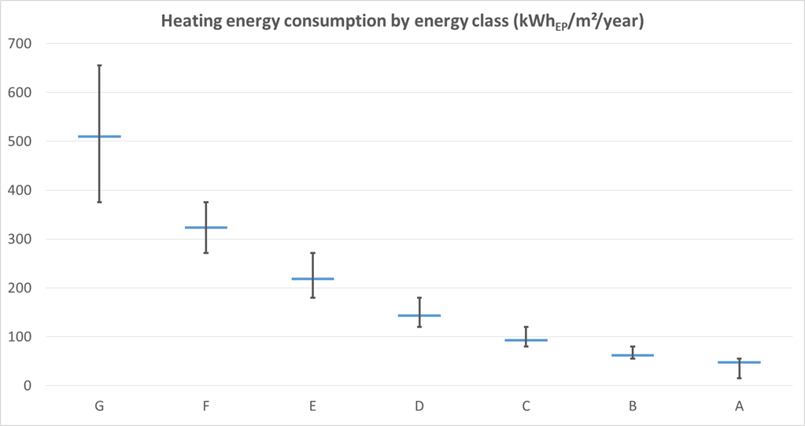
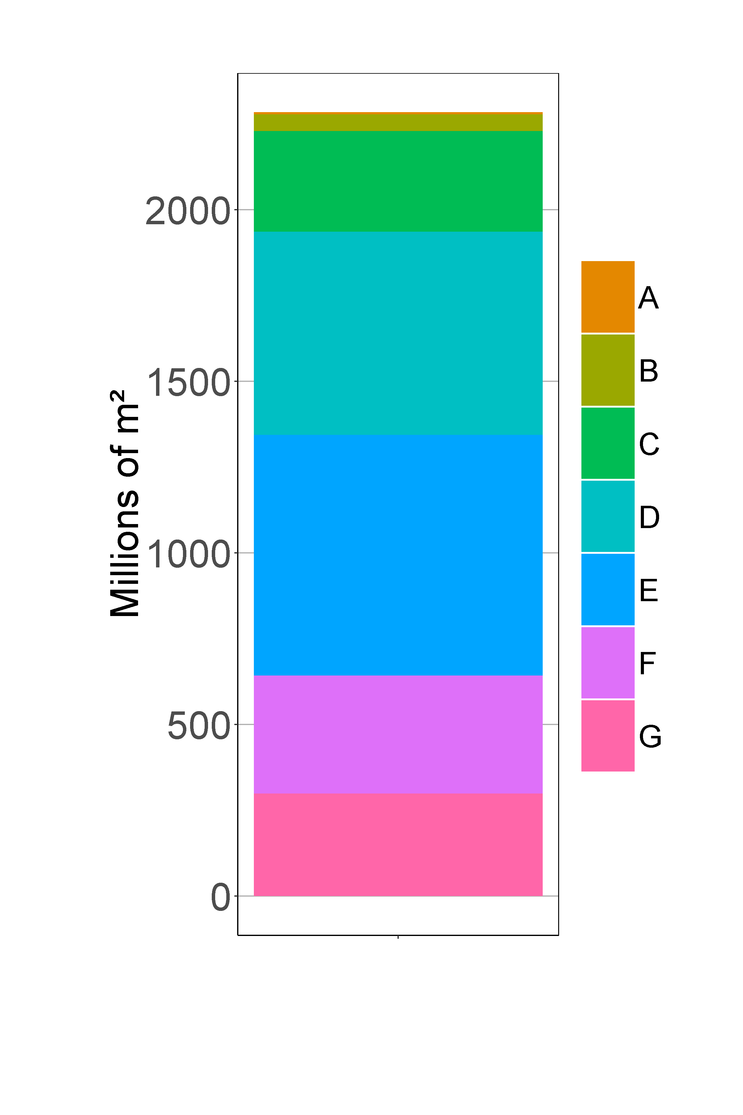
Description of the Res-IRF model : initial state of the housing stock
  Res-IRF model is based on a description of the energy performance of the housing stock
  In France, the DPE (energy performance diagnosis) is used to assess the energy efficiency of dwellings
  7 energy classes defined by a range of consumption
Initial housing stock by energy performance class in 2012 (Phébus survey)
  Energy class only gives theoretical energy performance which differs from actual consumption

Slide 11
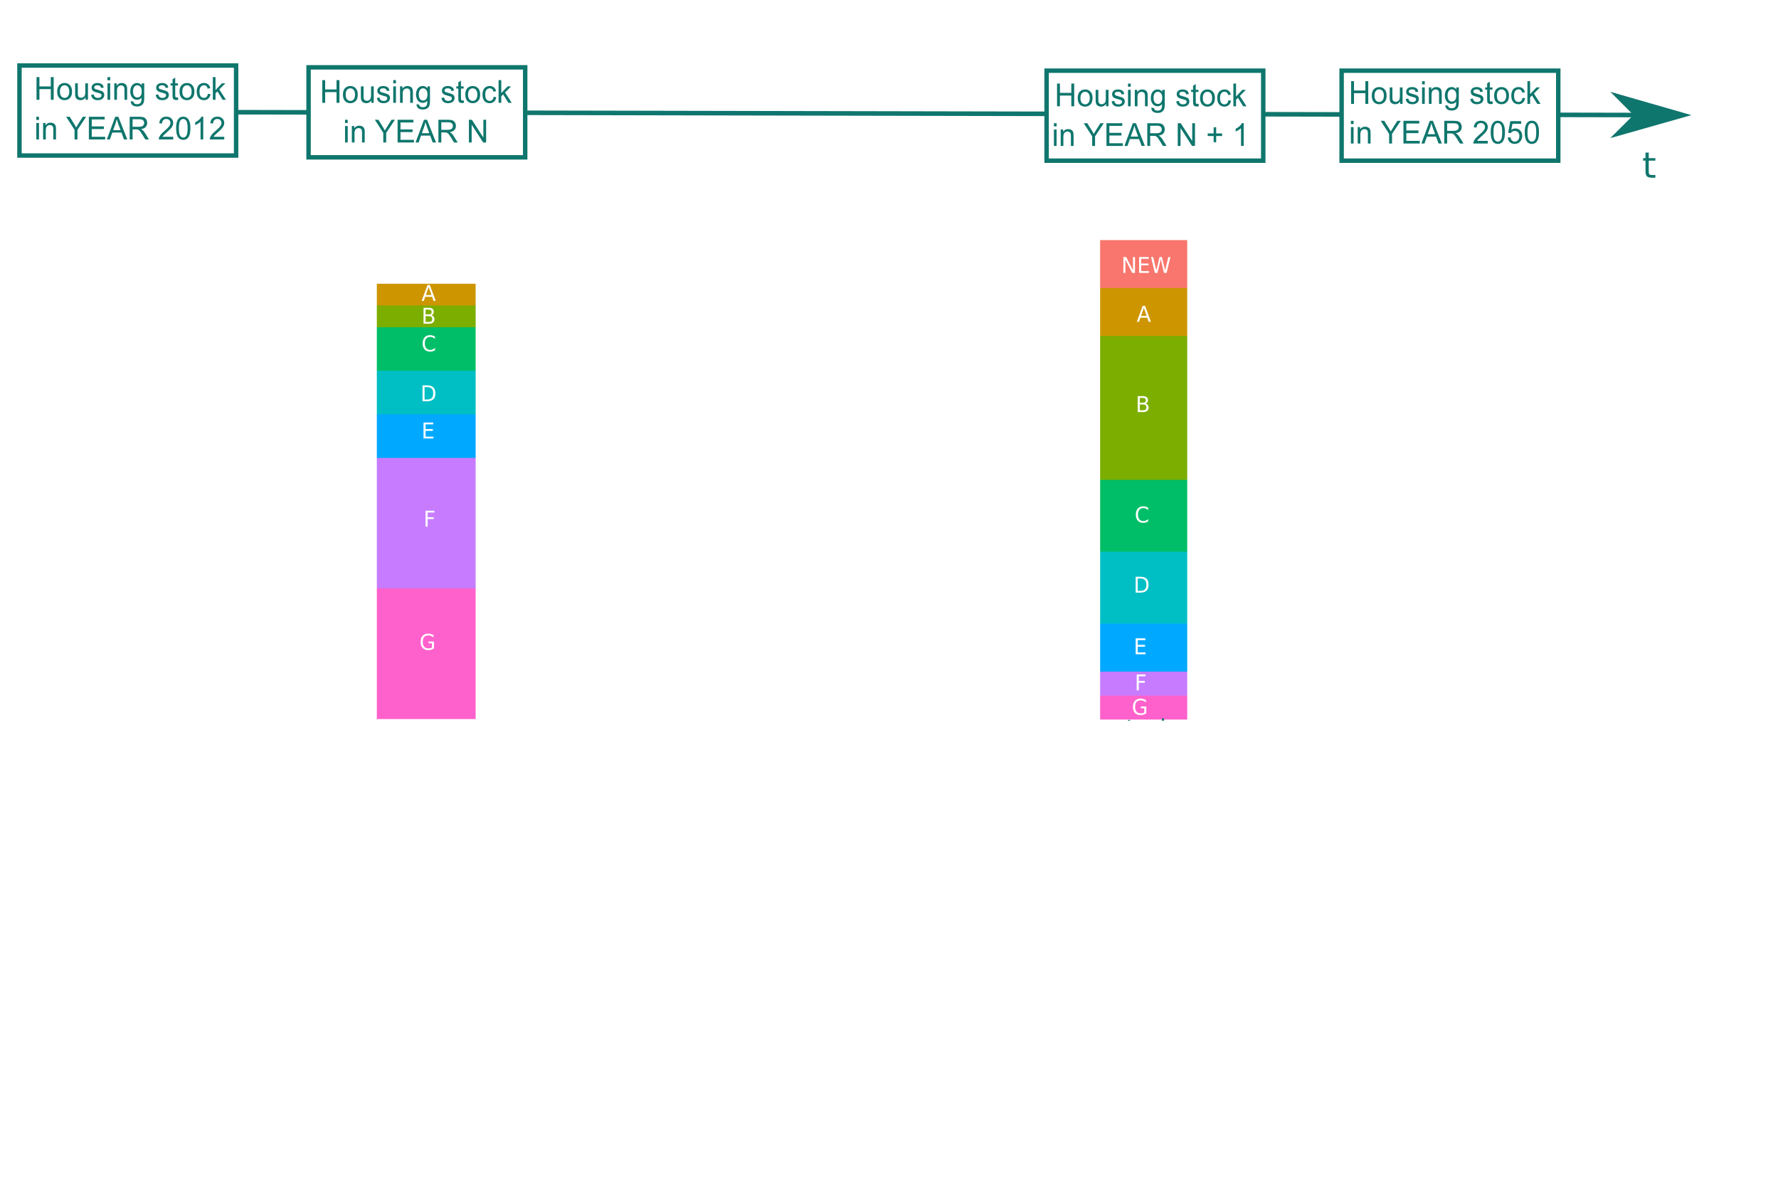
Description of the Res-IRF model : Housing stock dynamics

Slide 12
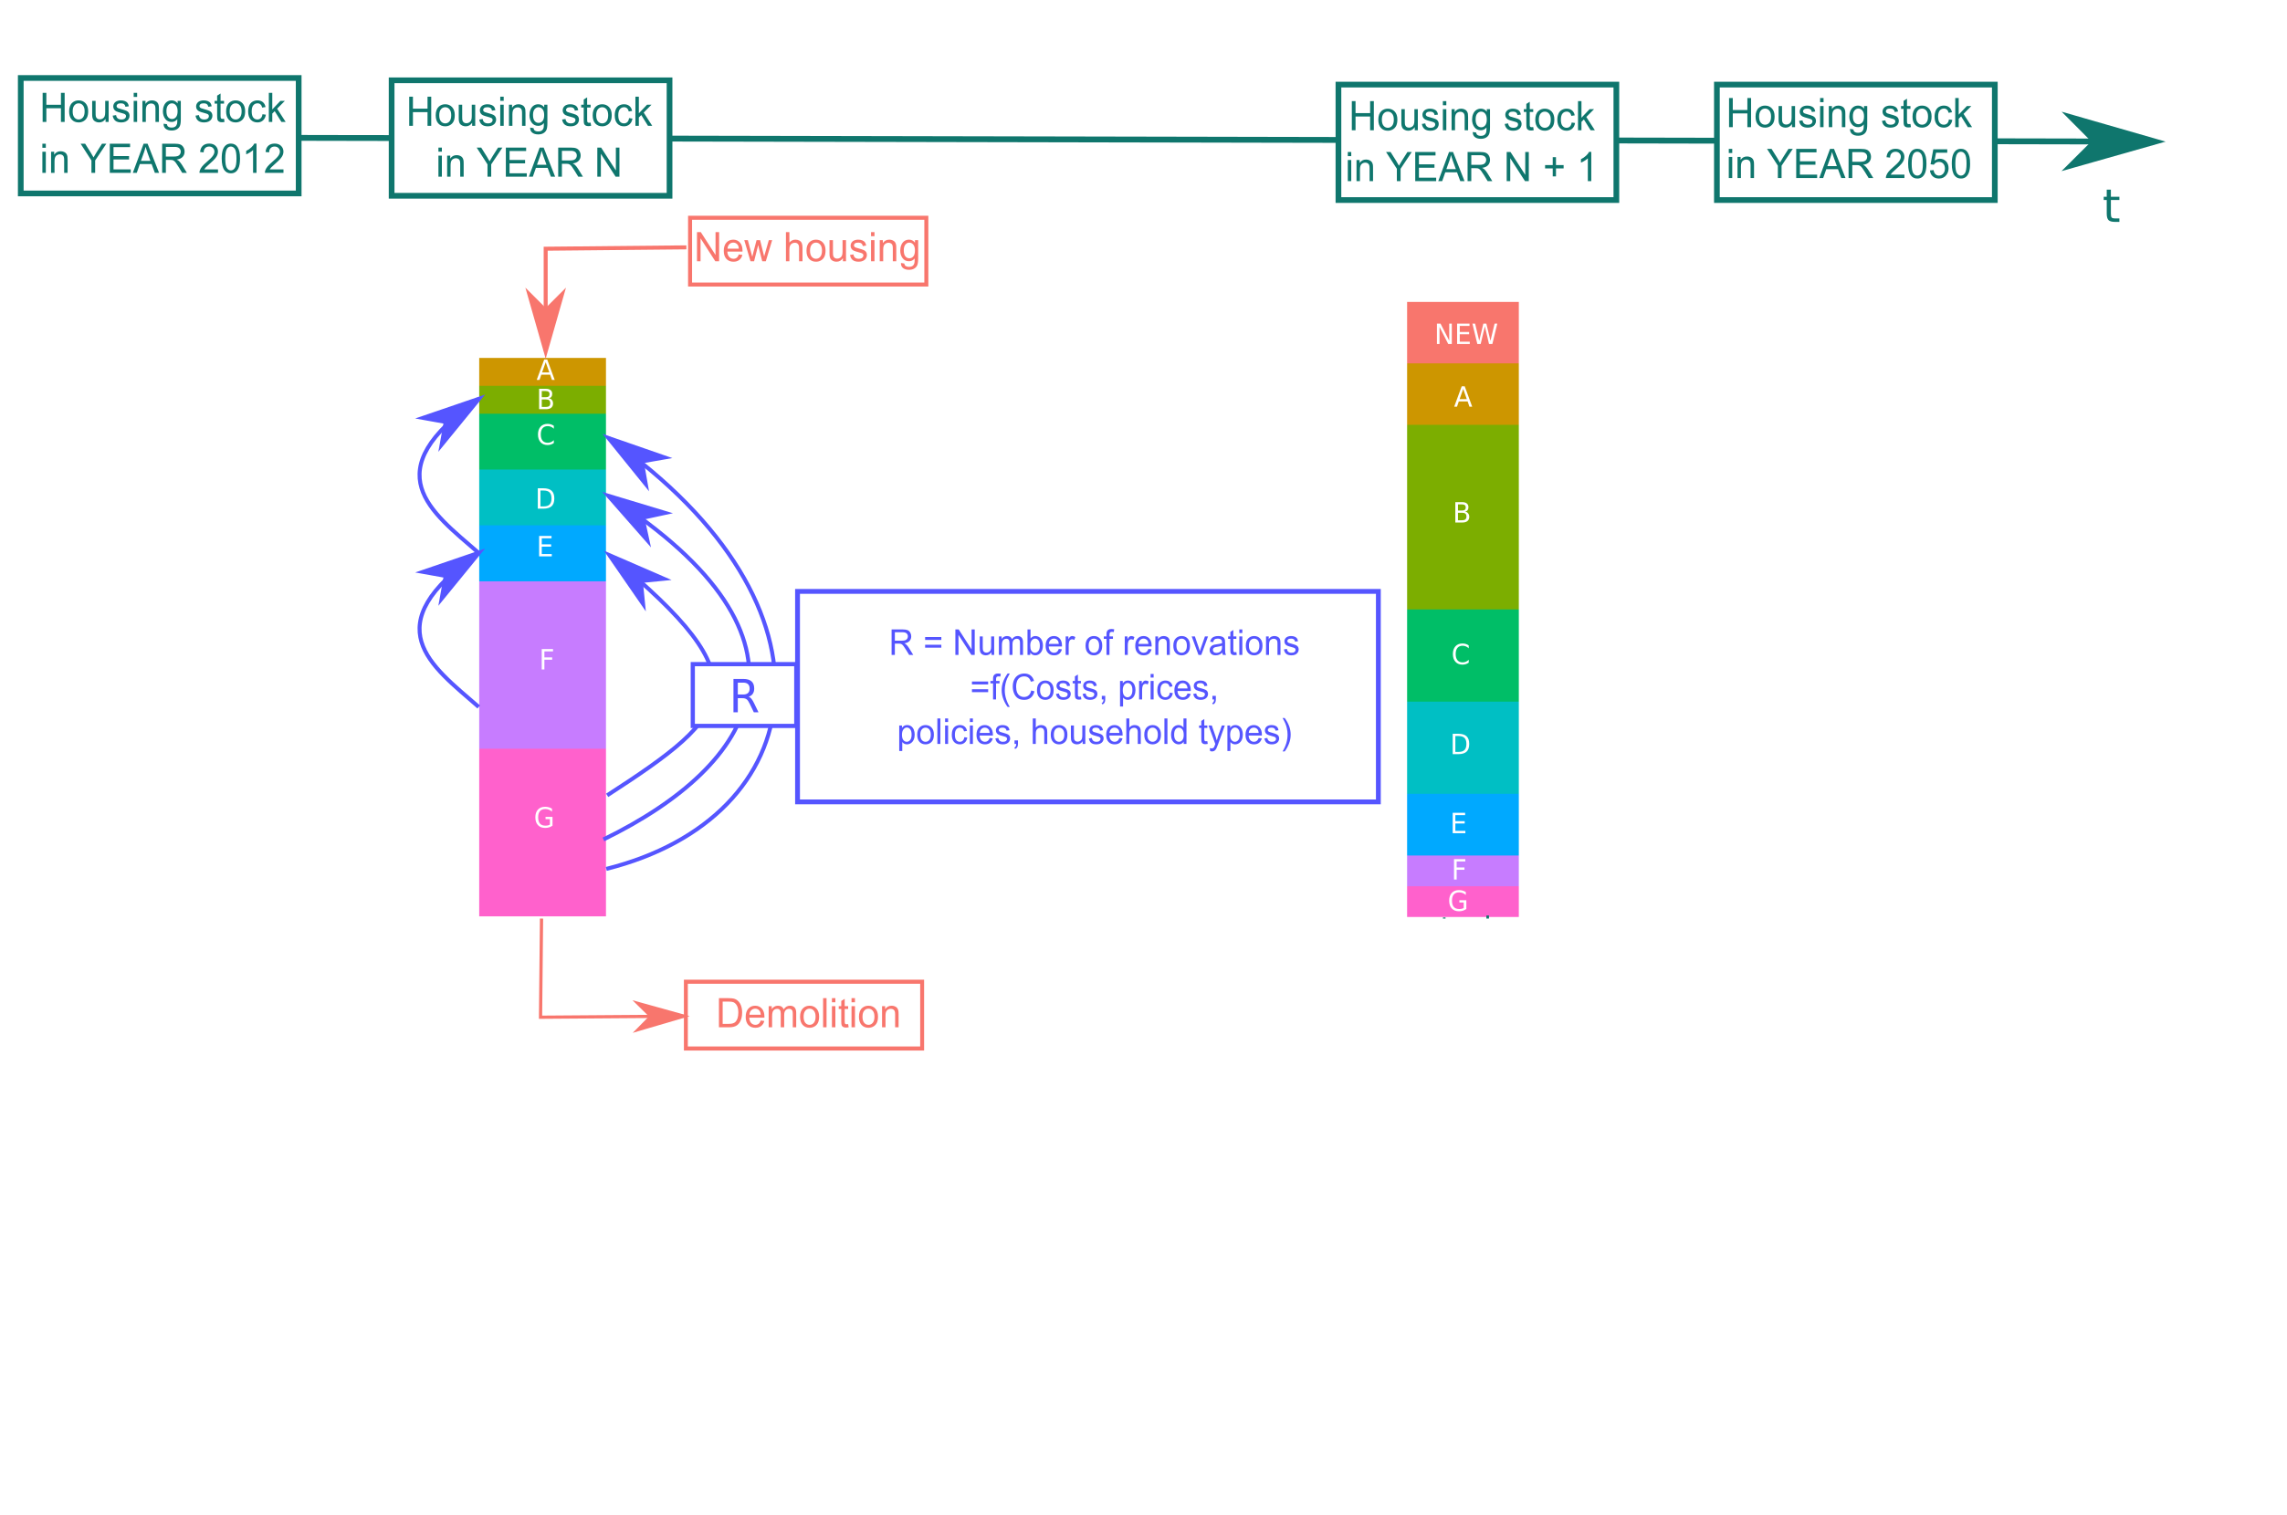
Description of the Res-IRF model : Housing stock dynamics

Slide 13
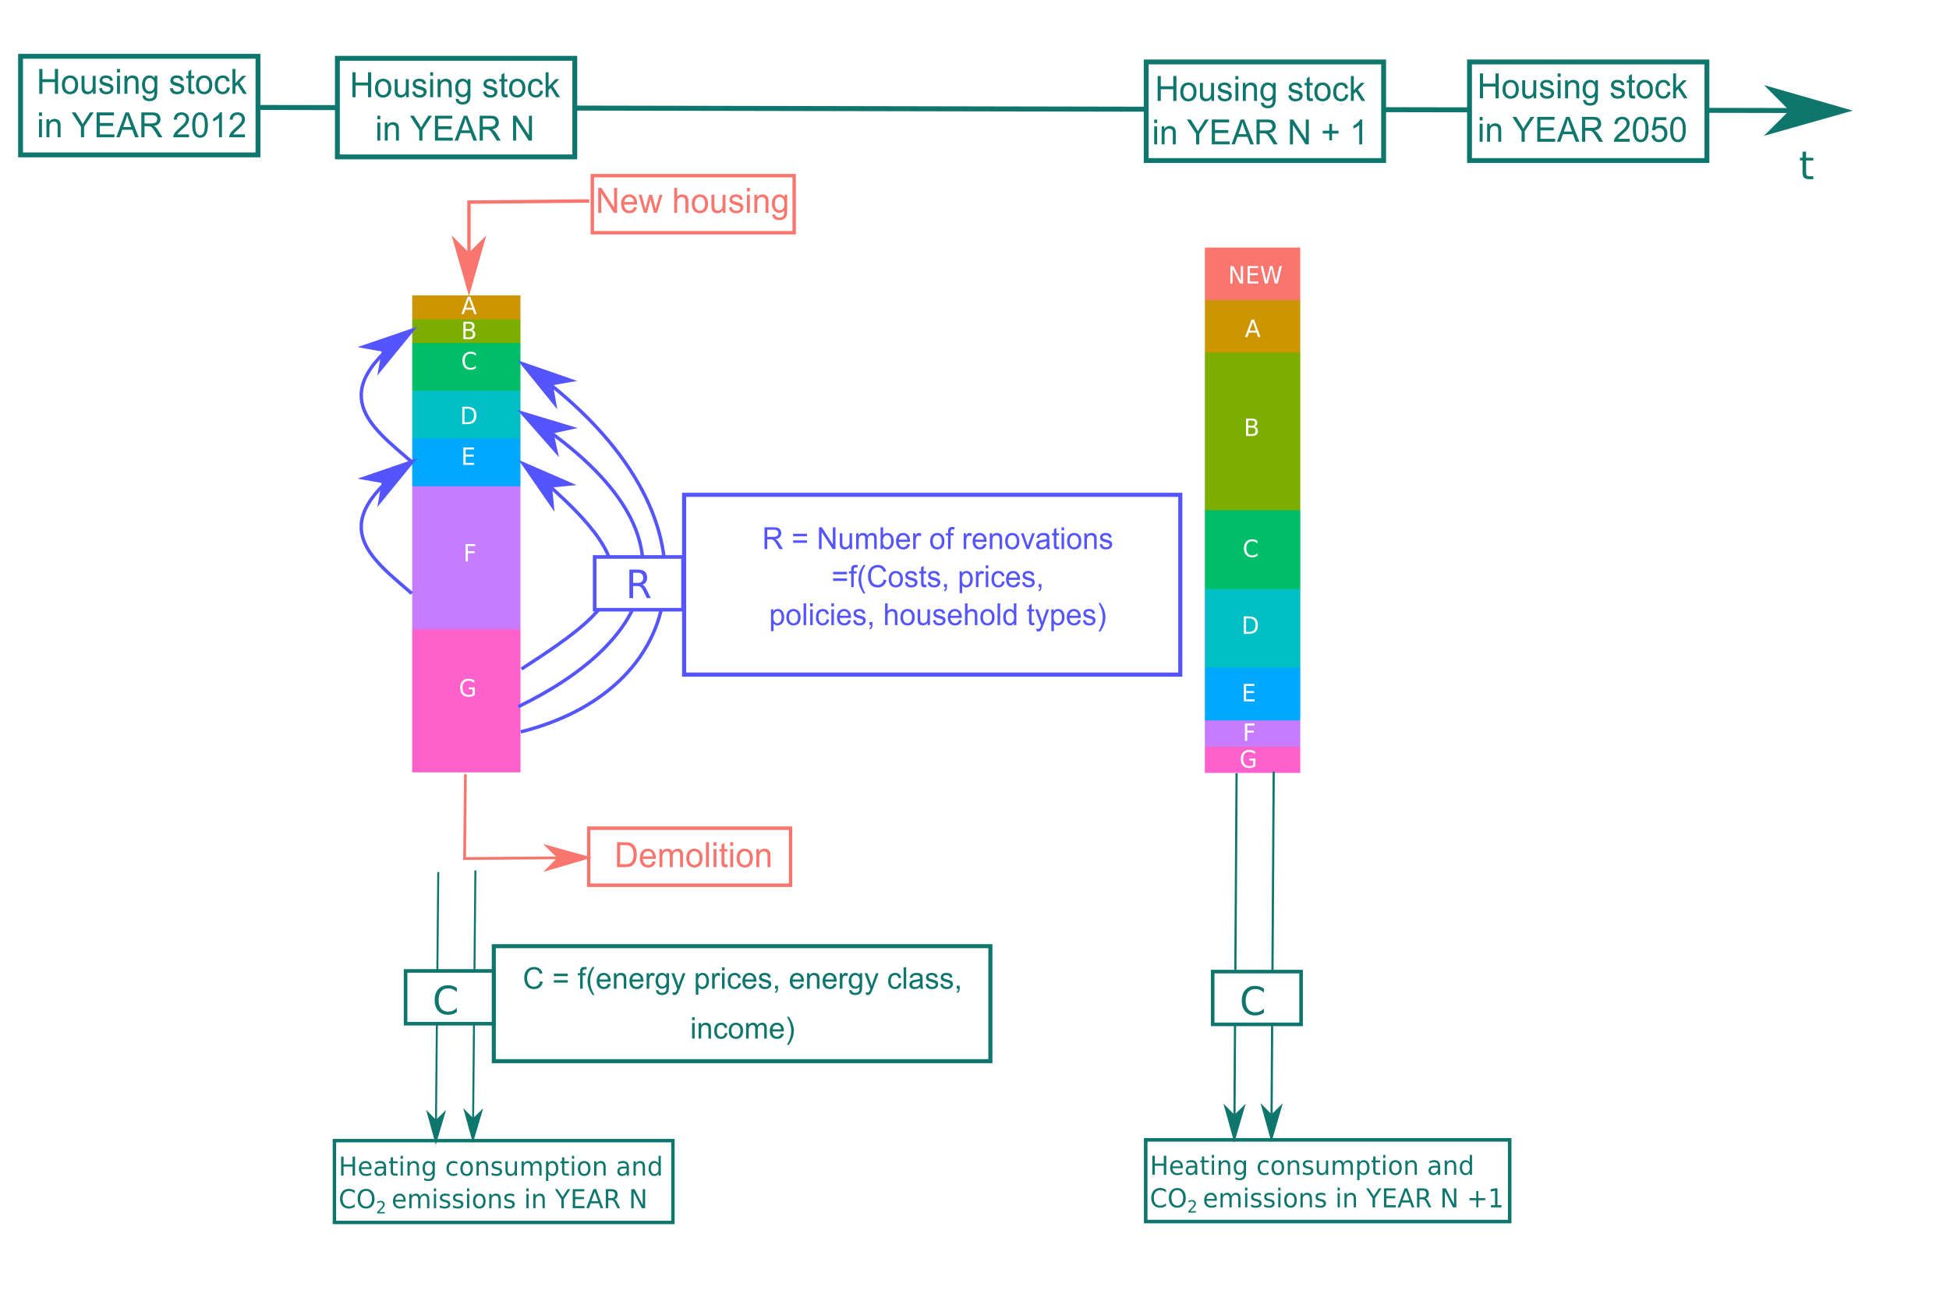
Description of the Res-IRF model : Housing stock dynamics

Slide 14
Description of the Res-IRF model : calibration and other key assumptions
Several data sources are used to calibrate the model (functions R and C):
  Total actual heating consumption per energy source are calibrated with statistical data from CEREN in 2012
  Retrofitting investment costs are in line with the French survey called “Observatoire permanent de l'amélioration énergétique du logement” (OPEN), average = 112 euros per m²
  Renovation level calibrated on observed renovation rates (OPEN survey, USH, PUCA...)
  CITE subsidy rate calibrated on observed budgetary cost of the CITE (DGEC)
  Major public policies on housing in 2012 (carbon tax, subsidies, low rate loans, low VAT, CEE...)
Other assumptions :
  Energy prices scenarios used in French public policies assessments
  Fixed CO₂ emission factors by energy (for the calculation of emission reductions)
  Technical progress : reduced renovation costs as the housing stock is renovated

Slide 15
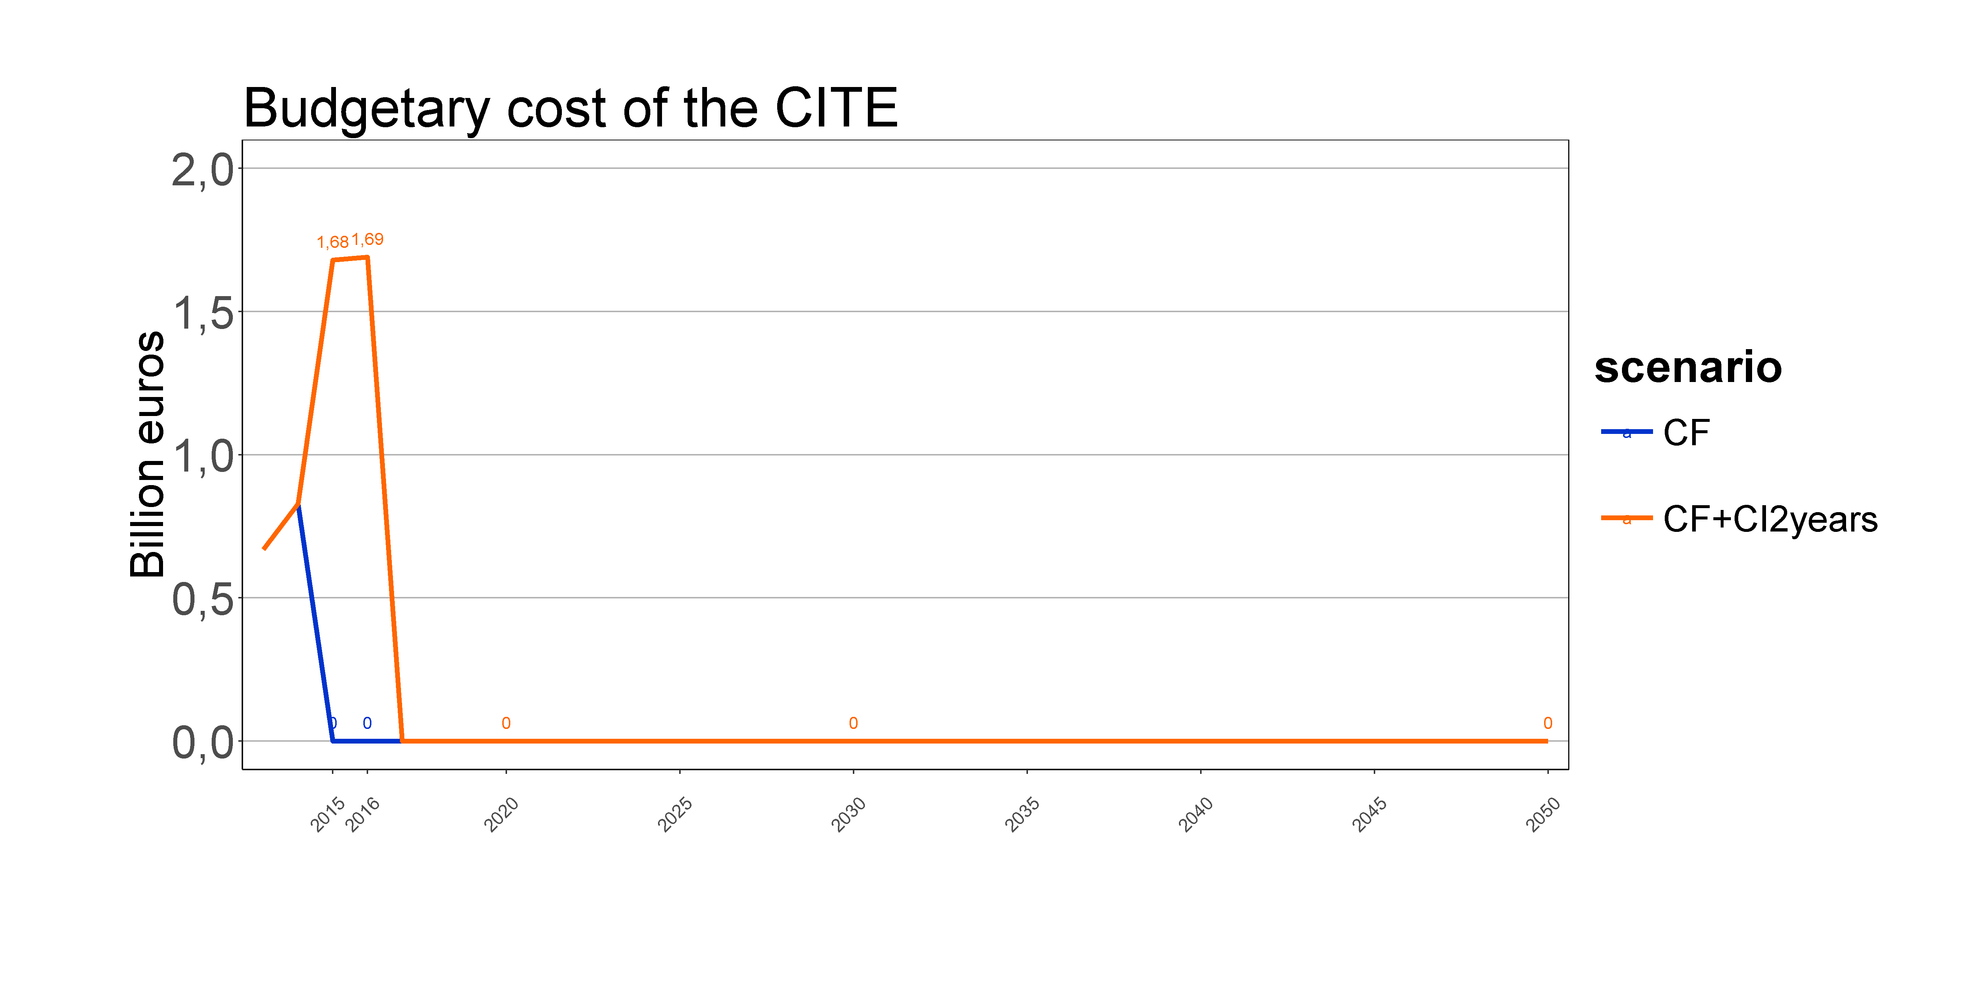
Description of the Res-IRF model : scenarios
Evaluation method “spot CITE” : 2 simulations are compared
  Counterfactual “CF” scenario : No CITE from 2015 until 2050
  Test scenario “CF + CI2years” :
  CITE in place only in 2015 and 2016
Two types of impact of the CITE are simulated
  Short run effects in 2015 and 2016 on investment level, retrofit rate, consumption...
  Long run effects because :
    Energy savings last several decades
    The building stock is modified in 2015 and 2016 which influences the future renovation decision

Slide 16
Advantages and drawbacks of the model approach
Advantages
Dynamic: long run effects (until 2050) are properly integrated
Behavioural module (R): enables to determine the additional effect of the CITE by comparing investments decisions with and without it (not possible in bottom up approach)
Actual energy consumptions are quite different from theoretical energy performance : this issue is addressed by the model (C). Benefits evaluation is conservative.
Drawbacks
“Macro” approach: cannot evaluate each type of investment eligible to he CITE, but only an “average effect” of all of them.
Doesn’t take into account “intra” energy classes performance improvement
Relies on many assumptions : results must be taken with caution even if calibration is informed by several observed data
Doesn’t take into account other externalities such as air pollution
          CAVEAT
The results must be taken as order of magnitude
Conservative approach: probably under-estimates actual benefits of the CITE and its efficiency

Slide 17
Detailed results

Slide 18
Relevance and effectiveness of the CITE:

Slide 19
Impact on energy consumption and CO₂ emissions
Annual differences in emission and consumption between the two scenarios
 | 2015 | 2016 | 2020 | 2030 | 2050 | Total 2015-2050
Emissions (MtCO₂ ) | -0.13 | -0.24 | -0.17 | -0.08 | -0.02 | -2.90
Energy consumption (Twh) | -0.89 | -1.76 | -1.59 | -1.29 | -0.80 | -43.10
Decrease of 0.3 % of heating energy consumption and 0.3 % of CO₂ emissions of the housing sector in 2015 and 2016
Effects last on the long run until 2050

Slide 20
Cost distribution analysis:

Slide 21
Impact on State finances
Direct cost for the State is the cost of the CITE tax credit : 1.7 billion euros per year in 2016 and 2017
Indirect costs for other policies :
  Eco-PTZ : Greater number of low rate loans because they are cumulative with the CITE
  Taxes : lower taxes revenues because less consumption and less emissions with the CITE
  Indirect positive effects on VAT revenues due to increased net income of households
These effects are neglected

Slide 22
Impact on households investment and energy savings
Additional investment and energy bill savings
 | 2015 | 2016 | 2020 | 2030 | 2050
Investments (G€) | 1.71 | 1.69 | -0.07 | -0.07 | -0.04
Energy bill savings (G€) | 0.06 | 0.12 | 0.12 | 0.10 | 0.07
Short run effect : Investments increase by 16% (2015 and 2016)
This renovation acceleration during two years is followed, when the support scheme is removed, by a period with a slightly lower renovation rate and less investment in renovation works
Indeed, the building stock is more efficient at the end of 2016: less renovation opportunities remain.

Slide 23
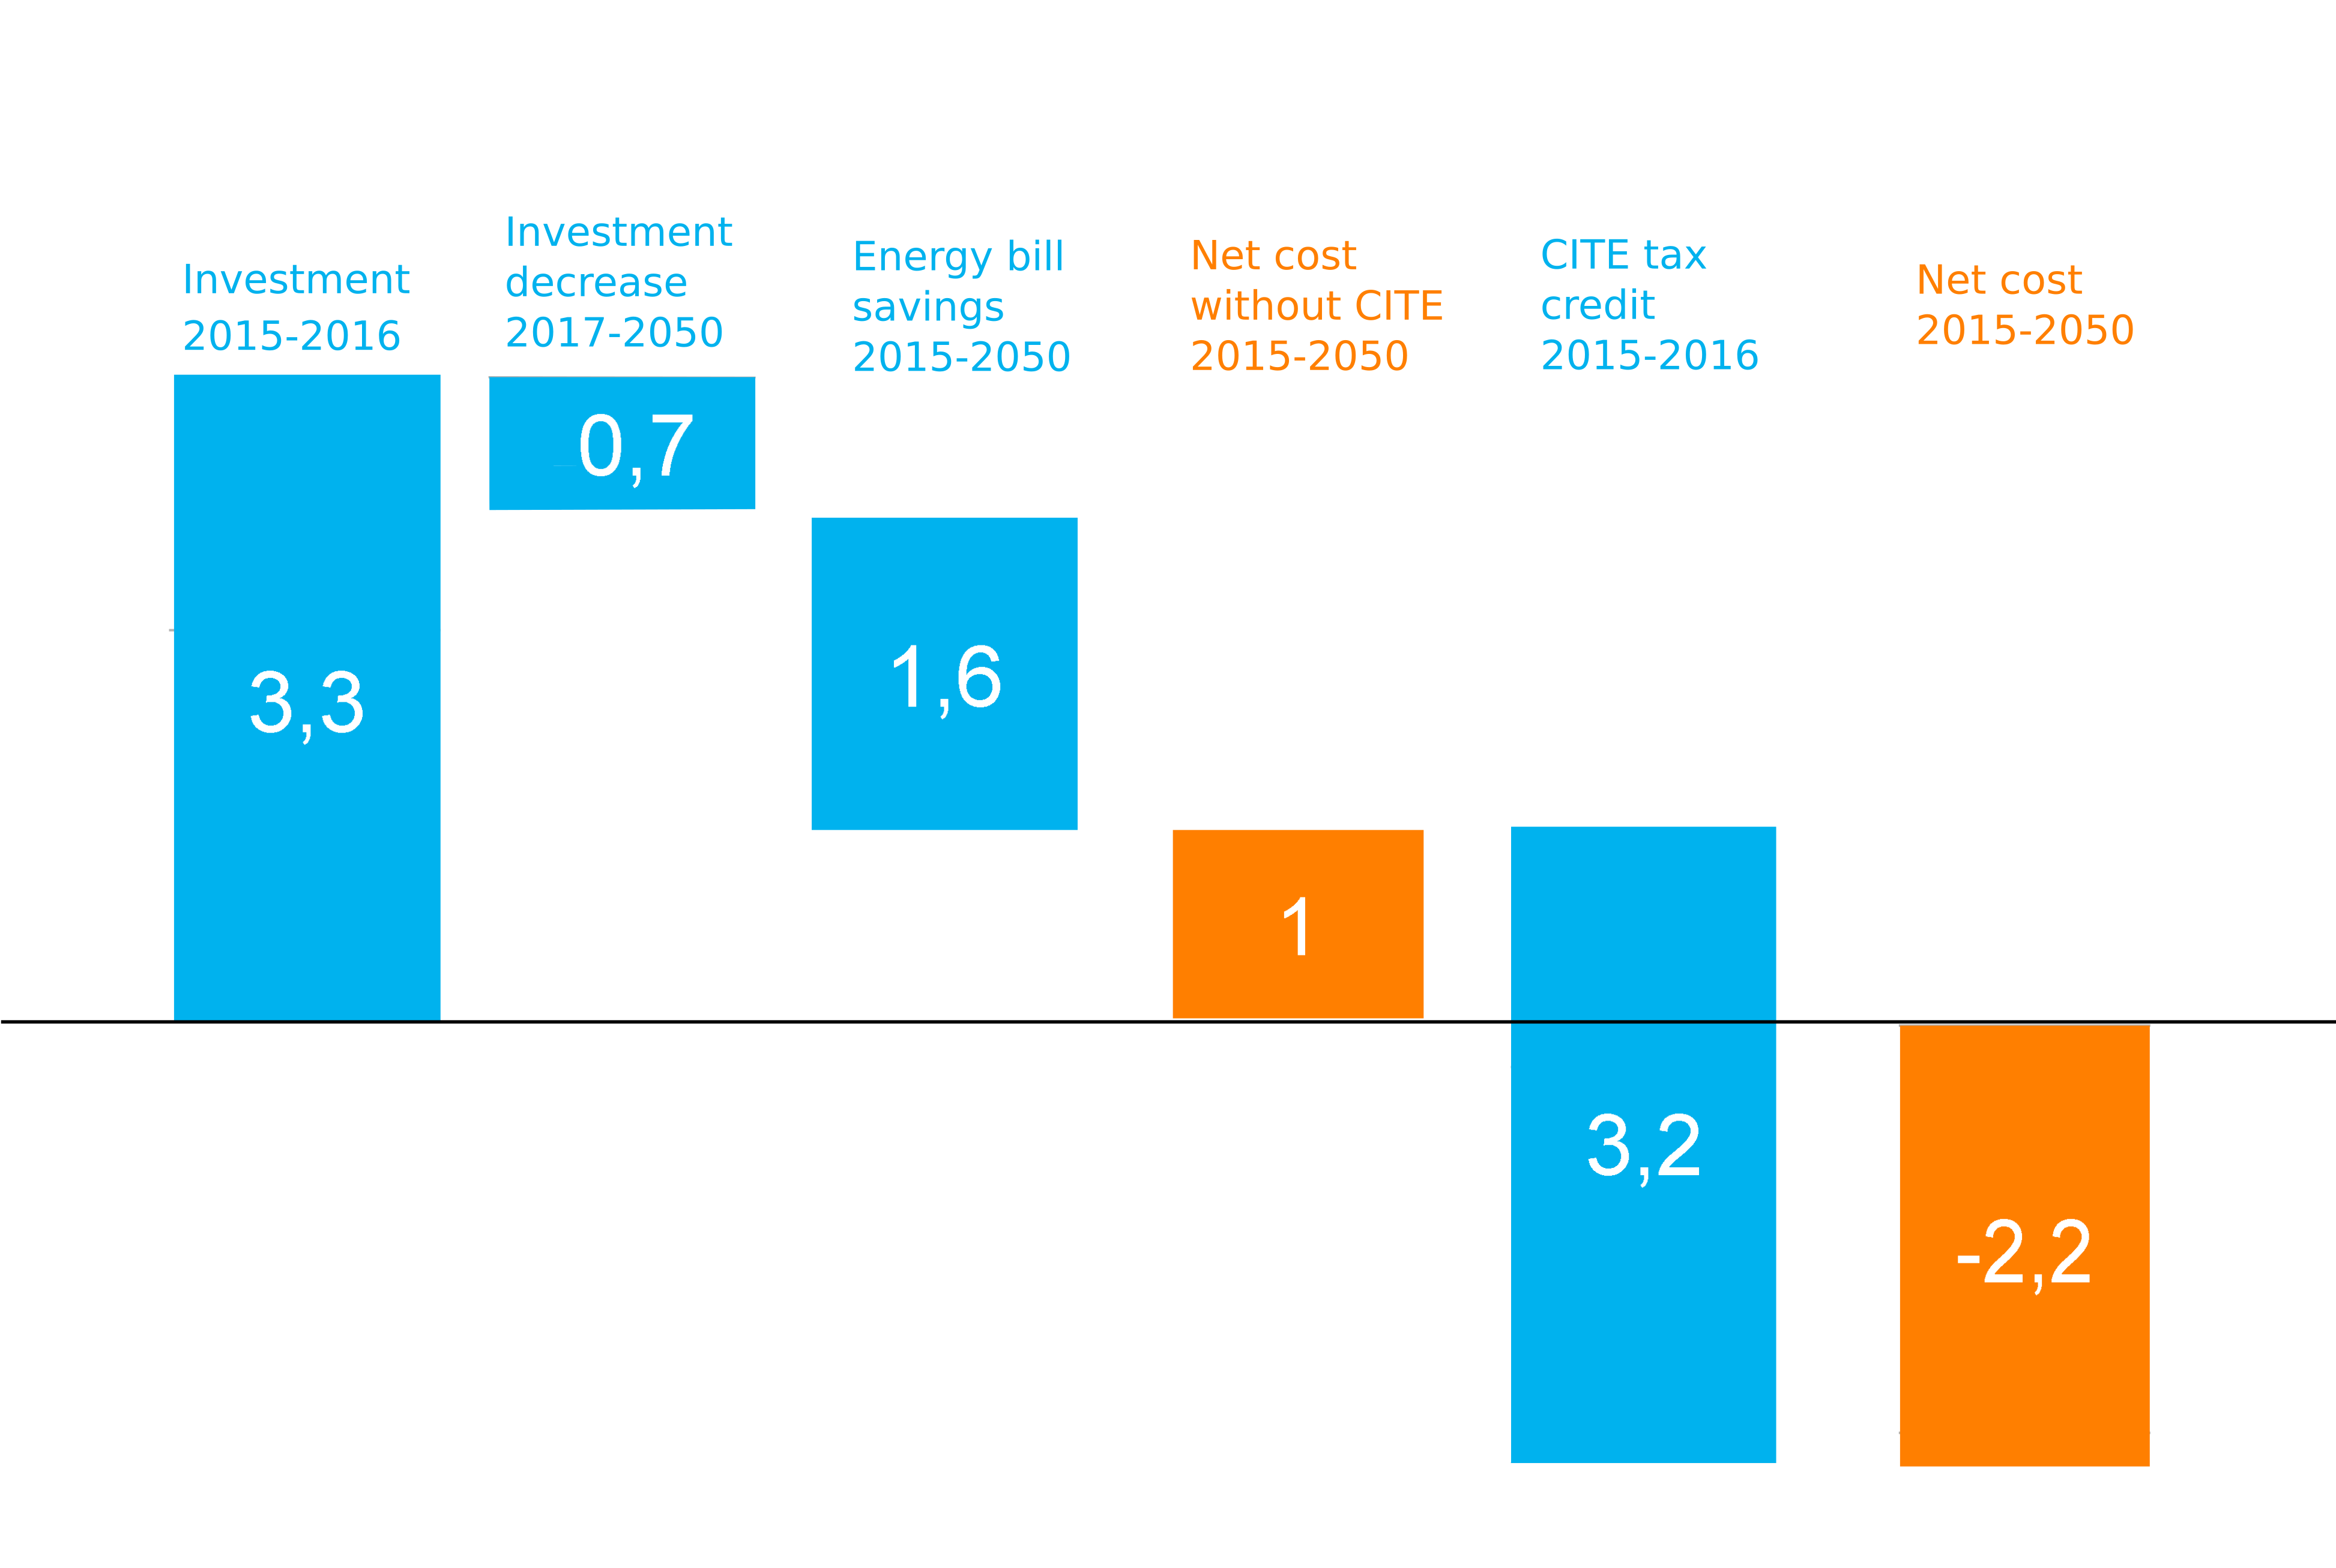
Impact on households: net effect
Net costs of the CITE for households over the 2015-2050 period (billion €)
Cumulative investments, energy savings and tax credit over 2015-2050 discounted at 7 %
Net cost for households without the CITE = 1 billion euros
  not profitable without CITE tax credit (3.2 billion euros)
Net cost with CITE = -2.2 billion euros
-
-
-
=
-
=

Slide 24
Additional effect:

Slide 25
Additional number of renovations and investment
 | 2015 | 2016 | 2020 | 2030 | 2050 | Total 2015-2050
Number of renovations | 75 000 | 76 000 | -1 000 | -2 000 | -3 000 | 97 000
Investment (G€) | 1.71 | 1.69 | -0.07 | -0.07 | -0.04
Increase of about 11 % of total number of renovations in 2016
Less renovations after 2016 because less potential number of profitable renovations remaining after two years with a high retrofit rate

Slide 26
Level of performance of renovations with and without the scheme
Two additional effects in 2016 :
  + 11 % of total number of renovation
  + 16 % of total investment
The more ambitious the renovations are the more costly they are.
→ It implies that renovations are, on average, more ambitious with the CITE than those done without the CITE

Slide 27
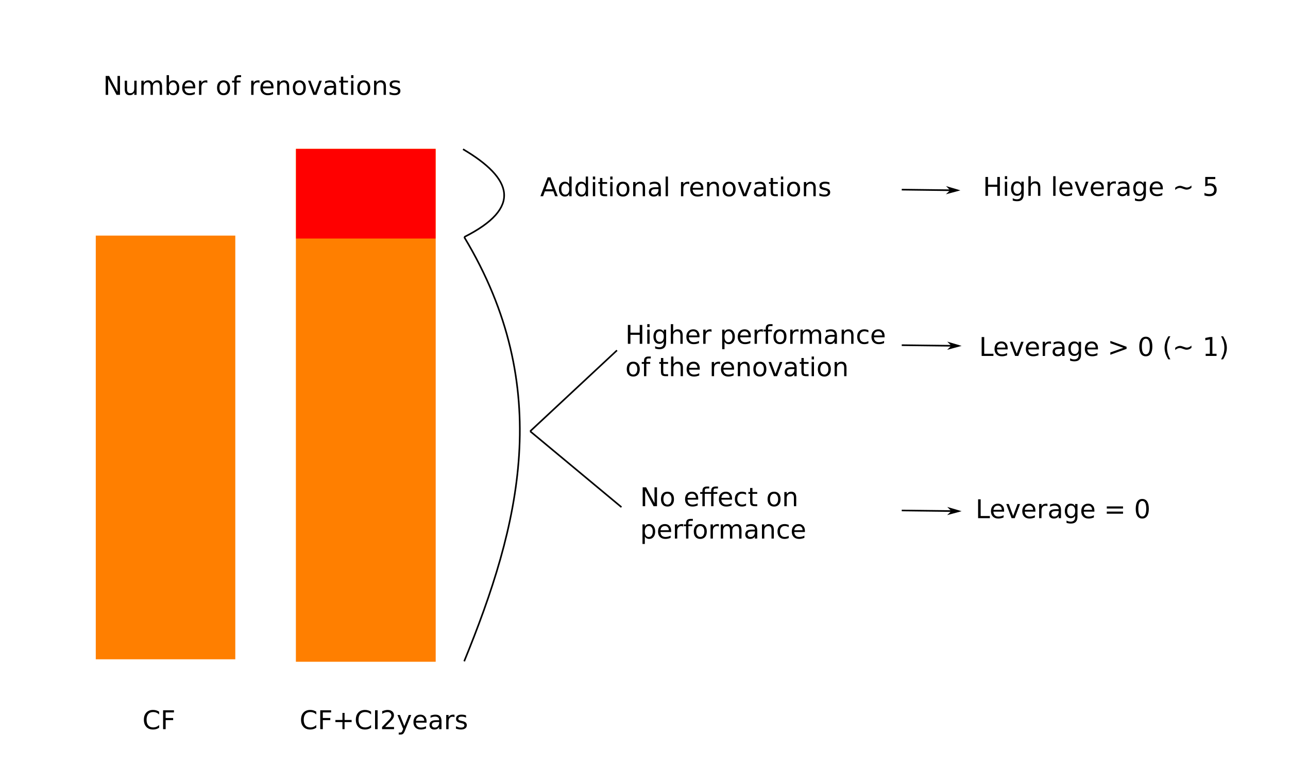
Leverage effect of the CITE
Additional investment in renovation operations year n
“leverage effect” =
CITE tax credit year n
scenario | 2015 | 2016
CF+CI2years | 1.04 | 1.02
All households receive the CITE including those who would have performed a renovation in the counterfactual scenario

Slide 28
Impact on the energy efficiency of the housing stock
Average heating energy consumption per m² by scenario
scenario | 2015 | 2016 | 2020 | 2030 | 2050
CF | 157.9 | 152.0 | 129.3 | 89.6 | 53.6
CF+CI2years | 157.3 | 150.7 | 128.3 | 89.0 | 53.3
Differences in the dwellings numbers by energy class between the CF + CI2years scenario and the CF scenario in 2016

Slide 29
Economic efficiency of the CITE:

Slide 30
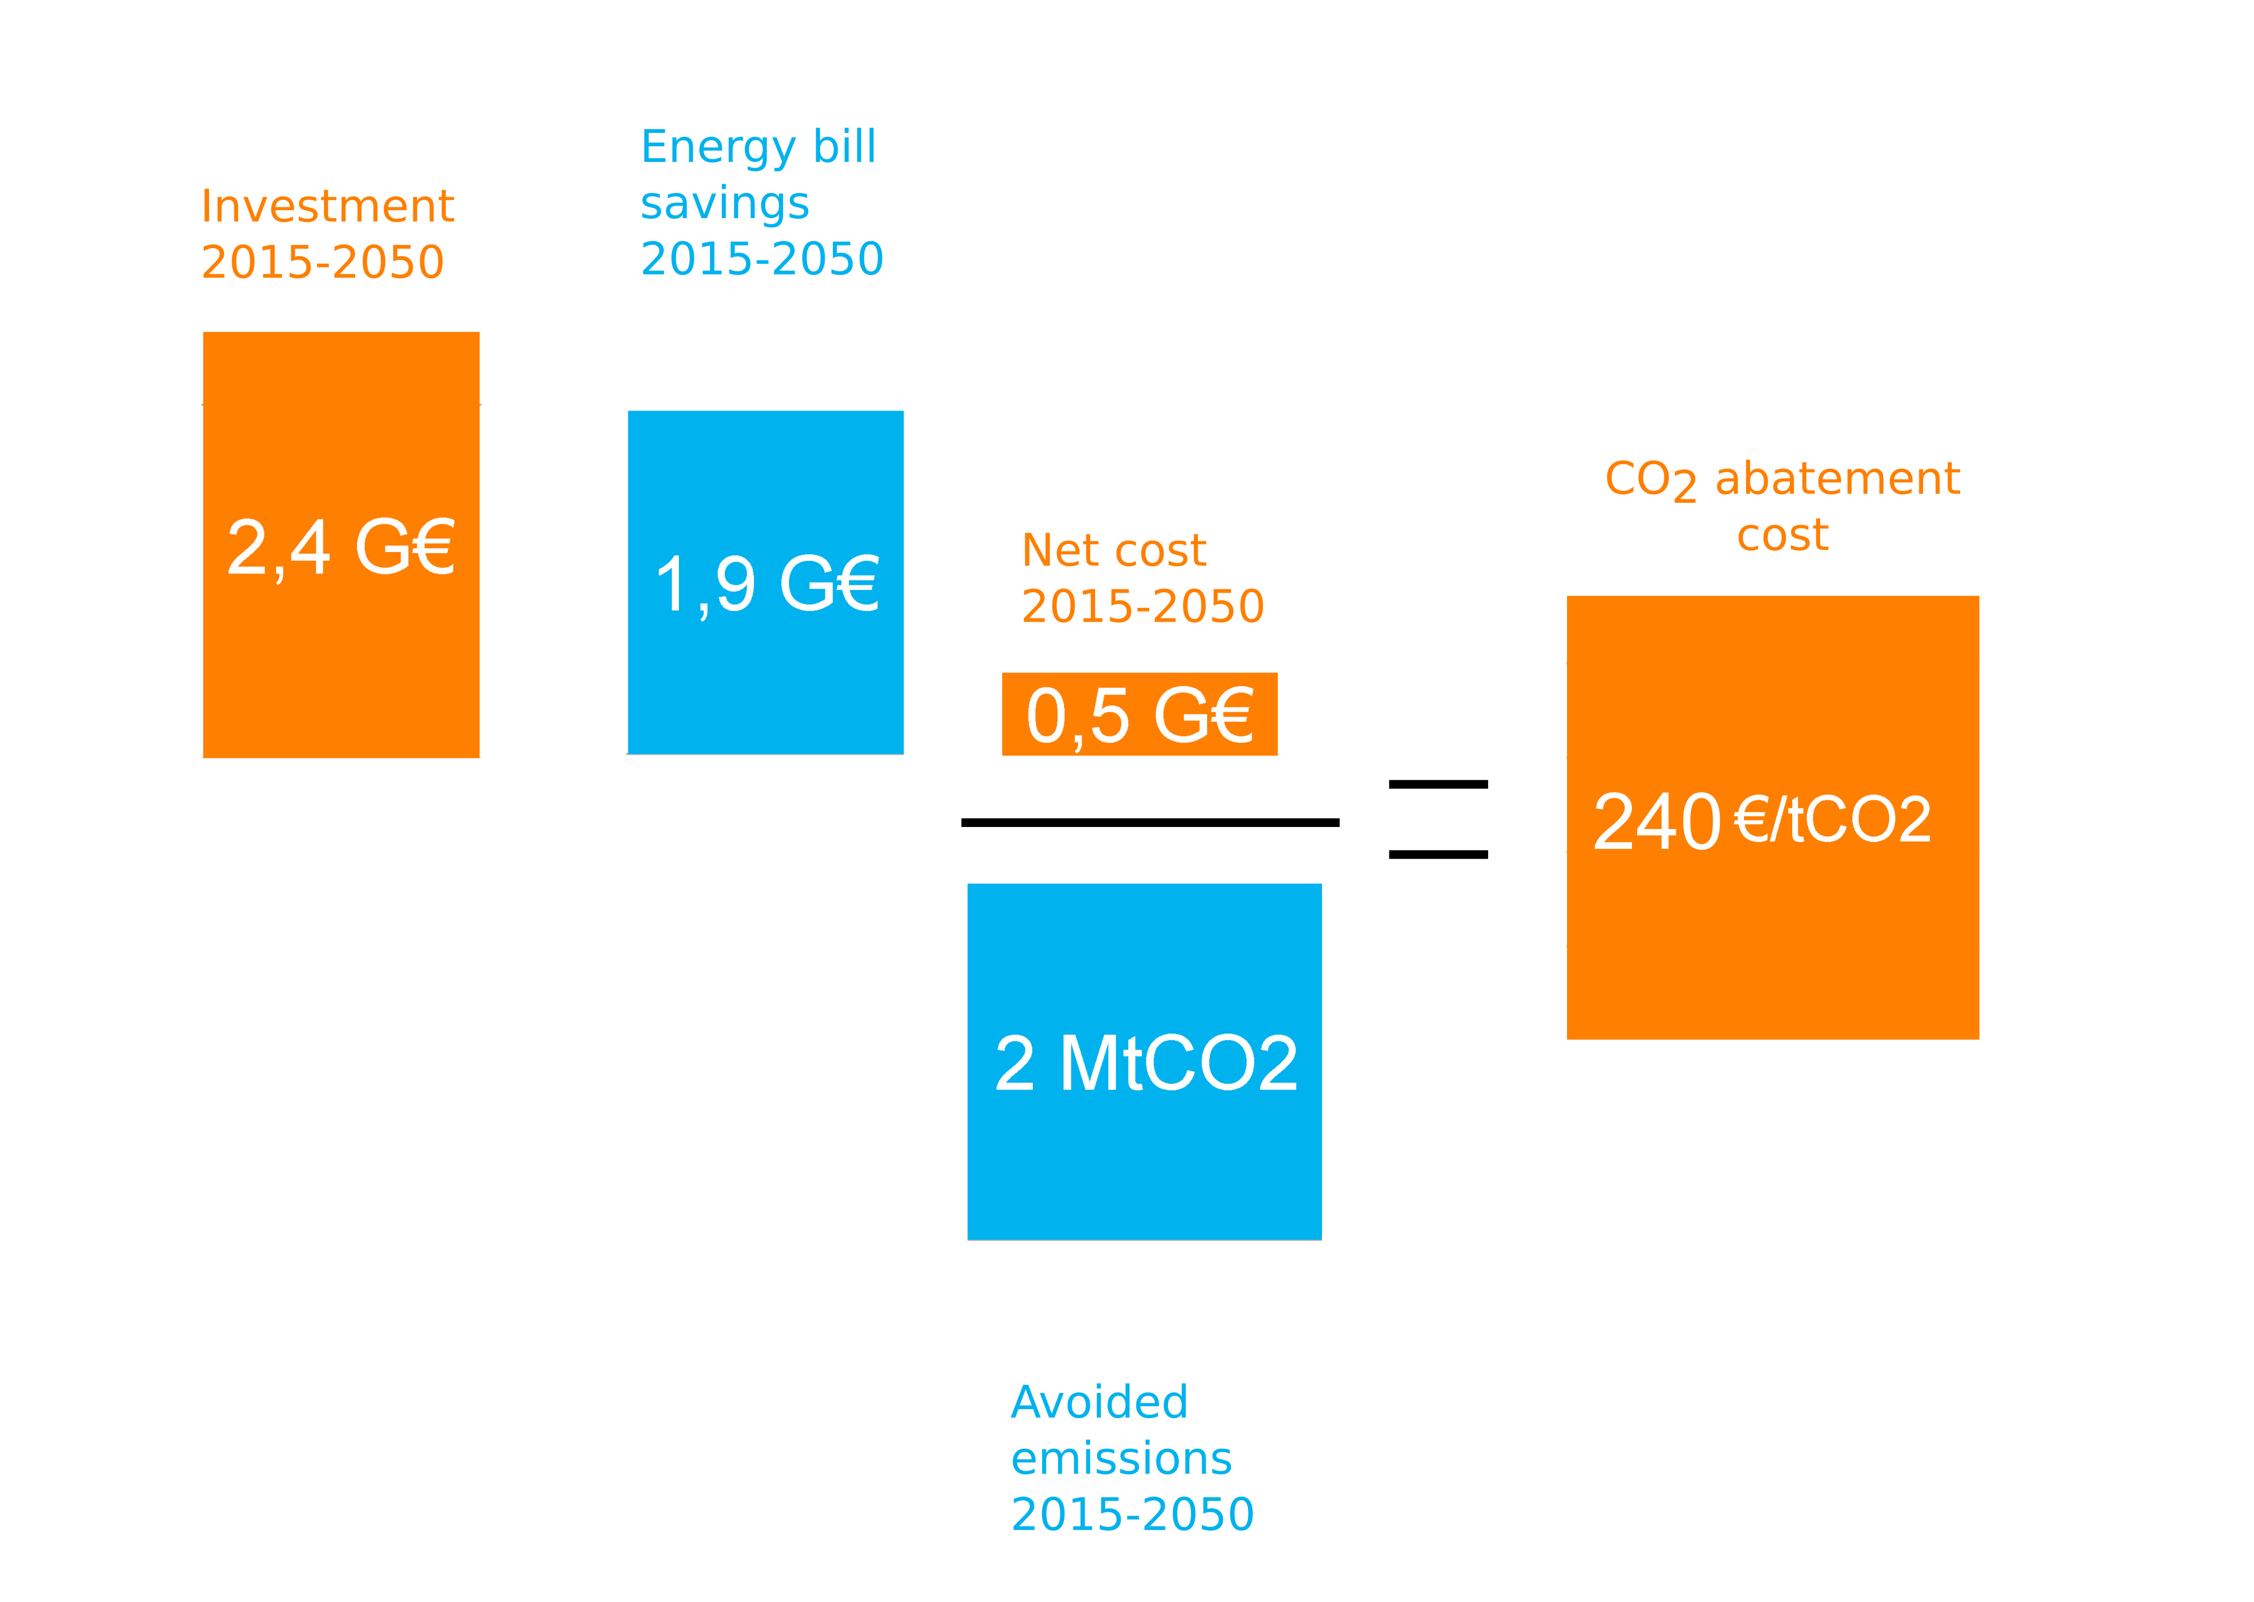
Socioeconomic elements on the CITE 2015-2016 (3.3 G€) over the 2015-2050 period
Socioeconomic methodology : Transfers between agents are not taken into account (taxes, CITE...)
Cumulative investments, energy bill savings and emissions over 2015-2050 discounted at 4.5 %
With this definition, abatement cost per ton of CO₂ avoided = constant price of CO₂ needed to make these investments profitable over 2015-2050
Abatement cost probably over estimated : (i) CO₂ emissions are discounted and probably underestimated (rebound effect), (ii) other externalities benefit not taken into account.
-
(discounted)

Slide 31
Sensitivity analysis:

Slide 32
Sensitivity analysis :
reminder of previous results
-
=
=
(discounted)

Slide 33
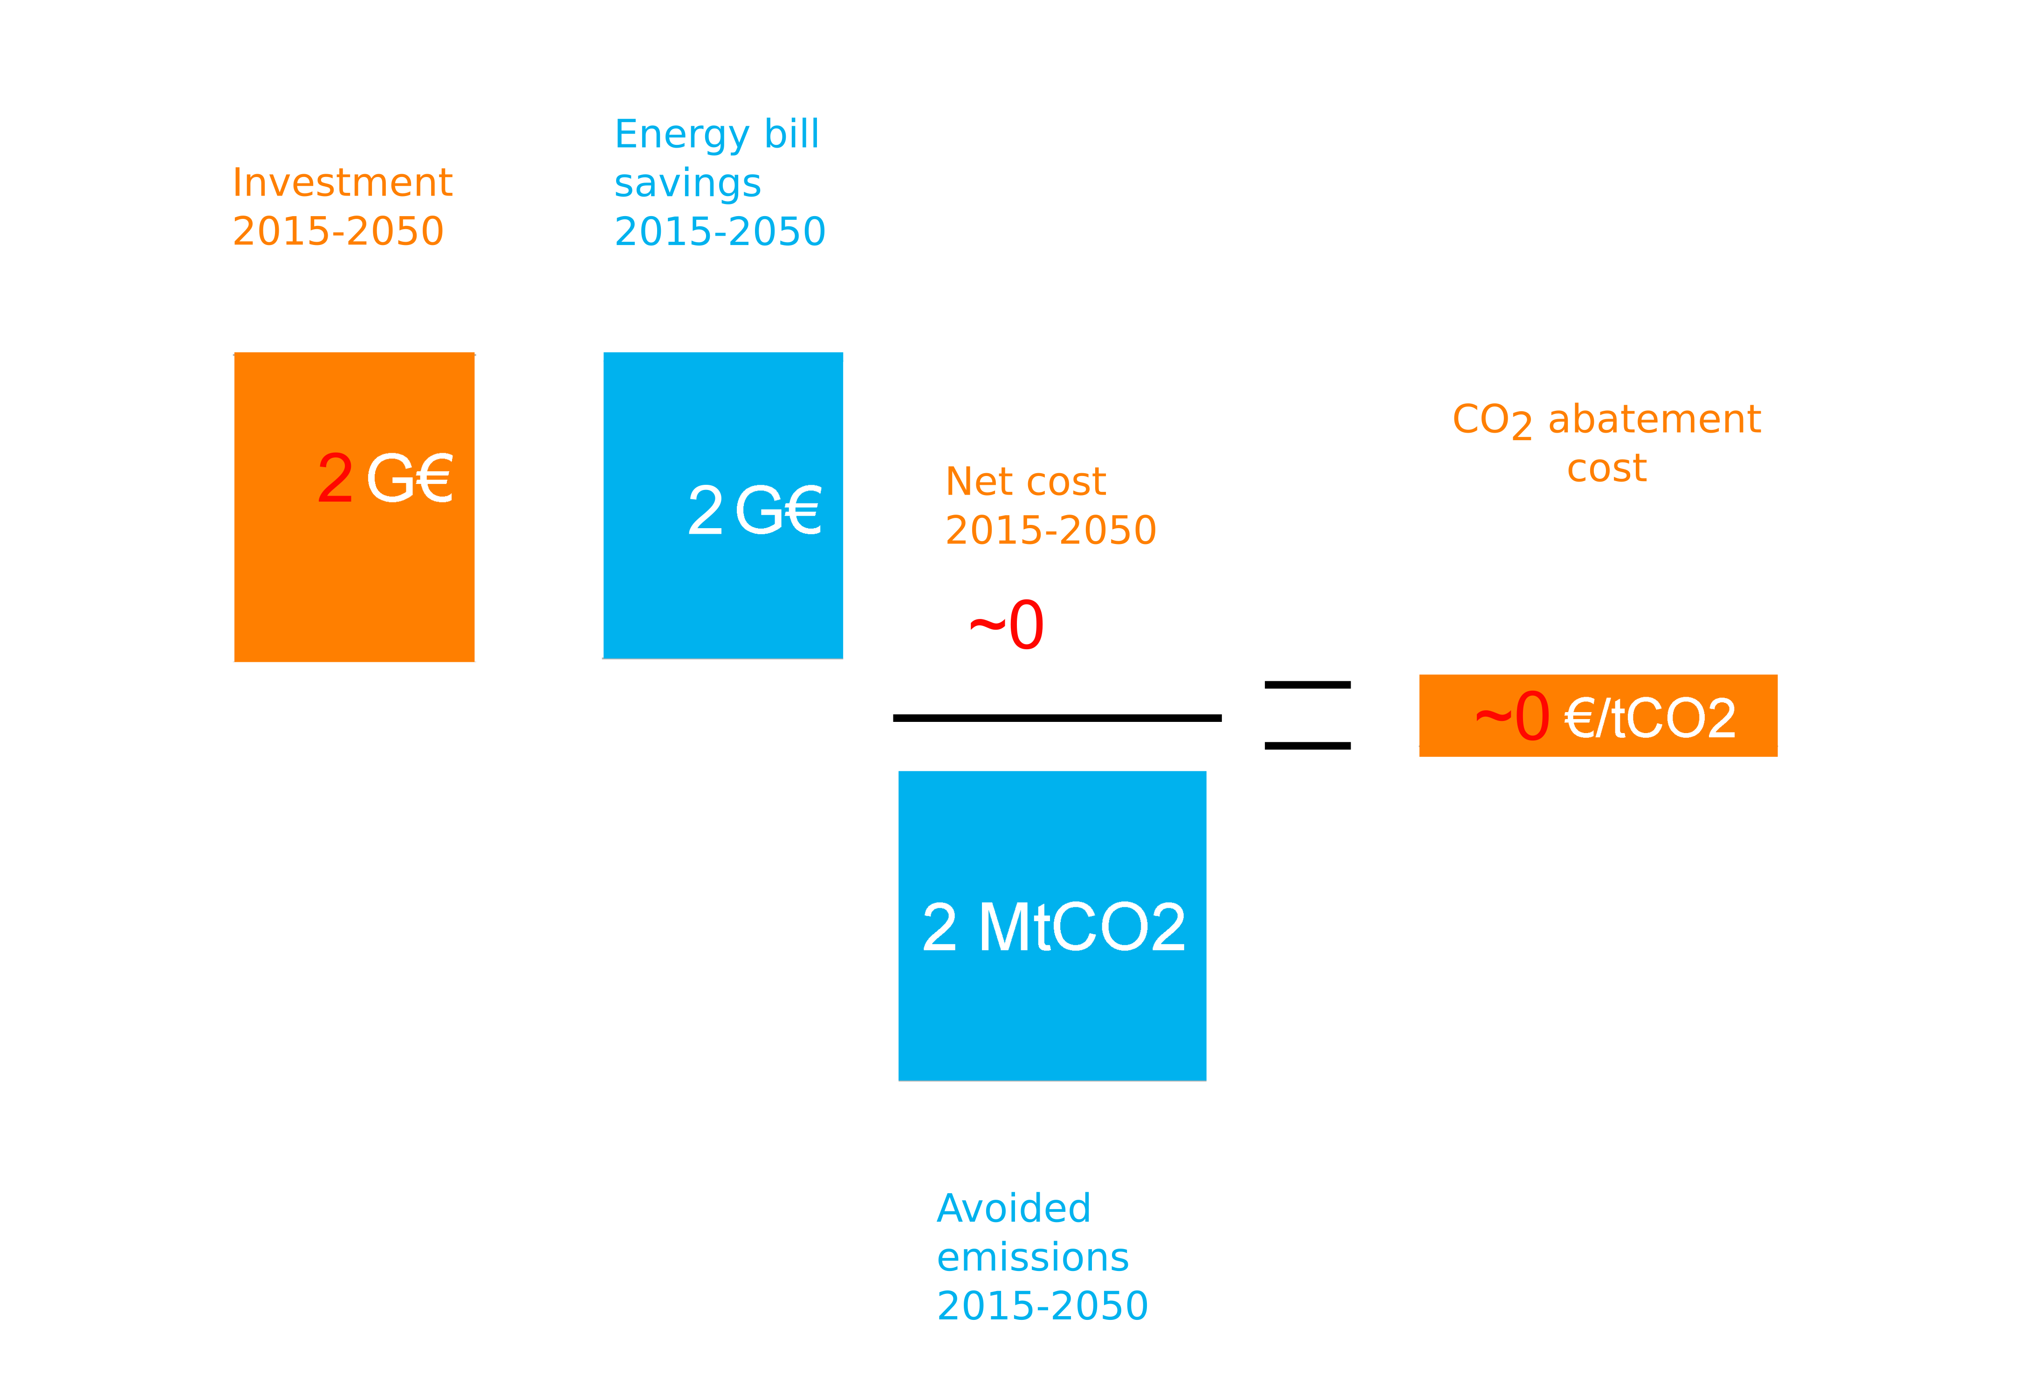
Sensitivity analysis : investment costs 20 % lower
OPEN survey, used to calibrate renovation costs, shows a dispersion in values
Uncertainty about investment costs used in the model
Sensitivity test with investment costs 20 % lower (new calibration of the model)
Mainly affects additional investment which is lower for similar energy bill savings
-
=
(discounted)

Slide 34
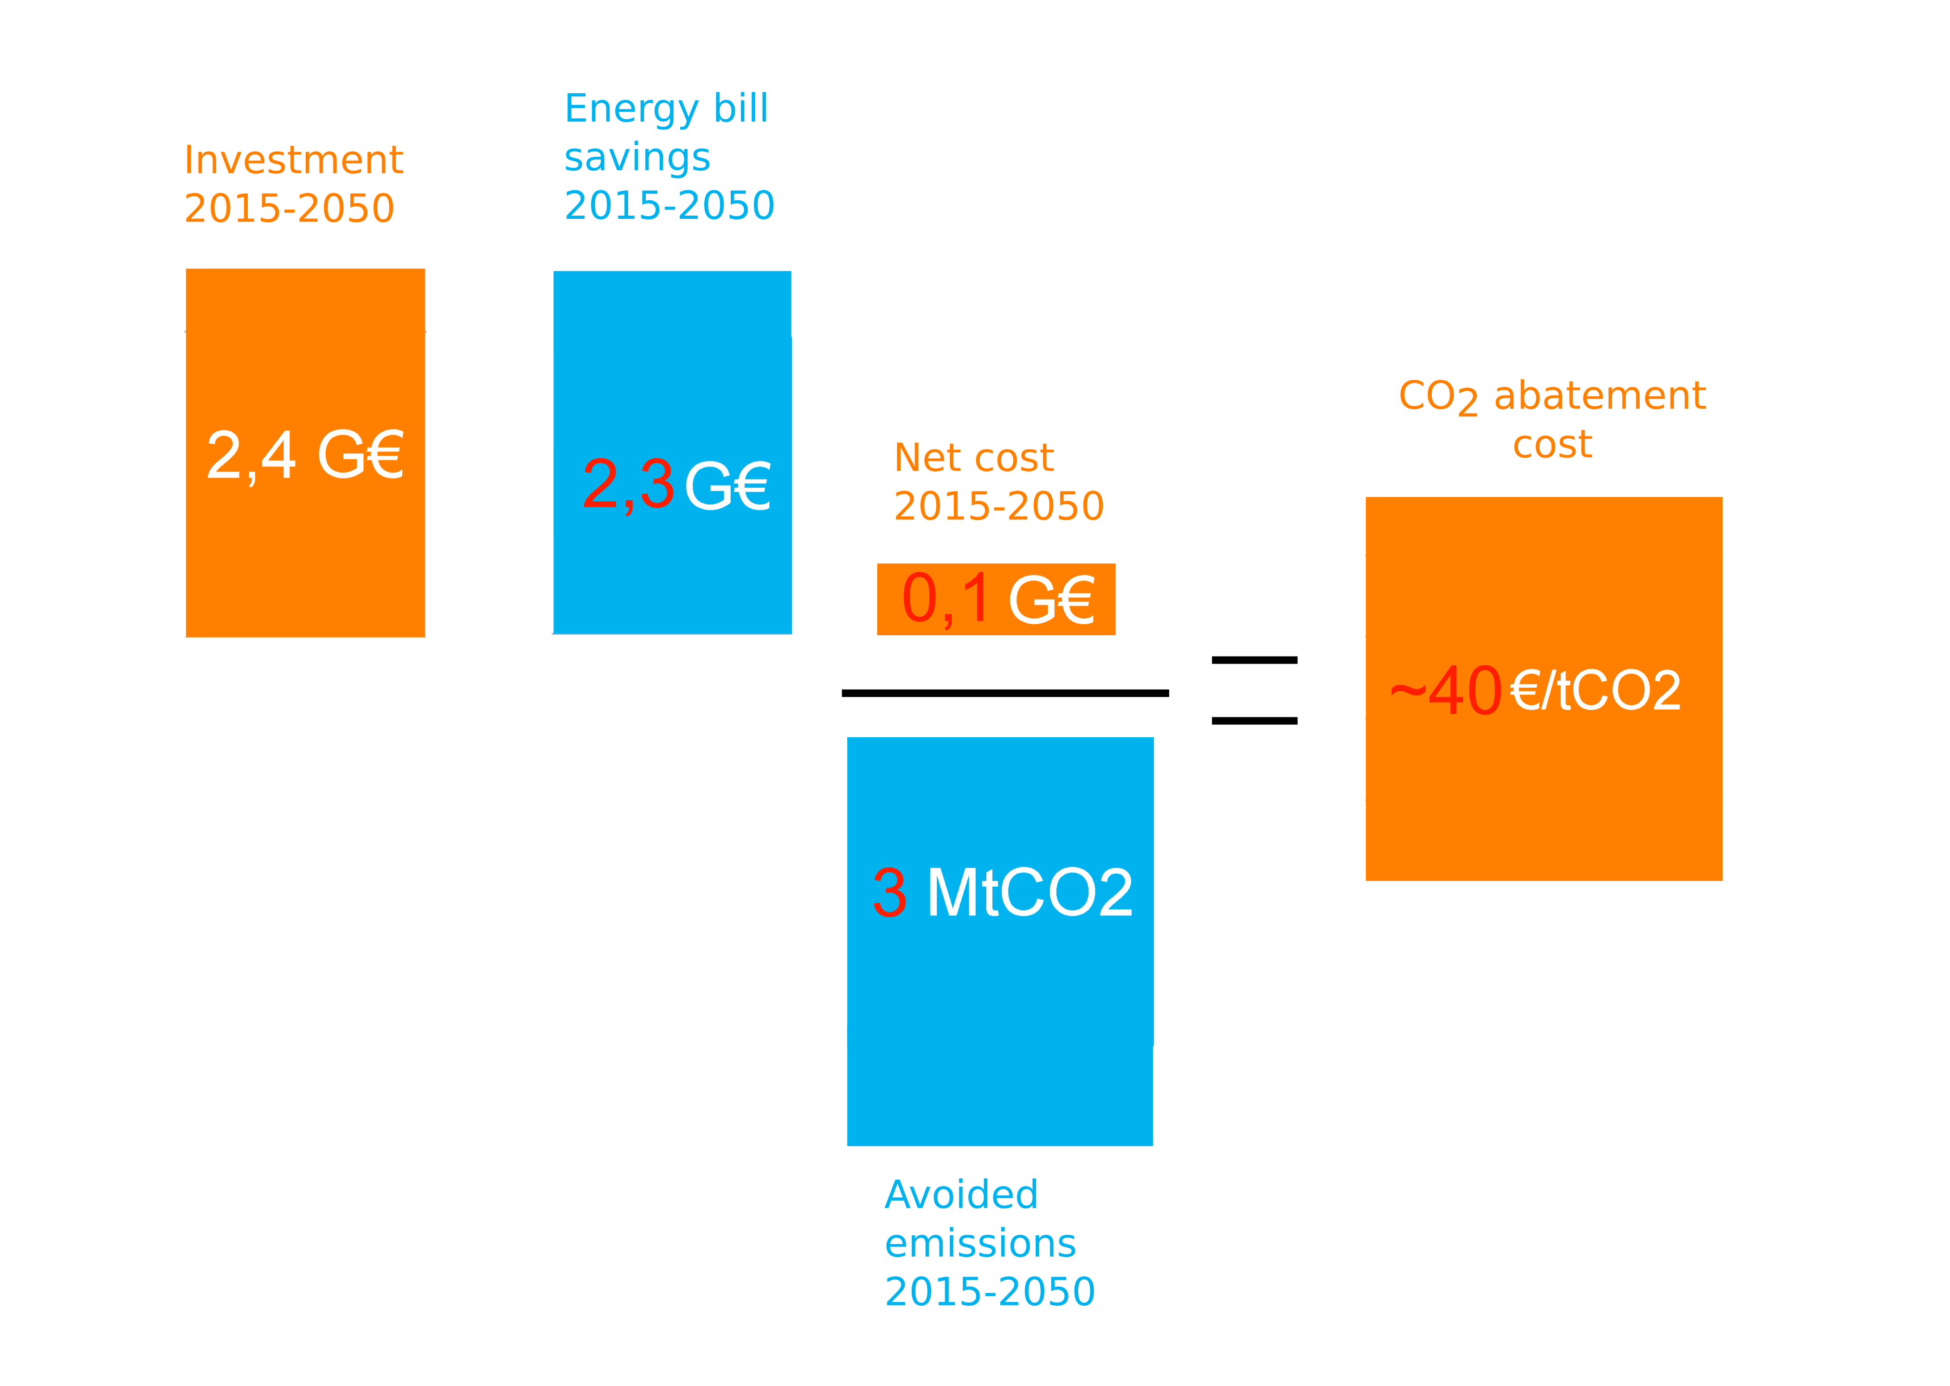
Sensitivity analysis : no thermal comfort adjustment after a renovation
In the model, after a renovation, households improve their thermal comfort using a part of the gain on the energy bill
Sensitivity test with no adjustments of thermal comfort
Greater energy savings and avoided emissions for similar additional investment
-
=
(discounted)

Slide 35
Appendix

Slide 36
Description of the Res-IRF model : initial state of the housing stock (appendix)
7 energy performance classes
2 types of dwellings : house / apartment
4 heating energies :
  Electricity
  Gas
  Fuel oil
  Wood
Households :
  5 income classes
  3 tenure status : owner/ tenant/ social housing
Energy performance class | Heating energy consumption(kWh_{EP}/m²/an)
G | 507
F | 321
E | 216
D | 141
C | 90
B | 59
A | 45
  Housing stock divided in 840 combinations in the model
  Initial housing numbers and energy performance class given by the Phébus survey for 2012

Slide 37
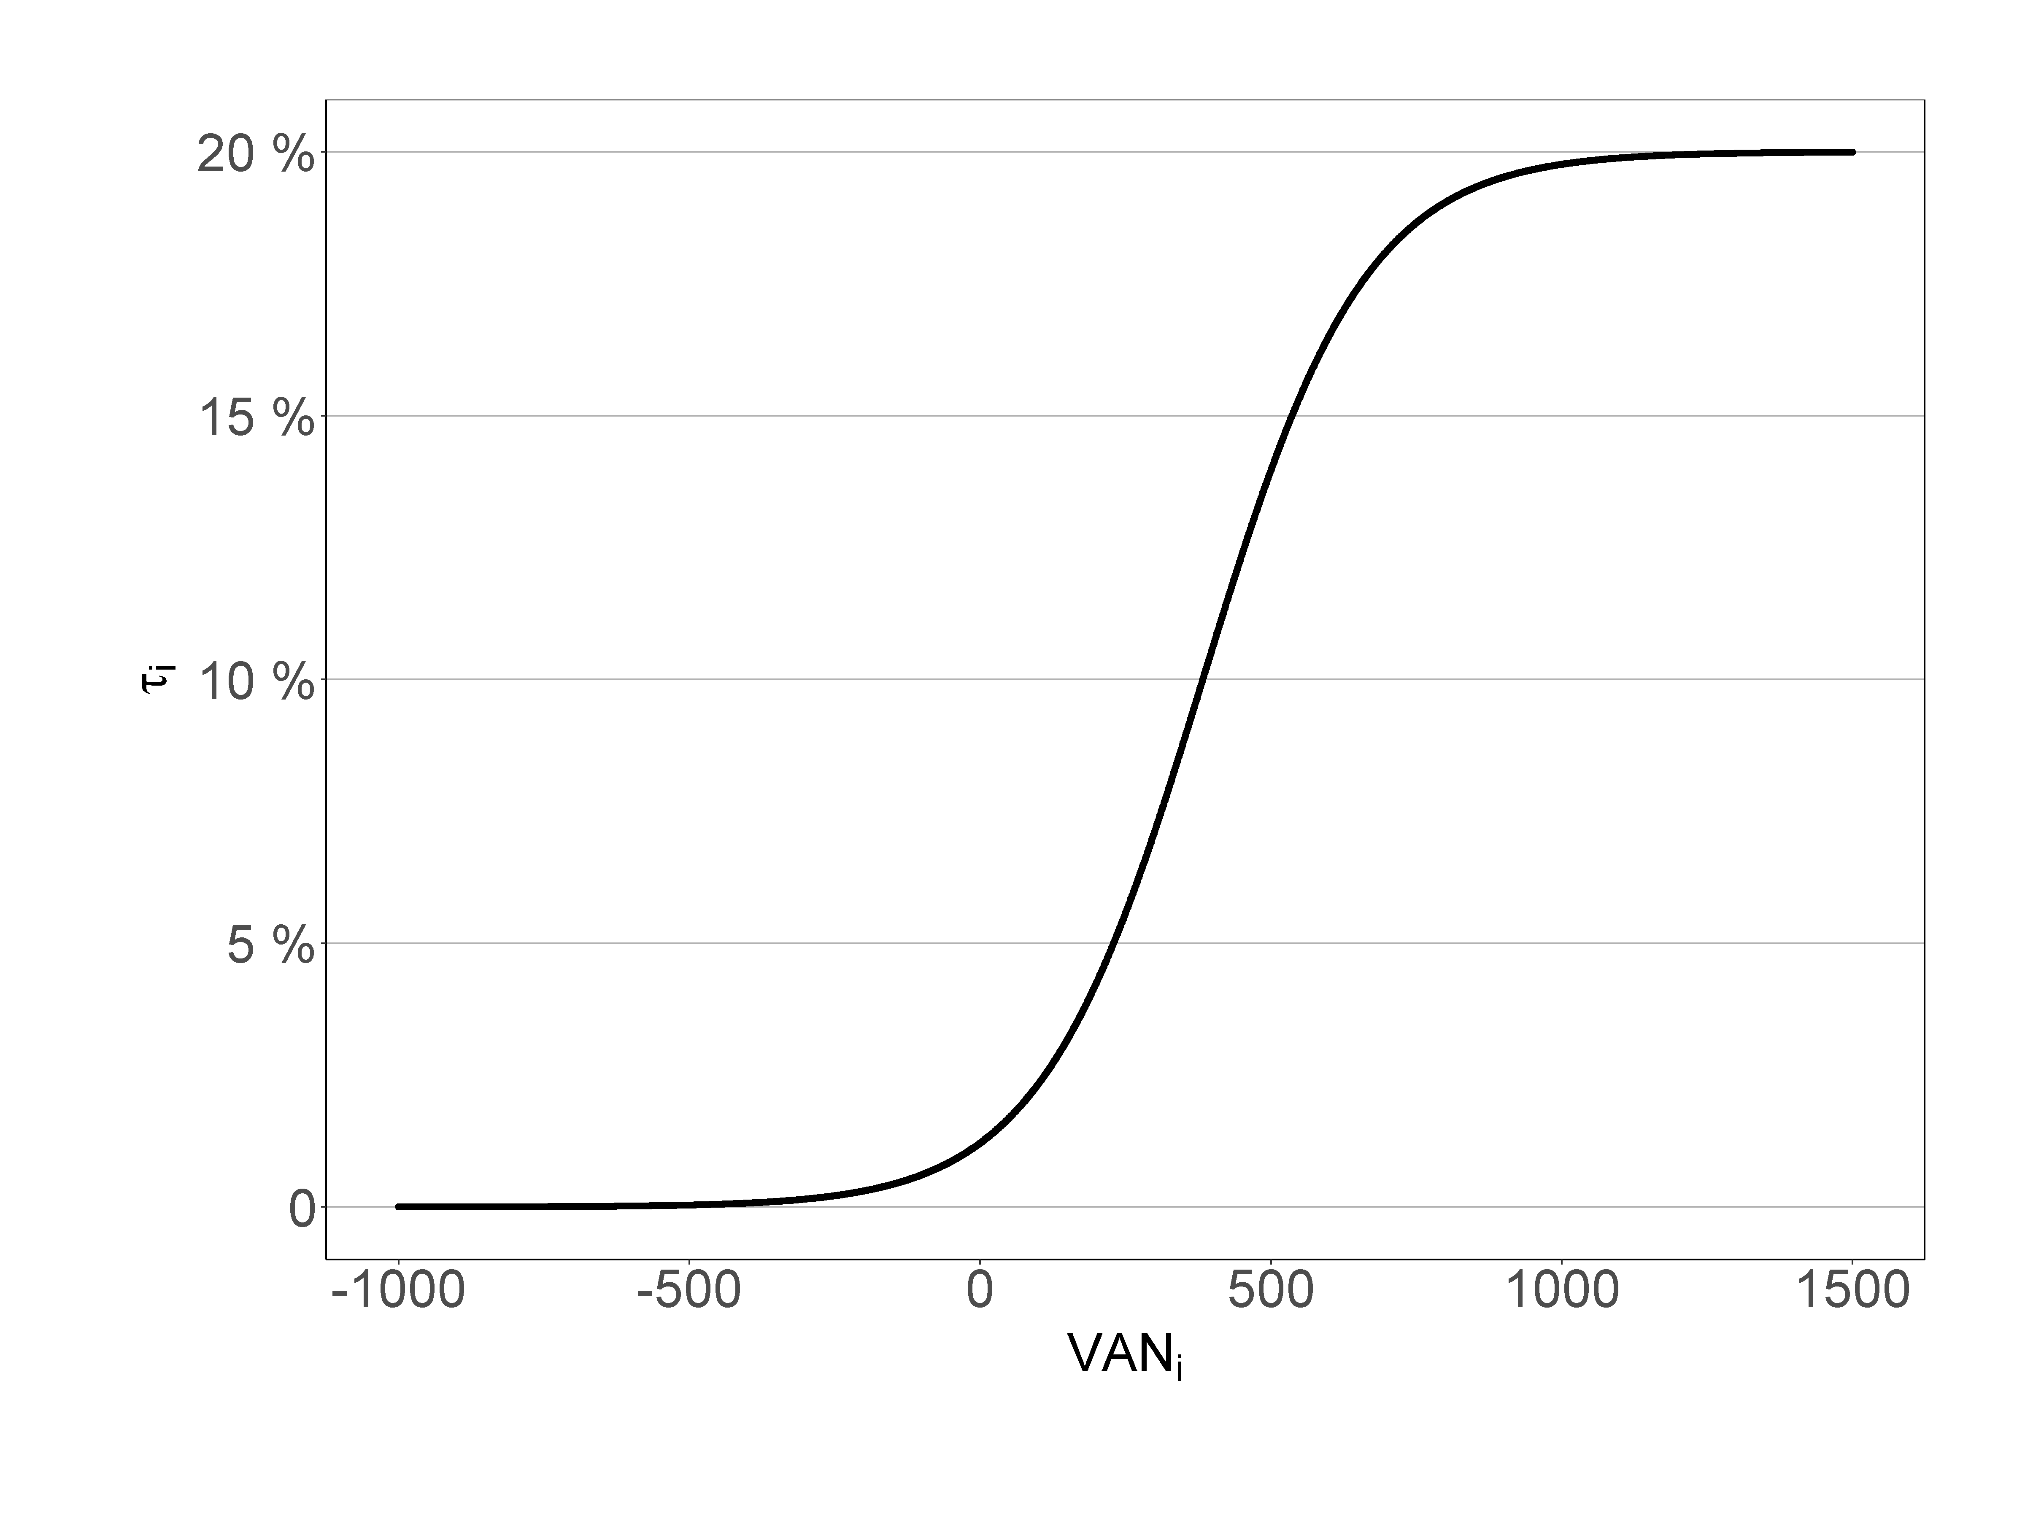
Description of the Res-IRF model : Household’s retrofitting decisions (Appendix)
 | F | E | D | C | B | A
G | 76 | 136 | 200 | 270 | 350 | 441
F |  | 63 | 130 | 203 | 286 | 381
E |  |  | 70 | 146 | 232 | 330
D |  |  |  | 79 | 168 | 270
C |  |  |  |  | 93 | 198
B |  |  |  |  |  | 110
1) Market share of jump from class I to j
Investment costs in euros/m²
increasing marginal cost
average investment cost in line with OPEN survey
2) Retrofit rate for class i
Retrofit rate = f(VANi)

Slide 38
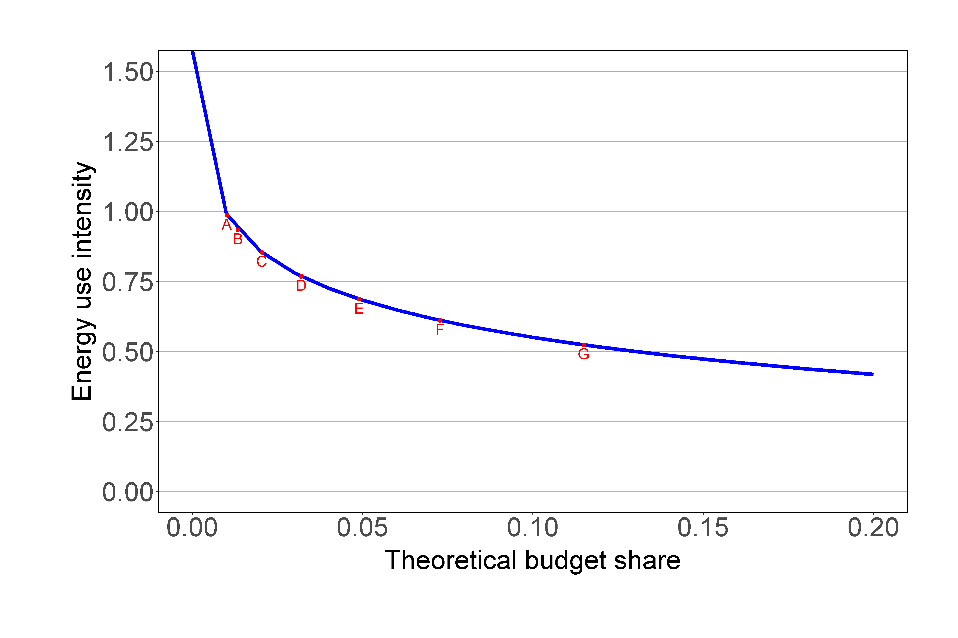
Description of the Res-IRF model : From theoretical to actual consumption
C_{A} = Actual consumption
C_{T} = Theoretical consumption (from the energy class of the dwelling )
I = income, S = surface area, p_{e} = energy price
C_{A} = f(energy class, energy price, income)

Slide 39
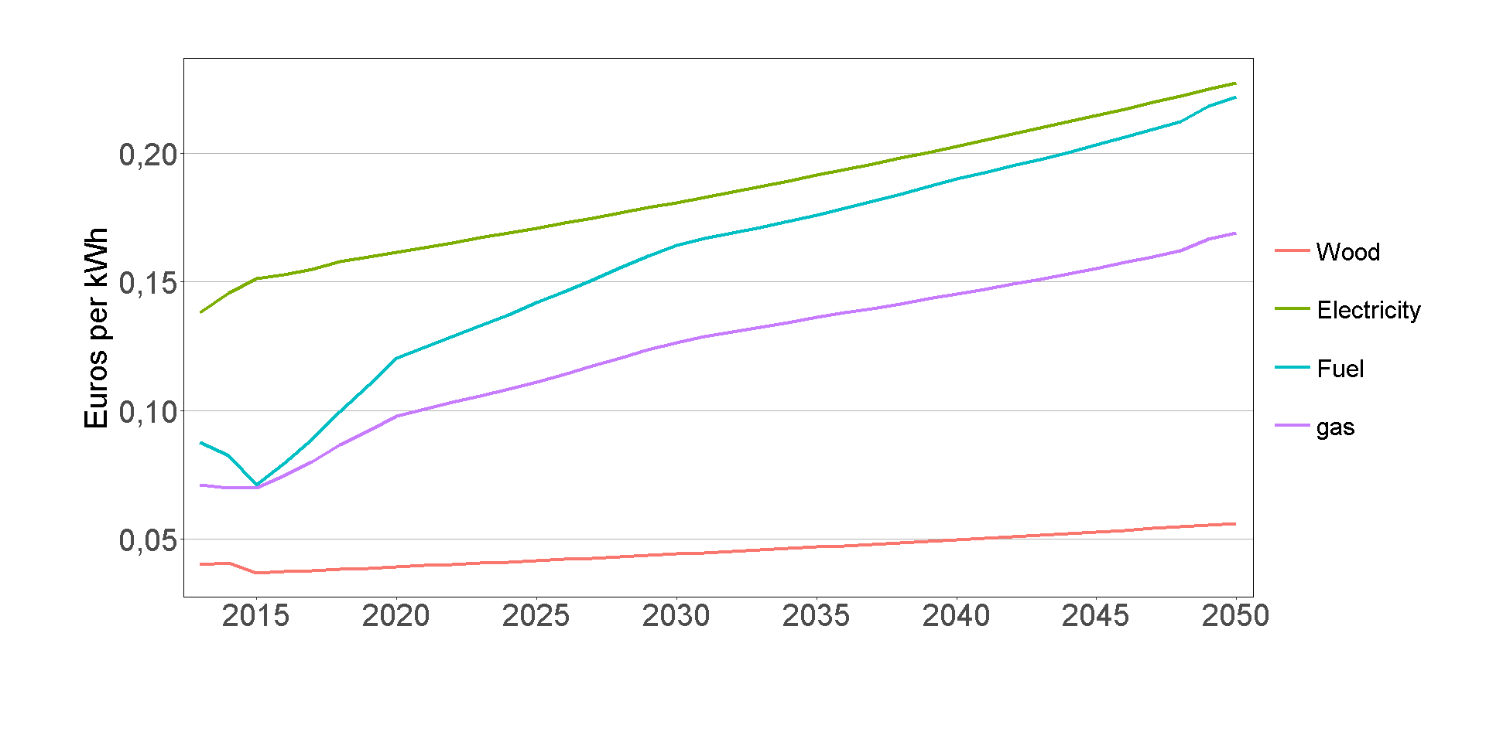
Energy prices scenarios
Energy prices scenarios in euros per Kwh, (exogenous)
Sources :
European Commission (EU reference scenario 2016),
DGEC

Slide 40
Discount rates used in the model (Renovation decisions)
Income quintile | House | apartment | Social housing
C1 | 15% | 37% | 4%
C2 | 10% | 25% | 4%
C3 | 7% | 15% | 4%
C4 | 5% | 7% | 4%
C5 | 4% | 5% | 4%

Slide 41
CO₂ content per energy used to calculate emissions (Source: ADEME)
 | g of CO₂ per kWh
Natural gas | 206
Oil | 271
Electricity | 180
Wood | 0

Slide 42
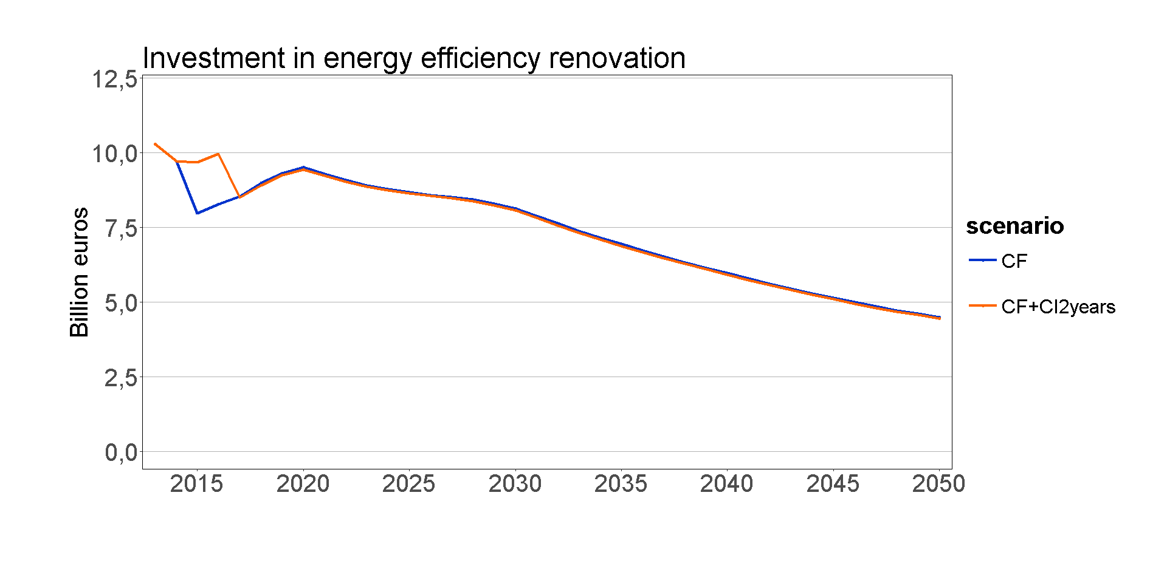

Slide 43
CITE cost and indirect decrease of tax revenues (billion euros)
 | CITE budgetary cost | Taxes revenues | Carbon Tax revenues | Other taxes revenues
CF + CI2years | 3.2 (3.3) | 0.24 (0.16) | 0.19 (0.12) | 0.05 (0.04)
Cumulative values discounted at 4.5% (not discounted values between brackets)

Slide 44
Impact of the CIDD (ex CITE) on household’s renovations (Source : Phébus survey)
 | Share of answering households
work delayed without CIDD | 16%
less amibitous work without CIDD | 11%
no work without CIDD | 11%
work without a professional | 4%
no impact of the CIDD | 57%

Slide 45
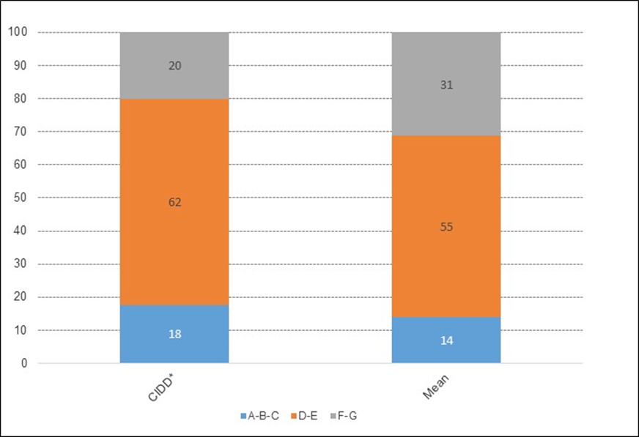
Distribution (in %) of energy performance classes for dwellings that benefited from the CIDD (left) and for all dwellings (right) (Source : Phébus Survey)
Housing that benefited from the CIDD has a better energy performance than the average

Slide 46
Socioeconomic assessment of the CITE between 2015 and 2050
Cumulative investments, energy bill savings and emissions over 2015-2050 discounted at a = 4.5 %
With this definition, abatement cost per ton of CO₂ avoided = constant price of CO₂ over 2015-2050 period needed to make these investments profitable

