Slide 1
Cadrage, reworked
From settings linter to camera school · August 2026
2026-08
1 / 19
Notes:
Formerly Rigcheck. Four commits: rename, lessons, the rework (0c83f50), the nav pass (6b7733b). 38 files, +4,058 / -413.

Slide 2
The site did not match its owner's view
Three routes shipped saying Not built yet
26 review rules cited 13 missing lessons
Camera view covered a movie-mode subset
Nav ordered around the tool, not the learning
Cadrage · cadrage.neorgon.com
2 / 19
Notes:
Old routes: review, menu, learn, post, profiles, tools. learn/post/profiles were placeholder views in render.js. findingCard already linked #/learn/<id>; every link 404'd in spirit.

Slide 3
"
Replicate the UI from the Sony a6700 to assist the full walkthrough of the camera menu.
— The brief, spelling normalised
Cadrage · cadrage.neorgon.com
3 / 19

Slide 4
Agenda
01
Learn
02
Walkthrough
03
The camera
Cadrage · cadrage.neorgon.com
4 / 19

Slide 5
Learn
Basics before advanced, six tracks
Cadrage · cadrage.neorgon.com
5 / 19

Slide 6
Every claim in the curriculum names its source
24 lessons, six tracks, three levels
Exposure triangle and focus, basics to advanced
Colour, light, format built from the rules' data
Each lesson links camera rows and calculators
Every rule's Read-why now lands somewhere
Cadrage · cadrage.neorgon.com
6 / 19
Notes:
js/data/lessons/: exposure (7), focus (7), colour (5), light (2), format-post (3). Drafted partly by agents from rules.js/gammas.js detail text, fact-checked against the repo, then integrated by hand.

Slide 7
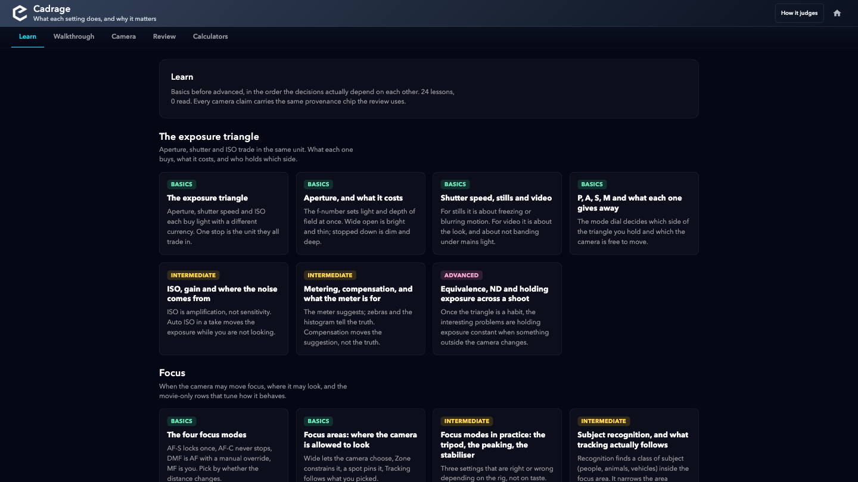
The Learn index
Tracks in learning order; read state is a local checkmark
Cadrage · cadrage.neorgon.com
7 / 19

Slide 8
Walkthrough
The camera, in dependency order
Cadrage · cadrage.neorgon.com
8 / 19

Slide 9
Video writes, photo teaches
Video, 13 steps
Photo, 11 steps
• Format, exposure, colour, focus, check
• Points at rows and explains
• Apply writes into the live setup
• Never writes: the setup models video
• Flicker-clean shutter computed per config
• Same lessons, same camera rows
Cadrage · cadrage.neorgon.com
9 / 19
Notes:
The asymmetry is deliberate honesty: stills fields do not exist in blank(), so photo steps pretending to write would drift from reality. Tested: photo steps with a non-empty set[] fail content.test.mjs.

Slide 10
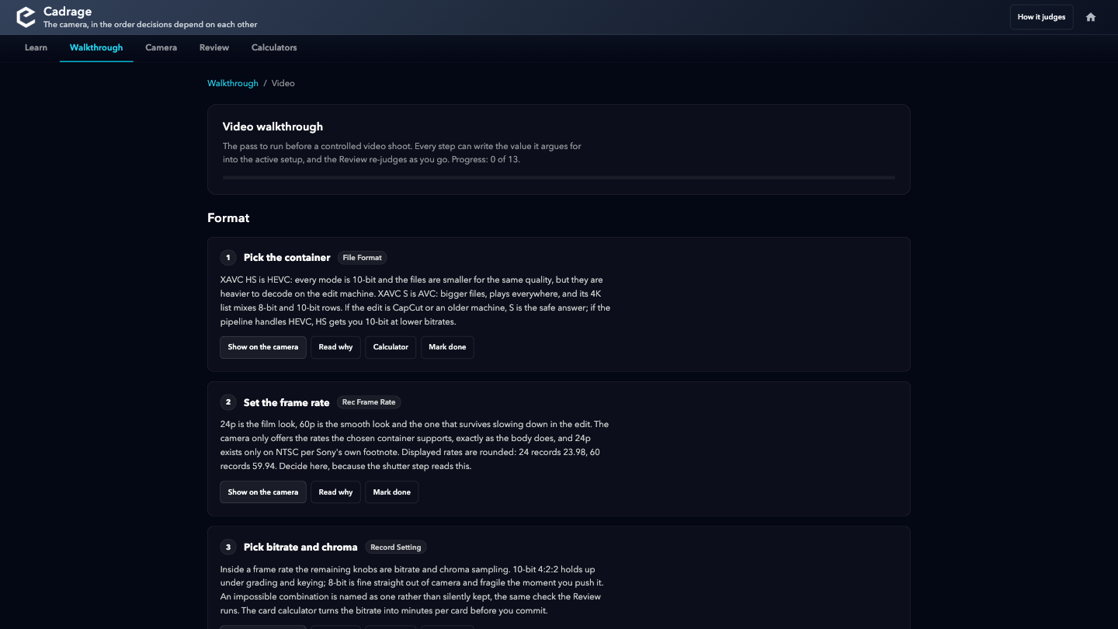
The video pass
Each step: why, where on the camera, and Apply
Cadrage · cadrage.neorgon.com
10 / 19

Slide 11
The camera
The a6700 menu, transcribed
Cadrage · cadrage.neorgon.com
11 / 19

Slide 12
The replica comes from the help guide, not memory
10-agent research pass over the official guide
8 tabs, 280 rows, verified screen layout
Main is a tile grid, as the body draws it
Arrows move, Enter descends, Escape is MENU
Live rows edit the setup; the rest say so
Cadrage · cadrage.neorgon.com
12 / 19
Notes:
helpguide.sony.net/ilc/2320/v1/en, read 2026-08-28. Transcription agents wrote per-tab JSON; a coverage verifier checked the rows the site already modelled before anything was generated. Tab accent colours are approximated: the guide's art is grayscale.

Slide 13
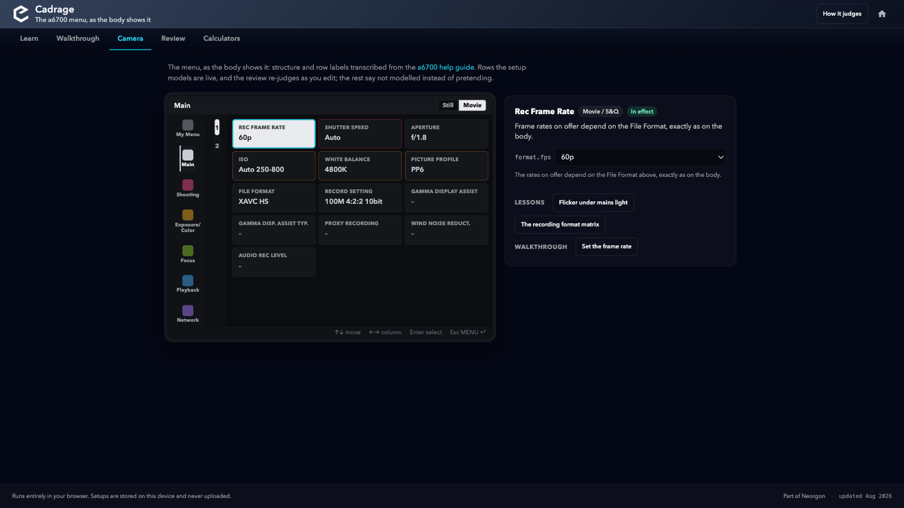
Movie Main
Live values, finding flags, and the detail card with its lesson links
Cadrage · cadrage.neorgon.com
13 / 19

Slide 14
The transcription judged the site itself
Embed LUT File: not on this body. Was Sony spec
Rule downgraded to unverified, ships off
Shutter Speed exists only as a Main tile
Var. Shutter nests inside Anti-flicker Set.
Cadrage · cadrage.neorgon.com
14 / 19
Notes:
FX-line documentation had leaked into the model. The fix follows the site's own ethos: the rule stays, labelled unverified, listed with the deliberate omissions; the config keeps colour.embedLut for old notes. Also gone: the Exposure Ctrl Type row my own draft lesson had claimed.

Slide 15
Nav in the headbar: reviewed, and rejected
Header actions collapse into the mobile overflow
Three of five sections would hide behind a tap
Rail became the headbar's second row instead
Fixed: rail slid under the bar on scroll
Fixed: patches wrote to a detached node
Cadrage · cadrage.neorgon.com
15 / 19
Notes:
The kit README's own pattern for app-mode sites is a docked strip that rises when the bar auto-hides (.header-hidden ~ sibling). The patchDerived bug: utils.$ caches elements forever; the derived zone is replaced by every full render, so patches landed in a detached node. Latent since the original build.

Slide 16
Held by tests, not by memory
1,143
280
24
+4,058
Content assertions, all green
Menu rows transcribed
Lessons across six tracks
Lines over 38 files
Cadrage · cadrage.neorgon.com
16 / 19
Notes:
tests/content.test.mjs holds the contracts: every learn, menu, ref, link, lesson and set[].path reference must resolve. Engine suite unchanged at 106. Line count from the collector over 7db5196..HEAD; no vendored or generated files in the diff.

Slide 17
What it cost
Two data layers to keep aligned: tree and registry
Tab colours approximated; guide art is grayscale
Engine still models video only
rules.js stays past the 500-line guideline
Cadrage · cadrage.neorgon.com
17 / 19
Notes:
Tree rows go live via ref into js/data/menu.js; the content test catches dangling refs, but a new row still needs a human to decide which layer owns it. Splitting rules.js is queued for whoever touches it next.

Slide 18
Still open
○
Publish: repo, Pages, DNS
TODO
docs/operations/publishing.md, end to end
○
OG image and hub card
TODO
Hub card stays Soon until the site serves
○
Registry description update
TODO
Source script has other sessions' pending edits
✕
Fn menu defaults
BLOCKED
Sony documents no factory defaults; needs a real body
○
Stills in the setup object
TODO
Deferred by design; photo track teaches without it
Cadrage · cadrage.neorgon.com
18 / 19

Slide 19
One word ships it
→ Say publish, and the runbook runs
Repo, Pages, DNS, hub card: docs/operations/publishing.md
Cadrage · cadrage.neorgon.com
19 / 19

