Slide 1
CEJST Data Pipeline
Shelby Switzer | Dec 2025

Slide 2
Principles
Scientific integrity: Every step of the data process is documented and reproducible by anyone.
Transparency: All data produced at every step is saved and accessible by anyone.
Open: Completely open source and utilizing open standards and open external assets (eg Open Street Map).
Lightweight and portable: The client is a static site, the data pipeline is serverless and modular, and the tiles are hosted as files on a cloudfront distro. Dockerized.
Peer-Reviewed, Documented, and Tested: All code went through review, and everything is extensively documented (docs, commits, and comments) and tested.

Slide 3
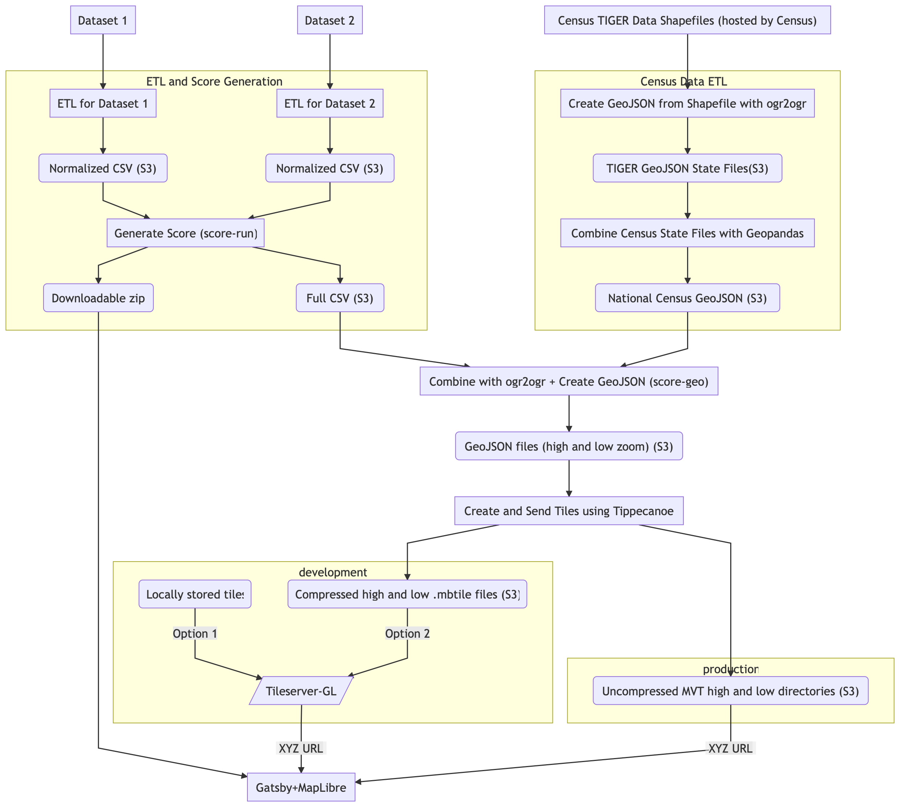

Slide 4
FILE HOST
Source Data
ETLed Data CSVs
Score CSV (full/usa.csv)
Downloadable and tile-ready data
Map Tiles (and shape files)
GeoJSON
score-run
generate-score-post
geo-score
generate-map-tiles
CEJST Client Application
etl-run
COMPUTE (GitHub actions)
STATIC SITE

Slide 5
Step-by-step
A walk-through of the data pipeline steps within poetry run python3 data_pipeline/application.py
as defined in
https://github.com/Public-Environmental-Data-Partners/j40-cejst-2/blob/main/data/data-pipeline/data_pipeline/application.py

Slide 6
poetry run python3 data_pipeline/application.py etl-run
1. ETL-RUN
Performs the ETL steps on external data sources, and saves the resulting intermediate file
Can run a specific ETL, or all ETLs (specified by an argument)
Because we were memory constrained on our infrastructure, we split datasets into those that are not memory intensive and thereby can be safely run in parallel, and those that require more RAM and thus should be run sequentially. The is_memory_intensive_flag is set manually in constants.py based on experience running the pipeline.
Source data > data/dataset

Slide 7
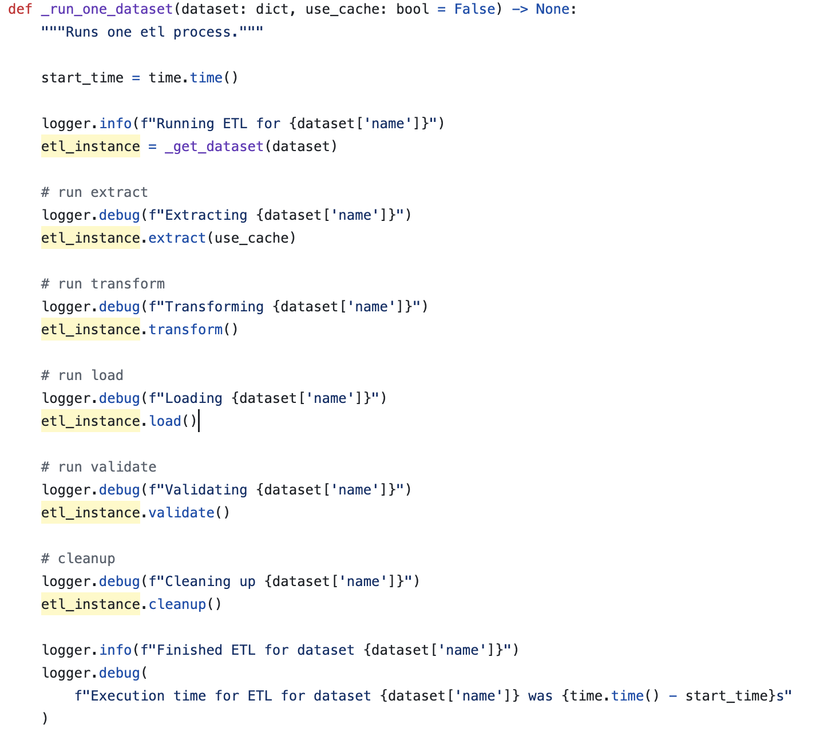
For each source dataset, the ETL runner extract-transform-loads the data by calling on an ETL class for that source designed using the adapter pattern.
https://github.com/Public-Environmental-Data-Partners/j40-cejst-2/blob/main/data/data-pipeline/data_pipeline/etl/runner.py

Slide 8
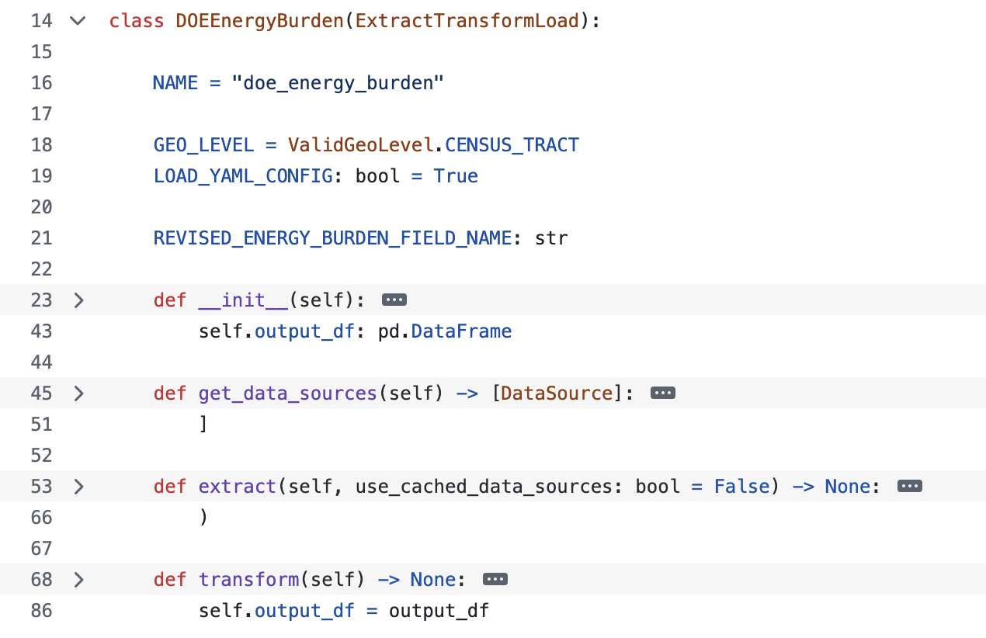
Example of a data source ETL class
https://github.com/Public-Environmental-Data-Partners/j40-cejst-2/blob/main/data/data-pipeline/data_pipeline/etl/sources/doe_energy_burden/etl.py

Slide 9
poetry run python3 data_pipeline/application.py score-run
Generates and stores the score:
Source files from the data_pipeline/data/dataset directory are loaded into memory (these source files were generated by the etl-run command)
These data sets are merged into a single dataframe using their Census Block Group GEOID as a common key, and the data in each of the columns is standardized in two ways:
Their percentile rank is calculated, which tells us what percentage of other Census Block Groups have a lower value for that particular column.
They are normalized using min-max normalization, which adjusts the scale of the data so that the Census Block Group with the highest value for that column is set to 1, the Census Block Group with the lowest value is set to 0, and all of the other values are adjusted to fit within that range based on how close they were to the highest or lowest value.
The standardized columns are then used to calculate each of the Justice40 scores, and the results are exported to data_pipeline/data/score/csv/full/usa.csv. Different versions of the scoring algorithm – including the current version – can be found in data_pipeline/score.
2. SCORE-RUN
data/dataset > data/score/csv/full/usa.csv

Slide 10
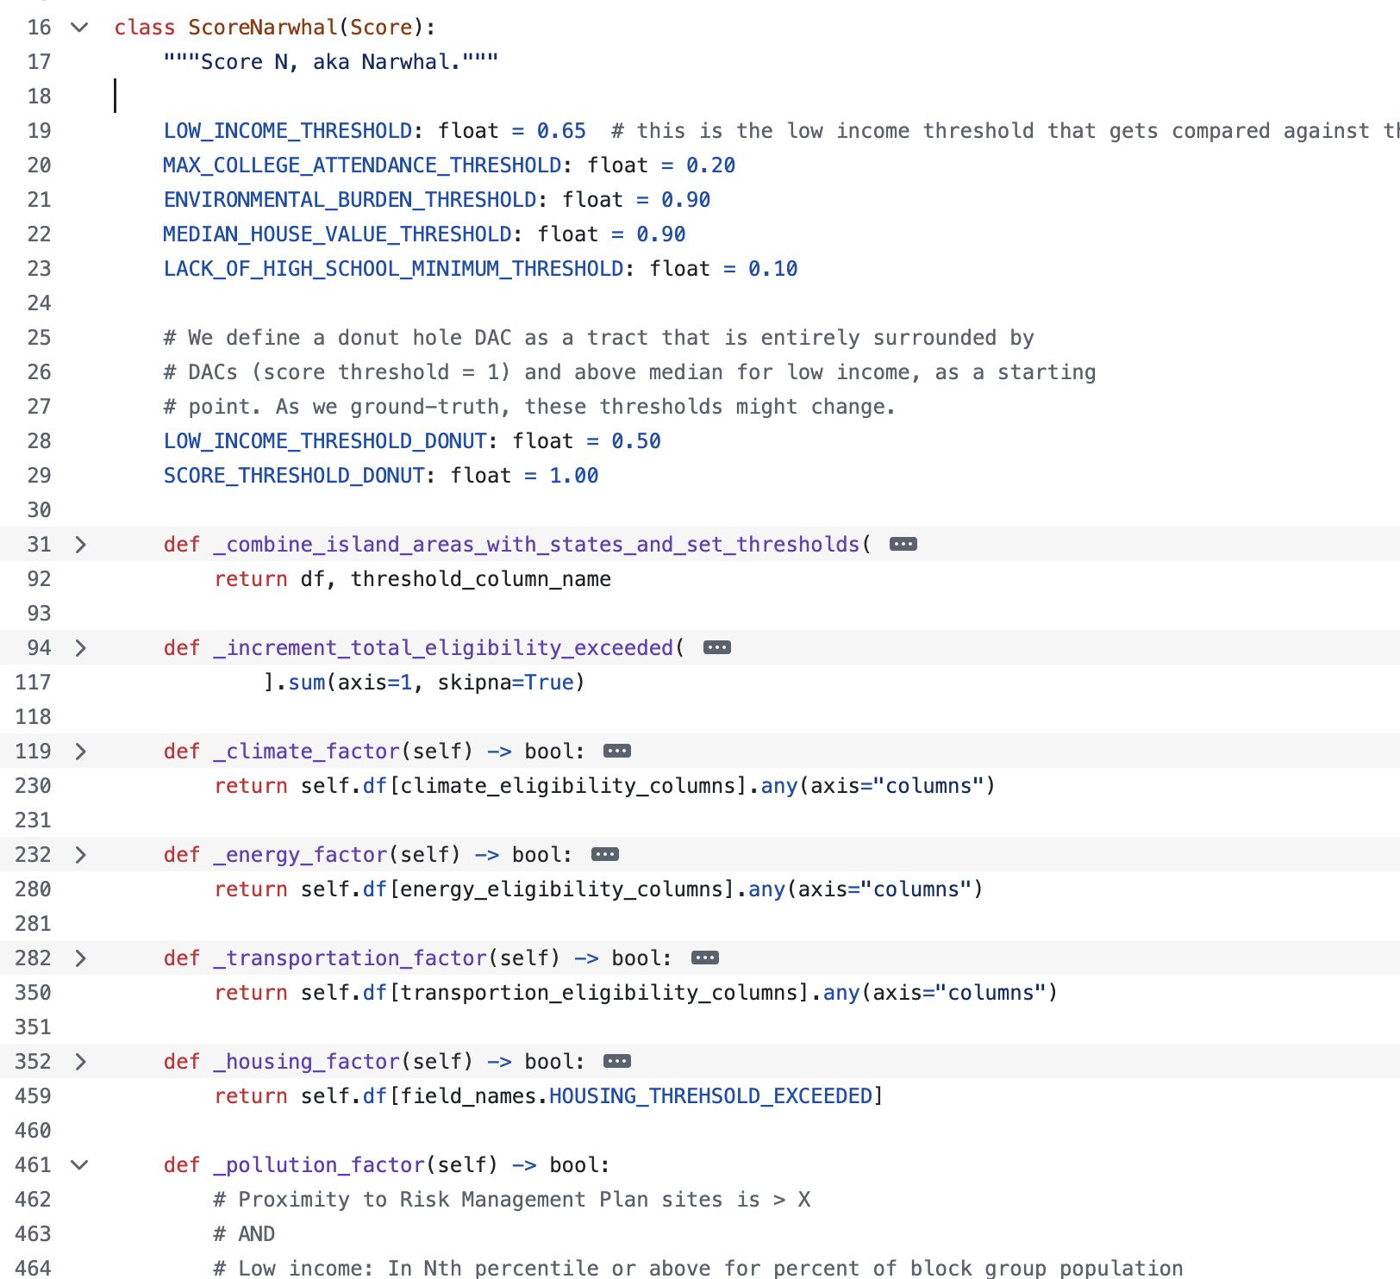
The Score Runner runs the current score (called Narwhal for N) and calculates which tracts meet the thresholds for each factor.
* Note the donuts!
https://github.com/Public-Environmental-Data-Partners/j40-cejst-2/blob/main/data/data-pipeline/data_pipeline/score/score_narwhal.py

Slide 11
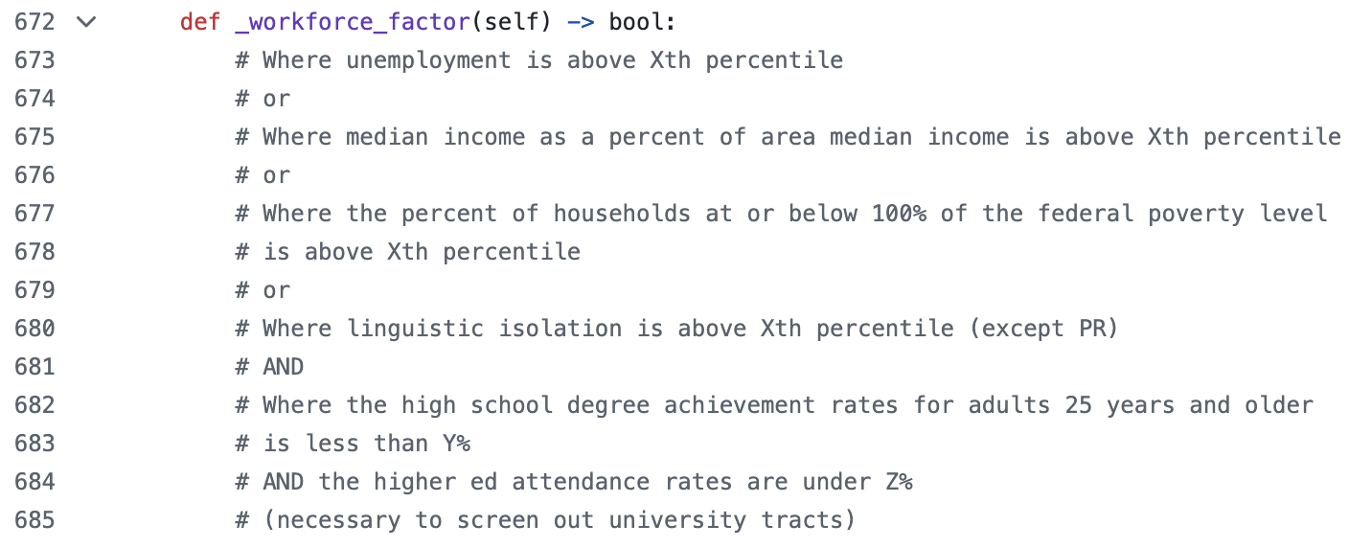
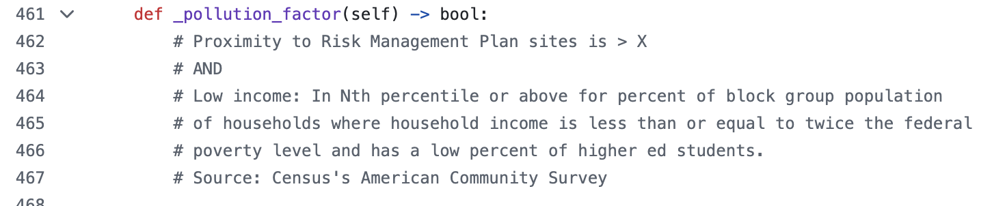
Examples of factor logic, from simple to complex

Slide 12
Side Quest: You can compare different score versions!
Use the Score Comparator or the Score Comparison Python Notebook. This is an opportunity for new feature/tool development.
https://github.com/Public-Environmental-Data-Partners/j40-cejst-2/blob/main/data/data-pipeline/data_pipeline/comparator.py
https://github.com/Public-Environmental-Data-Partners/j40-cejst-2/blob/main/data/data-pipeline/data_pipeline/ipython/scoring_comparison.ipynb

Slide 13
poetry run python3 data_pipeline/application.py generate-score-post
3. GENERATE-SCORE-POST
Performs a host of post-score activities, including adding county and state data to the score, shortening column names, and generating a downloadable package of data
application.py instantiates and uses PostScoreETL class
data/score/csv/full/usa.csv > data/score/csv/tiles/usa.csv, data/score/downloadable
https://github.com/Public-Environmental-Data-Partners/j40-cejst-2/blob/main/data/data-pipeline/data_pipeline/etl/score/etl_score_post.py

Slide 14
poetry run python3 data_pipeline/application.py geo-score
4. GEO-SCORE
Merges geoJSON data with score data, creating both high and low resolution results
application.py instantiates and uses the GeoScoreETL class
Also generates ESRI shapefiles
data/score/csv/tiles/usa.csv > data/score/geojson[usa high or low]
https://github.com/Public-Environmental-Data-Partners/j40-cejst-2/blob/main/data/data-pipeline/data_pipeline/etl/score/etl_score_geo.py

Slide 15
poetry run python3 data_pipeline/application.py generate-map-tiles
5. GENERATE-MAP-TILES
Generates map tiles for use in client website
Uses tippecanoe
Also generates tribal layer map tiles
data/score/geojson[usa high or low] > data/score/tiles/ high or low / {zoomLevel}
https://github.com/Public-Environmental-Data-Partners/j40-cejst-2/blob/main/data/data-pipeline/data_pipeline/tile/generate.py

Slide 16
FILE HOST
Source Data
ETLed Data CSVs
Score CSV (full/usa.csv)
Downloadable and tile-ready data
Map Tiles (and shape files)
GeoJSON
score-run
generate-score-post
geo-score
generate-map-tiles
CEJST Client Application
etl-run
COMPUTE (GitHub actions)
STATIC SITE

