Slide 1

R Spatial: Raster
Sushant Banjara
Pre-doctoral Fellow, EPIC

Slide 2
Introduction
Raster => Image + Geoinformation
Image => Matrix elements representing cell value
Geoinformation => Position on a map
Package => ‘raster’
Casts a non-raster object to a raster object
Reads a file from disk and loads as raster
Command => raster(filepath+filename)
Most common package
Slow but memory efficient

Slide 3
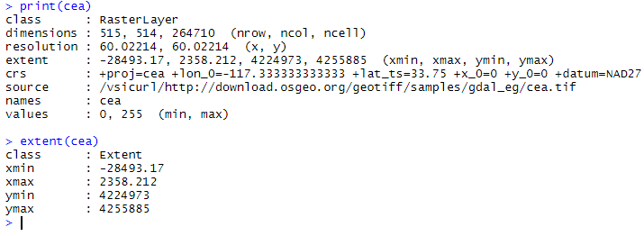
Raster Properties
Raster Properties
1. Dimension
2. Resolution(metre/degree) => res(rast)
3. Extent => extent(rast)
4. Values => values(rast), unique(rast)
5. Coordinate Reference System => crs(rast)
Crs()
1. Sets or gets the crs of a raster or a vector
2. Projection system, datum

Slide 4
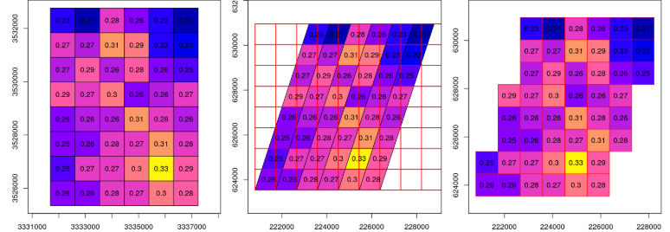
Reprojection
Spatial objects must have same crs
projectRaster(rast1, crs = crs(rast2))
rast1’s crs converts to rast2
projectRaster(rast1, rast2)
rast1’s geoinformation converts to rast2
projectRaster (rast1, rast2, method =?)
Method = ‘ngb’/‘bilinear’
Note: Generally speaking, use nearest neighbour (ngb) method for reprojection of rasters with categorical values

Slide 5
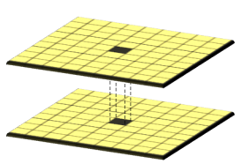
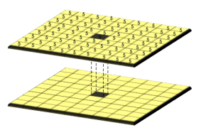
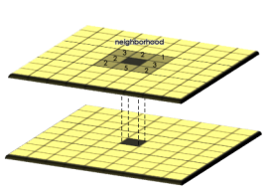
Map Algebra
Local: E.g. Raster Addition
rast3 = rast1+ rast2
Global: E.g. Scalar product
rast3 = 5*rast2
Focal: E.g. Slope computation
rast3 = terrain (rast2, opt = ‘slope’)
Local
Per pixel algebra
Global
Uniform change throughout the map
Focal
Pixel change based on neighbourhood values

Slide 6
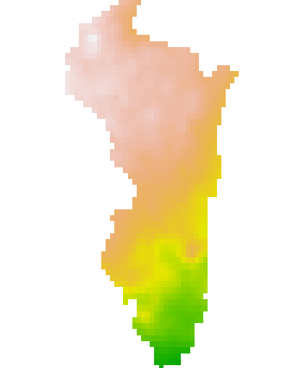
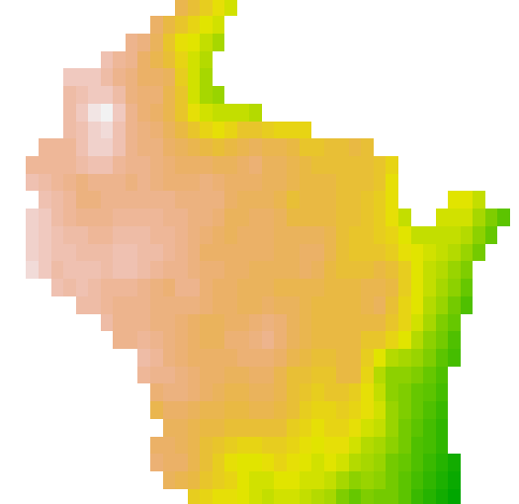
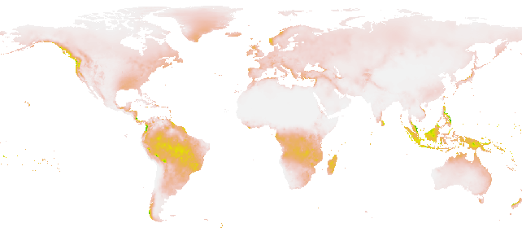
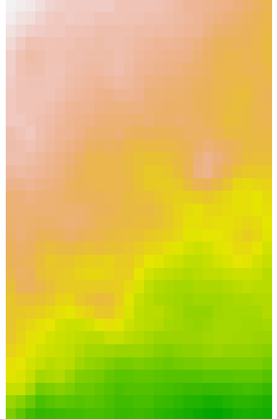

Raster Manipulation
Filtering: Returns raster with logical values
rast2 <- (rast1 >100)
Merging: Combines multiple raster to one
rast3 <- merge (rast1, rast2)
Cropping: Clips raster by extent object
rast3 <- crop (rast1, extent(spatial object))
Masking: Ignores pixels lying outside a boundary
rast3 <- crop (rast1, shp)
Modifying the shape, size, and pixel information of a raster to fit user’s purpose.
Merge
Crop
Mask

Slide 7
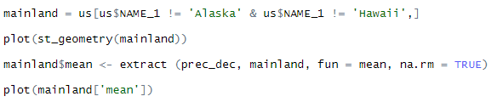
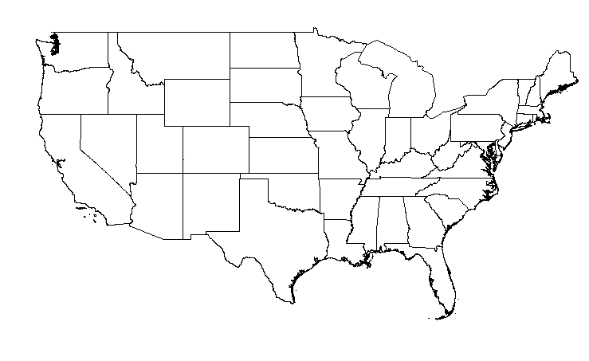
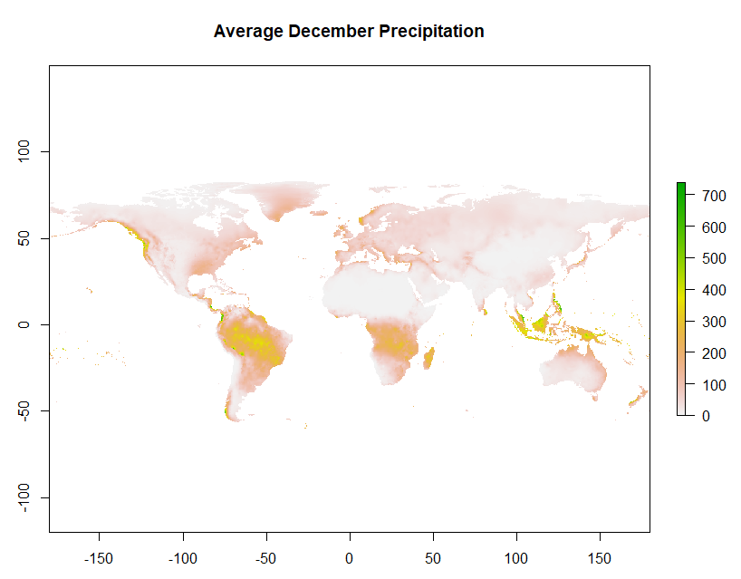
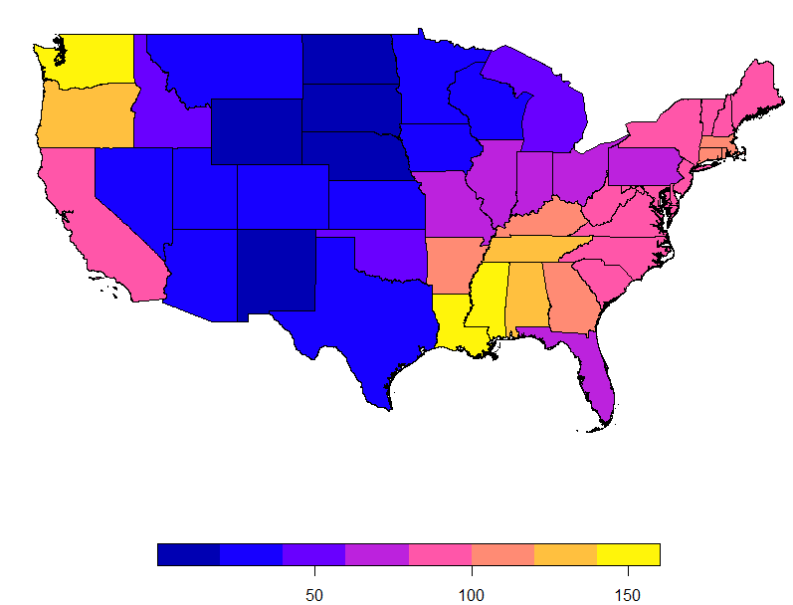
Raster Reduction
Extracting summary of a raster-portion that overlaps with a given shapefile.
extract (rast, shp, function)

Slide 8
Questions?
References:
https://gisgeography.com/map-algebra-global-zonal-focal-local/
http://132.72.155.230:3838/r/geometric-operations-with-rasters.html

