Slide 1

LLM-powered DB gateway service Professor Lorenzo Bottaccioli Professor Edoardo Patti Pietro Rando Mazzarino
Ali Taherdoust

Slide 2
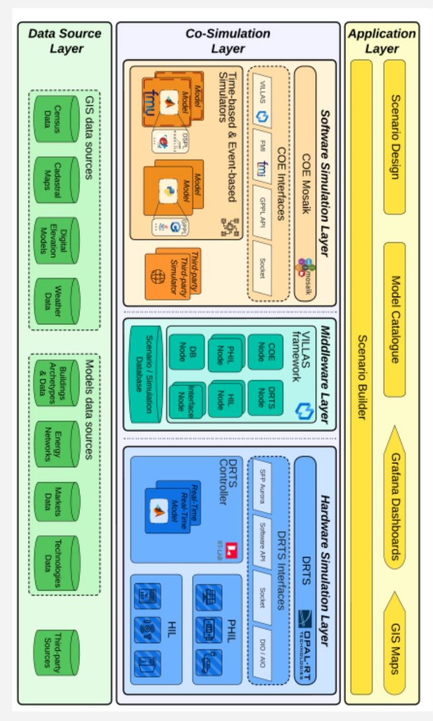
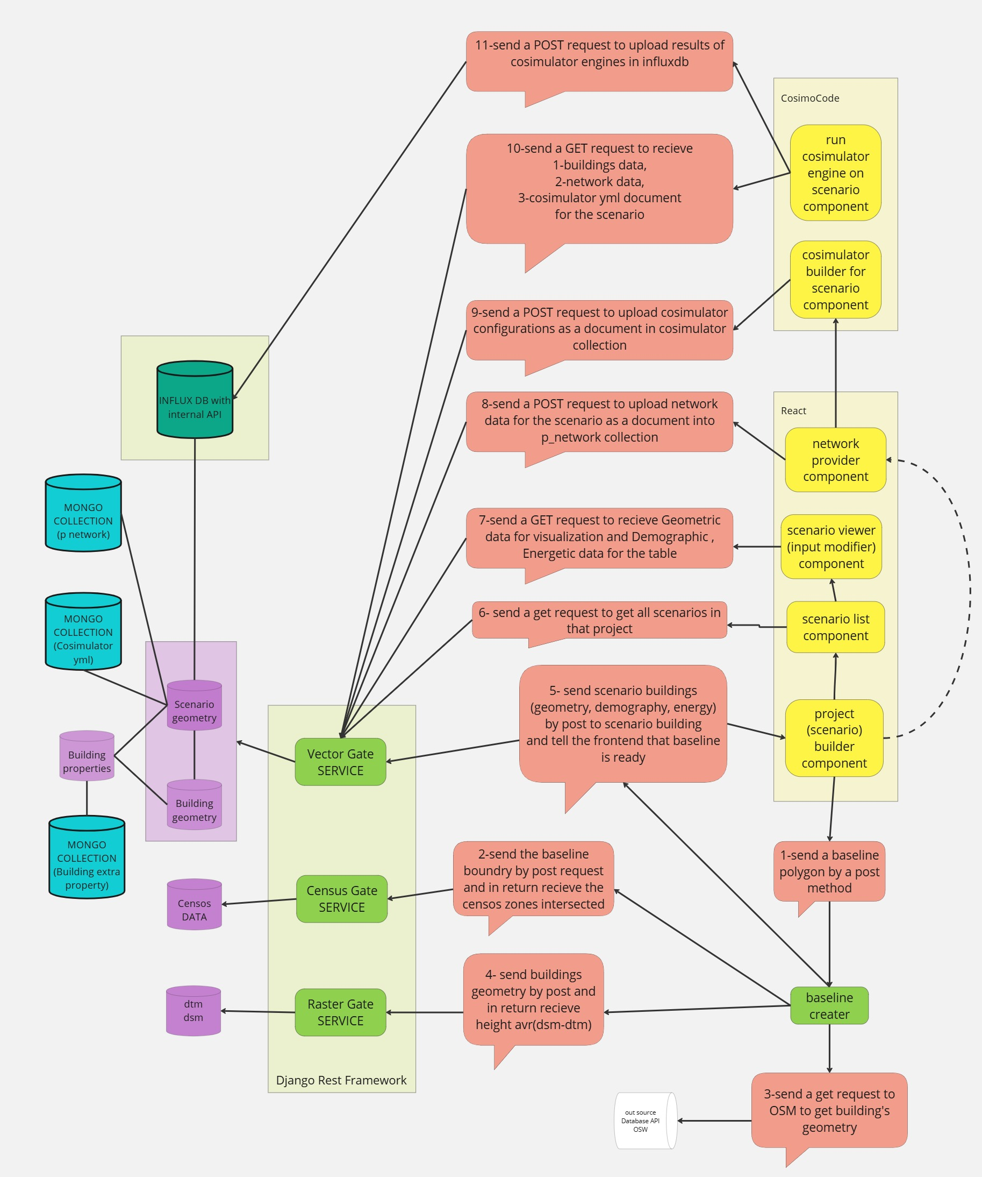
Coesi backend

Slide 3
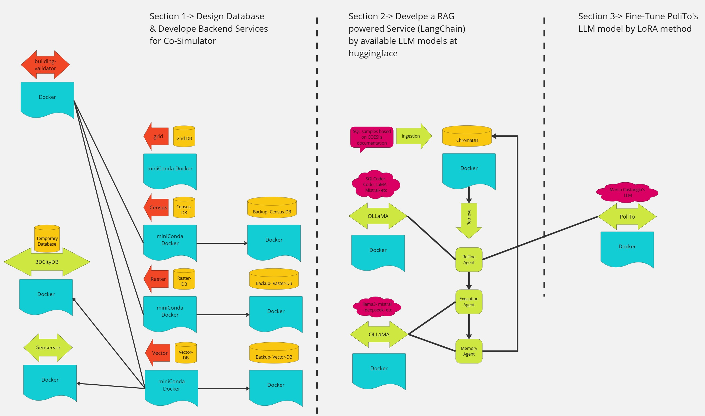
Define objectives for LLM powered Service
Accept user prompt and convert it to SQL command base on our DB schema
Refine the SQL Command
Return the requested data (Create the proper API request Base on our DB service)
Update the sample dataset

Slide 4



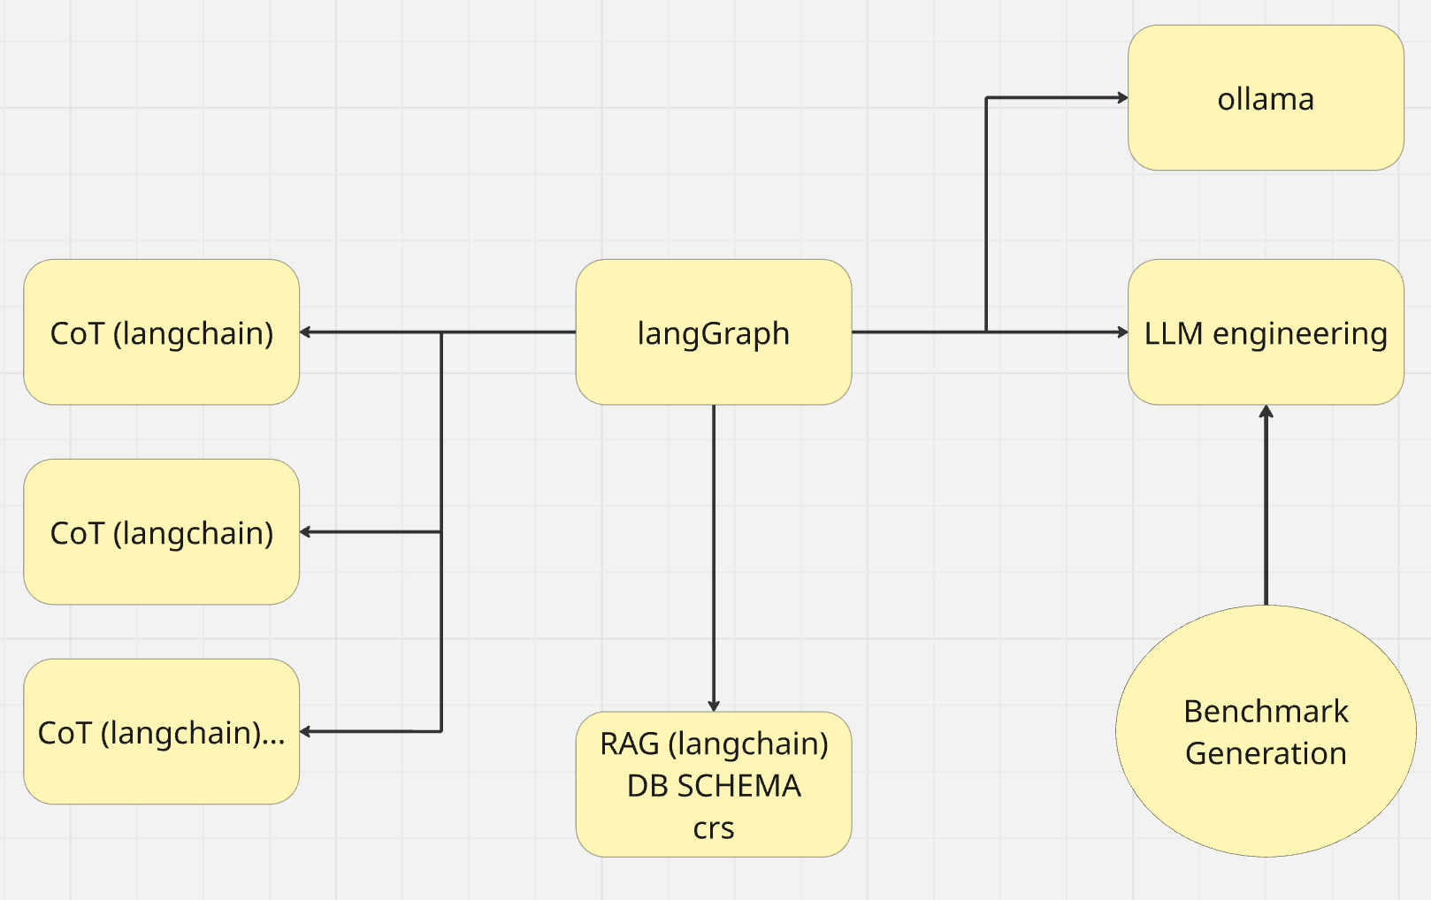


AI Engineering text2spatialSQL 1- Benchmark Generation fortuning and evaluating our AI
2- fine-tune LLM engine
3- RAG to project specificproject 2 conceptual spatialschema, crs,...
3- CoT to project specific project2 conceptual spatial schema,crs,...
4- Agentic Agent to useRAG/CoT/Tools to Deliver theresults

Slide 5
1- Benchmark generation text2spatialSQL
1-0-Introduction
1-1- Generate core dataset pairs of NLP to ground truth spatial sql
1-2- Syntactic data generation

Slide 6
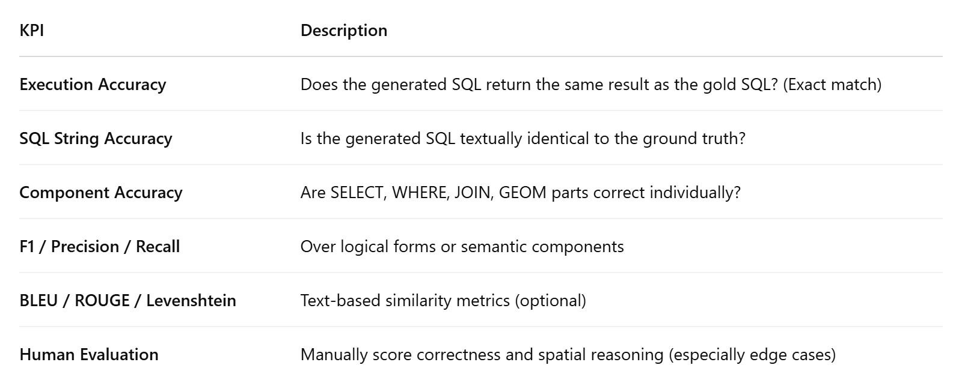
1-0- introduction, AI Evaluation, Gap in NLP2SpatialSQL Benchmark, dataset vs benchmark
Basic Metrics:
1-Parameters
2-Context Length
3- Pricing
Results:
1-Benchmarks
2-Leaderboard
3-Arenas

Slide 7
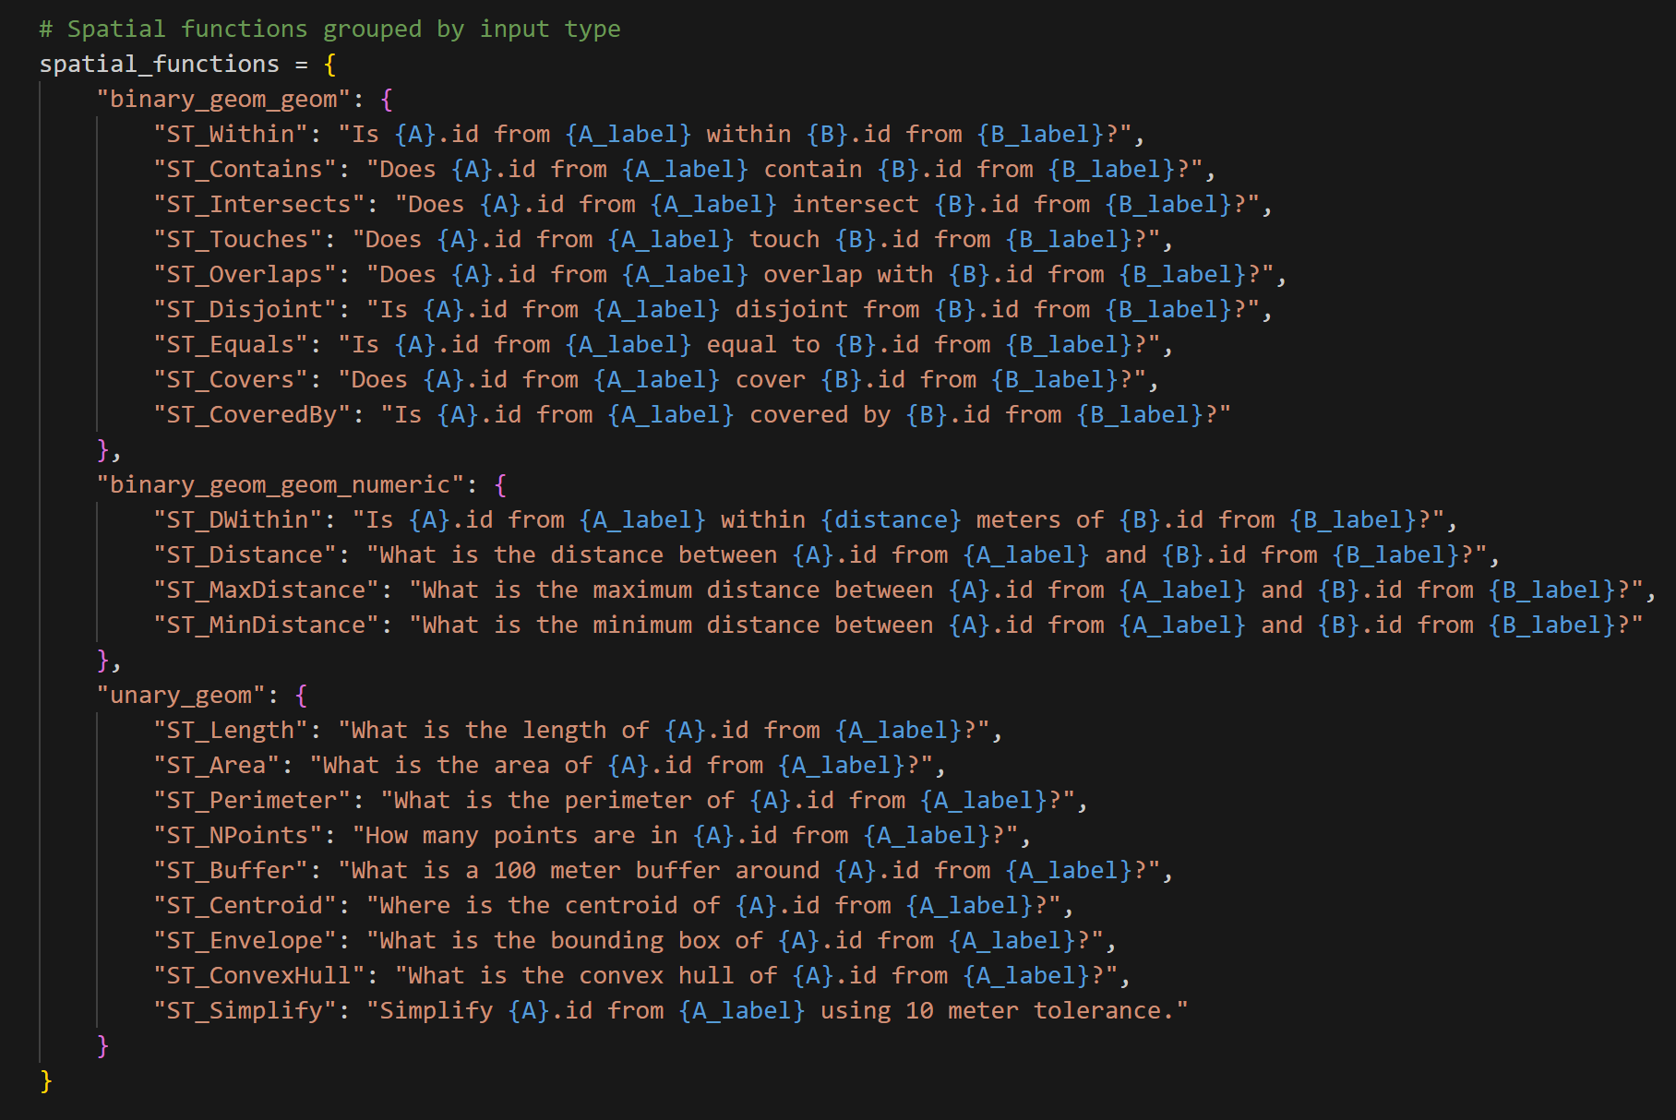
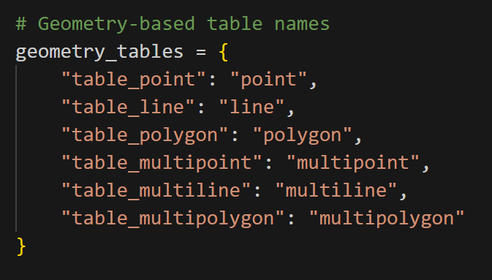
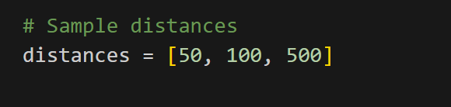
1-1- Benchmark NLP generator- Only SELECT, No DROP DELETE UPDATE

Slide 8
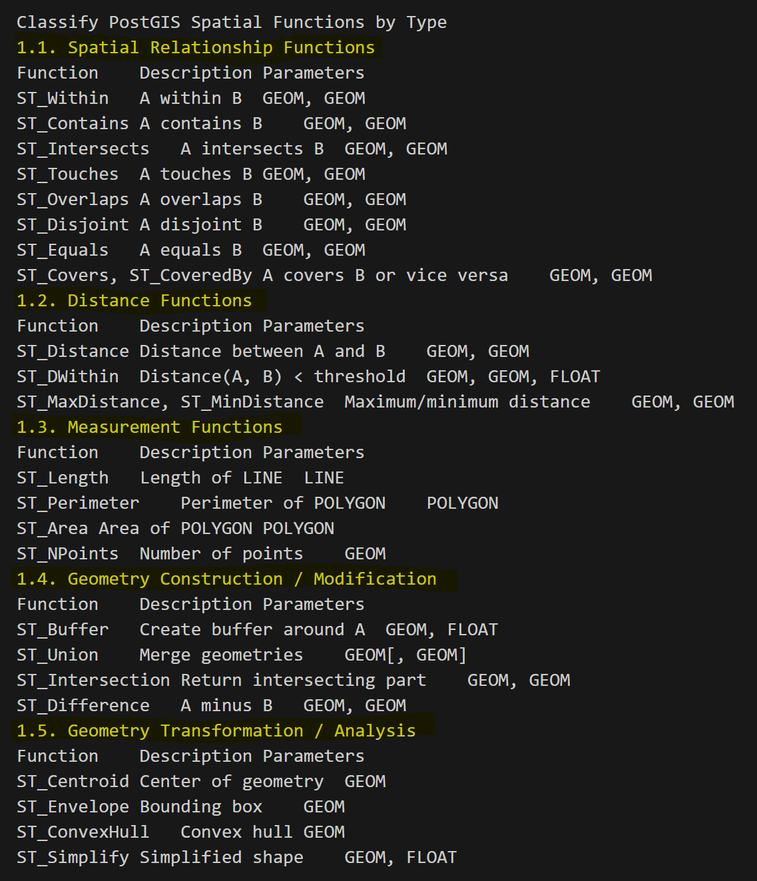
1-1-1- core PostGIS functions
Spatial Relationship Functions
Distance Functions
Measurement Functions
Geometry Construction / Modification
Geometry Transformation / Analysis

Slide 9
2- Fine-tunning LLM load base model without quantization using 8 bit using 4 bit
System requierment: for 8B parameter -->32GB VRam or 2x24GB
Llama (context_size:128256, Embed_dimentionality:4096)
LlamaDecoderLayer:
Self_attention
q_proj
k_proj
v_proj
o_proj
rotary_emb
Mlp
Gate_proj
Vp_proj
Down_proj
Act_fn SiLU
Input layer norm
Post attention layer norm
Lm_head

Slide 10
2-2- QLoRA (Quantized Low Ranked Adapter)
Three Essential Hyperparameters
r -> Rank (start with 8 then 16 then 32)
Alpha -> Scaling Factor (double r)
Target Modules -> (Target the attention head layers – and maybe Output)
PEFT (Parameter Efficient Fine Tunning)
Fine_tuned_model = PeftModel.from_pretrained(base_model,FINETUNED_MODEL)

Slide 11
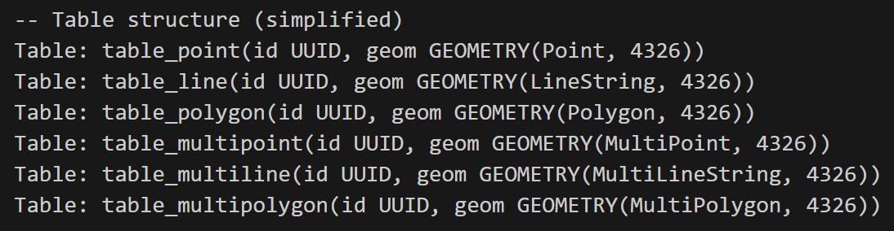
3- RAG/CoT - Adapt specific project for text2SpatialSQL AI
Describe schema (tables and their attributes)

Slide 12
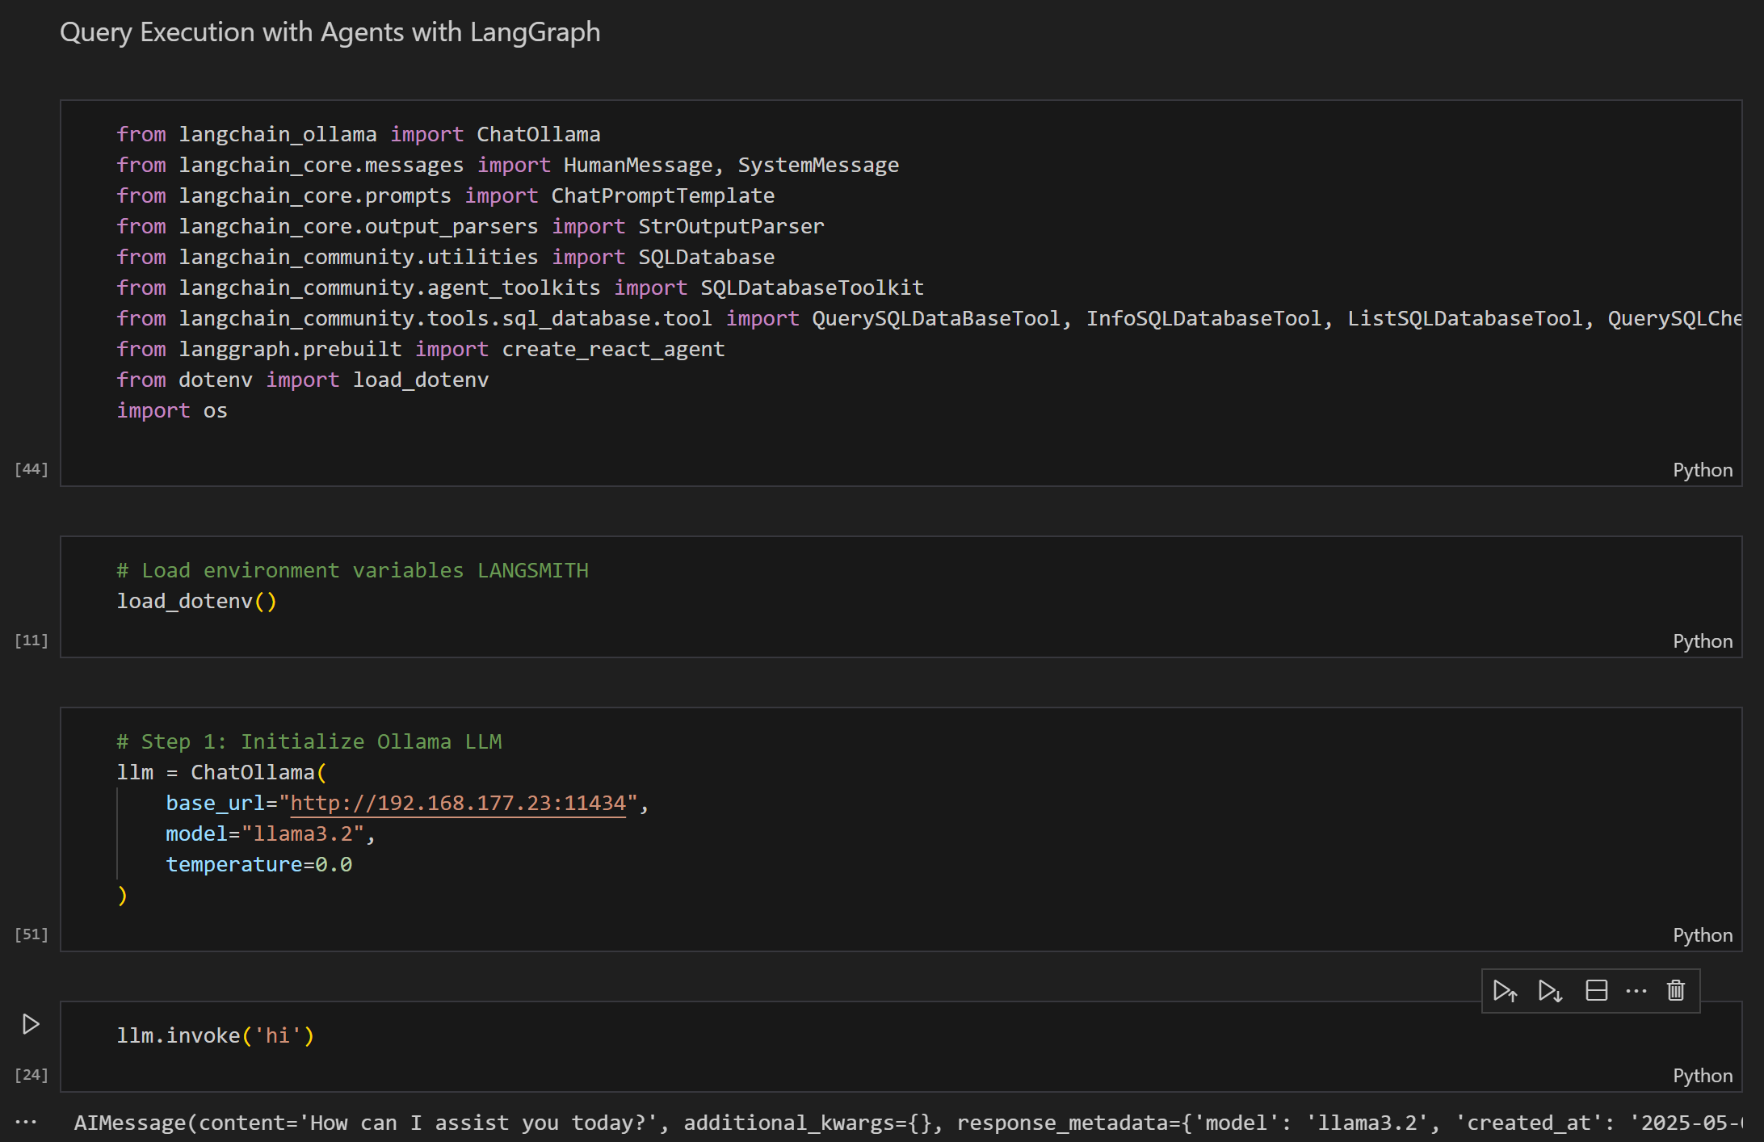
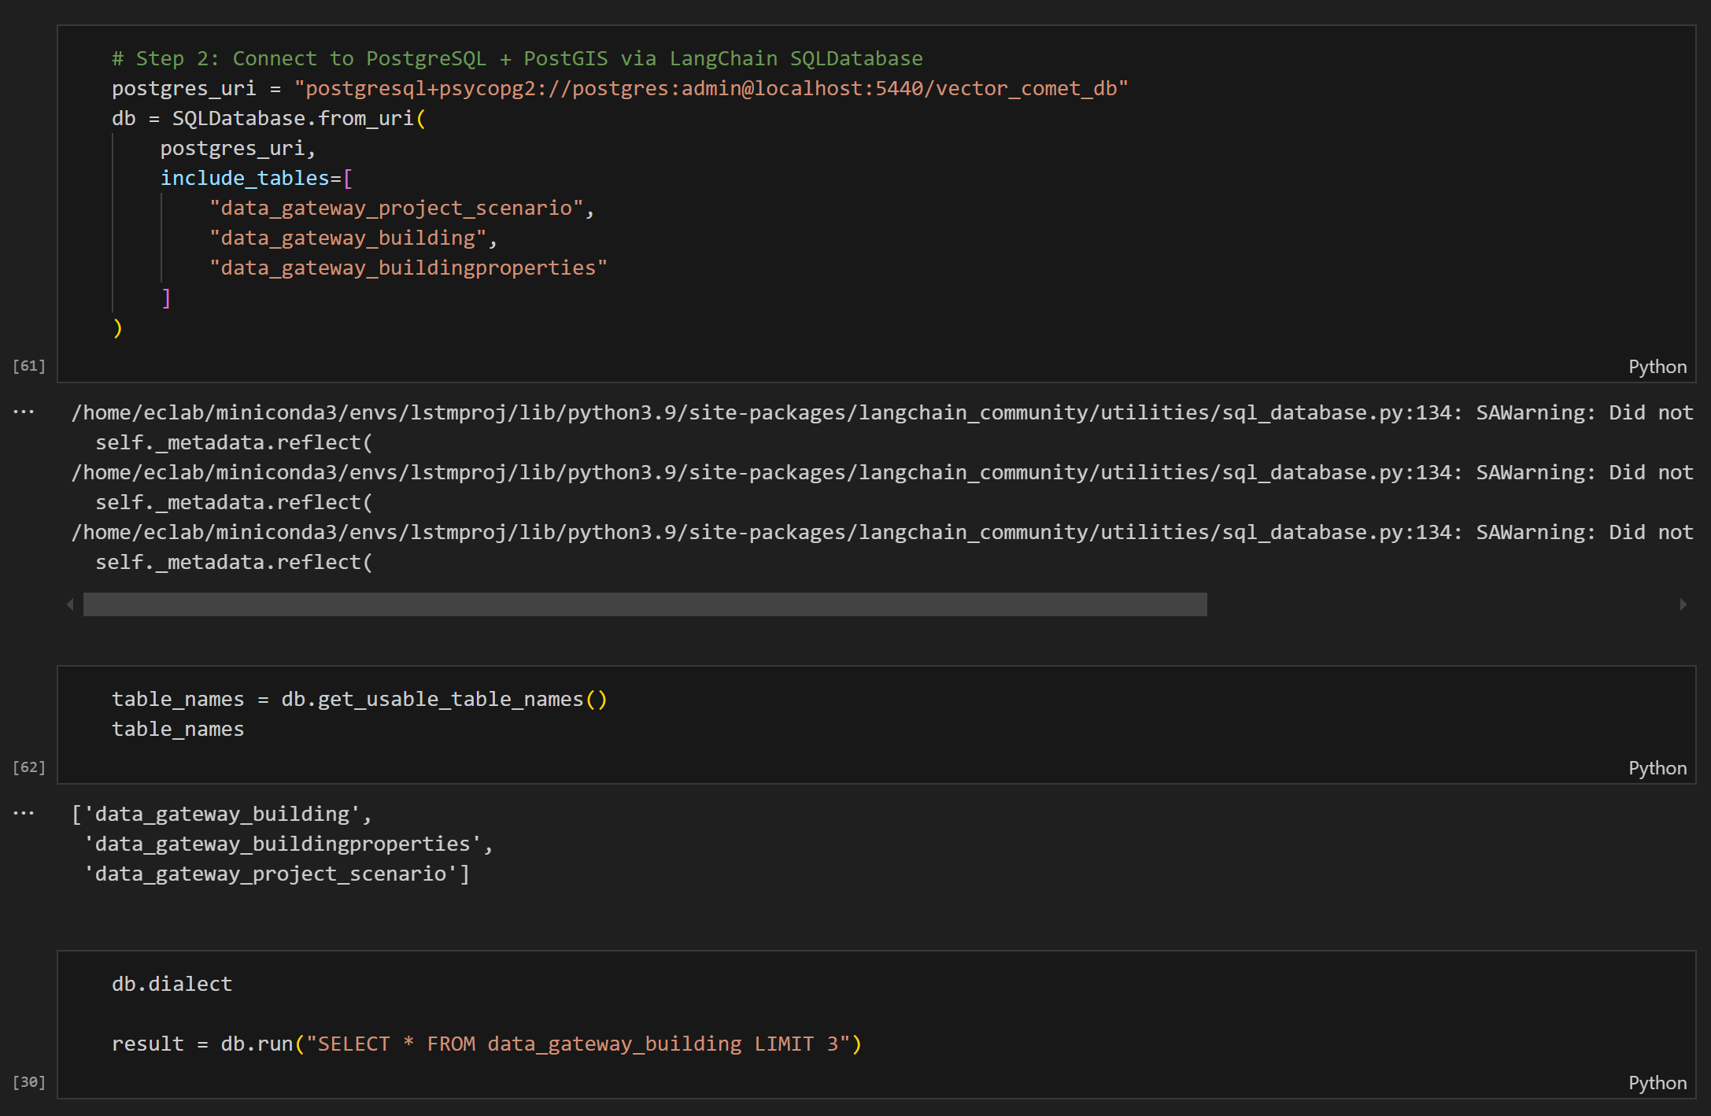
4- Agentic Agent to use RAG/CoT/Tools to Deliver the results
4-1- set Ollama& DB

Slide 13
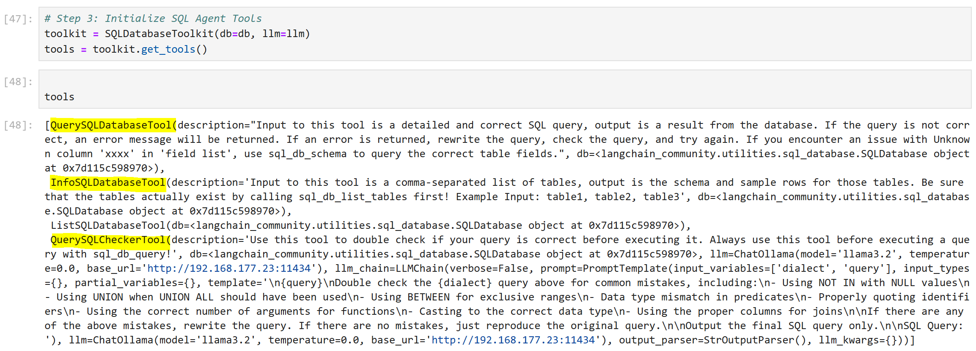
Langgraph Agent - tools

Slide 14
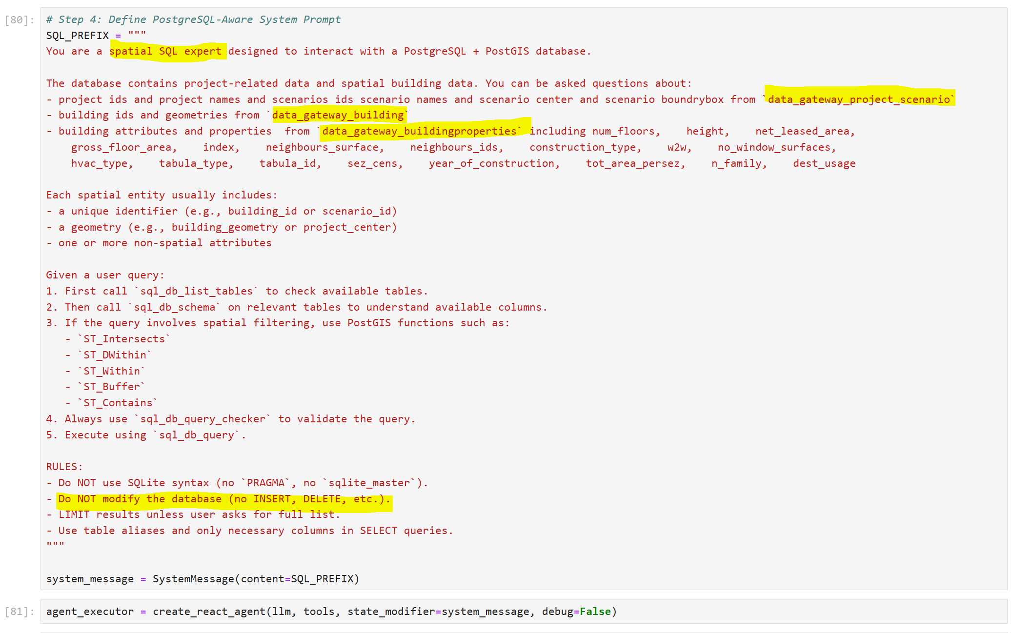
Langgraph Agent - Prompt

Slide 15
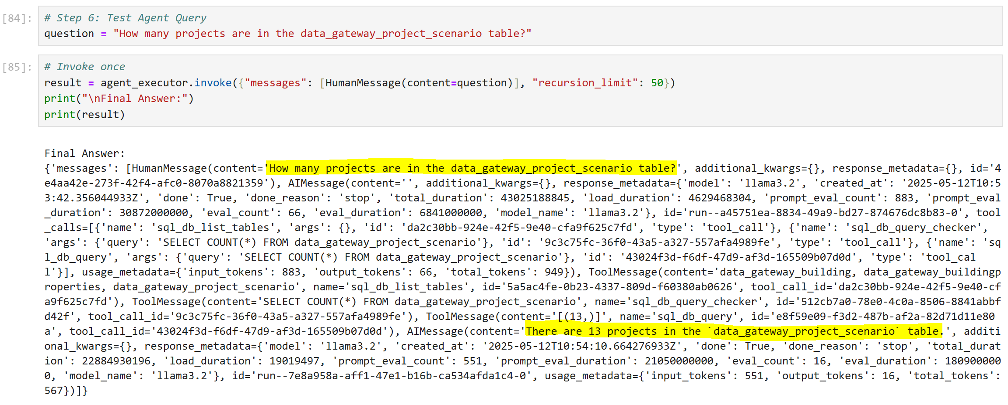

Slide 16
