Slide 1
Ontolgy, Semantics and Knowledge Graph, transdisciplinarity and so on.. Semantic Layer for new System and Software Engineering

Slide 2
Semantic Layer
Maps data to concepts, dimensions, measures, models, and results

Slide 3
Terms
List of Business Terms

Slide 4
Glossary
Terms + Definitions List of terms and their definitions, often used to align understanding across teams. Controlled Vocabulary

Slide 5
Taxonomy
Glossary + Hierarchical Structure A hierarchical classification system that organizes concepts into parent-child relationships

Slide 6
Ontology
Taxonomy + Relationtioships A formal model of concepts, attributes, relationships, and axioms within a domain, enabling shared understanding and reasoning

Slide 7
Knowledge-based
Ontology + Data A formal model of concepts, attributes, relationships, and axioms within a domain, enabling shared understanding and reasoning

Slide 8
competency questions
Ontology Development approach
Competency questions are user-oriented interrogatives that allow us to scope our ontology. In other words, they are questions that our users would want to answer by exploring and querying the ontology and its associated knowledge base.

Slide 9
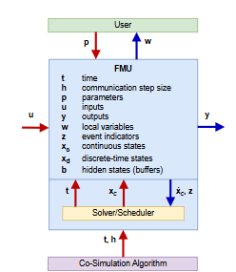
Co-simulation –based concept
Concept | Definition
Co-simulation Framework | Software architecture able to perform simulation by coupling and managing standalone subsystems (Simulators) while using their native domain-specific tools and languages in a black-box manner in a shared and distributed simulation environment. The co-simulation approach takes care of time synchronisation and data exchange management between the simulators and the shared simulation environment through the orchestrator algorithm in order to achieve the given Scenario.
Simulator | It is a software package that handles one or more simulation units of particular subsystems and provides functions for multiple instantiation, initialisation, advancing time and data propagation among the simulators. In general, the simulator should be capable of execute the model calling the following functions: initialization(), instantiation(), set_data(), do_step(), get_data(), terminate()
Simulation Unit | It represents a subsystem composed by a model and a solver.
Model | It is a representation of a subsystem with a certain level of detail, abstraction and perspective defined by its formal language, structure, characteristics, input variables, and parameters, and interpreted by a solver.
Solver | It is a software or library the solves a (mathematical) problem. In particular, it is generally specialised in solving a particular and domain-specific problem taking a formal problem description, i.e. the model, and calculating its solution
Scenario | A set of background assumptions on the system, sub-systems, and its environment that put a Use Case (or a group of Use Cases) in a certain context.
Use Case | It defines a user’s view (actors, stakeholders) thorugh interactions with (and within) the system to achieve a specific goal/outcome .
System | A set of interrelated or interacting elements. The term System is used in the ISO/IEC/IEEE 42010:2022 to refer to entities whose architectures and behaviours are of interest. The entities may be configured with one or more of the following: hardware, software, mathematics, data, humans, processes (e.g., processes for providing service to users), procedures (e.g. operator instructions or control strategies), facilities, materials, and naturally occurring entities.
Architecture | Fundamental concepts or properties of a System in its environment embodied in its elements, relationships, and in the principles of its design, functionality, and evolution. Following ISO/IEC/IEEE 42010:2022.
Case Study | Study and implementation of the system or sub-system with the aim of verifying or build the theoretical models, algorithms, and show its applications

Slide 10
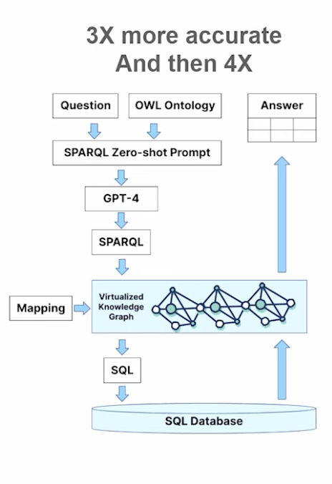
Next Actions
Lit and SoA on coesi and linked (ontology, simulation etc.)
Planning on semantics stuff with coesi (OKR) (AI-Assisted Ontology Creation, etc..)
Zotero group https://www.zotero.org/groups/6419675/settings/members
Creating Ontology (OWL/RDF, ttl, shared, ONE)
First KG should be on Metadata!
Coding Agent
https://github.com/Hawksight-AI/semantica
https://timbr.ai/timbr-core/ontology-based-semantic-layer/

