Slide 1

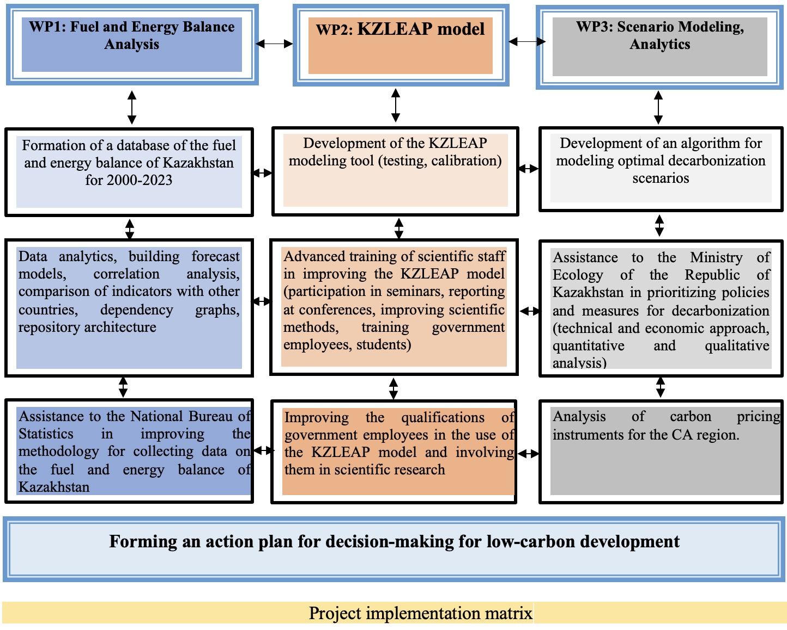
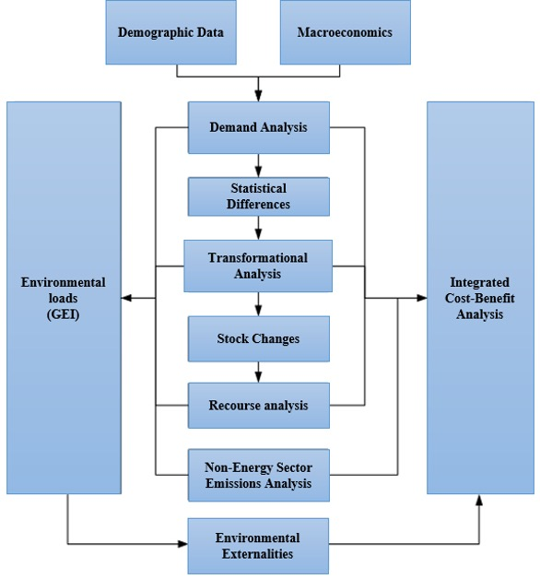





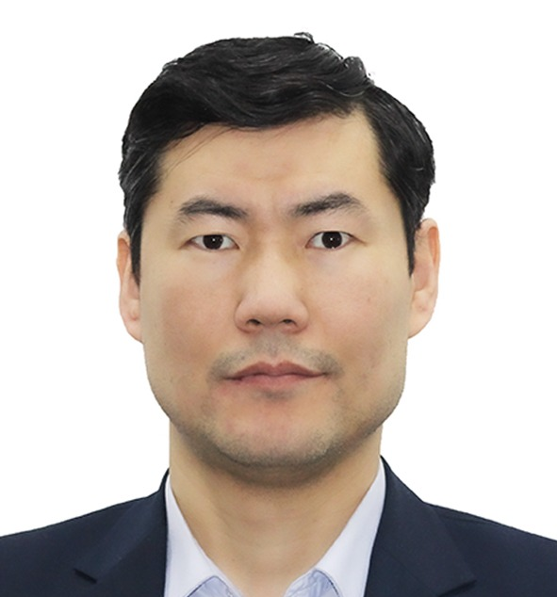


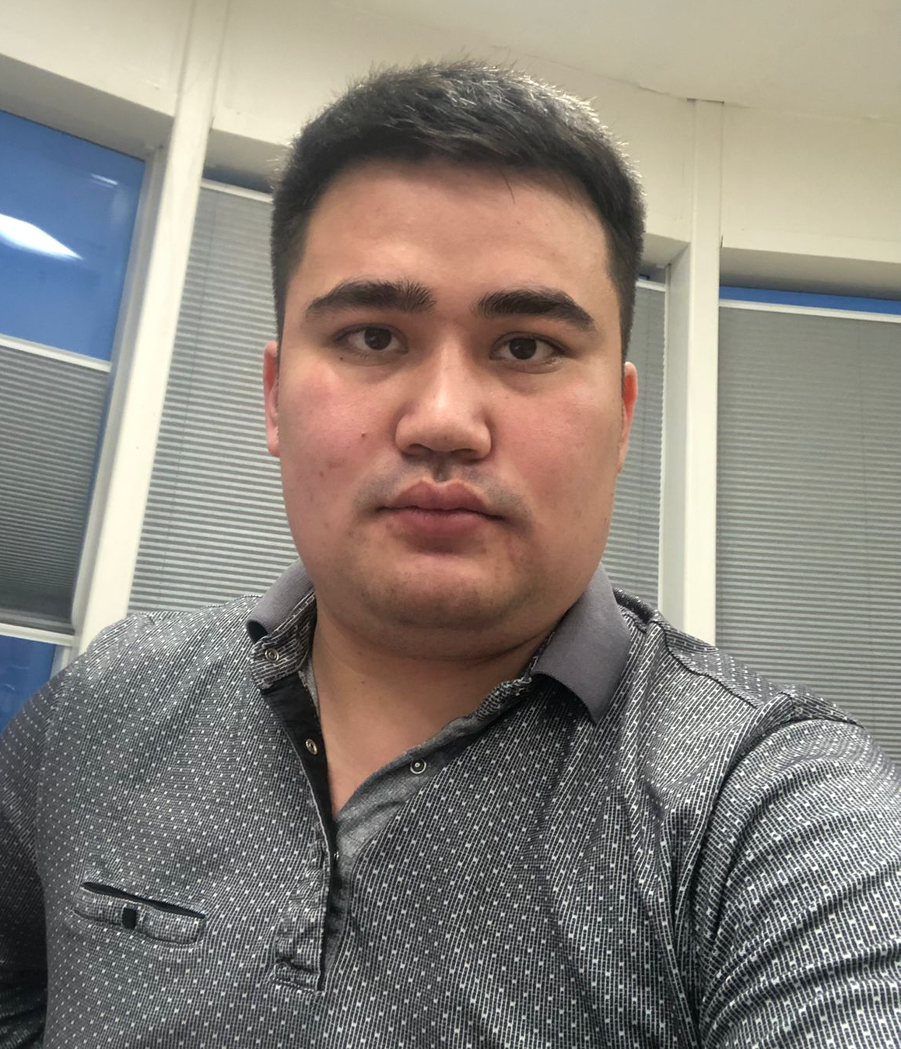
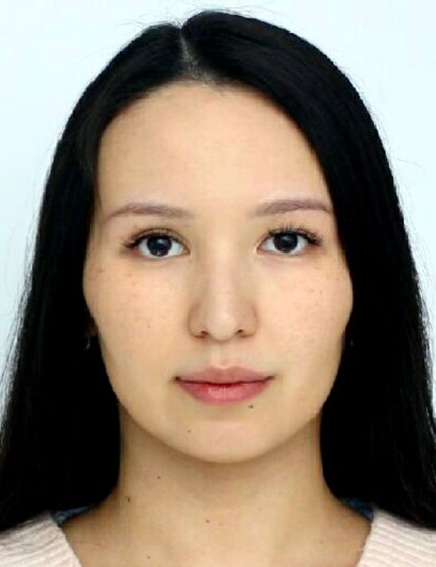
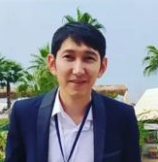
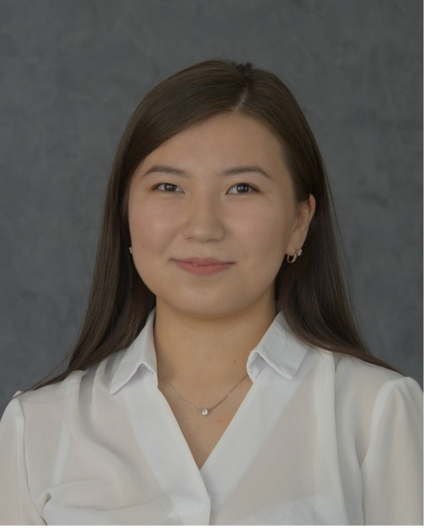

Modeling the fuel-energy balance of Kazakhstan (LEAP-KZ) to analyse decarbonisation scenarios and carbon pricing instruments
Principal investigator (PI): N. K. Zhakiyev Grant of the Ministry of Science and Higher Education of the RoK
Project duration: 08.2024-12.2026
Aim
Graphical Abstract
Development of a comprehensive modeling tool for the fuel and energy balance of Kazakhstan (LEAP-KZ), formation of an action plan for decision-making on an energy transition and analysis of carbon pricing instruments with a holistic cross-sectoral vision for the development of a green economy and achieving carbon neutrality.
Tasks
1. Analysis of the fuel and energy balance.
2. Development of the KZLEAP model.
3.Modeling of development scenarios, quantitative and qualitative analytics.
Current results
Research Methods
Energy system models are used to analyse long-term policies and pathways to reduce greenhouse gas (GHG) emissions. It is necessary to create 'net zero' or 'net-negative emissions' energy systems that decarbonize the entire economy, covering energy supply and demand, as well as other sources of emissions, including industrial processes, agriculture, and land use. A subset of these models are engineering-economic models that minimize the costs of achieving exogenously given annual reductions in GHG emissions to limit the increase in average global temperature. Their results, called deep decarbonization models (DDMs), include levels and timing of energy investment that meet projections of future energy demand across all energy sectors over several decades.
Modeling structure
Research Tool
LEAP (Long-range Energy Alternatives Planning) is an integrated modeling tool that can be used to track energy consumption, production and resource extraction across all economic sectors over medium to long term forecast periods. It can also be used to account for sources and sinks of greenhouse gas emissions from both the energy and non-energy sectors, as well as emissions of local and regional air pollutants.
LEAP calculation structure
Partners
International partners
National partners
Expected results
Tasks (WP- work packages) | Expected results
WP1. Analysis of fuel and energy balance | Data analytics, building forecast models, correlation analysis, comparison of indicators with other countries, dependency graphs, repository architecture. Collected data (datasets in monthly and seasonal resolution) included in the fuel and energy balance and collection of emissions data. Data processing in the SQL, Python, MS Excel, Wolfram Mathematica software environment.
WP 2. Development of the KZLEAP model | Simulation and simulation of various scenarios; Design and build an open, transparent and integrated modeling platform to assess low-carbon transition pathways for Kazakhstan's energy system in LEAP. Training in the field of modeling in LEAP and the formation of human capital of experts. Improving the qualifications of scientific staff in improving the KZLEAP model (participation in seminars, reporting at conferences, improving scientific methods, training undergraduates). Quantitative exploration of scenarios for medium- and long-term decarbonization pathways. Improving the qualifications of government employees to use the KZLEAP model and involving them in scientific research.
WP 3: Development scenario modeling, quantitative and qualitative analytics | Building scenario analyzes using the LEAP model for energy planning and climate change mitigation assessment. Exploring the potential of CA to develop carbon market pricing instruments to accelerate regional decarbonization and realize the benefits of sustainable energy cooperation in the region.
Project Team
Nurkhat Zhakiyev
PI, PhD in Physics. Head of the Department of Science and Innovation
Gulden Ormanova
Aidyn Bakdolotov
MS in Engineering (Purdue University). Director of Climate change Center, Economic Research Institute
Gulmira Ismagulova
Ruslan
Omirgaliyev
Ayagoz Khamzina
Mirat Karibayev
Balzhan Azibek
Ainur Medetkhan
Senior Researcher,
PhD in Science, Engineering and Technology (Nazarbayev University)
Project expert on macroeconomic analysis, carbon regulation and methodological
issues of primary
data processing
Researcher,
MSc in Electrical & Computer Engineering. Senior-lecturer, Astana IT University
Research associate
(MSc in Chemical Engineering)
Research Assistant,
PhD in Chemical Engineering
(Nazarbayev University)
Junior Researcher,
MSc in Electrical and Computer Engineering,
Senior-lecturer, Astana IT University
Junior Researcher,
MSc in Technical Sciences (Thermal Power Engineering, L.N.Gumilev Eurasian National University)

