Slide 1
Determining of Music Genres
Enes AYTEKİN
Çağatay DEMİREL
Advisor: Asisst. Prof. Mehmet BARAN

Slide 2
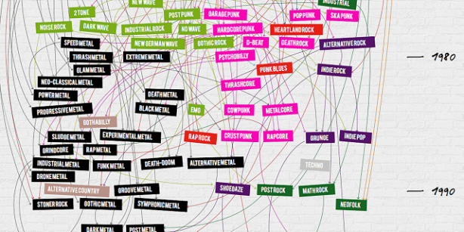
Definition of Project
Why this Project?
People wants to discover new musics.
Extendable larger projects
It touches daily life
Learn Artificial Intelligence and Machine Learning
Notes:
In daily life everyone listens music. Sometimes you stuck a music and listen all the time. And you can think about I want to discover new musics especially like this. This project allows to you discover new music that you want to listen more. Because if you don’t have enough information about music, you won’t find or it will be troublesome moments. Either you can find this project and it will be easier moments. We will see how this project works.
Artificial Intelligence and Machine Learning technologies are one from the fast growing engineering technologies.

Slide 3
Outline
Aims of the Project
Related Works
Project Scope
References
Notes:
We will see first aims of this project I was mention about in first slide but you will learn more information about this project.
We will see what they have done before.
We will see how big this project on the scope part.
And references.

Slide 4
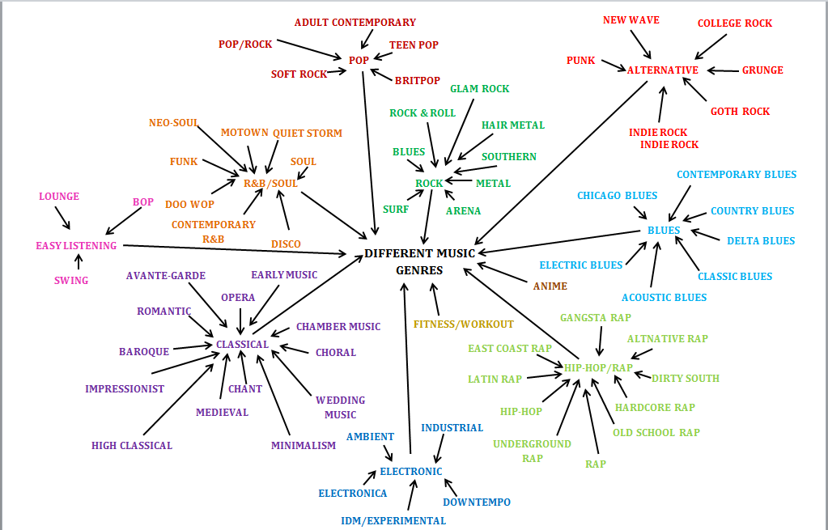
Aims of Project
Discovering new musics by genres.
Decrease time for finding new musics.
Automate the music genres.
Notes:
- Aims of this project are discovering new musics by genres, decrease the time for finding new music that are classified you liked and most important one automate the music genres. Our goals to realize these three statements. We will explain how you will find in methodology and technical approach parts. By the way most of the music web-sites seperate music genres by their hand. We are going to success this will happen automated. This make us exciteful about this project.

Slide 5
Related Works
Speech Recognition
Music vs. Speech Classification
Beat Tracking and Rhythm Detection
Notes:
Speech recognition is perhaps the most fundamental audio classification problem: giving a computer the ability to analyse and understand
speech. This task is generally difficult due to the large number of ambiguities in spoken language.
Music vs. Speech Classification: Speech recognition systems work well on speech input, but do not provide usable results when music is fed into the system. Likewise, it does not make much sense to try and determine the music genre of a phone conversation.
Beat Tracking and Rhythm Detection: Tapping their foot along with a musical performance is an easy thing to do even for nonmusicians,
but has been found to be a challenging problem for automatic systems. Rhythm seems to be one of the key elements of musical information. Beat tracking systems are therefore an important part in music genre recognition.

Slide 6
Scope of Project
Knowledge of HMM –Hidden Markov Model-
Knowledge of Bayes’ Rule
Knowledge of Baum-Welch Algorithm
Knowledge of Viterbi Algorithm
Knowledge of Artificial Intelligence & Machine Learning
Knowledge of Signals & Systems
Knowledge of HTK (Toolkit)
Knowledge of Gaussian Mixture Model
Notes:
These are what we need in the project. Every algorithms related to each other.

Slide 7

Understanding HMM
Notes:
In simpler Markov models (like a Markov chain), the state is directly visible to the observer, and therefore the state transition probabilities are the only parameters. In a hidden Markov model, the state is not directly visible, but output, dependent on the state, is visible. Each state has a probability distribution over the possible output tokens. Therefore the sequence of tokens generated by an HMM gives some information about the sequence of states.
For better understanding, we will explain on some animations. These animations, created by us. Focus on the man, this man we called him –lazy man- lives in 1950’s and likes ice-cream. Let’s say this lazy man eats ice-cream everyday and he writes in his diary that how many ice-cream eaten.
/*consider the case of the future archaeologist trying to infer the weather from a diary keeping track of the number of ice cream cones eaten by somebody. The archaeologist doesn't know the weather each day — it's the hidden state, either cold or hot. The only observations (emissions) are the number of cones eaten, as recorded in the diary. Transitions indicate whether the actual weather stays the same (likely) or switches (less likely), from day to day. Emissions indicate how many cones were eaten for the day, depending on whether it was hot (tends to be more) or cold (tends to be fewer). And somehow the whole process gets started, so we have a "start" state with equally likely transitions to go to a hot day or a cold day. (The same could be true of our game, or maybe there's a fixed start state.)*/

Slide 8
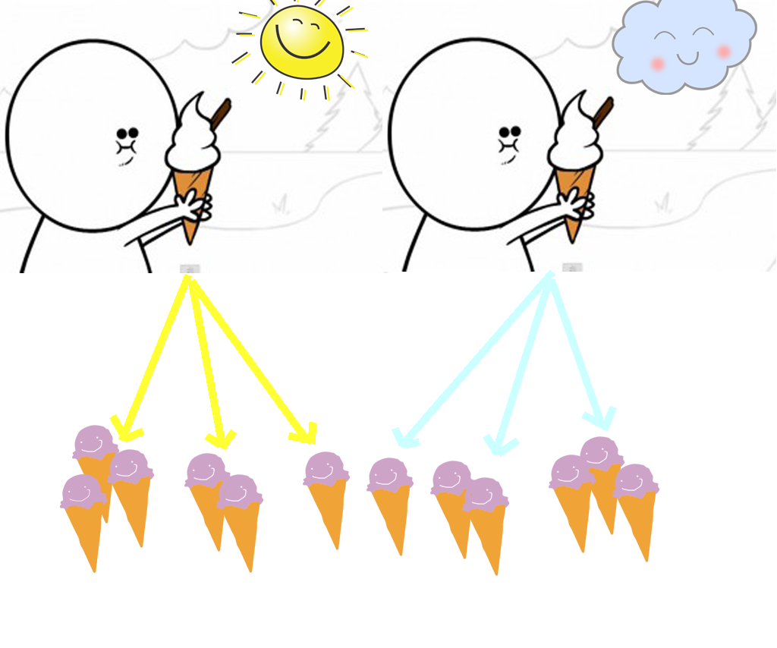
Notes:
This lazy man continues to eat ice-creams and notes day by day. He can eat at most 3 ice-creams and at least 1 ice-cream. We don’t know that how he decides to how many ice-cream will eat. We can just assume that in the sunny days, he can eat more ice cream and vice versa.

Slide 9
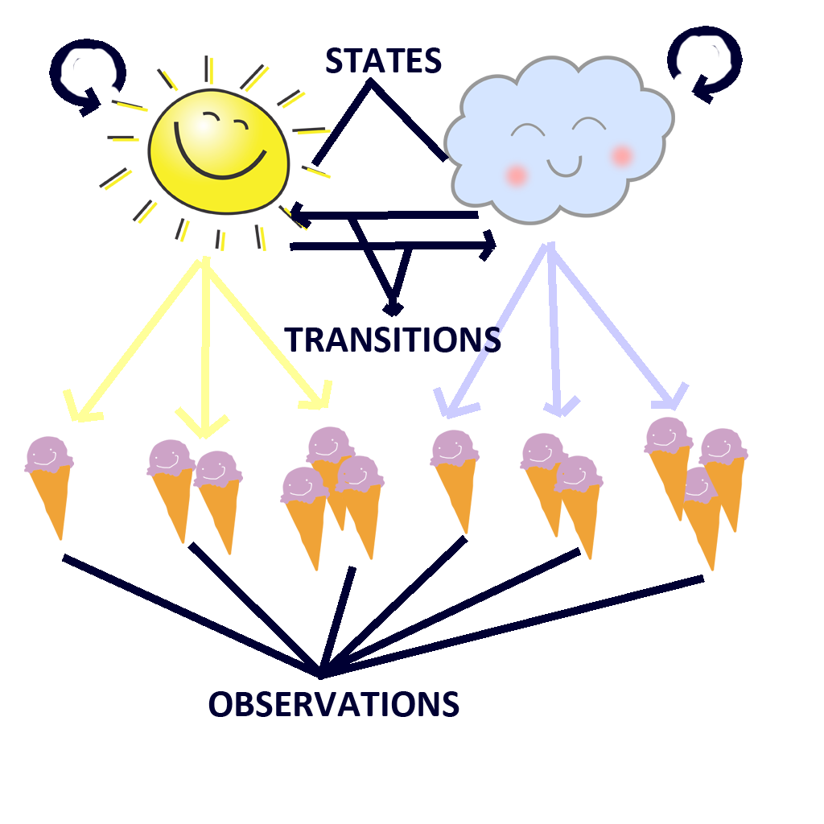
Notes:
Now, we are in the Baum-Welch algorithm. We have two conditions such as cloudy and sunny day. According to Baum-Welch algorithm we called this conditions as a state. And probablity of weather conditions we called them «transitions». For example if today is sunny and tomorrow must be sunny or cloudy and they have some probablities. Oh, I forgot to write blue and yellow line’s name. I must be hungry when I created these animations. Anyway, we called these lines «emitions». Belonging to these states we have some conclusions and we called them «observations». All these names have probablities.

Slide 10
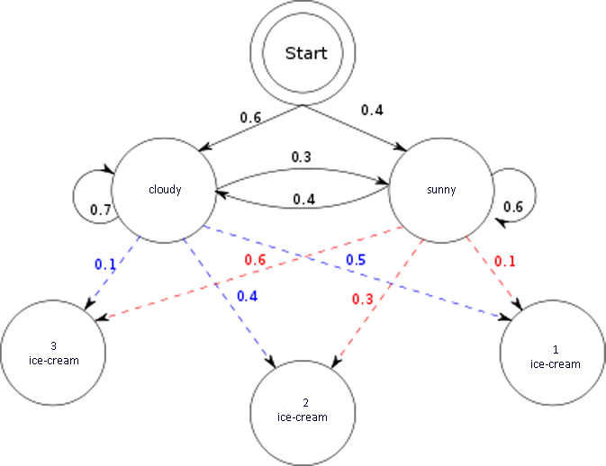
Example of Hidden Markov Model
Notes:
Here, there is a diagram that generated from us. This is called simple Hidden Markov Model. Let us continue to explain more HMM and Baum-Welch algorithm relations.
/*Baum–Welch algorithm is used to find the unknown parameters of a hidden Markov model. As we mention about the models. Let’s say we have number of sets that ice-creams. And we assume that this can be our probablities. */

Slide 11


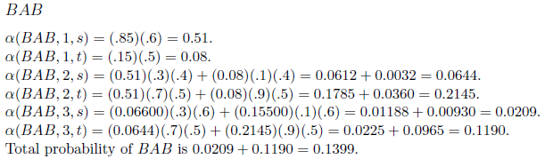
Forward Algorithm
Notes:
In this section i will tell you baum-welch algorithm. Baum-welch consist of forward, backward, gamma creation and delta creation. This is forward algorithm. Lets make it simplier. For this example, there are two states name “s” and “t” and there are two emission types as «A» and «B». Lets think that we observed sequence named «BAB» from nature. Forward algorithm, will find probability of creating BAB from this model from first letter to end. ☺ I say front-trace ☺

Slide 12

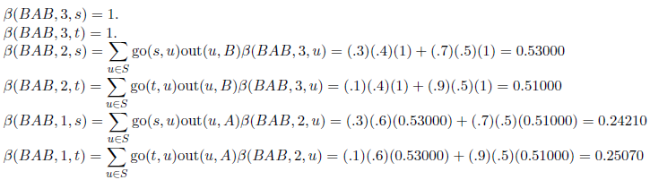
Backward Algorithm
Notes:
This is backward algorithm. There is a little difference between forward algorithm. It finds probability as back-trace. We assume probability of entering last state is 1. Then it goes to first state from last state. These forward and backward outputs will be used in gamma creation.
B(BAB,3,S) = 1
B(BAB,3,T)= 1
B(BAB,2,S) = (S>S)*(S>B)*B(BAB,3,S) + (S>T)*(T>B)*B(BAB,3,T)

Slide 13


Gamma Creation
Notes:
-Gamma algoritm provides, for finding transitions probability. Generally, it combine forward and backward outputs for each time of our observation. It makes better accuracy for finding transitions.
-Also, using gamma outputs, delta outputs will be created.
G(ABBA, 1, t, s) = ALPHA(ABBA, 1, t)*go(t, s)*out(s,B)*BETA(ABBA, 2, s)/Prh(ABBA) = SOME

Slide 14


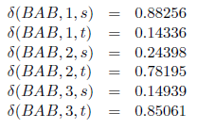
Delta Creation
Notes:
-Delta algorithm is used to find emission probabilities.
-For this example also, when two gamma outputs thats are in same time sequence will be summed and more consistent output will be created. This output , is advanced of gamma outputs and will give more consistent emission probabilities.
Del(BAB, 1, s) = Ga (BAB, 1, s, s)+Ga (BAB, 1, s, t).

Slide 15
Determining Transitions/Emissions
After creation deltas with alphas, betas and gammas, determining new start transitions and immediate transitions and also emissions will be updated from given train set.
For this train process, hidden markov model will be more consistent. Because, train datas will be absorbed from real world. For our project, real data will be feature that extracted from input signal.
Notes:
HMM özeti burada anlatılıyor. Train ederek hidden markov modelimiz daha tutarlı hale geldi.

Slide 16
Viterbi Algorithm
Notes:
Viterbi algorithm is used for testing. This is trellis structure time flows from left to right and for each nodes. For this example, it finds states of given test observation.
-It takes path that has maximum values that coming related node. This process will be implemented for each node.
-If the path will be end in a time. It will be eliminated.
-Finally, there will stay some paths. For this example, there are 5 paths remain. Because, there is 5 states in this hmm. Viterbi takes maximum value of paths. And backtracing states that related time will be founded.

Slide 17
Why do we need these knowledges?
For implementing our project
For recognition
For classification
For developing
Notes:
We didn’t mention about our project. Because it is a reserch project and we have to know firstly how can we do that and follow related work. At the end of the presentation we will show a speech recognition. How can we recognize, classify and develop let’s talk about next slide.

Slide 18
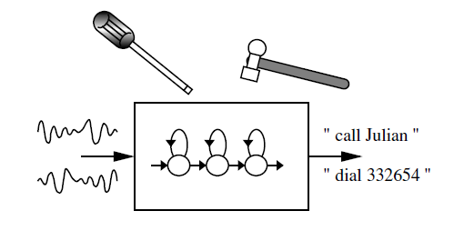
Introduction to Speech Recognition
Notes:
For this part, I will tell you sequence of creating speech recognition system.

Slide 19
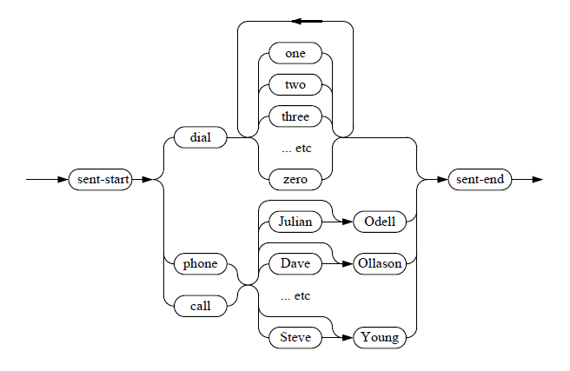
Example Grammar of Speech Recognition
Notes:
This is an example grammar to use in speech recognition. This is Backus–Naur Form to describe the syntax of languages. With using grammar like these, the toolkit that we will use will create automaton.
Backus-Naur Form : In computer science, BNF (Backus Normal Form or Backus–Naur Form) is one of the two^{[1]} main notation techniques for context-free grammars, often used to describe the syntax of languages used in computing

Slide 20
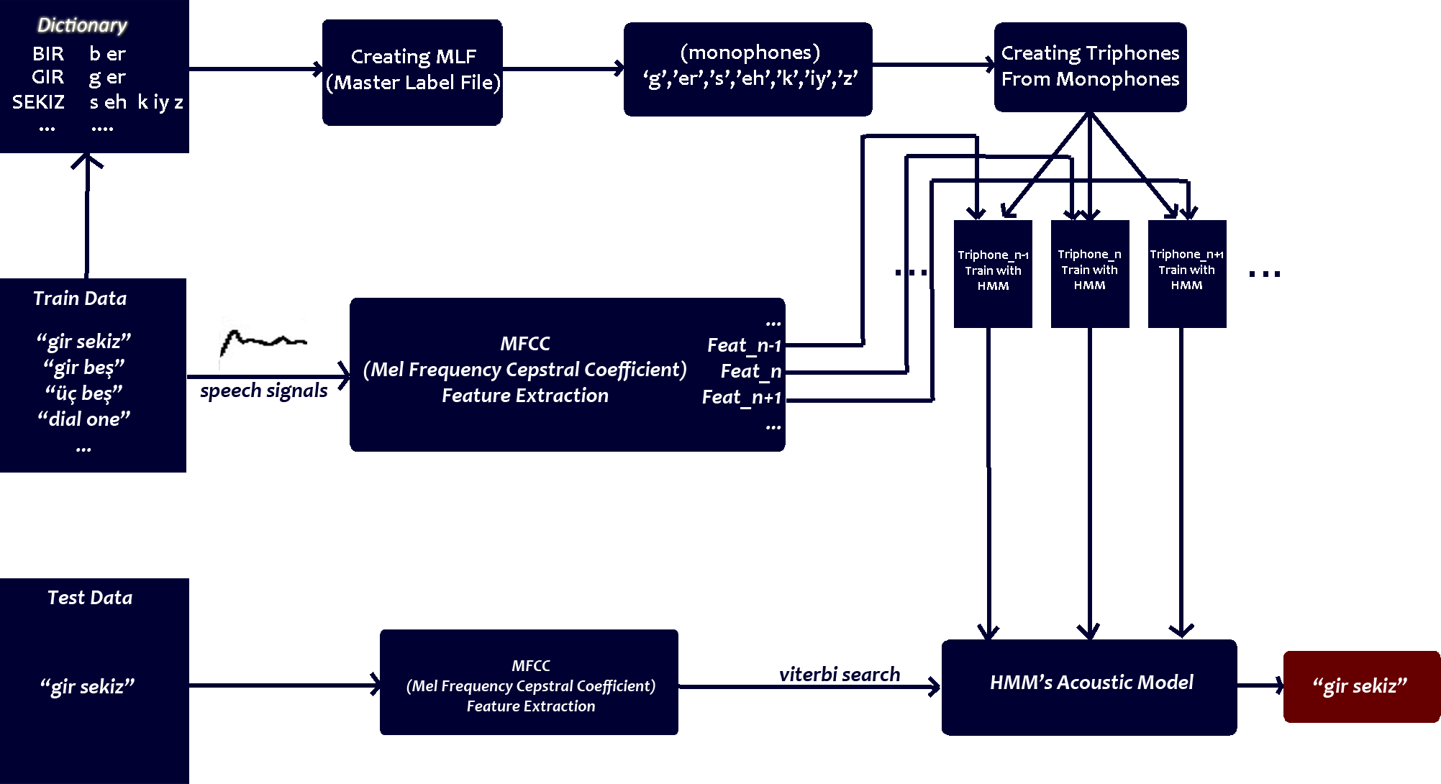
SPEECH DIAGRAM
Notes:
-This diagram is the summary of speech recognition that we implemented. We used voxforge toolkit for this example. Our aim for this example, is to recognize Turkish and English digits in one system. However, we added some Turkish digits with phones manually. Like: “sekiz” ,”dort”, “dokuz” ☺
We used dictionary that contains about 270.000 words from 9 languages to create Master Label File from our train data. Master Label File contains monophones for each word.
Then, we converted real speech signal into feature using Mel Frequency Cepstral Coefficient.
You can say feature is discrete signal that computer can understand.
Then, we created triphones from monophones to increase accuracy in final. It is essential to do. Then we trained features in hmm’s. Each feature is related one triphone. Then these hmm’s will be utterance of triphones and HMM’s acoustic model is created.
Final step is, we gain real voice from user, convert to feature using MFCC and search HMM’s with Viterbi. Then, output will be put into terminal.
By the way, to recognize two different languages we created and used two grammars.
Acoustic : An acoustic model is created by taking a large database of speech (called a speech corpus) and using special training algorithms to create statistical representations for each phoneme in a language. These statistical representations are called Hidden Markov Models ("HMM"s). Each phoneme has its own HMM.
***Determining of Music Genres is much more complicated than this. However, this is kind of similar with it.

Slide 21
Tasks Accomplished
Understanding HMM and HTK
Understanding Bayes’ Rule
Understanding Baum-Welch
Understanding Viterbi
Understanding Julius toolkit
Understanding related works
Creating Speech Recognition
Notes:
In this semester, we are center on research. We learnt these algorithms, rules and technical issues. Next semester, we have faith to complete this project.

Slide 22
Task to be completed
Understanding Gaussian Mixture Model.
Enhance choosing data.
Specify spectrum of genres from music utterance.
Creating harmonics from genres.
Implementing everything that we have learned.
Notes:
Moreover, these are the next semester subjects. Gaussian Mixture Model will the first handled issue. After that, we collect the data. We have to specify them. Creating harmonics can be more specific data. And after all words said from us, we will show a speech recognition. From that knowledge, we are going to use music genre’s recognition.

Slide 23
Difficulties Encountered
Genre standartization
Too many genres.
Need of huge music data.
Not exactly known area.
Notes:
There is a difficulty part to seperate them. Because, in some examples there is a neutral situation. They used neutral one to specify them. In music there is no standart or neutral music in genres. Almost every music related to each other. And there are too many genres. We are first interest 5 big genres. Using these genres cause some disadvantages such as need bigger data. We don’t afraid finding songs but, we don’t know how much do we need. And the most important problem is this area is new for us. And this is just crawling.

Slide 24
Future Plan
Plan A
While playing music, simultaneously wiriting notes.
Plan B
Predict author after given a passage.
Notes:
If we won’t complete – actually we want to complete but in any case- plan a going to go into operation. While playing a song, simultaneously translate to the notes.
If we complete this project, we are get rid of crawling and starting to run. This is one challenge for us, we belive that there are more future plans to do.

Slide 25
REFERENCES
http://millionmusic.net/mp3/about-music-genres
http://www.fastcodesign.com/3021791/infographic-of-the-day/100-years-of-rock-music-in-less-than-a-minute
https://en.wikipedia.org/wiki/Hidden_Markov_model
Example of the Baum-Welch Algorithm, Larry Moss, Q520, Spring 2008
The HTK Book, Steve Young, Gunnar Evermann, Mark Gales, Thomas Hain, Dan Kershaw, Xunying (Andrew) Liu, Gareth Moore, Julian Odell, Dave Ollason, Dan Povey, Valtcho Valtchev, Phil Woodland, Revised for HTK Version 3.4 December 2006

Slide 26
Any Questions

