Slide 1
Determining of Music Genres
Enes AYTEKİN
Çağatay DEMİREL Advisor: Mehmet BARAN

Slide 2
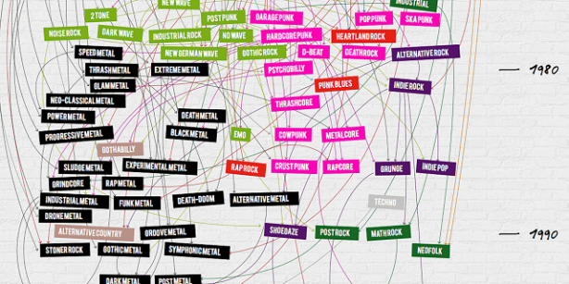
Definition of Project
Why this Project?
People wants to discover new musics.
Extendable larger projects
It touches daily life
Learn Artificial Intelligence and Machine Learning
Notes:
In daily life everyone listens music. Sometimes you stuck a music and listen all the time. And you can think about I want to discover new musics especially like this. This project allows to you discover new music that you want to listen more. Because if you don’t have enough information about music, you won’t find or it will be troublesome moments. Either you can find this project and it will be easier moments. We will see how this project works.
Artificial Intelligence and Machine Learning technologies are one from the fast growing engineering technologies.

Slide 3
Outline
Aims of the Project
Related Works
Project Scope
References
Notes:
We will see first aims of this project I was mention about in first slide but you will learn more information about this project.
We will see what they have done before.
We will see how big this project on the scope part.
And references.

Slide 4
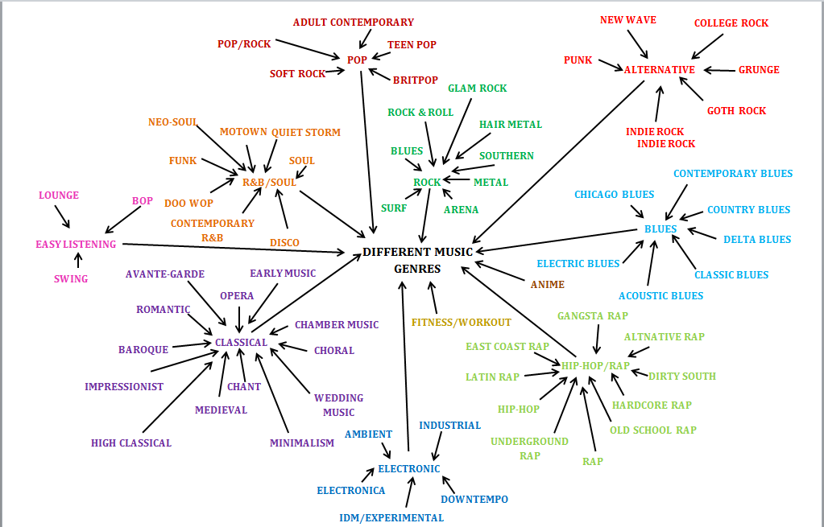
Aims of Project
Discovering new musics by genres.
Decrease time for finding new musics.
Automate the music genres.
Notes:
- Aims of this project are discovering new musics by genres, decrease to find new music that are classified you liked and most important one automate the music genres. Our goals to realize these three statements. We will explain how you will find in methodology and technical approach parts. By the way most of the music web-sites seperate music genres by their hand. We are going to success this will happen automated. This make us exciteful about this project.

Slide 5
Related Works
Speech Recognition
Music vs. Speech Classification
Beat Tracking and Rhythm Detection
Notes:
Speech recognition is perhaps the most fundamental audio classification problem: giving a computer the ability to analyse and understand
speech. This task is generally difficult due to the large number of ambiguities in spoken language.
Music vs. Speech Classification: Speech recognition systems work well on speech input, but do not provide usable results when music is fed into the system. Likewise, it does not make much sense to try and determine the music genre of a phone conversation.
Beat Tracking and Rhythm Detection: Tapping their foot along with a musical performance is an easy thing to do even for nonmusicians,
but has been found to be a challenging problem for automatic systems. Rhythm seems to be one of the key elements of musical information. Beat tracking systems are therefore an important part in music genre recognition.

Slide 6
Scope of Project
Knowledge of HMM –Hidden Markov Model-
Knowledge of Baye’s Rule
Knowledge of Baum-Welch Algorithm
Knowledge of Viterbi Algorithm
Knowledge of Artificial Intelligence & Machine Learning
Knowledge of Signals & Systems
Knowledge of HTK (Toolkit)
Knowledge of Gaussian Algorithm
Notes:
These are what we need in the project. Each algorithms related to again each other.

Slide 7

Understanding HMM
Notes:
In simpler Markov models (like a Markov chain), the state is directly visible to the observer, and therefore the state transition probabilities are the only parameters. In a hidden Markov model, the state is not directly visible, but output, dependent on the state, is visible. Each state has a probability distribution over the possible output tokens. Therefore the sequence of tokens generated by an HMM gives some information about the sequence of states.
a Markov model is a stochastic model used to model randomly changing systems where it is assumed that future states depend only on the present state and not on the sequence of events that preceded it (that is, it assumes the Markov property). Generally, this assumption enables reasoning and computation with the model that would otherwise be intractable.
For better understanding, we will explain on some animations. These animations, created by us. Focus on the man, this man we called him –lazy man- lives in 1950’s and likes ice-cream. Let’s say this lazy man eats ice-cream everyday and he writes in notebook that how many ice-cream eaten.
consider the case of the future archaeologist trying to infer the weather from a diary keeping track of the number of ice cream cones eaten by somebody. The archaeologist doesn't know the weather each day — it's the hidden state, either cold or hot. The only observations (emissions) are the number of cones eaten, as recorded in the diary. Transitions indicate whether the actual weather stays the same (likely) or switches (less likely), from day to day. Emissions indicate how many cones were eaten for the day, depending on whether it was hot (tends to be more) or cold (tends to be fewer). And somehow the whole process gets started, so we have a "start" state with equally likely transitions to go to a hot day or a cold day. (The same could be true of our game, or maybe there's a fixed start state.)

Slide 8
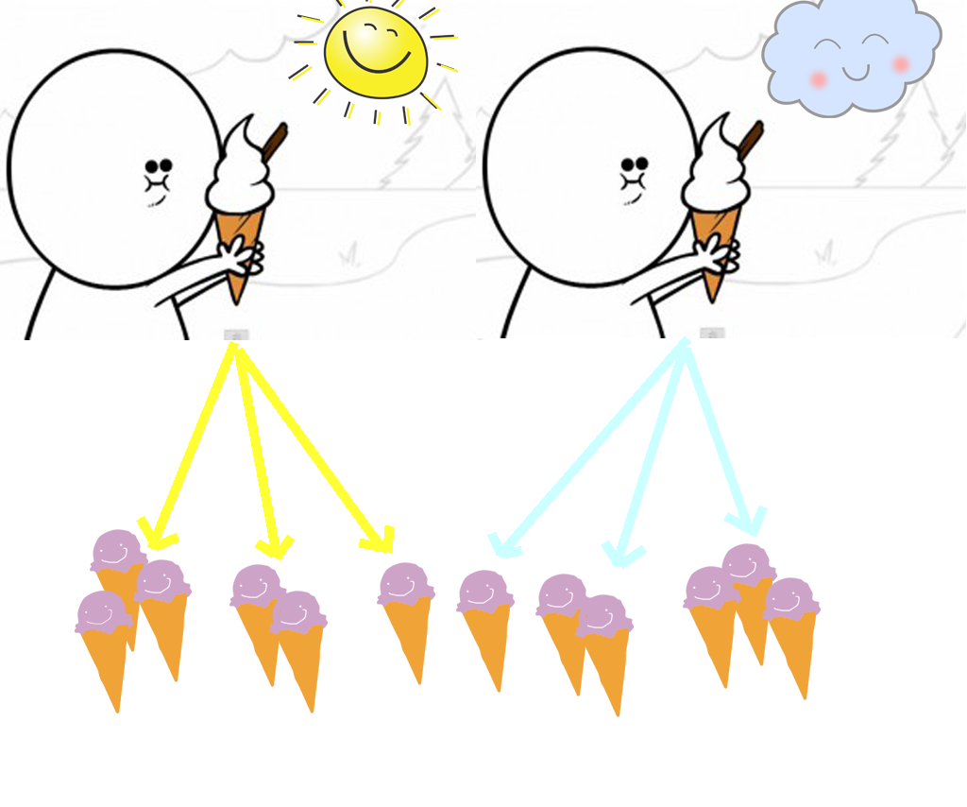
Notes:
This lazy man continues to eat ice-creams and notes day by day. He can eat at most 3 ice-creams and at least 1 ice-cream. We don’t know that how he decides to how many ice-cream will eat. We can just assume that in the sunny days, he can eat more ice cream and vice versa.

Slide 9
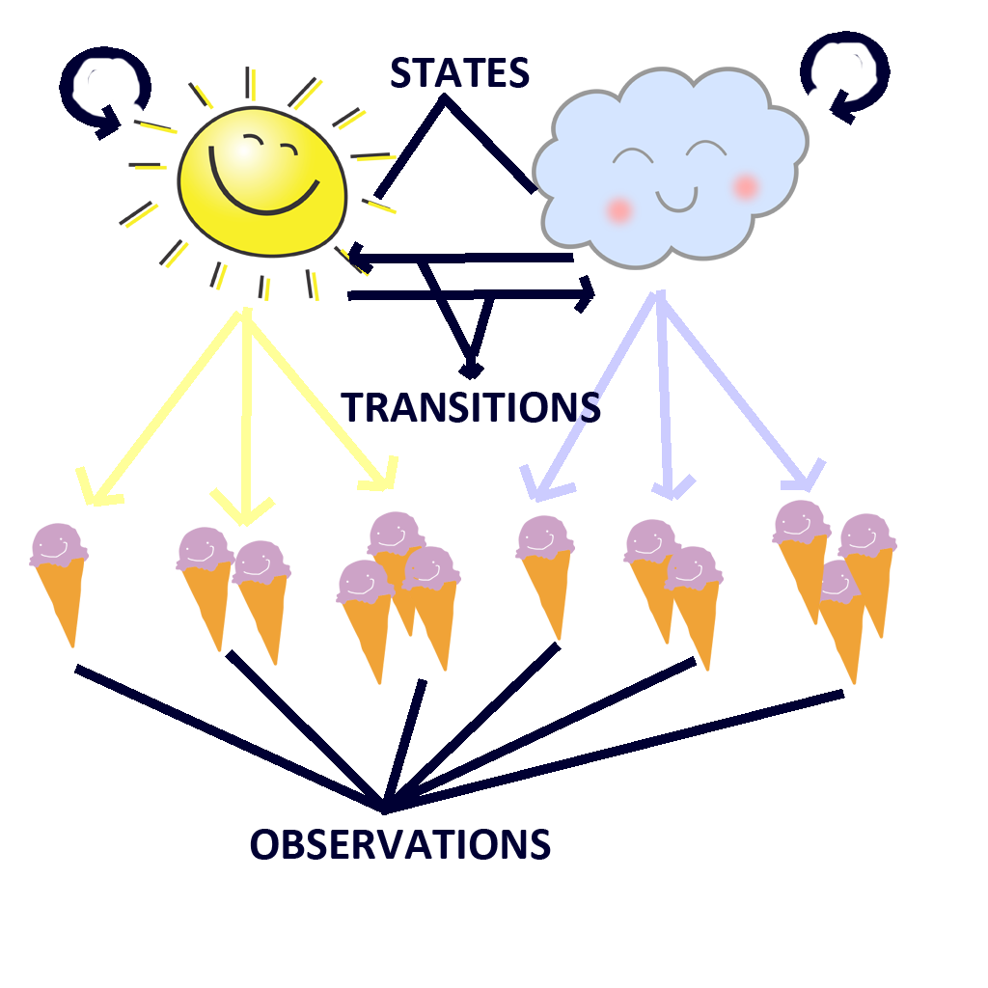
Notes:
Now, we are in the Baum-Welch algorithm. We have two conditions such as cloudy and sunny day. According to Baum-Welch algorithm we called this conditions as a state. And probablity of weather conditions we called them «transitions». For example if today is sunny and tomorrow must be sunny or cloudy and they have some probablities. Oh, I forgot to write blue and yellow line’s name. I must be hungry when I created the animations. Anyway, we called these lines «emitions». Belonging to these states we have some conclusions and we called them «observations». All these names have probablities.

Slide 10
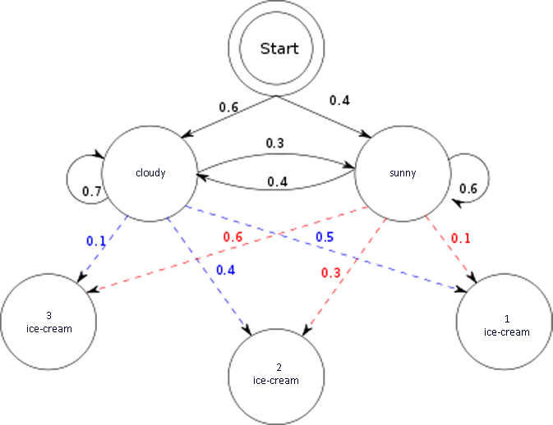
Example of Hidden Markov Model
Notes:
Baum–Welch algorithm is used to find the unknown parameters of a hidden Markov model. As we mention about the models. Let’s say we have number of sets that ice-creams. And we assume that this can be our probablities.

Slide 11


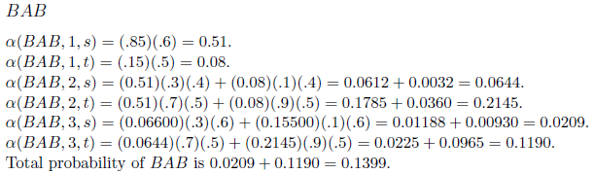
Forward Algorithm

Slide 12

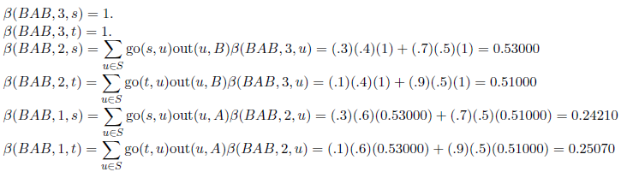
Backward Algorithm

Slide 13


Gamma Creation

Slide 14


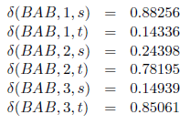
Delta Creation

Slide 15
Determining Transitions/Emissions
After creation deltas with alphas, betas and gammas, determining new start transitions and immediate transitions and also emissions will be updated from given train set.
For this train process, hidden markov model will be more consistent. Because, train datas will be absorbed from real world. For our project, real data will be feature that extracted from input signal.

Slide 16
Viterbi Algorithm
Notes:
The Viterbi algorithm is for finding the most likely sequence of hidden states – called the Viterbi path – that results in a sequence of observed events.
Buraları yine sana bırakıyom.

Slide 17
Why do we need these knowledges?
For implementing our project
For recognition
For classification
For developing
Notes:
We didn’t mention about our project. Because it is a reserch and we have to know firstly how can we do that and follow related work. At the end of the presentation we will show a speech recognition. How can we recognize, classify and develop let’s talk about next slide.

Slide 18
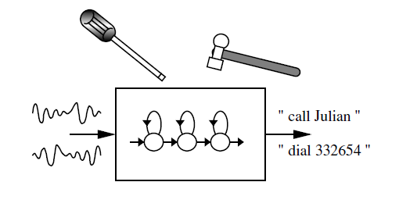
Introduction to Speech Recognition

Slide 19
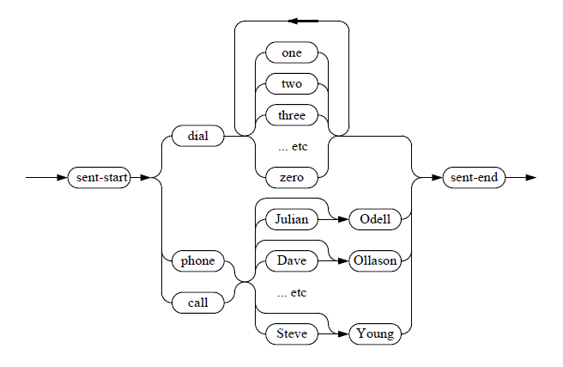
Example Grammar of Speech Recognition

Slide 20
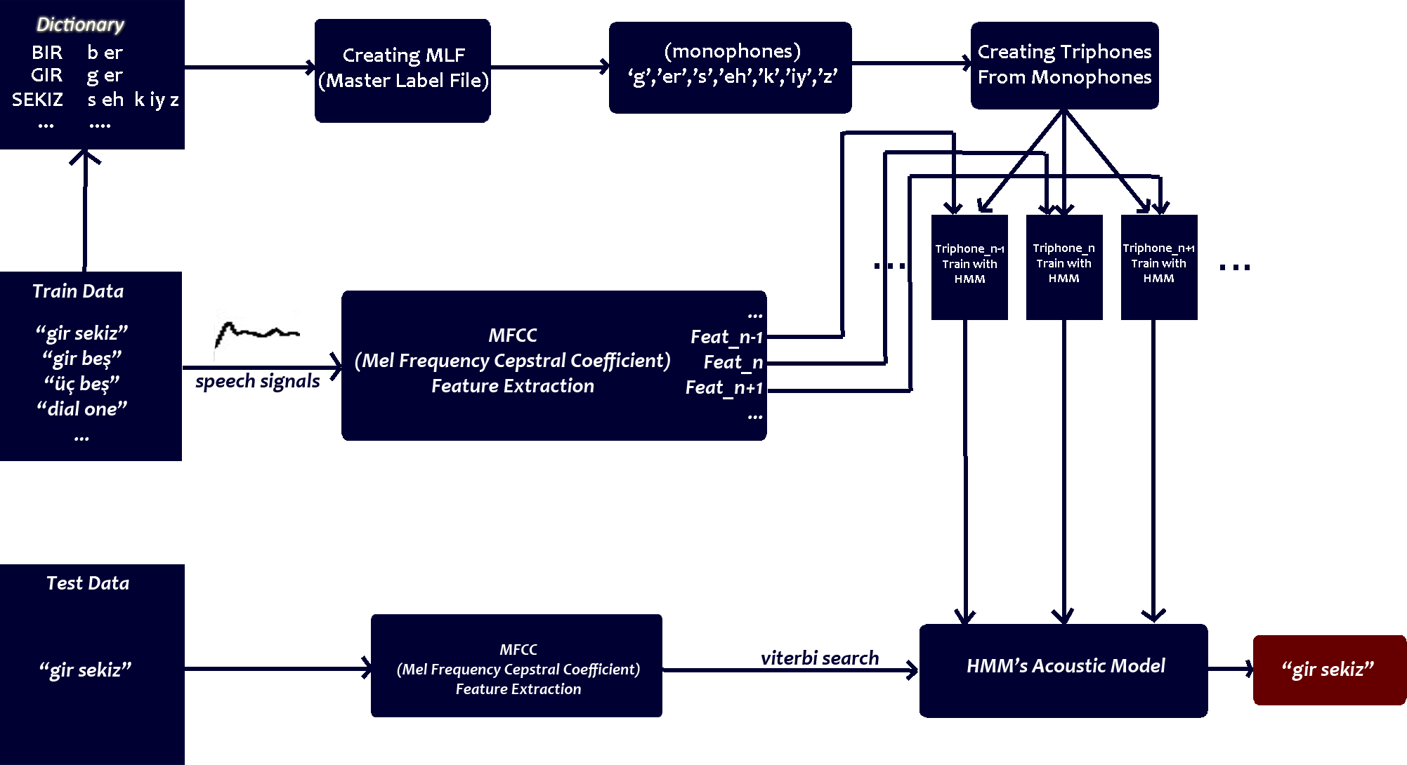
SPEECH DIAGRAM

Slide 21
Tasks Accomplished
Understanding HMM and HTK
Understanding Baum-Welch
Understanding Viterbi
Understanding Julius toolkit
Understanding related works
Creating Speech Recognition

Slide 22
Task to be completed
Understanding Gaussian Mixture algorithm.
Enhance choosing data.
Specify spectrum of genres from music utterance.
Creating harmonics from genres.
Implementing everything that we learned.

Slide 23
Difficulties Encountered
Genre standartization
Too many genres.
Need of huge music data.
Not exactly known area.

Slide 24
Future Plan
Plan A
While playing music, simultaneously wiriting notes.
Plan B
Predict author after given a passage.

Slide 25
Any Questions

