Slide 1
ENS 491/92
Final Presentation
Implementing Deep Neural Networks (DNNs) Using GPU’s
Group 219
Ada Boran Yılmaz (30789)
Enes Çağlar (31109)

Slide 2
ENS 491 Design

Slide 3
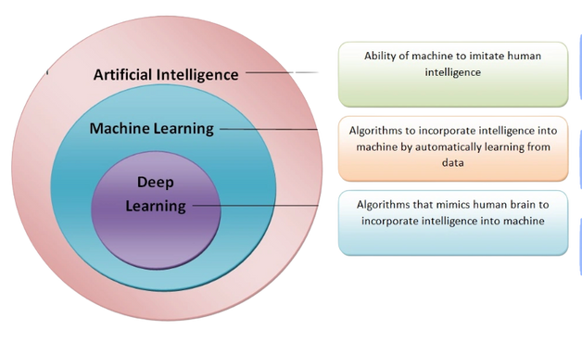
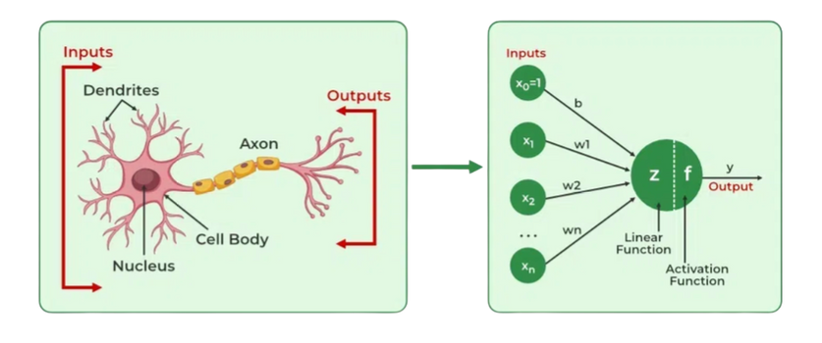
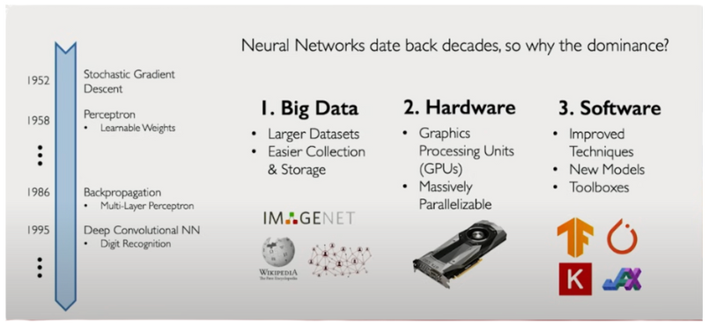
Theoretical Research & Deep Learning Fundamentals
Deep Learning Paradigms: Explored the distinctions between Artificial Intelligence, Machine Learning, and Deep Learning algorithms designed to mimic human brain functions.
Historical Evolution: Analyzed the rise of Deep Learning since 1952, driven by the emergence of Big Data (ImageNet) and parallelizable GPU hardware.

Slide 4
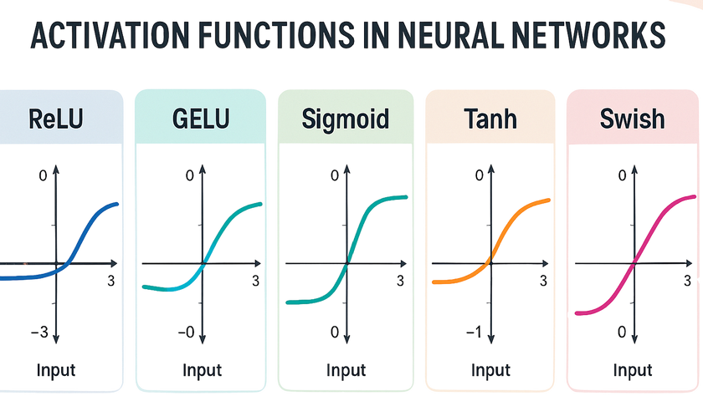
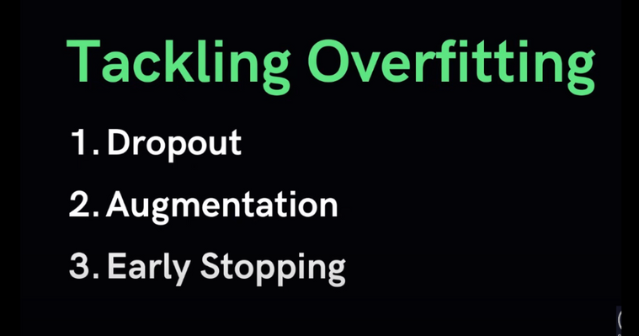
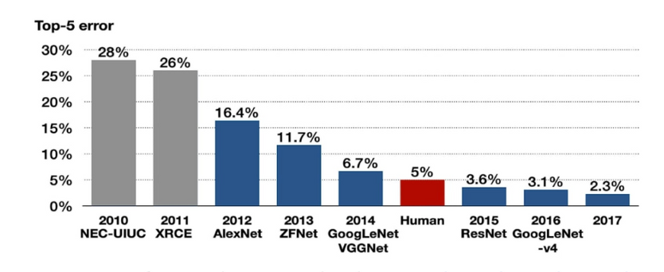
Core Components: Researched neural network essentials including Activation Functions (Sigmoid, Tanh, ReLU), Backpropagation, and Gradient Descent optimization.
Benchmarking Datasets: Evaluated performance metrics using standard datasets such as ImageNet (14M images) and Tiny ImageNet (100,000 images).
Overfitting Strategies: Investigated techniques to improve model generalization, such as Dropout, Data Augmentation, and Early Stopping.

Slide 5
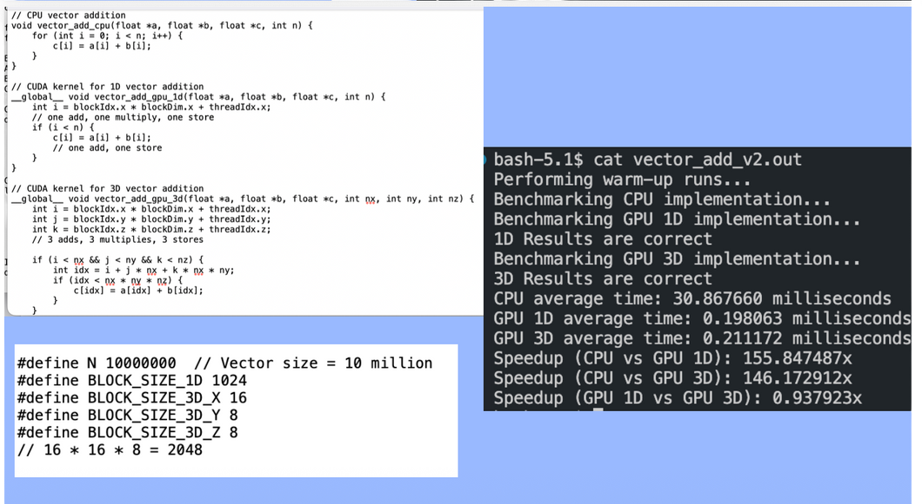
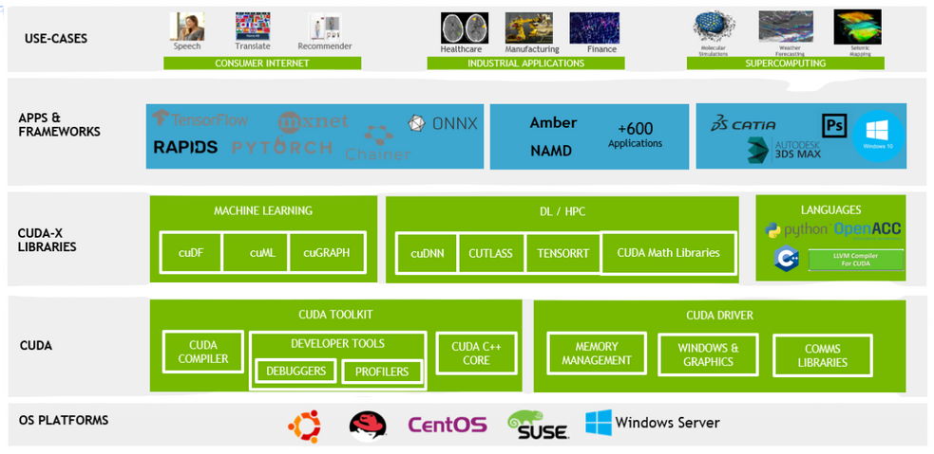
Technical Research & Hardware Optimization
CUDA Architecture: Investigated GPU-accelerated computing using Compute Unified Device Architecture (CUDA) to facilitate massively parallel workloads.
Heterogeneous Computing: Researched models to balance low-latency CPU processing with the high throughput capabilities of GPUs.

Slide 6
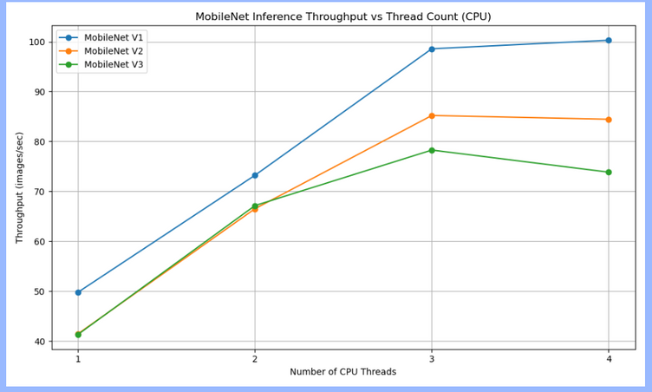
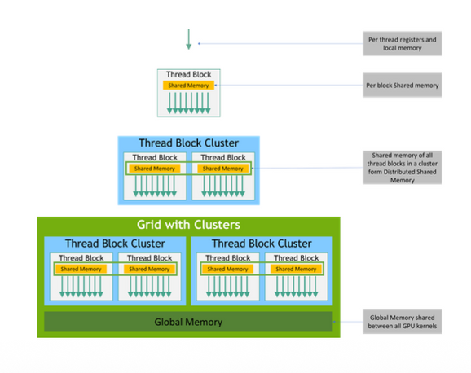
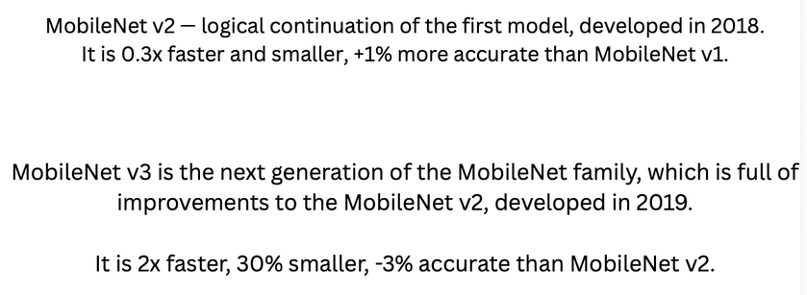
Lightweight Architectures: Analyzed the MobileNet family (V1, V2, and V3) and EfficientNet-B0, focusing on depthwise separable convolutions to reduce parameters for edge device efficiency.
Performance Benchmarking: Conducted initial CPU-based inference tests comparing throughput (images/sec) across different multithreading configurations.
GPU Memory Management: Studied CUDA memory hierarchy, including global, shared, and register memory to optimize data transfer and kernel execution.

Slide 7
ENS 492 Implementation: MobileNet

Slide 8

High-Performance Computing on TRUBA
Infrastructure: Utilized the Turkish National Science e-Infrastructure (TRUBA) for large-scale training and inference.
HPC Environments: Configured workloads across different node types (Arf, Orfoz, Hamsi) with varying GPU and memory configurations.
Job Management: Implemented sbatch scripts for automated scheduling and resource allocation on SLURM clusters.
Storage Optimization: Leveraged the WEKA high-performance file system (/arf) to minimize I/O bottlenecks during data-intensive tasks.
Resource Scaling: Tested performance across multi-CPU and GPU configurations to determine the optimal compute balance.

Slide 9
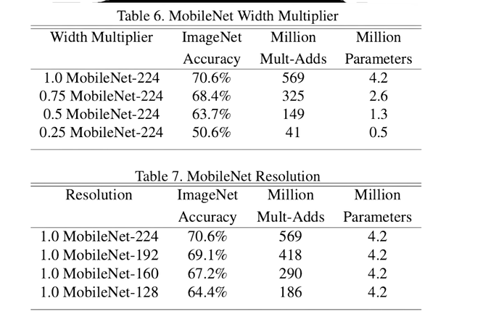
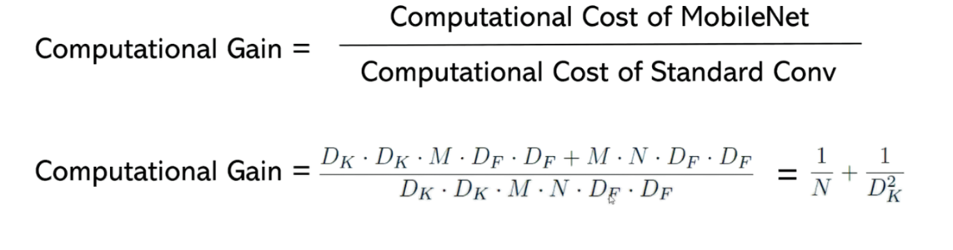
MobileNet Architecture & Efficiency Analysis
Computational Factorization: Analyzed the shift from standard convolutions to Depthwise Separable Convolutions to reduce Mult-Adds.
Mathematical Modeling: Calculated the theoretical speedup by comparing the costs of standard vs. separable operations.
Standard Benchmarking: Evaluated MobileNet against popular architectures like GoogleNet and VGG16 in terms of parameter counts and ImageNet accuracy.
Resolution Multipliers: Investigated the impact of varying input resolutions (e.g., 224 to 128) on total GFLOPs.

Slide 10
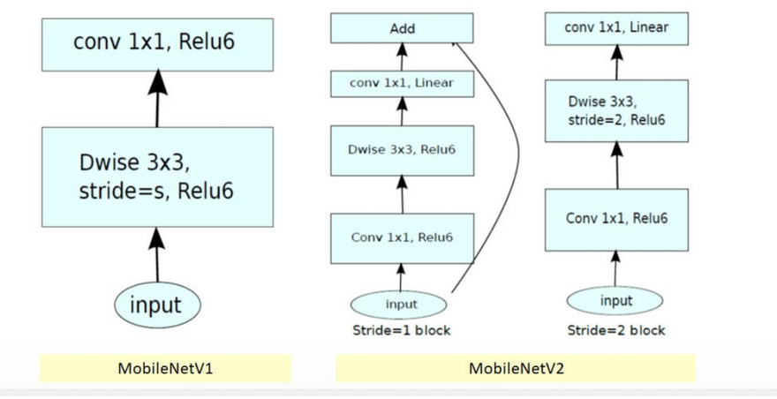
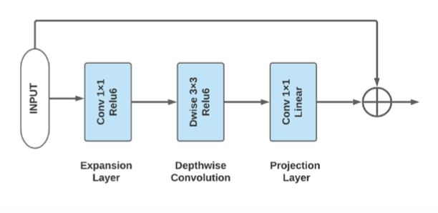
MobileNetV2: Inverted Residuals Implementation
Bottleneck Architecture: Implemented the "Expand-Conv-Squeeze" structure with Linear Bottlenecks to preserve information in low dimensions.
Shortcut Connections: Integrated residual links between narrow layers to facilitate gradient flow and improve training stability.
Deployment Mapping: Mapped the architectural structure to custom tensor formats for later migration to low-level languages.
Inference Logic: Defined the forward pass logic, ensuring proper handling of stride-2 blocks for spatial downsampling.

Slide 11
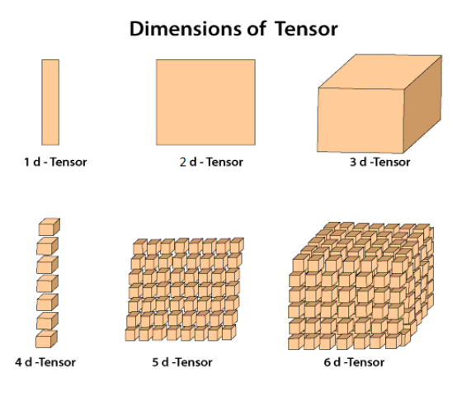
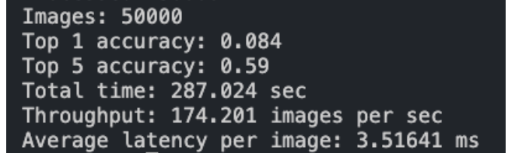
C++ Forward Pipeline & Tensor Design
Manual Inference Engine: Developed a C++ system for inference to bypass high-level framework overhead.
Tensor Structure: Designed a custom 3D Tensor class in C++ to manage Channel, Height, and Width (CHW) data layouts.
Weight Extraction: Automated the process of extracting pretrained weights from ONNX models into raw binary format for C++ loading.
Validation: Verified implementation accuracy by comparing C++ output logits with PyTorch reference results on 50,000 images.

Slide 12
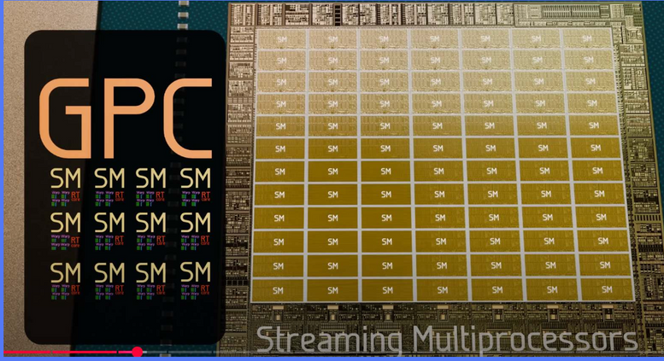
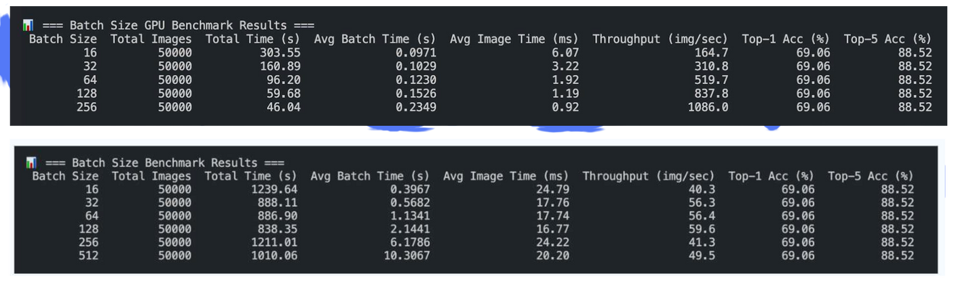
GPU Architecture & Scaling Benchmarks
Hardware Profiling: Studied the hierarchy of GPU compute units, including Graphics Processing Clusters (GPCs) and Streaming Multiprocessors (SMs).
Warp Execution: Analyzed the impact of warp divergence on kernel performance, specifically for conditional branching in convolutions.
Batch Size Scaling: Measured the performance of MobileNet across batch sizes ranging from 16 to 1024 to find the GPU saturation point.
Metric Analysis: Evaluated average image time (ms) vs. throughput (img/sec) to identify latency-throughput trade-offs.

Slide 13
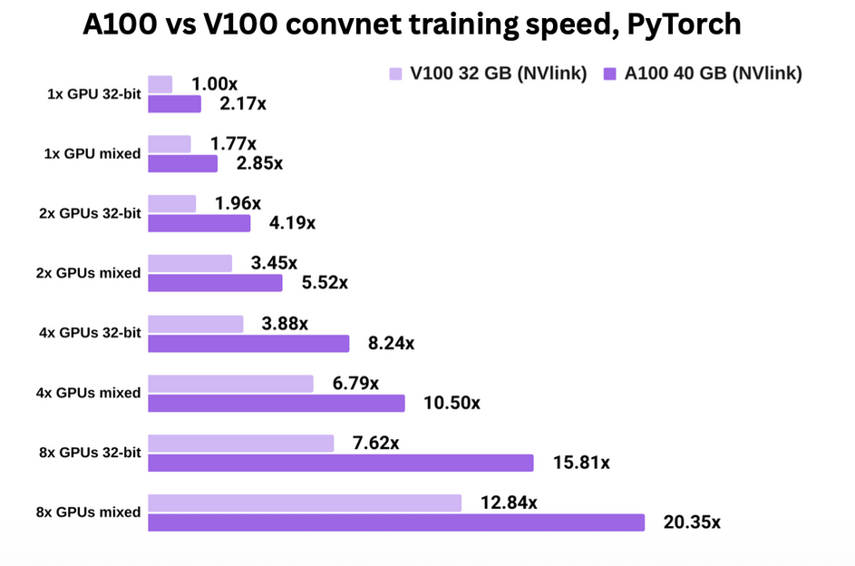
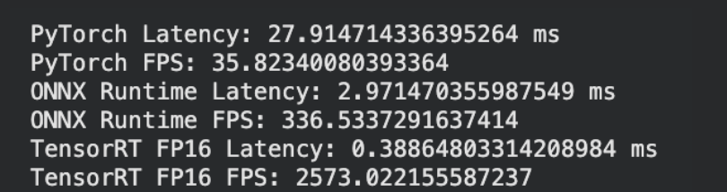
Cloud Computing Performance (A100 vs. V100)
High-End GPU Comparison: Benchmarked inference performance on NVIDIA A100 (Google Colab) vs. V100 (Akya CUDA) architectures.
Mixed Precision: Investigated the throughput gains provided by Tensor Cores when operating in FP16 precision.
Inference Frameworks: Compared standard PyTorch execution against optimized ONNX Runtime and TensorRT workflows on Ampere architecture.

Slide 14
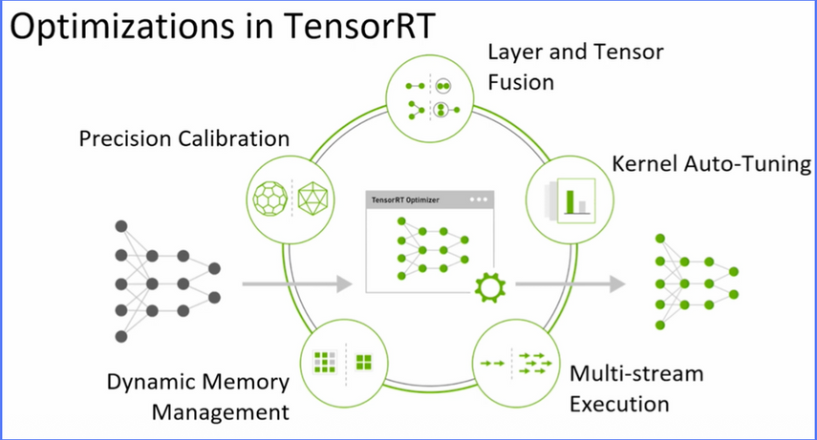
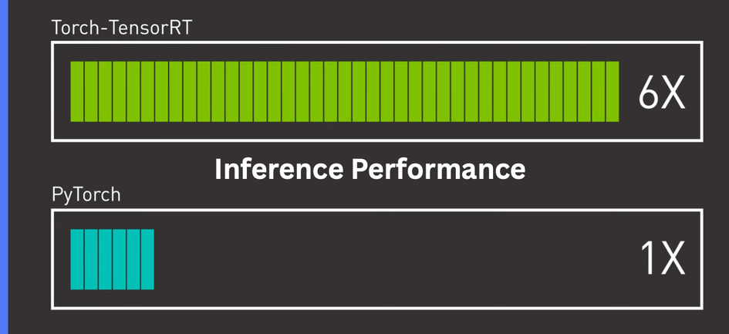
TensorRT Optimization Workflow
Optimization Pipeline: Established a conversion path from PyTorch → ONNX → TensorRT Engine for production-grade inference.
Layer Fusion: Utilized TensorRT’s vertical and horizontal layer fusion to reduce memory bandwidth requirements.
Kernel Auto-tuning: Allowed the engine to select the best CUDA kernels for specific GPU architectures (e.g., SM80 for A100).
Performance Gains: Achieved significant throughput increases over standard GPU inference.

Slide 15
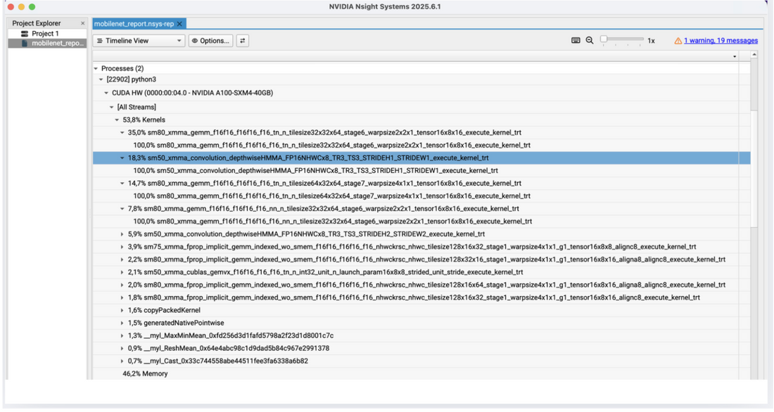
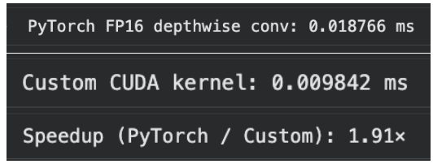
Custom CUDA Kernel Design & Profiling
Custom Depthwise Kernel: Developed a specialized FP16 CUDA kernel for 3x3 depthwise convolutions to outperform generic PyTorch kernels.
Design Choices: Simplified kernels to support fixed NCHW layouts, removing unnecessary branching to improve thread utilization.
Profiling with Nsight Compute: Analyzed compute-bound vs. memory-bound bottlenecks using NVIDIA Nsight tools.
Kernel Fusion: Investigated the benefits of fusing activation functions (ReLU6) directly into the convolution kernel.

Slide 16
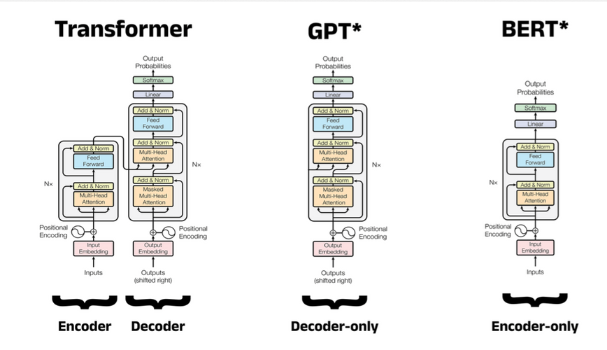
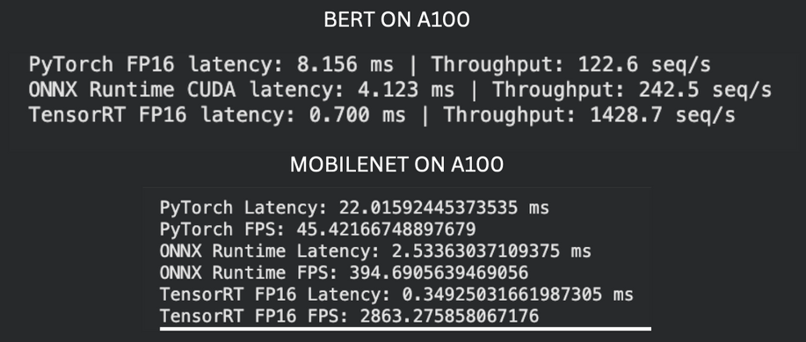
Large Language Model (BERT) Optimization
Cross-Domain Application: Applied MobileNet optimization principles to Large Language Models (LLMs) like BERT.
Sequence Length Impact: Measured the effect of padding and sequence length (SEQ_LEN) on inference latency.
Backend Comparison: Tested PyTorch FP16 vs. ONNX Runtime vs. TensorRT for NLP tasks.
Throughput Scaling: Demonstrated how TensorRT provides extreme speedups (~11x) for transformer-based architectures.

Slide 17
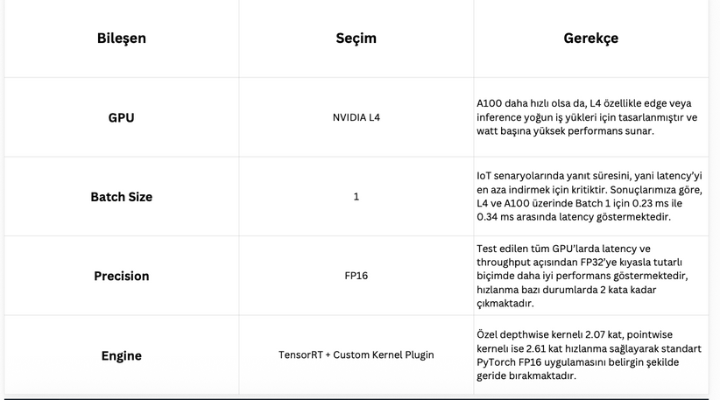
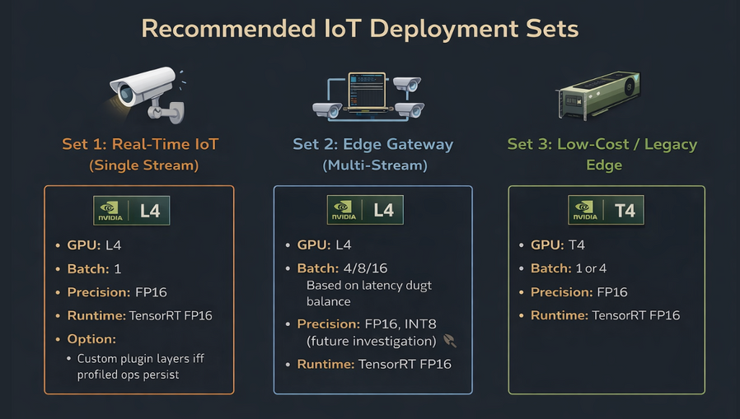
Performance Standards for IoT Deployment
IoT Latency Targets: Researched real-time vision requirements, targeting <33ms (30 FPS) for end-to-end processing.
Watt-per-Performance: Evaluated the NVIDIA L4 GPU for edge scenarios where power efficiency is as critical as throughput.
Precision Recommendations: Concluded that FP16 with TensorRT + Custom Kernels is the optimal configuration for modern IoT gateways.
Use-Case Scenarios: Defined deployment sets for real-time single-stream vs. multi-stream edge gateways.

Slide 18
ENS 492 Implementation: EfficientNet

Slide 19
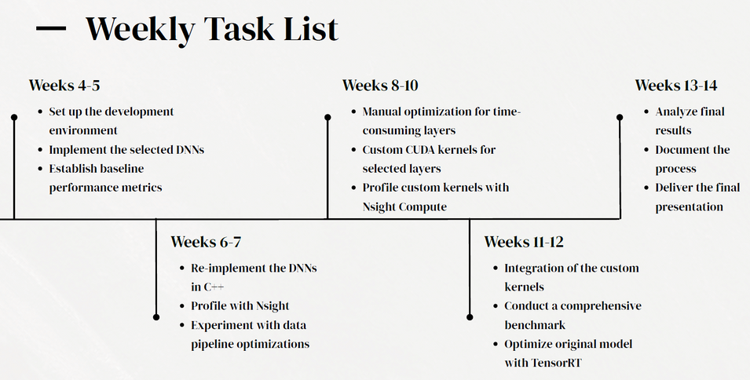
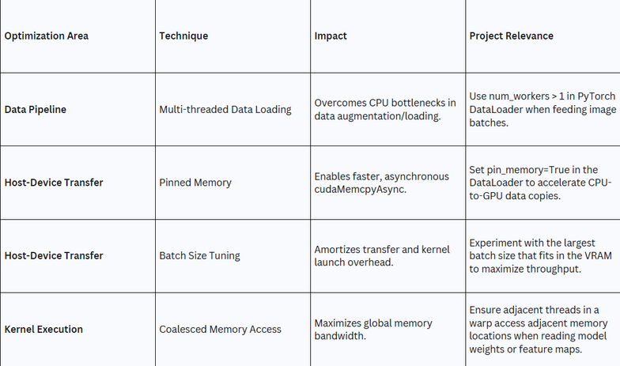
Project Foundations & Literature Review
Project Objectives: Defined the core goal of optimizing deep learning models for high-performance inference on GPU-based systems.
Literature Analysis: Conducted a deep dive into existing research regarding GPU-accelerated inference and various neural network architectures.
Methodology Design: Established a systematic pipeline involving model selection, performance profiling, and iterative optimization steps.
Environment Setup: Configured the initial development platform on TRUBA to ensure access to necessary CUDA and Python libraries.

Slide 20
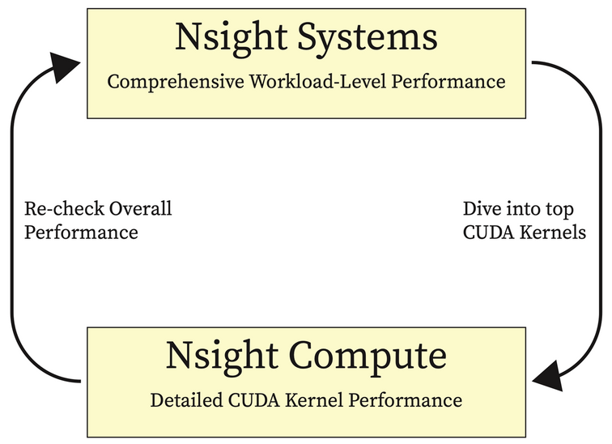
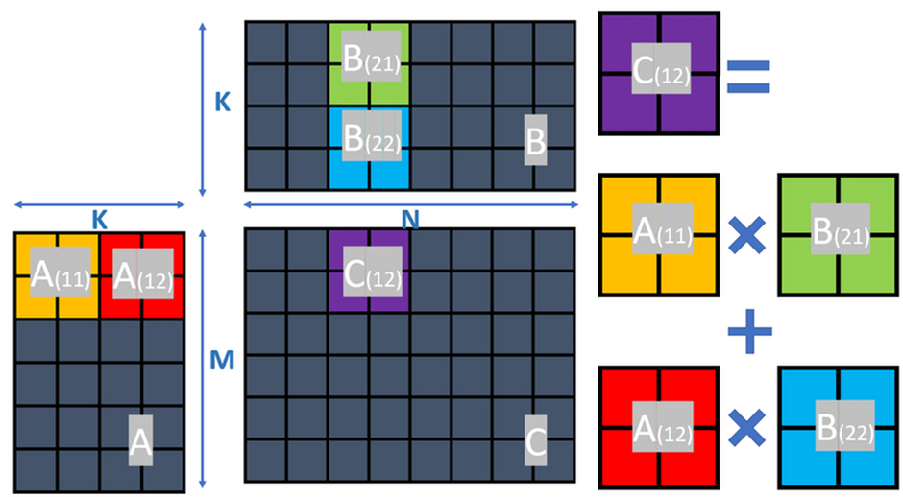
Framework Selection & Profiling Tools
Library Selection: Evaluated PyTorch, ONNX and TensorRT as the primary frameworks for building and deploying the inference pipeline.
Profiling Toolset: Integrated NVIDIA Nsight Systems and Nsight Compute to identify hardware bottlenecks and kernel execution times.
Initial Benchmarks: Performed baseline testing on standard convolutional models to establish a starting point for future speedup comparisons.
Hardware Evaluation: Assessed the compute capabilities of various NVIDIA GPUs available in the TRUBA cluster for heterogeneous testing.

Slide 21
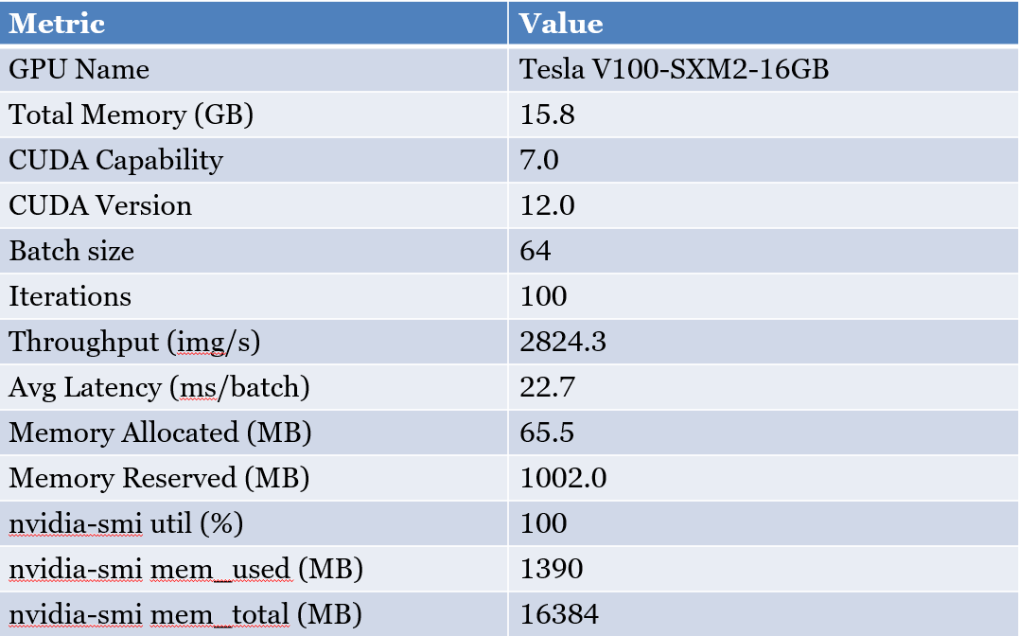
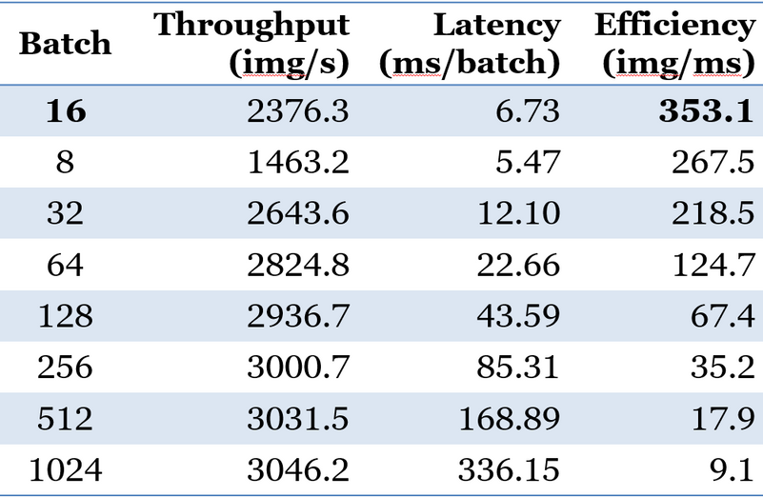
EfficientNet-B0 Benchmarking and Batch Optimization
System Configuration: Established a baseline using PyTorch and CUDA 12.0 on a Tesla V100 GPU within a SLURM-managed environment.
Performance Scaling: Tested batch sizes from 8 to 1024, achieving peak throughput of 3046.2 img/s before encountering memory limits.
Efficiency Analysis: Identified batch 16 as the most efficient setting at 353.1 img/ms for optimal edge/IoT performance.
Strategic Recommendations: Advised batch 16–32 for low-latency edge tasks and 64–128 for high-throughput server inference.

Slide 22
C++ Inference Transition and Environment Setup
Inference Transition: Aimed to move from Python-based training to high-performance C++ inference using EfficientNet-B0 to maximize Images Per Second (IPS) on NVIDIA GPUs.
Optimization Pipeline: Established a four-step workflow involving model export to ONNX, engine building with TensorRT, and creating a C++ runtime for optimized memory management.
Technical Implementation: Successfully exported the model using the PyTorch timm library and compiled C++ binaries by manually resolving missing development headers and linker dependencies.
Week’s Progress: Validated GPU hardware access and code logic despite a runtime failure caused by library version mismatches between Conda and Pip environments on the cluster.

Slide 23
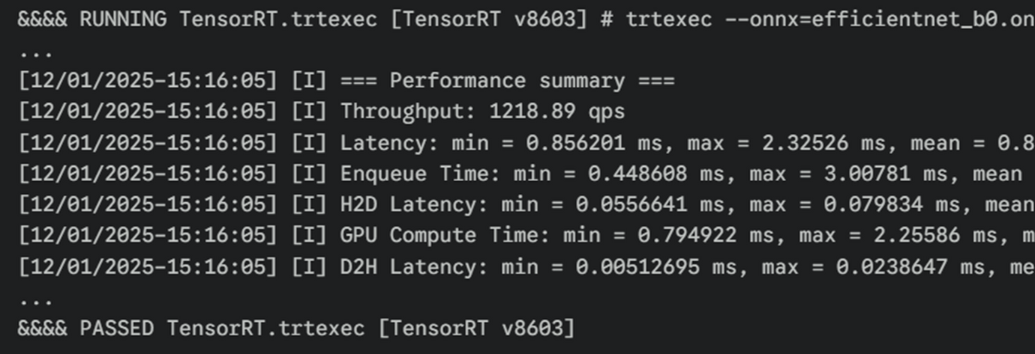
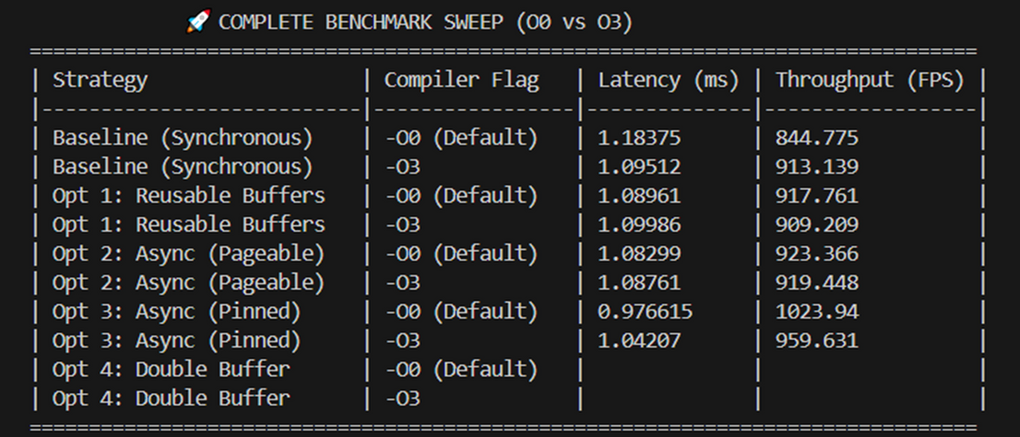
EfficientNet-B0 Optimization and C++ Benchmarking
Weekly Goal: Re-implement and optimize EfficientNet-B0 for high-performance inference, focusing on throughput and latency.
Benchmark Strategy: Prioritized latency-critical edge applications by fixing the batch size at 1, where CPU overhead typically dominates execution time.
Environmental Resolution: Resolved deep-seated library conflicts by deploying an Apptainer container to align OS, CUDA, and TensorRT versions.
Optimization Outcomes: Achieved 1,023 FPS and 0.97 ms latency using pinned memory and reusable buffers, extracting 84% of hardware's limit.

Slide 24
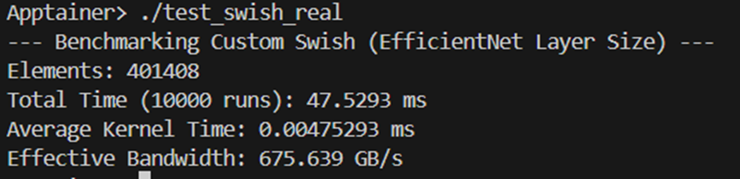
Kernel Profiling and Custom CUDA Development
Layer Optimization: Shifted from timeline profiling to detailed kernel analysis using Nsight Compute to perform manual layer tuning.
Bottleneck Identification: Discovered that Depthwise Separable Convolutions and Swish activations are the primary performance limiters.
Performance Speedup: Achieved a 1.85x speedup per layer, reducing latency by 45% with custom kernels (0.0047 ms) versus native TensorRT (0.0087 ms).
Technical Progress: Developed custom CUDA kernels in C++ to replace suboptimal layers and improve memory bandwidth.

Slide 25
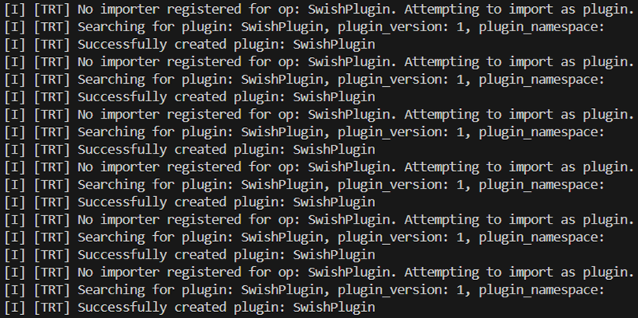
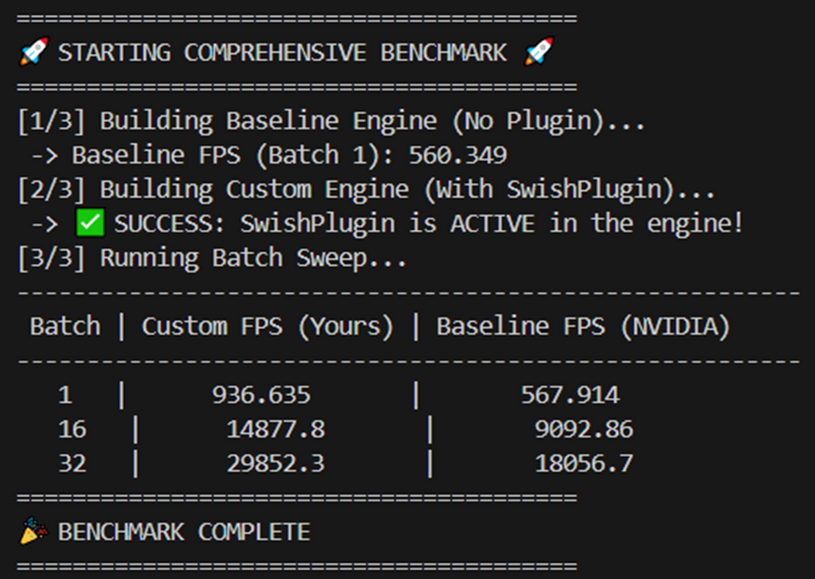
Kernel Integration & The “Perfect Run”
Integration Challenge: Overcame the "Black Box" issue where TensorRT defaults to slow, separate layers for Swish instead of fused kernels.
Graph Surgery: Implemented a four-step process to programmatically detect "Sigmoid + Multiply" patterns and implant custom SwishPlugin nodes.
Verification Success: Confirmed active plugin status via trtexec profiling on an NVIDIA Tesla P100, ensuring high-performance execution.
Benchmark Results: Achieved a ~65-67% speedup by reducing swish kernel memory transactions from six to two per pixel, reaching 29,852 FPS.

Slide 26
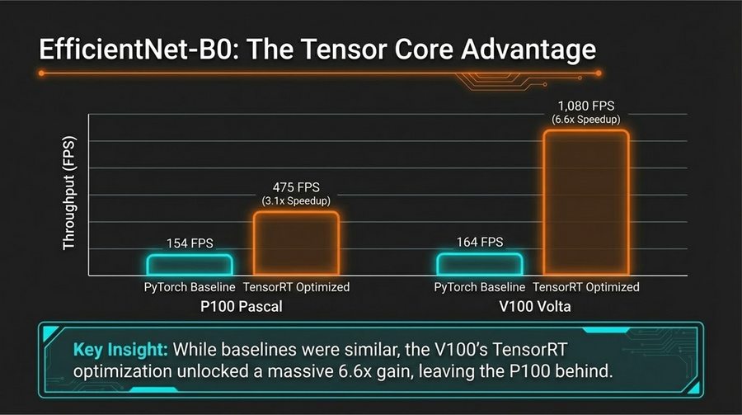
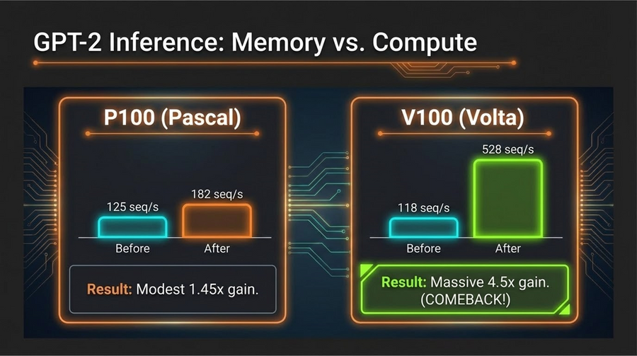
Legacy vs. Modern GPU Architecture Analysis
Pipeline Standardization: Developed a universal FP16 benchmarking script using 1,000 iterations to eliminate noise.
Vision Optimization: Reached 1,080 FPS on V100 via Tensor Cores, a 6.6x gain over baseline.
Transformer Throughput: Secured a 4.5x gain for GPT-2 on V100 by shifting to TensorRT (C++).
Deployment Insights: Validated P100 for basic video analytics, while V100 is mandatory for real-time LLMs.

Slide 27
Thank you!

