Slide 1
FINAL PROJECT
CHAMPIONS MAP
GMT458 – Web GIS | Web-based Geospatial Game (AWS Deployment)
Student: Enes Dicle
Core Gameplay: click the map → distance error (km) + time → score
Deployment: AWS EC2 (Live & Publicly Accessible)

Slide 2
Project Overview & Objectives
What we built and what we aimed to demonstrate
Champions Map is a browser-based Web GIS game where the map is the main gameplay interface.
Players receive a target club and try to locate the correct stadium by clicking on the map.
We compute the distance error using geographic coordinates and convert accuracy into points.
A time limit creates competitive pressure and adds a performance dimension to gameplay.
Objectives: Web GIS interaction + geospatial datasets + scoring/time mechanics + cloud deployment.

Slide 3
Implemented Items (Course Checklist Alignment)
Clear and honest mapping to the requested implementation items
Geospatial interaction: map-based selection + spatial reasoning task (stadium location).
Geospatial data usage: teams.geojson and coordinates.csv drive the gameplay.
Distance-based scoring: distance (km) between player click and true coordinate is computed and displayed.
Time-based performance: timer affects gameplay; points reward fast + accurate decisions.
Backend data persistence: score records are stored and retrieved via JSON (create/read).
Cloud deployment: the project runs live on AWS EC2 and is publicly accessible.
Not implemented (explicit): authentication/roles, advanced system monitoring, full UI CRUD.

Slide 4
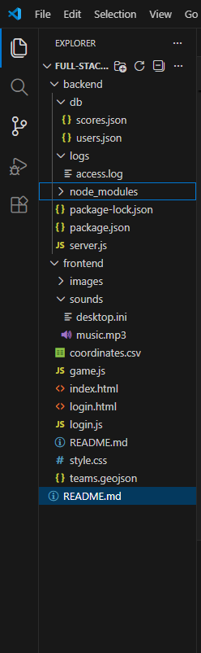
System Architecture & Repository Structure
Frontend / Backend separation (maintainable & scalable)
Repository shows distinct frontend/backend folders. Backend stores scores/users as JSON; frontend contains UI, game logic, and geospatial datasets.

Slide 5

Game Entry (Direct Guest Access)
Fast start without authentication (scope-focused design)
Direct access reduces complexity and lets users start playing instantly. Authentication can be added as a future enhancement.

Slide 6
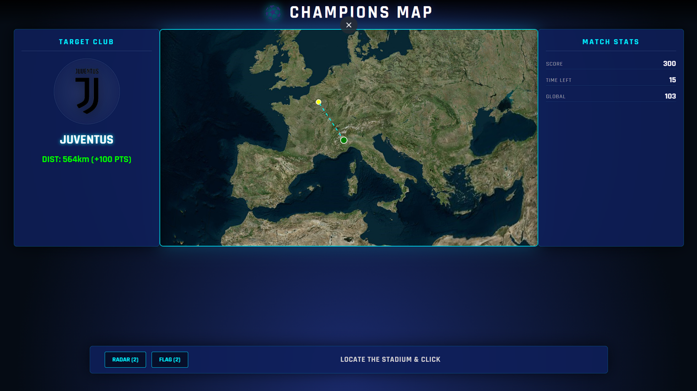
Gameplay (Distance + Score + Time)
Spatial accuracy is measured and turned into points
UI shows target club, distance error (km), score, and time left. This is the core Web GIS + game mechanic integration.

Slide 7
Backend & Data Handling
How data flows and how results are stored
Geospatial datasets: teams.geojson provides ground-truth stadium locations; CSV supports coordinate logic.
Backend (Node.js): provides endpoints / logic for storing and retrieving score records.
Persistence: scores.json keeps results across sessions (create/read). users.json exists as a lightweight structure for future login.
Basic operational evidence: access.log supports debugging and reliability during deployment.

Slide 8
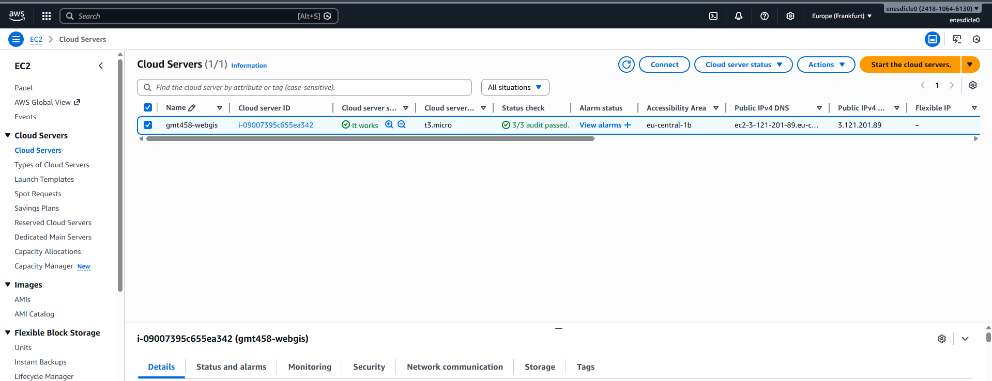
AWS EC2 Deployment (Live Proof)
Cloud hosting and availability
EC2 instance is running with health checks passed. The project is deployed as a live service and ready for demonstration/grading.

Slide 9
AWS Deployment – Setup Process
How the system was deployed before going live
An AWS EC2 instance was created using Amazon Linux and a t3.micro instance type.
Security groups were configured to allow HTTP (port 80) and SSH (port 22) access.
The project repository was transferred to the EC2 instance and dependencies were installed.
A Node.js server was configured to serve the backend and handle score persistence.
Frontend files were served through the same instance, enabling a single public entry point.
After testing locally on the server, the application was exposed via the EC2 public IPv4 address.

