Slide 1

42 Warsaw Campus Dashboard
API Research & Data Strategy — Endpoints, refresh strategy, data handling, and service reliability.
PREPARED BY EERAVCI & MAFZAL

Slide 2
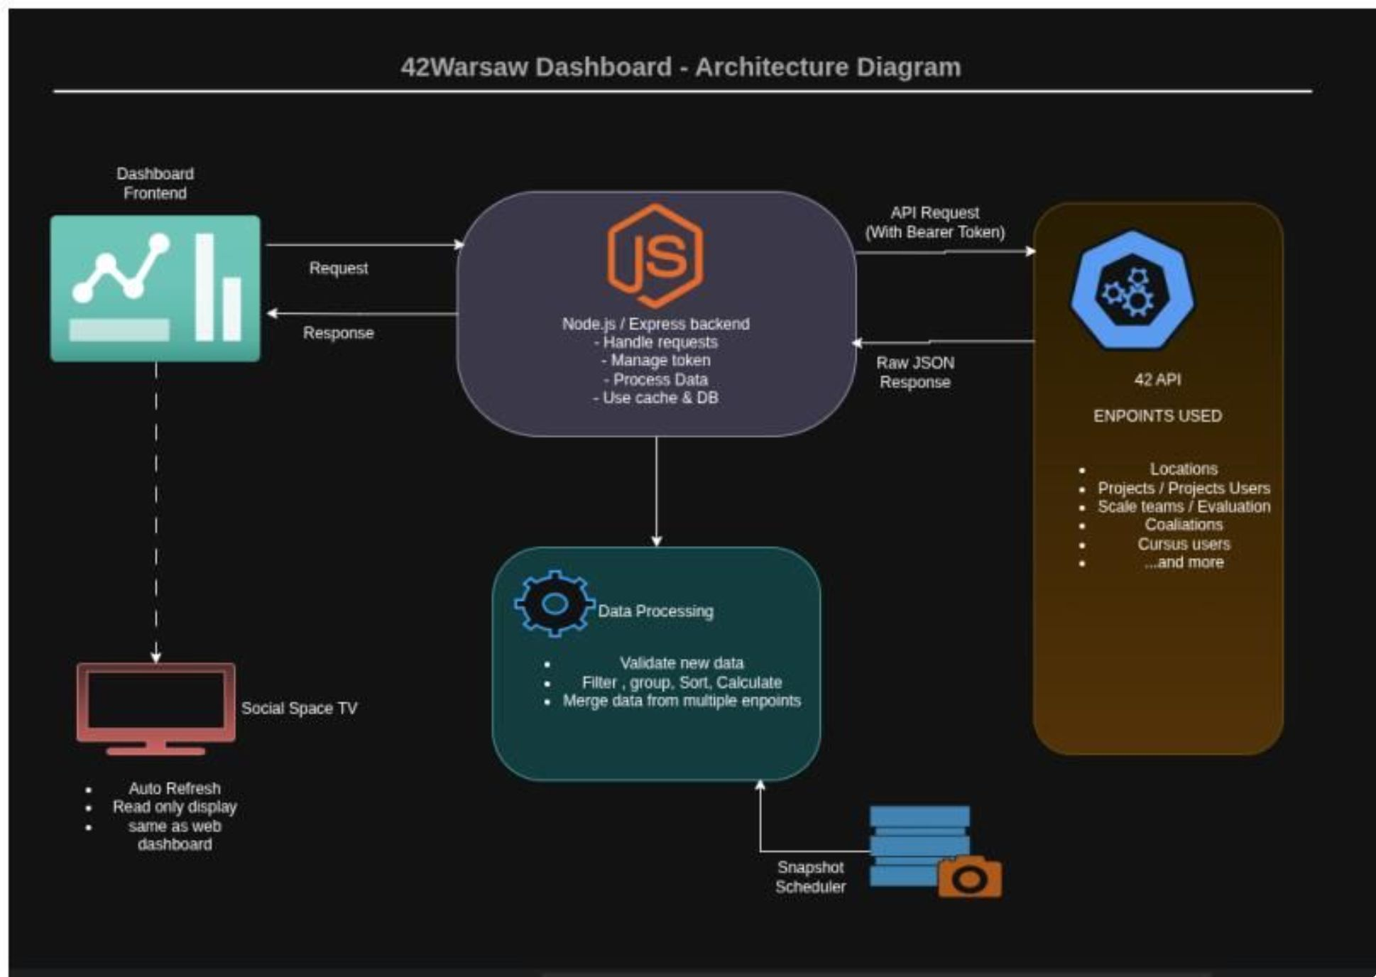
Solution Overview & Architecture
How It Works
The frontend never talks directly to the 42 API. It requests processed data from our Node.js / Express backend, which handles authentication, pagination, filtering, caching, and analytics.
Frontend
Backend
42 API
Social Space TV
Receives ready-to-use JSON
Manages token, cache & DB
Raw JSON via Bearer Token
Auto-refresh, read-only display

Slide 3

Authentication
The 42 API uses OAuth 2.0. The dashboard uses the client-credentials grant — it acts on its own, not tied to any user account.
Token Endpoint
Bearer Token
POST https://api.intra.42.fr/oauth/token
Every request includes Authorization: Bearer ACCESS_TOKEN
Security Rules
CLIENT_ID and CLIENT_SECRET stored in env vars. Secret never sent to frontend. Auto-renew on expiry; retry failed requests once.

Slide 4
API Endpoints at a Glance
Every dashboard feature maps to specific 42 API endpoints. Key groups:
Category
Refresh
Primary Use
Campus & Users
Daily
Warsaw campus ID, student population, profiles
Cursus Users
6–12h
Levels, progress, Black Hole monitoring
Locations
1–5 min
Live occupancy, Night Owls, Early Birds, session duration
Projects
5–15 min
Recently passed projects, completion rankings
Scale Teams
10–30 min
Top evaluators, most evaluated students, heatmaps
Coalitions
Hourly
Standings, member lists, contribution tracking

Slide 5


Refresh Strategy
Why It Matters
Protections
The backend avoids calling the 42 API on every TV refresh. Caching and scheduled jobs ensure the API is contacted only as often as necessary.
Cache all responses; fetch all paginated results
Respect rate-limit headers; pause on HTTP 429
Exponential backoff with jitter on retries
Keep latest successful dataset always available
Example Schedule: Live locations every 3 min · Coalition snapshot hourly · Daily analytics at 00:10 Europe/Warsaw
Live Locations
Coalition Scores
Cursus & Levels
Project Definitions
Every 1–5 min
Every hour
Every 6–12 hours
Daily

Slide 6


Error Handling & Historical Data
Error Handling
Historical Data Storage
API Unavailable
Some metrics require timestamped snapshots: coalition scores, seat occupancy, campus-time totals, project completions, and evaluation records.
Serve cached data; retry with backoff
Token Expired (401)
Renew token, retry once
Rate Limit (429)
Pause, serve cache, retry after delay
Partial Failure
Keep working sections live; mark failed sections cached
Weekly coalition gain
Weekly campus time
Current score − score 7 days earlier
Sum of session overlap with the reporting week

