Slide 1
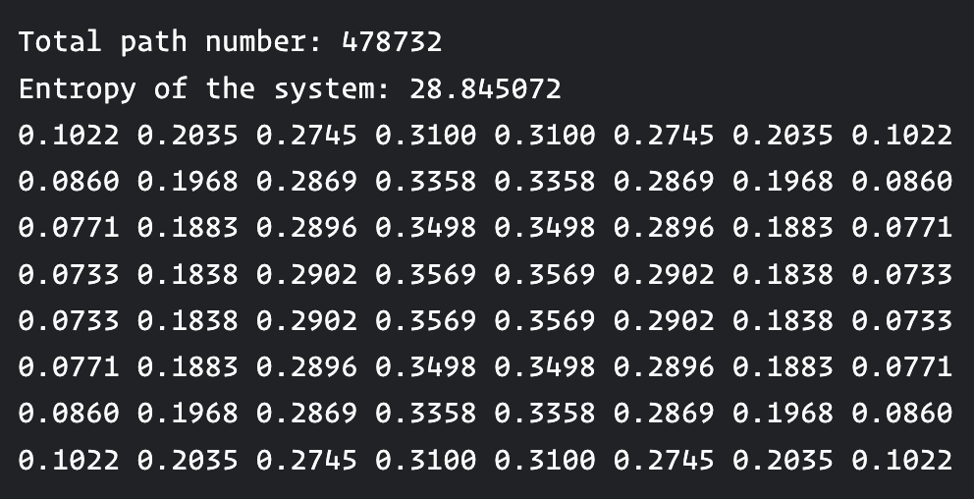
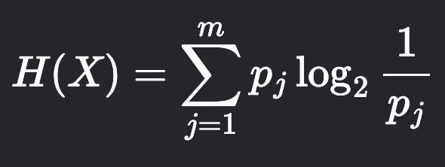
The Ideal World
Find all paths that goes from the start line to end and store them.
For each point, find how many of the paths pass through it.
This is the probability of finding each point in an unknown path.
Compute the entropy of this system:

Slide 2
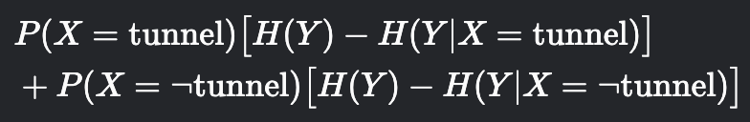

The Ideal World
For each point in the grid that has p > 0, compute the expected information gain:
Account for different tunnels here.
Compute probabilities by filtering all paths and counting like before.
Problem:

Slide 3
Spent too much time on..
How to estimate number of s-t paths..
How to count simple paths that has some known parts..
How to have a heuristic probability field that resembles the correct field
Points in the middle have larger probability
Points closest to all known parts have larger probability
Some points are impossible to reach

Slide 4
Lesson that I should have learned so far..
Don’t try to find the perfect solution, try to iterate from simpler solutions.

Slide 5
In the end,
Detector
Tunneller
Find the path whose segments lie on the most number of possible paths

