Slide 1

EE470/MACHINE LEARNING
Department of Electricial & Electronic Engineering
Provided by:
Enes ISIKLI
Submitted to:
Ast. Prof. Erkan KIYMIK

Slide 2
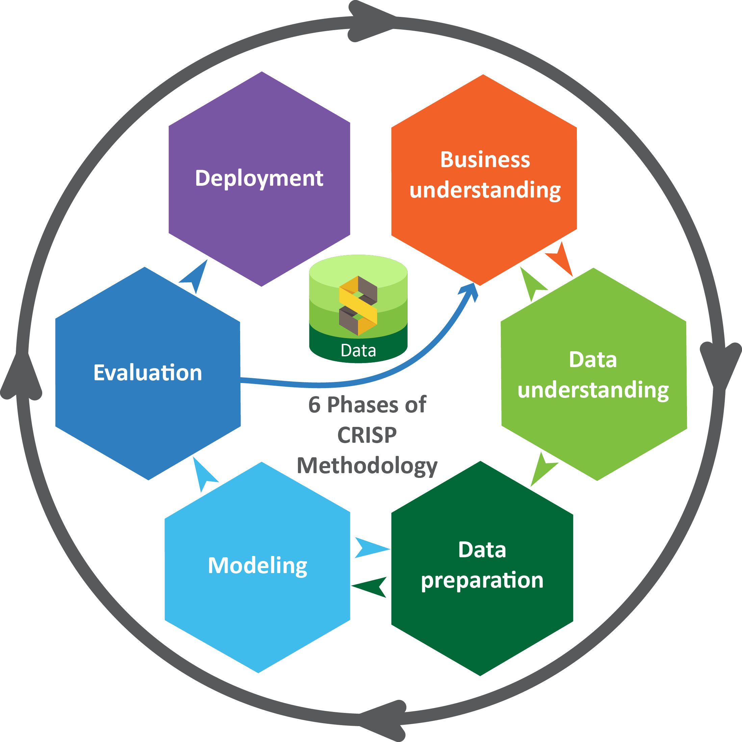
A.CRISP-DM Methodology
CRISP-DM (Cross-Industry Standard Process for Data Mining) is a widely used methodology for data mining and analytics projects. It provides a structured approach to guide the various stages of a data mining project. CRISP-DM is an iterative process, and it emphasizes the need for collaboration between business stakeholders, data experts, and analysts throughout the project. It provides a flexible framework to guide data mining projects while allowing for adjustments based on specific needs and circumstances.
EE470/ Machine Learning

Slide 3
A.1. Processes of CRISP-DM
Business Understanding
Identify the problem you're trying to solve and define the project's scope
Data Understanding
Identify data sources, understand their structure and limitatations
Data Preperation
Format the data in a way suitable for modeling
Modelling
Select appropriate modeling techniques and build predictive models
Evuluation
Assess the quality and effectiveness of the models
Deployment
Create documentation and provide necessary training

Slide 4

A.1.1. Business Understanding
Dataset : Spaceship Titanic(on Kaggle)
The Spaceship Titanic was an interstellar passenger liner launched a month ago. With almost 13,000 passengers on board, the vessel set out on its maiden voyage transporting emigrants from our solar system to three newly habitable exoplanets orbiting nearby stars.
To help rescue crews and retrieve the lost passengers, you are challenged to predict which passengers were transported by the anomaly using records recovered from the spaceship’s damaged computer system.
https://www.kaggle.com/competitions/spaceship-titanic/data

Slide 5
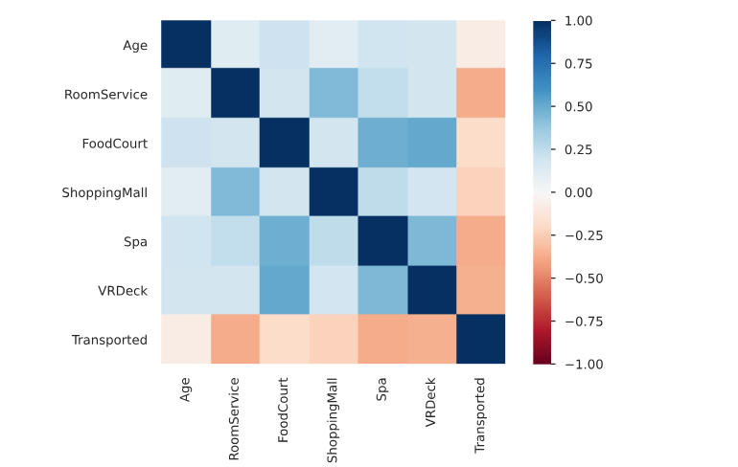
A.1.2. Data Understanding
In this competition your task is to predict whether a passenger was transported to an alternate dimension during the Spaceship Titanic's collision with the spacetime anomaly. To help you make these predictions, you're given a set of personal records recovered from the ship's damaged computer system.
Pandas profiling library was used for data engineering. This library is a useful tool used for quick and easy data analysis. It gives a file with html extension as output. This report is given below;
EDA_report.html

Slide 6
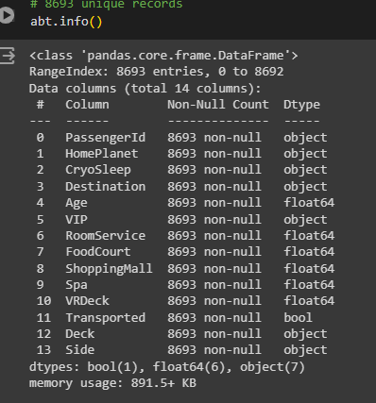
A.1.3. Data Preparation
Preparing data for the model plays an important role in machine learning. Preparing the data for the model is an important criterion for the successful operation of the model. The figure below shows the information of the Spaceship Titanic dataset after the data is processed. I looked at the following requirements for data processing in my project:
Need to fill if there is missing or faulty values on dataset
Balance out dataset if there is imbalance on dataset
Drop the columns, which has high cardinality, and etc.
Additionally, since the data in the Cabin column was written with slash, I separated each cell in the data.
You may have noticed that there is no Name column in the processed data frame. This column has been deleted due to high cardinality.

Slide 7
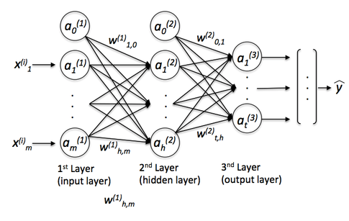
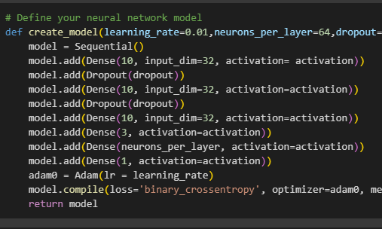
A.1.4. Modelling
Deep learning is a machine learning method used to discover complex relationships in artificial neural networks and large data sets. Deep learning models have the ability to automatically learn features from data using multilayer neural network architectures. Deep learning basically includes the following layers:
Input layer : This is the layer that represents the input of the data set. This layer contains neurons that are appropriately configured according to the size and characteristics of the data set.
Hidden layer : These are the layers where operations are performed and features are extracted. Here, activation functions and weight are calculated. In fact, we can say that it is the part where the real work is done.
Output layer : It is the last layer and usually represents the outcome or prediction of the model

Slide 8
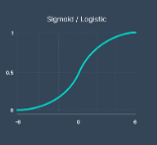
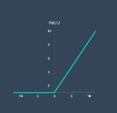
A.1.4. Modelling
Dense: Dense layer is one of the most commonly used layer types of an artificial neural network.
Dropout: Dropout is a training process in which neurons in the network are randomly disabled (discharged) and activated.
Activation function: It is a mathematical function used to calculate the output of each neuron in artificial neural networks.
Learning rate: determines how large the weight updates will be at each step during training of the model.
Loss: is a function that measures how much a model's predictions differ from actual values
Optimizer: It is an algorithm used to minimize the loss function of a model.
Gridsearch: is a method used to optimize the hyper parameters of a model
sonucunu veya tahminini temsil eder

Slide 9
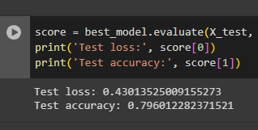
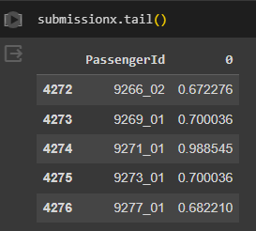
A.1.5. Evaulation
Many methods are used to evaluate the model. The most used of these is to use the confusion matrix structure. By looking at this matrix, we can look at the success rate, recall rate and precision rate. The relationship between all these is the measure of how successful the model is. In my project, as seen in the code snippet in the picture, while a success rate of 79.6% was achieved, we see that the model had a loss of 43%. As I mentioned before, this success rate is the data of the model best optimized with Grid search. In addition, before the data was submitted to the Kaggle platform, the predict function was estimated and the submission data frame was created. Here you see the Transported columns with passengerId number and target value.

Slide 10
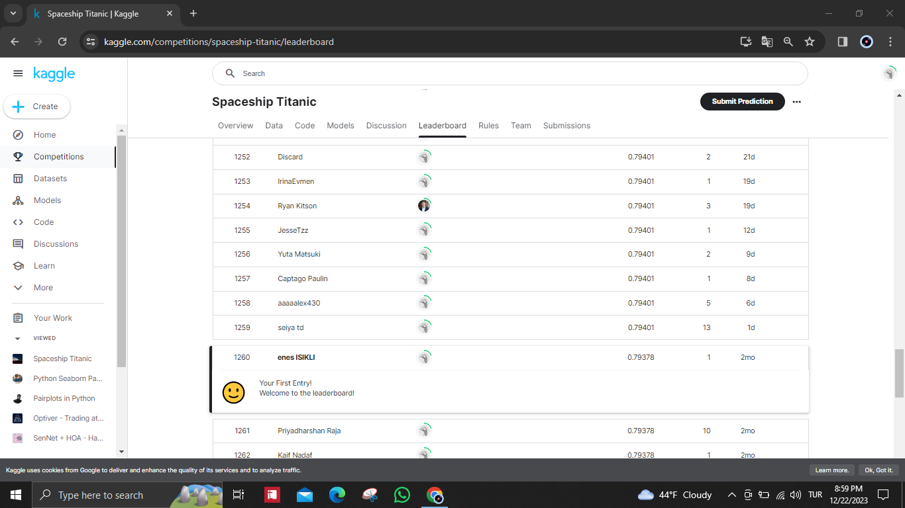

A.1.6. Deployment
Deployment is the final phase of the CRISP-DM (Cross Industry Standard Process for Data Mining) methodology. In this phase, the data mining results and insights obtained from the previous phases are put into action and integrated into the operational systems
After the deep learning model for machine learning was tested, it was uploaded to the Kaggle platform as a submission file. As a result of the submission.csv file submitted here, you are ranked according to the scoring system in the leader board area. In addition, all files required for the project have been uploaded to the Github site. or business processes. It ıncludes some steps for testing and reporting;

Slide 11
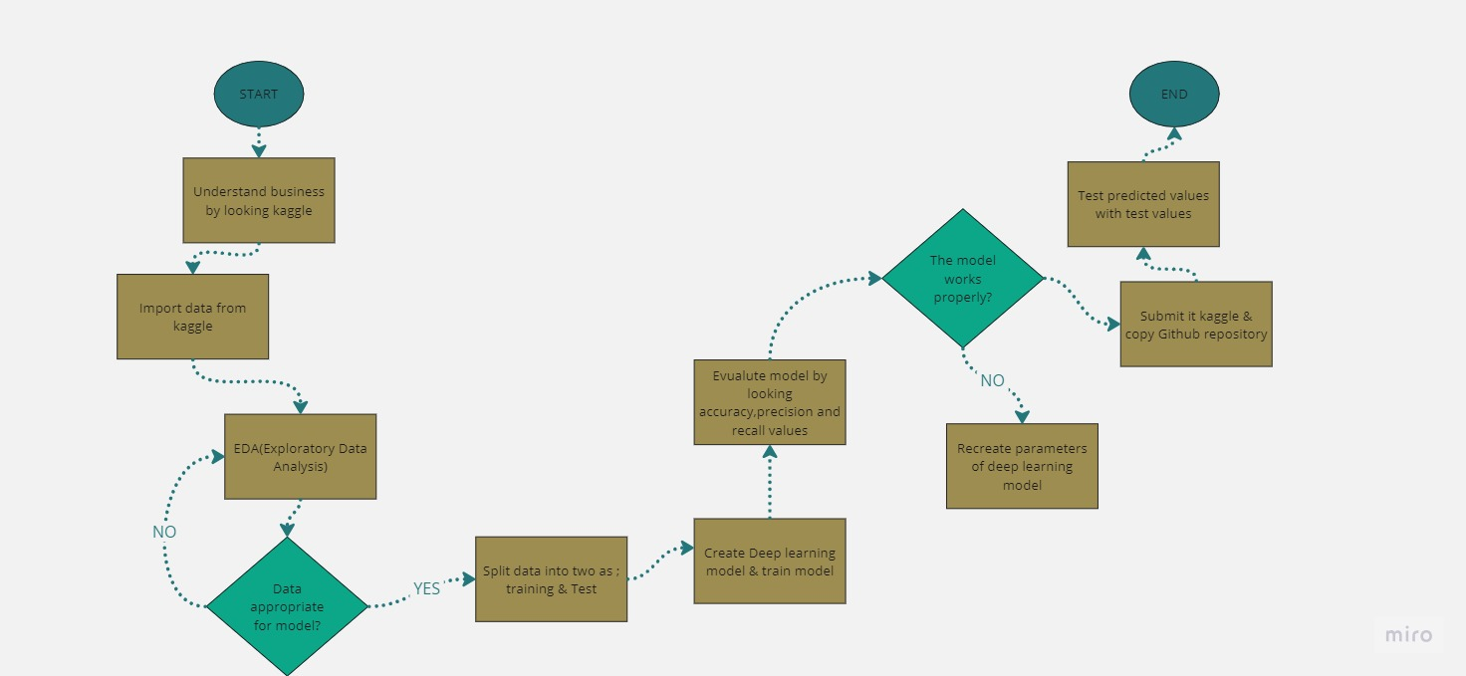
B. Flowchart

Slide 12

C. Link for code & dataset
https://github.com/enesisikli/Spaceship-Titanic-Kaggle

Slide 13
THANK YOU!
Enes ISIKLI
Candidate of Electricial & Electronic Engineer
enes.isikli@std.hku.edu.tr

