Slide 1
MMI 713 APPLIED PARALLEL PROGRAMMING ON GPU 2019-2020 SPRING TERM PROJECT PRESENTATION
CUDA Implementation of Banker’s Algorithm for Deadlock Avoidance
Enes Muvahhid ŞAHİN
2167195

Slide 2
DEADLOCK AVOIDANCE
Deadlock can be avoided by allocating resources to the processes carefully.
One possible algorithm used for deadlock avoidance and resource allocation is called Banker’s Algorithm.
Banker’s algorithm make use of following data structures while performing resource allocation and deadlock avoidance.
m: Number of resources n: Number of processes
Available[m]: One-dimensional array of size m. It indicates the number of available resources of each type.
Max[n, m]: Two-dimensional array of size n x m. It defines the maximum demand of each process from each resource type.
Allocation[n, m]: Two-dimensional array of size n x m. It defines the number of resources of each type currently allocated to each process.
Need[n, m]: Two-dimensional array of size n x m. It indicates the remaining need of each process, of each resource type.
Request[m]: Two-dimensional array of size n x m. It represents the allocation request of a process of each resource type.

Slide 3
BANKER’S ALGORITHM
Banker’s Algorithm consists of three parts:
Check whether the requested allocation is valid (Requested resources are not more than process’ needs or available resources)
Construct the necessary Available, Allocation, Need matrices as if allocation is made.
Check whether the resulting state is safe using the safety algorithm below (a safe state is a state for which there is an allocation sequence among processes which results in successful termination of all processes).
If the allocation leads to a safe state, allocation can be made. Otherwise requested allocation must wait.

Slide 4
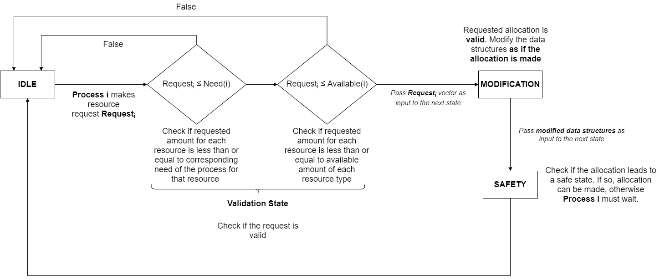
BANKER’S ALGORITHM – GPU

Slide 5
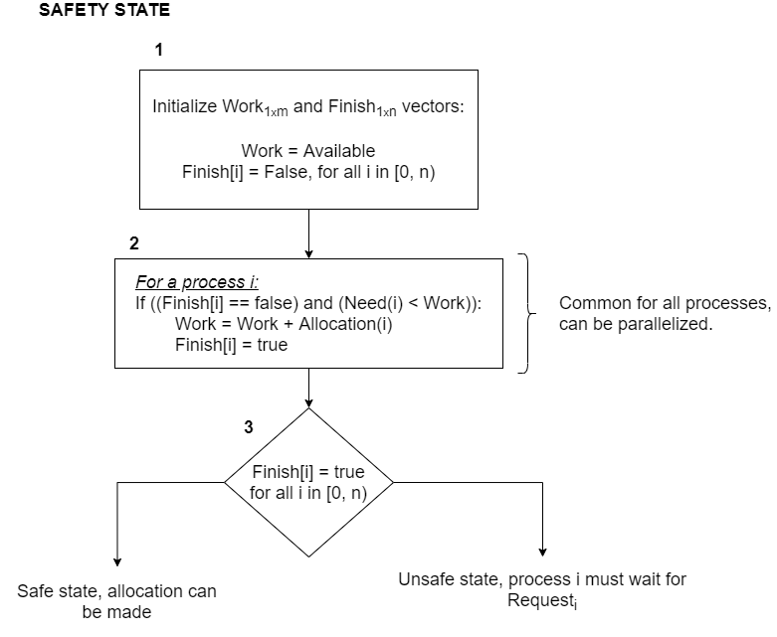
BANKER’S ALGORITHM – GPU

Slide 6
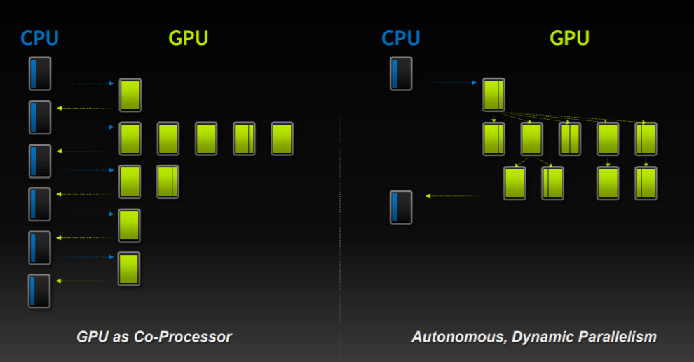
DYNAMIC PARALLELISM

Slide 7
DYNAMIC PARALLELISM
Introduced in CUDA 5.0.
Compute capability 3.5 or higer is required.
Dynamic parallelism is useful for problems where there exists a nested parallelism.

Slide 8
BANKER’S ALGORITHM – GPU

Slide 9
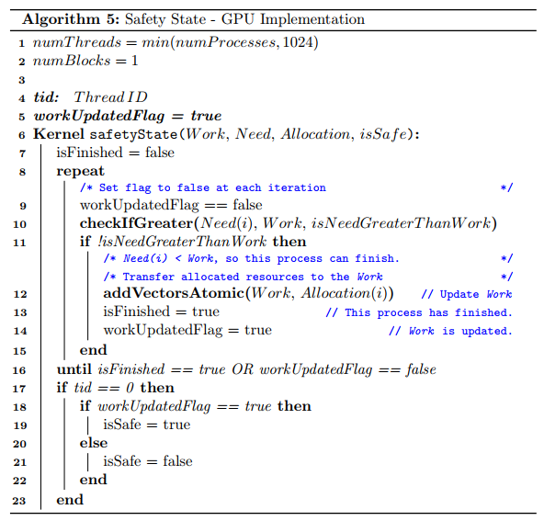
BANKER’S ALGORITHM – GPU

Slide 10
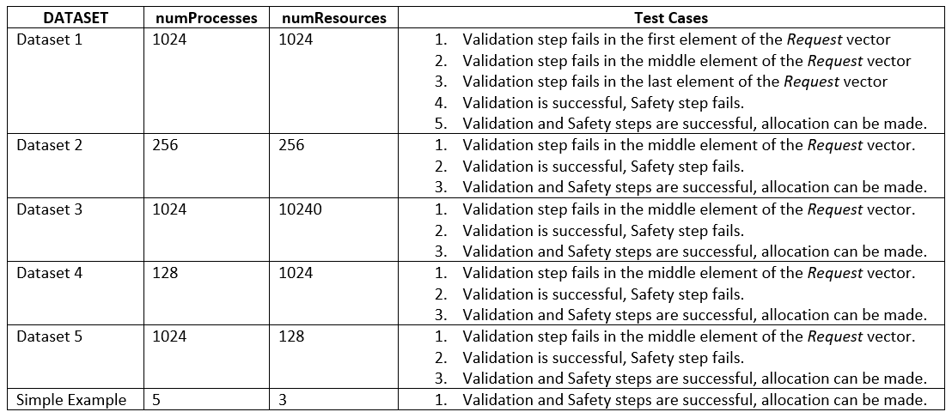
BANKER’S ALGORITHM – EXPERIMENTS

Slide 11
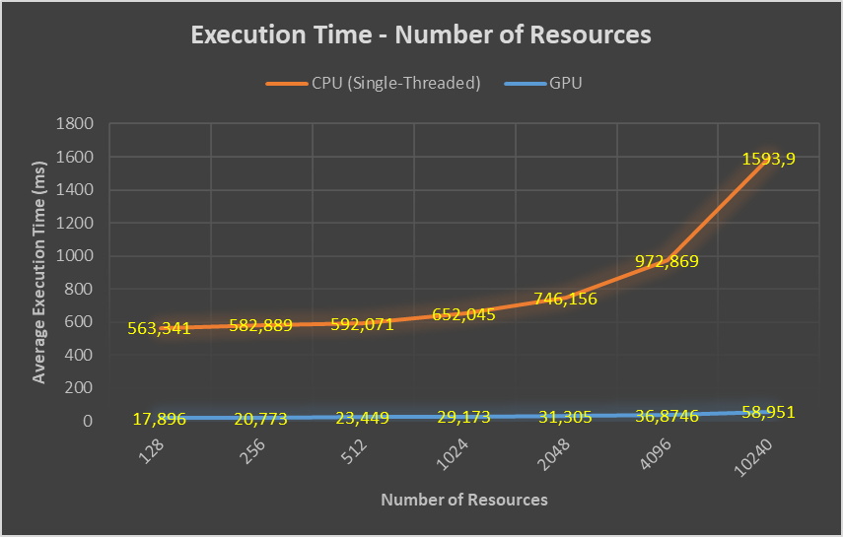
BANKER’S ALGORITHM – EXPERIMENTS

