Slide 1
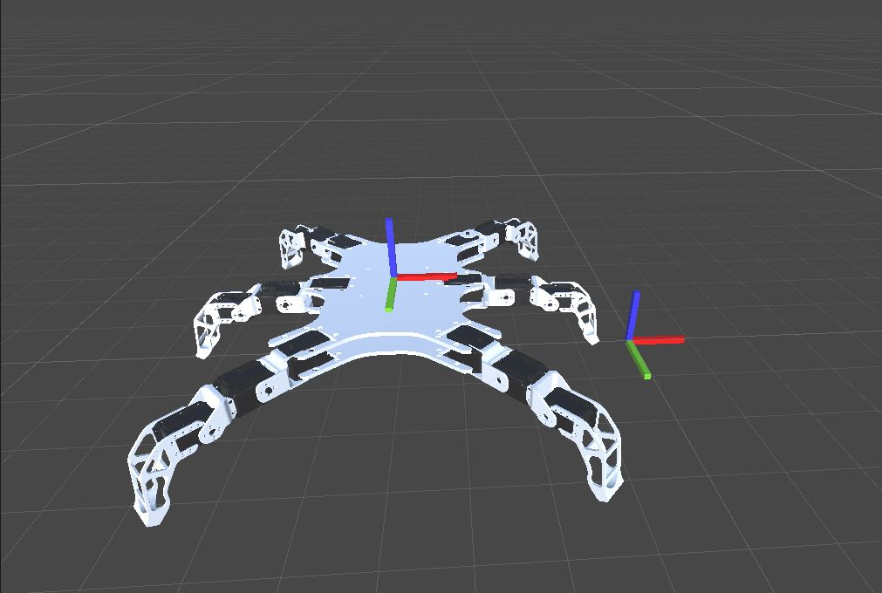
Body CS
Origin CS

Slide 2
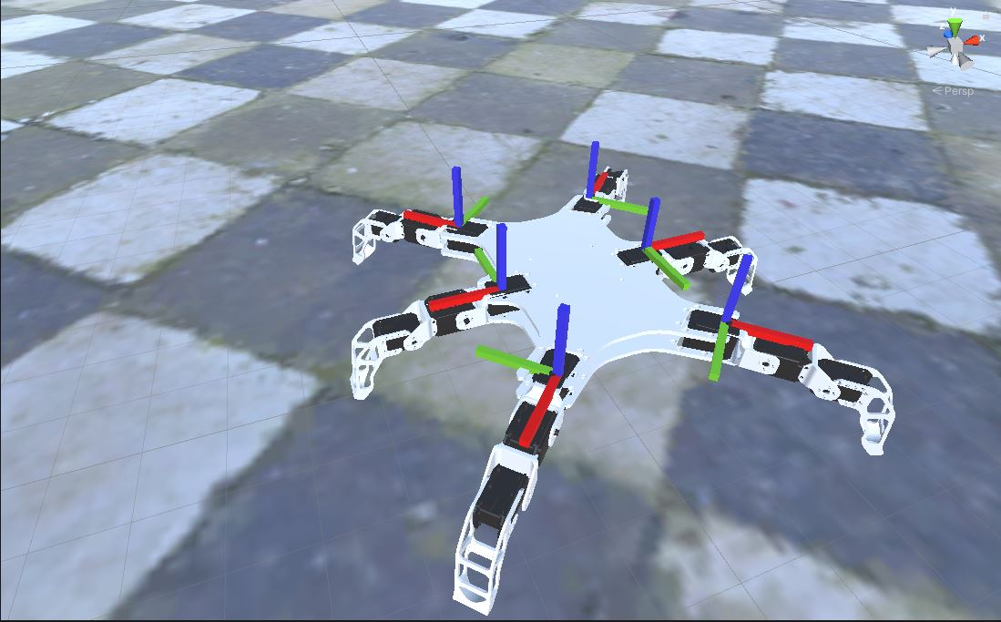
Right Front CS
Left Front CS
Right Middle CS
Left Middle CS
Right Back CS
Left Back CS

Slide 3
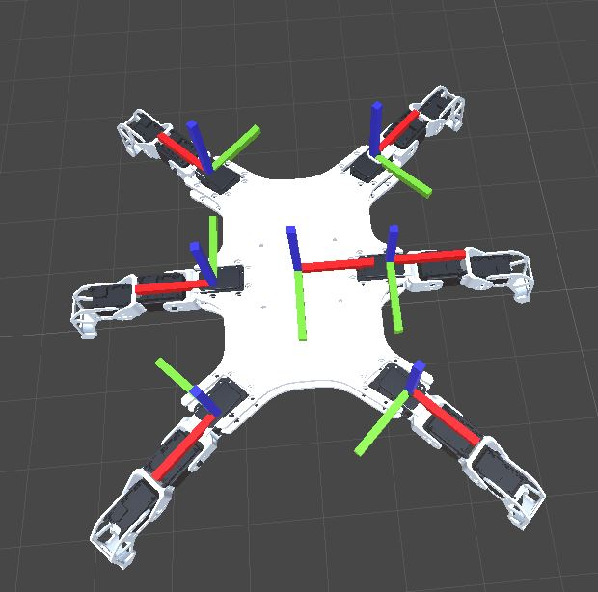
leg euler angles for Body CS
Vector3(X, Y, Z)
lbEulerAngles = Vector3(0, 0, 135) // left back
lmEulerAngles = Vector3(0, 0, 180) // left middle
lfEulerAngles = Vector3(0, 0, -135) // left front
rbEulerAngles = Vector3(0, 0, 45) // right back
rmEulerAngles = Vector3(0, 0, 0) // right middle
rfEulerAngles = Vector3(0, 0, -45) // right front
Right Front CS
Left Front CS
Body CS
Right Middle CS
Left Middle CS
lb = left back
lm = left middle
lf = left front
rb = right back
rm = right middle
rf = right front
Left Back CS
Right Back CS

Slide 4
leg CS pos for Body CS
Vector3(X, Y, Z)
lbContCntrPnt = Vector3(-120, 175.5f, 0) // left back
lmContCntrPnt = Vector3(-120, 0, 0) // left middle
lfContCntrPnt = Vector3(-120, -175.5f, 0) // left front
rbContCntrPnt = Vector3(120, 175.5f, 0) // right back
rmContCntrPnt = Vector3(120, 0, 0) // right middle
rfContCntrPnt = Vector3(120, -175.5f, 0) // right front
Right Front CS
Left Front CS
Body CS
Right Middle CS
Left Middle CS
Left Back CS
Right Back CS

Slide 5
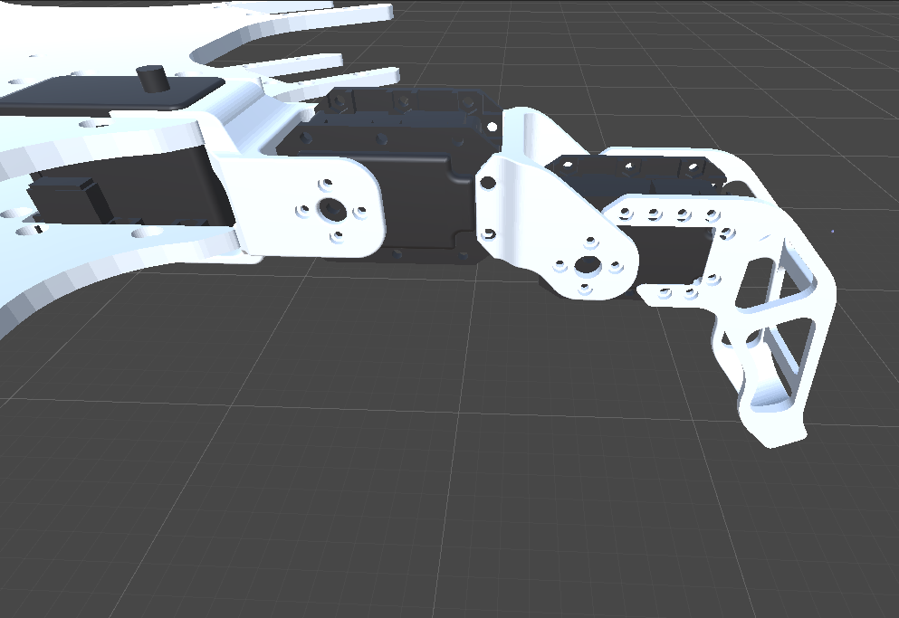
1
2
coxia
tibiaH
3
4
5
tibiaX
femuarX
femuarH
6
Leg Base

Slide 6
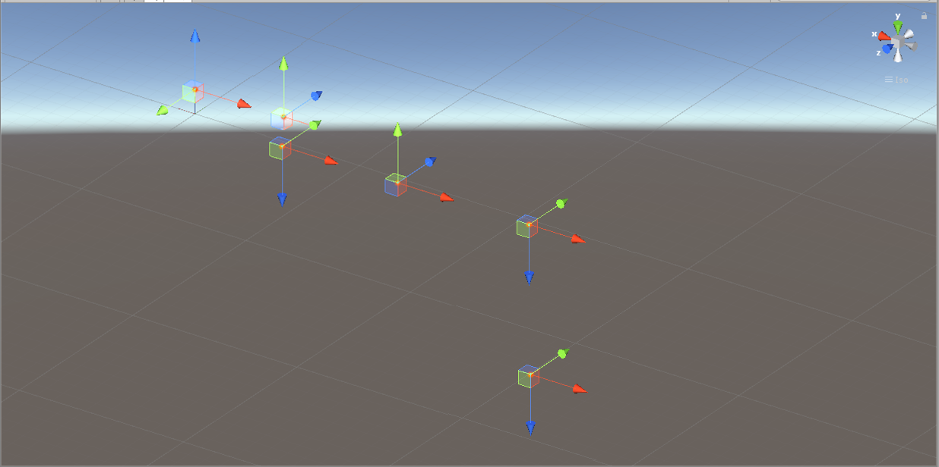
1
coxia = 53
tibiaH = 16.6
tibiaX = 70.8
femuarX = 79.8
femuarH = 85.00038
2
coxia
4
tibiaH
tibiaX
5
3
femuarX
femuarH
Leg Base
6

Slide 7
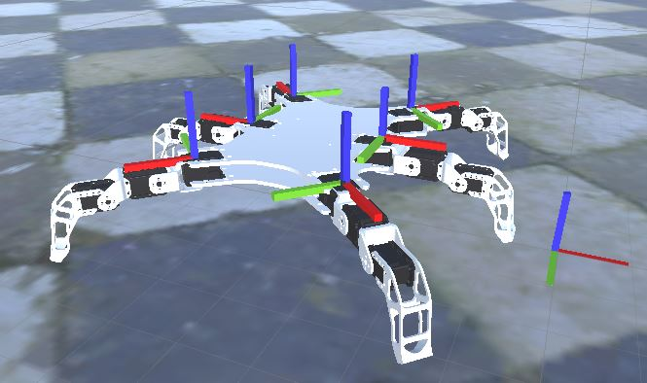
lenght = coxia + tibiaX + femuarX
X => lb, lm, lf, rb, rm, rf
XLegBaseFORG = XContCntrPnt + Vector3(Cos(PI * XEulerAngles.z / 180) * lenght, Sin(PI * XEulerAngles.z / 180) * lenght, 0)

Slide 8
1
Coxia = 53
tibiaH = 16.6
tibiaX = 70.8
femuarX = 79.8
femuarH = 85.00038
2
coxia
4
tibiaH
tibiaX
5
3
femuarX
$$i$$ | $$α_{i}$$ | $$a_{i−1}$$ | $$d_{i}$$ | $$Q_{i}$$
1 | 0 | 0 | 0 | $$Q_{1}$$
2 | 90 | coxia | 0 | $$Q_{2}$$
3 | 90 | 0 | tibiaH | 0
4 | -90 | tibiaX | 0 | $$Q_{3}$$
5 | 90 | femuarX | 0 | 0
6 | 0 | 0 | femuarH | 0
femuarH
6

Slide 9
Transform matrisleri aşağıdaki gibi elde edilir.
T01 =
[ cos(Q1), -1.0*sin(Q1), 0, 0]
[ sin(Q1), cos(Q1), 0, 0]
[ 0, 0, 1.0, 0]
[ 0, 0, 0, 1.0]
T12 =
[ cos(Q2), -1.0*sin(Q2), 0, coxia]
[ 0, 0, 1.0, 0]
[ -1.0*sin(Q2), -1.0*cos(Q2), 0, 0]
[ 0, 0, 0, 1.0]
T45 =
[ 1.0, 0, 0, femuarX]
[ 0, 0, 1.0, 0]
[ 0, -1.0, 0, 0]
[ 0, 0, 0, 1.0]
T56 =
[ 1.0, 0, 0, 0]
[ 0, 1.0, 0, 0]
[ 0, 0, 1.0, femuarH]
[ 0, 0, 0, 1.0]
T23 =
[ 1.0, 0, 0, 0]
[ 0, 0, 1.0, tibiaH]
[ 0, -1.0, 0, 0]
[ 0, 0, 0, 1.0]
T34 =
[ cos(Q3), -1.0*sin(Q3), 0, tibiaX]
[ 0, 0, -1.0, 0]
[ sin(Q3), cos(Q3), 0, 0]
[ 0, 0, 0, 1.0]
İleri kinematik çözümü aşağıdaki gibi elde edilir.
T06 =
[ cos(Q2 + Q3)*cos(Q1), sin(Q1), -sin(Q2 + Q3)*cos(Q1), cos(Q1)*(coxia + femuarX*cos(Q2 + Q3) - 1.0*femuarH*sin(Q2 + Q3) + tibiaX*cos(Q2) - 1.0*tibiaH*sin(Q2))]
[ cos(Q2 + Q3)*sin(Q1), -1.0*cos(Q1), -sin(Q2 + Q3)*sin(Q1), sin(Q1)*(coxia + femuarX*cos(Q2 + Q3) - 1.0*femuarH*sin(Q2 + Q3) + tibiaX*cos(Q2) - 1.0*tibiaH*sin(Q2))]
[ -1.0*sin(Q2 + Q3), 0, -1.0*cos(Q2 + Q3), - femuarH*cos(Q2 + Q3) - femuarX*sin(Q2 + Q3) - tibiaH*cos(Q2) - tibiaX*sin(Q2)]
[ 0, 0, 0, 1.0]

Slide 10
Ters kinematik çözümü aşağıdaki gibi elde edilir.
S_L =
px*cos(Q1)*cos(Q2) - pz*sin(Q2) - coxia*cos(Q2) + py*cos(Q2)*sin(Q1)
coxia*sin(Q2) - 1.0*pz*cos(Q2) - 1.0*px*cos(Q1)*sin(Q2) - 1.0*py*sin(Q1)*sin(Q2)
py*cos(Q1) - px*sin(Q1)
1
S_R =
tibiaX + femuarX*cos(Q3) - femuarH*sin(Q3)
tibiaH + femuarH*cos(Q3) + femuarX*sin(Q3)
0
1.0
Denklemler aşağıdaki gibi elde edilir.
px*cos(Q1)*cos(Q2) - pz*sin(Q2) - coxia*cos(Q2) + py*cos(Q2)*sin(Q1) = tibiaX + femuarX*cos(Q3) - femuarH*sin(Q3)
coxia*sin(Q2) - 1.0*pz*cos(Q2) - 1.0*px*cos(Q1)*sin(Q2) - 1.0*py*sin(Q1)*sin(Q2) = tibiaH + femuarH*cos(Q3) + femuarX*sin(Q3)
py*cos(Q1) - px*sin(Q1) = 0
3.denklem ile Q1 aşağıdaki gibi bulunur.
Q1 = atan(py/px)

Slide 11
Birinci ve ikinci denklemler aşağıdaki gibi sadeleştirilir.
cos(Q2)*(px*cos(Q1) - coxia + py*sin(Q1)) - pz*sin(Q2) - tibiaX = femuarX*cos(Q3) - femuarH*sin(Q3)
sin(Q2)*(coxia - px*cos(Q1) - py*sin(Q1)) - pz*cos(Q2) - tibiaH = femuarH*cos(Q3) + femuarX*sin(Q3)
K = px*cos(Q1) - coxia + py*sin(Q1)
cos(Q2)*K - pz*sin(Q2) - tibiaX = femuarX*cos(Q3) - femuarH*sin(Q3)
-sin(Q2)*K - pz*cos(Q2) - tibiaH = femuarH*cos(Q3) + femuarX*sin(Q3)
1. ve 2. Denklemler karesi alınır ve toplanır ise
sin(Q2)(2*K*tibiaH + 2*pz*tibiaX) + cos(Q2)*(-2*K*tibiaX + 2*pz*tibiaH) + K^2 + pz^2 + tibiaH^2 + tibiaX^2 = femuarH^2 + femuarX^2
sin(Q2)(2*K*tibiaH + 2*pz*tibiaX) + cos(Q2)*(-2*K*tibiaX + 2*pz*tibiaH) = femuarH^2 + femuarX^2 - K^2 - pz^2 - tibiaH^2 - tibiaX^2
A = (2*K*tibiaH + 2*pz*tibiaX) B = (-2*K*tibiaX + 2*pz*tibiaH) C = femuarH^2 + femuarX^2 - K^2 - pz^2 - tibiaH^2 - tibiaX^2
sin(Q2)*A + cos(Q2)*B = C
Q2 = atan2(A,B) + atan2(sqrt(A^2 + B^2 - C^2),C);

Slide 12
femuarH*cos(Q3) + femuarX*sin(Q3) = coxia*sin(Q2) - 1.0*pz*cos(Q2) - 1.0*px*cos(Q1)*sin(Q2) - 1.0*py*sin(Q1)*sin(Q2) - tibiaH
A = femuarX B = femuarH C = coxia*sin(Q2) - 1.0*pz*cos(Q2) - 1.0*px*cos(Q1)*sin(Q2) - 1.0*py*sin(Q1)*sin(Q2) - tibiaH
sin(Q2)*A + cos(Q2)*B = C
Q3 = atan2(A,B) + atan2(sqrt(A^2 + B^2 - C^2),C);

Slide 13
to be continued …

