Slide 1
COMPUTER VISION PROJECT
ASL Sign Language Classifier
A CNN trained on the ASL alphabet, deployed for real-time recognition through a Flask webcam app
Solis · BSCS 3A

Slide 2
Project overview
The goal is to demonstrate an end-to-end computer vision workflow: teach a model to recognize ASL hand signs from images, then run that model live against a webcam.
29
sign classes recognized
Model training
A Colab notebook prepares the dataset, trains a CNN, and saves it as a .h5 file.
Live inference
A Flask app loads that model and classifies hand signs from a live webcam feed.
29,000
training images
93.1%
validation accuracy
ASL Sign Language Classifier · Solis BSCS 3A
2

Slide 3
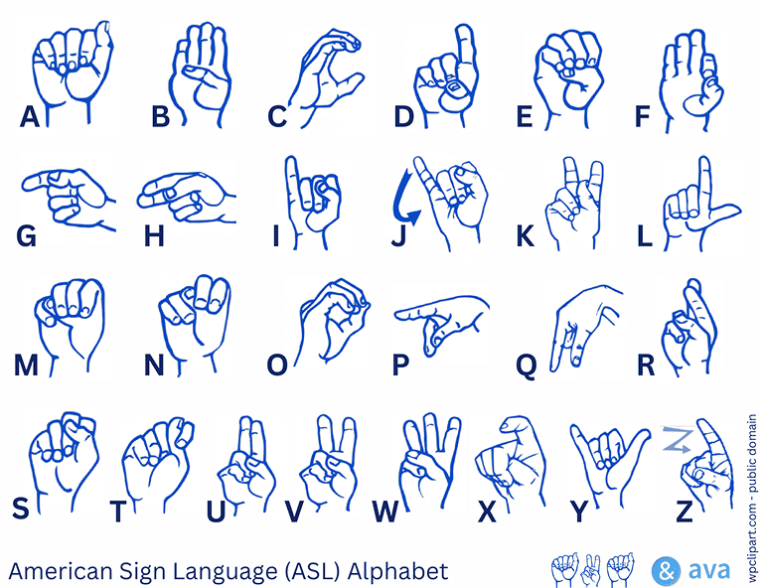
Dataset
ASL Alphabet dataset (Kaggle, grassknoted)
Classes
29 — A–Z, plus “del”, “nothing”, “space”
Images per class
1,000 (capped from the full Kaggle set)
Total images
29,000
Image size
64 × 64 pixels, RGB
Train / validation split
23,200 / 5,800 (80% / 20%, seed 42)
Public domain reference chart — not the training images themselves.
ASL Sign Language Classifier · Solis BSCS 3A
3

Slide 4
Training pipeline
From raw Kaggle images to a saved Keras model — run once, offline, in Colab
1
›
2
›
3
›
4
›
5
›
6
Kaggle dataset
Preprocess
Train / val split
Train CNN
Evaluate
Save model
29 classes, 1,000 imgs/class
Resize 64×64, RGB, /255
80% / 20%, seed 42
3 conv blocks + augmentation
93.1% val. accuracy
asl_classifier_model.h5
ASL Sign Language Classifier · Solis BSCS 3A
4

Slide 5
Model architecture
A compact sequential CNN — three convolution blocks feeding a dense classifier
1
›
2
›
3
›
4
›
5
Input
Conv blocks
Flatten
Dense 128
Output
64×64×3 RGB image
32→64→128 filters + dropout
4,608 features
ReLU, dropout 0.5
Dense 29, softmax
686,941
trainable parameters
ASL Sign Language Classifier · Solis BSCS 3A
5

Slide 6
Training results
10 epochs, with augmentation and early stopping
Why is validation higher than training?
Training images are augmented (harder to classify); validation images are not. Validation loss kept falling, so this isn’t overfitting.
Augmentation used
Rotation ±20°, shift 20%, shear 20%, zoom 20%
Horizontal flip: disabled
A mirrored hand sign can mean a different letter
ASL Sign Language Classifier · Solis BSCS 3A
6

Slide 7
Live inference
app.py — runs the saved model against a real-time webcam feed
1
›
2
›
3
›
4
›
5
Webcam frame
Detect hand
Crop & resize
CNN predicts
Stream to browser
OpenCV capture, BGR→RGB
MediaPipe, 1 hand tracked
+20px margin, 64×64
Loads asl_classifier_model.h5
Flask MJPEG at /video_feed
Displays the predicted letter and confidence, e.g. “A (0.95)”, overlaid on the video.
ASL Sign Language Classifier · Solis BSCS 3A
7

Slide 8
Technologies
Modeling
Vision
Deployment
Data & infra
TensorFlow / Keras
scikit-learn
OpenCV
MediaPipe Hands
Flask
Google Colab / Drive
Kaggle · kagglehub
Python ties every stage together, from dataset prep to the served web page.
Key versions pinned in requirements.txt
TensorFlow 2.17.0 · MediaPipe 0.10.14 · OpenCV (contrib) 4.10.0.84
ASL Sign Language Classifier · Solis BSCS 3A
8

Slide 9
Limitations to keep in mind
93.1% is validation accuracy on the notebook’s held-out set — not a guarantee of real-world webcam accuracy.
Single-hand only
MediaPipe is configured for max_num_hands = 1.
Different input distribution
Webcam crops differ from the clean dataset images — lighting, background, framing all vary.
Confidence ≠ correctness
The displayed value is a softmax probability, not a correctness guarantee.
Letters, not sentences
Classifies one of 29 signs per frame; no language model or word segmentation.
ASL Sign Language Classifier · Solis BSCS 3A
9

Slide 10
Thank you
Questions welcome.
29
29,000
93.1%
sign classes
training images
validation accuracy
github.com/enfaith1/Solis_Week7-8

