Slide 1
The AI Valet
CS275 Project
Paritosh Gupta
Yihang Zhong

Slide 2
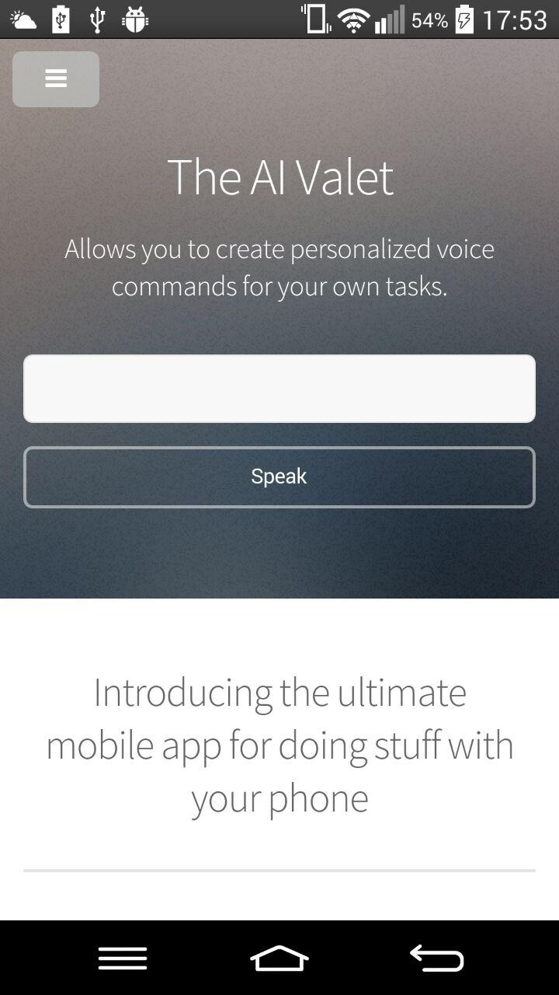
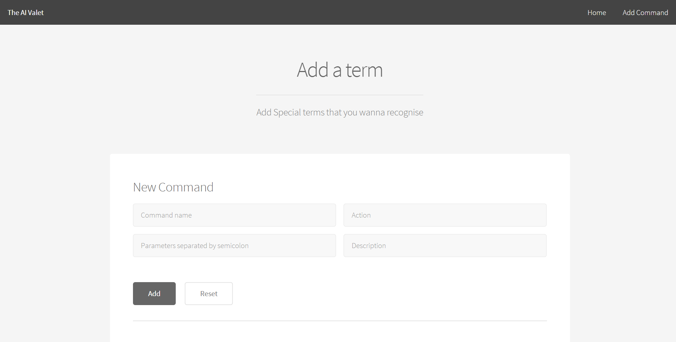
The AI Valet

Slide 3
Objective
Create an android mobile application as well as a web service that allows you to create personalized voice commands for your own tasks

Slide 4
Core Technique
HTML5 speech recognition function supported by Google Chrome
Google App Engine
Python
???

Slide 5
Project Features
Add personalized commands to database
Call the command to perform certain action

Slide 6

Demo

Slide 7
Design and implementation details
something

