Slide 1
The AI Valet
CS275 Project
Paritosh Gupta
Yihang Zhong

Slide 2
Objective
Create “yet another” an android mobile application as well as a web service that allows you to create personalized voice commands for your own tasks

Slide 3
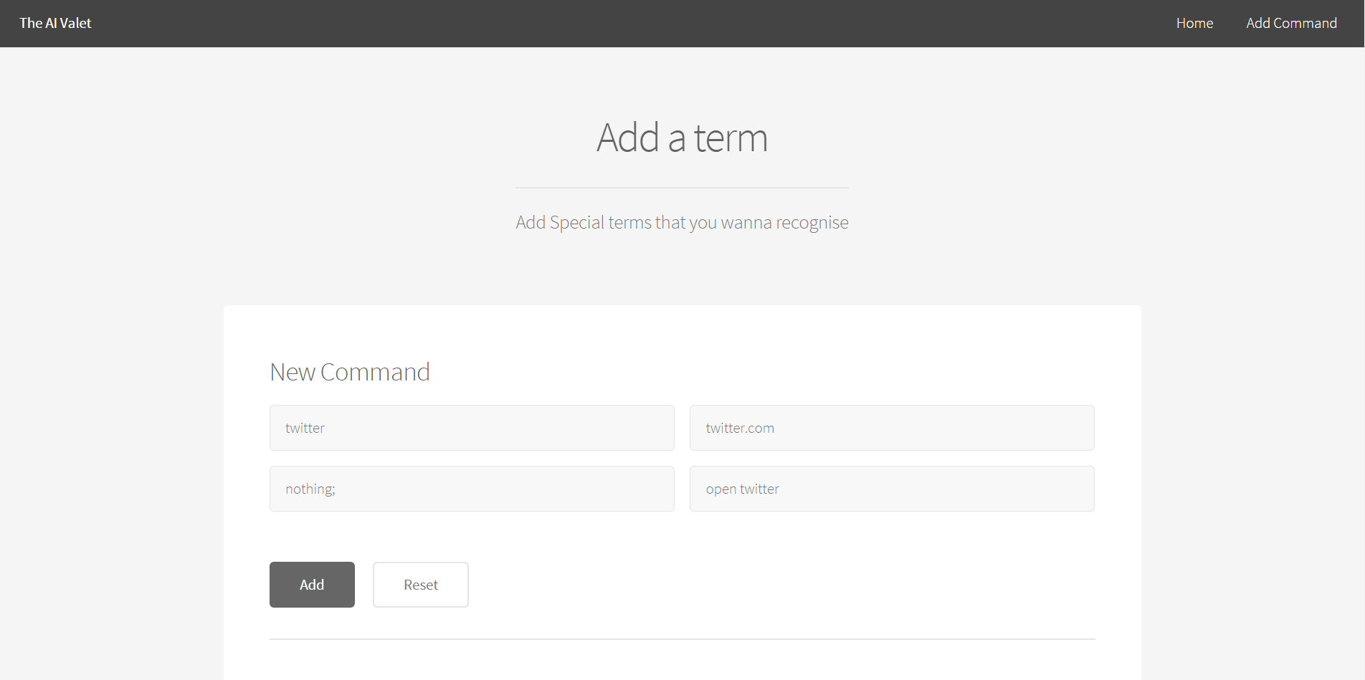
Demo

Slide 4
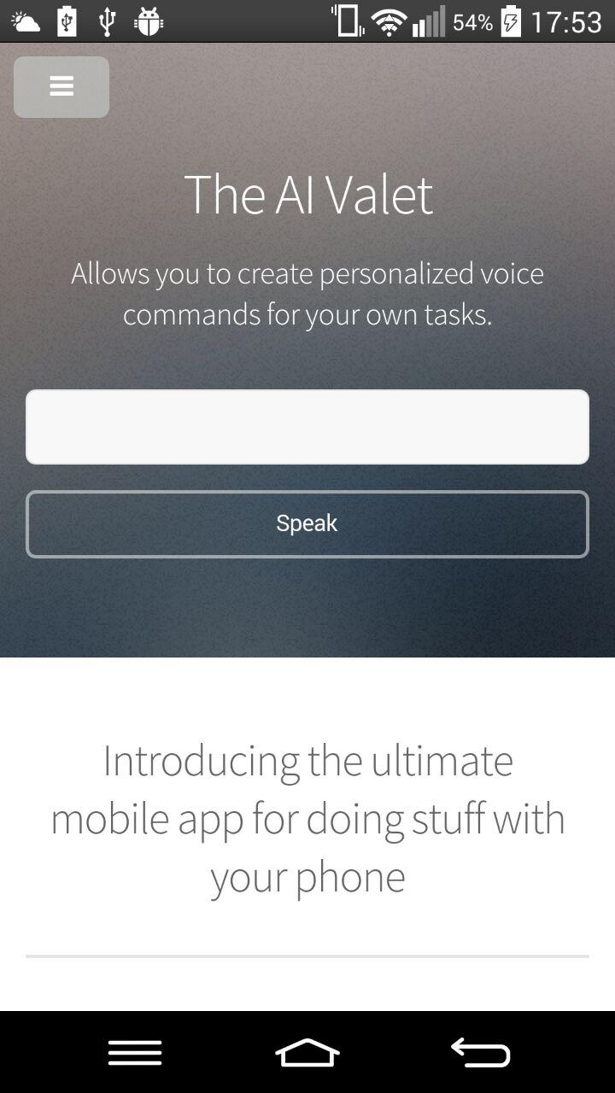

The AI Valet

Slide 5
Core Technologies
HTML5 webkit on chrome for speech recognition
Google App Engine and ndb storage
Python webbapp2
Apache Cordova

Slide 6
Project Features
Add personalized commands to database
Call the command to perform certain action

Slide 7
Design and implementation details
MVC Design Emulated
Online at myaivalet.appspot.com
Matches user query to database terms

Slide 8
Design and implementation details
If found searches for required parameters if present
The url present in the term is then executed (parameters are posted)

Slide 9
Things absent
Gui for adding required parameters easily
Browser plugin. Also integration with google now
Automatic Similar searches
Login.
Other speech to text suggestions in-case of incorrect detection

Slide 10
Other Issues
Running android activity from Cordova(javascript) – bug in new release of cordova.
An Api was used earlier. Didn't allow for user separation for commands.

Slide 11
Future additions?
User login to localize commands
Desktop App with hotword listener. Useful for linux.
Machine learning

Slide 12


