Slide 1
Unit testing in js
Eng / Ryhab Farouq

Slide 3
Why Use Jasmine?
Jasmine does not depend on any other JavaScript framework.
Jasmine does not require any DOM.
All the syntax used in Jasmine framework is clean and obvious.
Jasmine is an open-source framework and easily available in different versions like stand-alone, ruby gem, Node.js, etc.

Slide 4
Suite Block
Suite is the basic building block of Jasmine framework. The collection of similar type test cases written for a specific file or function is known as one suite. It contains two other blocks, one is “Describe()” and another one
is “It()”.
One Suite block can have only two parameters, one “name of that
suite” and another “Function declaration” that actually makes a call to our unit functionality that is to be tested.

Slide 5
Suite Block
describe("add", () =>{
it('should add', ()=>{
expect(add(7,3)).toEqual(10)
});
it('should return 0', ()=>{ expect(add(2,2)-4).not.toEqual(2)
})
})

Slide 6
JasmineJS - Matchers
Matchers are the JavaScript function that does a Boolean comparison between an actual output and an expected output
toEqual() is the inbuilt matcher which will compare the result of
the add() method with the arguments passed to toEqual() matchers
it('should add', ()=>{ expect(add(7,3)).toEqual(10)
});

Slide 7
JasmineJS - Skip Block
Jasmine also allows the developers to skip one or more than one test cases.
These techniques can be applied at the Spec level or the Suite level.
Skipping Spec
it(‘should add', ()=>{ expect(add(7,3)).toEqual(10)
});
xit('should return 0', ()=>{ expect(add(2,2)-4).not.toEqual(2)
})
 | ribe("add", () =>{
xdesc
it(‘should add', ()=>{ expect(add(7,3)).toEqual(10) }); it('should return 0', ()=>{ expect(add(2,2)-4).not.toEqual(2) }) })
Skipping suit

Slide 8
JasmineJS - Equality Check
Jasmine provides plenty of methods which help us check the equality of any JavaScript function and fil
ToEqual() is the simplest matcher present in the inbuilt library of Jasmine. It just matches whether the result of the operation given as an argument to this method matches with the result of it or not.
not.toEqual() works exactly opposite to toEqual(). not.toEqual() is used when we need to check if the value does not match with the output of any function.

Slide 9
toBe() matcher works in a similar way as toEqual(), however they are technically different from each other. toBe() matcher matches with the type of the object whereas toEqual() matches with the equivalency of the result.
not.toBe() As seen earlier, not is nothing but a negation of the toBe() method. It fails when the expected result matches with the actual output of the function or JavaScript file.
describe("Different Methods of Expect Block",function () { it("The Example of not.toBe() method",function () {
expect(true).not.toBe(false);
});
});

Slide 10
JasmineJS - Boolean Check
Jasmine provides some methods to check Boolean conditions too. Following are the methods that help us check Boolean conditions.
ToBeTruthy()This Boolean matcher is used in Jasmine to check whether the result is equal to true or false
toBeFalsy() also works the same way as toBeTruthy() method. It matches the output to be false whereas toBeTruthy matches the output to be true.

Slide 11
window.expectexam = { exampleoftrueFalse: function (num) {
if(num < 10) return true;
else
return false;
},
};
describe("Different Methods of Expect Block",function () { it("The Example of toBeTruthy() method",function () {
expect(expectexam.exampleoftrueFalse(5)).toBeTruthy();
});
});

Slide 12
toContain() matchers provide us the facility to check whether any element is a part of the same array or some other sequential objects
describe("Different Methods of Expect Block",function () {
it("The Example of toContain() method",function () { expect([1,2, 3, 4]).toContain(3);
});
});

Slide 13
ToMatch() matcher works on String type variable. It is helpful to find whether a specific String is present in the expected output or not.
describe("Different Methods of Expect Block",function () {
it("Example of toMatch()", function () {
expect("Jasmine tutorial in tutorials.com").toMatch(/com/);
});
});

Slide 14
ToBedefined() This matcher is used to check whether any variable in the code is predefined or not.
currentVal = 0;
describe("Different Methods of Expect Block",function () { it("Example of toBeDefined", function () {
expect(currentVal).toBeDefined();
});
});

Slide 15
ToBeUndefined()This matcher helps to check whether any variable is previously undefined or not, basically it works simply opposite to the previous matcher that is toBeDefined.
describe("Different Methods of Expect Block",function () { it("Example of toBeUndefine()", function () {
var undefineValue; expect(undefineValue).toBeUndefined();
});
});

Slide 16
toBeNull() As the name signifies this matcher helps to check null values.
describe("Different Methods of Expect Block",function () {
var value = null;
it("Example of toBeNull()", function () { expect(value).toBeNull();
});
});

Slide 17
ToBeGreaterThan() As the name suggests this matcher helps to check greater than condition
ToBeLessThan() This matcher helps to check the less than condition of the test scenario. It behaves exactly opposite to that of toBeGreaterThan() matcher
describe("Different Methodsof Expect Block",function () { var exp = 4;
it("Example of toBeLessThan()", function() {
expect(exp).toBeLessThan(5);
});
});

Slide 18
toBeNaN().
describe("Different Methods of Expect Block",function () { it("Example of toBeNaN()", function () {
expect(0 / 0).toBeNaN();
});
});

Slide 19
beforeEach(), afterEach()
Using these two functionalities, we can execute some pieces of code before and after execution of each spec. This functionality is very useful for running the common code in the application.

Slide 20

spy
Jasmine has test double functions called spies. A spy can stub any function and tracks calls to it and all arguments.
A spy only exists in the describe or it block in which it is defined, and will be removed after each spec. There are special matchers for interacting with spies

Slide 21
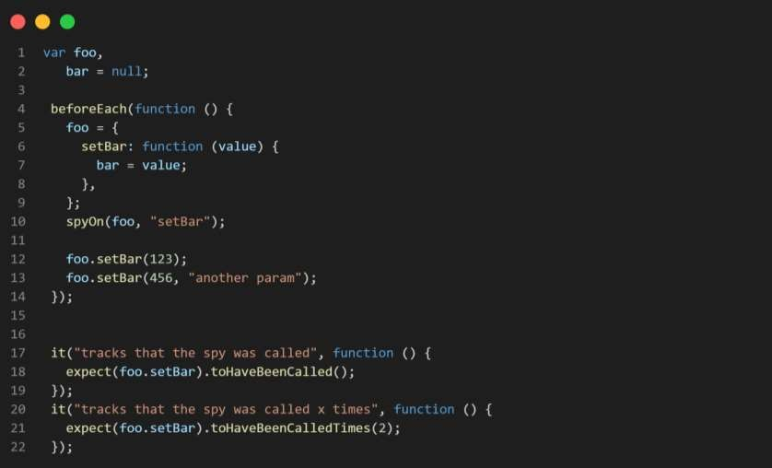
Spy Example :

Slide 22
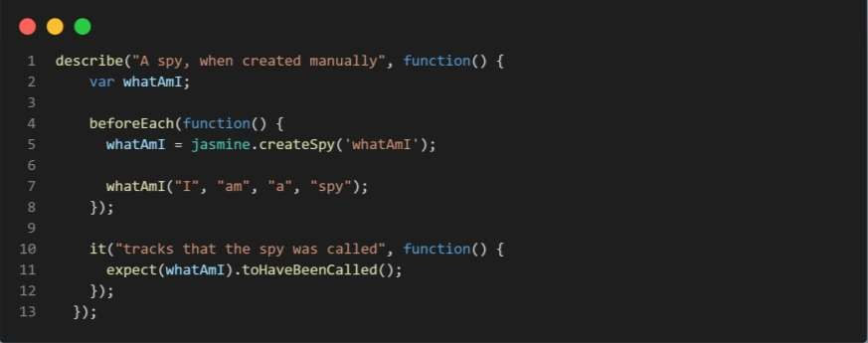
Spies: createSpy

Slide 23
Any &Anything
Sometimes you don't want to match with exact equality. Jasmine provides a number of asymmetric equality testers.
*-Jasmine.any takes a constructor or "class" name as an expected value. It returns true if the constructor matches the constructor of the actual value.
*- jasmine.anything returns true if the actual value is not null or undefined.

Slide 24
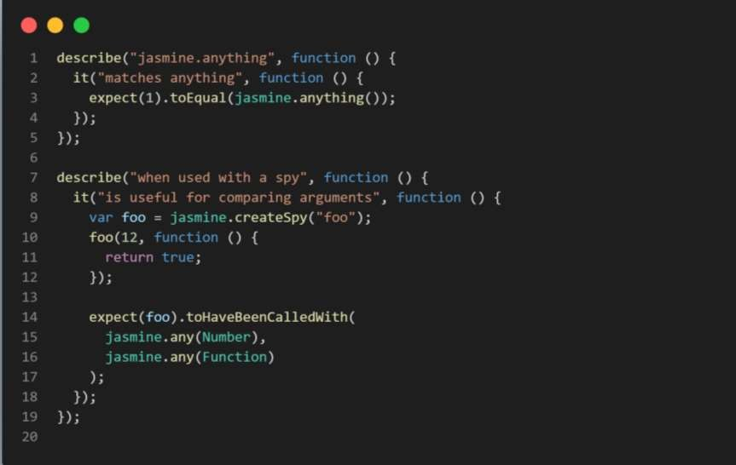
Example :

Slide 25

Jasmine Clock
The Jasmine Clock is available for testing time dependent code.
It is installed with a call to jasmine.clock().install in a spec or suite that needs to manipulate time.
Be sure to uninstall the clock after you are done to restore the original functions

Slide 26
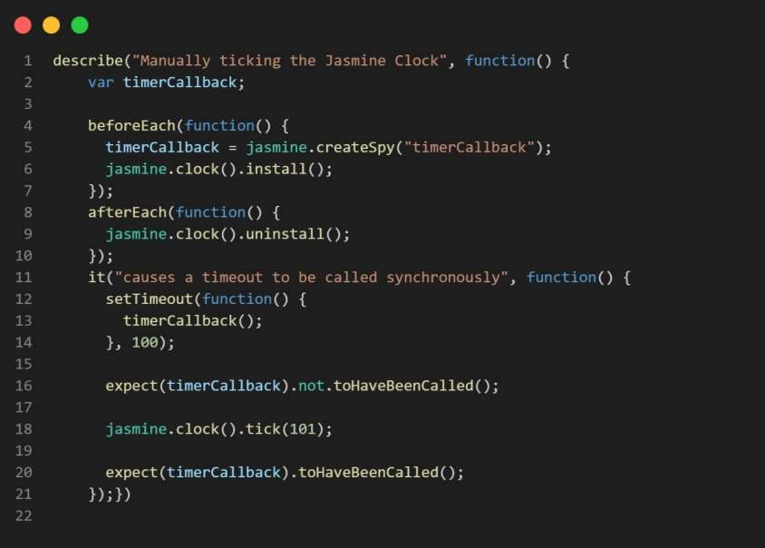
Example :

