Slide 1
Petcare
E-Business Presentation

Slide 2
Problems
1- Number of pets.
2- Reservation.
3- Hoisting

Slide 3
Team Members
01
02
03
04
05
Ziad Ahmed Eleraky
Nisma Ahmed Elagder
Ashraf Ahmed Thabet
Ahmed Ayman Abdelfattah
Ahmed Mahmoud Abouraia

Slide 4
Table of contents
01
02
03
04
BUSINESS OVERVIEW
Marketing Plan
Product Definition
Business Canvas

Slide 5
Petcare Idea

Slide 6
Why use e-business?
1- Saving money
2- Most used
3- Easy & Fast
4- Flexible
5- Follow transaction

Slide 7
Marketing Plan

Slide 8
Situational
Analysis
(SWOT)

Slide 9
Situational Analysis (SWOT)
1- Strengths
1- Doctor visiting
2- Pets Clinics
3- Pets Care
4- Adoption
5- Hosting
6- Pet Walking

Slide 10
Situational Analysis (SWOT)
cont’d
2- Weakness
1- We can't cover all areas.
2- Hoisting limitations.

Slide 11
Situational Analysis (SWOT)
cont’d
3- Opportunity
1- Competitors don't have our features.(EGY,City)
2- Recently, People in egypt like to have pets.
3- There are too many charities that want to buy pet food.

Slide 12
Situational Analysis (SWOT)
cont’d
4- Threats
1- There are too many competitors that sell supplements for pets.
2-The economic conditions of the country

Slide 13
STP

Slide 14
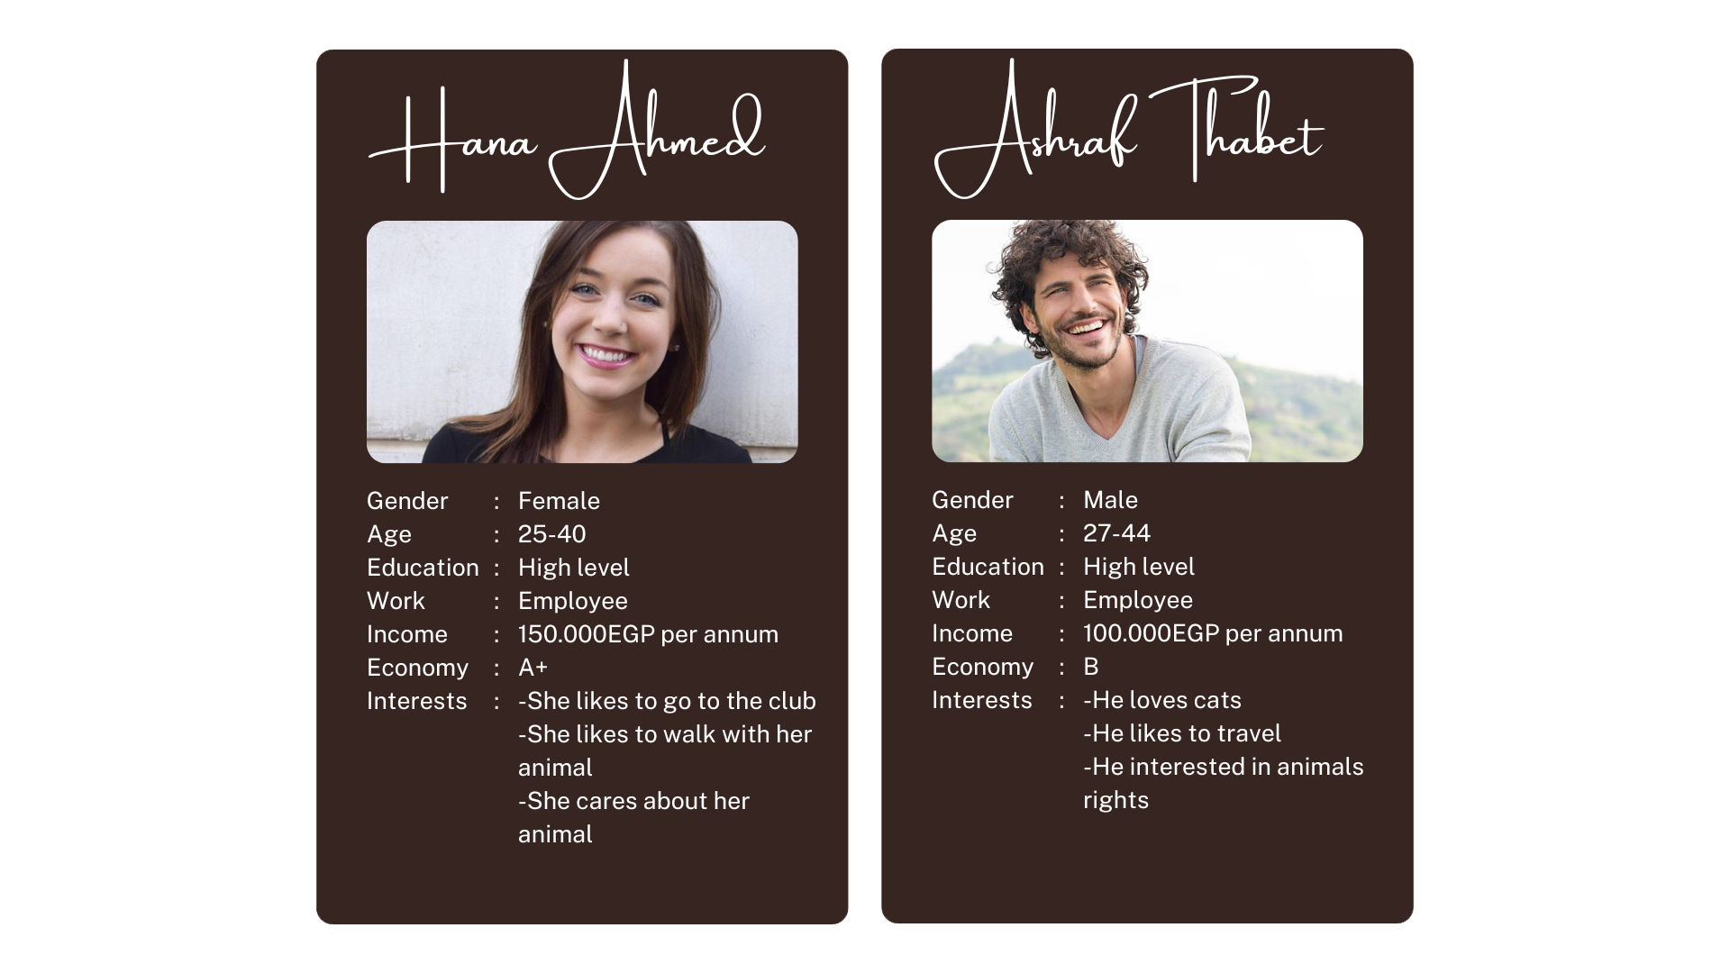
STP
1- Segmentation

Slide 15
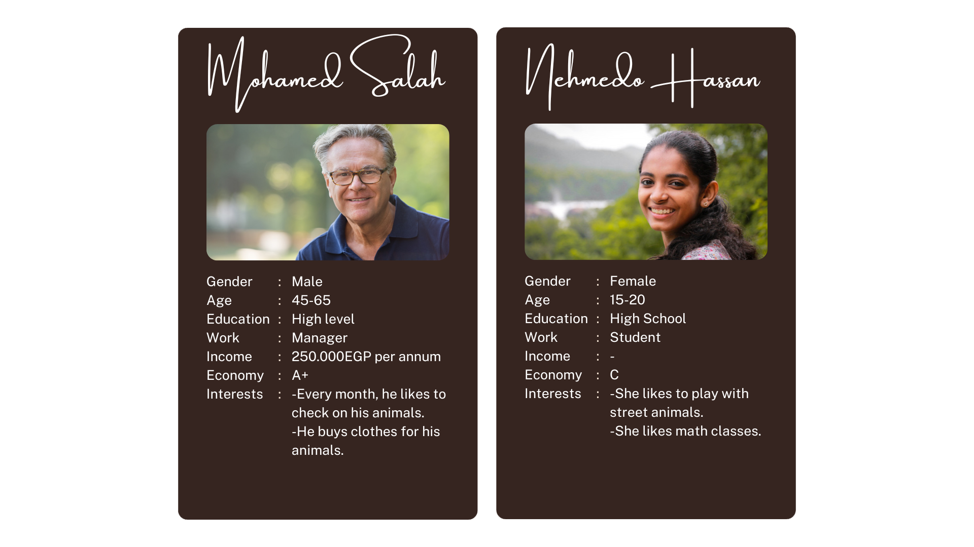
STP
1- Segmentation (Cont’d)

Slide 16
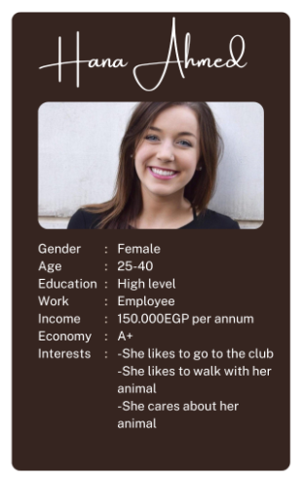
STP
2- Targeting
Discount on pet accessories
Free session pet care the next time
Discount on pet walking
3- Positioning
Public places
Social media

Slide 17
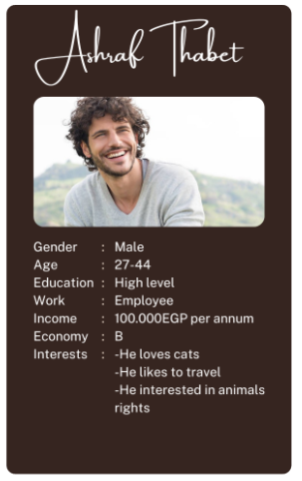
STP
2- Targeting
Discount on pet accessories
First hosting is free
3- Positioning
Social Media
Stations and airports

Slide 18
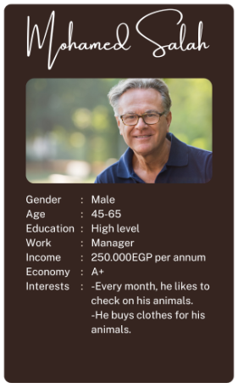
STP
2- Targeting
Discount 50% next Doctor Visiting
Discount on pet Clothes
Discount on pet walking
3- Positioning
Radio
Stations and airports

Slide 19
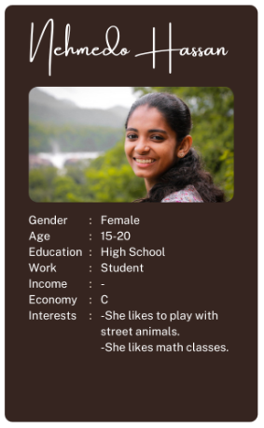
STP
2- Targeting
Free food with adopting
3- Positioning
Social Media
Public places

Slide 20
Product Definition

Slide 21
4ps
Product
Price
Our product is pet healthy care
Mid to high
Place
Promotion
Zayed, Maadi
Coupons,discounts,
offers

Slide 22
Business Model
B2B
B2C
C2C

Slide 23
Revenu
Transaction Fees
Subscription Fees
Ads On App

Slide 24
Price Plan
Free | Standard | Premium
Customer support Ads | 140 EGP monthly 1500 EGP annually Customer support No ads Video tutorial Special offer | 170 EGP monthly 2000 EGP annually Customer support Special offer and coupon Video tutorial Free session for animal care No ads

Slide 25


Pet Care online Identity
Our logo.
Color theme.
A professional App design.
Personalized email address: petcare_app@gmail.com.
Social Media profiles: Pet Care facebook page
Provide high quality content.
Engage with customers.

Slide 26
Advertisement plans
Ads on sports club.
Ads on Malls.
Ads on social media.
Ads on streets.
Ads on radio.

Slide 27
Extend our project in future
Cover all Cairo
open our stores and clinics in cairo
2 years
5 years
Cover all Egypt
Cover all Africa region
4 years
6 years

Slide 28
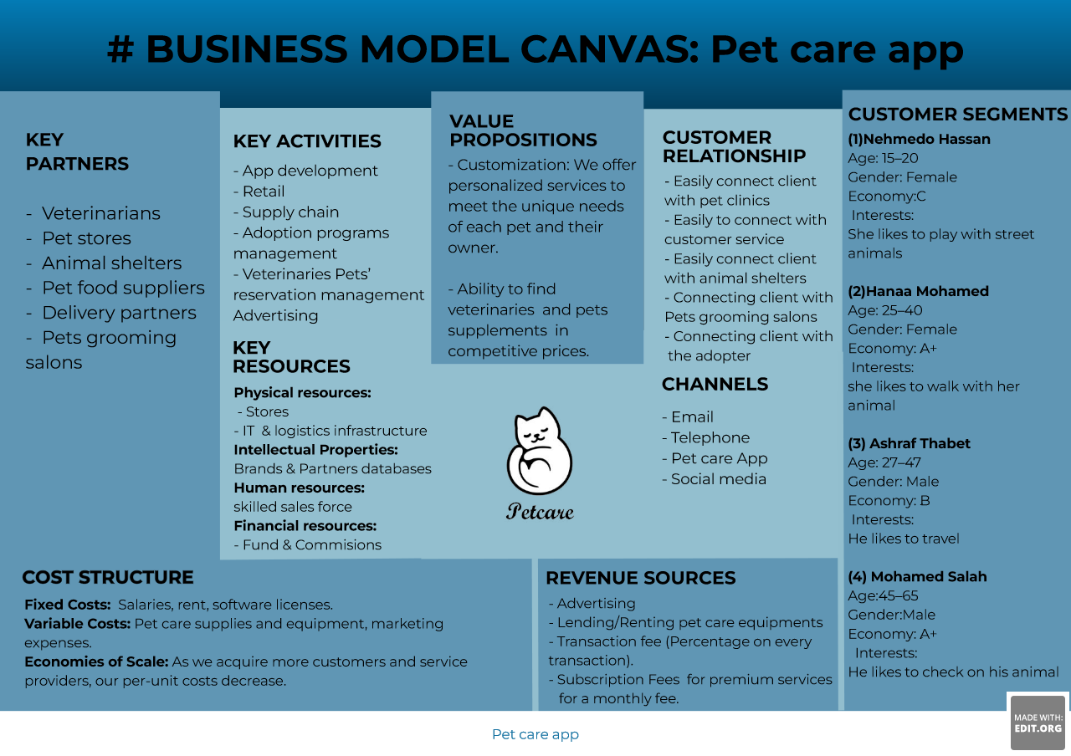

Slide 29
Thanks!

