Slide 1
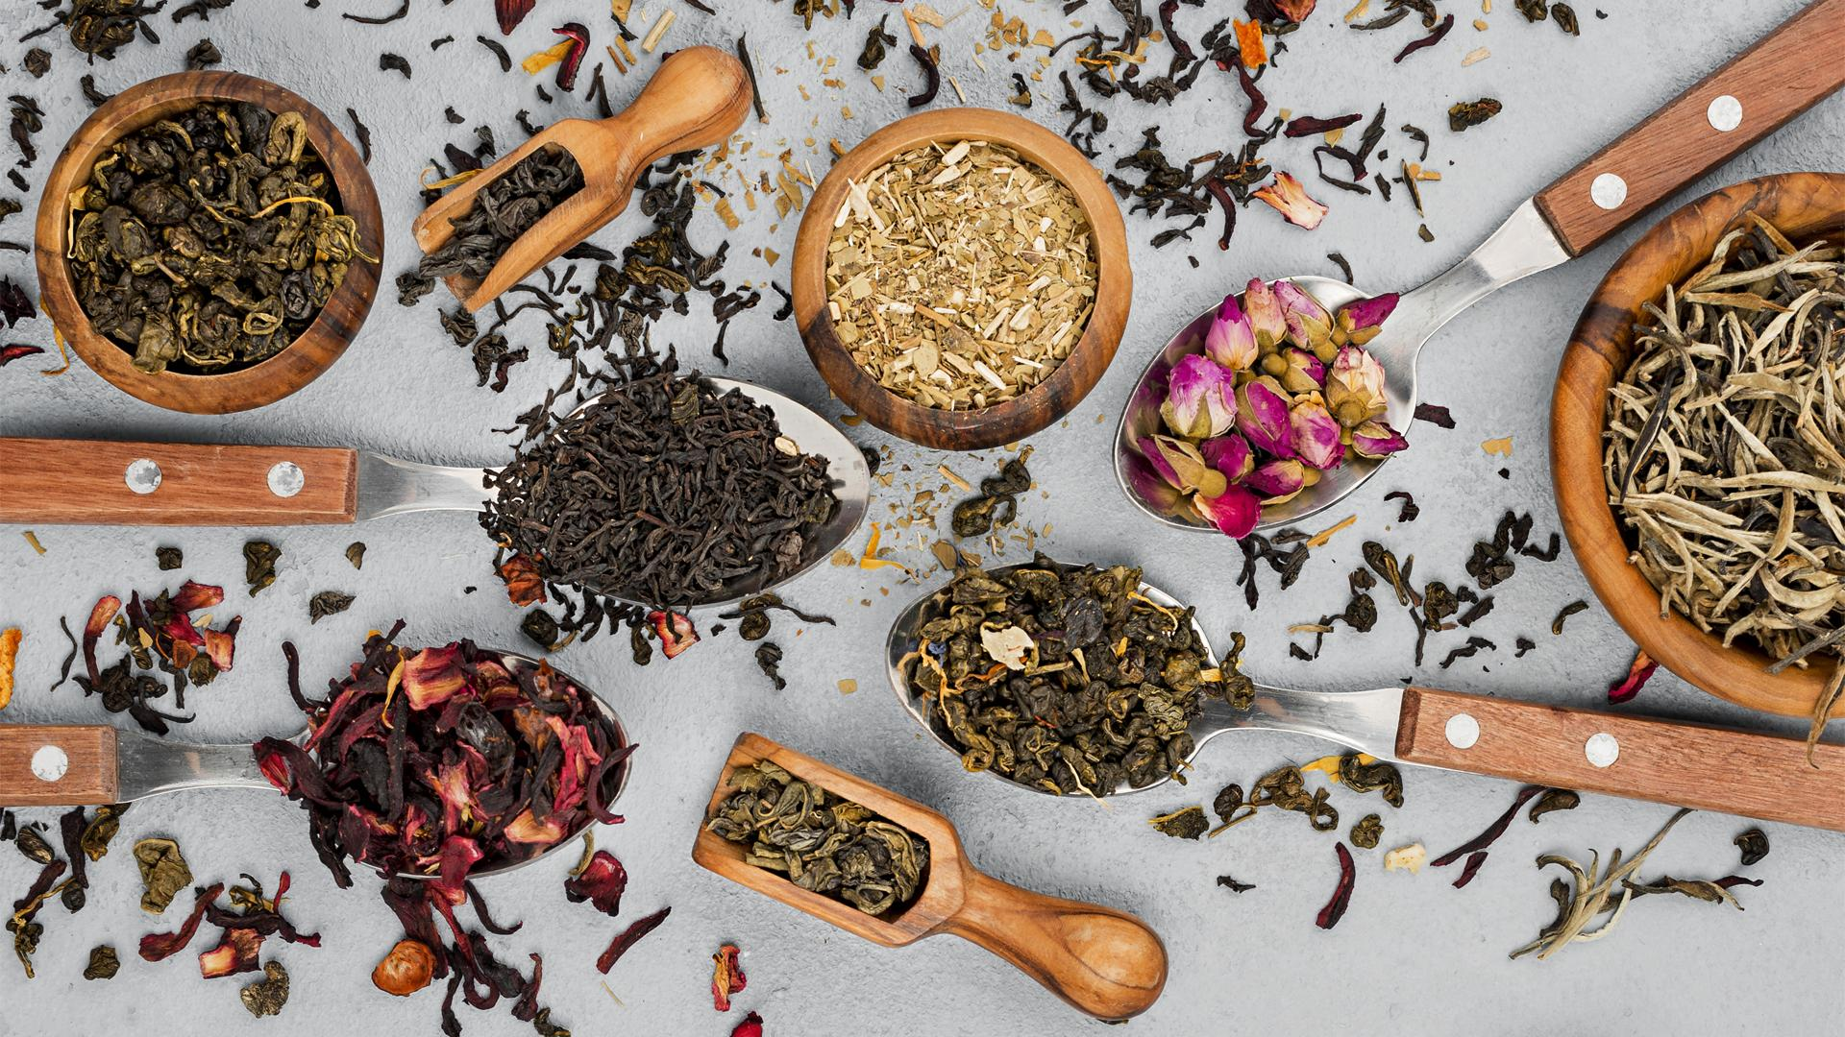
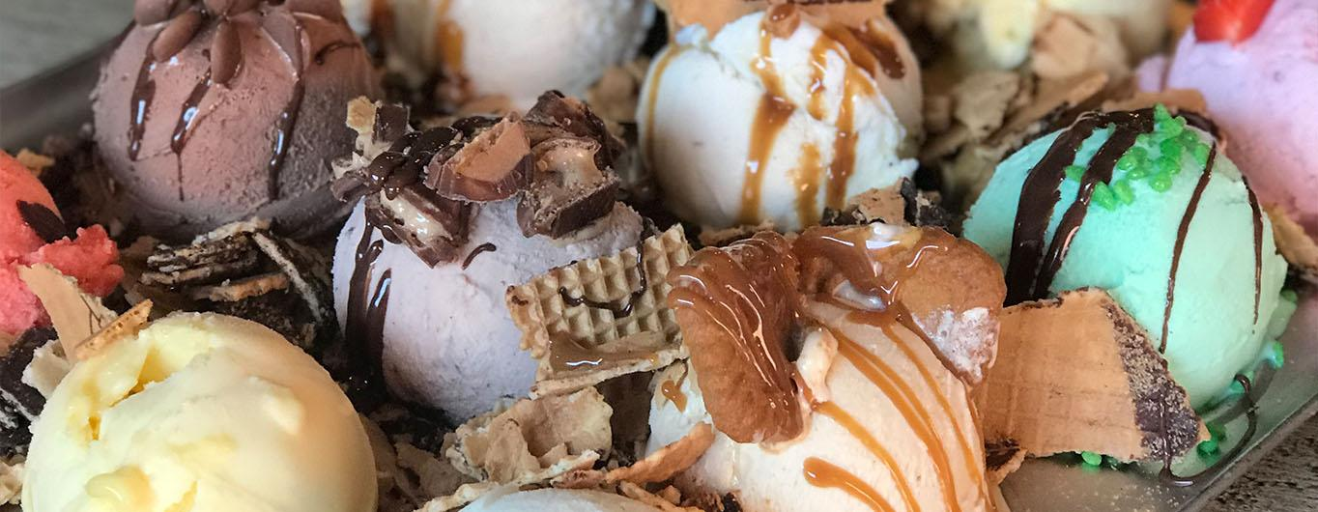
5 Bizarre Dishes
But lets go sweet…

Slide 2
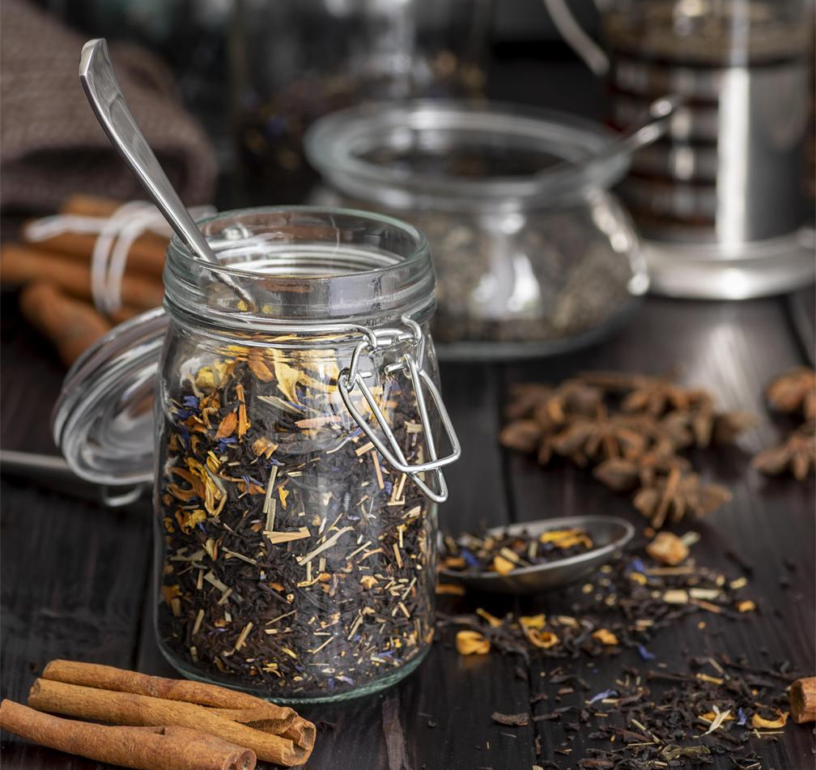
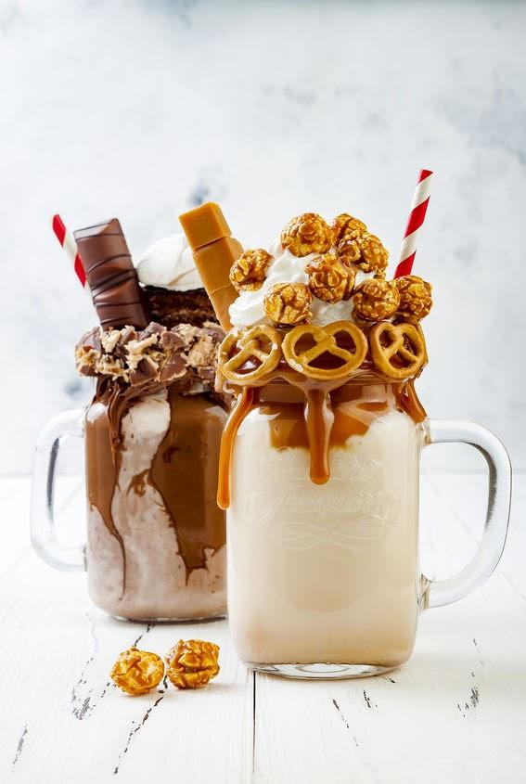
1. FREAK SHAKES
When people say you can make anything out of a milkshake,
you normally wouldn’t think they mean that literally.

Slide 3
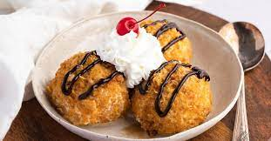
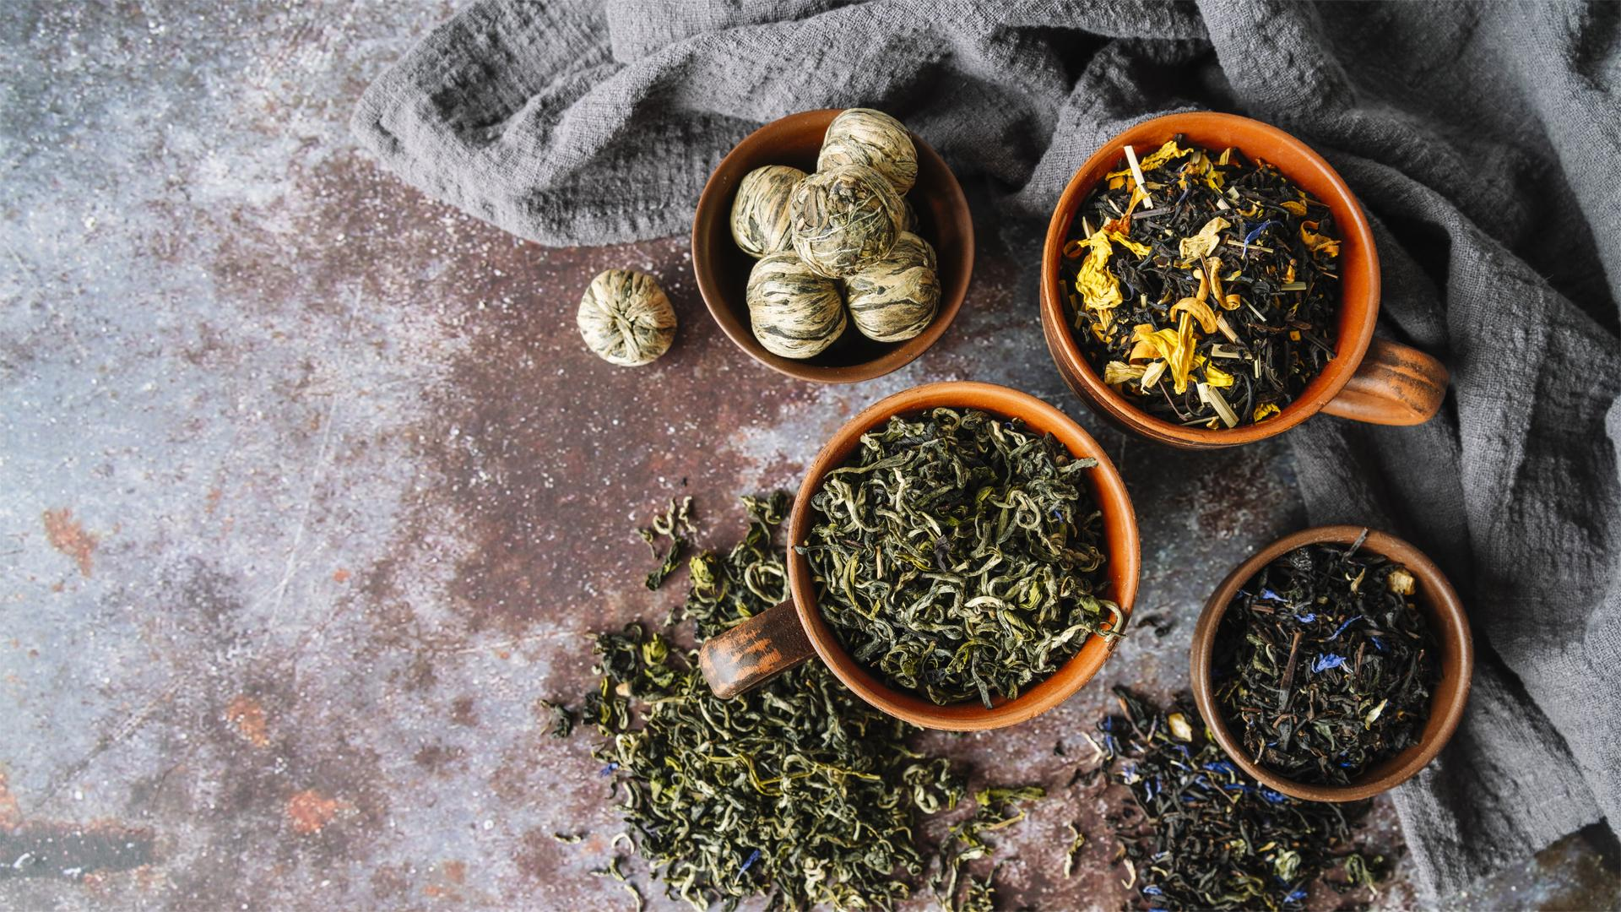
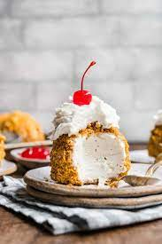
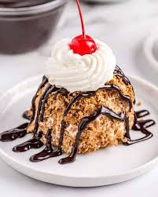
2. Deep-Fried Ice Cream
Probably the most contradictory food item we could find,
fried ice cream is a popular treat in the United States.

Slide 4
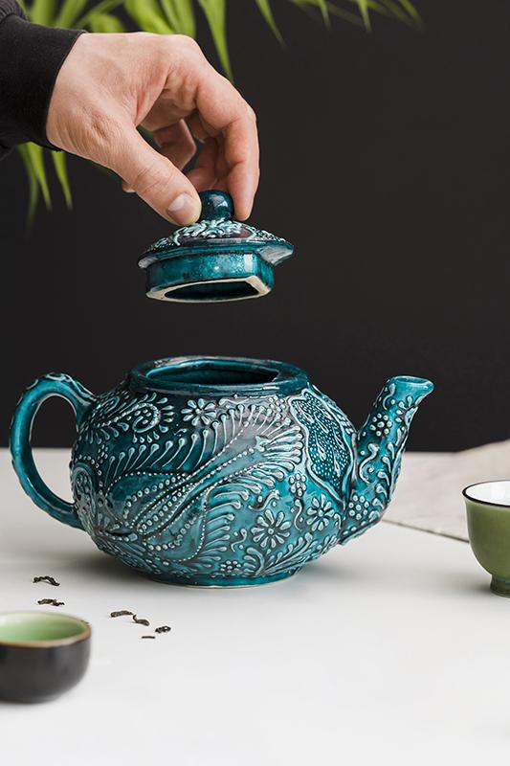
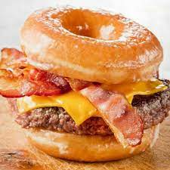
3. Doughnut Burgers
If anything will give you cholesterol, this tasty treat will. Doughnut burgers are exactly what you think they are:
burger fillets wedge between two sliced halves of a ringed doughnut.

Slide 5
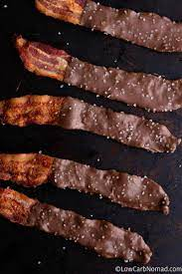
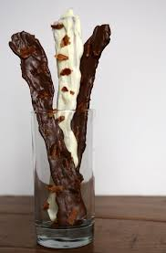

4. Chocolate Bacon
A truly unthinkable mix, it’s now becoming a growing trend to put chocolate on bacon.
This savoury-sweet treat is another one that might tickle your fancy if you like the idea of the doughnut burger.

Slide 6
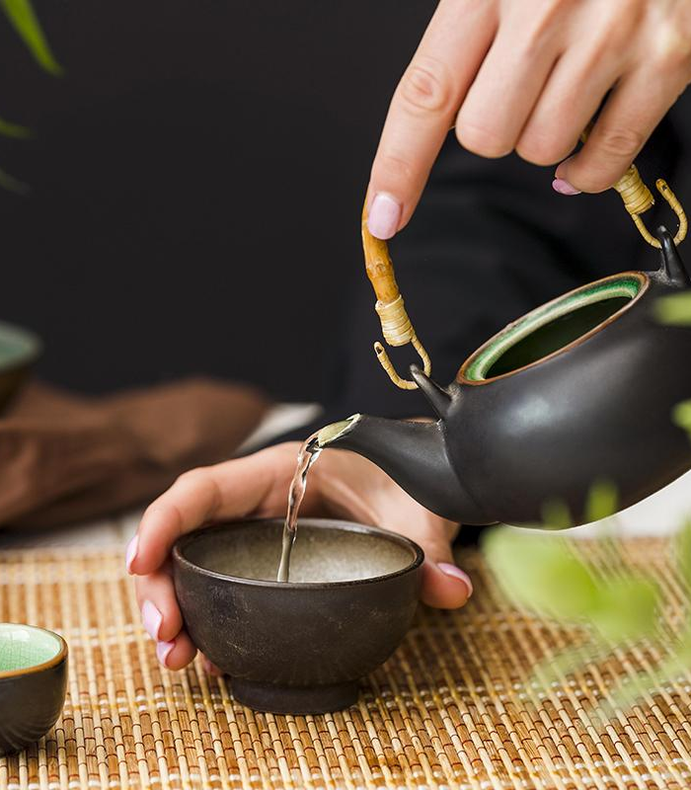
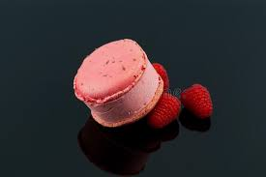
5. Macaron
Ice Cream Sandwich
Making a decent macaron is in of itself a challenge. Making ice cream to go in the middle of that while delicately balancing the flavours together has got to be even more challenging.

Slide 7
Thank you

