Slide 1

The University of Jordan
School of Engineering Department of Computer Engineering
Real-Time and AI-Based Automated Trading App
(Kryseos)
Supervisor: Prof. Iyad Jafar
June 2025
Graduation Project – AI-Powered Trading System

Slide 2
Project Motivation and Overview
“What is the problem Kryseos solves, and how does it do it?”
In recent years, Bitcoin and Ethereum markets have grown rapidly, but their 24/7 volatility creates challenges for manual trading.
To address this, we developed Kryseos — an AI-powered, real-time automated trading system tailored for cryptocurrencies.
It combines a Flutter mobile app and a FastAPI backend, allowing users to automate trades, monitor live performance, and reduce emotional bias.
The system enhances trading efficiency using real-time data, technical indicators, and machine learning models.
Graduation Project – AI-Powered Trading System (Kryseos)

Slide 3
Why Cryptocurrency & Target Users
“Why we chose cryptocurrency as our domain and who our users are”
We chose cryptocurrency for several reasons:
It operates 24/7 with no market closures,
Offers high liquidity and fast execution,
Allows leverage up to 100:1 on some platforms.
These features make it ideal for real-time automated trading.
Our target audience includes traders in regions like UAE, Bahrain, and Turkey, where crypto trading is active.
In Jordan, while institutions are restricted, individuals can trade at their own risk — and Kryseos is designed for them.
Graduation Project – AI-Powered Trading System (Kryseos)

Slide 4
Related Work and Innovation
“How Kryseos compares to academic research and existing platforms”
Prior research has used indicators like SMA, MACD, and RSI, and applied machine learning (e.g., ANN, Deep Q-networks) to predict trades.
Kryseos improves on this by integrating modular strategies — technical and ML-based — with flexible configuration.
Compared to platforms like Pionex, 3Commas, and HaasOnline, Kryseos is:
Self-hosted for user control,
API-encrypted for security,
And fully customizable with a clean mobile interface.
Graduation Project – AI-Powered Trading System (Kryseos)

Slide 5
Architecture and Core Components
“An overview of Kryseos’s modular architecture and key subsystems”
Kryseos follows a full-stack architecture:
Mobile App (Flutter): for user login, strategy setup, and monitoring.
Backend Server (FastAPI): manages trading logic, user sessions, and strategy execution.
Broker APIs: Binance provides real-time market data; Alpaca handles order execution.
SQLite Database: stores encrypted API credentials and trading equity for history tracking.
This modular structure allows flexibility, scalability, and future extension.
Graduation Project – AI-Powered Trading System (Kryseos)

Slide 6
Strategy Logic and System Flow
“How user inputs are turned into trades and live feedback”
Our system continuously:
Fetches market data,
Applies the selected strategy (SMA, MACD, ML, etc.),
Generates BUY or SELL signals,
Executes orders through Alpaca.
All performance feedback is pushed to the app in real time using WebSockets.
The user simply sets up the strategy from the app — the backend handles the rest autonomously, securely, and with low latency.
Graduation Project – AI-Powered Trading System (Kryseos)

Slide 7
Trading Strategies in Kryseos
Kryseos implements multiple trading strategies to accommodate different market conditions and user risk preferences.
Strategies fall into two categories:
Rule-Based Strategies: Use predefined logic based on technical indicators.
Machine Learning Strategy: Uses LSTM to adaptively learn from market data.
All strategies were backtested using the Lumibot framework to
ensure consistent evaluation under historical market conditions.
Graduation Project – AI-Powered Trading System (Kryseos)

Slide 8

Using Lumibot for Backtesting and Evaluation
What is Lumibot?
An open-source Python framework for automated trading strategy development
and backtesting.
Supports live trading and historical simulations with multiple data providers (e.g., Polygon, Yahoo Finance).
Used Lumibot to get:
Trade execution
Visualizations
Performance metrics
Graduation Project – AI-Powered Trading System (Kryseos)

Slide 9
Rule-Based Strategy Types
SMA Crossover: Buys when the 9-period SMA crosses above the 21-period SMA, using 16-hour candlesticks.
MACD: Buys when the MACD line crosses above the signal line, using 8-hour candlesticks.
RSI + SMA(50): Trades when RSI signals overbought/oversold and SMA confirms trend direction, using 10-hour candlesticks.
HMA: Buys when the HMA turns upward after a downtrend, using 1-day candlesticks.
ADX + SMA : Buys when the 9-day SMA crosses above the 21-day SMA and the ADX is greater than 20, signaling a strong uptrend, using 1-day candlesticks.
Graduation Project – AI-Powered Trading System (Kryseos)

Slide 10
Strategies Performance Comparison
Strategy | Total Return (%) | Max Drawdown (%) | RoMaD | Sharpe Ratio | Sortino Ratio
SMA | 94 | -12.97 | 7.2 | 1.98 | 3.33
MACD | 77 | -13.32 | 5.7 | 1.65 | 2.81
RSI + SMA(50) | 86 | -10.93 | 7.88 | 1.85 | 3.24
HMA | 80 | -27.03 | 2.96 | 1.46 | 2.22
ADX + SMA | 101 | -22.52 | 4.48 | 1.52 | 2.25
ADX + SMA delivered the highest return (101%) but showed weaker risk-adjusted performance. RSI + SMA(50) provided the best balance, with the highest RoMaD (7.88).
Graduation Project – AI-Powered Trading System (Kryseos)

Slide 11
Why Use Machine Learning in Trading?
Traditional strategies use technical indicators (like SMA, RSI) based on past price data and fixed rules.
These rules are rigid and may miss complex, non-linear patterns.
Machine Learning (ML) dynamically learns from data to capture subtle trends and adapt to new market behaviors.
Market data is sequential and noisy — predicting price requires models that understand temporal dependencies
Graduation Project – AI-Powered Trading System (Kryseos)

Slide 12
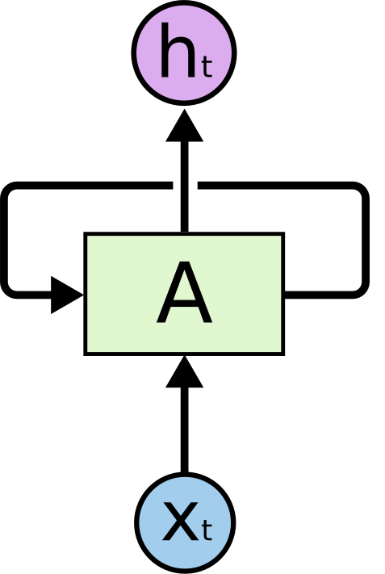
Modeling Time with RNNs
RNNs are designed for sequential data like price movements and volume.
They maintain a hidden state that carries information across time steps, enabling pattern learning over time.
Benefits:
Capture temporal dependencies
Share weights across steps
Model non-linear time relationships
Limitation: Prone to vanishing/exploding gradients, making it hard to learn long-term dependencies.
Graduation Project – AI-Powered Trading System (Kryseos)

Slide 13

LSTM to solve RNN’s Gradient Problem
LSTM splits memory into two components:
Long-Term Memory: Flows across time mostly unchanged and is not multiplied by weights. This stability helps prevent vanishing gradients.
Short-Term Memory: Multiplied by weights at each time step and captures recent, short-term patterns.
Information flow is regulated by gating mechanisms:
Forget Gate – removes irrelevant data.
Input Gate – adds new info.
Output Gate – passes info to next layer
Graduation Project – AI-Powered Trading System (Kryseos)

Slide 14
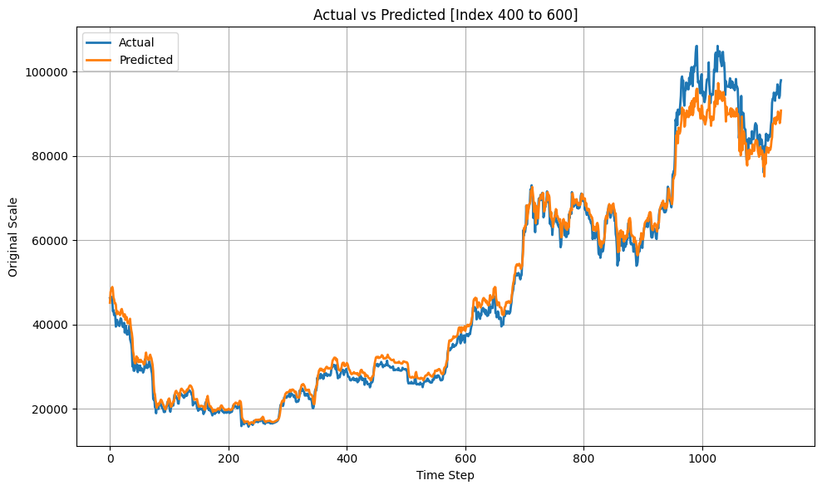
First Model – Predicting Next-Day Price (BTC)
Data Preparation:
Input: 10-day sliding window of closing prices
Target: Closing price on day 11
Scaling: All values normalized to [0, 1]
Model Testing Period:
April 1, 2022 – May 8, 2025
Applied to unseen BTC data
Predicted prices visually align with
actual values at first glance.
Graduation Project – AI-Powered Trading System (Kryseos)

Slide 15
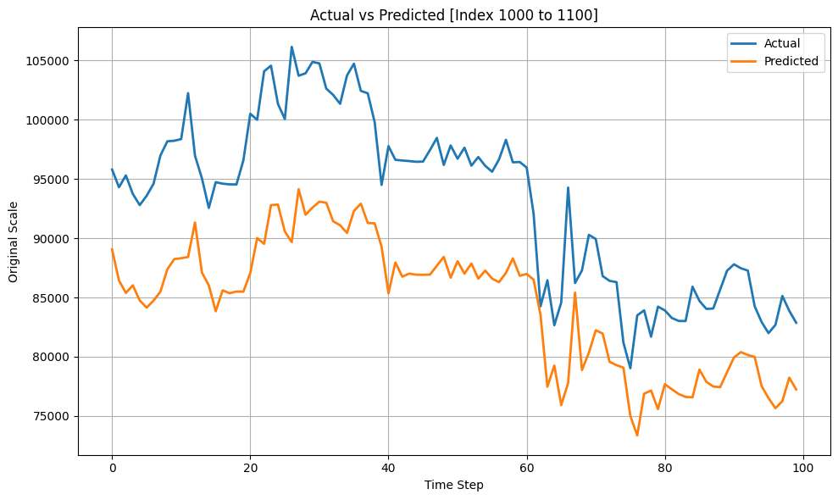
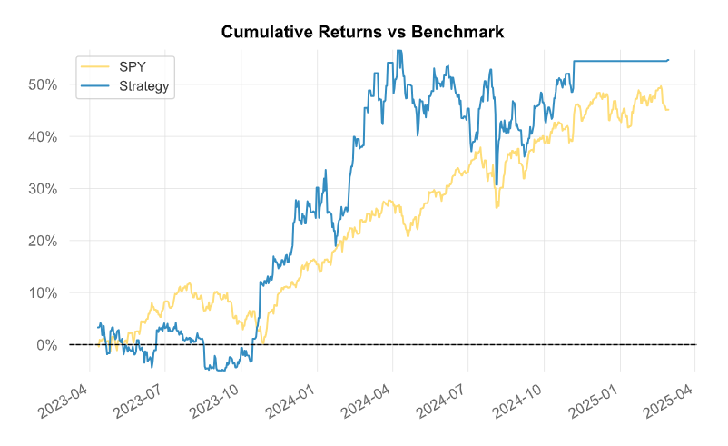
Visual Accuracy ≠ Real Predictive Power
On closer inspection, predictions lag
and are often slightly offset.
The model mostly copies recent prices
instead of learning meaningful patterns.
Strategy logic :
Buy → if predicted price > current price;
Sell → otherwise.
Using Lumibot, this strategy achieved a total
return of 55% with a maximum drawdown
of 16.56%.
Graduation Project – AI-Powered Trading System (Kryseos)

Slide 16
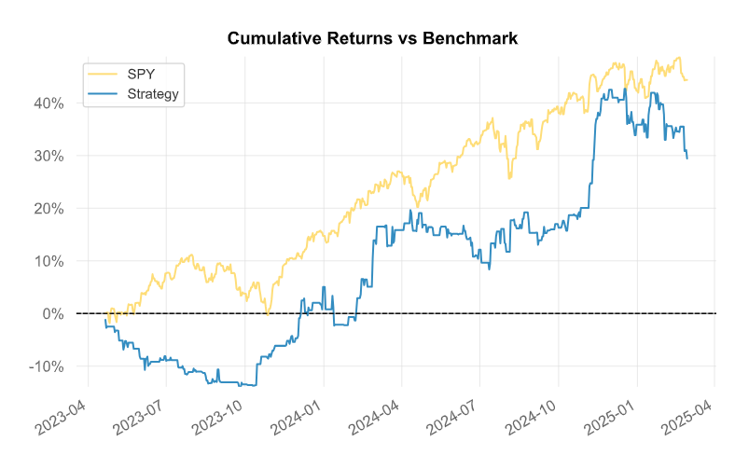
Second Model – Binary Classification (BTC)
Data Preparation:
Input: 20-day sequence of binary movement labels (1 = up, 0 = down/stable)
Target: Direction of movement on day 21 (1 or 0)
Abstraction: Removes price scale and focuses on trend direction
Strategy logic:
Buy → if predicted probability > 0.5
Sell → otherwise.
Using Lumibot, this strategy achieved a total
return of 29% with a maximum drawdown
of 12.87%.
Graduation Project – AI-Powered Trading System (Kryseos)

Slide 17
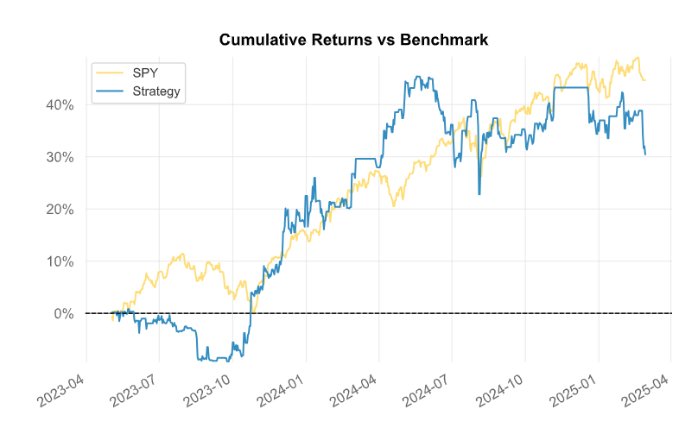
Third Model – Binary Classification with MACD/RSI (BTC)
Data Preparation:
Input: 10-day sequences of 4 features:
MACD, MACD Signal, RSI, and binary price movement
Target: Binary label (1 = price up, 0 = price down)
Feature Scaling: Scaled RSI (min-max); standardized MACD & Signal
Strategy logic:
Buy → if predicted probability > 0.5
Sell → otherwise.
Using Lumibot, this strategy achieved a
total return of 30% with a maximum
drawdown of 15.52%.
Graduation Project – AI-Powered Trading System (Kryseos)

Slide 18
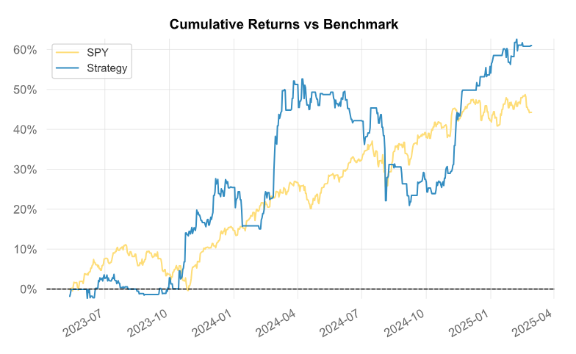
Fourth Model – pct return with MACD/RSI (BTC)
Data Preparation:
Input: 10-day sequences of 4 features:
MACD, MACD Signal, RSI, and daily return percentage
Target: Next-day percentage return
Feature Scaling: Scaled RSI (min-max); standardized MACD & Signal
Strategy logic:
Buy → if predicted return > 0
Sell → otherwise.
Using Lumibot, this strategy achieved a total
return of 61% with a maximum drawdown
of 20.76%.
Graduation Project – AI-Powered Trading System (Kryseos)

Slide 19
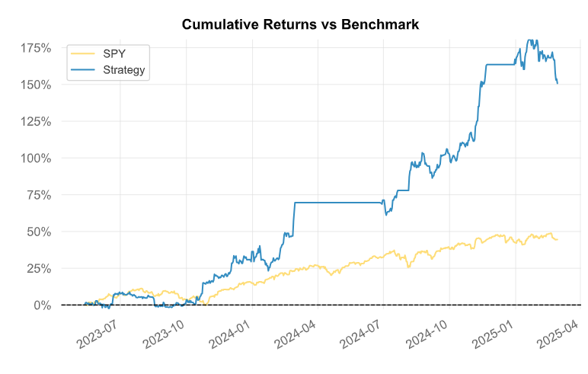
Fifth Model – Hybrid Regression with RSI Filtering (BTC)
Data Preparation:
Input: 10-day sequences of 3 features:
MACD, MACD Signal and daily return percentage
Target: Next-day percentage return
Feature Scaling: standardized MACD & Signal
Strategy logic:
Buy → if predicted return > 0 and RSI < 25
Sell → if predicted return < 0 and RSI > 75
Using Lumibot, this strategy achieved a total
return of 150% with a maximum drawdown
of 12.12%.
Graduation Project – AI-Powered Trading System (Kryseos)

Slide 20
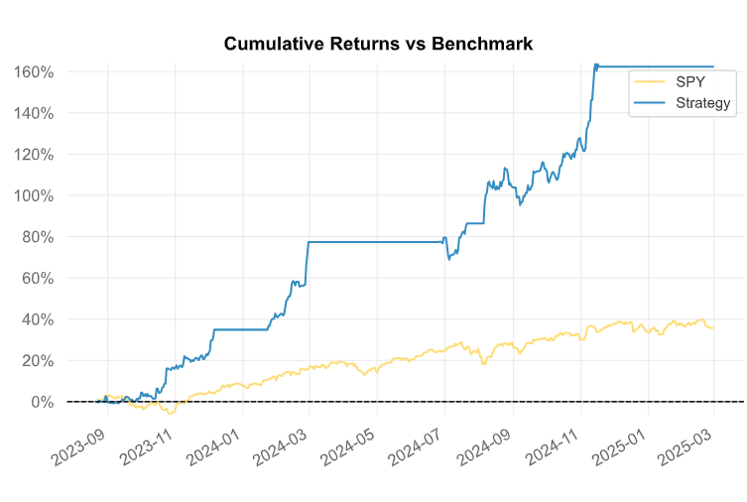
Optimized Fifth Model – Tuned RSI & Lookback (BTC)
Configuration changes:
Lookback Window: 25 days
RSI Thresholds: Buy if RSI < 25, Sell if RSI > 83
Input Shape: (25, 3)
Same strategy logic.
Using Lumibot, this strategy achieved a
total return of 162% with a maximum
drawdown of 8.44%.
Graduation Project – AI-Powered Trading System (Kryseos)

Slide 21
Model Strategies Performance Comparison
Strategy | Total Return | Max Drawdown | RoMaD | Sharpe Ratio | Sortino Ratio
Model 1 | 55% | 16.56% | 3.32 | 1.45 | 2.15
Model 2 | 29% | 12.87% | 2.25 | 0.88 | 1.40
Model 3 | 30% | 15.52% | 1.9 | 0.81 | 1.2
Model 4 | 61% | 20.76% | 2.94 | 1.43 | 2.21
Model 5 | 150% | 12.12% | 12.37 | 2.43 | 4.3
Optimized Model 5 | 162% | 8.44% | 19.19 | 3.65 | 8.75
As the table shows, the optimized fifth model consistently outperforms all previous models across all major performance metrics, offering the highest return with the lowest drawdown and superior risk-adjusted returns.
Graduation Project – AI-Powered Trading System (Kryseos)

Slide 22
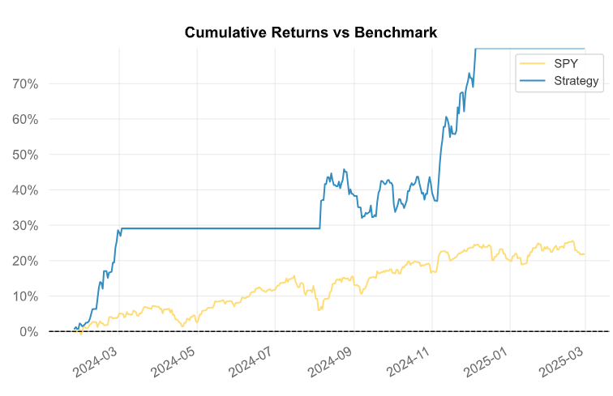
ETH Model – Retraining the Optimized Hybrid Strategy
Overview:
Directly applying the BTC model to ETH gave limited results but retraining on ETH data significantly improved performance.
Best setup: 10-day lookback, RSI < 15 (oversold → buy)
RSI > 80 (overbought → sell).
Same strategy logic.
Using Lumibot, this strategy achieved a
total return of 80% with a maximum
drawdown of 9.43%, from June 26, 2023,
to February 28, 2025.
Graduation Project – AI-Powered Trading System (Kryseos)

Slide 23
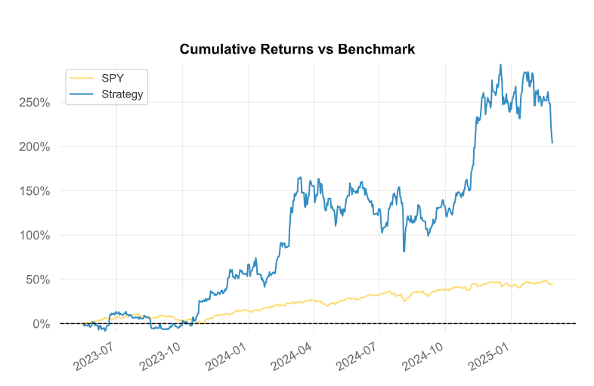
Optimized Model vs. Buy-and-Hold Strategy on BTC
Buy-and-Hold Strategy:
Invest all capital in BTC at the start
and hold without trading.
Test Period:
May 15, 2023 – February 28, 2025.
Buy-and-Hold had higher return, but the
Optimized Model showed much better
risk-adjusted performance across all metrics.
Metric | Optimized Model | Buy-and-Hold
Total Return | 162% | 204%
Max Drawdown | 8.44% | 31.67%
RoMaD | 19.19 | 6.44
Sharpe Ratio | 3.65 | 1.51
Sortino Ratio | 8.75 | 2.3
Graduation Project – AI-Powered Trading System (Kryseos)

Slide 24
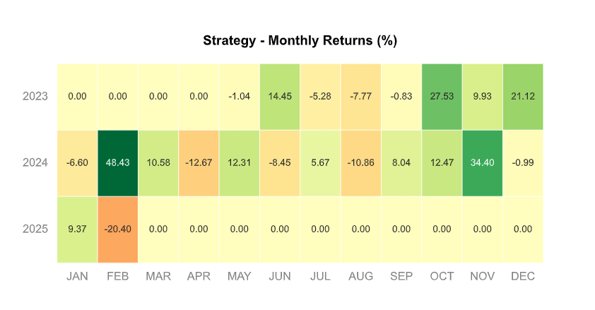
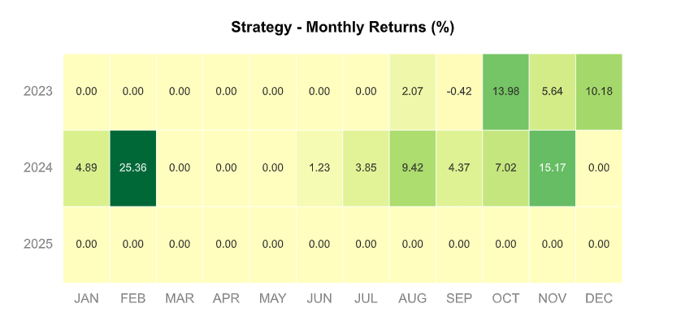
Monthly Return Heatmaps – Optimized Model vs. Buy-and-Hold (BTC)
Buy-and-Hold strategy
Heatmap.
Optimized Model strategy
Heatmap.
Graduation Project – AI-Powered Trading System (Kryseos)

Slide 25
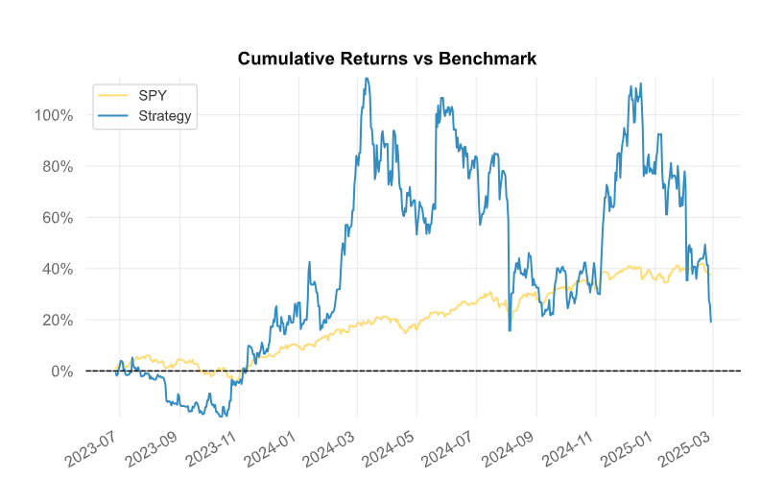
Optimized Model vs. Buy-and-Hold Strategy on ETH
Buy-and-Hold Strategy Cumulative
return Graph shows a high volatility
behavior.
Test Period:
June 26, 2023 – February 28, 2025.
The Buy-and-Hold strategy on ETH
performed poorly, while the Optimized Model
delivered higher returns and superior
risk-adjusted metrics across the board.
Metric | Optimized Model | Buy-and-Hold
Total Return | 80% | 19%
Max Drawdown | 9.43% | 46.08%
RoMaD | 8.48 | 0.41
Sharpe Ratio | 3.0 | 0.48
Sortino Ratio | 6.03 | 0.67
Graduation Project – AI-Powered Trading System (Kryseos)

Slide 26
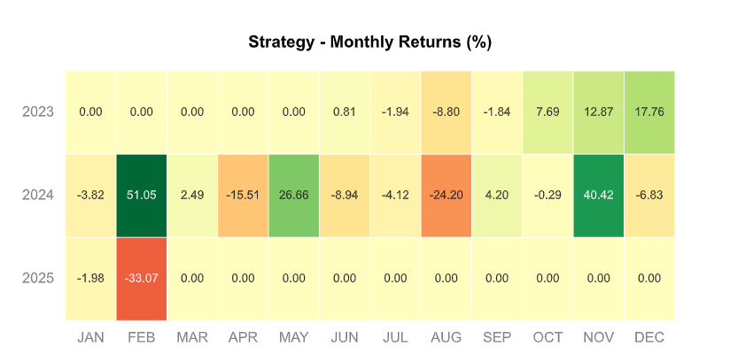
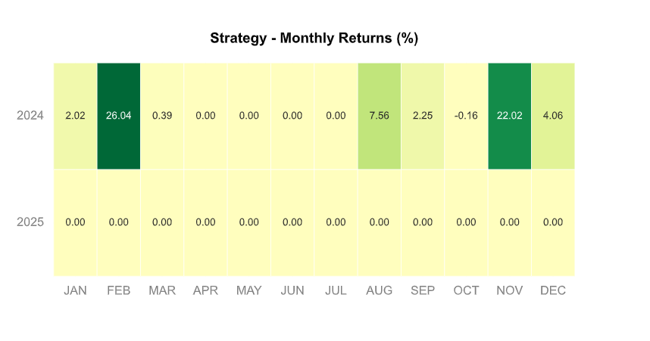
Monthly Return Heatmaps – Optimized Model vs. Buy-and-Hold (ETH)
Buy-and-Hold strategy
Heatmap.
Optimized Model strategy
Heatmap.
Graduation Project – AI-Powered Trading System (Kryseos)

Slide 27
Server-Side : In-Memory State Model
“How we manage user sessions in real time”
In our server, every user has a dedicated in-memory state that we initialize either during login or at server startup.
We use Python dictionaries like user_credentials, user_configs, user_feedback, and more, to track key session data during runtime such as:
Decrypted API credentials
Strategy configuration
Performance feedback
WebSocket connections
Thread references and locks
This design allows us to isolate users completely, so each one can trade independently without affecting others. It's also extremely fast,
since all data is available in memory of server without needing to hit the database constantly.
Graduation Project – AI-Powered Trading System (Kryseos)

Slide 28
Thread Model for Isolated Trading Sessions
“Each user has an independent trading thread”
Once a user logs in, we spawn a Python thread just for them using threading.Thread.
This thread:
Waits for the user’s strategy configuration to be set
Monitors changes in that config
Executes trades and computes performance
Stops cleanly when the user logs out or presses "Stop”
Because every user gets their own thread and our system can handle many users in parallel.
We also use user_locks to avoid race conditions when threads read/write shared data.
Graduation Project – AI-Powered Trading System (Kryseos)

Slide 29
Starting and Stopping Sessions
“Controlling when and how trading runs”
Our backend exposes two API endpoints: /start-trading and /stop-trading.
When the user starts trading, we:
Store their strategy configuration in user_configs
Set a run flag to True
Notify their thread to begin execution
The thread then loads the Alpaca client, starts looping, fetches live data, and applies the strategy.
When stopping:
We clear their config
Set the flag to False
Push a “Stopped” message to the app via WebSocket
This clean API-based control lets the user manage their trading session with full confidence.
Graduation Project – AI-Powered Trading System (Kryseos)

Slide 30
Strategy Execution Based on ID
“Modular trading logic driven by ID”
We implemented 6 modular strategies that can be selected by ID:
Machine Learning model (ML model)
Simple Moving Average crossover (SMA)
MACD
Hull Moving Average
SMA + ADX
RSI + SMA50
Each ID is mapped to a function in services.py.
Once the thread detects the config, it loads the corresponding strategy logic and starts producing signals: BUY, SELL, or NONE.
This approach keeps our system modular and scalable.
We can easily add new strategies in the future without touching the core loop.
Graduation Project – AI-Powered Trading System (Kryseos)

Slide 31

Signal Logic and Risk-Based Trade Sizing
“Modular trading logic driven by ID”
When a strategy produces a BUY signal, the thread only executes it if no open position exists.
When it receives a SELL signal, it closes all positions using Alpaca’s close_all_positions().
To control risk, we compute the trade quantity using this formula:
This ensures that every trade respects the user’s risk preference. It’s calculated dynamically on every signal, so even price volatility is accounted for.
Graduation Project – AI-Powered Trading System (Kryseos)

Slide 32
Live Performance Monitoring
“Our system doesn't just trade — it analyzes results in real time”
We use a function called analyze_trading_performance() that:
Checks the user's current equity from Alpaca
Matches filled BUY and SELL orders into trade pairs
Calculates per-trade profit ratios
Updates win rate and equity history
This function runs continuously inside each user’s thread, so feedback is always up to date with the most recent trades and portfolio value.
Graduation Project – AI-Powered Trading System (Kryseos)

Slide 33
Real-Time Feedback Broadcasting
“Live streaming of bot status and metrics”
Once the analysis is done, we push it to the mobile app using WebSockets.
We use two main functions:
broadcast_feedback_to_user() for metrics
send_bot_status() for status like “Running” or “Stopped”
This feedback includes:
Total equity
Win rate
Trade count
Recent profits
We also send a full snapshot immediately when the user connects. This ensures the app is always in sync with the server.
Graduation Project – AI-Powered Trading System (Kryseos)

Slide 34
WebSocket-Based Live Updates
“Low-latency, multi-device connection layer”
Each user has a dedicated WebSocket route: /ws/{user_id}.
When the app connects:
The server accepts the connection
Adds it to user_sockets[user_id]
Sends initial updates instantly to UI
While the session is running, all future performance and status updates are sent through that channel.
If the user disconnects, we cleanly remove the WebSocket to avoid memory leaks. This mechanism supports multi-device usage and keeps the app reactive.
Graduation Project – AI-Powered Trading System (Kryseos)

Slide 35
Encryption and Security Measures
“Encryption, validation, and thread protection”
We designed the backend with strong enough security principles:
API keys are encrypted with Fernet using a key loaded from .env.
They’re only decrypted in memory and never stored in the DB as plaintext.
Only valid Alpaca endpoints are accepted:
https://paper-api.alpaca.markets
https://api.alpaca.markets
We also validate each key before storing it by calling /v2/account endpoint on Alpaca's API.
Threading locks ensure that user A can’t affect user B, even under high concurrency. Every session is fully sandboxed.
So, Thread locks (user_locks) protect all shared structures.
Graduation Project – AI-Powered Trading System (Kryseos)

Slide 36
Summary of Backend Capabilities
“Scalable, reactive, and secure server-side core”
The Kryseos backend offers:
Every user session is backed by an isolated thread
Strategy logic is modular, dynamic, and risk-aware
Real-time performance analysis is computed and pushed live
The WebSocket layer ensures instant feedback in the app
API keys are encrypted and validated securely
SQLite provides persistent user storage across restarts
This architecture gives us a reliable, secure, and real-time multi-user trading system that can be fully controlled from the mobile app — with no need for manual server access.
Graduation Project – AI-Powered Trading System (Kryseos)

Slide 37
Role of the Mobile App
“How the mobile application interfaces with the trading system”
The Kryseos mobile app acts as the user’s control panel.
It allows users to input credentials, configure trading strategies, and monitor performance in real-time.
Uses REST API for sending credentials and configs.
Uses WebSocket for receiving live bot status and metrics.
Offloads all strategy logic to the backend — keeping the app lightweight and responsive.
Prioritizes ease of use, portability, and real-time feedback.
Graduation Project – AI-Powered Trading System (Kryseos)

Slide 38
main.dart, login.dart, mainPage.dart, trade.dart, dashboard.dart, market.dart
Application Architecture
“Modular structure, state management, and data flow”
The app follows a modular and reactive architecture using Flutter and the Provider package.
Core files:
main.dart, login.dart, mainPage.dart, trade.dart, dashboard.dart, market.dart
Data flow:
Server → REST/WebSocket → AppData → UI Widgets
State is centralized in AppData using ChangeNotifier and Manages:
Login state
Bot status
Strategy configurations
Real-time performance feedback
Graduation Project – AI-Powered Trading System (Kryseos)

Slide 39
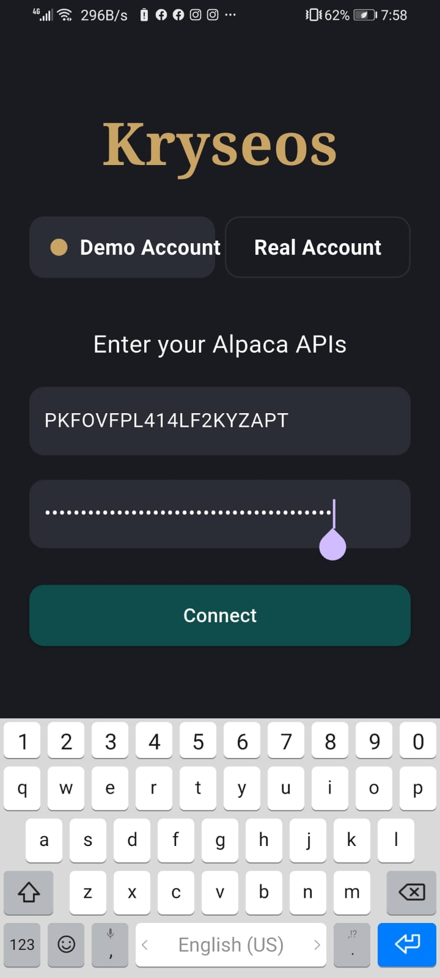
Login Page of Kryseos
"User Authentication and Secure Setup"
This page allows users to input their API credentials securely.
We use HTTP communication to send these credentials to the backend for validation.
No credentials are stored locally — only the user ID is saved using SharedPreferences for session continuity.
The app performs input validation to ensure only valid credentials are submitted.
Once authenticated, the user proceeds to the main control interface.
Graduation Project – AI-Powered Trading System (Kryseos)

Slide 40
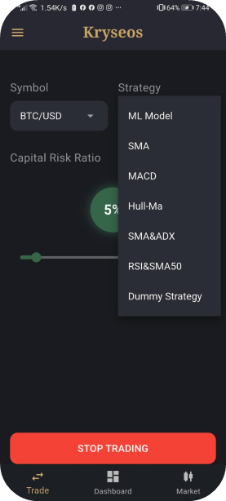
Trade Page of Kryseos
"Strategy Configuration and Session Control"
The trade tab allows the user to select a trading symbol, such as BTC/USD or ETH/USD.
Users choose from several strategies like SMA, MACD, or Machine Learning, using dropdown menus.
A risk slider is provided to configure the investment size per trade.
Buttons are used to start or stop trading sessions, which trigger backend thread activation.
Input validation is applied to prevent incomplete or invalid strategy configurations.
Graduation Project – AI-Powered Trading System (Kryseos)

Slide 41
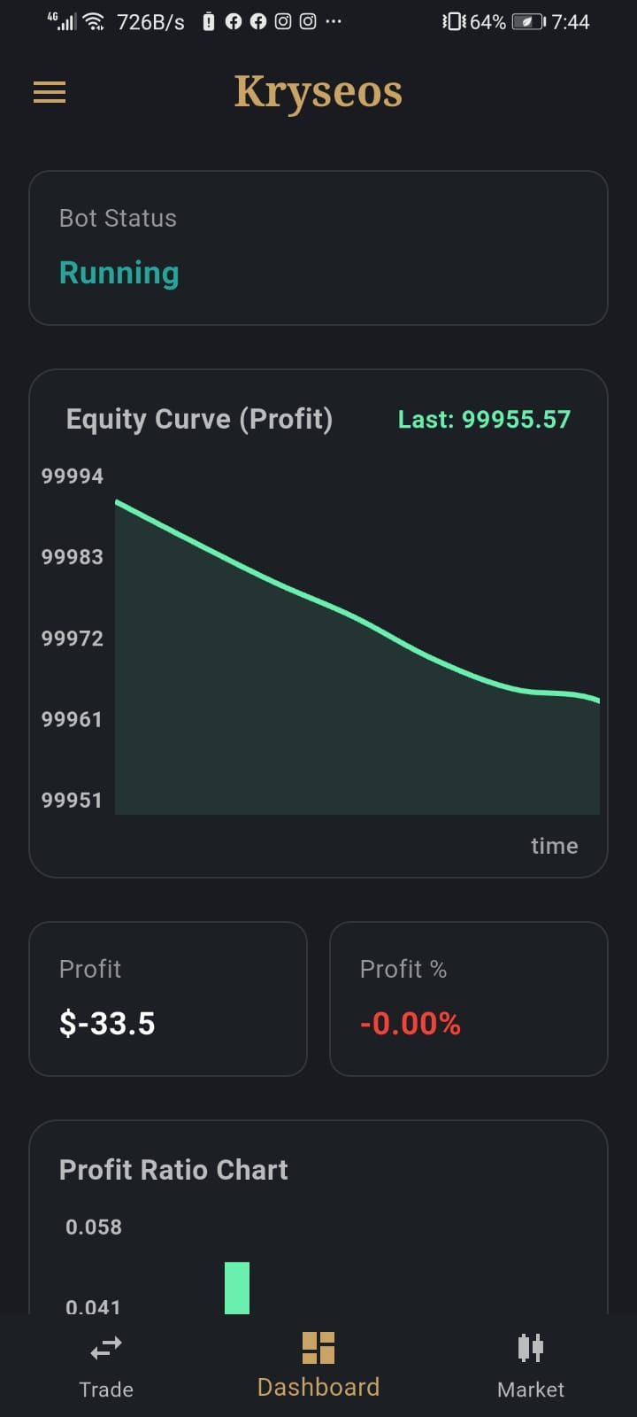
Dashboard Page of Kryseos
"Performance Monitoring in Real Time"
This page streams live trading performance metrics from the backend via WebSocket.
We display key metrics including win rate, equity, profit ratio, and number of trades.
Charts update automatically without user interaction, giving a responsive and real-time experience.
This page reflects all live trading results with high reliability and minimal latency.
Graduation Project – AI-Powered Trading System (Kryseos)

Slide 42
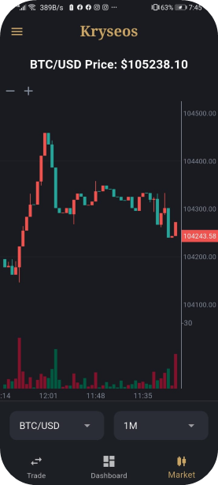
Market Page of Kryseos
"Live Market and Visualization“
The market tab displays live data fetched from Binance.
Users see candlestick charts for their selected asset to understand current trends.
The side menu Encrypted User ID display
Real-time Cash and Equity values
A Logout button for secure session termination
Graduation Project – AI-Powered Trading System (Kryseos)

Slide 43
Real-Time Communication Logic
“How the app receives live feedback via WebSocket”
The mobile app maintains a persistent WebSocket connection to receive updates without delay.
main.dart opens the socket via startWebSocket()
Incoming messages are parsed in AppData
performance: updates equity, trades, profit
status: updates bot activity (running/stopped)
Widgets auto-refresh on notifyListeners() and Includes:
Reconnection logic on disconnect
Clean closure on logout or session end
Enables real-time dashboard sync and accurate status reflection.
Graduation Project – AI-Powered Trading System (Kryseos)

Slide 44
Summary of the App’s Contribution
“How the mobile app integrates into the full system”
The Kryseos mobile application completes the loop between the user and backend.
Structured tab navigation: Login, Trade, Dashboard, Market
Supports real-time control and monitoring from anywhere
Balances usability with security:
Auto-login with user_id
No credential storage
Built entirely with Flutter + Provider
Future-ready architecture for UI/UX upgrades and new strategies
It empowers users to automate trading confidently and safely on their phones.
Graduation Project – AI-Powered Trading System (Kryseos)

Slide 45
Thank You
Graduation Project – AI-Powered Trading System

