Slide 1


Slide 2

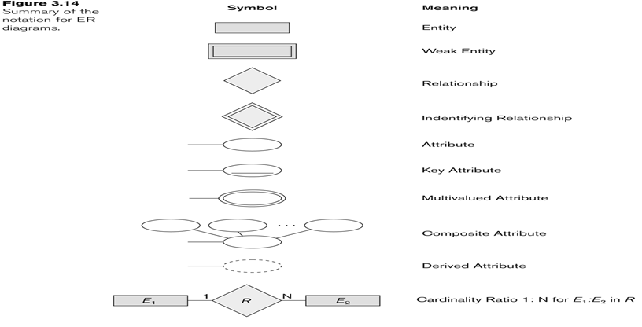

Slide 3

Table or entity: a collection of records
Attribute or Column or field: a Characteristic of an entity
Row or Record or tuble: the specific characteristics of one entity
Database: a collection of tables

Slide 4

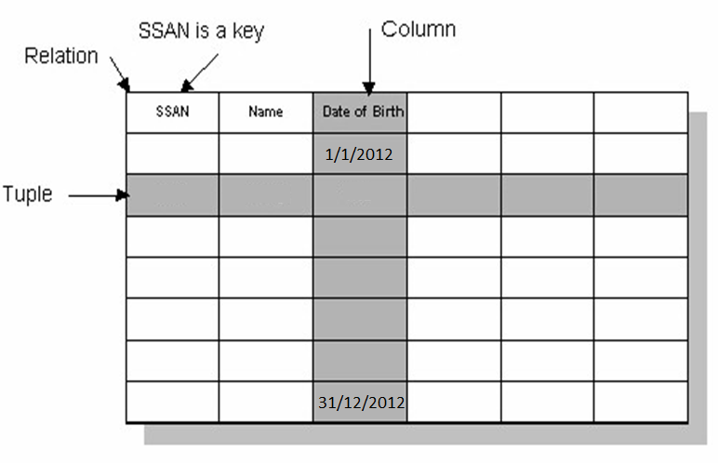

Slide 5

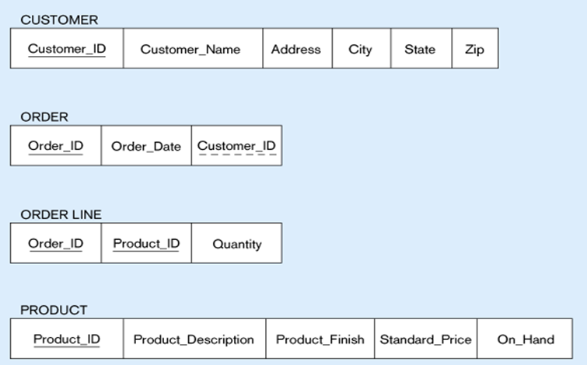
Primary Key
Foreign Key
composite primary key

Slide 6

Step 1: Mapping of Regular Entity Types
Step 2: Mapping of Weak Entity Types
Step 3: Mapping of Binary 1:1 Relation Types
Step 4: Mapping of Binary 1:N Relationship Types.
Step 5: Mapping of Binary M:N Relationship Types.
Step 6: Mapping of N-ary Relationship Types.
Step 7: Mapping of Unary Relationship.

Slide 7

Create table for each entity type
Choose one of key attributes to be the primary key

Slide 8



(a) CUSTOMER entity type with simple attributes
(b) CUSTOMER relation

Slide 9


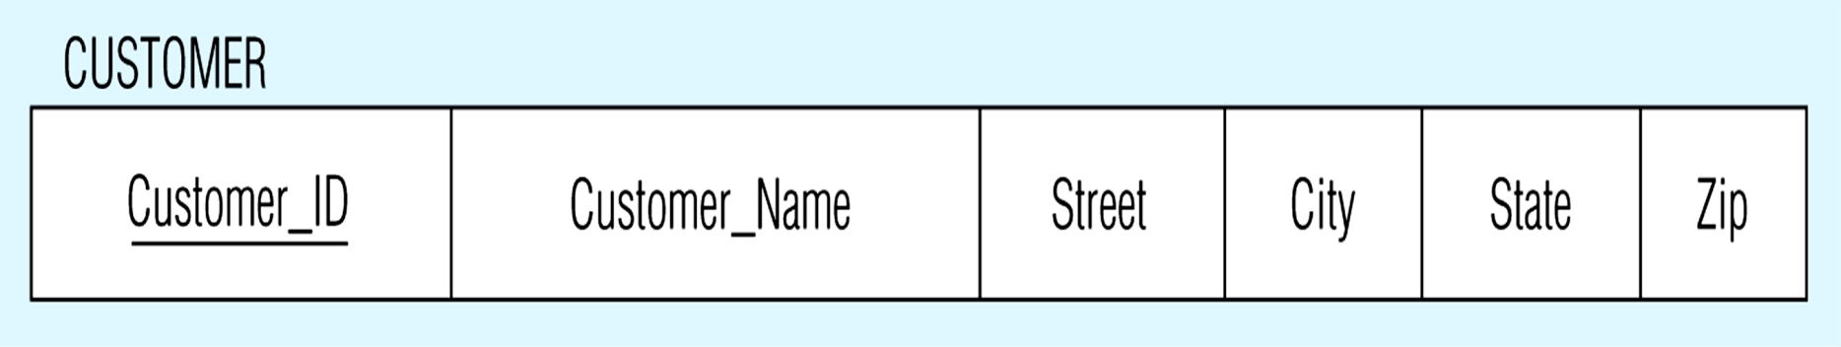
CUSTOMER entity type with composite attribute
CUSTOMER relation with address detail

Slide 10



Multivalued attribute becomes a separate relation with foreign key
1 – to – many relationship between original entity and new relation

Slide 11

In the most cases Derived attribute not be stored in DB
Mapping Complex Like Mapping Multivalued attribute then including parts of the multivalued attributes as columns in DB

Slide 12

Street
City
Country
number
address
has
customer
account
balance
2 tables
Customer
ADDRESS(CID,Street,City,Country)
ERD Concepts

Slide 13

Create table for each weak entity.
Add foreign key that correspond to the owner entity type.
Primary key composed of:
    Partial identifier of weak entity
    Primary key of identifying relation (strong entity)

Slide 14

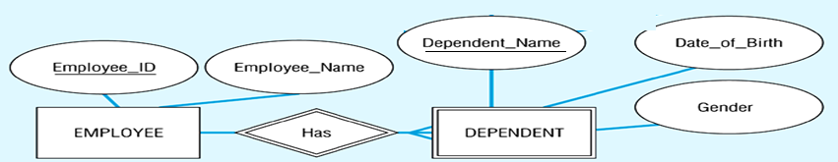
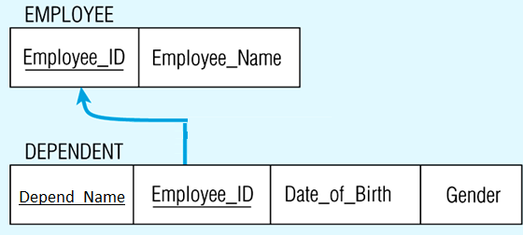
Composite primary key

Slide 15



EID
EName
CID
CName
1
Has
1
Employee
Computer
Employee(EID, Ename)
Computer(CID, Cname, EID_FK)

Slide 16


EID
EName
DID
DName
M
work
1
Employee
Department
Department(DID, Dname)
Employee(EID, Ename,DID)

Slide 17

Create a new third table
Add FKs to the new table for both parent tables
Add simple attributes of relationship to the new table if any .

Slide 18


Many-to-Many
SID
SName
CID
CName
M
take
M
Student
Course
3 tables
tbl_x (PKx,….,…….)
tbl_y (PKy,….,…….)
tbl_xy (PKx ,PKy, ….,…….)
PKxy= PKx+PKy
Student(SID, Sname)
Course(CID, Cname)
Stud_Course(SID, CID)

Slide 19

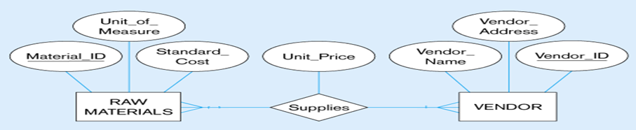

The Supplies relationship will need to become a separate relation
Foreign key
Composite primary key
Foreign key

Slide 20

If n > 2 then :
Create a new third table
Add FKs to the new table for all parent tables
Add simple attributes of relationship to the new table if any .

Slide 21
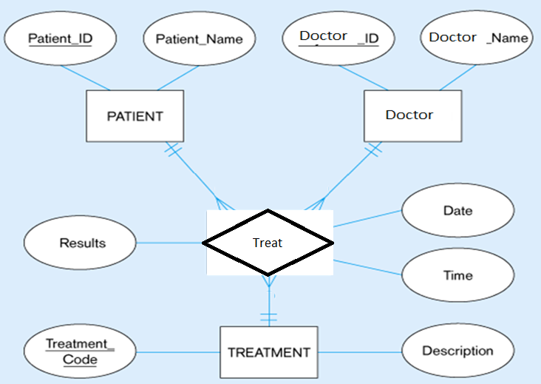

Slide 22
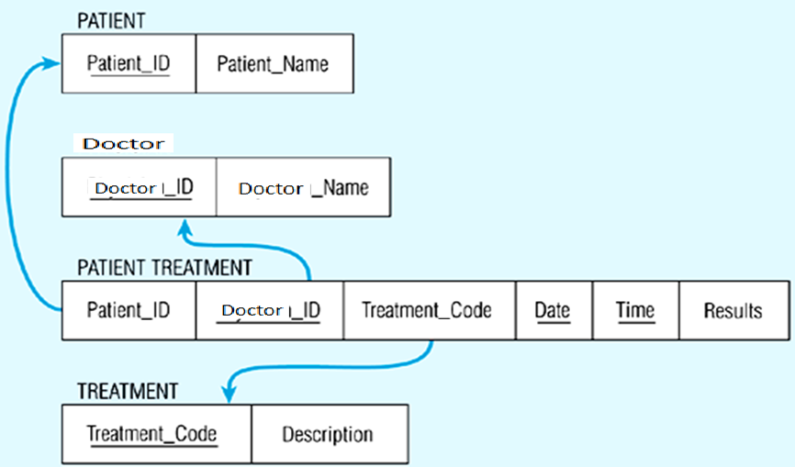

Slide 23

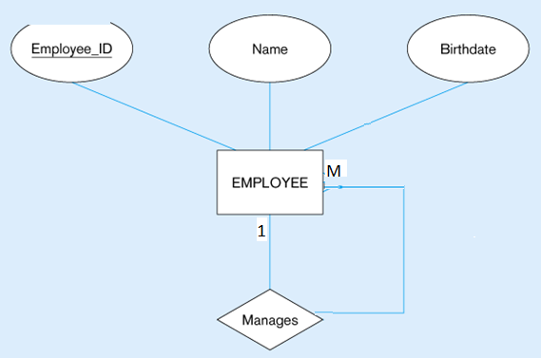

(a) EMPLOYEE entity with Manages relationship
(b) EMPLOYEE relation with recursive foreign key

Slide 24


(a) Bill-of-materials relationships (M:N)
(b) ITEM and COMPONENT relations

Slide 25

ERD Concepts

Slide 26



Slide 27

ERD Concepts

