Slide 1




Clean Code & Refactoring in Python
Alaa’ Omar
B.Eng. Computer Engineering
(2009)
M.Sc. Software Engineering
2019

Slide 2
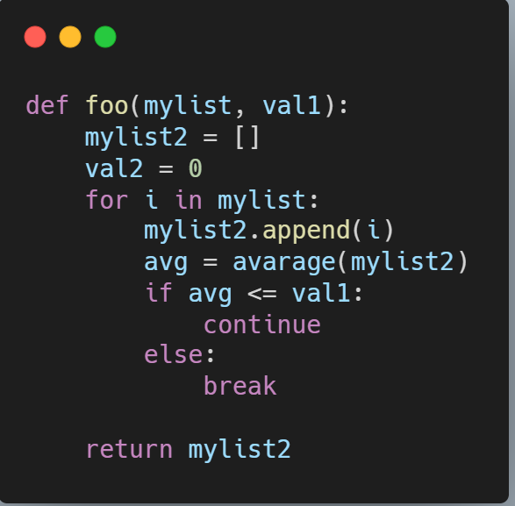
What is wrong?
Not a descriptive function name.
No Docstrings and annotations.
Variable names are not descriptive.
Calculates average at each iteration from scratch.
One branch of the if is used for loop continuation.
Unused variable val2

Slide 3
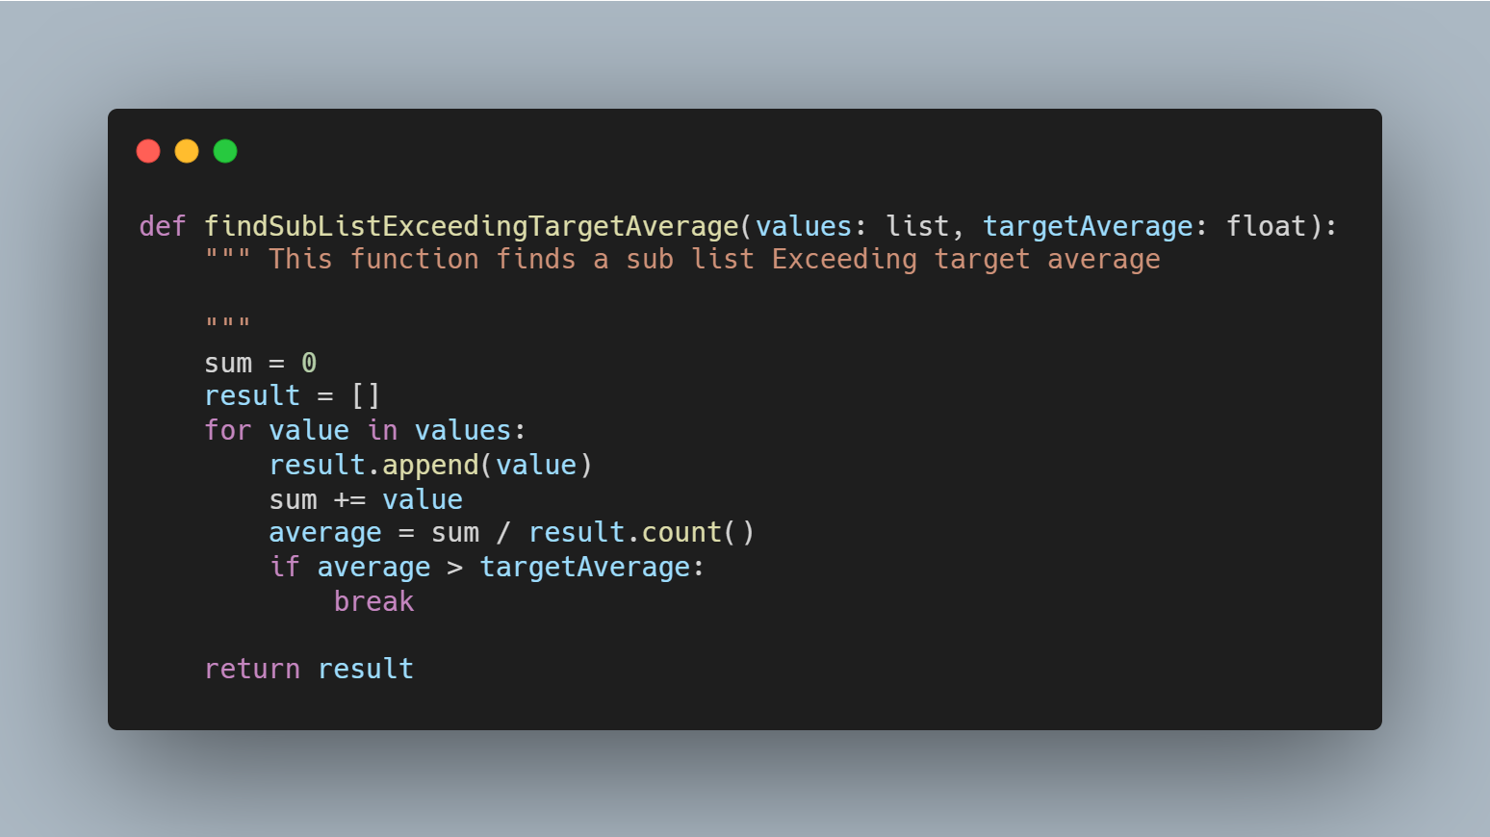
A better version:

Slide 4
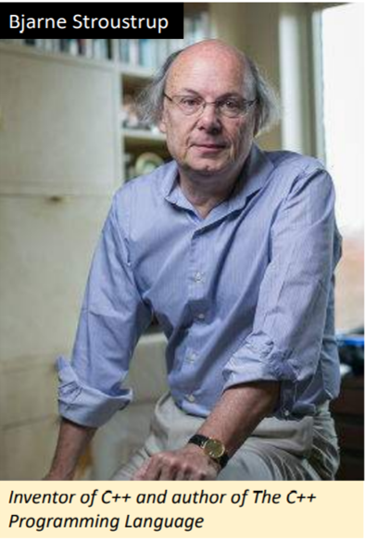
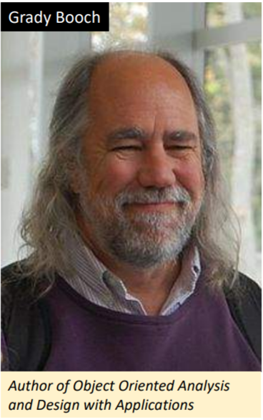
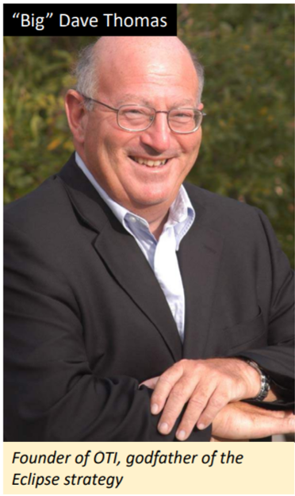
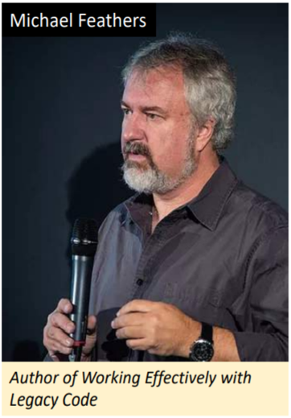
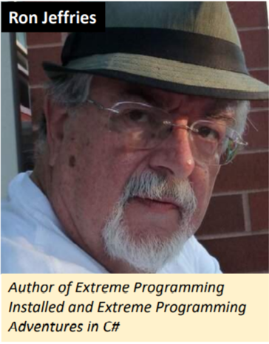
What is Clean Code?
Elegant and efficient.
The logic is straightforward to make it hard for bugs to hide.
The dependencies minimal to ease maintenance, error handling complete
Performance close to optimal.
Simple and direct.
Reads like well-written prose.
Clean code never obscures the designer’s intent but rather is full of crisp abstractions and straightforward lines of control.
Can be read and enhanced by a developer other than its original author.
It has unit and acceptance tests.
It has meaningful names.
It has minimal dependencies.
Always looks like it was written by someone who cares.
There is nothing obvious that you can do to make it better.
Runs all the tests
Contains no duplication.
Expresses all the design ideas that are in the system.
Minimizes the number of entities such as classes, methods, functions, and the like.

Slide 5
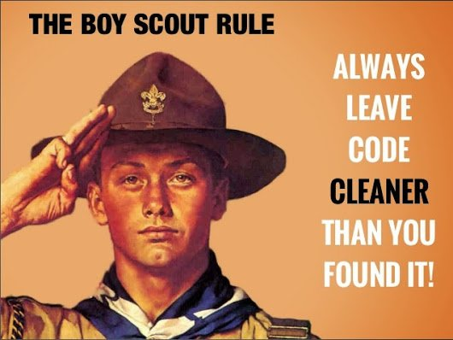

Slide 6
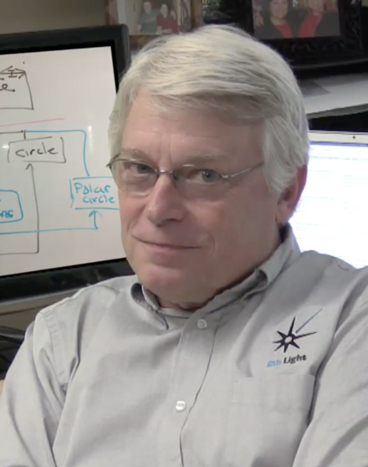
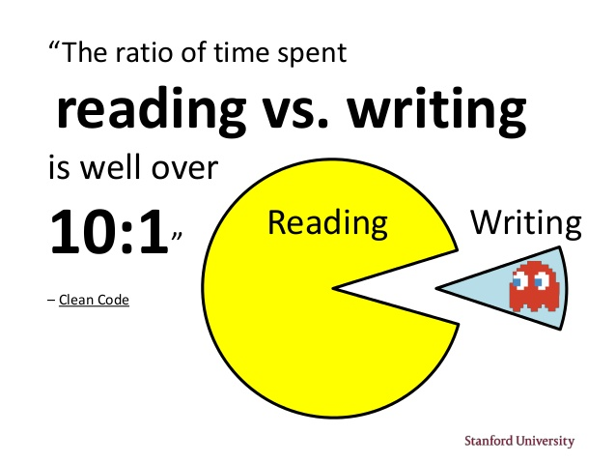
“Making it easy to read makes it easier to write.”
― Robert C. Martin, Clean Code: A Handbook of Agile Software Craftsmanship

Slide 7

Why clean code is important
Maintainability.
Reducing technical debt.
Working effectively with agile development.
Managing a successful project.

Slide 8
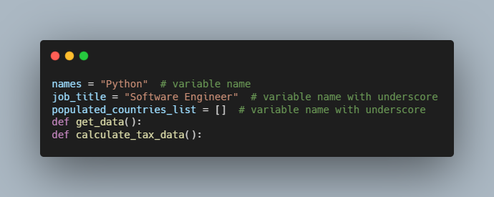
Write pythonic code
Follow PEP-8 Style guide for python to enhance readability.
Naming variable and Functions:

Slide 9
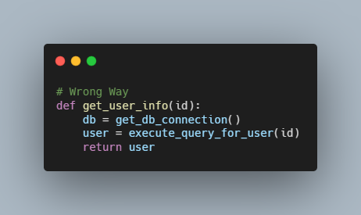
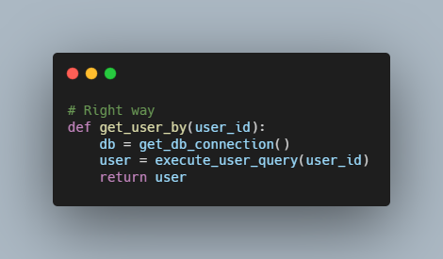
Write pythonic code Function Names:
The first function, get_user_info, is ambiguous because the parameter id could mean anything.
This kind of code can create confusion for other developers using your API.
To fix this, change two things, the function name and pass an argument name, which makes code much more readable.

Slide 10
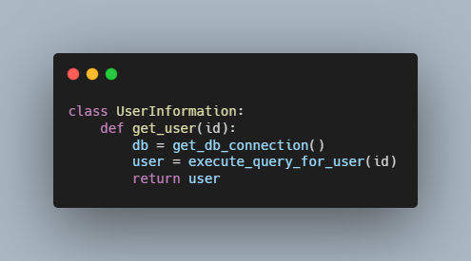
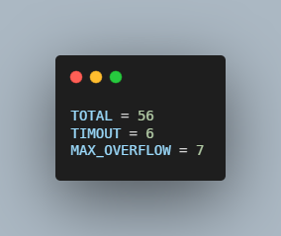
Write pythonic code Classes and Constants:
Class names should be in camel case like in most other languages.
You should define constant names with capital letters.

Slide 11
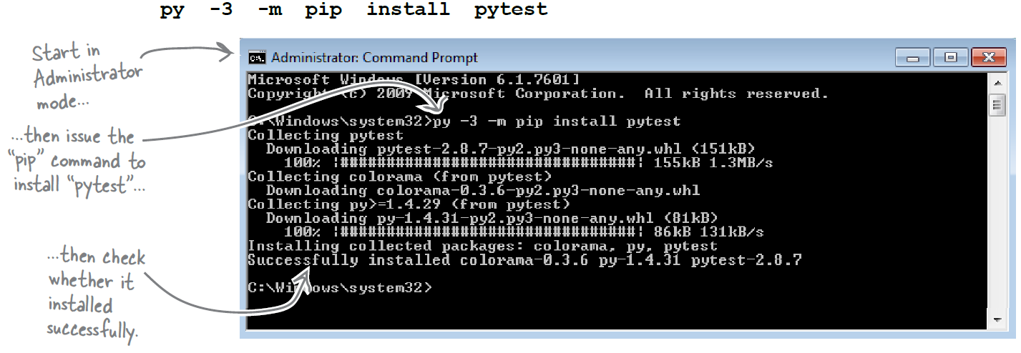
Helpful Tools
1. Pytest tool
The pytest framework makes it easy to write small tests, yet scales to support complex functional testing for applications and libraries.

Slide 12
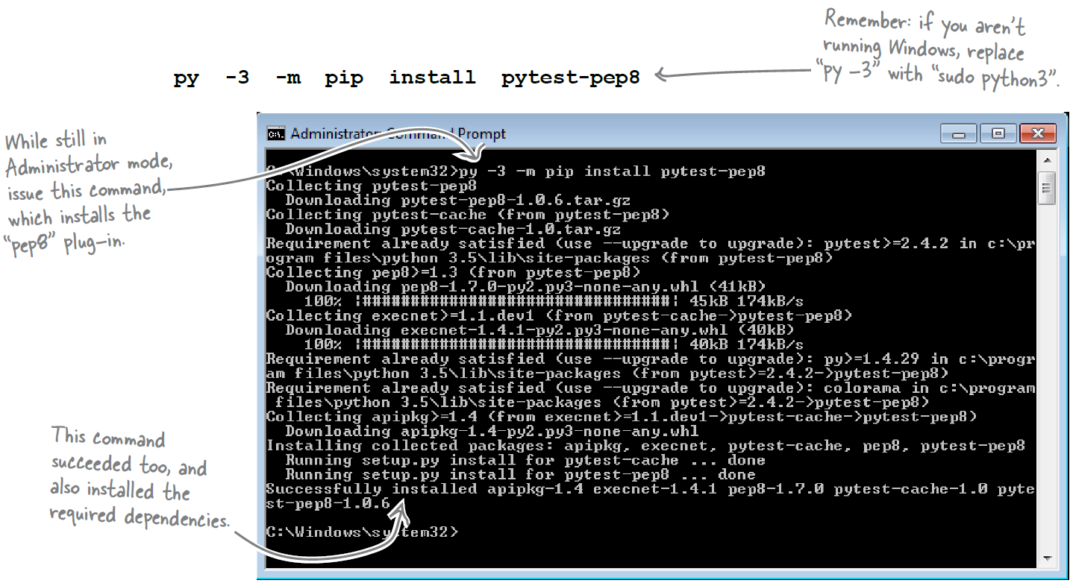
Tools for checking PEP 8 Compliance
2. PEP8 Tool
pep8 - Python style guide checker
pep8 is a tool to check your Python code against some of the style conventions in PEP 8.

Slide 13
Tools for checking PEP 8 Compliance
3. Pylint Tool [1][2] ( pip install pylint)
4. Mypy tool [1] ( pip install mypy)
Pylint is a Python static code analysis tool which looks for programming errors, helps enforcing a coding standard, sniffs for code smells and offers simple refactoring suggestions.
Mypy is an optional static type checker for Python that aims to combine the benefits of dynamic (or "duck") typing and static typing. Mypy combines the expressive power and convenience of Python with a powerful type system and compile-time type checking. Mypy type checks standard Python programs; run them using any Python VM with basically no runtime overhead

Slide 14
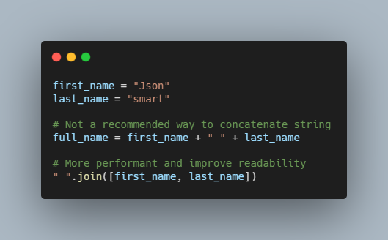
Prefer join Instead of In-Place String Concatenation
"".join() method guarantees leaner time concatenation across various Python implementations.
The reason for this is that when you use join, Python allocates memory for the joined string only one time, but when you concatenate strings, Python must allocate new memory for each concatenation because the Python string is immutable.

Slide 15
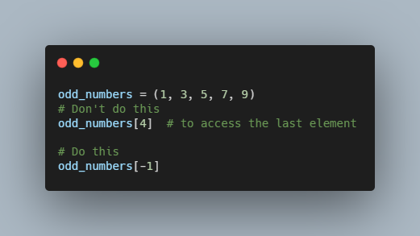
Indexes and slices
Python provides extra Features.
We could also use a negative index number, which will start counting from the last.

Slide 16
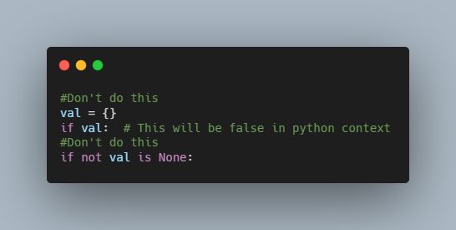
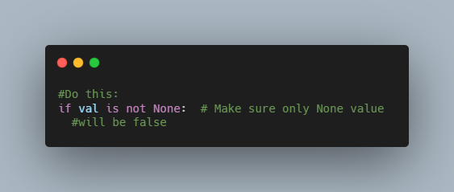
Consider Using is and is not Whenever You Need to Compare with None
val is an empty dictionary; however, val is considered false, which might not want in your code, so be careful while
writing this kind of code.
Instead, write code as explicit as possible to make your code less error
prone.
There is no difference between using is not and using not ... is.
However, the is not syntax is more readable compared to not ... is.

Slide 17
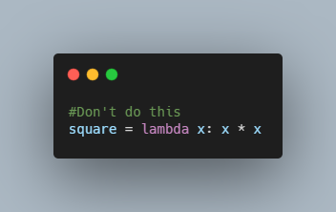
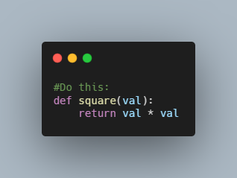
Consider Using a Function Instead of a Lambda When Binding to an Identifier
lambda is a keyword in Python to perform one-line operations; however, using lambda for writing a function might not be as good a choice as writing a function using def.
The def square(val) function object is more useful for string representation and traceback than the generic <lambda>. This kind of use eliminates the usefulness of lambdas. Consider using lambdas in larger expressions so you don’t impact the readability of code.

Slide 18
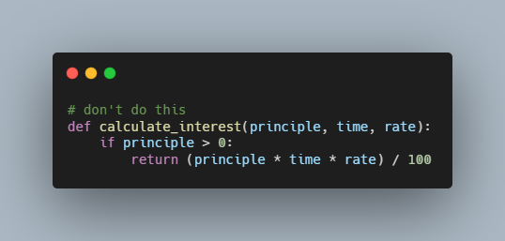
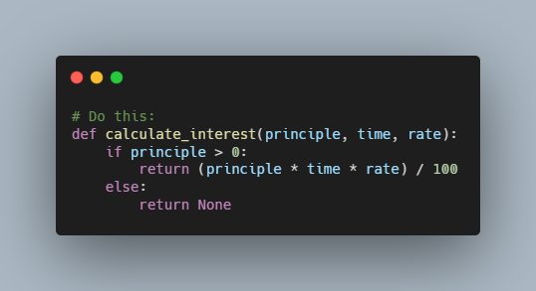
Be Consistent with the return Statement
It’s good practice to make sure you have a return expression in all the places your function exits. But if a function is expected to simply perform an action without returning a value, Python implicitly returns None as the default from the function.

Slide 19
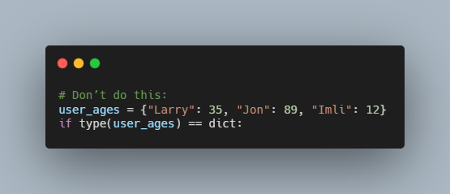
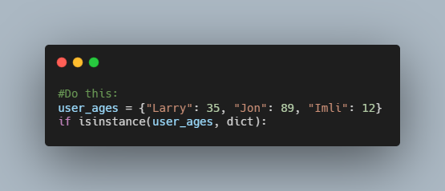
Use the isinstance() Method Instead of type() for Comparison
When you are comparing two objects’ types, consider using isinstance() instead of type because isinstance() is true for subclasses. Consider a scenario where you are passing a data structure that is the subclass of a dict like orderdict. type() will fail for that specific type of data structure; however, isinstance() will recognize that it’s the subclass of dict.

Slide 20
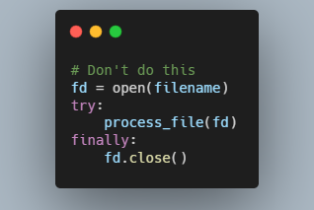
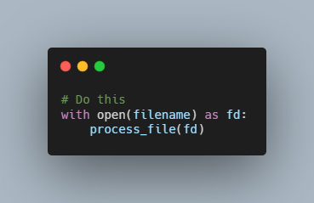
Context Manager: Use with keyword
The with statement (PEP-343) enters the context manager. In this case, the open function implements the context manager protocol, which means that the file will be automatically closed when the block is finished, even if an exception occurred.

Slide 21
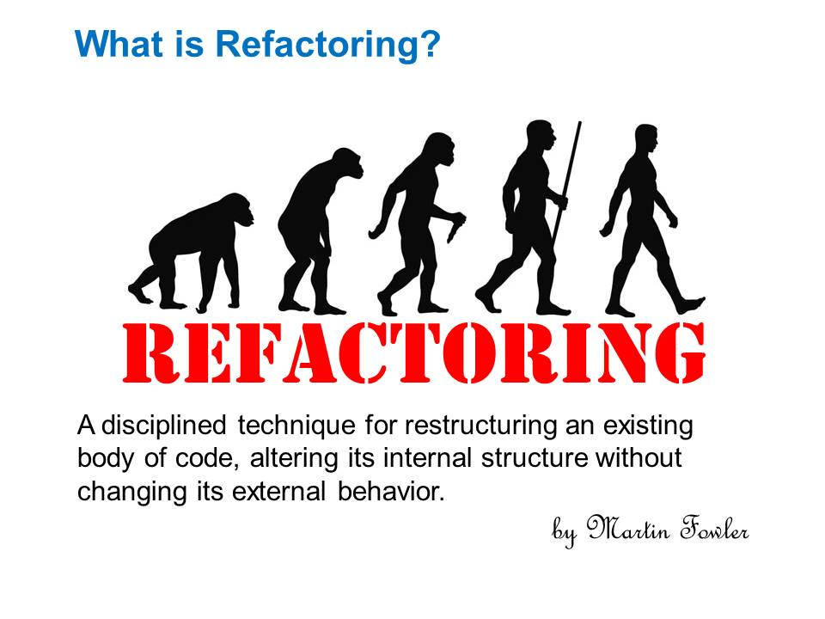

Slide 22
Refactoring List:
[1] Extract Variable.
[2] Method Refactoring.
[3] Replace Temp with Query.
[4] Split Temporary Variable.
[5] Consolidate Conditional Expression.
[6] Consolidate Duplicate Conditional Flag.
[7] Decompose Conditional.
[8] Remove Control Flag.
Source Code: https://github.com/eng-aomar/python_refactoring
Clean code cheat sheet : https://github.com/eng-aomar/python_refactoring/blob/master/clean_code_cheat_sheet.pdf

Slide 23
References:
Robert C. Martin's \Clean Code: A Handbook of Agile Software Craftsmanship," 1st Edition (ISBN 978-0132350884).
Steve McConnell's \Code Complete: A Practical Handbook of Software Construction," 2nd Edition, (ISBN 978-0735619678).
Sunil Kapil Clean Python: Elegant coding in python ISBN-13 (pbk): 978-1-4842-4877-5 ISBN-13 (electronic): 978-1-4842-4878-2 https://doi.org/10.1007/978-1-4842.
Marino Anaya Clean code in Python: Refactor your legacy base code.
Paul Barry, Headfirst Python: A Brain friendly guide ," 2nd Edition.
https://refactoring.guru/
https://realpython.com/python-refactoring/
Source Code: https://github.com/eng-aomar/python_refactoring
Clean code cheat sheet : https://github.com/eng-aomar/python_refactoring/blob/master/clean_code_cheat_sheet.pdf

