Slide 1


BIG DATA MANAGEMENT PROJECT
Students: Francesco Raco, Gianmarco Marcello
Master Degree: Computer Engineering for the Internet of Things, A.Y. 2020/2021
Professors: Sergio Flesca, Linda Oro

Slide 2
What we used:
DATA SOURCES | HDFS, LOCAL FILE SYSTEM, SOCKET TCP
FRAMEWORKS | HADOOP, SPARK, SPARK STREAMING
DATA STORES | HDFS, MONGODB

Slide 3
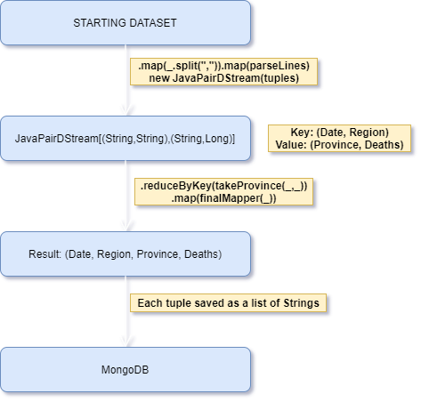
Query 1 (source: local fs, framework: Spark Streaming, store: MongoDB, dataset: https://www.kaggle.com/sudalairajkumar/covid19-in-italy?select=covid19_italy_province.csv)
For each day, return for each region the province with the highest number of total positive cases

Slide 4
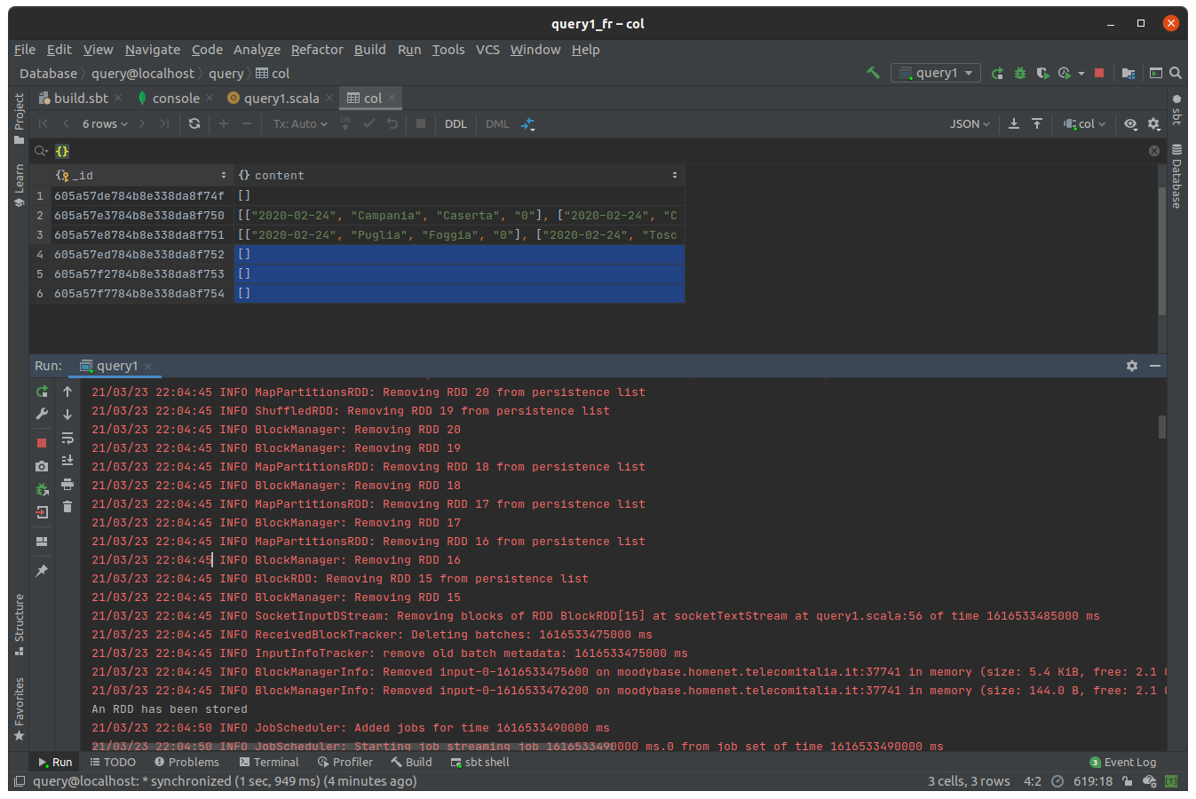

Slide 5
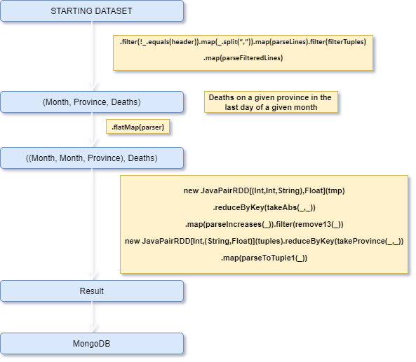
Query 2 (source: local fs, framework: Spark, store: MongoDB, dataset: https://www.kaggle.com/sudalairajkumar/novel-corona-virus-2019-dataset?select=covid_19_data.csv)
Return, for each month of 2020, the Chinese province with the highest increase in terms of cumulative deaths with respect to the previous month

Slide 6
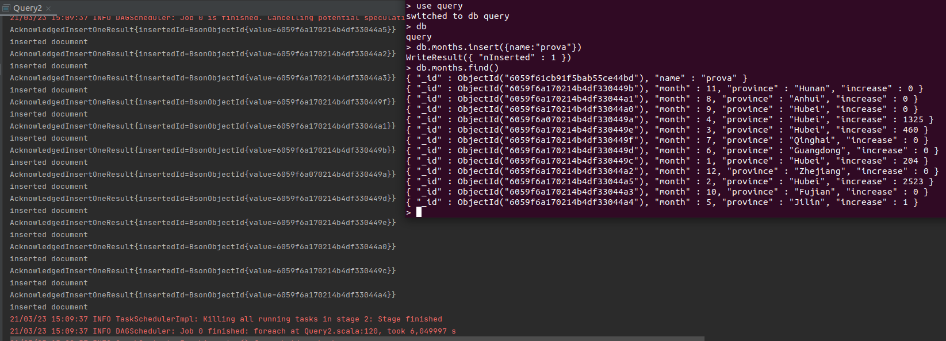

Slide 7
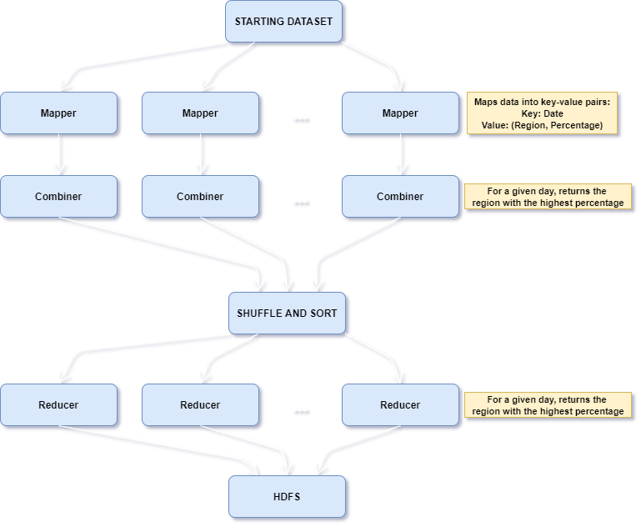
Query 3 (source: HDFS, framework: HADOOP, store: HDFS, dataset: https://www.kaggle.com/sudalairajkumar/covid19-in-italy?select=covid19_italy_region.csv)
For each day, return the region with the highest percentage of intensive care patients over total hospitalized patients

Slide 8
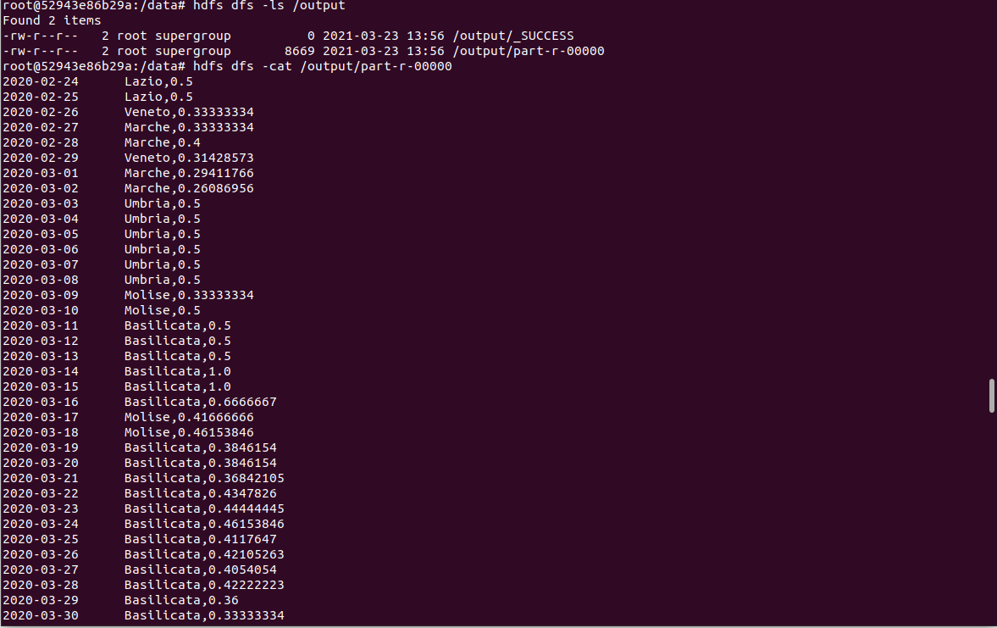

Slide 9
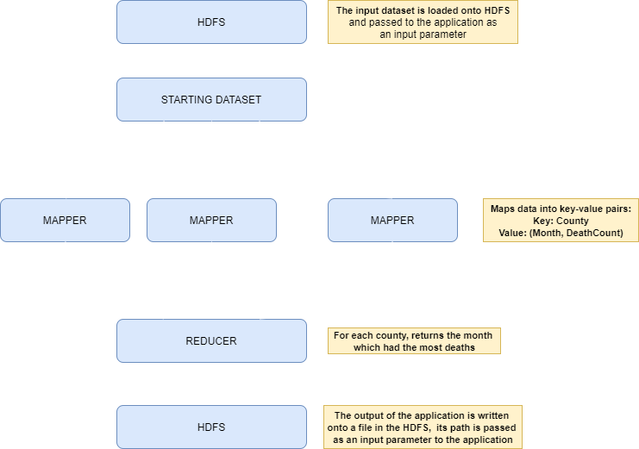
Query 4 (source: HDFS, framework: HADOOP, store: HDFS, dataset: https://www.kaggle.com/sudalairajkumar/covid19-in-usa?select=us_counties_covid19_daily.csv)
For each county, return the month which had most cases
A compose file is used to initialize the Hadoop architecture with 1 master and 3 slaves
A utility script is used to setup the master node, load the dataset and execute the application

Slide 10
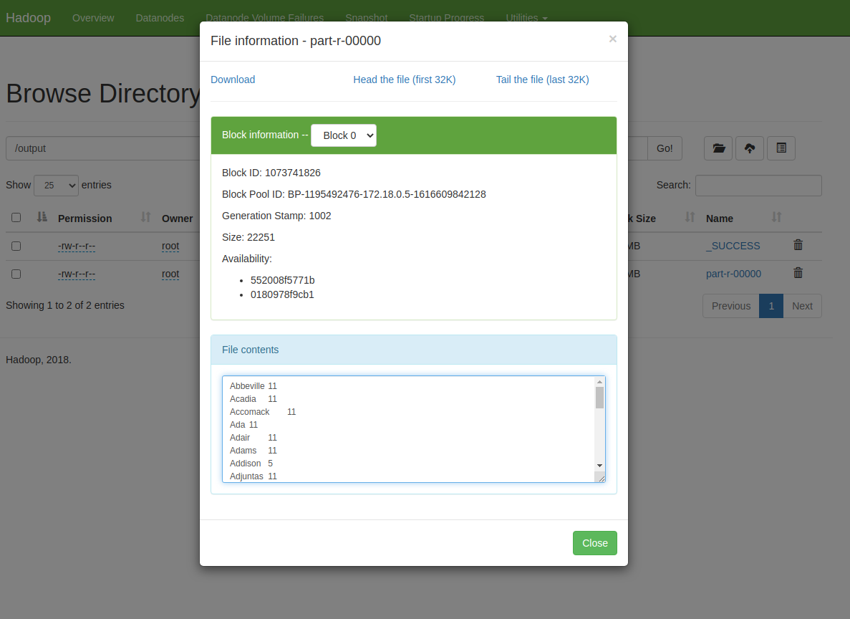
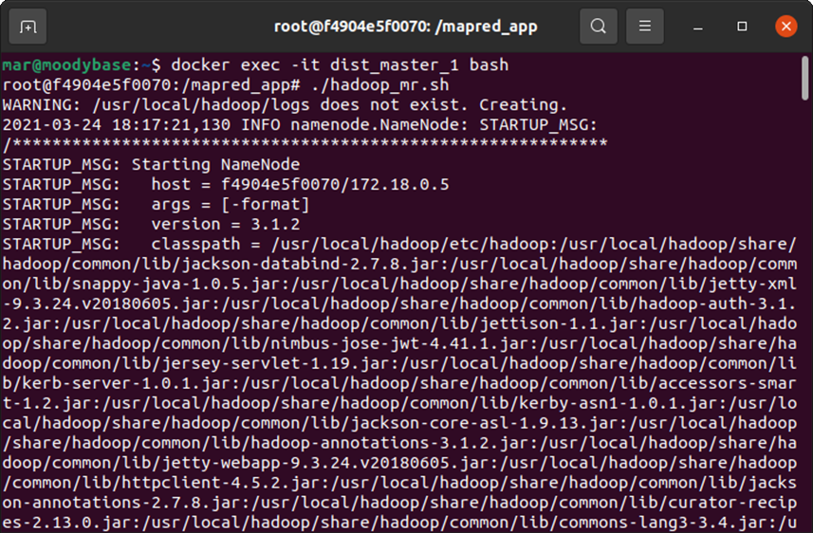
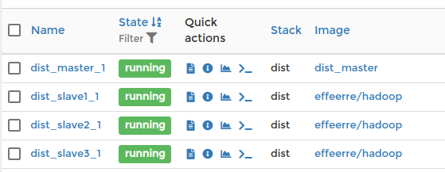

Slide 11
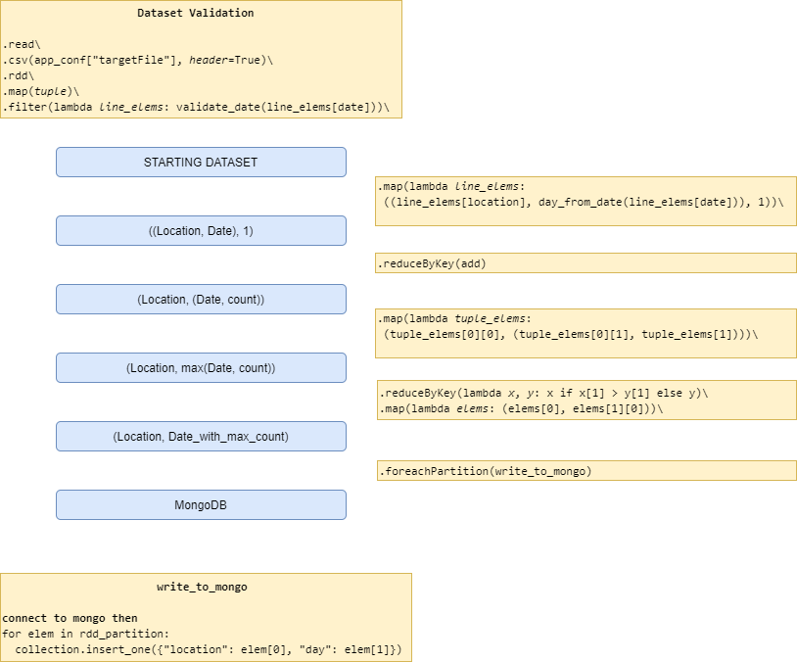
Query 5 (source: local fs/docker img, framework: Spark (pyspark), store: MongoDB, dataset: https://www.kaggle.com/andradaolteanu/covid-19-sentiment-analysis-social-networks/data?select=covid19_tweets.csv)
For each user location, find the day that had the most tweets about covid
Python based approach, using pyspark through the spark-submit utility.
A compose file is used to create a stack of two containers (the spark master and the mongo server) connected through a network.

Slide 12
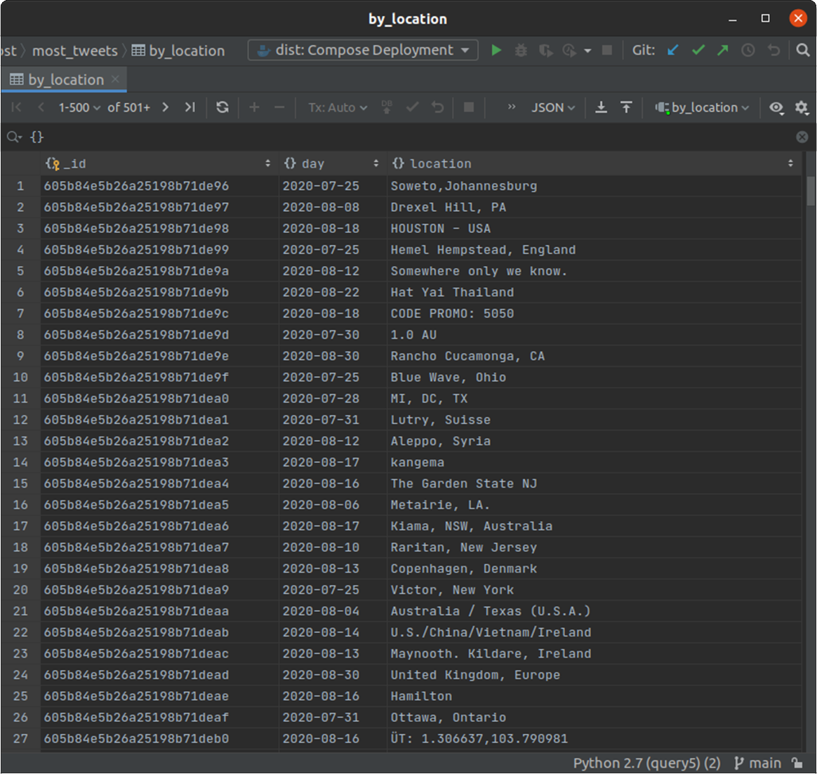
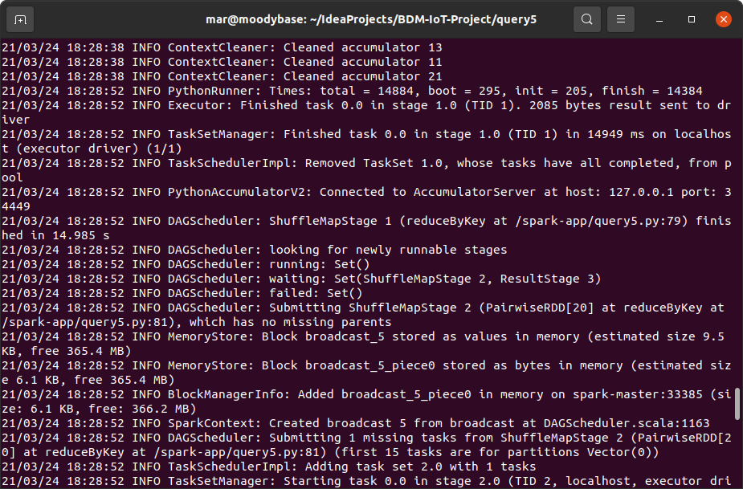

Slide 13
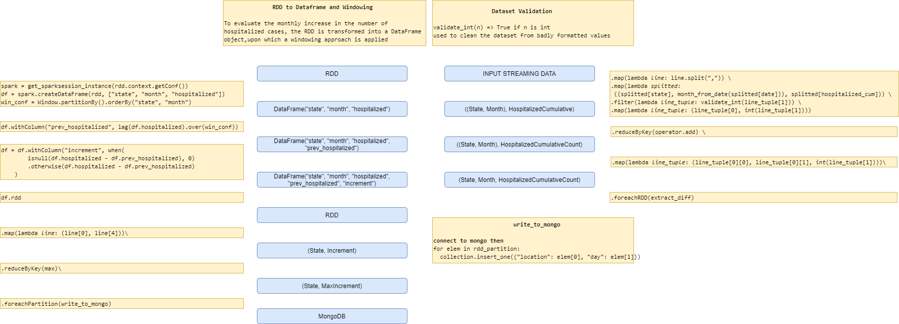
Query 6 (source: local fs/docker img, framework: Spark Streaming (pyspark.streaming), store: MongoDB, dataset: https://www.kaggle.com/sudalairajkumar/covid19-in-usa?select=us_states_covid19_daily.csv)
For each state, find the month that had the highest increase in hospitalized patients
pyspark.streaming + pyspark.sql (which contains the windowing utilities)

Slide 14
Query 6 (source: local fs/docker img, framework: Spark Streaming (pyspark.streaming), store: MongoDB, dataset: https://www.kaggle.com/sudalairajkumar/covid19-in-usa?select=us_states_covid19_daily.csv)
A compose file is used to create a stack with a sender server, a spark node and an instance of a mongo server.
The sender server listens on a specified port (that is set through a json configuration file) and, on request, streams the csv data line by line
def main():
sock = socket.socket()
try:
sock.bind(("", conf["recv-port"]))
sock.listen()
while True:
conn, addr = sock.accept()
threading.Thread(target=init_sender, args=(conn,)).start()
except KeyboardInterrupt:
print("Bye")
finally:
sock.close()
def init_sender(conn):
while True:
with open(conf["dataset"], "r") as dataset:
dataset.readline()
for line in dataset:
conn.send(line.encode("utf-8"))

Slide 15
