Slide 1
SWE – Project – E-SHOP
George Hanna Amin Samaan
Iyosiyas Workie Mitiku
Rashid Ismoilov
Awais Iftikhar
Elbek Shaykulov

Slide 2
Project Idea
We created Online Shopping WEB Application. And we used SpringBoot framework for BackEnd and React for FrontEnd.

Slide 3

Use-cases
As a customer
I should be able to browse shop categories, so that I can find the product I want easily.
As a customer
I should be able to view the product details, so that I can see the product (Price, Details).
As a customer
I should be able to add product, so that I can view the product in my shopping cart.
As a customer
I should be able to view my shopping cart, so that I can see the already added products.
As a customer
I should be able to update the shopping cart, so that I can add/remove products to it.
As a customer
I should be able to view the total order cost, so that I can review how much I will pay.
As a customer
I should should be able to cancel order. (not ready yet)
As a customer
I should be able to checkout order (not ready yet).

Slide 4






Architecture & Software Developing Methodology
Database : MySQL
GitHub as version control
Maven
Layered Architecture
Front-End: React JS
Back-End: Spring Boot

Slide 5
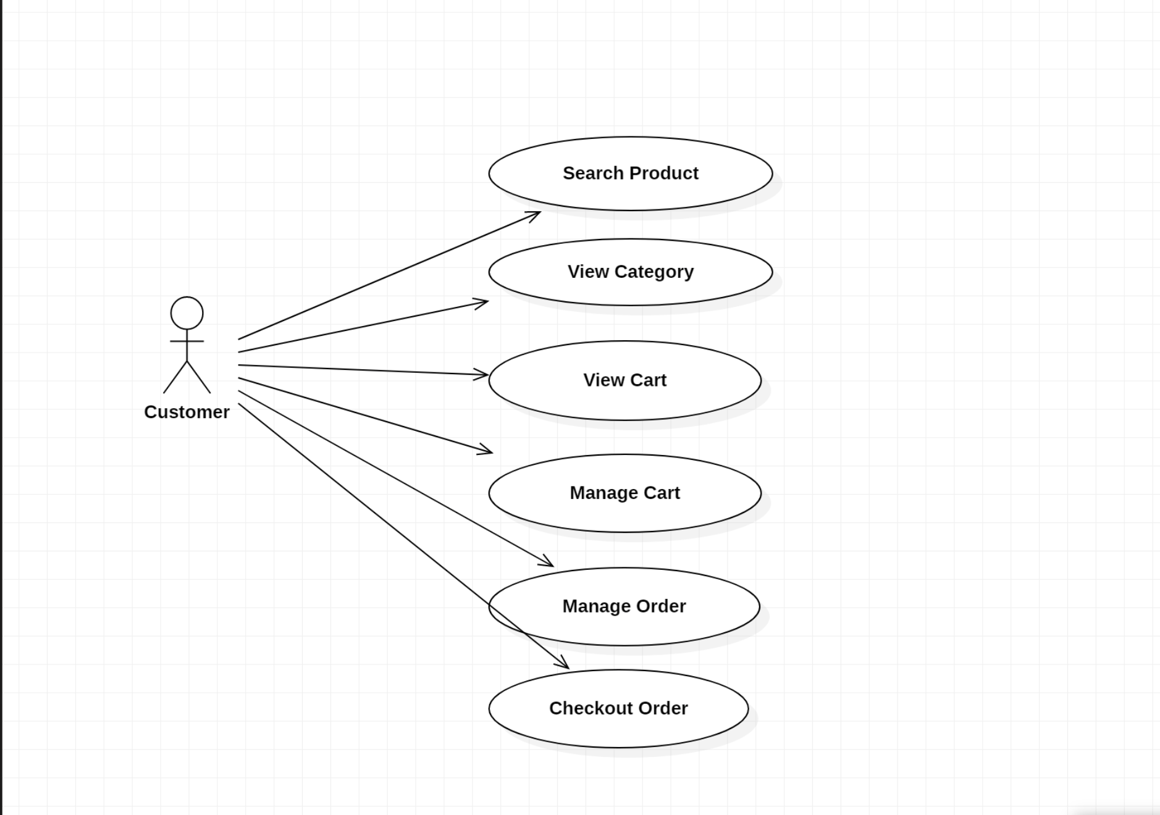
Use-Case Diagram

Slide 6
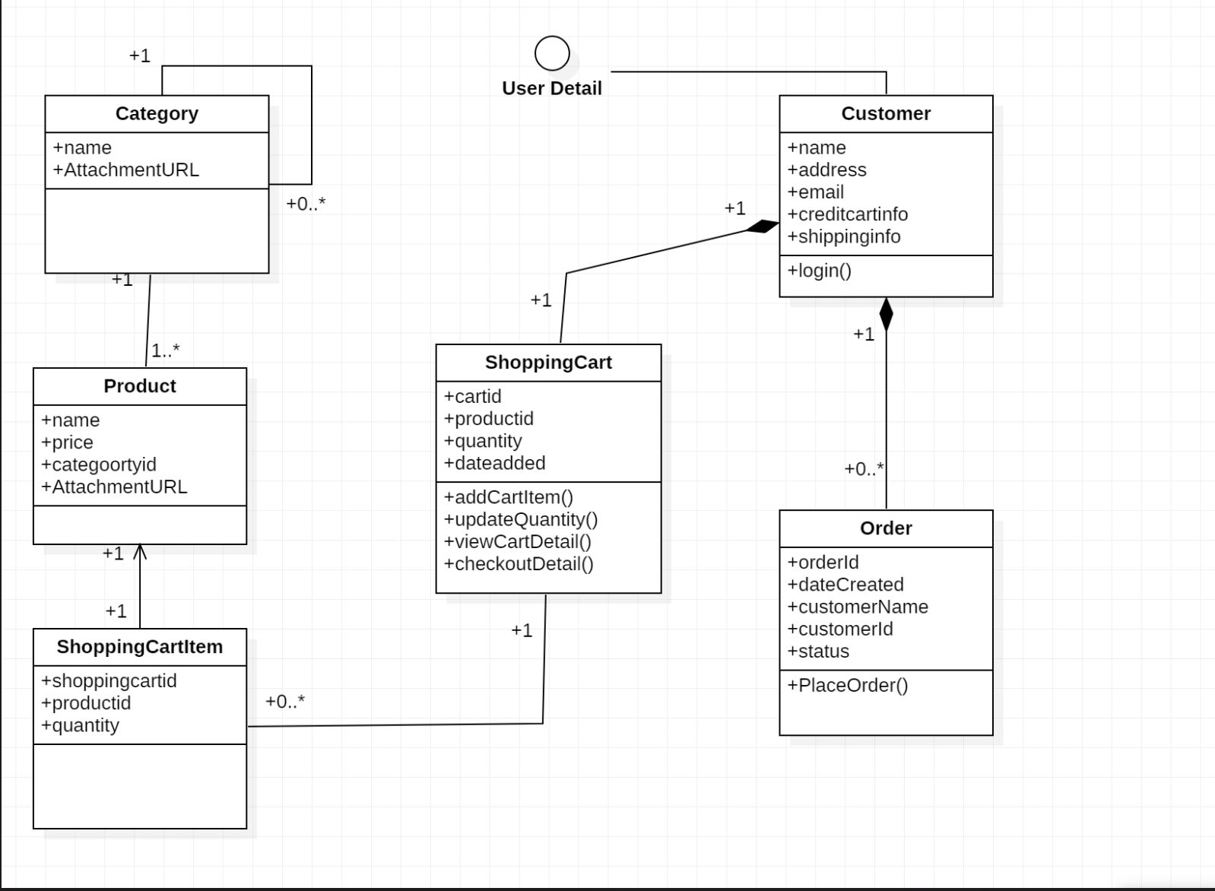
Class Diagram

Slide 7
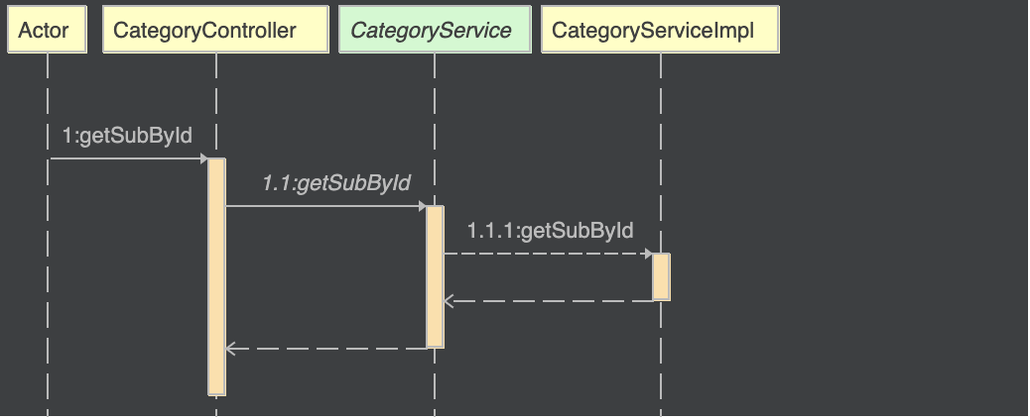
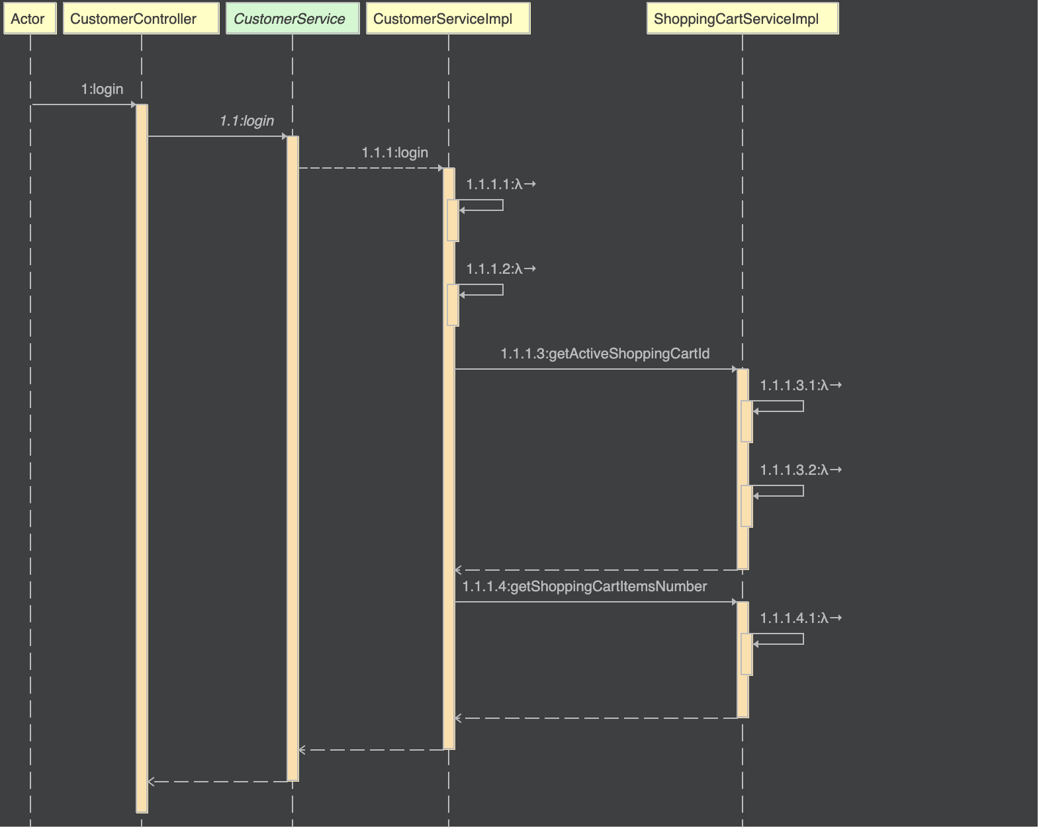
Sequence Diagram
CategoryController_getSubById
CustomerController_login

Slide 8
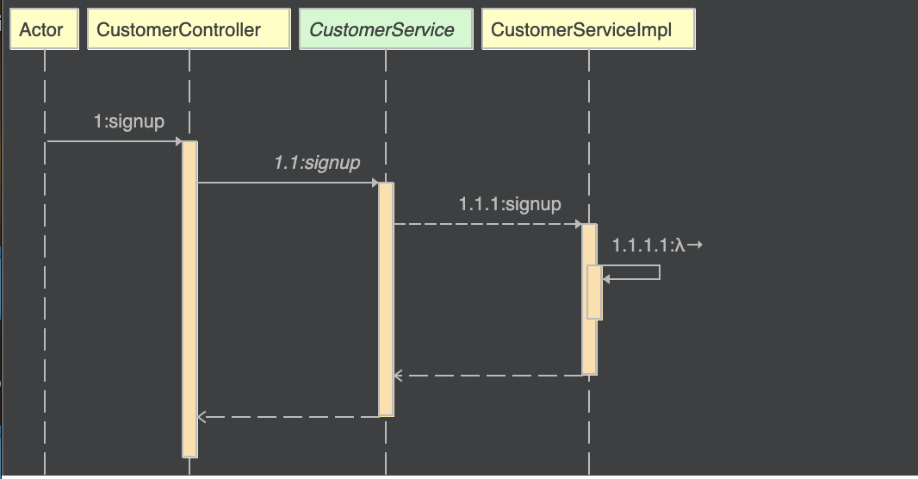
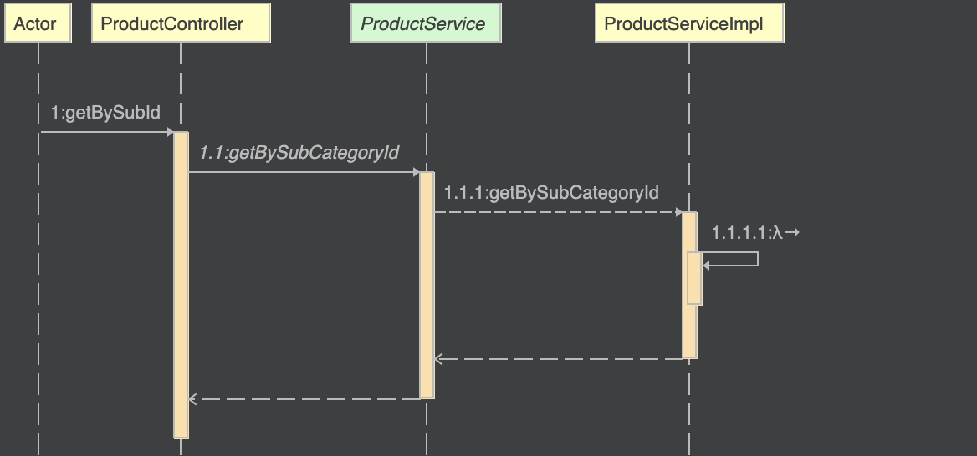
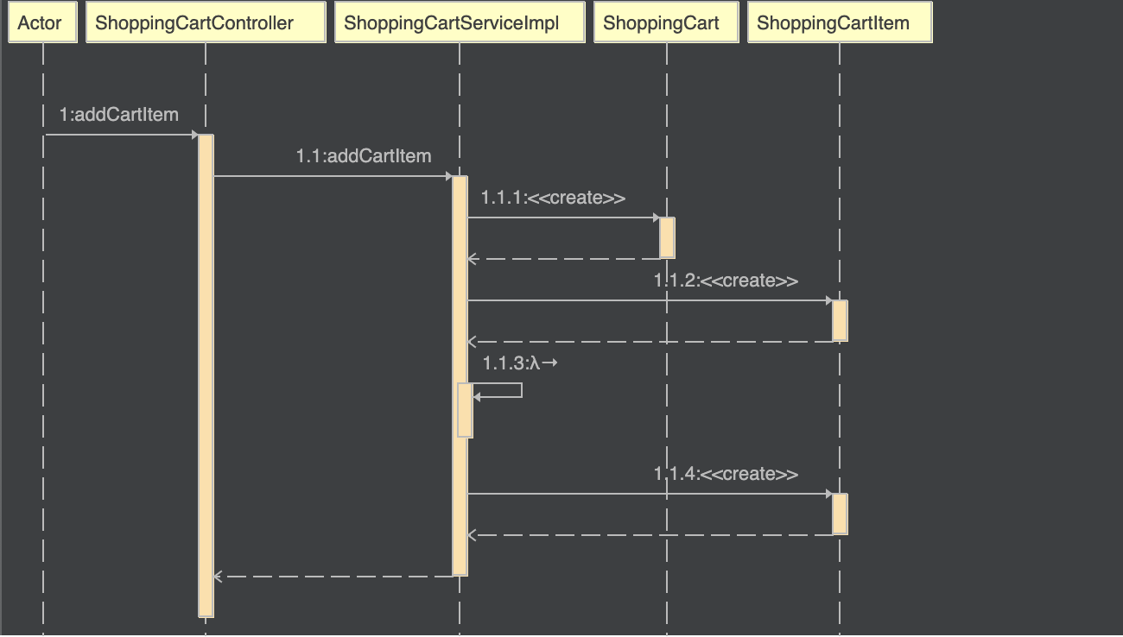
CustomerController_signup
ProductController_getBySubId
ShoppingCardAddItemSequence

