Slide 1
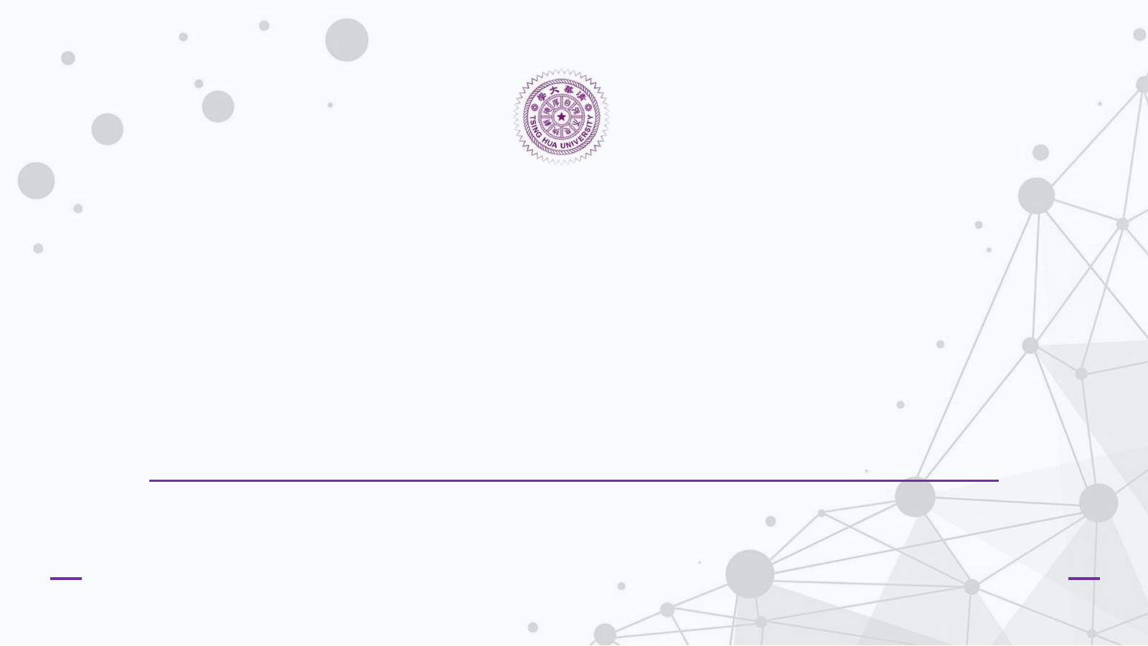

Edge AI-Oriented Quantization Sensitivity Analysis
of YOLO Layers
A experiment for layer-group quantization, accuracy degradation, and mixed-precision FPGA design implications
Group 10: 黃裕傑、李祐庭、郭景淳、陶安、王靖崴、王睿綸、李彥廷
Date: 2026/6/16
Computer Vision Final Report
1

Slide 2

1
Introduction/Background/Motivation
2
Problem Description
Outline
3
Technical Approach (Methodology)
4
Results
5
Conclusion
2

Slide 3
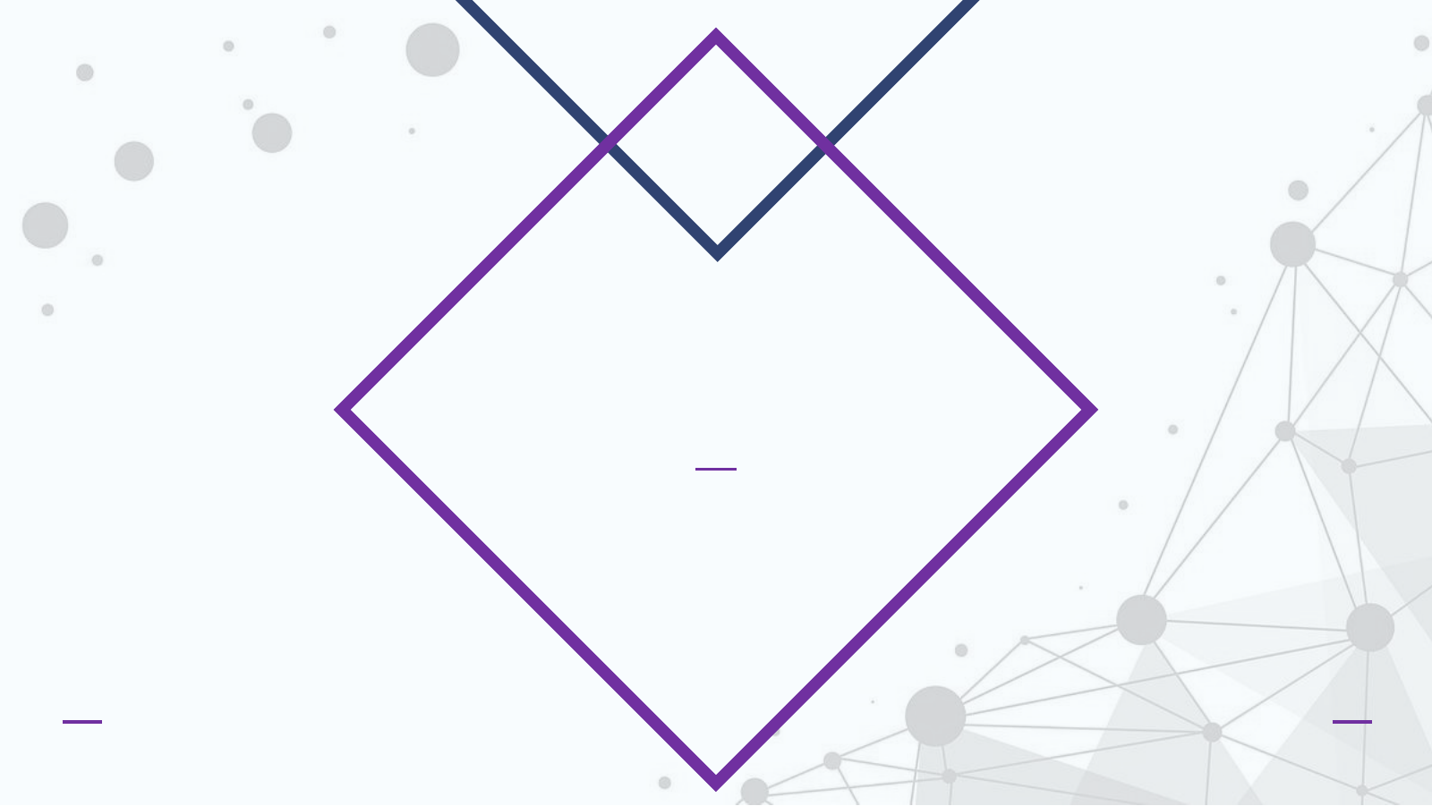
Introduction/Background/Motivation
5

Slide 4
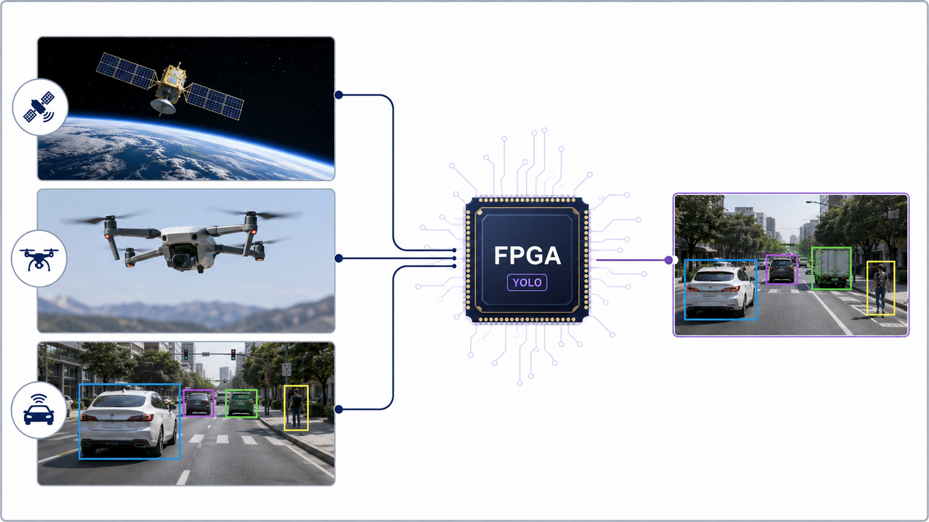
Edge AI Applications
From real-time vision workloads to FPGA-oriented object detection acceleration
Where Edge AI is Needed
• Satellites: onboard detection before downlink
• Drones: inspection, search, tracking, mapping
• Autonomous vehicles: obstacle and traffic perception
Common System Constraints
• Real-time response under limited power and cooling
• Limited memory bandwidth and unreliable cloud access
• Deterministic latency is often more important than peak TOPS
Bridge to YOLO FPGA: YOLO provides fast single-stage object detection; FPGA maps repeated convolution operations into custom parallel pipelines; quantization reduces weight memory and arithmetic cost so the model becomes edge-deployable.
1

Slide 5
What Is an FPGA?
Field-Programmable Gate Array: a reconfigurable hardware fabric between CPU flexibility and ASIC efficiency
An FPGA is not a processor running instructions one-by-one. It is a chip whose logic circuits, memory blocks, DSP units, and interconnects can be configured to form a custom datapath for a target algorithm.
FPGA Fabric
CPU
GPU
FPGA
ASIC
LUT / FF
Logic
DSP
Multiply-Accumulate
More software flexibility
More hardware specialization
BRAM
On-chip Buffer
Routing
Interconnect
Key idea : convert repeated operations such as convolution into deeply pipelined parallel hardware, so many pixels, channels, and partial sums are processed at the same time.
2

Slide 6
Why Put YOLO on FPGA?
Object detection is useful only when latency, power, and deployment constraints are satisfied
Image
Stream
Backbone
Features
Neck
Fusion
Head
Boxes
NMS /
Control
Detections
Low latency
Power efficiency
Edge deployment
A streaming pipeline can output detections with deterministic timing, important for robotics, inspection, and autonomous systems.
Fixed-point datapaths avoid the overhead of full FP32 arithmetic and reduce external memory movement.
FPGA boards can be placed close to sensors when cloud latency, privacy, or network reliability is unacceptable.
For YOLO, the main advantage is not “higher peak TOPS” alone. It is predictable, customized, low-power inference under real-time constraints.
3

Slide 7
Challenges in FPGA-Based AI Acceleration
The bottleneck is often data movement and numerical representation, not only MAC count
Model size
Bandwidth
Weights exceed on-chip memory
Feature maps move repeatedly
YOLO
Accelerator
Precision
Irregular ops
FP32 is expensive in LUT/DSP
NMS, dynamic shapes, control flow
Timing closure
High parallelism makes routing hard
Result: a naive YOLO-to-FPGA mapping may be slower or larger than expected unless the model and hardware dataflow are co-designed.
4

Slide 8
Solutions: Quantization Is One Part of Hardware-Aware Design
The final goal is an accuracy-preserving model that maps efficiently to FPGA resources
Quantization
Pruning /
Slimming
Dataflow
Pipelining
Layer-wise
Sensitivity
FP32 → INT8/INT6/INT4
Reduce DSP, BRAM, bandwidth
Remove redundant channels
Lower MAC count
Tiling + buffering
Reuse activations and weights
Overlap load, compute, store
Improve throughput
Keep sensitive layers higher precision
Quantize tolerant layers aggressively
Quantization principle
Why our experiment matters
Represent weights and activations with fewer bits. The hardware becomes cheaper, but numerical error increases.
Layer-wise sensitivity analysis tells us where low-bit quantization is safe and where higher precision must be preserved.
FPGA acceleration is not just “deploy the model.” It is a co-design problem across model architecture, numerical precision, memory hierarchy, and pipeline scheduling.
5

Slide 9
Background: Why Quantization Is Central to FPGA Vision
FPGA accelerators benefit from integer arithmetic and reduced memory traffic
FP32 inference is convenient for training, but it is expensive for edge hardware. FPGA implementations often prefer fixed-point arithmetic because it can reduce DSP usage, BRAM pressure, bandwidth, and dynamic power.
Lower bit-width
Smaller weight and activation storage
Integer arithmetic
More efficient DSP/LUT mapping
Reduced bandwidth
Lower data movement energy
Mixed precision
Protect sensitive layers while shrinking tolerant
Research gap: many reports compare FP32 vs INT8 globally. This project asks where accuracy actually breaks inside YOLO.
6

Slide 10
YOLOv8n Functional Grouping
The notebook partitions convolutional layers into hardware-relevant regions
Input
Image
Backbone
Early
Backbone
Deep
Neck
Head
Detection
Outputs
Group
Conv layers
Parameters
Param share
backbone_early
7
30,848
0.98%
backbone_deep
20
1,239,296
39.32%
neck
18
984,960
31.25%
head
19
896,800
28.45%
all
64
3,151,904
100%
Design meaning: each group maps to a different hardware region, so sensitivity can guide bit-width allocation before RTL/HLS implementation.
7

Slide 11
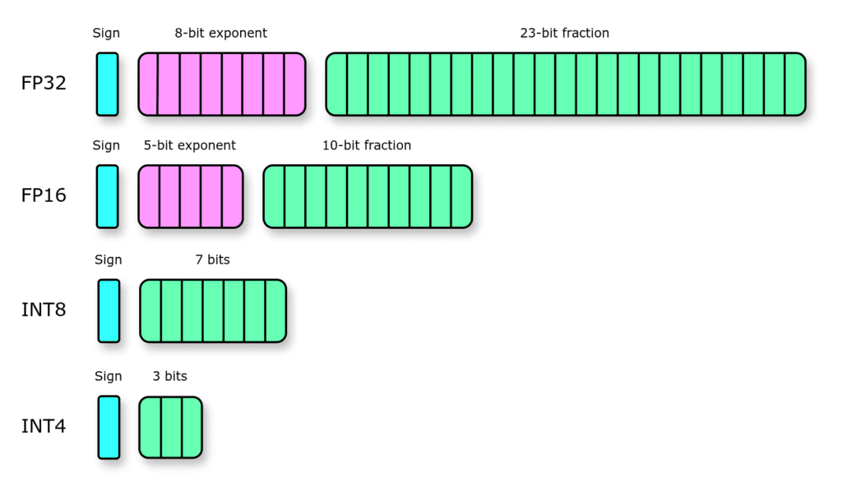
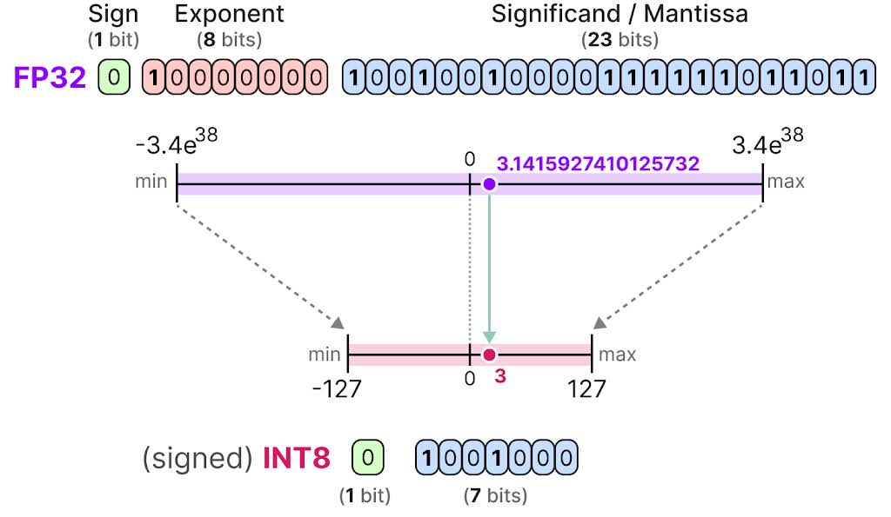
Quantization Design
The experiment simulates low-bit arithmetic while remaining executable in Colab
Uniform affine quantization
Implementation logic
• Selected group convolution weights are quantized.
• Activation tensors are quantized with forward hooks.
• No retraining is used; this is post-training sensitivity testing.
• The method estimates accuracy impact before HLS/RTL work.
10

Slide 12
Problem Description
Nano/Micro Engineering Analysis and Fabrication Lab
3

Slide 13
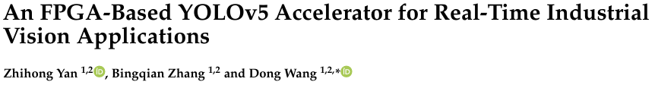
Objective: From Benchmark to Research Question
Layer-level quantization sensitivity for FPGA-oriented YOLO deployment
Paper: An FPGA-Based YOLOv5 Accelerator for Real-Time Industrial Vision Applications

Slide 14
Objective: From Benchmark to Research Question
Layer-level quantization sensitivity for FPGA-oriented YOLO deployment
Main question: Which functional parts of YOLO are most sensitive to low-bit quantization?
Instead of only reporting that “INT8 is smaller,” this work measures accuracy degradation when different YOLO groups are selectively quantized.
What is varied?
Quantized group and bit-width
What is measured?
mAP50-95, mAP50, Precision, Recall
What is inferred?
Layer sensitivity and mixed-precision FPGA policy
Why it matters?
Bit-width should be assigned where accuracy is least sensitive
4

Slide 15
Technical Approach (Methodology)
8

Slide 16
Notebook Experiment Pipeline
A reproducible Python workflow using YOLOv8n and COCO128 validation
1
2
3
4
5
Load model
Build groups
Apply quantization
Evaluate
Analyze
YOLOv8n pretrained weights
Index convolutional modules into early/deep/neck/head
mAP50-95, mAP50, Precision, Recall
Sensitivity ranking and FPGA cost proxy
Weight + activation quantization at 8/6/4-bit
Academic value: the experiment is an ablation study. It isolates each functional group and measures how much quantization error propagates to detection quality.
9

Slide 17
Evaluation Metrics and FPGA Cost Proxy
The notebook links vision performance to hardware-oriented interpretation
Category
Metric
Purpose
Accuracy
mAP50-95
Primary detection quality indicator
Accuracy
mAP50
Localization-tolerant detection indicator
Accuracy
Precision / Recall
False-positive / false-negative tendency
Sensitivity
mAP drop
Damage caused by quantization
FPGA proxy
Parameter share
Estimated memory pressure of each group
FPGA proxy
Weight memory MB
Theoretical storage after low-bit quantization
Interpretation principle: if a group has high parameter share but low sensitivity, it is a strong candidate for lower bit-width on FPGA.
11

Slide 18
Baseline Result and Sanity Check
FP32 YOLOv8n on COCO128 validation
0.4440
0.6079
0.6385
0.5379
3.15M
mAP50-95
Primary metric
mAP50
IoU=0.50
Precision
Box(P)
Recall
Box(R)
Parameters
Model size proxy
Why this baseline is reasonable:
• COCO128 is small, so absolute mAP is not a final COCO benchmark number.
• It is sufficient for a controlled ablation study because every quantization setting is evaluated on the same data.
• Runtime is not the main claim; accuracy degradation and relative sensitivity are the research outputs.
12

Slide 19
Experimental Results
13

Slide 20
Group-wise Weight + Activation Quantization Results
Selected program outputs: mAP50-95 and absolute drop from FP32
Group
8-bit mAP
8-bit drop
6-bit mAP
6-bit drop
4-bit mAP
4-bit drop
backbone_early
0.4337
0.0103
0.2288
0.2152
0.0019
0.4422
backbone_deep
0.4457
-0.0016
0.4107
0.0333
0.0007
0.4434
neck
0.4430
0.0010
0.4381
0.0059
0.1637
0.2804
head
0.4412
0.0028
0.3777
0.0664
0.0857
0.3583
all
0.4243
0.0197
0.1438
0.3002
~0
0.4440
Observations:
• 8-bit quantization is mostly safe; all-group quantization only drops mAP50-95 by 0.0197.
• 6-bit is group-dependent: neck remains stable, but early backbone and all-group quantization degrade strongly.
• 4-bit uniform quantization is not directly usable without calibration or retraining.
14

Slide 21
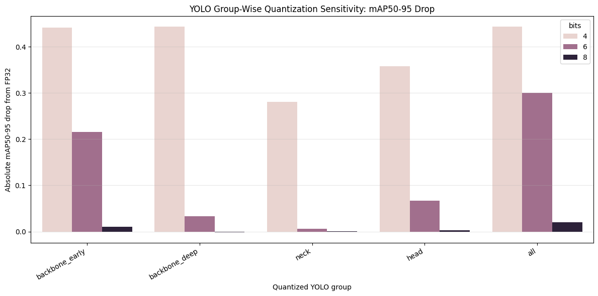
Result I: mAP50-95 Drop by Group and Bit-width
Lower bars indicate better quantization tolerance
Key reading:
• At 8-bit, all groups remain close to FP32.
• At 6-bit, backbone_early is much more sensitive than neck.
• At 4-bit, most groups collapse, while neck retains partial detection ability.
• Quantizing all layers accumulates error, especially at 6-bit and 4-bit.
Finding: bit-width should not be assigned uniformly across YOLO.
Fig. 1: Absolute mAP50-95 drop for group-wise W+A quantization.
15

Slide 22
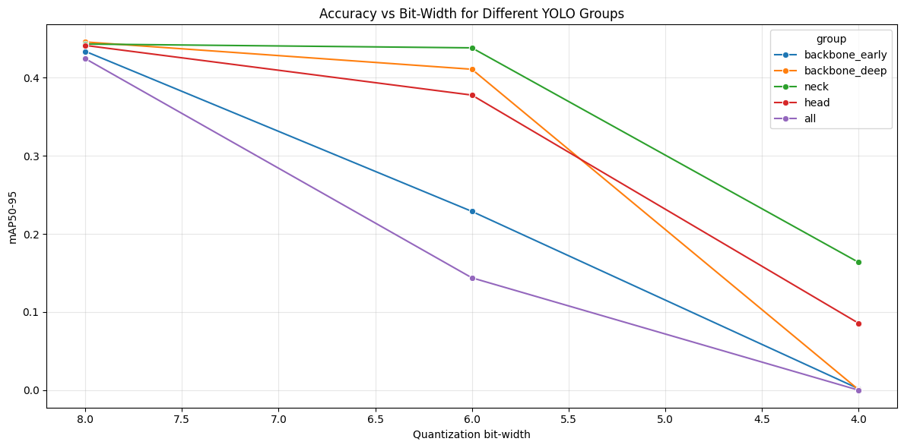
Result II: Accuracy Curve versus Bit-width
Sensitivity becomes nonlinear below 8-bit
Interpretation:
• YOLO does not degrade linearly as bit-width decreases.
• 8-bit is close to baseline for all groups.
• 6-bit exposes architectural sensitivity.
• 4-bit behaves like a stress test: only neck retains meaningful mAP.
• This supports mixed precision instead of uniform quantization.
Fig. 2: mAP50-95 under 8-bit, 6-bit, and 4-bit quantization.
16

Slide 23
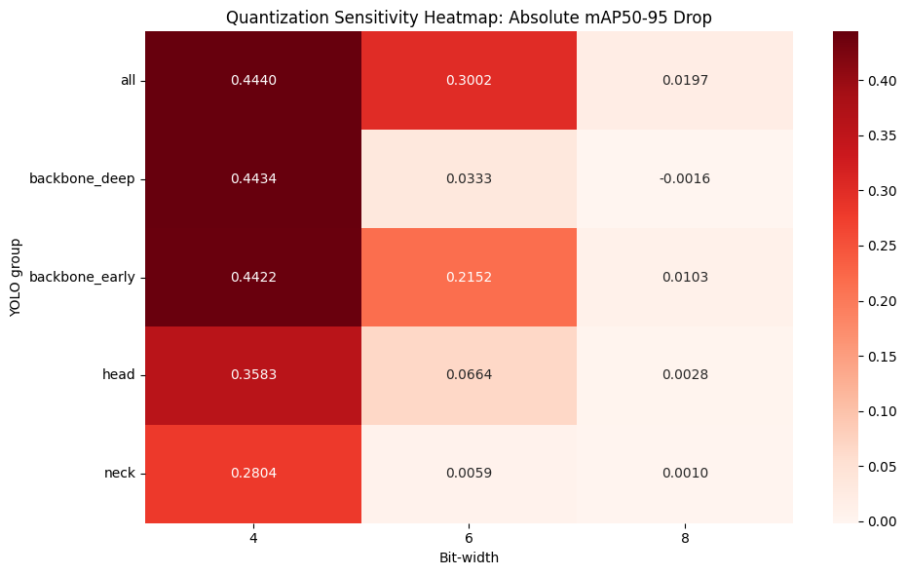
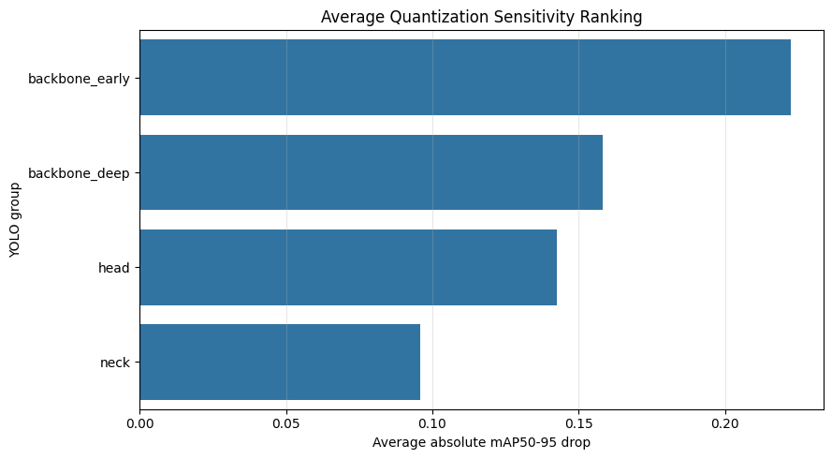
Result III: Sensitivity Heatmap and Ranking
The experiment identifies the most fragile YOLO regions
Fig. 4: Average sensitivity ranking.
Fig. 3: Heatmap of absolute mAP50-95 drop.
Rank
Group
Avg drop
Worst drop
1
backbone_early
0.2226
0.4422
2
backbone_deep
0.1583
0.4434
3
head
0.1425
0.3583
4
neck
0.0958
0.2804
17

Slide 24
Finding I: 8-bit Is Safe, but 6-bit Requires Selective Design
Accuracy loss differs sharply across YOLO groups
2.33%
−0.36%
0.24%
0.63%
4.44%
backbone_early
8-bit mAP drop
backbone_deep
8-bit mAP change
neck
8-bit mAP drop
head
8-bit mAP drop
all
8-bit mAP drop
6-bit observations
• neck: only 1.33% mAP drop → strong low-bit candidate
• backbone_deep: 7.50% drop → likely acceptable with calibration/QAT
• head: 14.95% drop → should be protected
• backbone_early: 48.47% drop → highly sensitive to activation quantization
• all layers: 67.62% drop → error accumulation dominates
Suggested policy: use INT8 globally as a safe baseline; explore INT6 first in neck and possibly deep backbone.
18

Slide 25
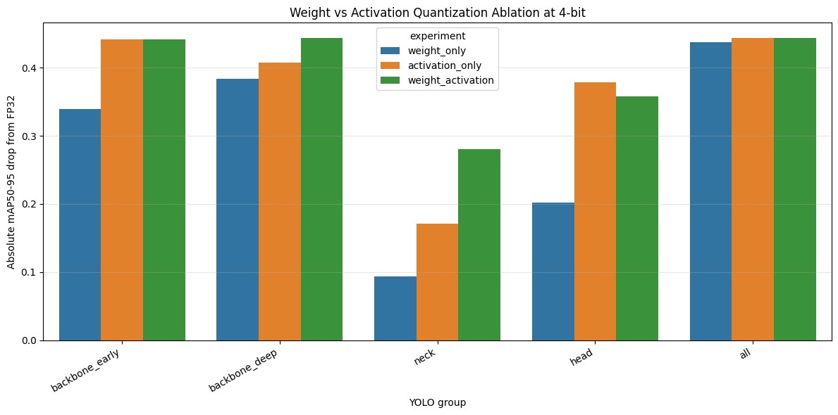
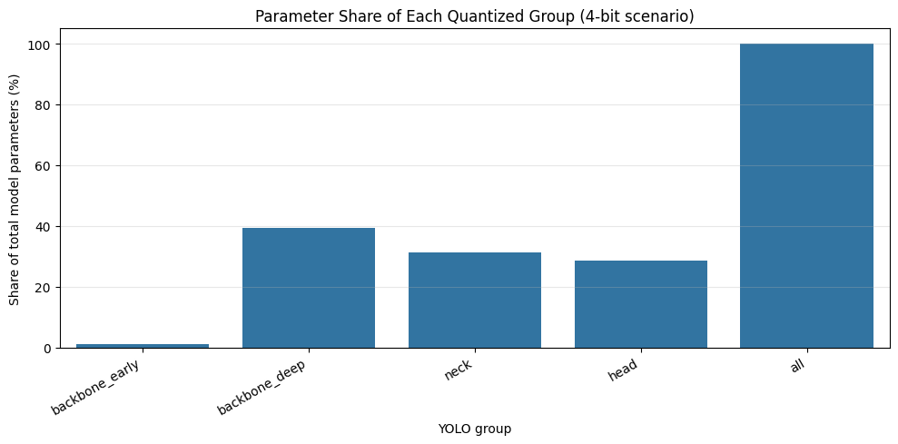
Finding II: 4-bit Uniform Quantization Breaks YOLO
Ablation reveals activation quantization as a major source of collapse
Fig. 6: Parameter share of quantized groups.
Fig. 5: Weight-only, activation-only, and W+A ablation at 4-bit.
FPGA implication:
Although backbone_deep has the largest parameter share, direct 4-bit quantization destroys accuracy. Neck is a better low-bit target because it has large parameter share and lower average sensitivity.
19

Slide 26
Conclusion
13

Slide 27
Conclusion & Takeaways
Layer-wise sensitivity turns quantization into a design methodology
Conclusion 1
8-bit quantization is a robust FPGA-oriented baseline.
Conclusion 2
6-bit quantization should be applied selectively; neck is the safest group.
Conclusion 3
Uniform 4-bit quantization is not suitable without calibration, QAT, or mixed precision.
Conclusion 4
Sensitivity ranking provides a practical guide for FPGA accelerator bit-width allocation.
Future work: calibration dataset enlargement, per-channel scaling, quantization-aware training, ONNX/TensorRT validation, and HLS/RTL implementation.
20

