Slide 1






Smart Glasses Remote Control

Slide 2


Smart Glasses Remote Control
College of Computers and Information Technology
Department of Computer Engineering Taif University
Supervised by:
Dr. Sameer Alsharif – Dr.Rania Mokhtar

Slide 3




Contents
01
Introduction
02
Objectives
03
literature review
05
Experiments and Results
06
Conclusion
04
System Model

Slide 4

Introduction
01

Slide 5



Introduction
Within the landscape of wearable technology, the smart glasses project embarks on a journey to redefine user interaction through the fusion of innovative hardware and intelligent software. This project aims to achieve two main points.
To incorporate technology into every day life by controlling every day objects remotely.
Incorporating object detection that help the elderly and the disabled especially with being aware of their surroundings and making them more independent.

Slide 6



Objectives
02

Slide 7


Objectives
1
2
Implement AI for device control: Use AI to interpret movements for controlling lights, appliances, etc.
3
Help make the lives of the elderly and people with disability to control their home appliance without any trouble
Implement a smart remote controlling system based on gesture-responsive smart eyewear device

Slide 8

Literature Review
03

Slide 9

Literature Review
 | System | Application | Merits
1 | Use of smart glasses for controlling remotely manipulable systems (RMS) | Manufacturing and remote surveillance | Improve accuracy. Improve the working efficiency of the operator
2 | Design and implementation of a remote- controlled surgical system | Healthcare applications | Seamless interface between the surgeon and patient data
3 | Use of smart glasses for remotely controlling a drone | Select specific targets and objects | Improved the accuracy of the mapping process
4 | Use of smart glasses for remote assistance in aerospace maintenance and repair operations | Aerospace maintenance and repair operations | Complete tasks faster and with fewer errors
5 | Use of smart glasses in remote controlling of medical devices | Surgery | Improve surgical outcomes and reduce the risk of infection
6 | Use of smart glasses in remote controlling home devices (this project) | Smart home | Seamless interface trough touch-free and hand-free

Slide 10



System Model
04

Slide 11

System Model
Camera setup: A USB-connected webcam is attached to a Raspberry Pi to capture images of the hand or the overall frame.
Hand detection: Deep learning algorithms equipped with hand detection capabilities analyze the captured image to detect the presence of a hand.
Data analysis: If a hand is detected, comprehensive data about the hand, including each finger and its orientation, is gathered for further analysis
Command execution: Based on finger signal analysis, there are two
options:
Execute a command present within the Raspberry Pi.
Send a command via the MQTT protocol to the NodeMCU, which controls the IoT devices.

Slide 12
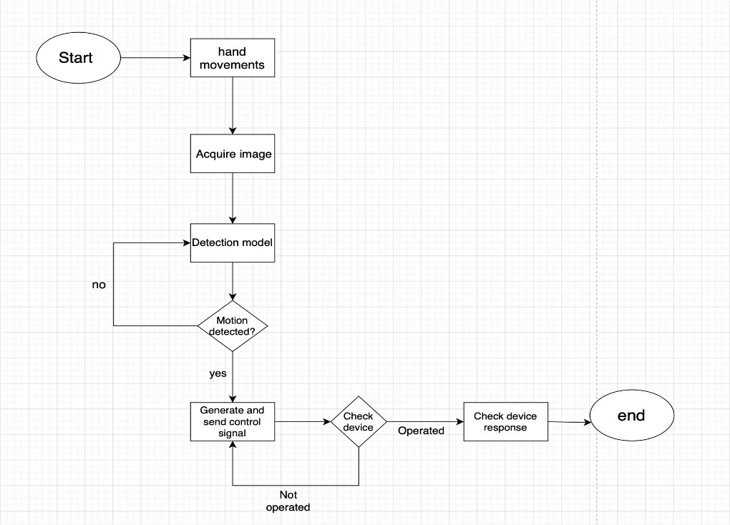
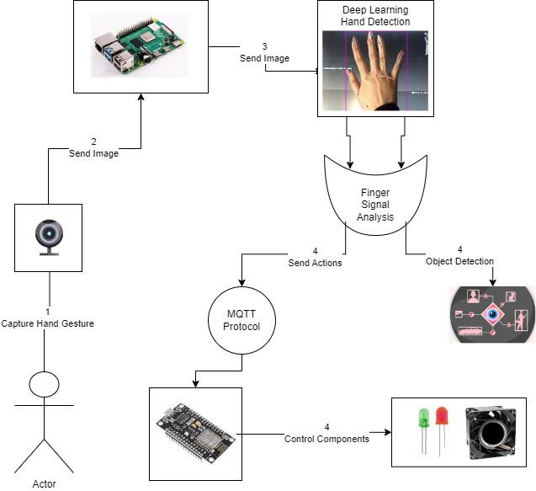
System Model

Slide 13


Hand Gesture Control
Users can control IoT devices through intuitive hand gestures recognized by the hand-tracking module.
Raising fingers or forming specific gestures can trigger actions like turning on/off LEDs or activating the fan.

Slide 14


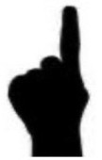
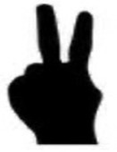
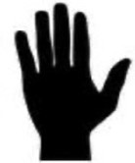
Gesture Recognition
Numbers | Gesture | Left-hand finger states (thumb, index finger, middle finger, ring finger,Pinky)
0 |  | (0,0,0,0,0)
1 |  | (0,1,0,0,0)
2 |  | (0,1,1,0,0)
3 |  | (1,1,1,1,1)

Slide 15
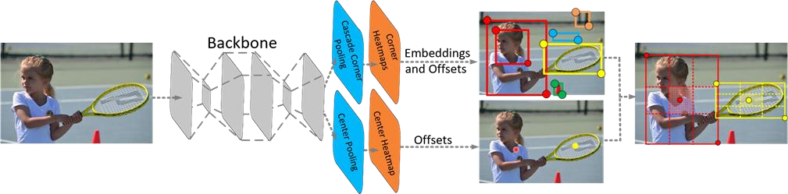
Detector Module
1. Detector Module Overview: Integrates TensorFlow Lite object detection model for recognizing objects, providing real-time feedback and capable of drawing bounding boxes.
1. Utilized Model: CenterNet MobileNetV2 FPN 512x512 pre-trained model trained across 91 classes, optimized for
deployment on resource-constrained devices.
1. Model Optimization: Conversion to TensorFlow Lite format and quantization for reduced memory footprint and computational complexity while maintaining high speed.
1. CenterNet Architecture: Utilizes center pooling and cascade corner pooling for improved bounding box identification, with a convolutional backbone network for feature extraction.

Slide 16


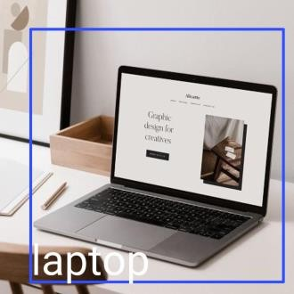
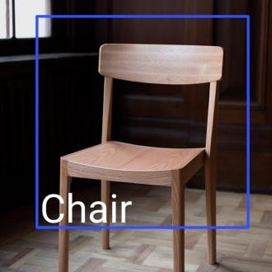
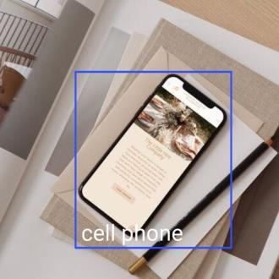


Object Recognition
The object detection capabilities of the smart glasses enable users to identify and interact with objects in their surroundings.
By detecting close objects and providing real-time feedback, users can make informed decisions and execute commands accordingly.

Slide 17


IoT Device Activation
Based on the detected hand gestures and recognized objects, the smart glasses activate or deactivate IoT devices connected to the ESP.
This seamless integration allows users to control their environment effortlessly, wirelessly and enhancing convenience and accessibility.

Slide 18

Experiment and Results
05

Slide 19

Software configuration
MQTT Connection and
LED Control: MQTT Enables communication
Between Raspberry Pi
And ESP, allowing commands to control
efficiently. LEDs
ESP Code
Implementation: The ESP code establishes Wi-Fi connectivity and MQTT communication to control LEDs and a fan, facilitating seamless interaction with the Raspberry Pi.
Integration and Functionality: The Run
Module combines hand-
tracking and object detection to control IoT devices, ensuring real- time responsiveness.

Slide 20

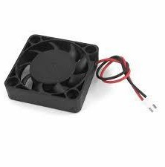
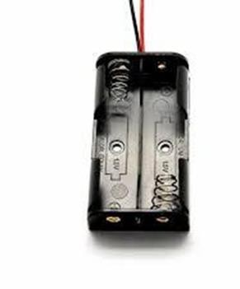
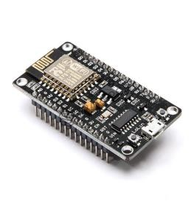
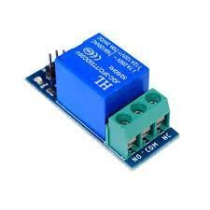
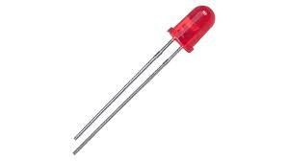
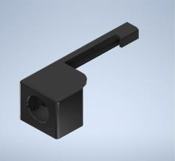
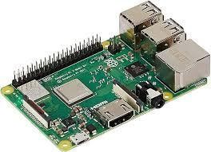
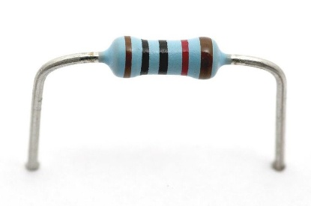
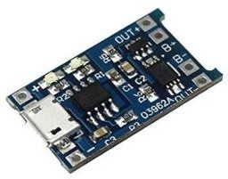
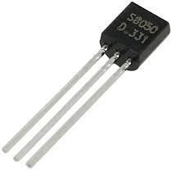
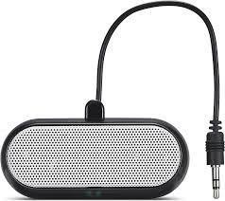

Hardware Part
ESP8266
microcontroller chip
Relay
LED
Fan
Battery Pack
Web camera
Battery Charger
Transistor
Raspberry Pi
Resistor
Speaker

Slide 21
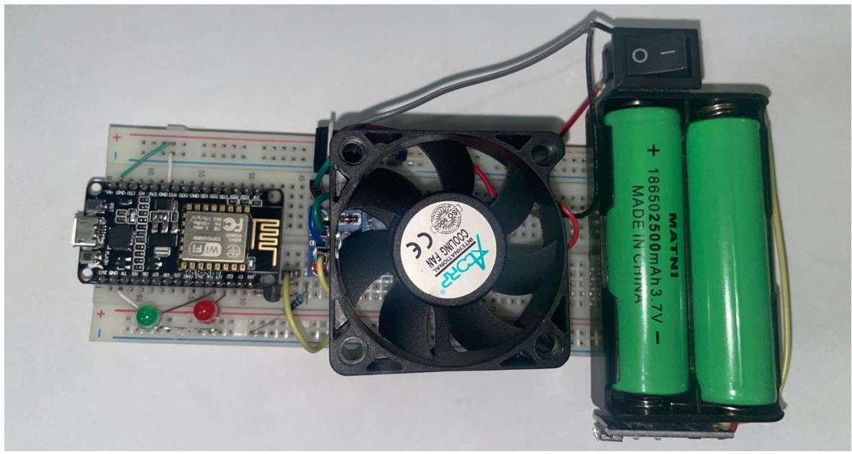
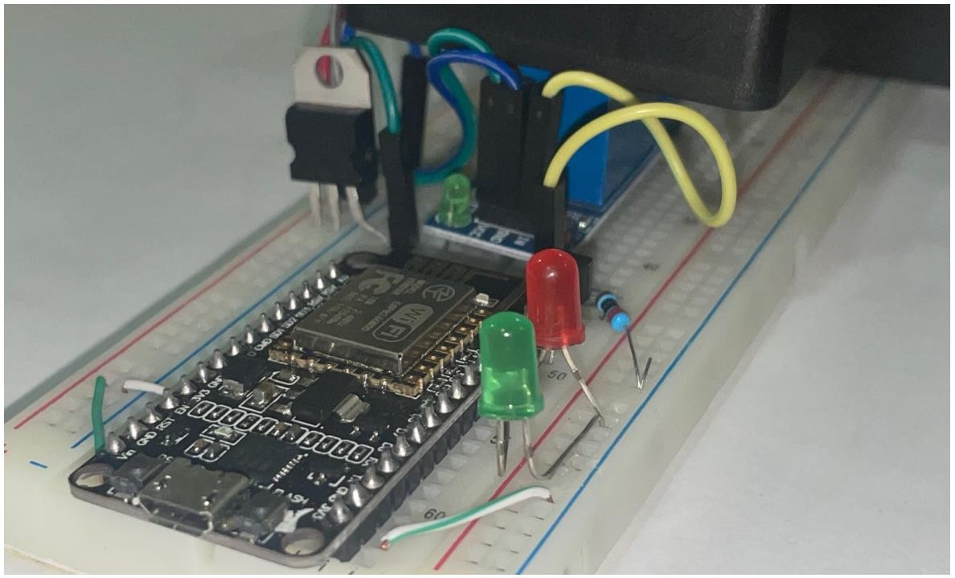



Hardware Configuration
ESP8266 microcontroller: WiFi- enabled, with pins for connecting to accessories like LEDs, fans, and relays.
LED connections: Two pins for each LED, one for power and one for ground, connected to D4 and D3 on the controller.
Relay control: Relay operated by the controller for fan control, requiring a transistor for voltage conversion
Transistor function: Converts controller voltage from 3.3V to 5V for relay operation, with connections to D0 pin, ground, and relay control.
Fan connection: Red cable connected to relay terminal, black cable to battery box negative terminal.
Battery box setup: Connected to switch and battery charger circuit for power management.

Slide 22
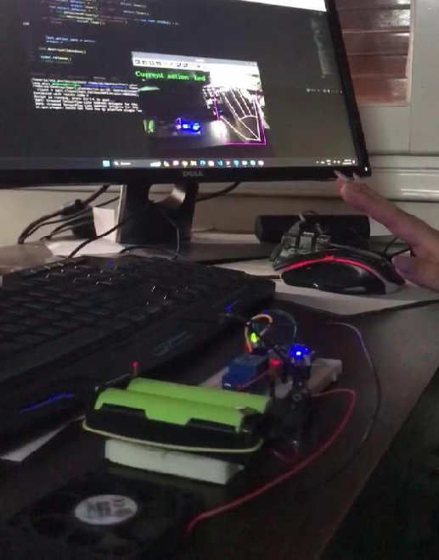
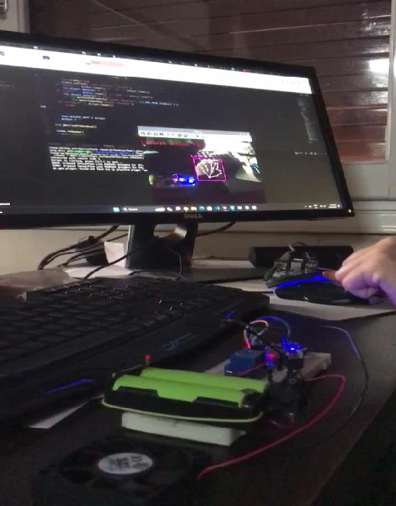
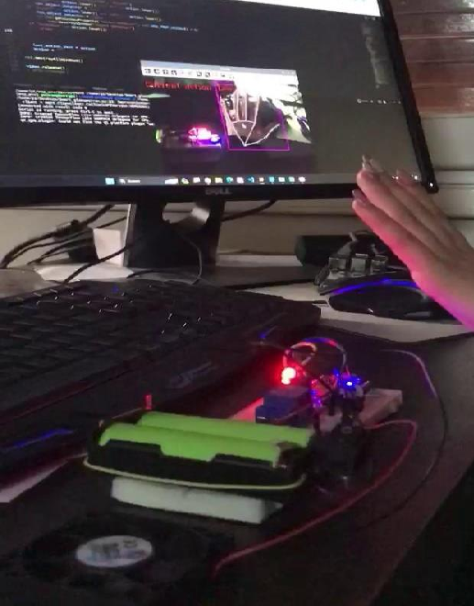
Led 1 On
Led 1 Off
Led 2 On

Slide 23
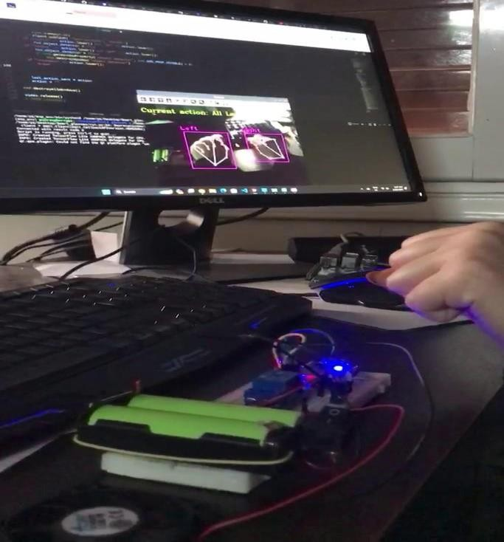
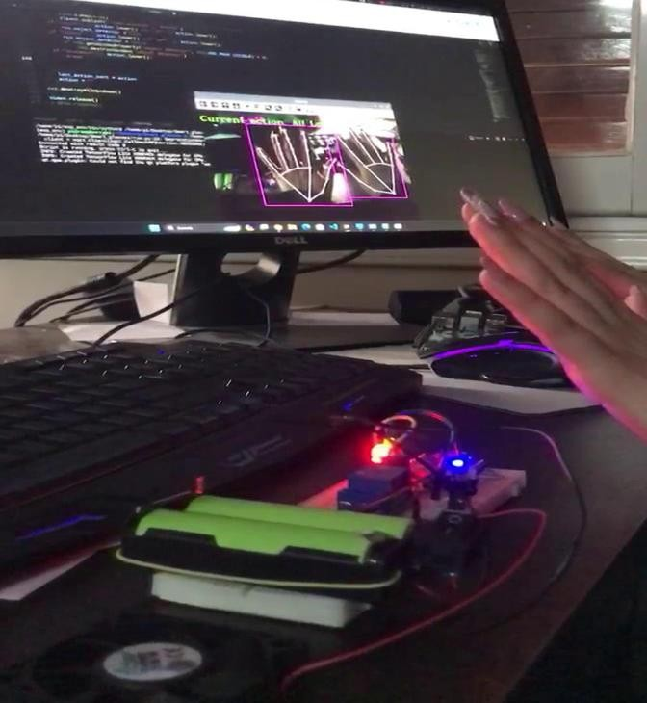
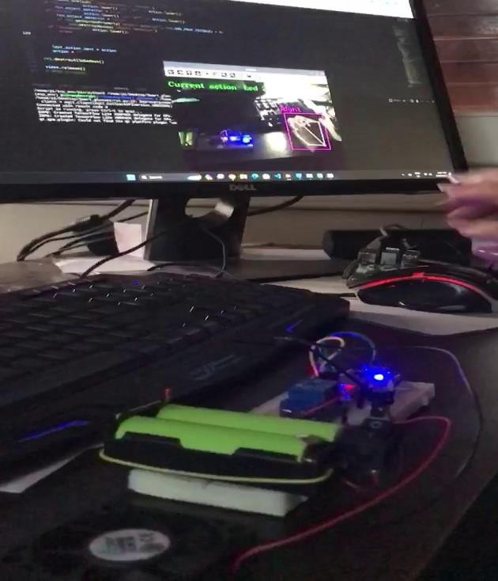

Led 2 Off
All Led On
All Led Off

Slide 24

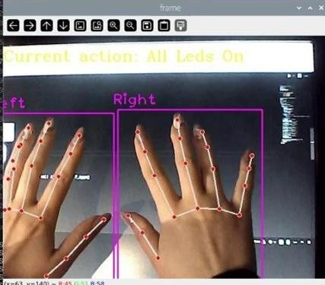
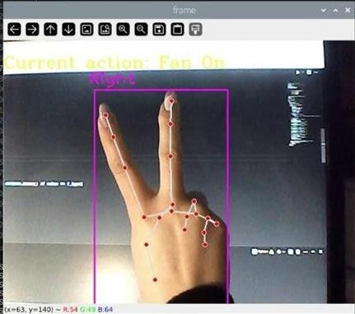
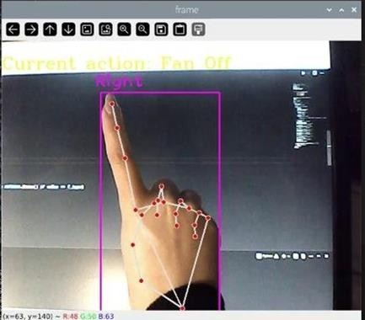
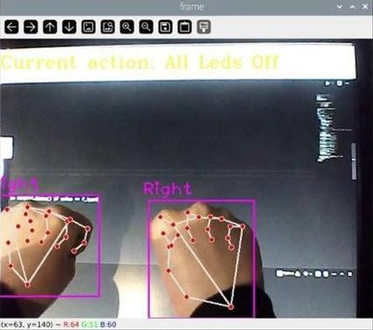

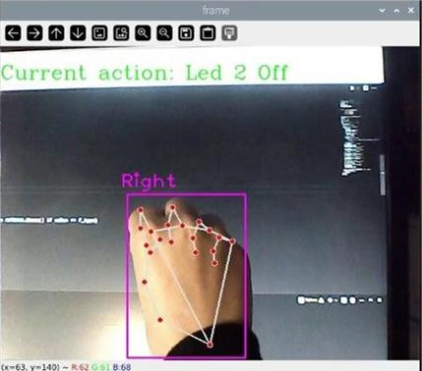
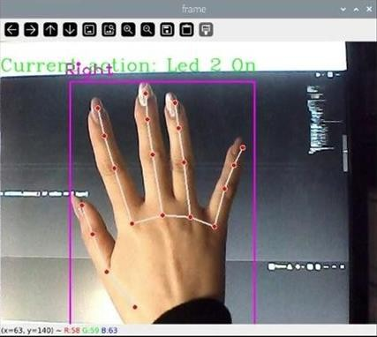
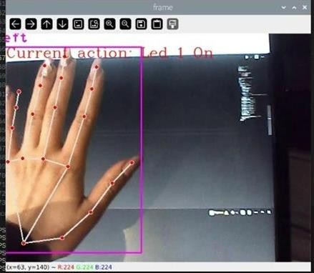
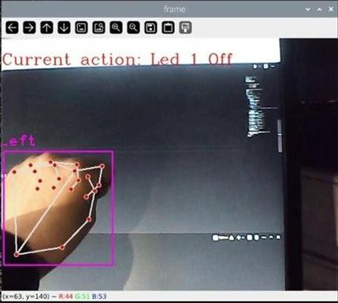
All Leds Off
All Leds On
Fan Off
Fan On
Led 2 Off
Led 2 On
Led 1 On
Led 1 Off

Slide 25


Slide 26

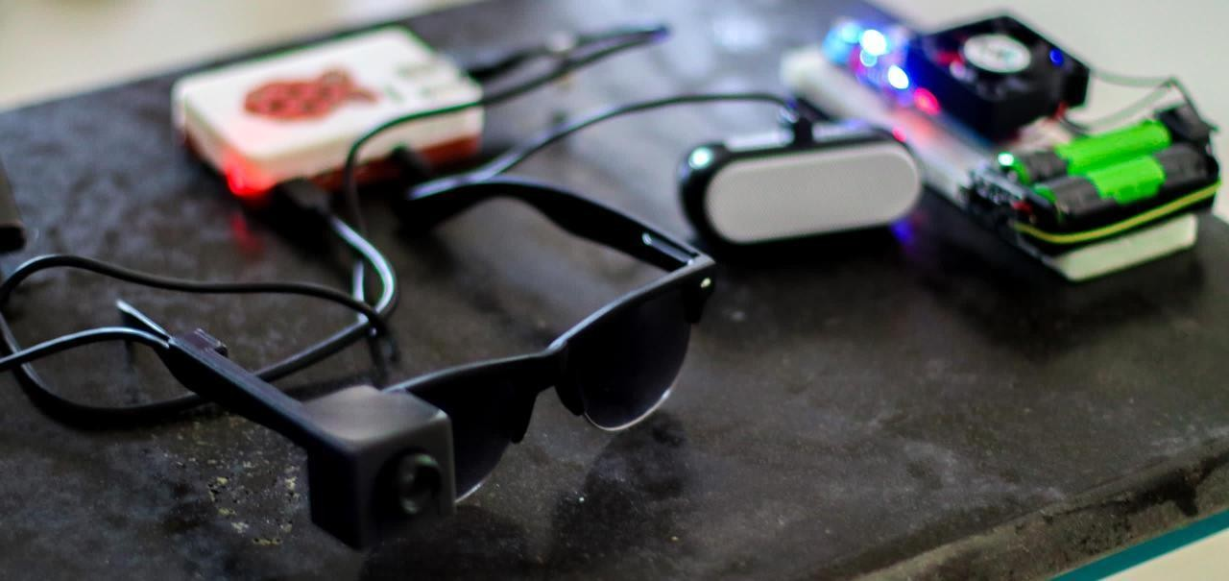

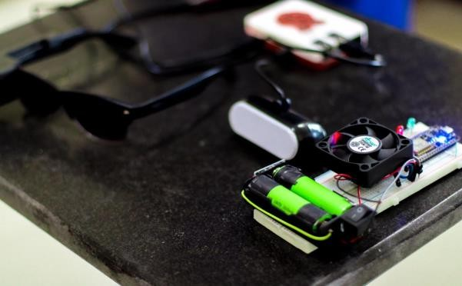
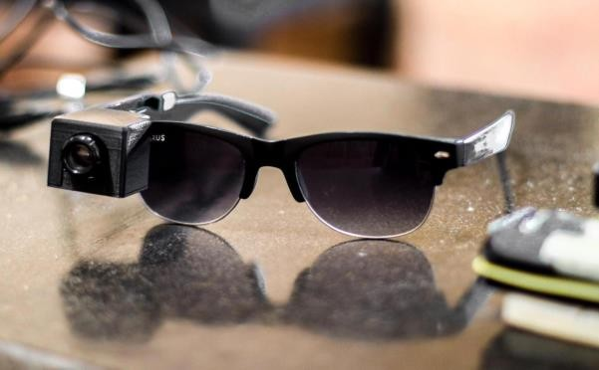

Slide 27
Conclusion
06

Slide 28
Conclusion
The project integrates hand tracking, object detection, and IoT device control into an interactive system. Hand gestures are detected and tracked using computer vision, enabling control of IoT devices. Object detection utilizes a pre-trained model for real-time identification of diverse objects. The IoT device controller communicates wirelessly with ESP-based devices via MQTT protocol. Overall, the system demonstrates the feasibility of interactive IoT applications leveraging computer vision and machine learning, with broad potential across various domains.

Slide 29
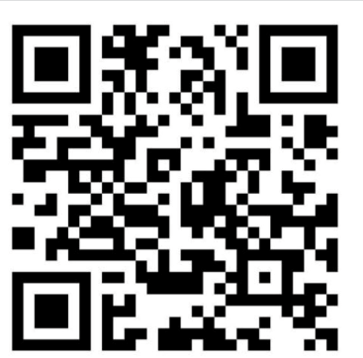
THANKS!
Project Demonstration

