Slide 1

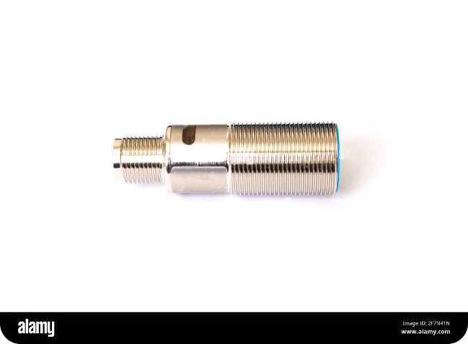

Introduction to Ultrasonic Sensors
Ultrasonic sensors are devices that use sound waves to measure distance or detect objects. They emit a pulse of ultrasonic sound and then measure the time it takes for the sound to return after being reflected by an object. This time is used to calculate the distance to the object.
by Swaraj kumar

Slide 2

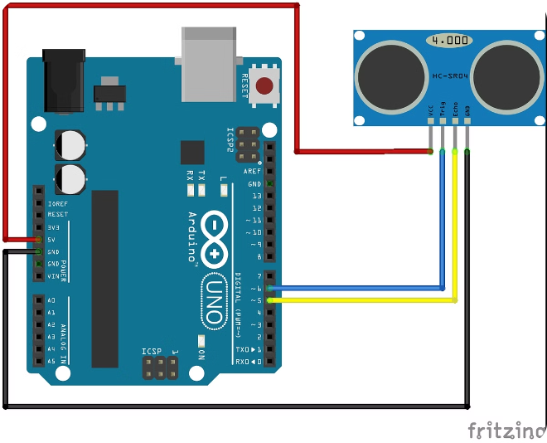
Principle of Ultrasonic Sensing
1
Emission
The sensor emits a pulse of ultrasonic sound waves.
2
Reflection
The sound waves travel outwards and are reflected by an object.
3
Reception
The sensor receives the reflected sound waves.
4
Calculation
The sensor calculates the distance by measuring the time it takes for the sound to travel to the object and back.

Slide 3
Components of an Ultrasonic Sensor
Transmitter
Receiver
Controller
Generates and emits ultrasonic sound waves.
Detects the reflected sound waves.
Processes the signal and calculates the distance.

Slide 4

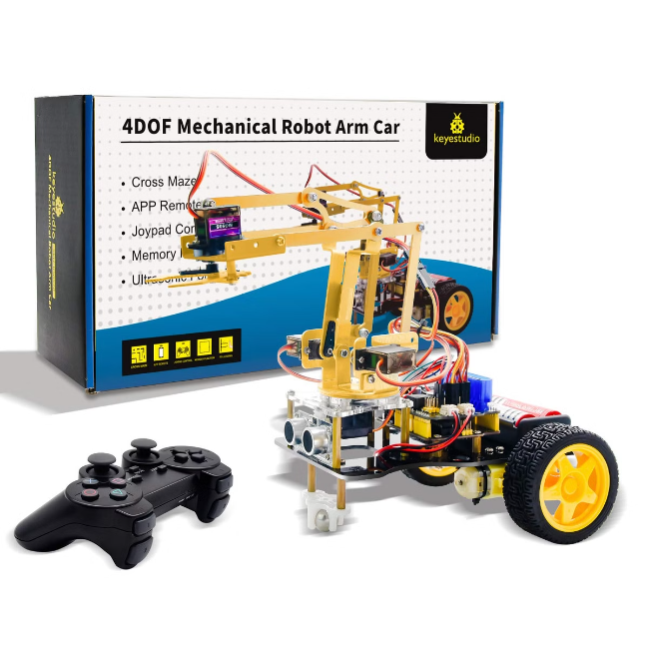



Measuring Distance with Ultrasonic Sensors
Emit Pulse
The sensor sends out a short burst of ultrasonic sound waves.
Time of Flight
The sensor measures the time it takes for the sound waves to travel to the object and back.
Distance Calculation
The sensor calculates the distance using the speed of sound and the time of flight.

Slide 5


Advantages of Ultrasonic Sensors
1
Non-Contact
2
Wide Range
They do not require physical contact with the object being measured.
They can measure distances over a wide range, from a few centimeters to several meters.
3
Versatility
4
Cost Effective
They can be used to detect various materials, including solids, liquids, and gases.
They are relatively inexpensive compared to other distance-measuring technologies.

Slide 6

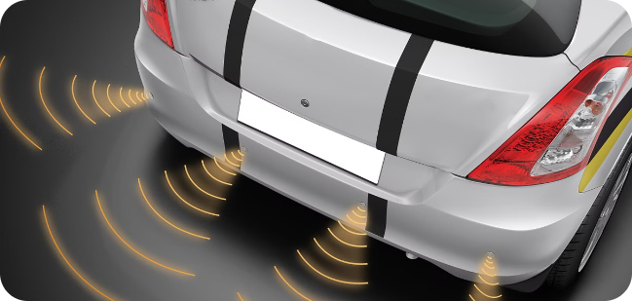
Applications of Ultrasonic Sensors
Robotics
Automotive
Navigation, obstacle avoidance, and object manipulation.
Parking assistance, blind spot detection, and adaptive cruise control.
Industrial Automation
Consumer Electronics
Level sensing, proximity detection, and quality control.
Smart home devices, gaming consoles, and wearable technology.

Slide 7
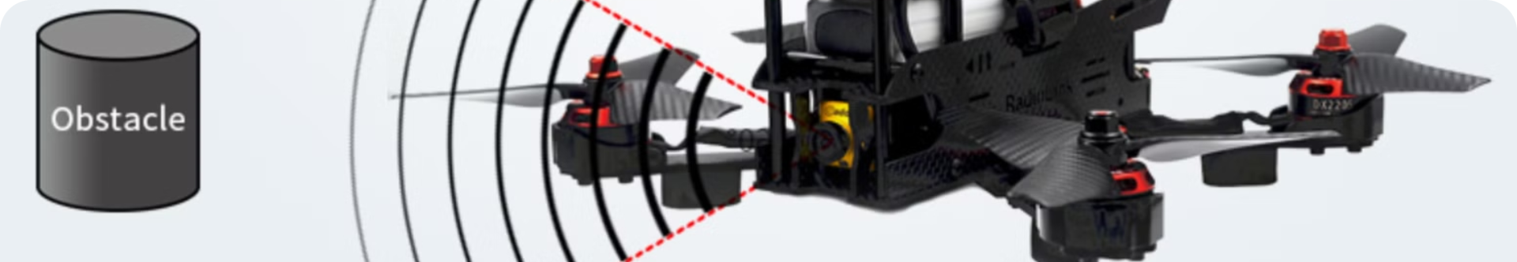
Limitations and Considerations
Temperature
The speed of sound varies with temperature, which can affect distance measurements.
Humidity
High humidity can attenuate the sound waves, reducing the sensor's range.
Materials
Some materials, like soft materials or rough surfaces, may reflect sound waves poorly, making it difficult to get accurate measurements.
Noise
External noise can interfere with the sensor's readings.

Slide 8

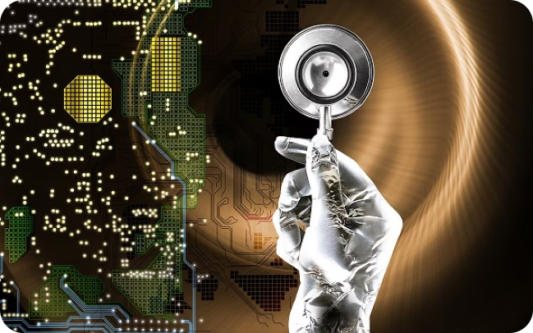
Conclusion
Ultrasonic sensors are versatile and reliable devices that are widely used in various applications. Understanding their principles and limitations is essential for their effective implementation in real-world scenarios.

