Slide 1

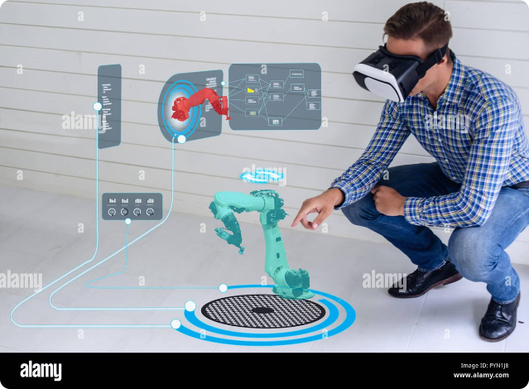


Introduction to the IoT Job Market
The Internet of Things (IoT) has transformed various industries, creating a rapidly growing job market for skilled professionals. Explore the diverse range of IoT-related careers that are shaping the future of technology and innovation.
swaraj kumar | LinkedIn
@crosXplatform

Slide 2
IoT Engineer
Key Responsibilities
Required Skills
Career Outlook
Design, develop, and integrate IoT systems and devices. Ensure seamless connectivity and data flow across the IoT ecosystem.
Proficiency in embedded systems, sensors, communication protocols, and cloud computing. Strong programming skills in languages like C, C++, and Python.
High demand for IoT engineers as the industry continues to grow. Opportunities in various sectors, including smart homes, industrial automation, and transportation.

Slide 3

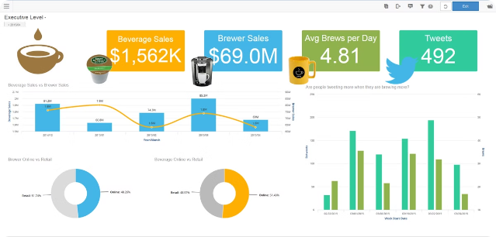
IoT Analyst
1
Data Analytics
Collect, analyze, and interpret data from IoT devices and sensors to uncover insights and trends.
2
System Monitoring
Track and assess the performance of IoT systems, identifying issues and optimizing operations.
3
Business Intelligence
Translate IoT data into actionable business strategies and solutions for clients.

Slide 4

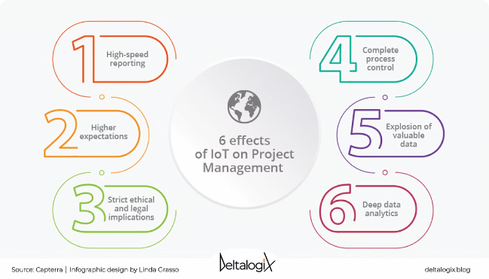
IoT Project Manager
Coordinating IoT Projects
Oversee the entire lifecycle of IoT projects, from planning and implementation to deployment and maintenance.
Stakeholder Management
Effectively communicate with cross-functional teams, clients, and stakeholders to ensure successful project delivery.
Risk Mitigation
Identify and manage potential risks, such as security vulnerabilities and integration challenges, throughout the project.

Slide 5


IoT Technician
1
Installation
Set up and configure IoT devices, sensors, and related infrastructure at client sites.
2
Maintenance
Perform routine checks, troubleshoot issues, and provide ongoing support for IoT systems.
3
Optimization
Continually monitor and optimize IoT systems to ensure optimal performance and efficiency.

Slide 6


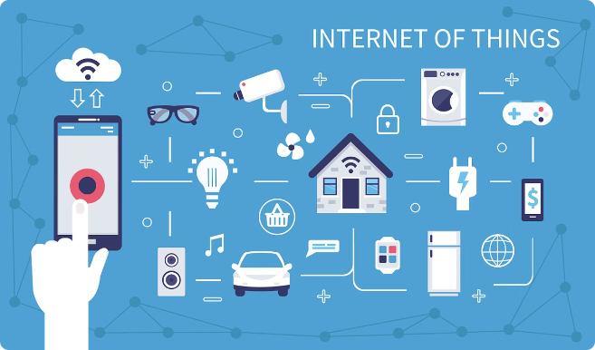


IoT Data Scientist
Machine Learning
Develop and apply advanced algorithms to extract valuable insights from IoT data.
Data Visualization
Create intuitive and visually compelling representations of IoT data to inform decision-making.
Predictive Analytics
Use IoT data to forecast trends and identify potential issues before they arise.

Slide 7




IoT Security Specialist
Risk Assessment
Threat Mitigation
Continuous Monitoring
Identify and evaluate potential security threats and vulnerabilities in IoT systems.
Implement robust security measures, such as encryption, access controls, and anomaly detection.
Continuously monitor IoT networks and devices for suspicious activities or breaches.

Slide 8

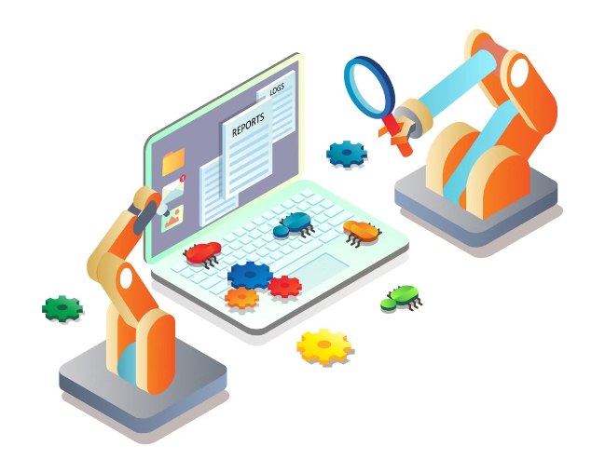
IoT Quality Assurance Tester
Functionality Testing
Ensure IoT devices and systems work as intended across different scenarios and use cases.
Compatibility Testing
Verify the interoperability of IoT components and their integration with existing systems.
Performance Testing
Assess the scalability, reliability, and responsiveness of IoT solutions under various loads.

Slide 9
IoT Technical Support
Troubleshooting
User Training
Escalation Management
Provide timely and effective troubleshooting assistance to IoT device users and customers.
Educate and train users on the proper operation and maintenance of IoT systems.
Collaborate with cross-functional teams to resolve complex IoT-related issues and escalate as needed.

Slide 10

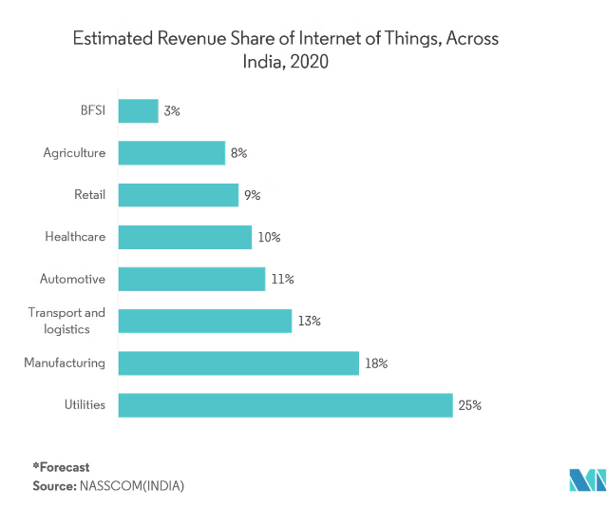
Thriving in the IoT Job Landscape
The IoT job market is rapidly expanding, offering diverse and rewarding career opportunities. By developing the necessary skills and expertise, you can position yourself to thrive in this dynamic and innovative industry, shaping the future of technology and connectivity.

